Slide 1
The Inflammasome: Critical Roles in Intestinal Homeostasis
Hasan Zaki, PhD
Department of Pathology
UT Southwestern Medical Center

Slide 2
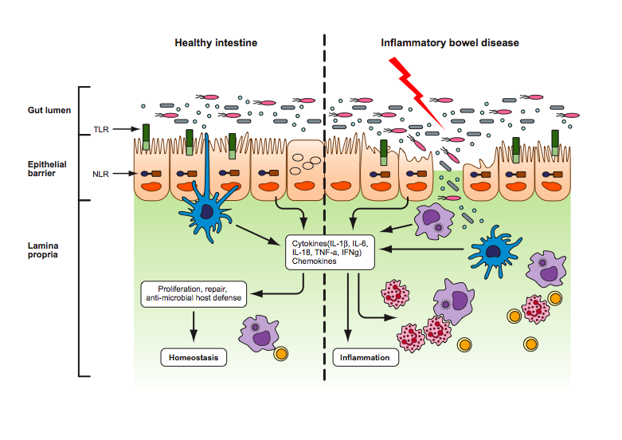
Intestinal Homeostasis vs Inflammation
Cytokines, Chemokines, Inflammatory mediators
Homeostasis
Inflammation

Slide 3
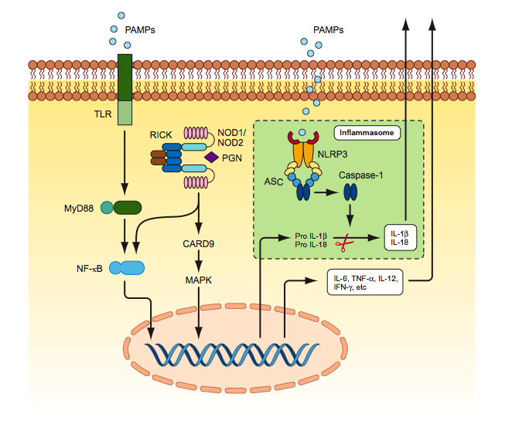
Pathogen recognition receptors and inflammatory signaling pathways
Toll-like receptors (TLRs) senses pathogen associated molecular patterns at cells surface and endosomal compartment.
Nod-like receptors (NLRs) are cytosolic sensors for pathogen and danger associated molecular patterns.

Slide 4
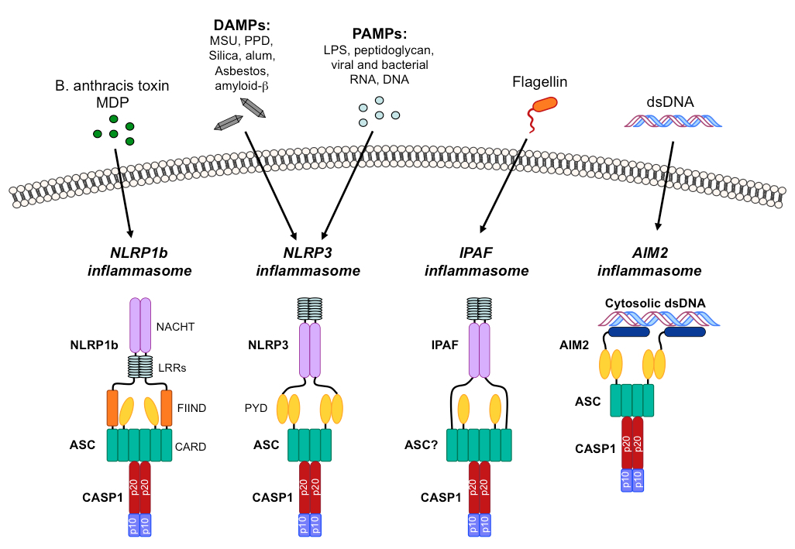
Major inflammasome pathways
NLRP1b inflammasome
NLRP3 inflammasome
NLRC4 inflammasome
AIM2 inflammasome
Active caspase-1
Pro IL-1β
Pro IL-18
Pro IL-1β
Pro IL-18

Slide 5
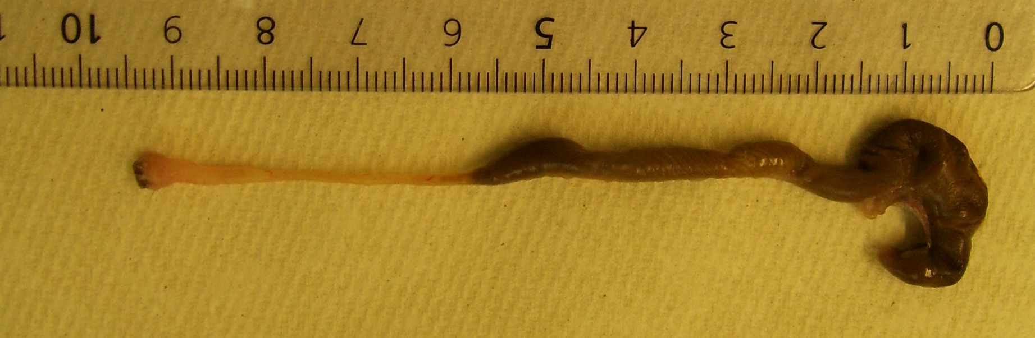
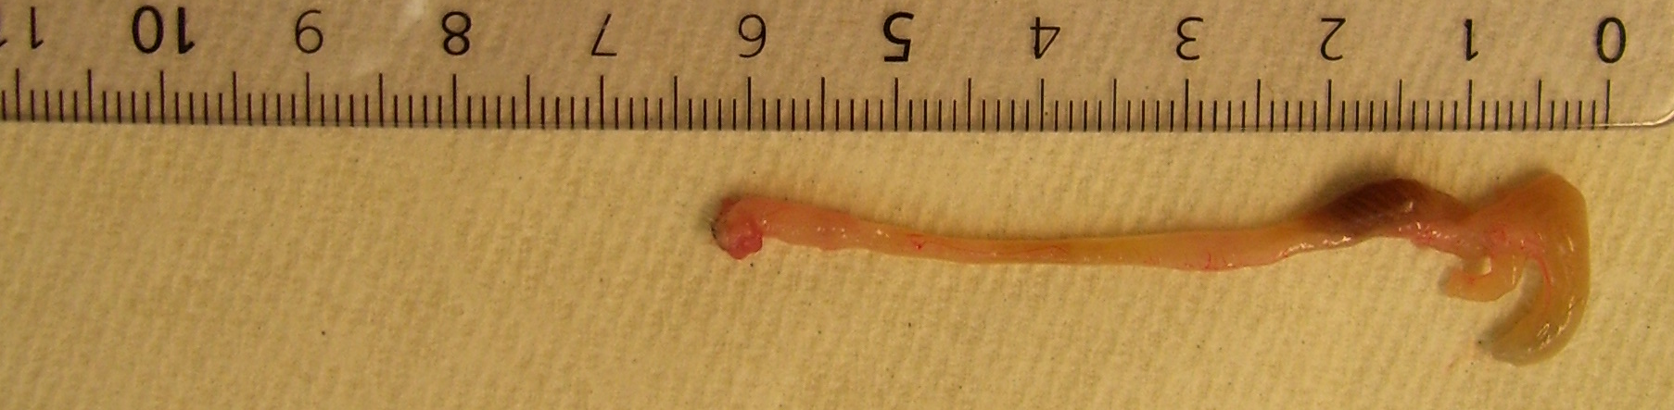
The Nlrp3 inflammasome protects mice from dextran sodium sulfate (DSS)-induced colitis
WT
Nlrp3^{-/-}
Survival (%)
Nlrp3^{-/-}
4% DSS
Time after DSS-administration (days)
Zaki MH, Immunity, 2010

Slide 6
Multiple inflammasome pathways maintain intestinal homeostasis
NLRP3
Pro IL-1β & IL-18
ASC
Body weight (%)
Caspase-1
Active Caspase-1
IL-1β, IL-18
3% DSS
Days after DSS
*
**
Nlrp3^{-/-}
Casp1^{-/-}

Slide 7
NLRP1b inflammasome
NLRP3 inflammasome
NLRC4 inflammasome
AIM2 inflammasome

Slide 8
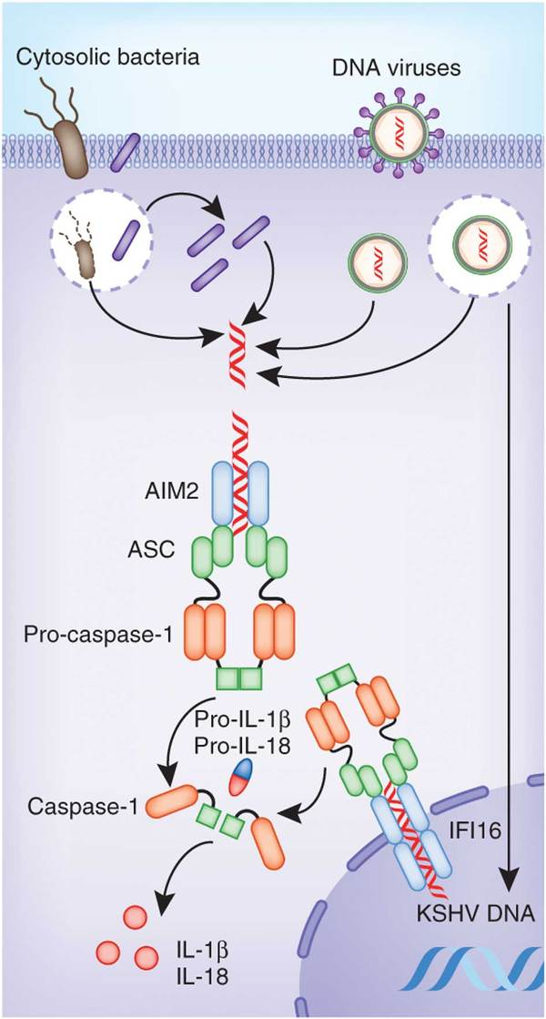
Absent in Melanoma 2 (AIM2)
Absent in Melanoma 2 (AIM2) is a member of interferon inducible gene HIN-200 family.
AIM2 contains an N-terminal Pyrin domain and a C-terminal HIN-200 oligonucleotide binding domain.
AIM2 is a cytosolic sensor for dsDNA.
Interaction of AIM2 with DNA leads to the inflammasome activation.
Several bacteria and virus including Listeria monocytogenes, Francisella Tulerensis, Streptococcus pneumoniae, Staphylococcus aureus, murine cytomegalovirus and vaccinia virus can activate AIM2 inflammasome.

Slide 9
Aim2-deficient mice are susceptible to DSS-induced colitis

Slide 10
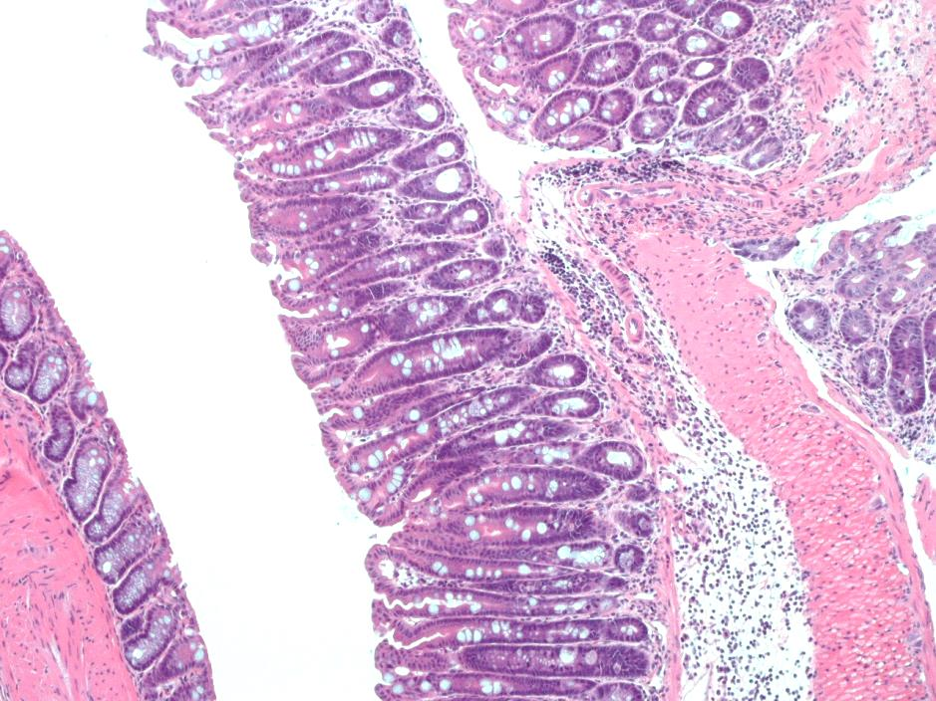
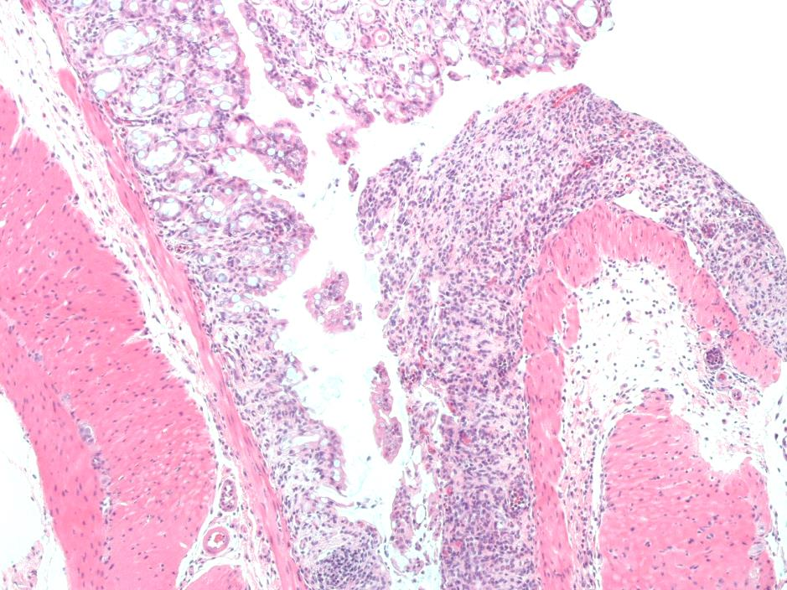
Colitis susceptibility of AIM2-deficient mice is associated with increased inflammation
IL-6
KC
WT
Aim2^{-/-}

Slide 11
AIM2 is involved in the activation of the inflammasome
*
**
**
**
**
**
**
**

Slide 12
How does AIM2 protect mice from colitis?
Bacterial burden in colon tissue
Cytokines and Chemokines
Bacterial burden in stool
Inflammation

Slide 13
Gut microbiota plays an essential role in Aim2-dependent colitis susceptibility
WT and Aim2^{-/-} mice were treated with antibiotics (ampicillin, neomycin, metronidazole, vancomycin) for 3 weeks before colitis induction.

Slide 14
AIM2 regulates the growth of E. coli
E. coli Count

Slide 15
Microbiota in Aim2^{-/-} mice are colitogenic
Littermate study

Slide 16
E. coli is responsible for higher colitis pathogenesis in Aim2^{-/-} mice
Germ-free (GF) mice were co-housed with either conventionally raised wild-type or Aim2^{-/-} mice.

Slide 17
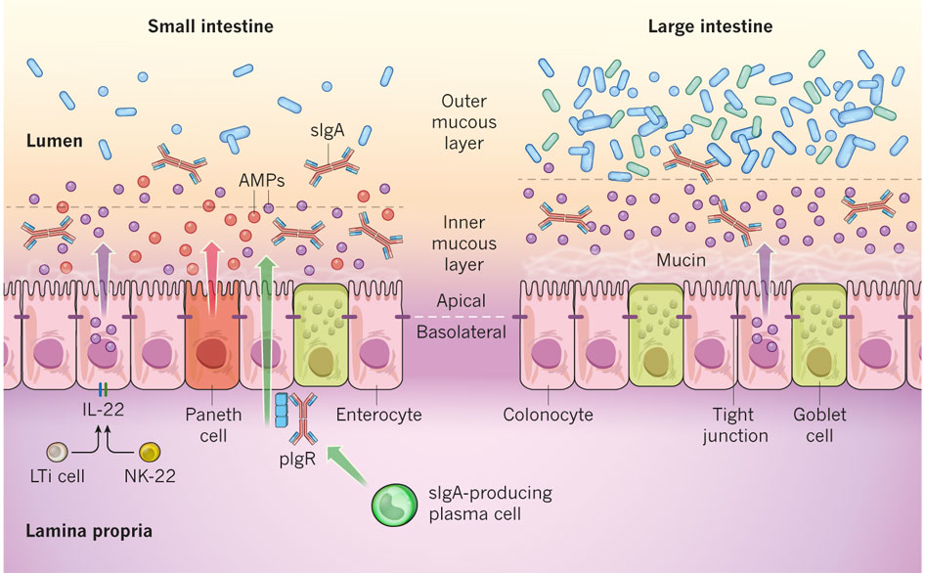
How does AIM2 control the growth of E. coli?

Slide 18
AIM2 regulates production of anti-microbial peptides
β-defensin
Reg3b
Reg3g
Lipocalin 2
S100A8
S100A9

Slide 19
The inflammasome downstream cytokines induces expression of anti-microbial peptides in intestinal epithelial cells
AIM2
Pro IL-1β & IL-18
ASC
Caspase-1
Active Caspase-1
IL-1β, IL-18
Primary intestinal epithelial cells were treated with either IL-1b (10 ng/ml) or IL-18 (10 ng/ml).

Slide 20
IL-18 treatment reduces colonic burden of E. coli and rescue Aim2^{-/-} mice from DSS-induced colitis.
IL-1β (0.3 ng/mouse)
IL-18 (0.5 ng/mouse)
3 %DSS
d0
d7
d12
d14

Slide 21
Conclusion
Microbiota
E. coli
Antimicrobial host defense
IL-1R
IL-18R
TLR
dsDNA
Lcn2, Reg3β,
Reg3γ, S100A8,
S100A9
AIM2 Inflammasome
Pro-IL-1β, Pro-IL-18
IL-1β IL-18
Proliferation
Antimicrobial peptides
Cytokines, Chemokines
Inflammation

Slide 22
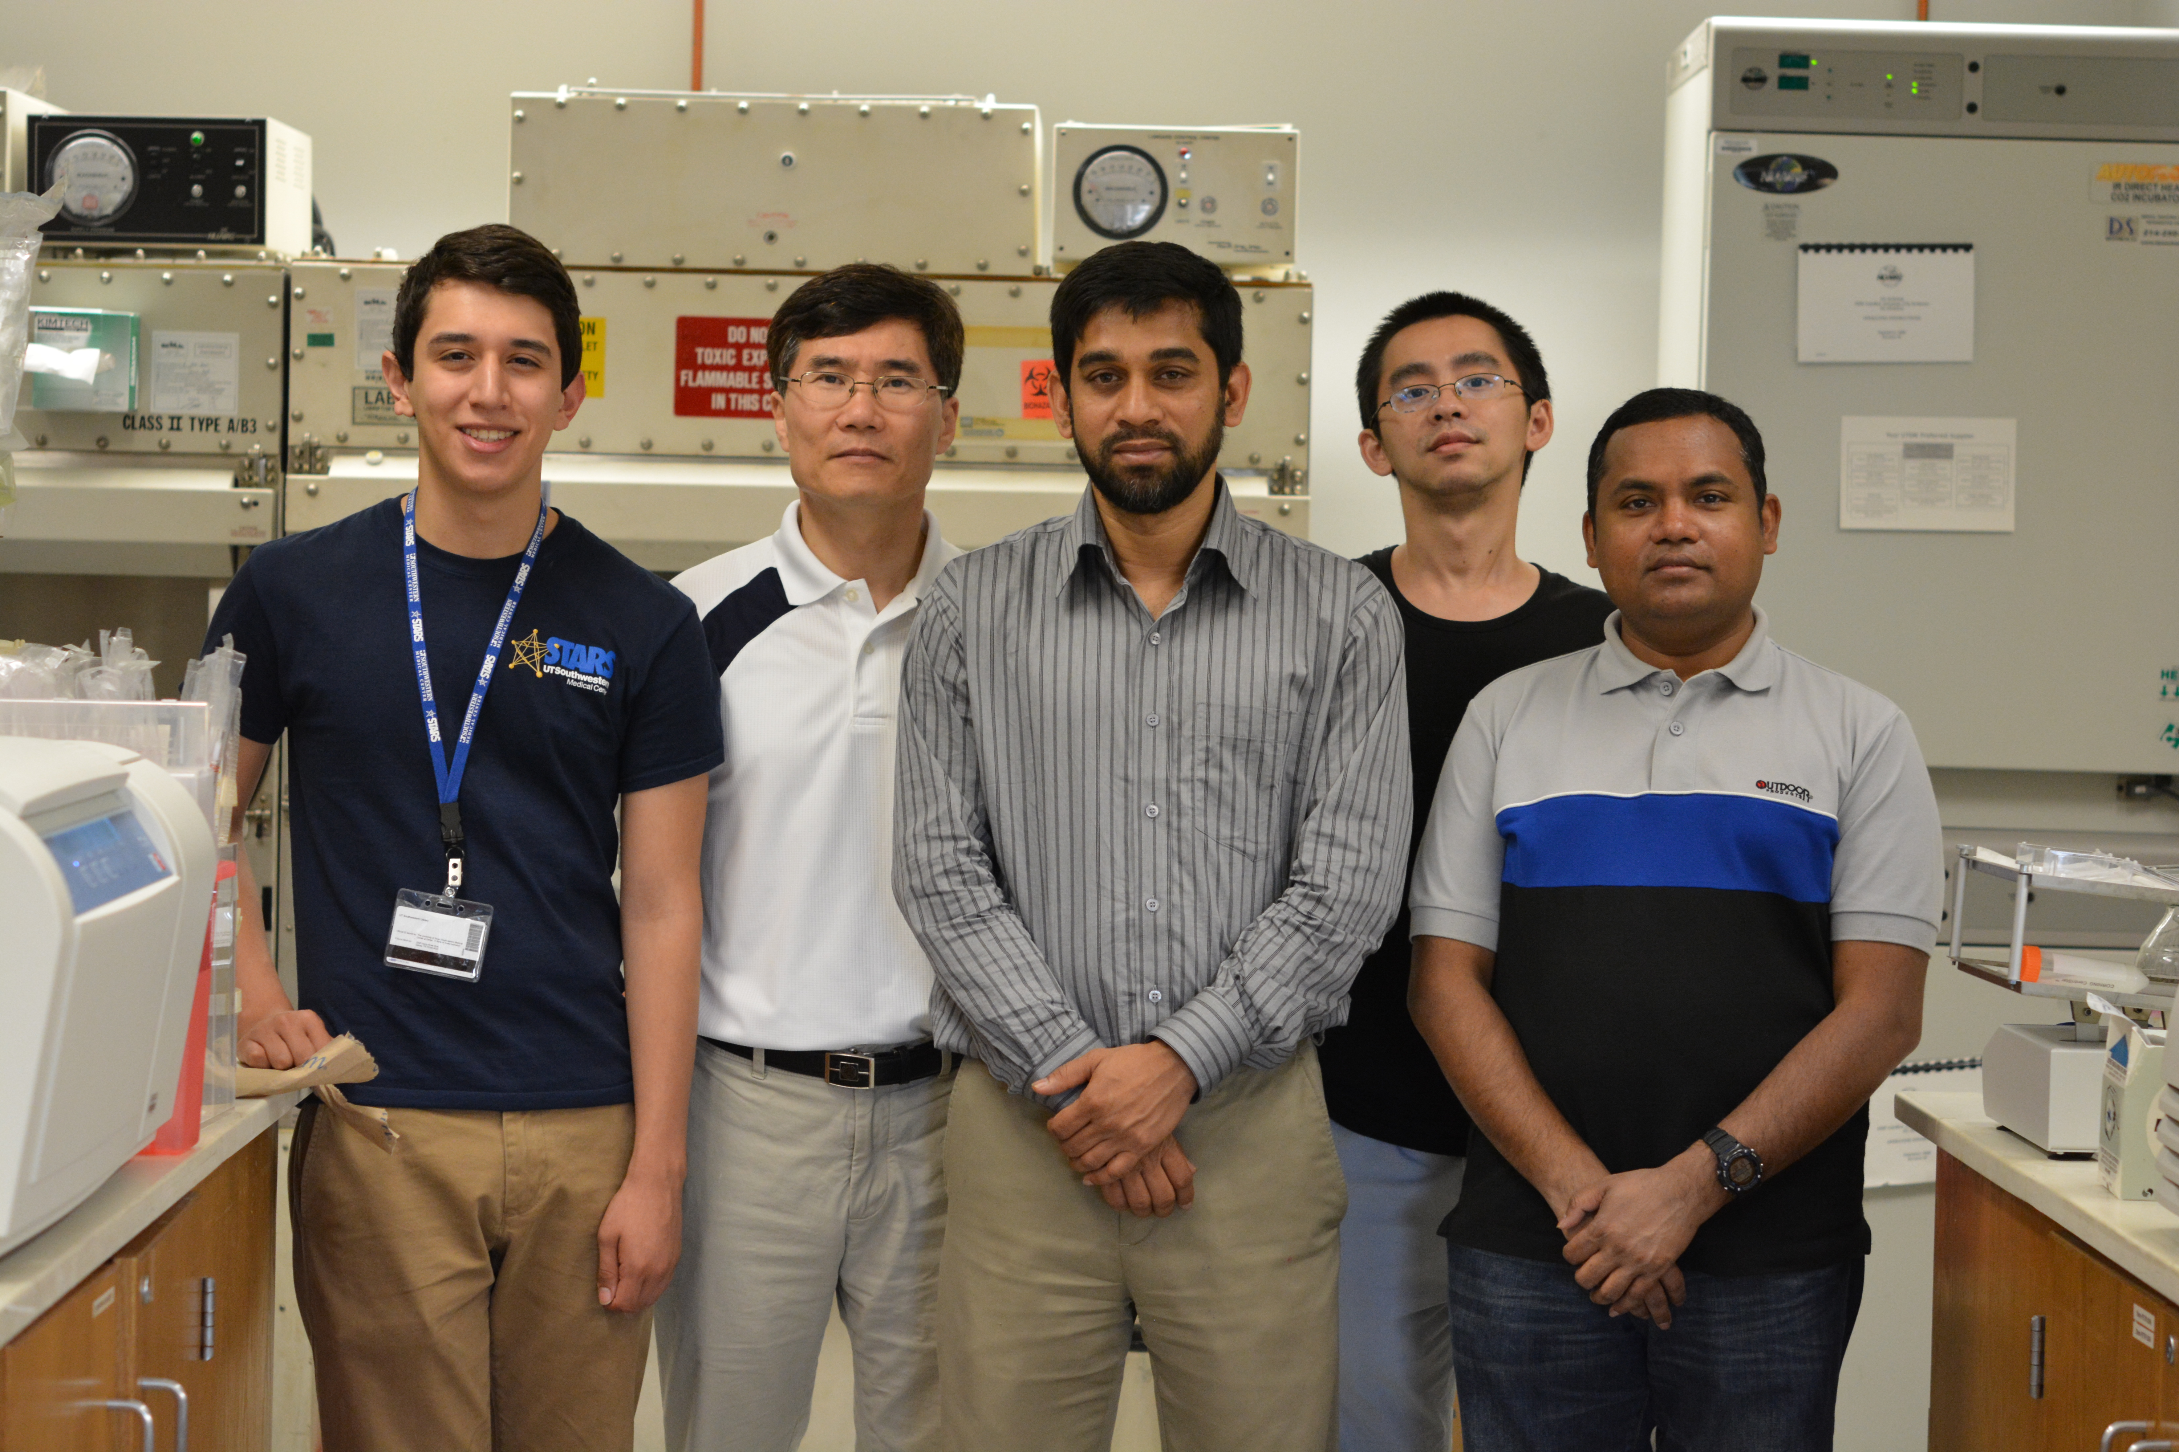
Acknowledgement
Lab Members
Shuiqing Hu, Postdoctoral Fellow
Nashir Udden, Postdoctoral Fellow
Youn-tae kwak, Research Associate
Collaborators
Supports
Dr. Lan Peng, Pathology, UTSW
Dr. James Malter, Pathology, UTSW
Dr. Lora Hooper, Immunology, UTSW
Dr. Chadrashekhar Pasare, Immunology, UTSW
UT Southwestern start up fund
Crohn’s and Colitis Foundation of America Career Development Award
American Cancer Society new investigator award

