Slide 1
About OMICS Group
OMICS Group is an amalgamation of Open Access Publications and worldwide international science conferences and events. Established in the year 2007 with the sole aim of making the information on Sciences and technology ‘Open Access’, OMICS Group publishes 500 online open access scholarly journals in all aspects of Science, Engineering, Management and Technology journals. OMICS Group has been instrumental in taking the knowledge on Science & technology to the doorsteps of ordinary men and women. Research Scholars, Students, Libraries, Educational Institutions, Research centers and the industry are main stakeholders that benefitted greatly from this knowledge dissemination. OMICS Group also organizes 500 International conferences annually across the globe, where knowledge transfer takes place through debates, round table discussions, poster presentations, workshops, symposia and exhibitions.

Slide 2
OMICS International Conferences
OMICS International is a pioneer and leading science event organizer, which publishes around 500 open access journals and conducts over 500 Medical, Clinical, Engineering, Life Sciences, Pharma scientific conferences all over the globe annually with the support of more than 1000 scientific associations and 30,000 editorial board members and 3.5 million followers to its credit.
OMICS Group has organized 500 conferences, workshops and national symposiums across the major cities including San Francisco, Las Vegas, San Antonio, Omaha, Orlando, Raleigh, Santa Clara, Chicago, Philadelphia, Baltimore, United Kingdom, Valencia, Dubai, Beijing, Hyderabad, Bengaluru and Mumbai.

Slide 3
New Generation RF Technology
Treatments & Benefits for Patients & your Bottom Line
Dr. Bojana Matovski
Hannelore Leavy

Slide 4
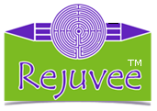
www.rejuvee.com

Slide 5
Continuing Education
Institute Rejuvee™ offers professionals Certification hands-on workshops & on-line training
Our students become proficient in:
Three Polar RF-I & RF- II-Level
Q-Polar RF
PDT Light Therapy
Ultrasound Cavitation RF
Mesotherapy RF
Electrotherapy
RF Electrocoagulation

Slide 6
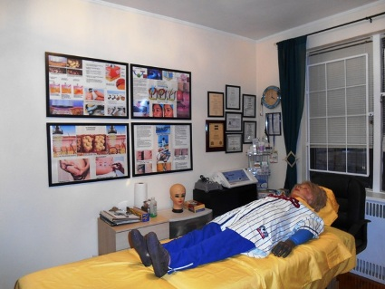
Location:
New York City
The Rejuvee™ Institute offers quality training since 2012
Certification for:
Cosmetologist
Estheticians
Massage therapist
RN’s & other Medical professionals

Slide 7
Spanish & English
RF-Technology training NOW AVAILABLE IN SPANISH!
For most popular classes:
RF – First Level & RF- Second Level
Ultrasound Cavitation RF
PDT Light Therapy
www.rejuvee.com can be read in both languages English / Spanish

Slide 8
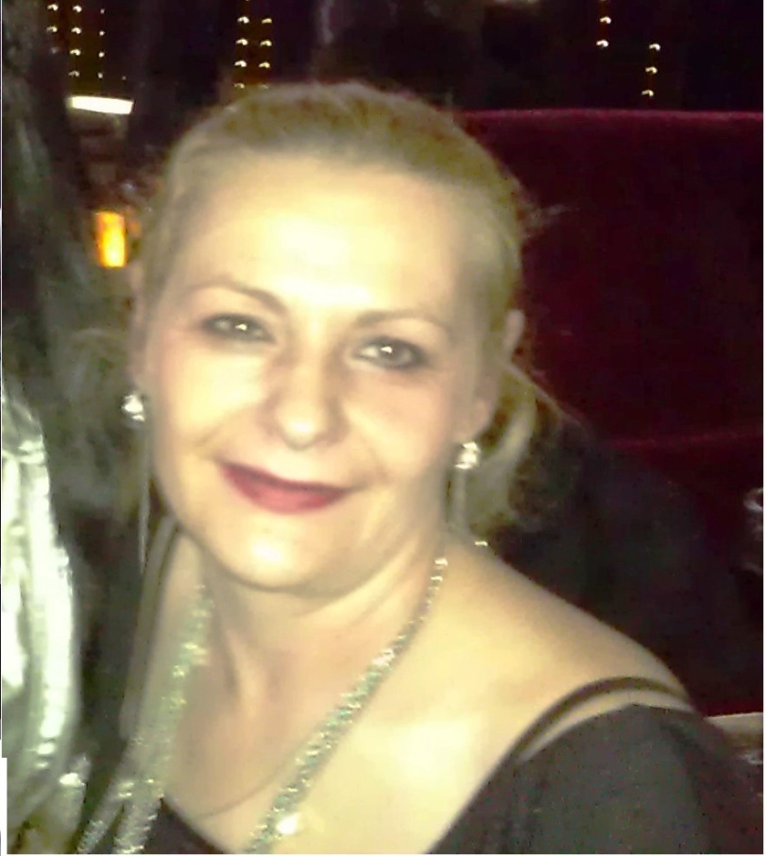
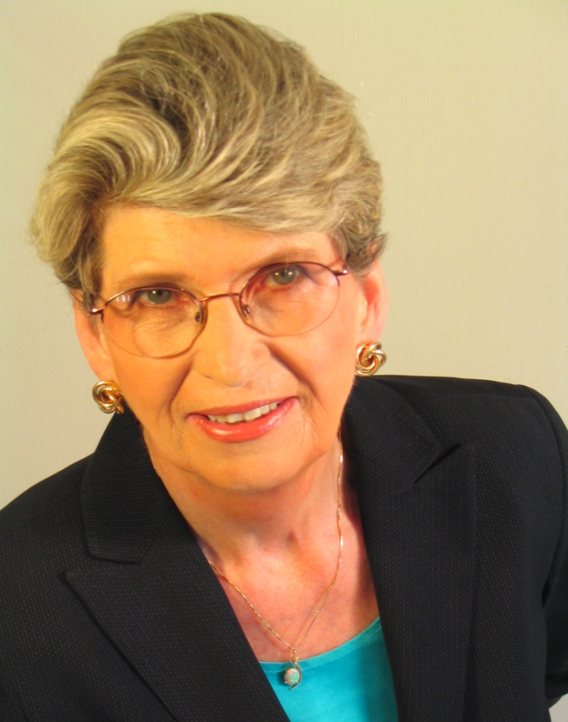
Part of a Team
Dr. Bojana Matovski
Owner/President/Trainer
Hannelore Leavy
HR Leavy LLC SPA&Wellness Consultancy

Slide 9
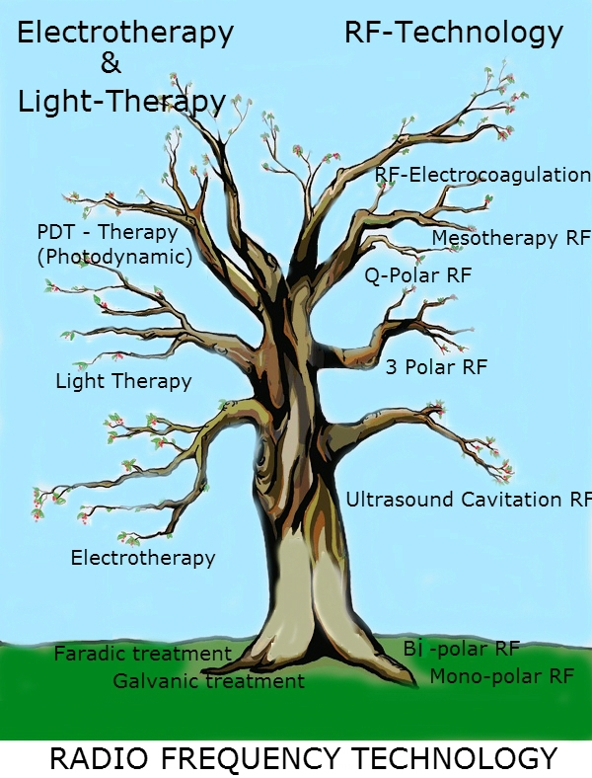
New Generation Technology

Slide 10
What is RF Technology?
Non-invasive methods of facial and body rejuvenation
Effective ways to increase skin laxity without downtime
Minimal recovery but high level of safety with aesthetic RF treatments

Slide 11
Applications of RF
Ultrasound Cavitation RF
Three Polar RF
Q-Polar RF
Mesotherapy RF
Electrocoagulation RF

Slide 12
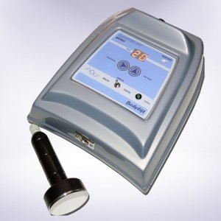
Ultrasound Cavitation RF
-Ultrasonic Cavitation Technology concentrated sonic energy to localized treatment areas
-Breakdown fat cell membrane
-The fat is released into the interstitial fluid between the cells
-They are enzymatically metabolized to glycerol and free fatty acids
-Water-soluble glycerol travels into the circulatory system
-Free fatty acids enter the liver

Slide 13
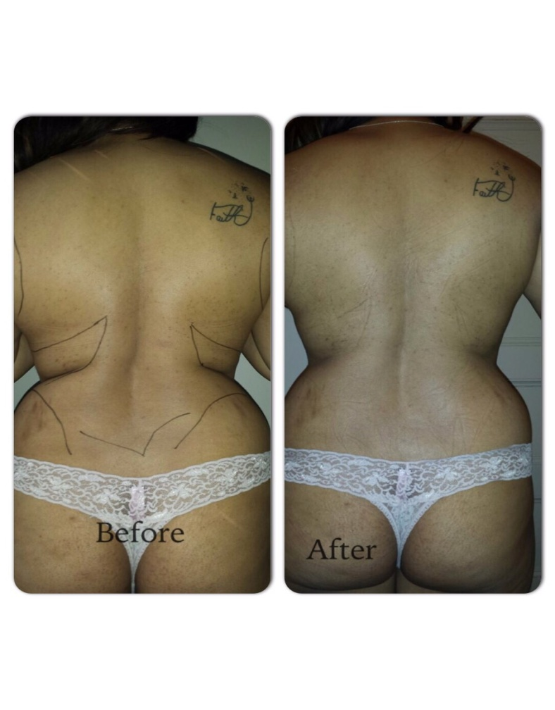
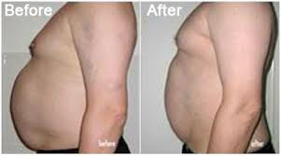
Ultrasound Cavitaton RF
Before / After
Before / After

Slide 14
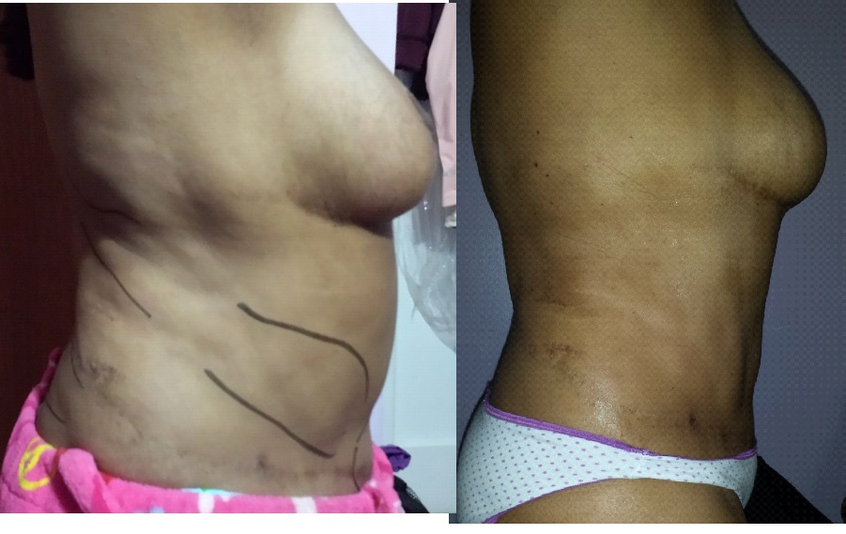
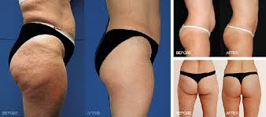
Ultrasound Cavitation RF
Shaping the body
Before / After Treatment
Reduction of cellulite & shaping the body

Slide 15
Results
- Non-surgical solution for local fat deposit reduction
- The results guarantee a diameter loss of up to 2 cm in the area treated in each session
- Cellulite reduction and body shaping
- No pain
- No-Zero risk

Slide 16
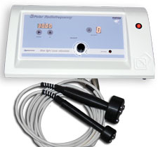
3rd Generation RF Technology
What is it?
-Applies three or more electrodes
-High frequency electric current under the skin
-Focused electric energy
- Without any active cooling

Slide 17
Treatments
Selective heating of the fat cells increased rate of lipolysis
Metabolic processes
Dermal tightening is simultaneously achieved by the heating of collagen fibers in the extra cellular matrix
The tightening effect is immediately
Fibroblast proliferation, as well as long-term collagen remodeling

Slide 18
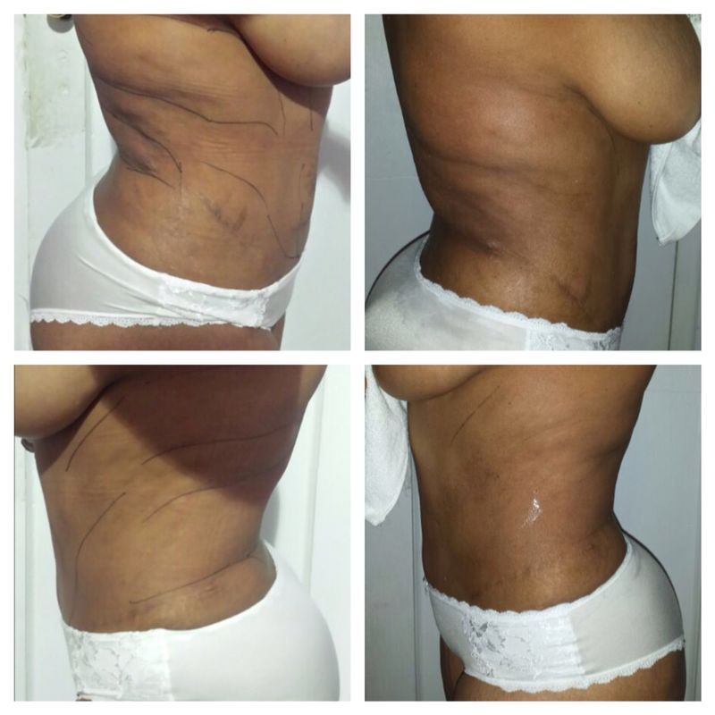
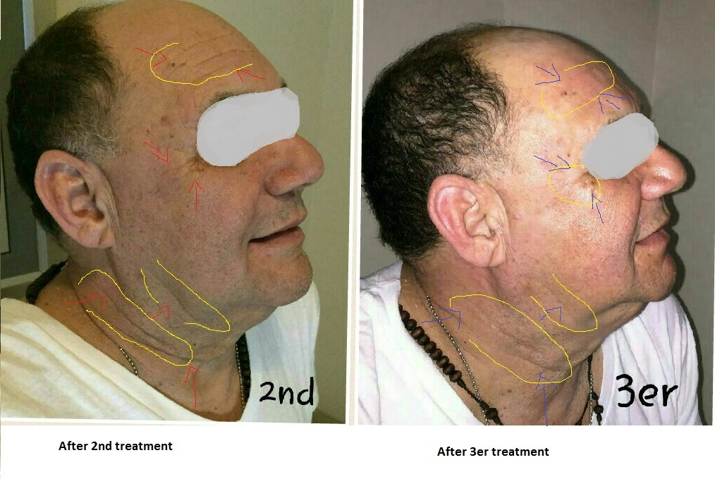
3rd Generation RF Technology
Before/After
Before/After

Slide 19
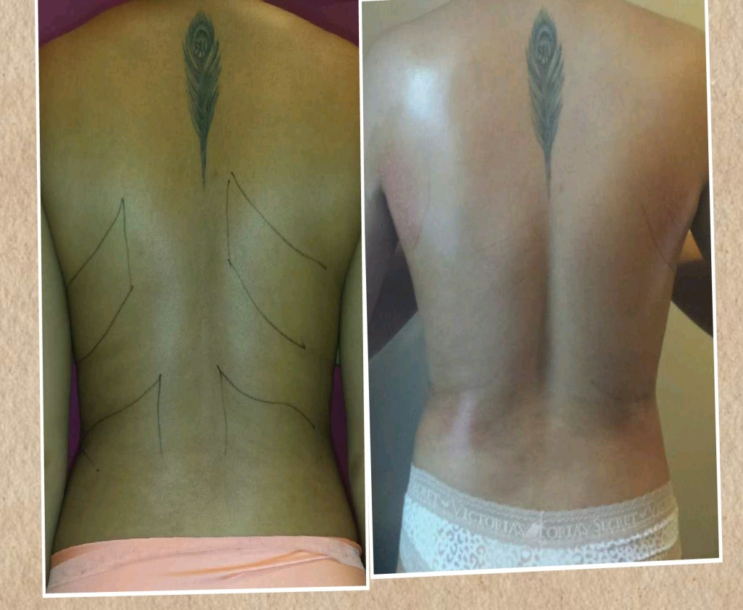
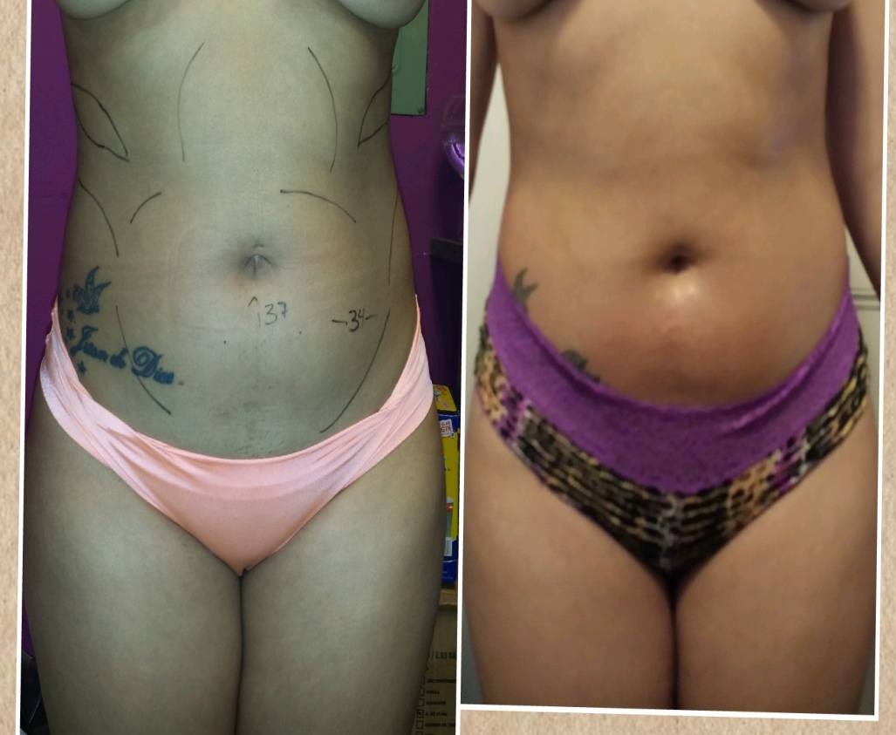
Body Contouring
Before/After Treatments
Before/After Treatments

Slide 20
Results
Clinical safety
The treatments are pleasant for all skin types
Immediate face lifting and instant reduction of facial wrinkles and contours
Measurements depicts reduced tummy circumference by up to 9 cm
Long terms results include cellulite, wrinkles and contours improvement

Slide 21
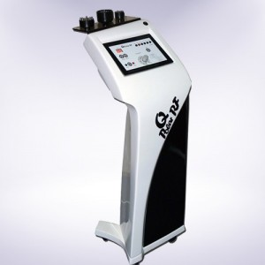
Q-Polar RF Technology
RF Q–Polar is based on Active's BRF Technology
(Burst Repetition Frequency).
Combined with real–time
Q-Polar RF is designed to produce skin-tightening
Removes unwanted fat and toxins

Slide 22
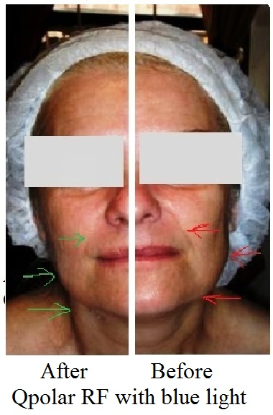
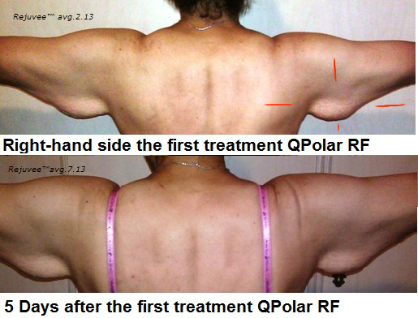
Q-Polar RF Technology
10 minutes after the first
treatment.
Before/ After First Treatment

Slide 23
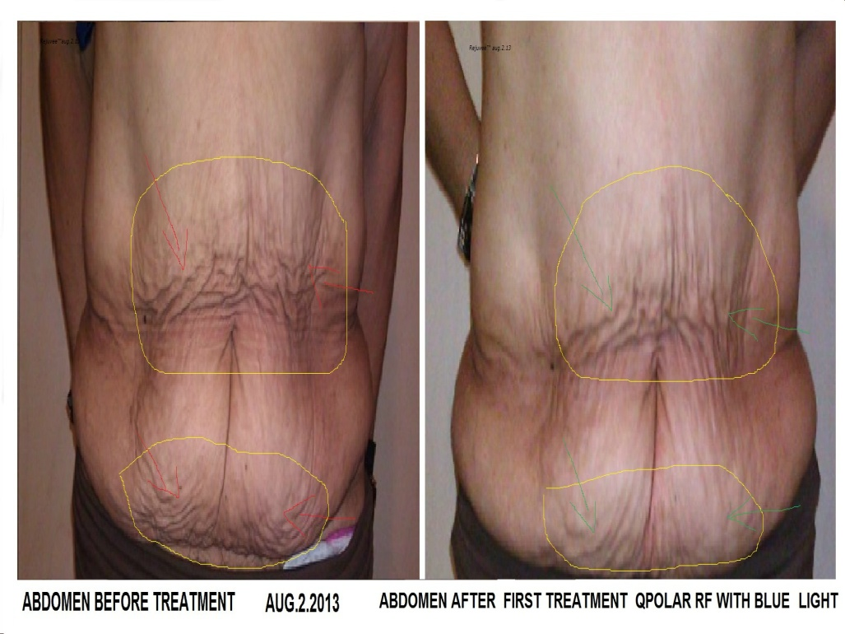
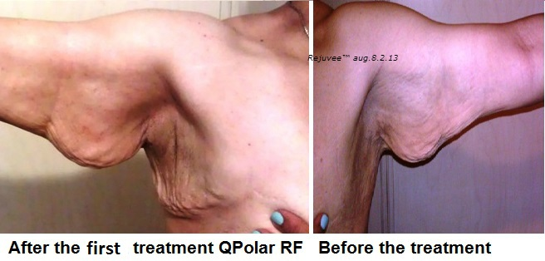
Body Contouring
Before /After First Treatment
Before /After First Treatment

Slide 24
Results
The treatment results are:
- Improvement of wrinkles and expression lines
- skin elasticity and texture
- tissue flaccidity
In the long run, this technique will activate fibroblasts to produce new collagen fibers
The goal of skin tightening and rejuvenation is:
- Reshape the skin with no side effects on the Epidermis
- Selective contraction of collagen by Dermal Heat
- Enhancement of new collagen synthesis

Slide 25
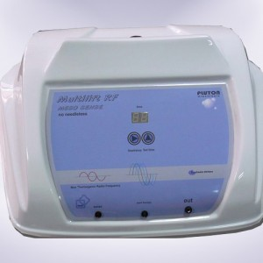
Mesotherapy RF
-Needle free -Mesotherapy RF
-Without the assist of any injector
-Mesotherapy RF transmit nutrients into the inner membrane through AQP
-Bipolar RF energy can act on the deep dermis
-Part of trichology treatment

Slide 26
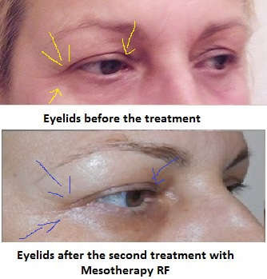
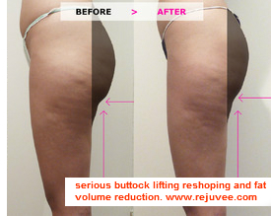
Mesotherapy RF
Before/After
Before/After

Slide 27
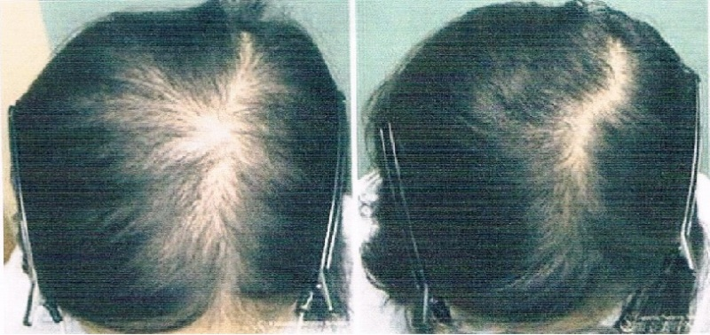
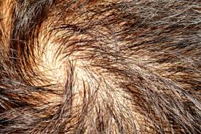
Mesotherapy RF in Trichology
Before/After treatment with stem cell
Hair & Scalp Problems

Slide 28
Results
All the benefits RF with those of active ingredients:Hyaluronic Acid, Centella Asiatica, Hydroxyproline, Skin Peptides, Vitamin C and many others
Mesotechnology RF - Facial rejuvenation
Mesotherapy RF - sculpts the body
-specifically attacks the causes of cellulite
–part of treatment in trichology

Slide 29
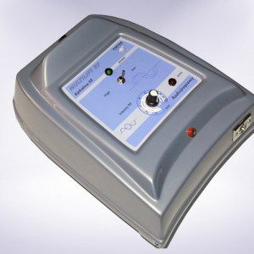
Electrocoagulation RF
RF Epilator - Electrocoagulation system
-A safe, non-invasive, effective treatment for embarrassing skin blemishes
-It is a means to quickly remove vascular lesions such as, cherry angiomas
-Spider veins, and skin tags found on the face and body
-This quick and simple treatment will not cause scarring or hyperpigmentation

Slide 30
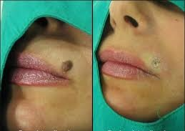
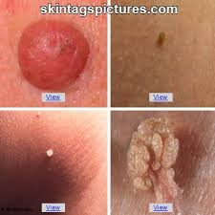
Electrocoagulation RF
Before/After
Skin tags

Slide 31
Results
Electrocoagulation may be used to remove vascular blemishes such as:
Broken Capillaries (Telangiectasia)
Ruby points
Spider Angioma
Skin Tags
Warts

Slide 32
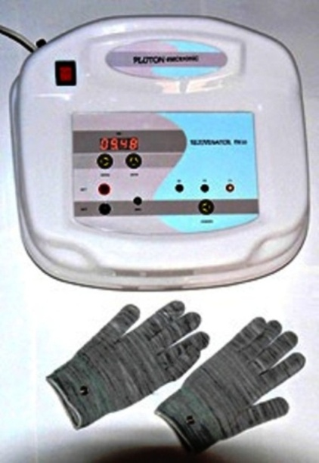
Newest Electrotherapy
-Microcurrent - or bioelectric therapy because it encourages cell physiology and growth
-Ionic exchanges across the cell membranes
-function: cell-to-cell communication
-nutrients from the blood
-essential for healthy cell
-removal of cellular waste

Slide 33
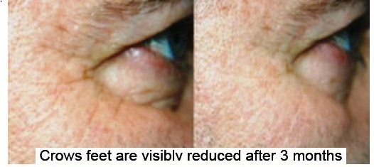
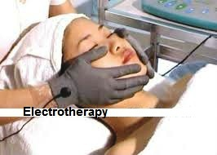
Newest Electrotherapy
Before/After
Electrotherapy with magic gloves

Slide 34
Results
Promotes cell metabolism and tissue repair
✔ Supports circulation – blood and lymph
✔ Reduces inflammation
✔ Diminishes lymphedema in cancer patients
✔ Increase natural production of collagen and elastin
✔ Support scar repair by dispersing scar tissue and collagen remodeling
✔ Increase protein synthesis, gluconeogenesis (GNG) and membrane transport.
✔ Reeducate and rejuvenate muscle tissue
✔ Supports healing of bone
✔ Heals skin ulcerations
✔ Used in equine medicine

Slide 35
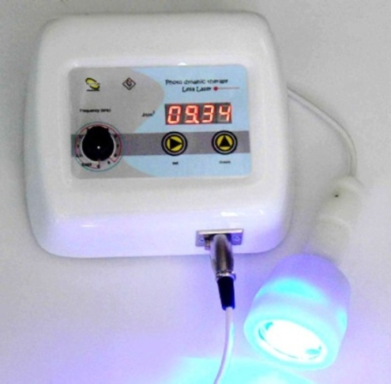
PDT –LIGHT – PHOTODYNAMIC THERAPY
PDT is the photon-induced stimulation of porphyrin, compounds used in the production of hemoglobin
porphyrin moves into a higher energy state, reacts with oxygen
The central nervous system triggers whole-body metabolism, cellular exchange of nutrients and other products of metabolism

Slide 36
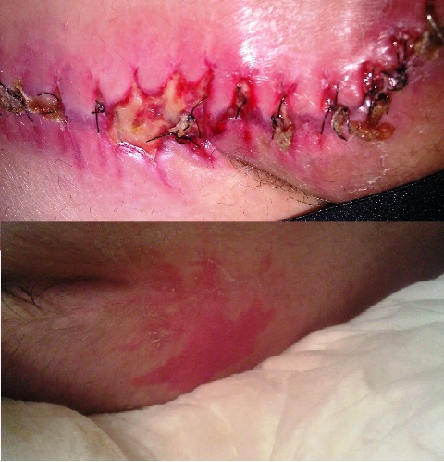
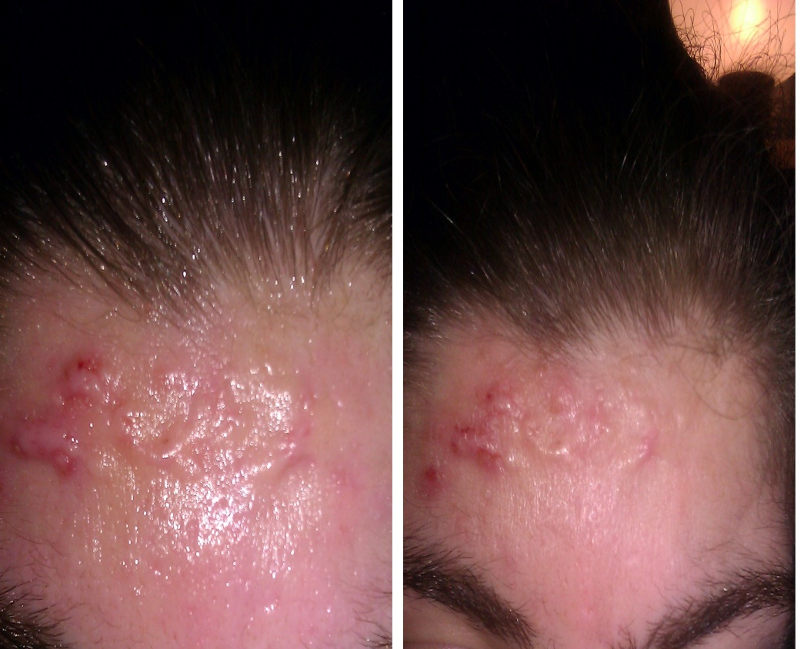
PDT-LIGHT-PHOTODYNAMIC THERAPY
FOR ACNE TREATMENT
BEFORE/AFTER
POST-OPERATIVE INFECTIONS

Slide 37
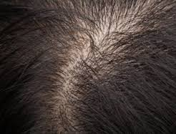
PDT-PART OF TRICHOLOGY
BEFORE
AFTER

Slide 38
INDICATIONS IN COSMETICS AND
MEDICINE
ACNE
BURNS
CUTS
SCRATCHES
ECZEMA
HERPES
BRUISES
POST-OPERATIVE INFECTIONS
HAEMATOMAS
SOFT-TISSUE SPRAINS
NECK AND BACK INJURIES
SMALL-BONE FRACTURES
ACUTE AND CHRONIC PAIN
JOINT TREATMENT
- TRICHOLOGY

Slide 39
Newest Technology
Treatments should not take place during:
1. Menstruation
2. Pregnancy
3. Breastfeeding
Do not give treatments to a client with:
1. A malignant tumor in the body
2. Pacemaker
3. Metal implants of any kind

Slide 40
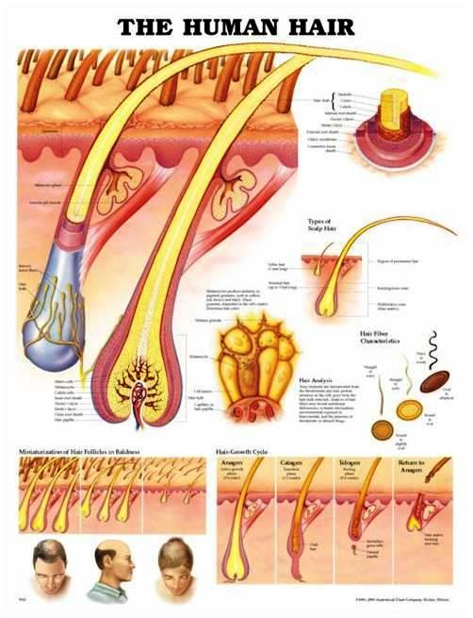
WHAT IS TRICHOLOGY?
-Is the para-medical science of the hair, hair loss and associated scalp problems
-Trichology is perceived as the “bridge between cosmetology and dermatology”

Slide 41
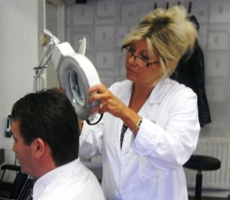
What is a trichologist?
-Is a hair and scalp specialist
-suggests individualized treatments
-gives nutritional advice
-recommends lifestyle changes
-works with physician associated with your hair loss
-advises the best treatment regimen

Slide 42
Newest Technology for hair & scalp problems
Analyzing hair & scalp problem
Consultation with physician
Regimen treatment
PDT – Therapy
Mesotherapy RF
Home care

Slide 43
Questions?
Dr. Bojana Matovski

Slide 44
HR LEAVY LLC
Spa & Wellness Consultancy
THE SPA ENCYCLOPEDIA (Co-Author)
Founder & previous Executive Director THE INTERNATIONAL MEDICAL SPA ASSOCIATION
Publisher – THE DAY SPA & MEDICAL SPA DIRECTORY; THE DAY SPA / MEDICAL SPA BUSINESS BIBLE; EVOLUTION & FUTURE OF THE Day Spa & Medical Spa Industries; dozens of articles in trade & consumer publications, TV appearances on CNN + MSNBC

Slide 45
PROFIT CENTER
INSTANT UPGRADE OF YOUR PRACTICE OR SPA
Join numerous facilities around the world to offer their clients the ultimate in advanced treatments
RF TECHNOLOGY will increase your income over
$100,000 per year
NO RISK or EXPENSE

Slide 46
Profit Center Rejuvee™
RENT or FINANCE/LEASE TO OWN
- No Upfront Investment
- Financing options through https://www.amerifund.cc/secure/partners/rejuvee/ You can buy your machine at the end of your leasing term for only 1 penny
BUY UPFRONT

Slide 47
3 Polar RF with blue light
RENTAL/LEASE INCOME YOU’RE COST
$150-300 per treatment (30-45 min.) (MONTHLY MINIMUM)
Tri Polar treatments provide immediate 1-month-$1200- per day $40
visual effect and a long-term result. 3-month-$ 990 - per day $33
The immediate visible effects are a 6-month-$890 - per day $29
smoother, tightened appearance 12-month-$790 - per day $26
Texture visible from the very 1st treatment
BUY TO OWN
3 Polar RF $4,399.00
Min. $150.00 per treatment X 6 =$900.00 5-6 clients $4500.00

Slide 48
Ultrasound Cavitation
RENTAL/LEASE INCOME YOU’RE COST
$115-230 per treatment (50 min.) (MONTHLY MINIMUM)
The Ultrasonic Cavitation RF 1-month-$929-per day $30
low-frequency used for reducing 3-month-$810-per day $27
localized fat and cellulite 6-month-$750-per day $25
Results guarantee a diameter 12-month-$700-per day $23
Loss of up to 2 cm in the area treated per session
BUY TO OWN
Ultrasound Cavitation $3,999.00
Min. $100 per treatment X 6 = $600.00 6-7 clients $3600

Slide 49
MESOTHERAPY RF
RENTAL/LEASE INCOME YOU’RE COST
$115-230 per treatment (30 min.) (MONTHLY MINIMUM)
Results after first 1 month-$740- per day $24
Meso Lift-RF treatment 3-month-$680-per day $22
Mesotherapy-simulators 6-month-$590-per day $19
improvements continue 12-month-$550-per day $18
over the following months
BUY TO OWN
Mesotherapy RF $2,899.00
Min $100.00 per treatment X 6 = $600.00 4–5 clients $2400

Slide 50
PDT Light Therapy
RENTAL/LEASE INCOME YOU’RE COST
$70-115 per treatment (30 min.) (MONTHLY MINIMUM)
PDT - face or body acne or 1-month-$450-per day $15
keratosis on the hands 3-month-$370-per day $12
PDT-reducing pigmentation, erasing 6-month-$350-per day $11
broken capillaries, skin texture 12-month-$320-per day $10
In summary, ALA selectively targets the cells that cause acne and particular skin cancers like solar keratosis, and then is activated by a LED light or laser, which selectively destroys these cells.
BUY TO OWN
PDT-light $1,499.00
Min. $70.00 per treatment X 6 = $420.00 3–4 clients $1260

Slide 51
BUY UPFRONT
ROI Calculation Break even
Ultrasound Cavitation $3,999.00
Min. $100 per treatment X 6 = $600.00 6-7 clients $3600
3Polar RF $4,339.00
Min. $150.00 per treatment X 6 =$900.00 5-6 clients $4500
Mesotherapy RF $2,899.00
Min $100.00 per treatment X 6 = $600.00 4–5 clients $2400
PDT-light $1,499.00
Min. $70.00 per treatment X 6 = $420.00 3–4 clients $1260

Slide 52

THE SPA ENCYCLOPEDIA
The first & only book that explains over 70 spa treatments, their benefits and therapeutic powers for specific conditions.
This book examines the different types of spas - destination, resort, and day spas -- and explains exactly what visitors should expect from each. The role of physicians and medical specialties in a "medical spa" are included, as well as an ongoing maintenance regimes.
This book reveals the spa world and benefits it offers. It also helps spa technicians, owners, managers, and health care professionals as well as physicians determine how best to help their clients, guests, and patients.
16-page, illustrated reference section, explaining each treatment - what happens during each treatment, which ailment or condition it is intended for, what the benefits are, and what are the counter-indications.
An appendix cross-references each treatment by ailments/conditions for easy searches.

Slide 53
HR LEAVY LLC
Spa & Wellness Consultancy
Hannelore Leavy
CONTACT:
HRLEAVYLLC@AOL.COM;
201-590-8115

Slide 54
www.rejuvee.com
Questions?
THANK YOU FOR YOUR ATTENTION
Team Rejuvee
Dr. Bojana Matovski (info@rejuvee.com) ; 201-660-0321
Hannelore Leavy (hrleavyllc@aol.com); 201-590-8115

Slide 55
Let us meet again..
We welcome you all to our future conferences of OMICS International
5th International Conference and Expo
on
Cosmetology, Trichology & Aesthetic Practices
On
April 25-27, 2016 at Dubai, UAE
http://cosmetology-trichology.conferenceseries.com/

