Slide 1
Therapy with immune modulators (Cyclosporine A) in dermatology (focusing on psoriasis, atopic eczema, allergic vasculitis, and chronic urticaria)
Hana Zelenková, M.D., Ph.D.
Private Clinic of Dermatovenereology
DOST Svidník, Slovakia

Slide 2
Cyclosporine A
Cyclosporine A is an immunosuppressant cyclic polypeptide isolated from the Tolypocladium inflatum fungus
Indications:
  organ transplantations (kidney, liver, heart, lungs, pancreas, skin), bone marrow transplantations, autoimmune disorders, and
selected dermatoses such as psoriasis or atopic dermatitis

Slide 3
Cyclosporine A - indications
First choice drug to treat selected dermatoses like psoriasis, or AD
Autoimmune disease like SLE, pemphigus, urticaria
The indication range is constantly widening
Important note – inform your patients and other physicians that CsA must not be combined with certain other drugs that might either increase or decrease its effect, and certain foodstuffs!

Slide 4
Cyclosporine A
Dosing and monitoring
Oral CsA is preferred in most indications
Optimum dosing: two doses, one taken in the morning and one in the evening (suitable in patients with dermatoses)
Transplanted patients require routine monitoring of CsA levels in blood
In non-transplanted patients CsA monitoring is only of limited importance

Slide 5
Cyclosporine A – laboratory screening, adverse effects
creatinine levels, liver functions, and blood pressure must be monitored
most often reported adverse effects include: hypertrichosis, tremor, weakness, disturbed kidney functions, loss of appetite, nausea, vomiting, and allergic skin reactions
considering the potential risk of skin malignancy, it is necessary to warn CsA patients about sun exposure!

Slide 6
Cyclosporine A in dermatology
Therapeutic indications – 3 groups:
Group I - dermatoses treated with maximum efficacy drugs, where CsA represents an extraordinarily effective first choice drug: pyoderma gangrenosum; generalised unmanagable scleroderma; morphaea, psoriasis generalisata et psoriasis arthropatica, acrodermatitis continua suppurativa, atopic dermatitis

Slide 7
Cyclosporine A in dermatology
Group II - dermatoses treatable with an alternative systemic drug based on the therapist’s choice, however, with CsA as the best choice: psoriasis vulgaris gravis, psoriasis pustulosa, neurodermitis gravis, Bechcet syndrome, actinic reticuloid, bullous dermatoses, dermatomyositis

Slide 8
Cyclosporine A in dermatology
Group III – other dermatoses
Individual therapy ➔ considering the expected prognosis and potential relapses
Group III ➔ is still widening, and is expected to become the most numerous group in the future (chronic urticaria, vitiligo)

Slide 9
Cyclosporine A in dermatology
In clinical dermatology, CsA therapy must be used in a uniform manner
Criteria must be set to identify those patients who might benefit from CsA therapy
CsA therapy must be tailor made to the patient to fit their current condition

Slide 10
Cyclosporine A in dermatology - therapeutic schemes
Rapidly decreased high initial doses
"Low dose CsA" – slower onset of action, and prolonged optimum dosing
Maintenance weekend therapy“
In literature there are cases described of patients with various dermatoses using maintenance doses of CsA for months or even years

Slide 11
CsA in dermatology- therapeutic schemes
Continuous and intermittent therapy (cyclosporine consensus 2003)
General consensus about the risk of rapid discontinuation of high CsA doses ➔ which may lead to severe complications
Usage at 12-hour intervals
1 hour prior to administration
grapefruit juice should be avoided

Slide 12
INTERMITTENT THERAPY SCHEME

Slide 13
CsA and Psoriasis vulgaris
in 18 years we treated more than 660 patients
with initial doses of 3-5 mg /kg
in form of continuous and intermittent therapy, with doses decreased according to condition
and at the end we switched to weekend therapy
with maximum dosing period of 3 years
6 patients had increased blood pressure
16 patients discontinued the therapy due to intolerance

Slide 14
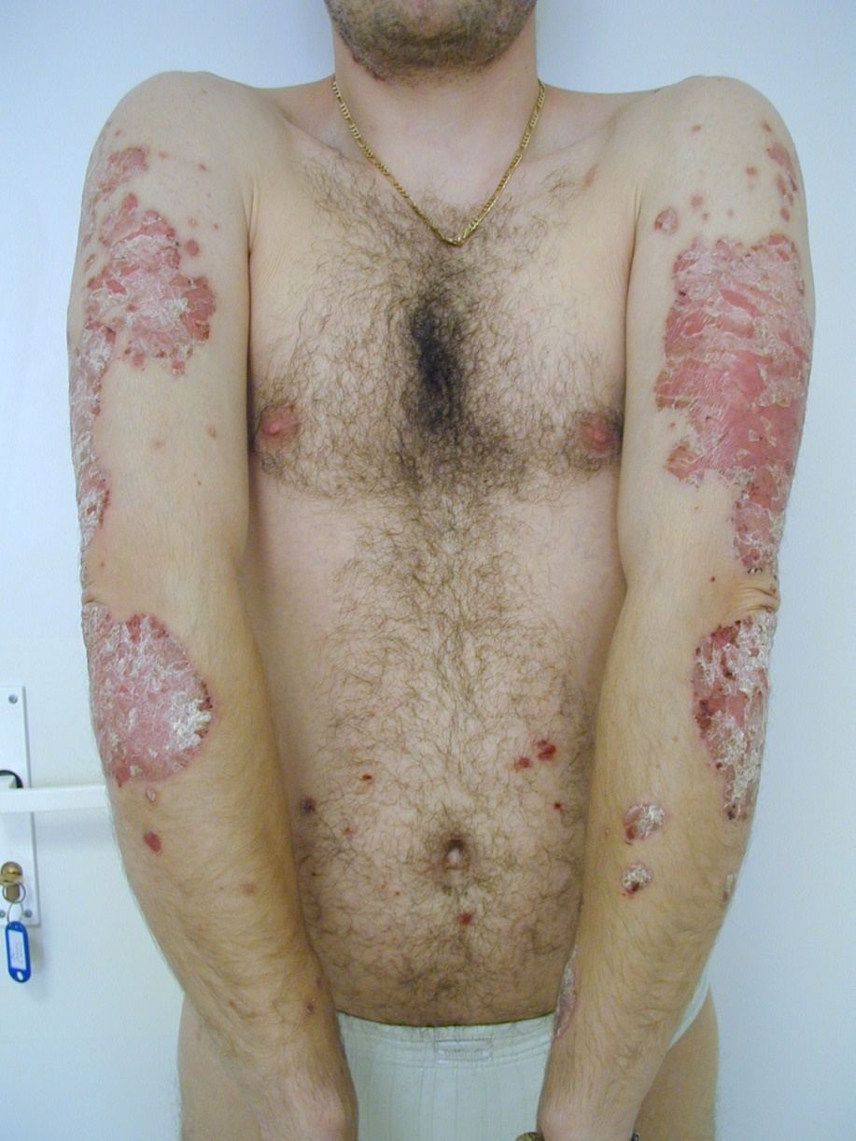
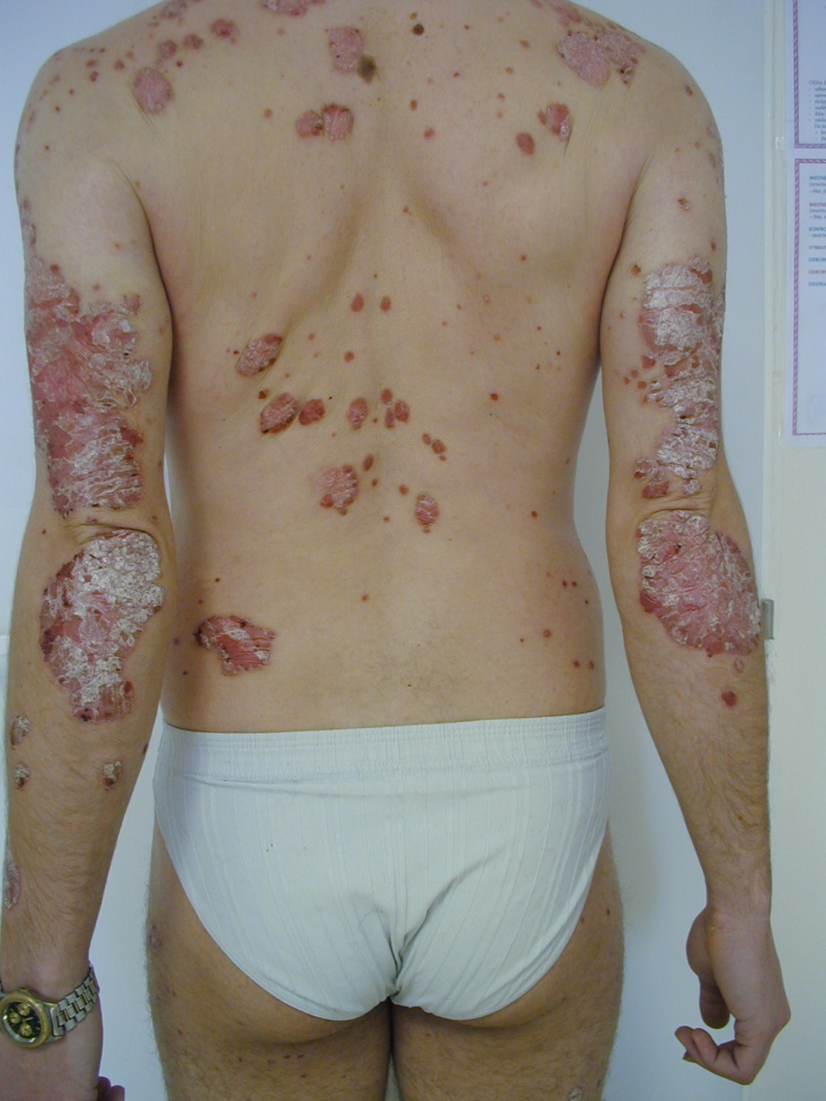
Clinical effect - before therapy

Slide 15
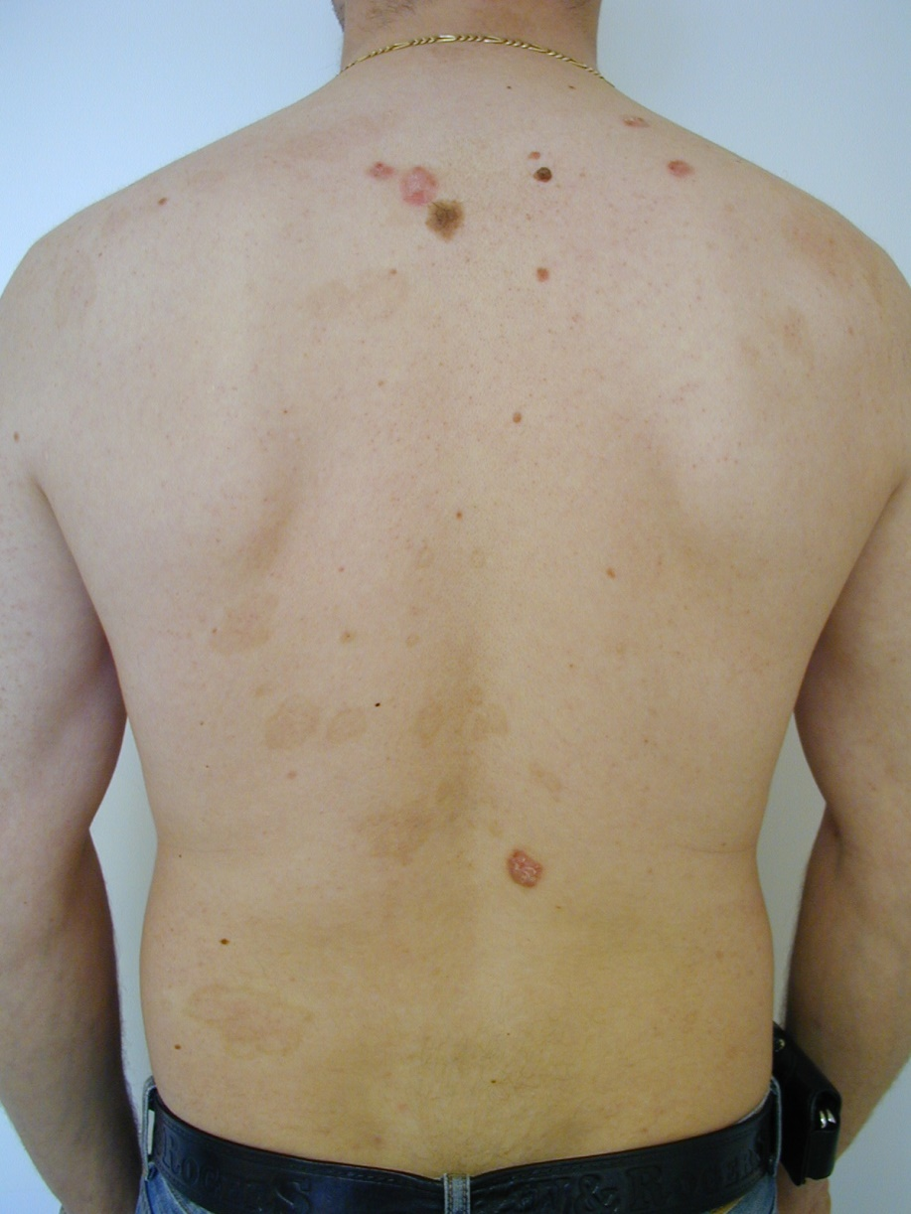
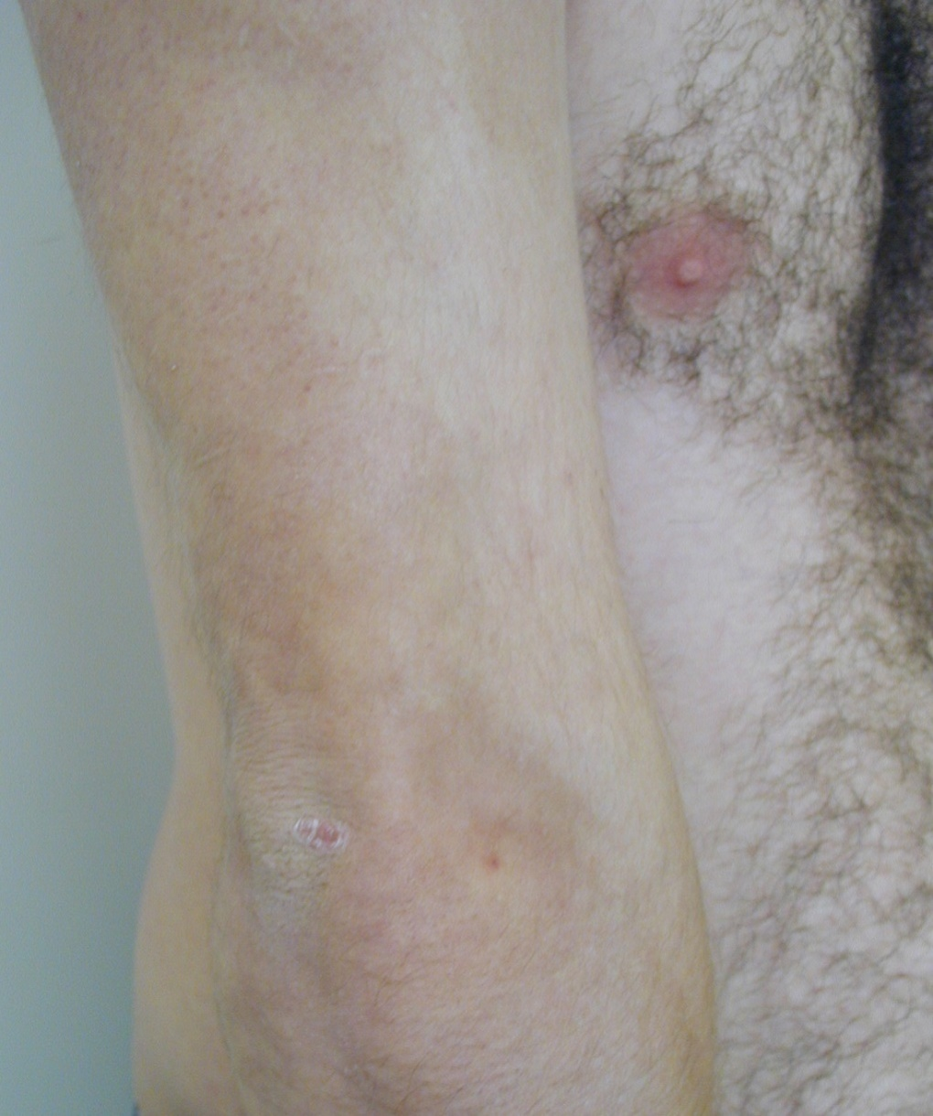
Clinical effect after 14 months of therapy, with 8 years in remission

Slide 16
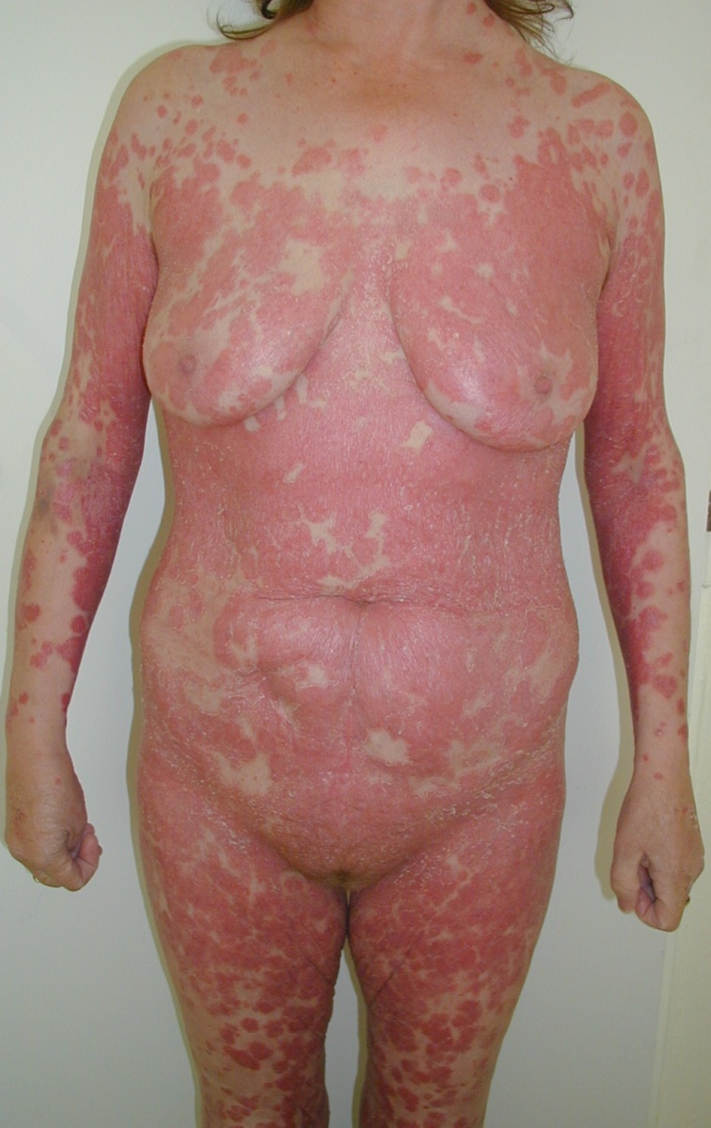
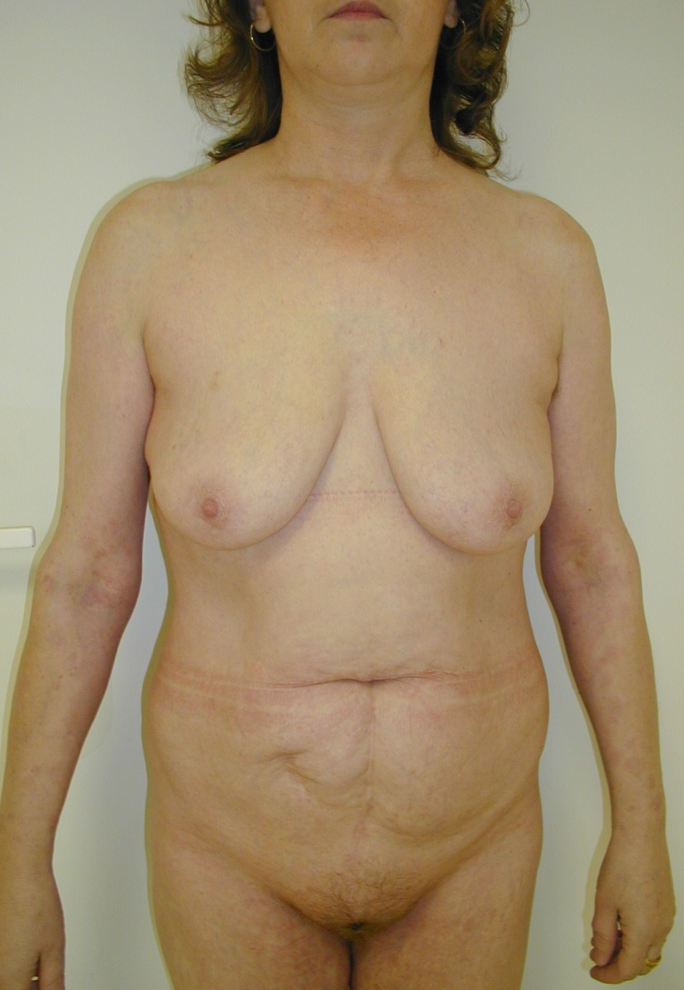
Local finding before and after therapy

Slide 17
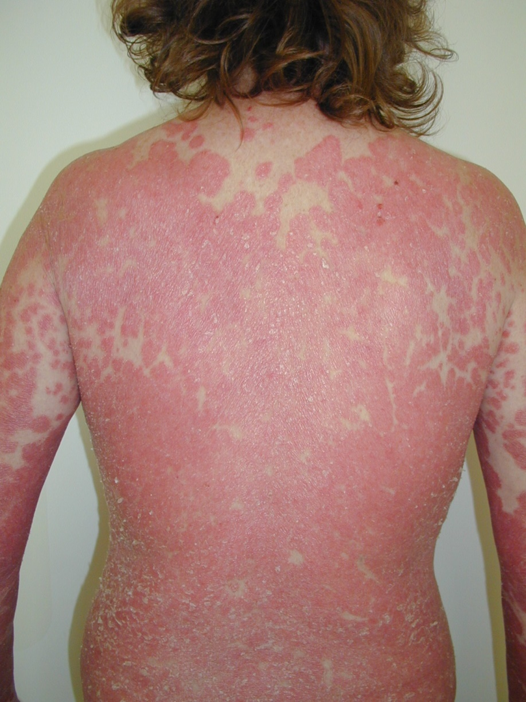
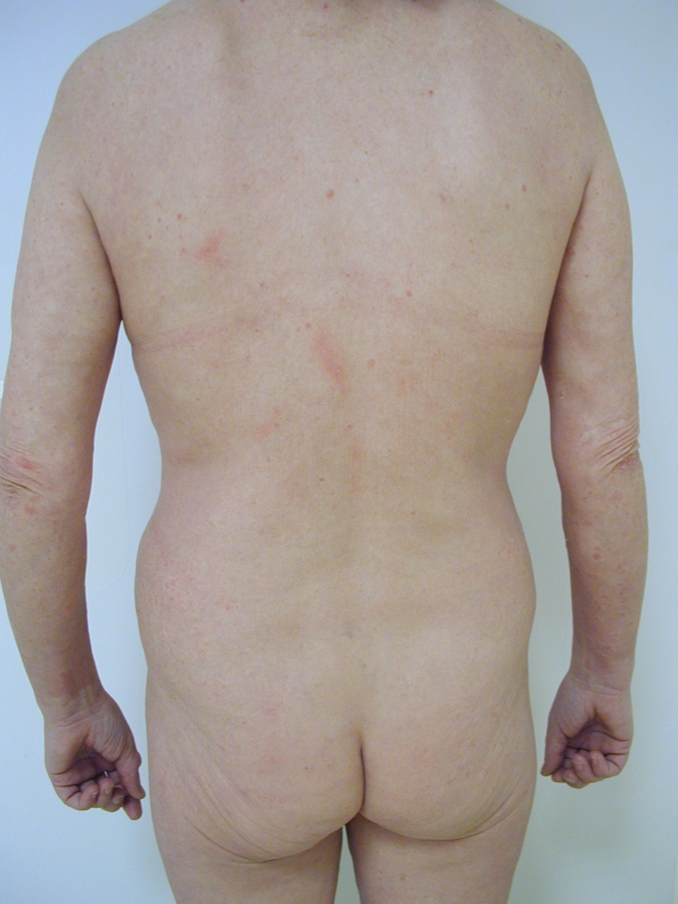
Local finding after 8 months of therapy, 1 year of weekend therapy, with 6 years in remission

Slide 18
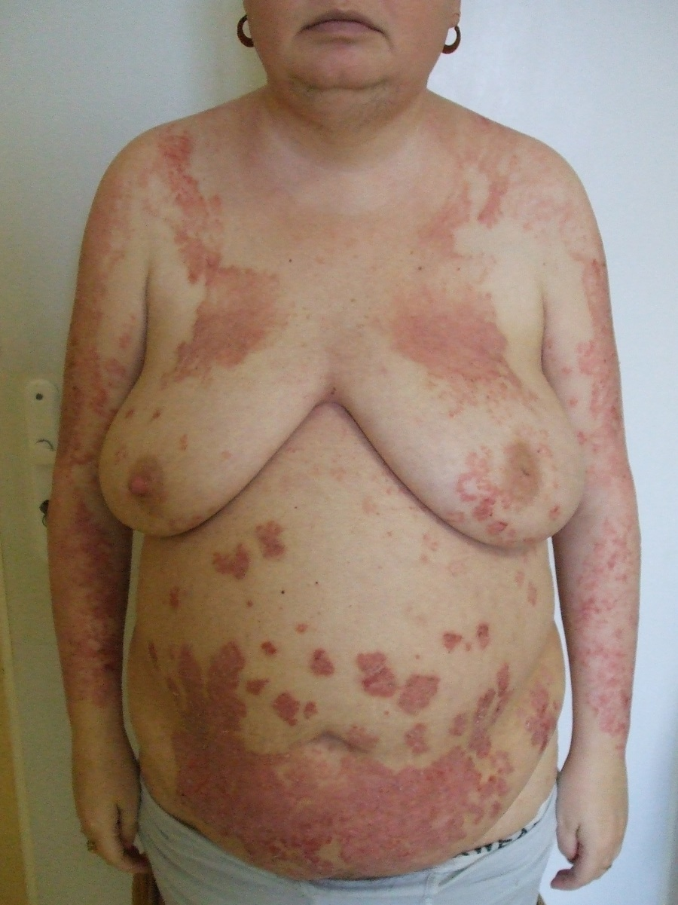
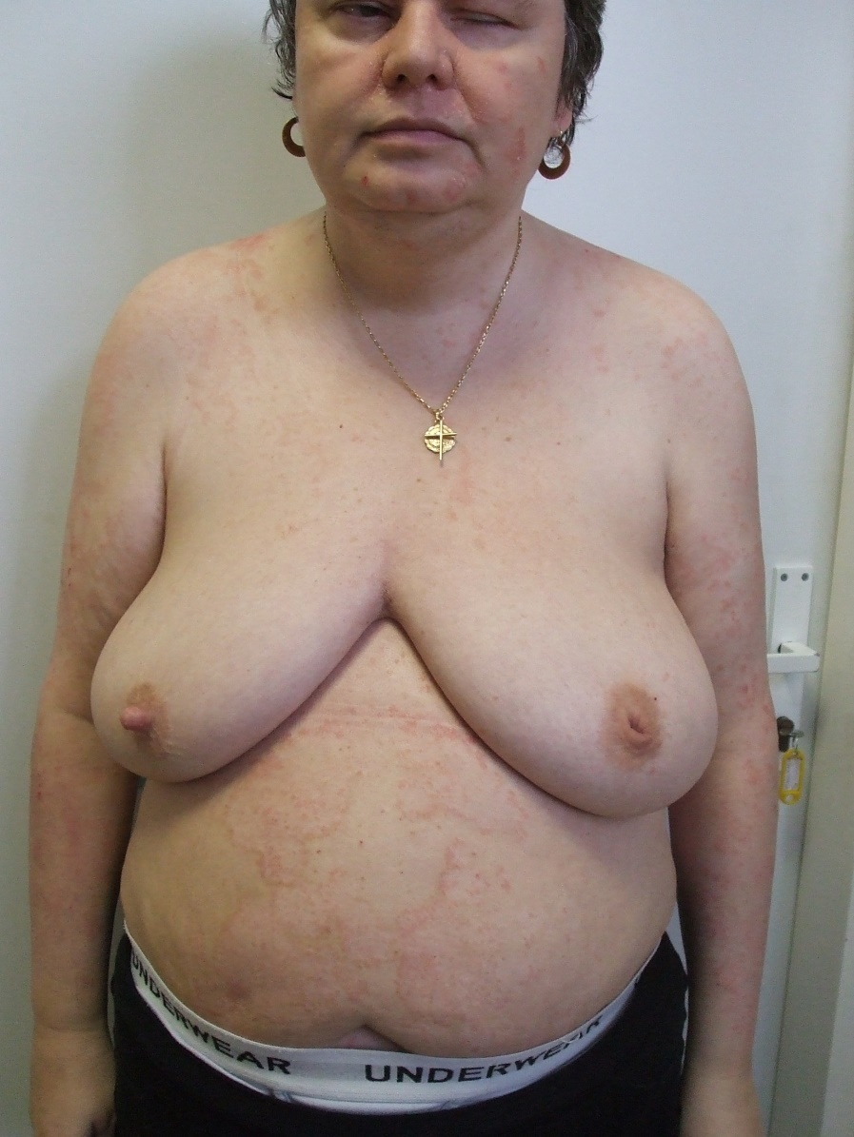
Local finding before and after 6 months of therapy, with 3 years in remission

Slide 19
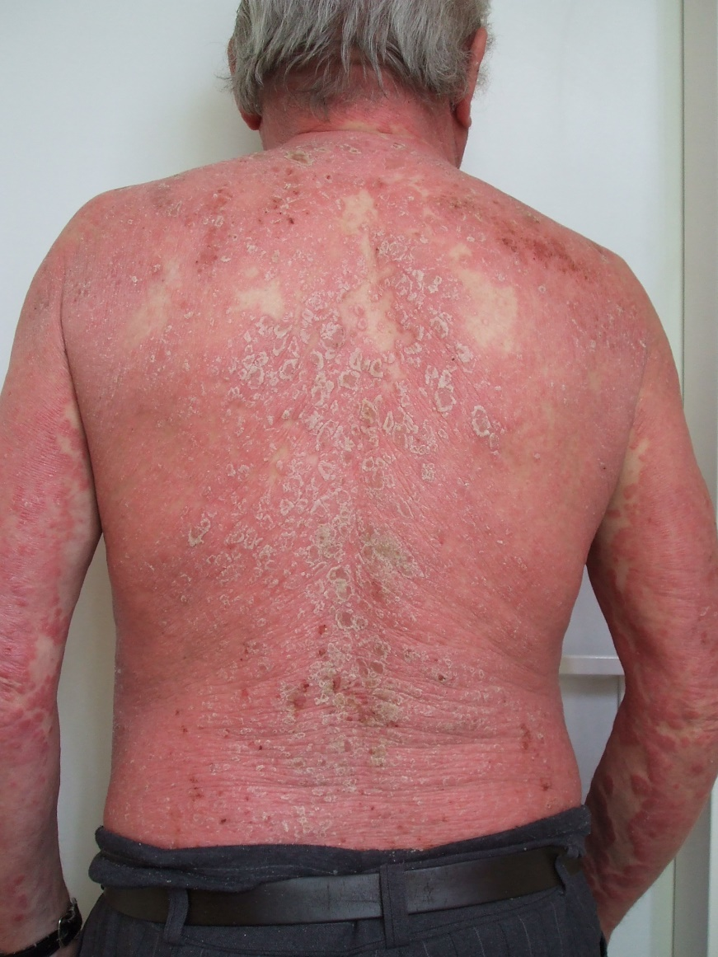
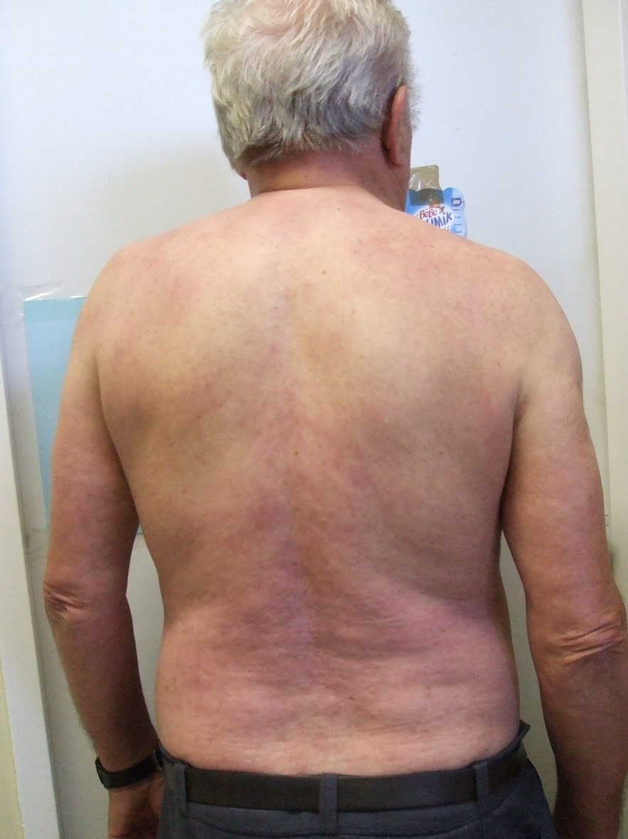
Local finding before and after 7 months of therapy, with 5 years in remission

Slide 20
CsA and atopic dermatitis
in 18 years we treated more than 480 patients
with initial doses of 3-4 mg /kg
in form of continuous therapy, and doses decreased according to condition
at the end we switched to weekend therapy
with a maximum dosing period of 2 years
11 patients had increased blood pressure
19 patients discontinued the therapy due to intolerance

Slide 21
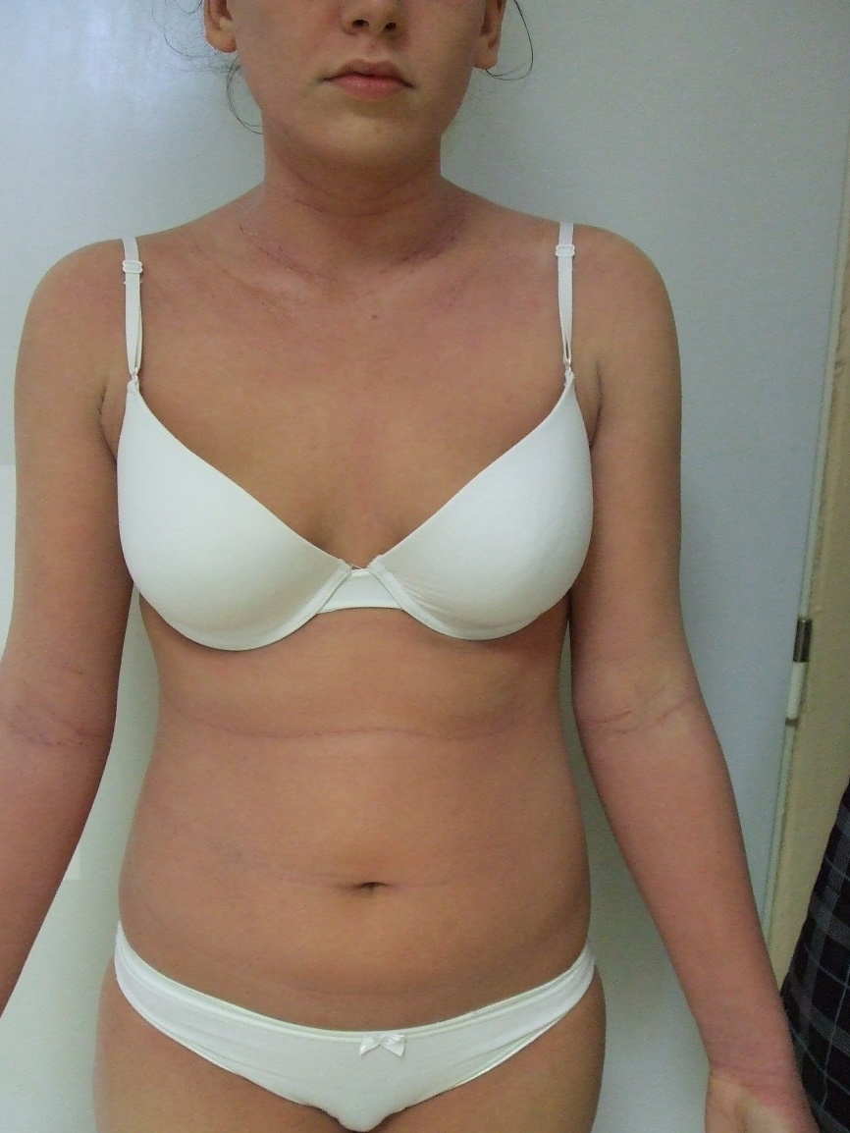
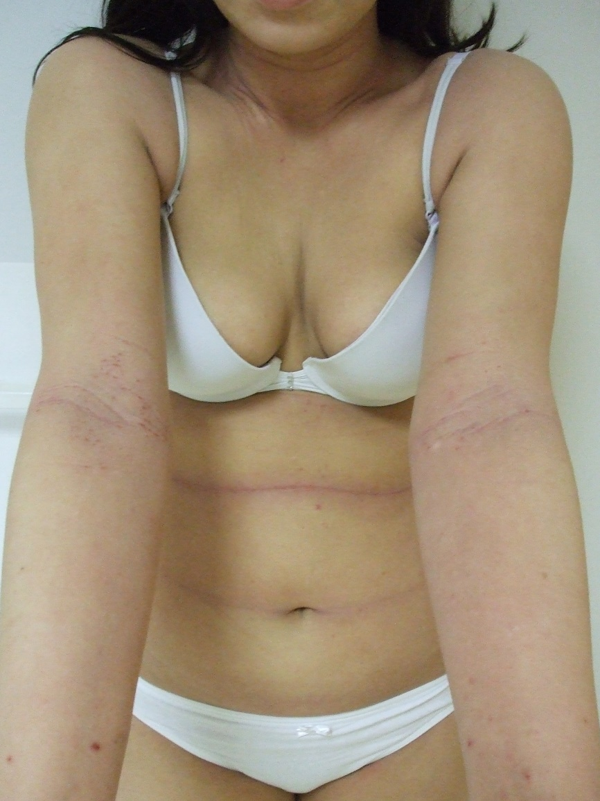
CsA therapy of atopic dermatitis after 6 months

Slide 22
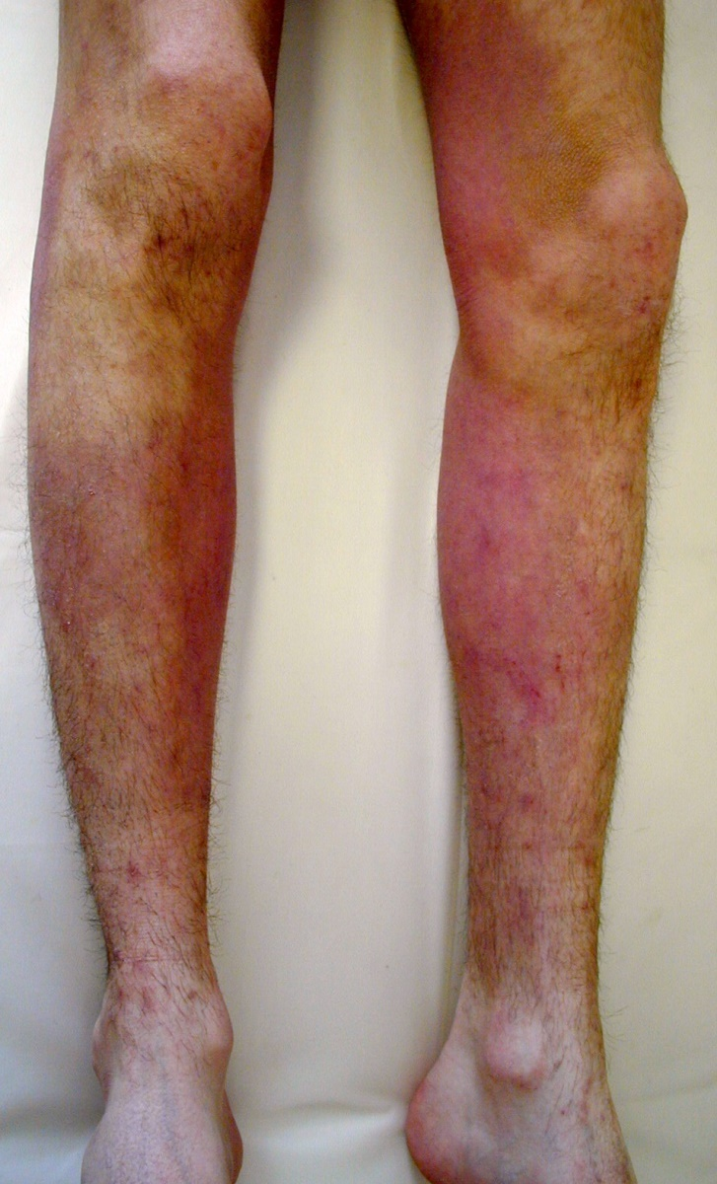
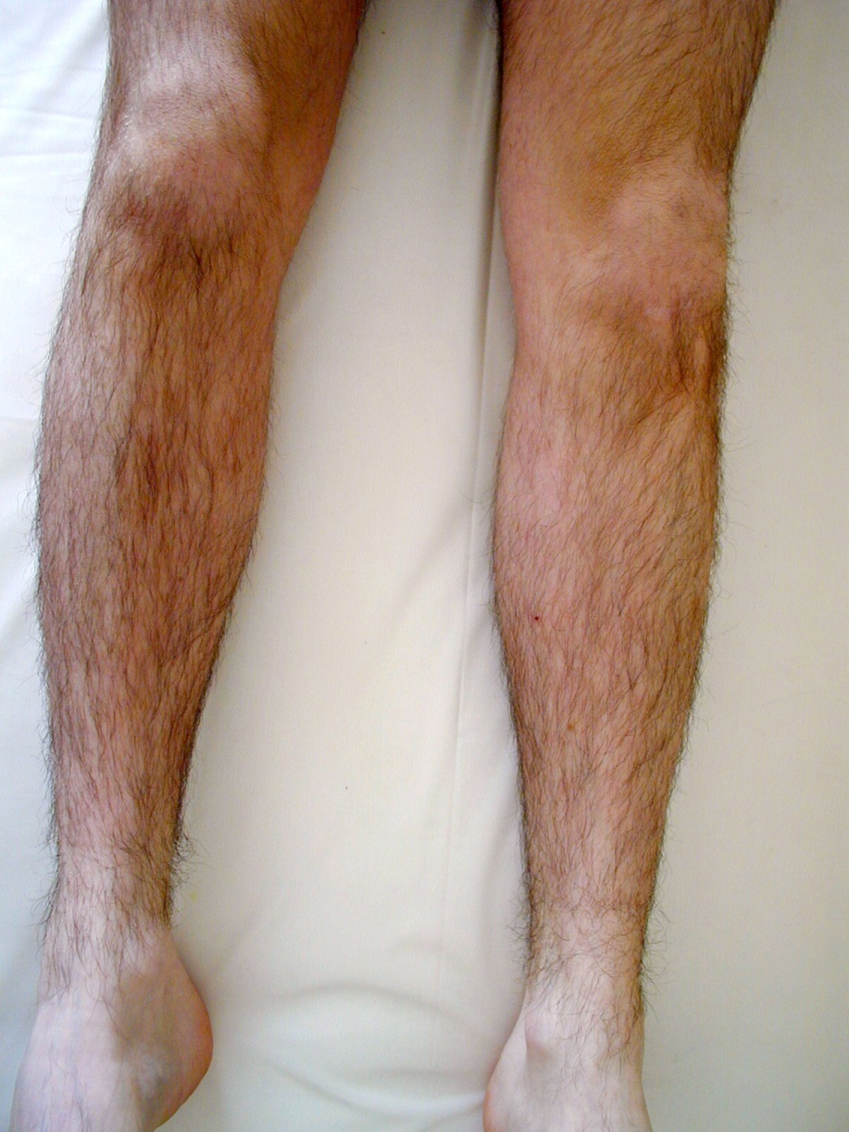
CsA therapy of atopic dermatitis after 8 months

Slide 23
CsA therapy of urticaria Information in literature
Autoimmune concept
Presence of systemic auto-antibodies
Presence of anti FcRI
Concomitant autoimmune disease
(vitiligo, thyroiditis, collagenosis,...)
Blinded placebo controlled study in 99 patients, with an initial dose of 5 mg/kg, gradually reduced+ Cetirizine or placebo, with significantly decreased urticaria severity score and DQLI in the CsA group, acute therapy was needed in much less patients in the CsA group
KV Godse Indian J Dermatol 2008;53:101-2 - 5 patients with positive ASS test, 3 mg/kg for 12 weeks+ Cetirizine, CsA is suitable also in long-term maintenance therapy
Grattan CE.: BJD 143, 2000, 365-72 - 30 patients with histamine resistant CIU, 20 patients with CsA and 10 patients with Pb for 4 weeks, monitored until week 20
Kessel A et al.: Allergy 65, 2010, 1478-82 - 120 patients treated due to severe CIU with CsA 3 mg/kg, 20 patients were excluded due to adverse effects, some patients were treated for 5 to 10 years

Slide 24
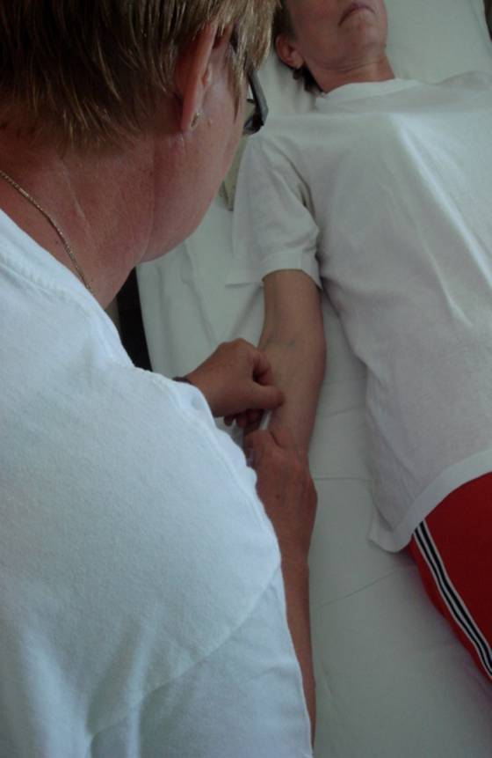
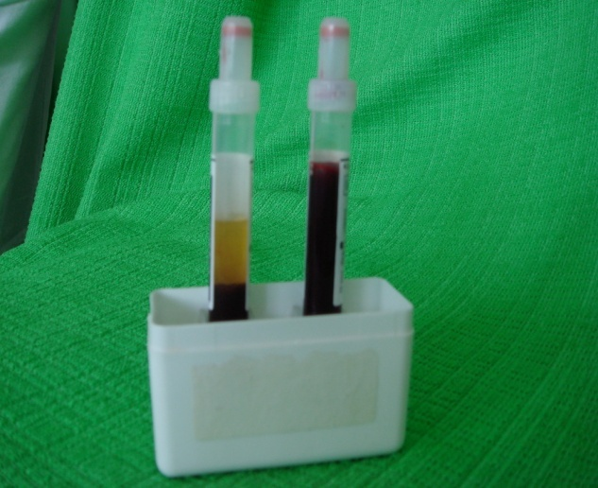
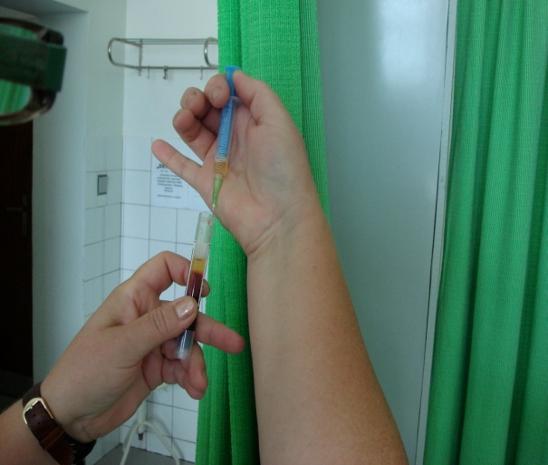
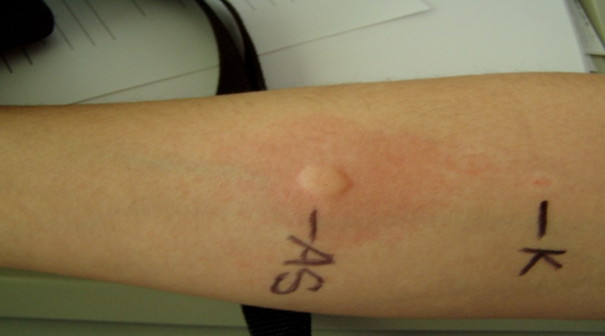
Autologous serum test
Mečiarová P., Urbanček S.: Kongres SDS-ČDS jún 2008

Slide 25
Our own experience with the therapy of urticaria
In 11 years we treated 16 patients
in form of continuous and intermittent therapy, with doses decreased according to condition
towards the end we switched to weekend therapy
with a maximum dosing period of 1 year
9 patients concluded the therapy, and have been without manifestations for 4 to 9 years
3 patients discontinued due to adverse effects
2 patients discontinued after 3 months due to non-provable effect

Slide 26
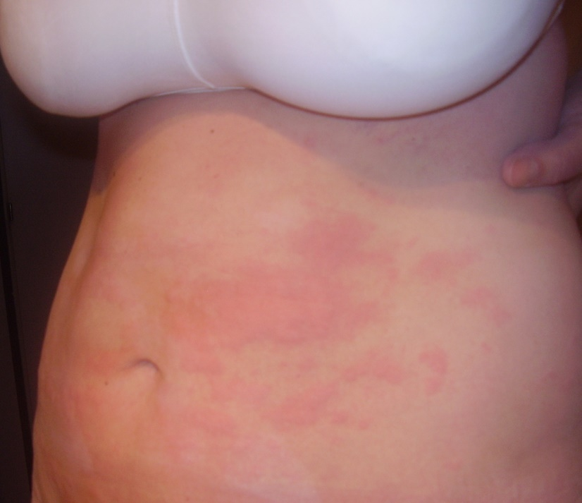
CsA therapy of urticaria
Our own experience
The data stated in literature was not proven in the monitored group
Antihistamine drugs were necessary
In patients with chronic urticaria effects were better after biologic therapy

Slide 27
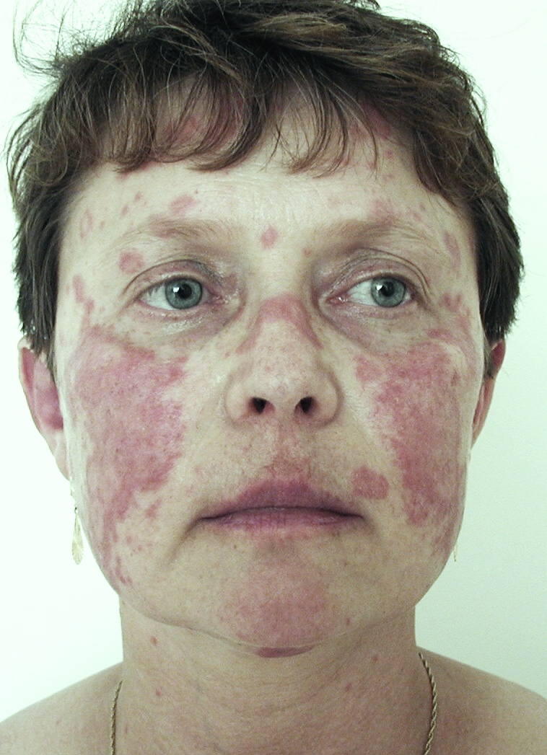
SCLE therapy (Subacute Cutaneous Lupus Erythematosus)
Recommended as 5th experimental line  Cyclosporine A (proffered in SLE and lupus nephritides (Dubertret L et al.: Therapeutique dermatologique, Paris, Flammarion, 3-éme ed, 2002.)

Slide 28
Pemphigus
there are only limited cohorts and cases
we have experience with a significantly efficient combined therapy in 8 patients
Important especially in COMBINATION with CORTICOIDS, which is more comfortable forr the patient
Barthelemy H et al.: JAAD 18, 1988, 1262-1266

Slide 29
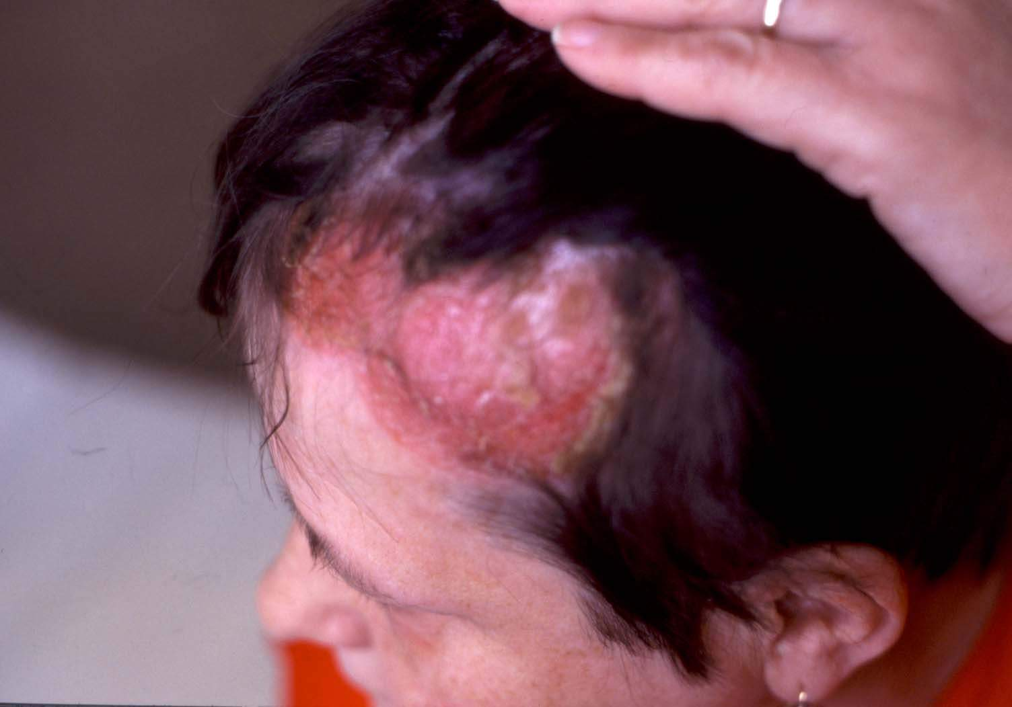
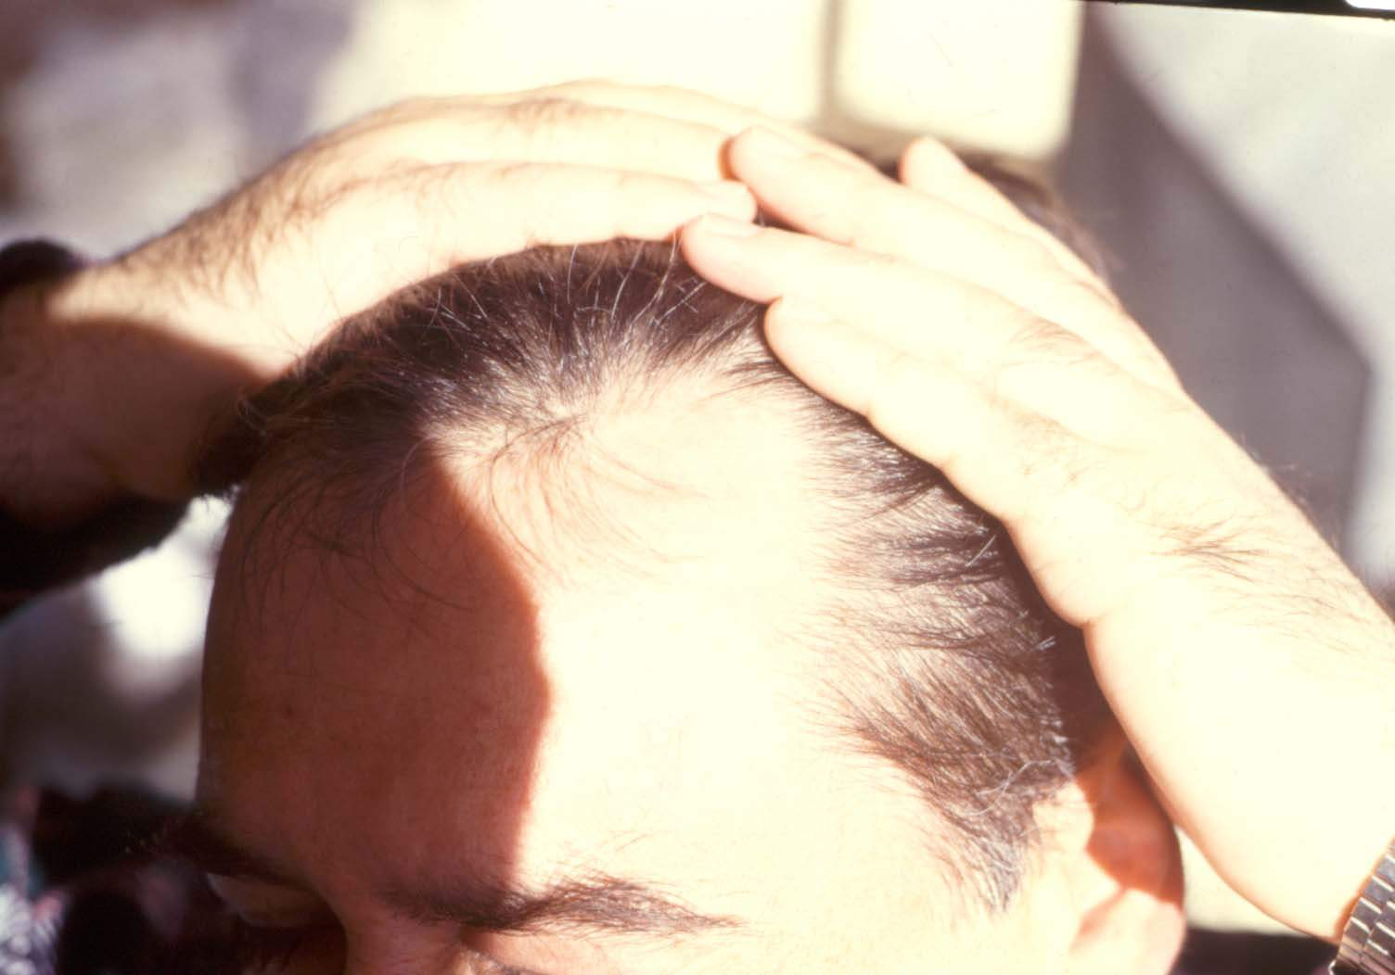
PEMPHIGUS VULGARIS

Slide 30
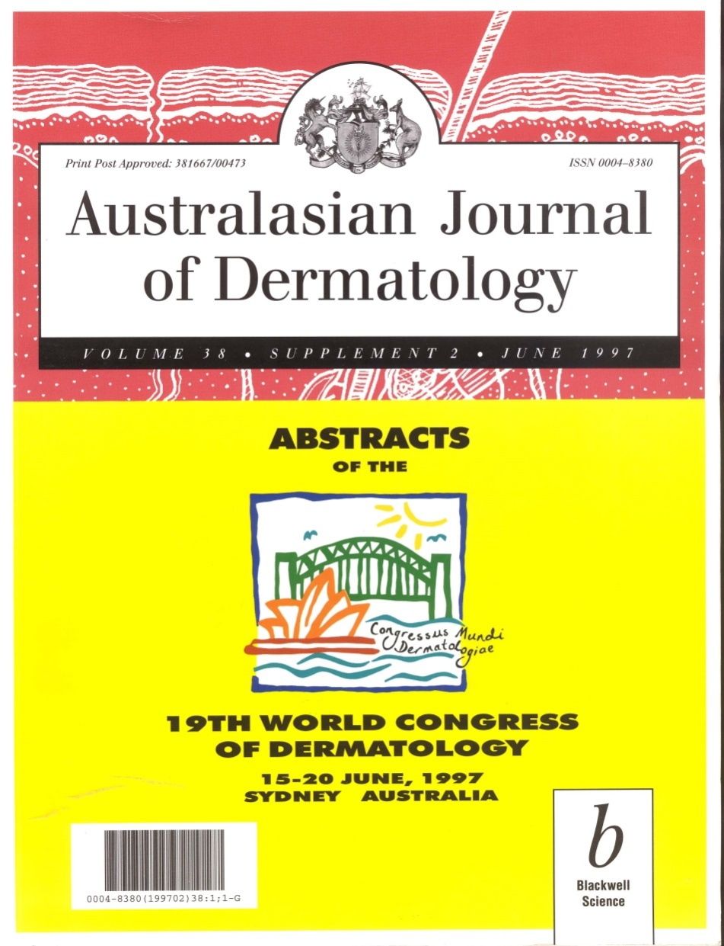
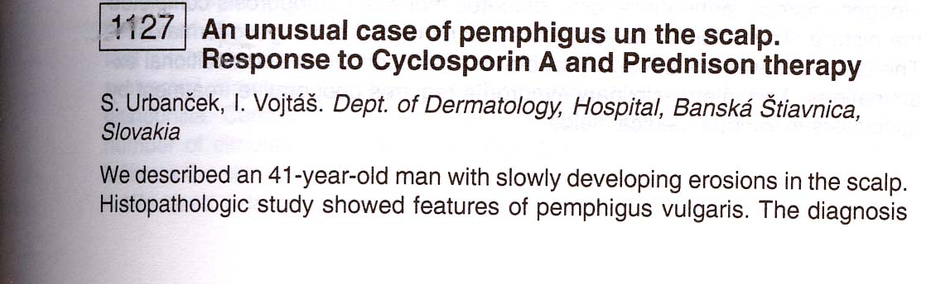
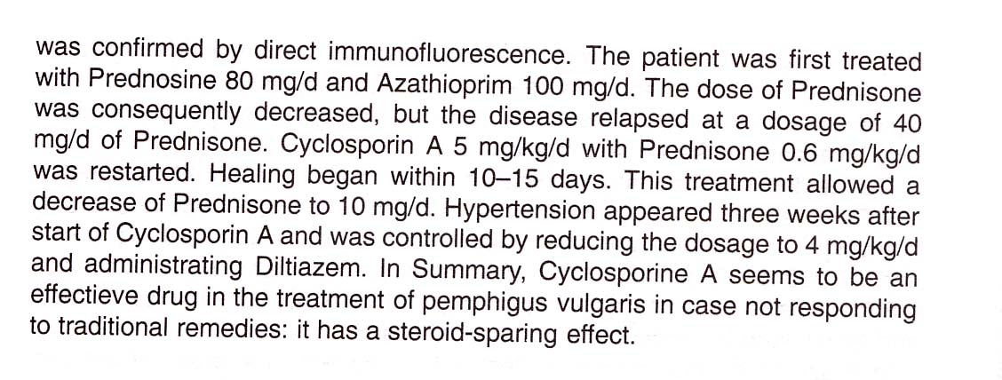
1997 – Urbanček, Vojtáš from the SR „Were among the first...!“

Slide 31
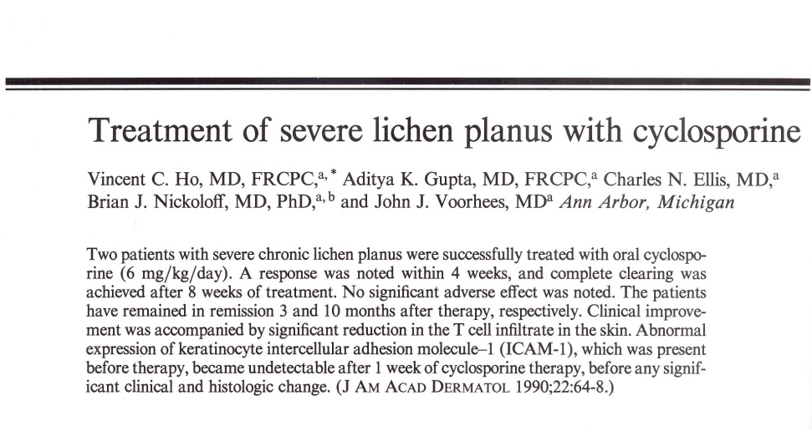
Cases
Sarcoidosis - Badgwell and Rose.: AAD, 56, 2007, 69-83, controversial indication
Alopecia areata - Gupta A K.: JAA 1990;22(2 Pt 1):242-50 ; Kim BJ, J Dermatolog Treat. 2008;19(4):216-20. - CsA is theoretically suitable to treat AA, in practice the results are ambiguous
Severe lichen planus

Slide 32
Pyoderma gangrenosum
Miller J.: J Am Acad Dermatol 2010;62:646-54
CsA is used usually in combination with corticoids in corticoid resistant or contraindicated cases
corticoids spare the patient
and are suitable in idiopathic forms
we should rather use short term regimens (ca risk in chronic inflammatory bowel diseases after long term therapy)

Slide 33
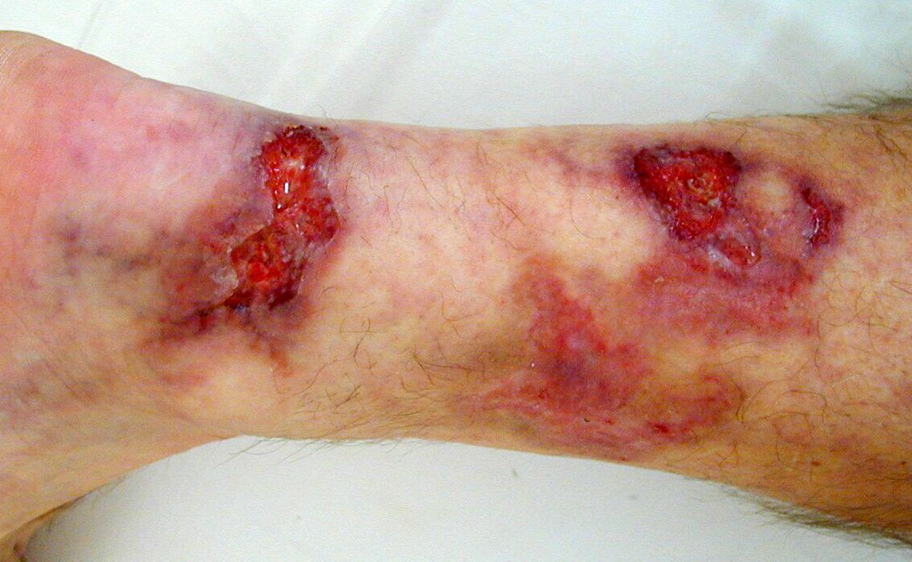
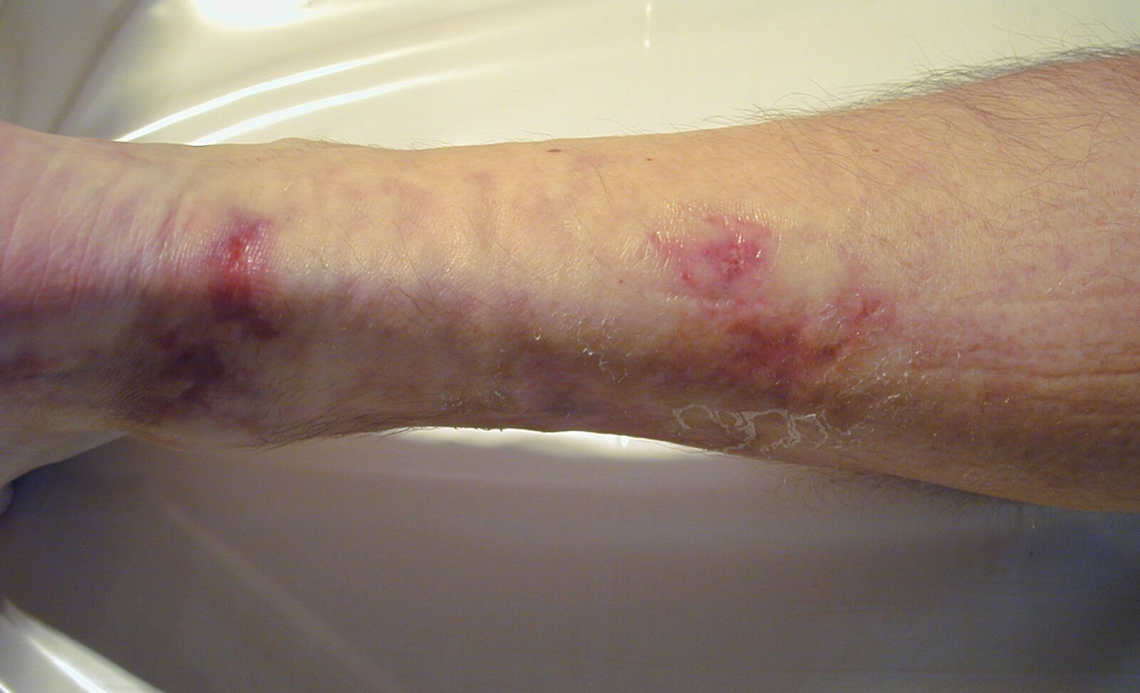
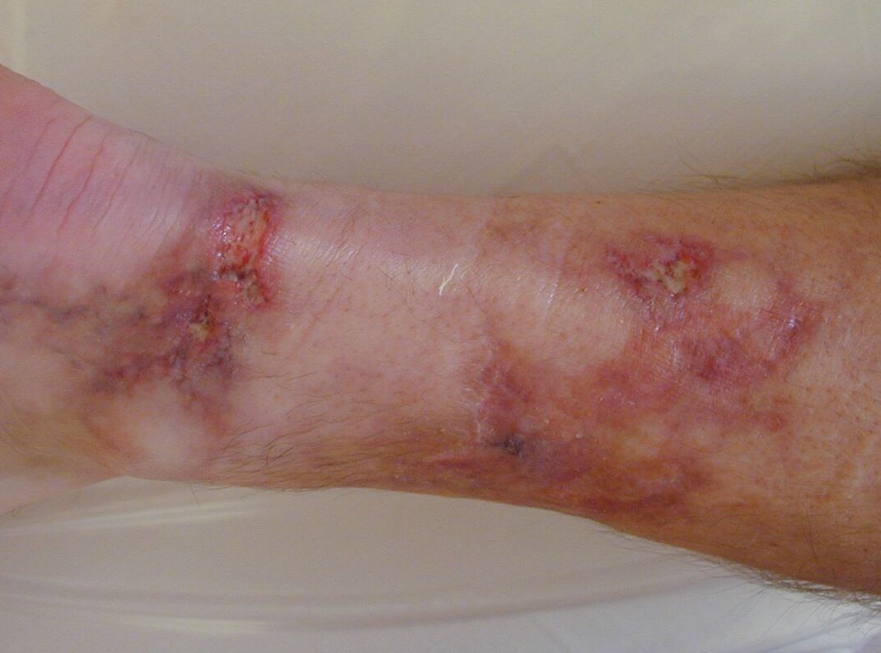
Pyoderma gangrenosum
Our own experience
Male patient aged 49 years,
without associated disease
Therapy: CsA, corticoids, with complete healing (in 7 months)

Slide 34
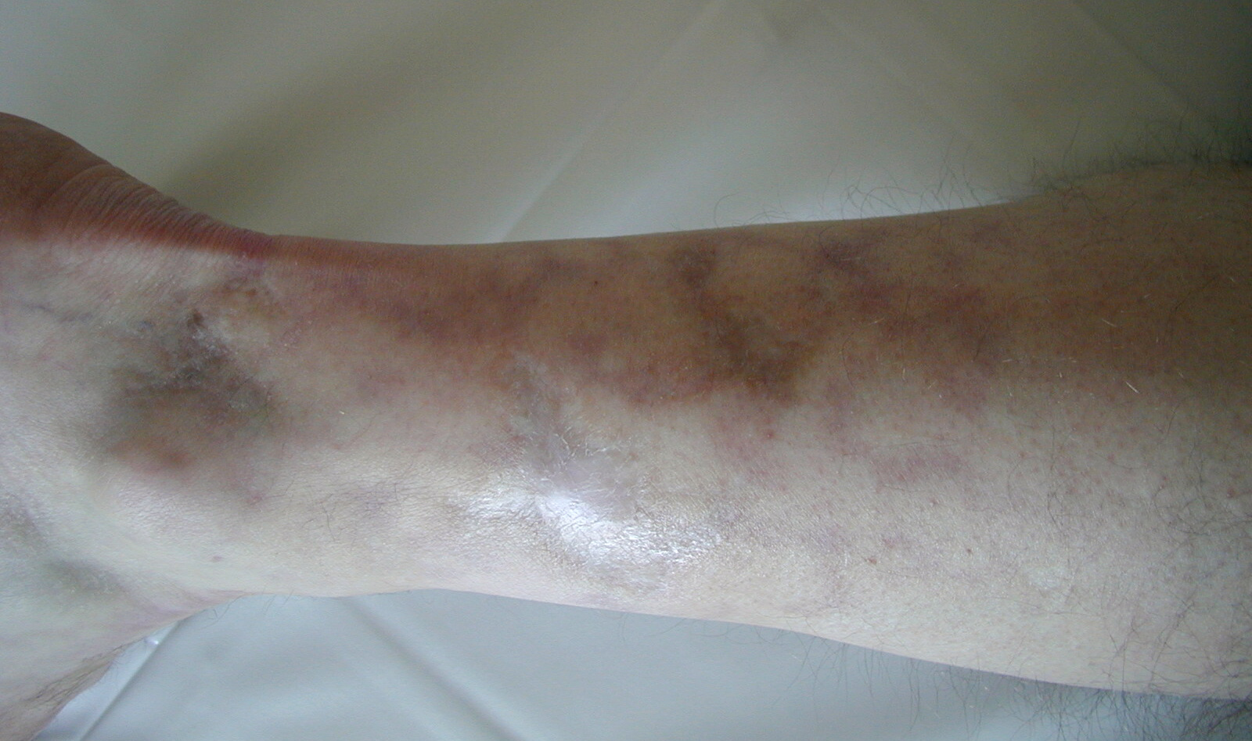
Pyoderma gangrenosum
Our own experience

Slide 35
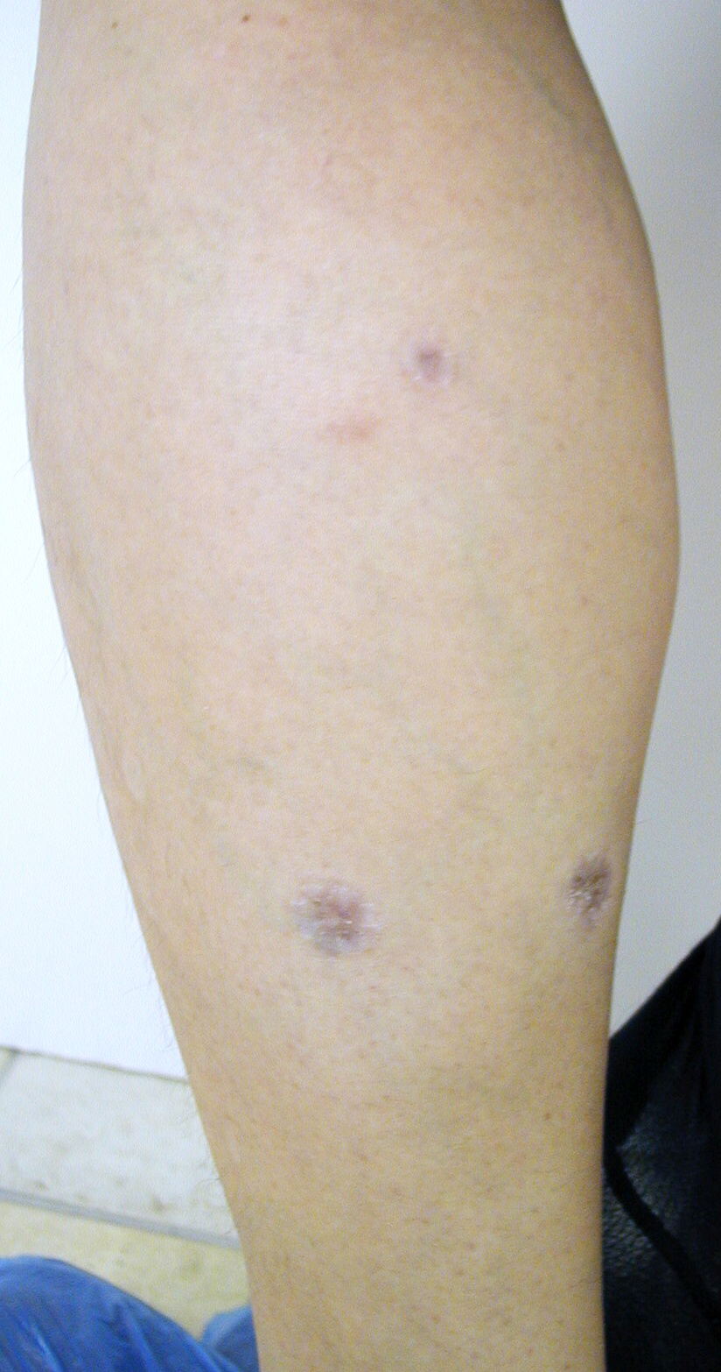
Allergic vasculitis
Diagnostic bottlenecks
scars after healed minor ulcerations have a typical shape
If you recognize it, you may determine the proper diagnosis

Slide 36
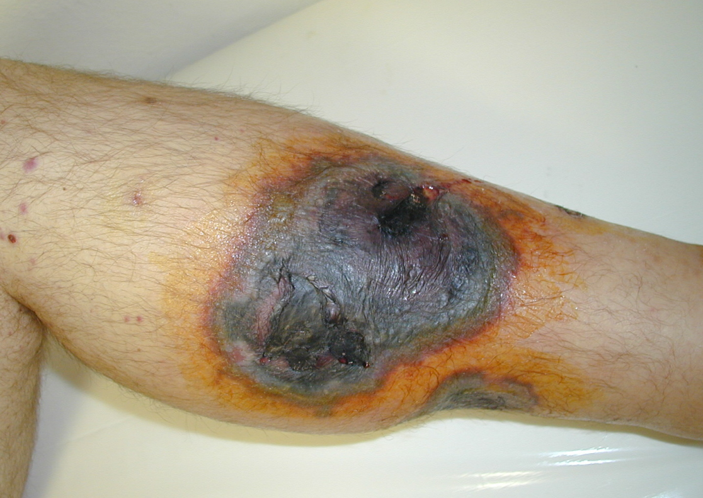
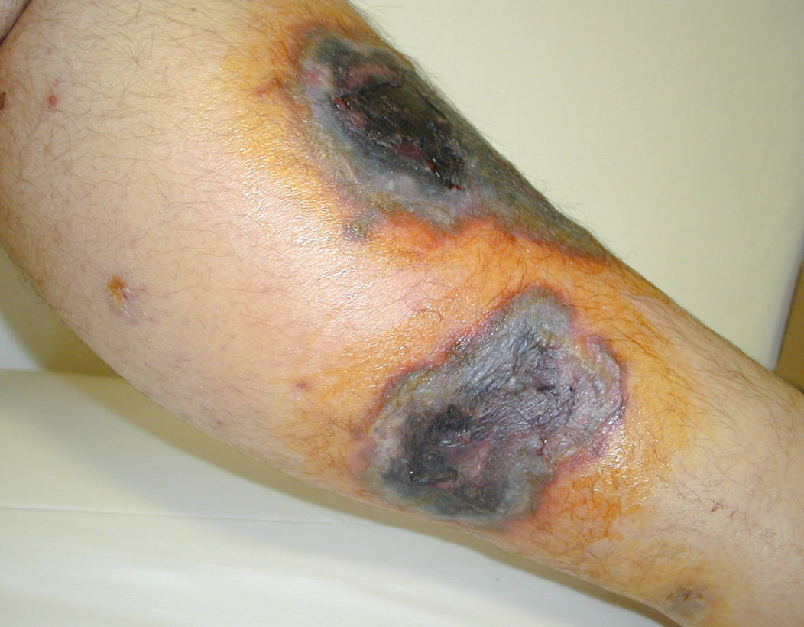
Case I - condition before CsA therapy

Slide 37
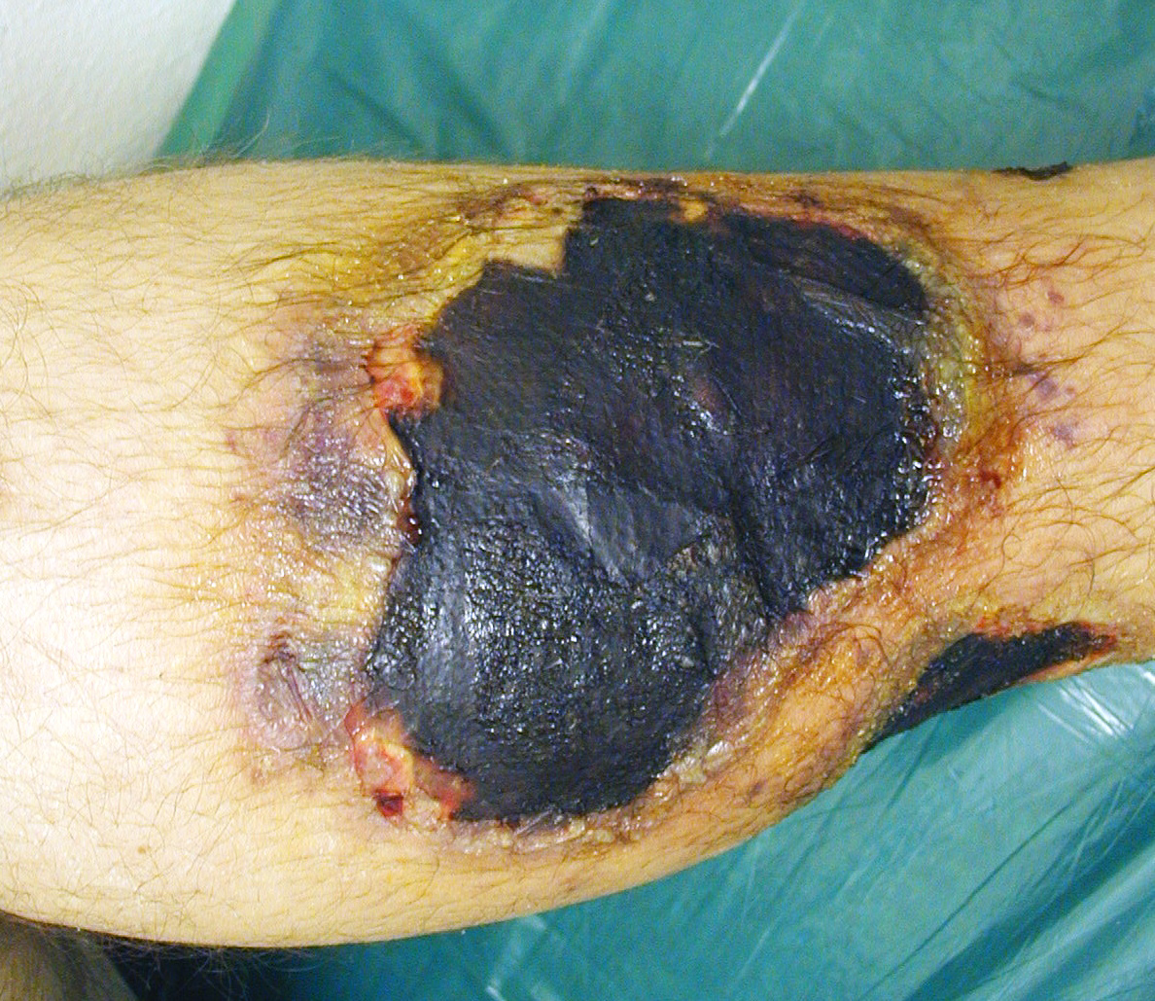
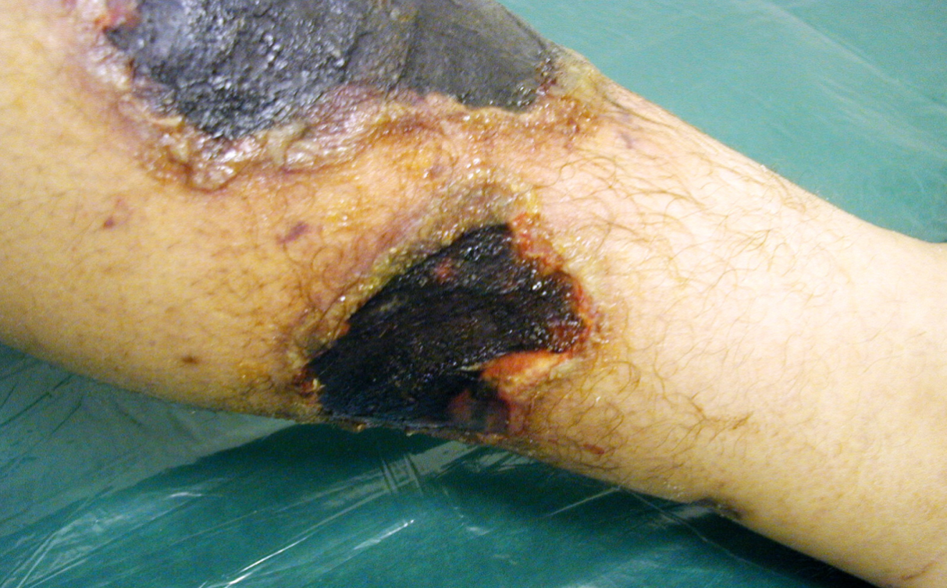
Case I – condition after 14 days of CsA and Prednisone therapy

Slide 38
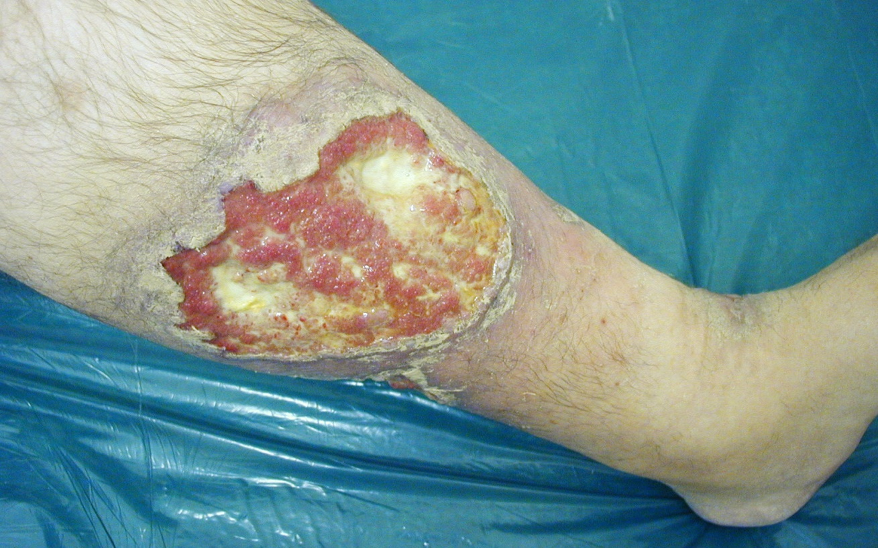
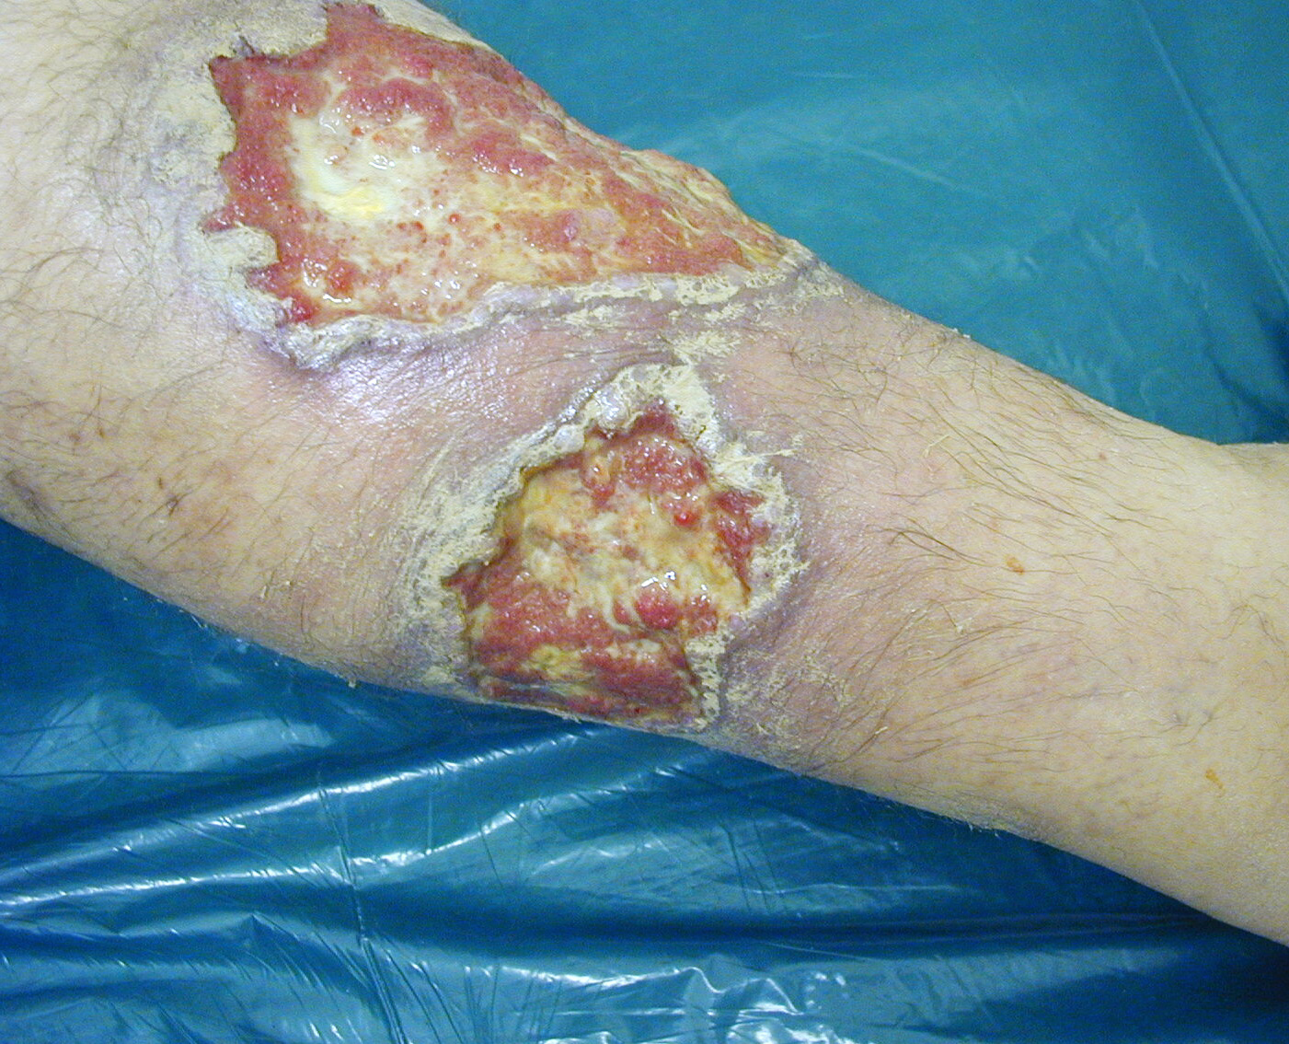
Case I – during CsA and Prednisone therapy (skipped month 12)

Slide 39
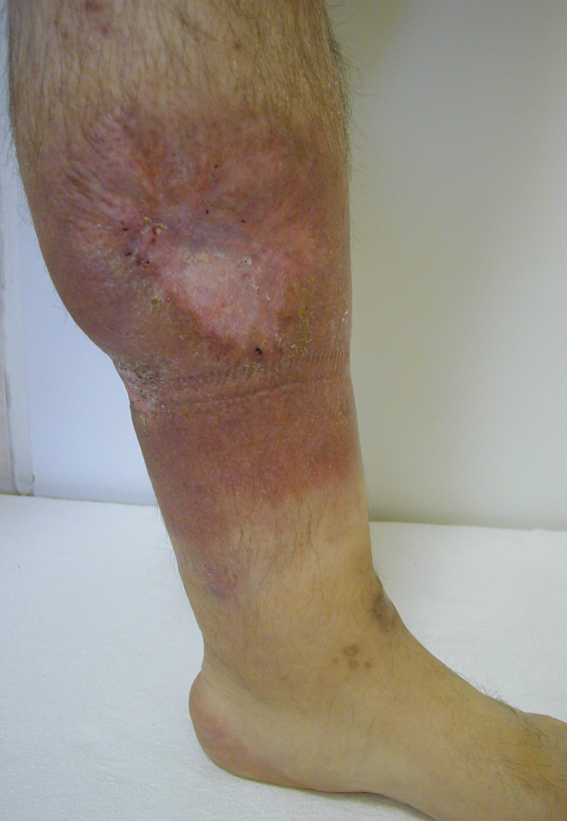
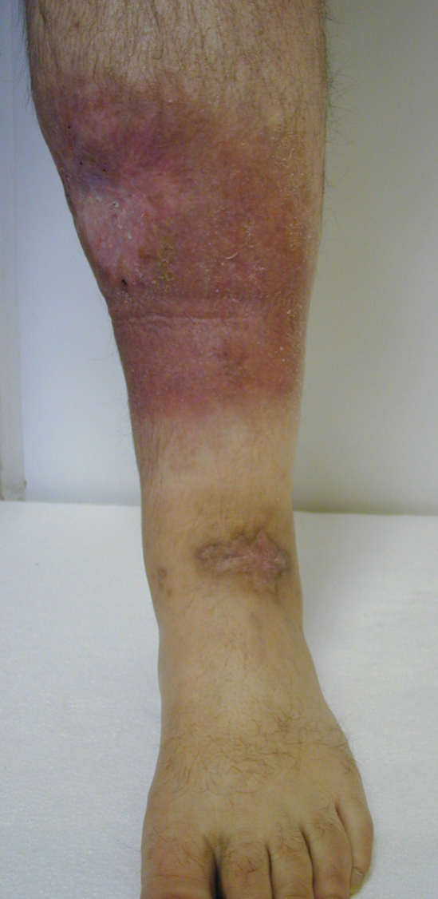
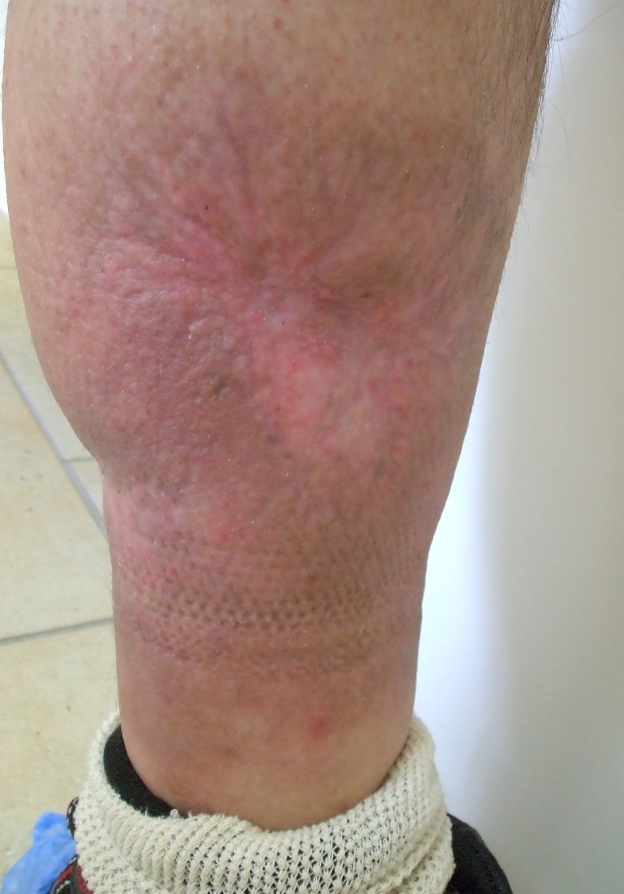
Case I – total healing after 14 moths of CsA therapy

Slide 40
Dermatomyositis
there is only little data in literature
a histological examination verified dermatomyositis and Raynaud's phenomenon in our male patient aged 28 years
after unsuccessful therapy with Plaquenil, Methotrexate, Prednisone, Imuran
we started continuous CsA therapy with the initial dose of 4mg/kg
we concluded the treatment course with 6 months of weekend therapy

Slide 41
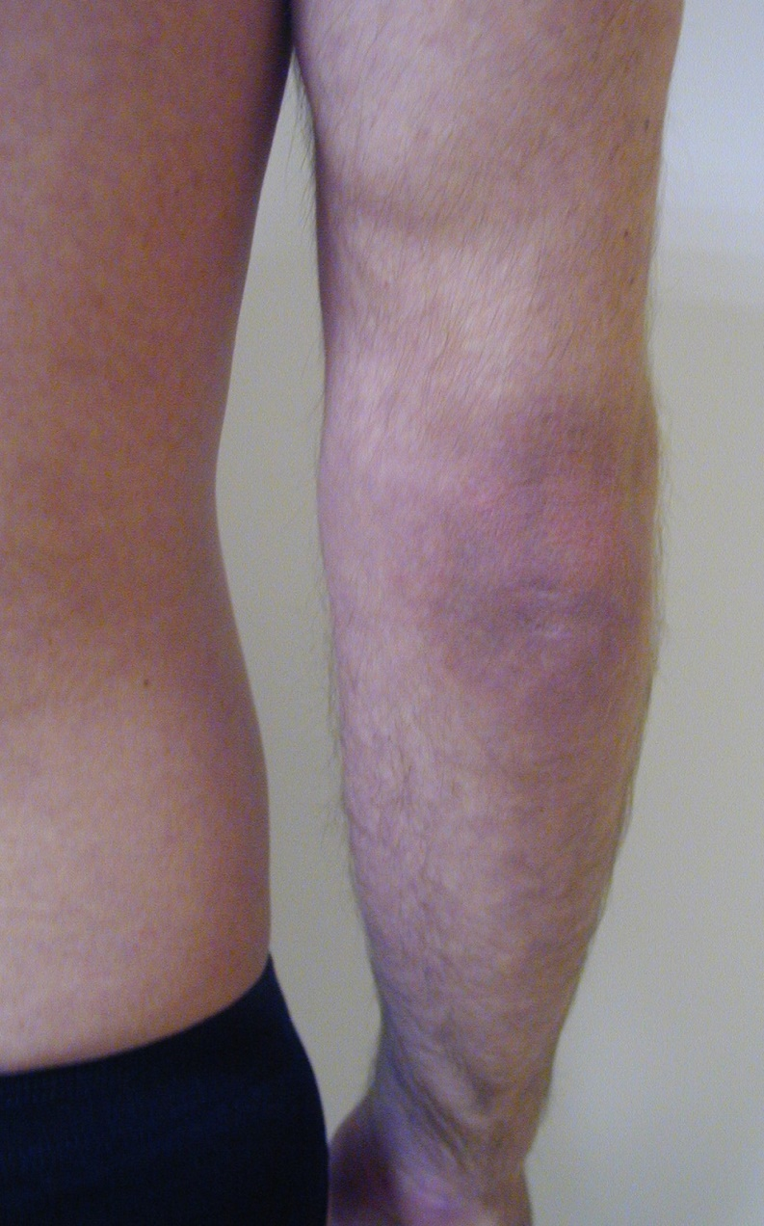
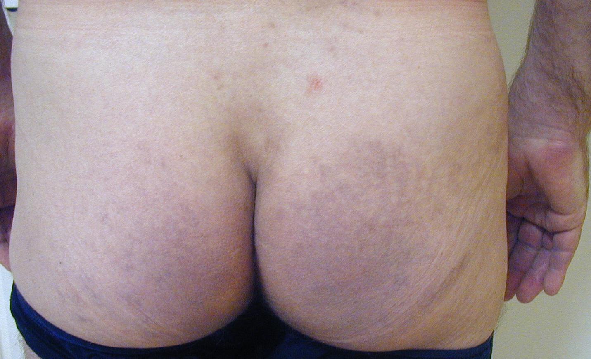
First examination

Slide 42
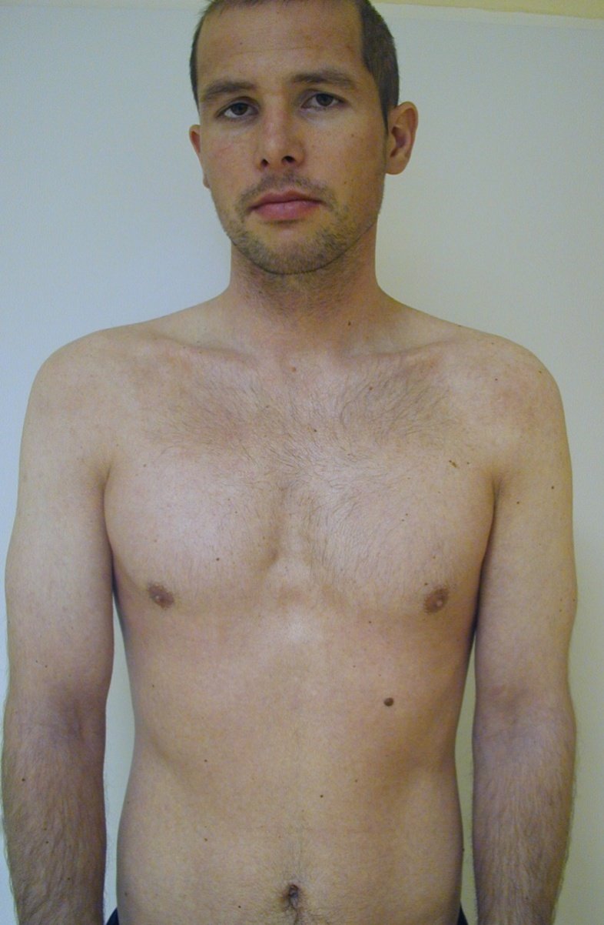
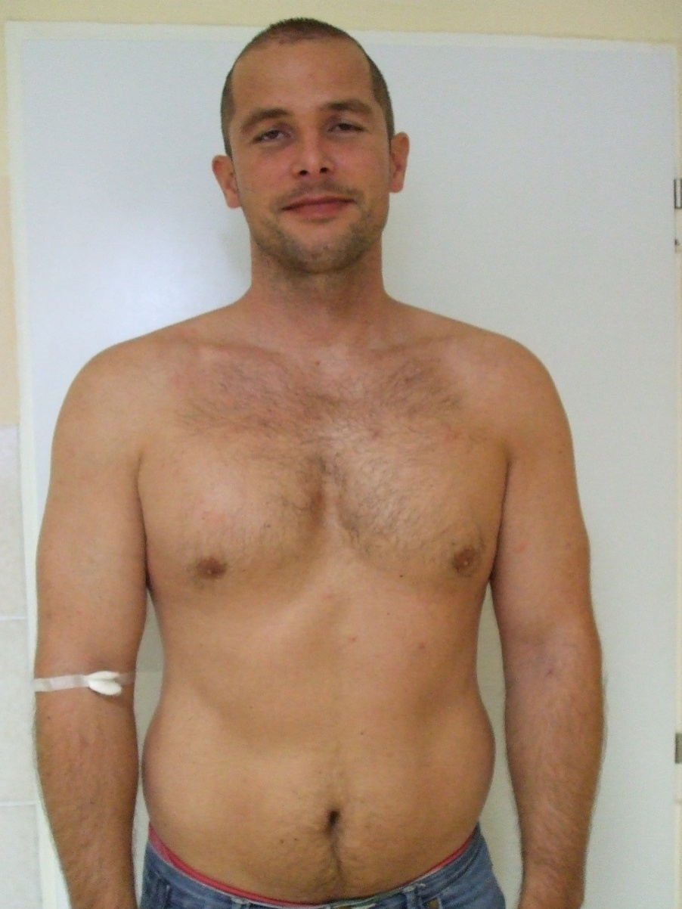
After 14 months of CsA therapy, our patient has been without any problems for 4 years

Slide 43
CONCLUSION
CsA therapy in 1st to 3rd line requires erudition and experience.
In patients with severe dermatoses CsA therapy improves not only the local finding, but also the quality of life
CsA therapy must be administered according to the principles of EVIDENCE BASED MEDICINE !!!

Slide 44
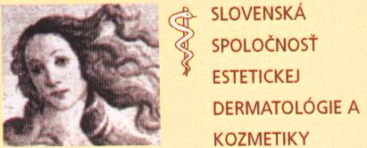
INVITATION
Slovak Society of Aesthetic and Cosmetic Dermatology (SSACD)
European Society for Cosmetic and Aesthetic Dermatology (ESCAD)
International Academy of Cosmetic Dermatology (IACD)
16th anniversary biggest Congress of the Slovak Society of Aesthetic and Cosmetic Dermatology
with international participation
DERMAPARTY 2015
December 3. - 5. 2015
Holiday Inn Congress Centre Žilina

Slide 45

Thank you for your attention!

