Slide 2
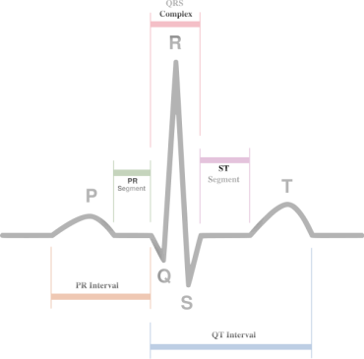
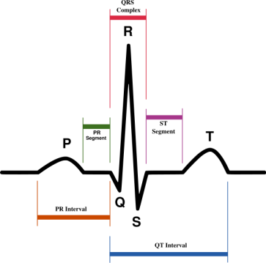
"A comparative study between players of football and handball in Egyptian national team in Heart Rate Variability(HRV)."
Professor, DR.Hamdy Abdou Asem
Chairman of Sports Health Sciences Department
Physical Education College Sadat City University EGYPT

Slide 3
Introduction
Heart rate variability (HRV) has been verified as a noninvasive indicator of the autonomic nervous system for both normal people and heart patients (Kardelen et al. 2006; Malliani et al. 1991; Stejskal et al. 2001)
Decreases and increases in vagal-derived indices of HRV have been suggested to indicate negative and positive adaptations.
Measures of an athlete’s heart rate variability (HRV) have shown potential to be of use in the prescription of training. However, little data exists on elite athletes who are regularly exposed to high training loads

Slide 4
Training programs of elite athletes typically consist of periods of high training loads with limited periods of rest and recovery (Fiskerstrand and Seiler 2004; Laursen 2010; Seiler 2010). Knowing when to recover and for how long to do so in elite athletes can therefore be difficult. Overreaching (OR) , non-functional over-reaching (NFOR) and over-training (OT) are terms often used to describe a stress regeneration imbalance, with negative outcomes, such as hormonal changes (Meeusen et al. 2004), disturbed sleep, increased levels of fatigue and reductions in performance commonly reported (Meeusen et al. 2006).

Slide 5
While short-term OR is typically an important component of the elite training cycle, prolonged OR pushes an athlete into NFOR or OT, which results in performance impairment and possible negative health consequences However, where the point of transition between OR and NFOR/OT has been unsuccessfully sought by researchers and practitioners for decades (Barron et al. 1985; Morgan et al. 1987).

Slide 6
One of the difficulties faced by practitioners attempting to solve this problem is that the symptoms of OR and NFOR are similar, and not necessarily more severe than for OR (Halson and Jeukendrup 2004). For example (Rowbottom et al. 1995) showed that, with the exception of glutamine, resting hematological, biochemical and immunological measures in ten overtrained athletes were identical to age-matched controls. As such, detecting early signs of NFOR may be difficult (Halson and Jeukendrup 2004).

Slide 7
Indeed, the current consensus is that no sound objective tool has been indentified which can detect the early signs of NFOR (Halson and Jeukendrup 2004).
Conventionally, an individual’s change in resting heart rate has been used by sport practitioners as a practical method to detect early signs of NFOR and central nervous system fatigue (Halson et al. 2002; Lehmann et al. 1992; Dressendorfer et al. 1985).
However, with advancements in technology, the beat-to-beat variation in resting pulse rates, or heart rate variability (HRV) (TaskForce 1996), can now be easily assessed and provide an indication of autonomic nervous system (ANS) status (Lehmann et al. 1998), and has become more popular over recent times.

Slide 8
It has been proposed that an altered ANS status may coincide with a number of hormonal changes often observed during OT and NFOR (Kuipers 1998). As such, for more than a decade, HRV has been suggested to be a practical non-invasive method of assessing cardiac ANS status, and possibly NFOR/OT (Uusitalo et al. 1998). This has further lead researchers to suggest that HRV may be used to guide the training of elite athletes on a day-to-day basis (Hautala et al. 2009; Kiviniemi et al. 2007, 2009).

Slide 9
The cardiovascular system is mostly controlled by autonomic regulation through the activity of sympathetic and parasympathetic pathways of the autonomic nervous system. Analysis of HRV permits insight in this control mechanism. It can easily be determined from ECG recordings, resulting in time series (RR-intervals) that are usually analyzed in time and frequency domains.

Slide 10
Aerobic endurance is important for Football players because of them covering between;10 and 12 km during a match . It has also been suggested that 98% of total energy used by players during a game is derived from aerobic metabolism .
While we find that Handball players cut between (6-7 km) during the game while the distance traveled in the transition between defense and attack and vice reach (3-5 km).

Slide 11
The development level of performance through the upgrading programs and loads of training affect a range of biological agents, including Provisions of the physiological and morphological factors but the physiological factors come in the forefront of those effects on the level of physical performance and therefore the skill and tactical, as this is closely linked to the training loads experienced by player.
All of this requires physiological responses of the musculature and the league and respiratory devices, and the ability of the player to the oxygen consumption and speed the occurrence of fatigue and restore rates of hospitalization.

Slide 12
The study terms
* Wave (R)
It is the peak of the demise of the polarization in the vehicle (RQS) in the heart scheme before the contraction (0.01) second.
* Distribution of distances (R-R):
Phase (RR) reflect the temporal distance between the two waves in a row, a period in which the occurrence of heart muscle contraction and used within the Heart scheme to calculate the heart rate variability (HRV)
* Overall capacity of the low and high frequencies (Total Power)
Refers to the total energy expended from the catalyst and the inhibitor of neural activity of the heart through the body change modes.
* Combined ability of the nervous system of the heart (Cumulative Power)
It refers to the energy expended from the nervous system of the heart to reach the steady state of change and the conditions of activity of the body while working.

Slide 13
* CVr-r rate
The differences between the distances rate (R_R)
* Measure MV
Average measure distances between bands (RR)
* Measure I.E
The difference between heart rate during inhalation and exhalation
* Measure% I / E
The rate of change in a heartbeat during inhalation and exhalation%

Slide 14
Vital capacity (VC)
It is equal to the sum inspiratory reserve volume of air in addition to the normal inspiratory and expiratory reserve capacity and this is the largest volume of air that a person can get it out after taking maximum inspiration and usually amounting to 4600 ml and can be up to 6.7 liters with tall.
* Inspiratory capacity (IC)
It is equal to the normal respiratory volume of air in addition to the air inspiratory reserve (about 3500 ml), a capacity that can be used by a person in the ordinary course of events.
* The Tidal Volume (TV)
Is the volume of air inhale or exhale in a time ranging from 350 to 800 million liters and increases during physical activity to around the liter to two liters (1.2 liters) at the expense of reserve inspiratory volume more than a reserve exhale .
* Expiratory Reserve Volume (ERV)
Is the volume of air that can get him out in addition to the normal air volume of air exhaled size and usually has a size of 1 100 ml.
* Inspiratory Reserve Volume (IRV)
Is the volume of air that can be inhaled as well as the size of the normal air inspiration and eluting usually about 3,000 million liters.

Slide 15
Importance of the study:
The current study is one of the scientific research attempts to study the functions of the lungs and the rate of change heart rate variability (HRV) of a sample of the elite players in Egyptian football, handball and learn about the impact of different technical requirements between football players and handball players.

Slide 16
Aim of the study:
Identification of lung function and the rate of change in heart rate variability (HRV), compared to the elite players in Egyptian football and handball.
Question of the study:
Do the different technical requirements of the duties between the the Egyptian elite players in football and handball affect In lung function and heart rate variability (HRV)?

Slide 17
The study procedures:
The curriculum:
The researcher used the descriptive approach to suitability with the nature of the study.
The Subjects :
The study sample was chosen intentional way to number (40) player of the national team players for the football team handball (20) player for each team.

Slide 18
Measuring protocol
Participants were measured in two basic measures :
1- rate of change in heart rate variability (HRV) using TF4 device.
2- lung function using electronic Spirometr device.
Notes:
otocol

Slide 19
The Results Table ( 1)
المتغيرات Variables |  | المتوسطات Mean | Differences between the groups |  | T value
 |  |  | Mean difference | Standard deviation
الطول ( سم ) cm Length | Football | 184.95000 | 5.250000 | 7.040298 | 3.335*
 | Handball | 190.20000
الوزن ( كجم ) Weight k | FootBall | 87.48550 | 1.584500 | 3.505343 | 2.022*
 | Handball | 89.07000
السعة الحيوية ( لتر ) Vital capacity (VC) | FootBall | 4.96825 | .329450 | .270250 | 5.452*
 | Handball | 5.29770
أحتياطى هواء الزفير لتر Air inspiration IRV | FootBall | 1.82735 | .550250 | .206997 | 4.789*
 | Handball | 2.04900
أحتياطى هواء الشهيق • reserves exhaled air ERVRV ) | FootBall | 3.06760 | .495400 | .166277 | 13.324*
 | Handball | 3.56300
الحجم الطبيعي للتنفس Tidal Volume (TV) | FootBall | .75445 | .176100 | .136907 | 5.752*
 | Handball | .93055
سعه الشهيق (IC ) Inspiratory capacity (IC) | FootBall | 3.87920 | .550250 | .411668 | 5.978*
 | Handball | 4.42945
السعة الحيوية القصوى لتر (FVC) Force Vital capacity | FootBall | 4.78885 | .511400 | .331990 | 6.889*
 | Handball | 5.30025

Slide 20
Table ( 2)
المتغير Variables |  | المتوسطات Mean | Differences between the groups |  | T value
 |  |  | Mean difference | Standard deviation
القدرة المجمعة للجهاز العصبي للقلب Cumulative Power ( ms² ⁾ | FootBall | 20554.218250 | 14119.120150 | 10865.161399 | -5.811-*
 | Handball | 6435.098100
القدرة الكلية للذبذبات المنخفضة والمرتفعة (ms²) Total Power | FootBall | 3958.907750 | 1497.1200450 | 466.5144048 | -14.352*
 | Handball | 2461.787705
متوسط قياس المسافات بين الموجات (R-R ) MV | FootBall | 801.235000 | -84.9898400 | 54.4386553 | -6.982*
 | Handball | 716.245160
معدل الفروق بين مسافات ( R-R ) CV r-r | FootBall | 12.674495 | -1.0538400 | 1.0543258 | -4.470*
 | Handball | 11.620655
الفرق بين ضربات القلب أثناء الشهيق والزفير I.E | FootBall | 24.314650 | 3.7615550 | 2.4080204 | 6.986*
 | Handball | 28.076205
معدل التغير فى ضربات القلب أثناء الشهيق والزفير % I/E | FootBall | 1.615650 | .0184500 | .0470794 | 1.753*
 | Handball | 1.634100

Slide 21
The study concluded the following results
1-Results of lung function represented by the (VC=vital capacity- FVC=Force Vital capacity (in favor of the Handball players.
2-Results of lung function represented by the (VC=vital capacity- FVC=Force Vital capacity (in favor of the Handball players.
3- Heart Rate Variability (HRV) for the Handball players Superiority
Compared with the Football (I / E -MV)
4-Handball players in the rear with their length Heavier home better low rate in heart rate represented by the shortage of (MV: Average R-R interval) and ratio ( I-E: Difference Inspirium and Expirium heart rate)
5-Index overall Total Power in favor of the Football players.
6-Capacity index Cumulative Power in favor of the Football players.

Slide 22
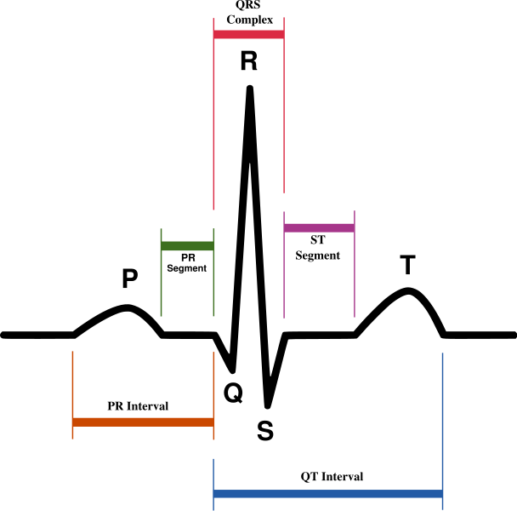
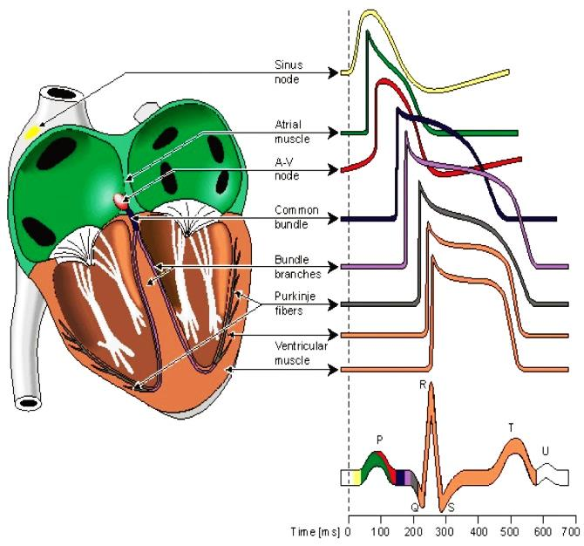
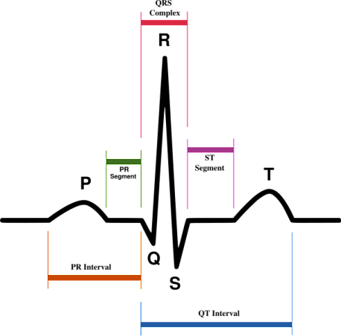
THANK YOU
DR.Hamdy Abdou Asem

Slide 23
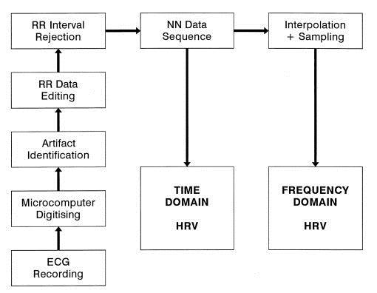
Methods of measuring heart rate variability can be subdivided into time domain and frequency domain measurements.
Overview of HRV analysis methods from an ECG recording, where NN are the normal-to-normal intervals between adjacent QRS complexes

