Slide 1
UNILATERAL SUDDEN SENSORINEURAL HEARING LOSS AFTER GENERAL ANESTHESIA
Hakan Emirkadi, MD
Department of Anesthesiology
Golcuk Military Hospital
Kocaeli / TURKEY

Slide 2
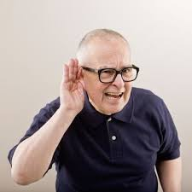
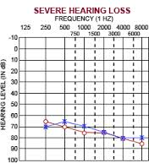
Background-Sudden Sensorineural Hearing Loss
30 dB or more loss of at least three consequent audiometric frequencies occured within the last three days.
15.000 new cases are reported annually worldwide.¹
¹ Hughes GB, Freedman MA, Hamerkamp TJ et al: Sudden Sensorineural Hearing Loss. Otolaryngol Clin North Am 29: 393-405

Slide 3
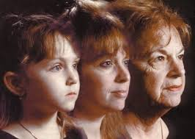
Background-Sudden Sensorineural Hearing Loss
Incidence increases with age²
No consistence of sexual predominance
No seasonal variation
No geographical distribution
² Delleyn A (1944): Sudden complete or partial loss of function of the octavus system in apparently normal persons. Acta Otolaryngol (stoch) 32: 407-429

Slide 4
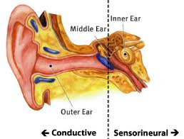
Background-Sudden Sensorineural Hearing Loss
Possible causes are:³
viral infection
vascular compromise
disruption of cochlear membrane
immunologic diseases
otological tumors
Only in 10% of cases of SSHI the causes can be identified
³ Anderson RG, Meyerhoff WL (1983): Sudden Sensorineural Hearing Loss. Otolaryngol Clin North Am 16: 189-194

Slide 5
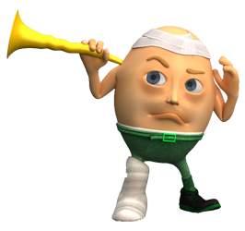
Background-Sudden Sensorineural Hearing Loss
Infections:
Inflammatory process of the inner ear-Viral causes
70% herpes simplex virus
Vascular:
Intolerance to hypoxia → after 30 mins. Permanent damage occurs
Membrane Rupture:
Rupture of the Reisner’s membrane

Slide 6
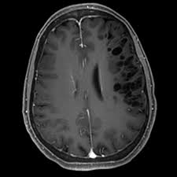
Background- Diagnosis
1. Discover and avoid potential ototoxic drugs:
Streptomycin, Acetyl salicilates, Gentamycin, etc
2. Control co-morbid metabolic diseases:
DM, CVS diseases, etc
3. Detailed audiometry must be performed in all patients
4. Routine blood tests must be performed to rule out systemic and metabolic diseases
5. MR scans (if needed) to rule out cerebellopontine angle tumors and neurological lesions

Slide 7
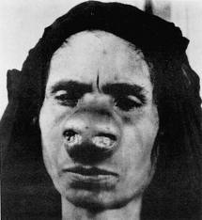
Case Report
36 year-old female
septal deviation and external nasal deformity
breast deformity
Medical history
lipoma excision (shoulder, general anesthesia, one year ago)
No known allergy
Heavy smoker
Not receiving any kind of medication

Slide 8
Case Report
preoperative evaluation
systemic examination
Lab tests
ECG
chest x-ray
blood tests were normal
NORMAL !!!

Slide 9
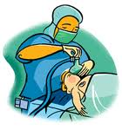
Case Report- ANESTHESIA
Premedication: Midazolam 1.5 mg I.V
Induction: Nitrous oxide, oxygen and remifentanyl
Maintenance: Isoflurane and vecuronium bromide

Slide 10
Case Report- ANESTHESIA
Nasal surgery: ENT surgeon ; Breast reduction: Plastic surgeons.
Dexamethasone 4 mg
Metoclopramide HCL 10mg
Cefazoline sodium 1gr
perioperatively advised by the anesthesiologist

Slide 11
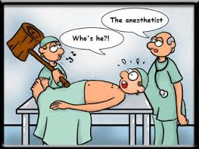
Case Report- ANESTHESIA
On the third hour of the surgery, Gentamicin 100mg I.V.: as a routine of plastic surgery.
Total operative time was approximately five hours

Slide 12
Case Report- ANESTHESIA
Postoperatively:
sefazoline sodium I.V. 3g/day
paracetamol 1500 mg/day
xylometazoline spray
pethidine HCL
pantoprazole HCL I.V. 80mg/day

Slide 13
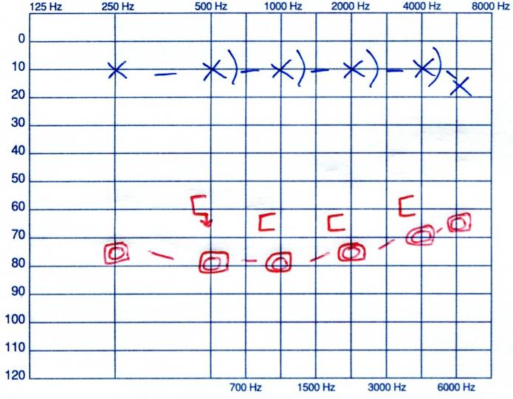
Case Report- Postoperative
Postoperative 1st day:
Tinnitus + Right hearing loss
Physical examination was normal.
Audiogram: Right sensorineural
hearing loss (average 101 dB )

Slide 14
Case Report- Postoperative work-up
Diagnostic work-up:
Neurological consultation
Lab tests
CBC, creatinine, BUN, CRP, B12, folic acid
Cranial MRI
NORMAL !!!

Slide 15
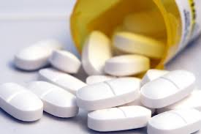
Case Report- Treatment
Pentoxifylline 600mg b.i.d + Pentoxifylline 100mg I.V. in one hour
Dextrane in isotonic NaCl solution 500cc IV in six hours
Methylprednisolone sodium succinate 80mg IV
Acetylsalicylic acid 100mg p.o.
Acyclovir 250mg q.i.d IV
Vitamin E 200IU
Vitamin B1, B6, B12 complex 250mg b.i.d.

Slide 16
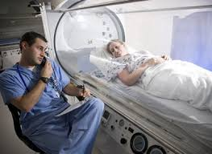
Case Report- Postoperative
Postoperative 2nd day:
Hyperbaric O2 treatment was started on the postoperative second day and continued for 20 sessions
Hearing level was monitored with serial audiograms
on postoperative 3rd, 6th, 8th,13th and 24th days
On postoperative third day pure tone air and bone conduction average in the right ear was 78dB and 63dB respectively

Slide 17
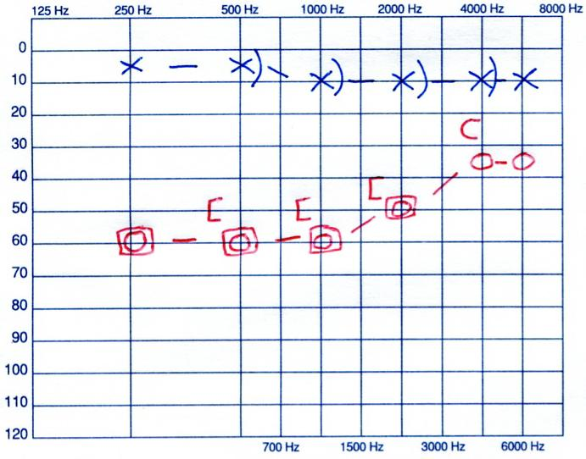
Case Report- Postoperative
Discharged on the postoperative sixth day
During the six month follow-up, the air and the bone conduction averages recovered to 58dB and 50dB in lower frequencies

Slide 18
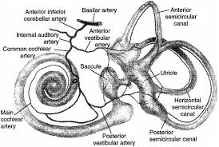
Discussion
SSHL after non-otologic surgery is a rare entity and is mostly reported in association with cardiac bypass surgery. Microemboli occluding internal auditory artery is the proposed underlying mechanism of SSHL associated with cardiac surgery.⁴
⁴ Walsted A, Andreassen UK, Berhelsen PG, Olesen A. Hearing Loss after cardiopulmonary bypass surgery. Eur Arch Otorhinolaryngol (2000) 257 :124–127

Slide 19
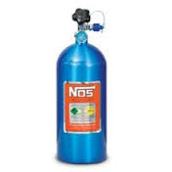
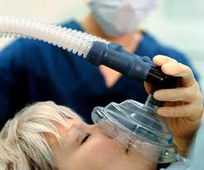
Discussion
Nitrous oxide administration during the general anesthesia may cause rapid increase in the middle ear pressure up to 450 mm/Hg. This relatively high middle ear pressure may cause cochlear membrane breaks and perilymph fistula.^{5,6}
⁵ Evan KE, Tavill MA, Goldberg AN, Silverstein H. Sudden sensorineural hearing loss after general anesthesia for nonotologic surgery. Laryngoscope 1997 Jun; 107(6):747-52.
⁶Segal S, Man A, Winerman I. Labyrinthine membrane rupture caused by elevated intratympanic pressure during general anesthesia. Am JOtol 1984;5(4):308-10.

Slide 20
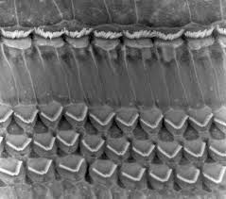
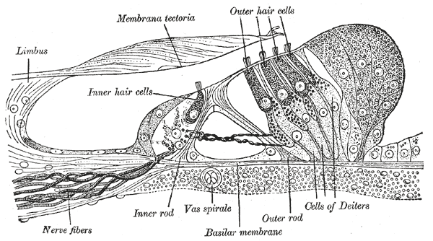
Discussion
In our case, perioperative administration of single dose gentamicin reminded us ototoxicity. But after detailed evaluation of clinical signs and occurrence pattern we decided that aminoglycoside ototoxicity is debatable to be the final diagnosis. Aminoglycoside ototoxicity is irreversible and auditory toxicity occurs as a result of the accumulation of aminoglycosides in the perilymph of the inner ear with subsequent damage of the sensory cells of the organ of Corti. Cochlear damage is usually permanent since cochlear hair cells do not regenerate.

Slide 21
In this case there are some points of interest:
If the hearing loss is due to ototoxicity, even minor doses of aminoglycosides must be avoided
We managed this case as postoperative SSHL since characteristic features of aminoglycoside ototoxicity were missing

Slide 22
Although improvement in hearing level was not satisfactory in our case, we believe that early detection and prompt evaluation of hearing loss may improve outcome despite the uncertainty in the etiology, the management and the prognosis

