Slide 1
Sex Differences in Central Expression and Effects of Brain-Derived Neurotrophic Factor
Haifei Shi
Department of Biology, Miami University
International Conference on Endocrinology
October 22, 2014

Slide 2



Arcuate melanocortin system
BDNF
VMH
+
BDNF
ARC
Expenditure Intake
+
POMC
3V
Lepr
Xu, et al., Nat Neurosci 2003
Komori, et al., Neuroscience 2006
Wang, et al., AJP 2007, 2010
Leptin

Slide 3
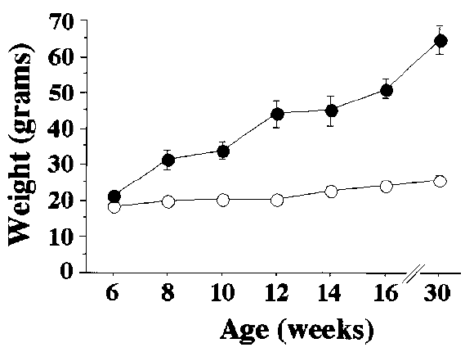


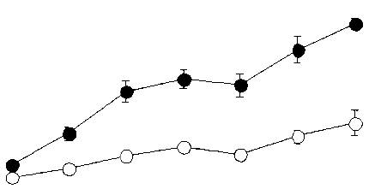
Transgenic mouse models
BDNF conditional deficient mice
Control
Bdnf deficient
Rios, et al., Mol Endocrinol 2001

Slide 4
Estradiol regulates food intake
VMH
ARC
Expenditure Intake
estradiol
3V
Asarian & Geary, Philos T Roy Soc B 2006

Slide 5
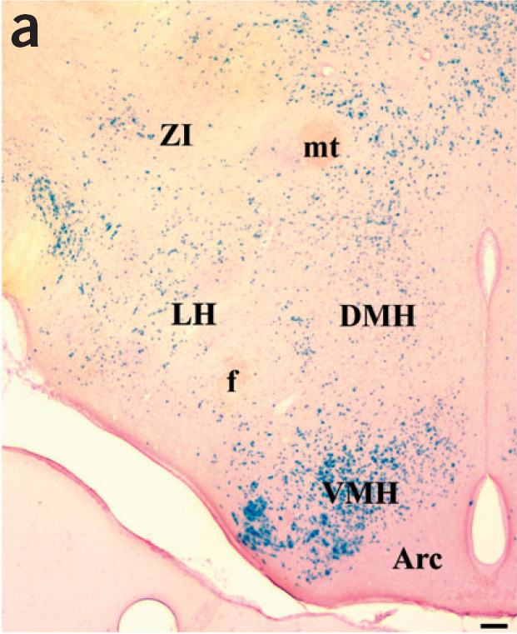
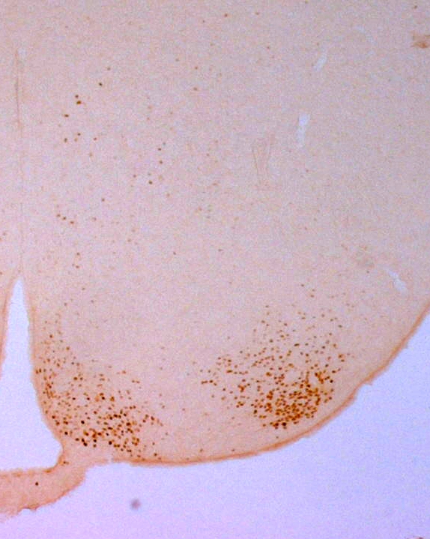
BDNF in the hypothalamus
BDNF and estrogen receptor alpha (ERα) in the hypothalamus
BDNF
ERα
VMH
Arc
100 μm
100 μm
Xu, et al., Nat Neurosci 2003
Shi Lab

Slide 6
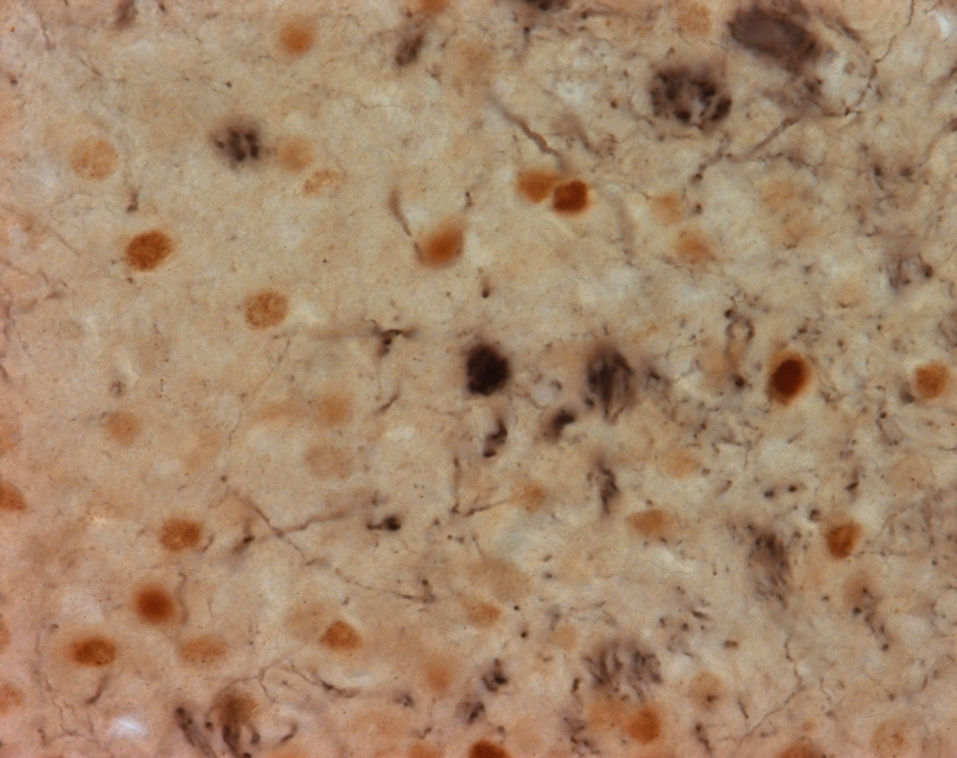
Colocalization of ERα and BDNF in the VMH
ER α: brown (DAB)
BDNF: blue black (nickel-enhanced DAB)
BDNF + ER α
Shi Lab
ERα: brown
BDNF: blue
Blurton-Jones, et al., J Comp Neurol 2004

Slide 7

Potential regulation of BDNF by estradiol
VMH
BDNF
ARC
estrogen
Expenditure Intake
POMC
estradiol
3V
Leptin

Slide 8

Hypothesis: Central BDNF expression and action are regulated by estradiol.
Q1: Is central BDNF expression regulated by estradiol?
Q2: Is central BDNF action regulated by estradiol?
VMH
BDNF
ARC
Expenditure Intake
POMC
estradiol
3V
Leptin

Slide 9

Hypothesis: Central BDNF expression and action are regulated by estradiol.
Q1: Is central BDNF expression regulated by estradiol?
Q2: Is central BDNF action regulated by estradiol?
VMH
BDNF
ARC
Expenditure Intake
POMC
estradiol
3V
Estradiol (E2; subcu)
Leptin
Ovariectomy (OVX)

Slide 10
Q1: Is central BDNF expression regulated by estradiol?
(1) Does ovariectomy (OVX) or estradiol (E2) replacement modulate VMH BDNF gene expression?
Experiment groups
Sham-Oil
OVX-Oil ad lib
OVX-Oil pairfeed (PF) (pairfeed to Sham-Oil)
OVX-E2

Slide 11
Q1: Is central BDNF expression regulated by estradiol?
(1) Does ovariectomy (OVX) or estradiol (E2) replacement modulate VMH BDNF gene expression?
Zhu, Liu, et al., Horm Behav 2014

Slide 12
Q1: Is central BDNF expression regulated by estradiol?
(2) Do male and female rats have different BDNF expression? Does estrous cycle modulate VMH BDNF gene expression?
Experiment groups (Ordered 10-week old male and female rats, sacrificed at 12-week of age)
Zhu, Liu, et al., Horm Behav 2014; Liu, Zhu, et al., Physiol Behav 2014

Slide 13
Summary 1
Q1: Is central BDNF expression regulated by estradiol?
BDNF gene expression is regulated in an estradiol-sensitive manner.
OVX decreases BDNF gene expression; reversed by estradiol replacement.
Estrous female rats have greater BDNF expression than males.
BDNF expression is dynamically regulated across estrous cycle with a temporal elevation at estrous phase.

Slide 14
Hypothesis: Central BDNF expression and action are regulated by estradiol.
Q1: Is central BDNF expression regulated by estradiol?
Q2: Is central BDNF action regulated by estradiol?
VMH
BDNF
ARC
Expenditure Intake
POMC
estradiol
3V
Clegg, et al., Diabetes 2006
de Souza, et al., Eur J Pharmacol 2011
Gao, et al., Nat Med 2007
Leptin

Slide 15
Q2: Is central BDNF action regulated by estradiol?
(1) Is central BDNF’s anorexic effect regulated by estradiol?
Experiment groups
Male-Oil
Sham-Oil
OVX-Oil ad lib
OVX-Oil pairfeed (PF) (pairfeed to Sham-Oil Female)
OVX-E2

Slide 16
Q2: Is central BDNF action regulated by estradiol?
(1) Is central BDNF’s anorexic effect regulated by estradiol?
Experiment procedure
Light
Dark
Light
Lights i3vt Lights out; 4-hour 24-hour
On 0.1μg, 0.3μg food intake food intake
BDNF or
vehicle
Zhu, Liu, et al., Horm Behav 2014

Slide 17
Q2: Is central BDNF action regulated by estradiol?
(1) Is central BDNF’s anorexic effect regulated by estradiol?
Zhu, Liu, et al., Horm Behav 2014

Slide 18
Q2: Is central BDNF action regulated by estradiol?
(2) Does ovariectomy or estradiol replacement regulate BDNF’s anorexic effect?
Zhu, Liu, et al., Horm Behav 2014

Slide 19
Q2: Is central BDNF action regulated by estradiol?
(3) Is central BDNF’s effect on energy expenditure different between males and females?
Experiment procedure
Light
Dark
Light
Lights i3vt Lights out; 24-hour
On 0.1μg energy expenditure
BDNF or
vehicle

Slide 20
Q2: Is central BDNF action regulated by estradiol?
(3) Is central BDNF’s effect on energy expenditure different between males and females?
*
*
*
Liu, Zhu, Shen, Shi. Unpublished.

Slide 21
Summary 2
Q2: Is central BDNF’s action regulated by estradiol?
Estrous female rats respond to a lower dose of BDNF than male rats to reduce food intake.
Estradiol-replaced OVX rats respond to a lower dose of BDNF than oil-injected OVX rats to reduce food intake.
Central administration of a low dose (0.1 µg) of BDNF increased energy expenditure in female but not male rats.
Central administration of a low dose (0.1 µg) of BDNF increased lipid oxidation during dark and light phases in females and only during light phase in males.

Slide 22
Conclusion
Estradiol increases BDNF central expression and action.
VMH
BDNF
ARC
Expenditure Intake
POMC
estradiol
3V
Leptin

Slide 23







Acknowledgement
Graduate students:
Zheng Zhu
Xian Liu
Minqian Shen
Shiva Senthil-Kumar
Undergraduate students:
Ashley Goudjo-Ako
Sean Pugh
Funding:
R15DK090823
Undergraduate research funding
Summer research fellowship
SDG4520028

