Slide 1

About OMICS Group
OMICS Group International is an amalgamation of Open Access publications and worldwide international science conferences and events. Established in the year 2007 with the sole aim of making the information on Sciences and technology ‘Open Access’, OMICS Group publishes 400 online open access scholarly journals in all aspects of Science, Engineering, Management and Technology journals. OMICS Group has been instrumental in taking the knowledge on Science & technology to the doorsteps of ordinary men and women. Research Scholars, Students, Libraries, Educational Institutions, Research centers and the industry are main stakeholders that benefitted greatly from this knowledge dissemination. OMICS Group also organizes 300 International conferences annually across the globe, where knowledge transfer takes place through debates, round table discussions, poster presentations, workshops, symposia and exhibitions.

Slide 2
About OMICS Group Conferences
OMICS Group International is a pioneer and leading science event organizer, which publishes around 400 open access journals and conducts over 300 Medical, Clinical, Engineering, Life Sciences, Pharma scientific conferences all over the globe annually with the support of more than 1000 scientific associations and 30,000 editorial board members and 3.5 million followers to its credit.
OMICS Group has organized 500 conferences, workshops and national symposiums across the major cities including San Francisco, Las Vegas, San Antonio, Omaha, Orlando, Raleigh, Santa Clara, Chicago, Philadelphia, Baltimore, United Kingdom, Valencia, Dubai, Beijing, Hyderabad, Bengaluru and Mumbai.

Slide 3


The study of the selectivity of methane over carbon dioxide and inert gases using composite inorganic membranes
Habiba shehu and Edward Gobina
Centre for Process Integration and Membrane Technology, (CPIMT),
School of Engineering, The Robert Gordon University, Aberdeen, AB10 7GJ. United Kingdom
h.shehu@rgu.ac.uk, e.gobina@rgu.ac.uk Tel ; +44(0)1224262309, +44 (0)1224262348
3rd International Conference and Exhibition on Mechanical & Aerospace Engineering October 05-07, 2015 San Francisco, USA

Slide 4
OUTLINE
Introduction
Greenhouse gases
Membrane materials
Aim and Objectives
Gas separations
Experimental Rig
Results and Discussion
Conclusion
Further work
Q & A

Slide 5
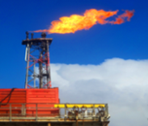
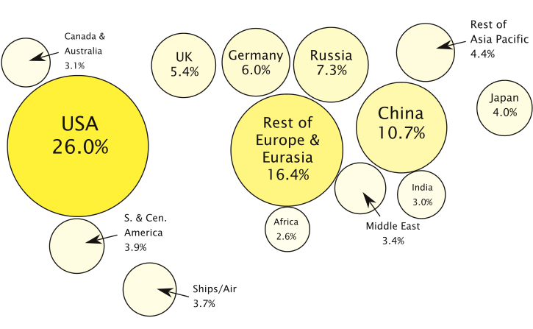
INTRODUCTION
GREENHOUSE GASES
Gaseous hydrocarbons that are prevalent under increased pressure include solution gases in oil reservoirs.
These gases are usually conserved but in some cases they are flared (Fig. 1).
The main gas in Natural gas is methane.
Flaring brings about the emissions of carbon dioxide which is one of the main gases responsible for global warming.
Fig. 1: Natural gas flaring
Greenhouse gases that include carbon dioxide, methane and other non-methane hydrocarbons are responsible for global warming
The distribution of emissions world wide (Fig. 2) shows USA to be the main contributor
Fig. 2: Cumulative CO2 emissions, 1751 – 2012 (courtesy Hansen, J., et al. (2013)

Slide 6
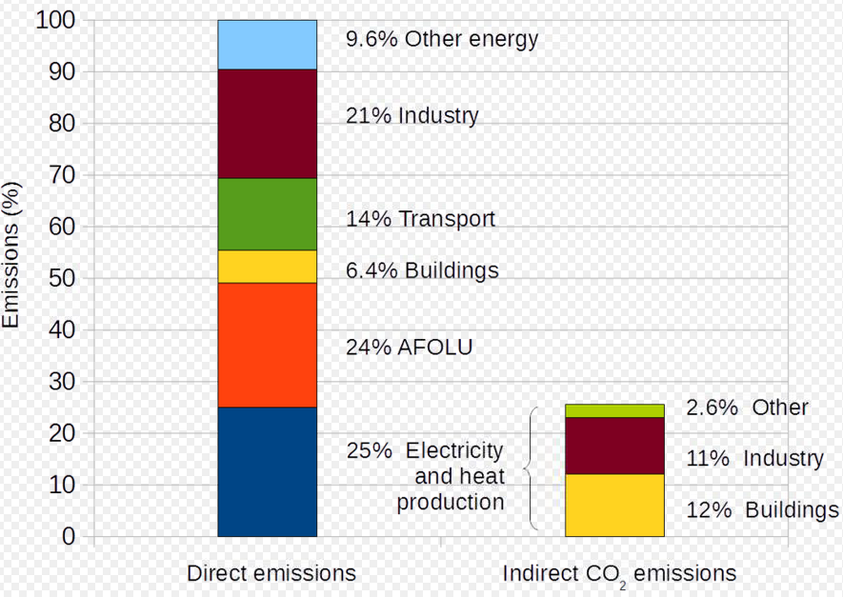
Different sectors that contribute to the emission of green house gases in 2010 are presented in Fig. 3.
The highest contributors are industry, Agriculture, Forestry and Other Land Use (AFOLU), electricity and heat production.
There are regulations in place in many countries for the emissions of these gases into the atmosphere.
Fig. 3: Annual world greenhouse gas emissions by sector, 2010
Focussing on natural gas as it is an important fuel gas that can be used for power generation as well as a raw material in petrochemical industries.
There are various measure in place for the treatment of natural gas and its transportation to pipelines as well storage facilities.
Membrane Technology has only about 5% of the market for processing natural gas in the United States.
This percentage is expected to rise as better carbon dioxide selective membranes are developed.

Slide 7
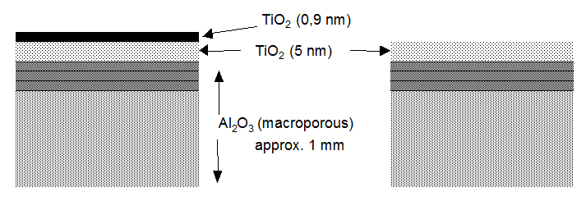
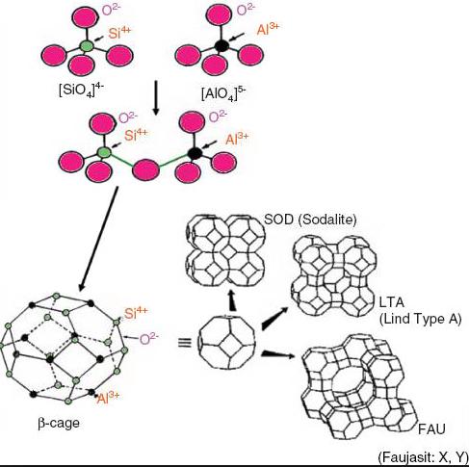
INTRODUCTION
MEMBRANE MATERIALS
Fig. 4: Schematic representation of titania-alumina membrane cross-section
Fig. 5: Basic zeolite structure
The choice of membrane material is dependent on the application of the membrane. The basic support used in this work is alumina support that is macro-porous with a large pore size of 6000 nm. It has an intermediary layer consisting of titanium oxide. The outer layer can be modified with various components such as metals, silica, zeolites or it can be mixed matrix and contain a mixture of polymer incorporated in the zeolitic pores.

Slide 8
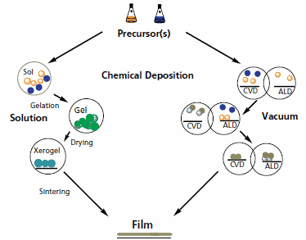
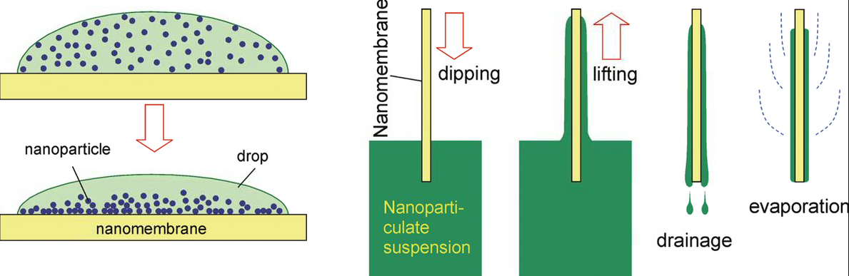
MEMBRANE PREPARATION
Fig. 7: Chemical vapour deposition process
Fig. 6: Dip coating process
There are different procedures that can be used for the modification of a membrane support. The dip-coating process (Fig. 6) was used in this work and it involves the preparation of a nano-particulate suspension and immersing the membrane into the suspension for a period of time.
Chemical vapour deposition (Fig. 7) is used for high quality modification of membranes. The nano-particle thin film is deposited as a vapour on the membrane support. This is a future methodology to be used in my research work.

Slide 9
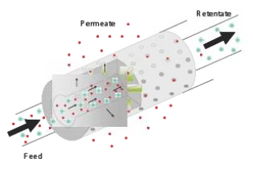
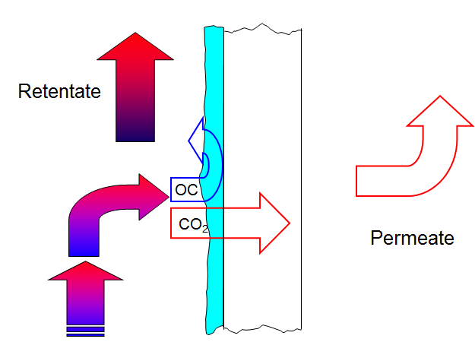
GAS SEPARATIONS
CO
Fig. 8: Gas flow through a membrane
Fig. 9: Membrane process
Gas flow through a membrane can be a pressure driven process. The feed gases are fed into the membrane, the gases that don’t go through the membrane are called the retentate and the gases that go through the membrane are referred to as the permeate (Fig. 8).
The flux (J) of a gas is the amount passing per unit time and per unit of membrane surface area. Flux has an impact on the economic feasibility on the use of membrane technology since high flux for a low membrane surface area reduces the capital costs of operation.
Selectivity is the partitioning of a component into permeate and feed. This gives an idea of how a particular component moves through the membrane in relation to another component. Selectivity strongly determines the technical feasibility of a membrane separation process.

Slide 10
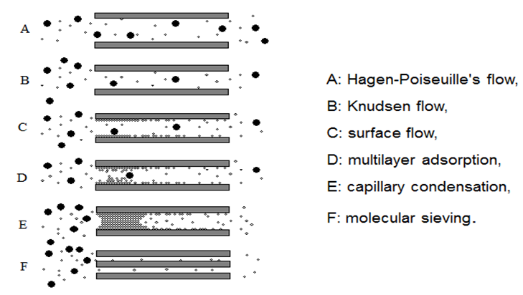
GAS SEPARATIONS
Fig. 9: Mechanism of gas transport through a membrane
The type of membrane material, pore size and nature of the components to be separated determines the type of transport mechanism through the membrane. A membrane can separate components using a combination of flow mechanisms.
Poiseuille’s flow separate gases based on their viscosities.
Knudsen flow is dependent to the molecular mas of the gas components.
Surface flow involves the adsorption of a component on the surface of the membrane.
Different gases have different condensation pressures, hence capillary condensation uses this difference to separate gases.
Various gases have different kinetic diameters hence molecular sieving is possible when the pore size of the membrane support is in the nano scale.

Slide 11
AIM AND OBJECTIVES
CH₄, C₃H₈, C₄H₁₀, N₂, O₂, CO₂, He
separations
Zeolite incorporated with polymer on alumina support
Silica on alumina support
Zeolite on alumina support
Prepare and characterise a silica and zeolite membrane on an alumina support
Determine the flux of methane and CO2, through the prepared membranes
Determine the separation factors of the gases through the membrane in relation to methane

Slide 12
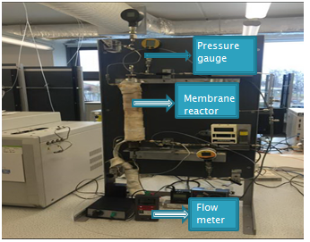
EXPERIMENTAL RIG
Zeolite membrane was fabricated using the dip-coating method (Fig. 10)
Characterisation was done by carrying out nitrogen adsorption-desorption measurements using the Quantachrome gas analyser (Fig. 12)
Permeation tests were carried out using a membrane reactor (Fig. 11).
Zeolite crystals on alumina support
Dip-coating gel
Fig. 10: Zeolite membrane preparation
Sample cell
Out gasser chamber
Liquid nitrogen dewar
Fig. 11: Quantachrome gas analyser
Fig . 12: Permeation setup

Slide 13
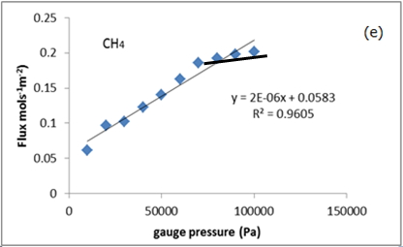
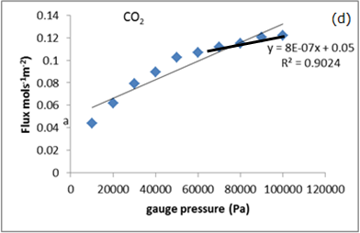
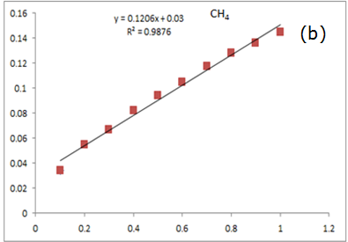
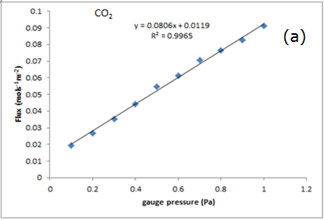
RESULTS AND DISCUSSION
Fig. 13: Flux of CH4 and CO2 through a silica membrane
Fig. 14: Flux of CH4 and CO2 through a zeolite membrane
The molar flux of both gases increased linearly with increase in pressure
This is in agreement with literature
At pressures above 6x10⁵ Pa the slope remained constant and hence this could indicate the contribution due to viscous flow (previous work) being prevalent for the silica membrane at a higher pressure
The molar fluxes are linear functions of the pressure drop across the zeolite membrane

Slide 14
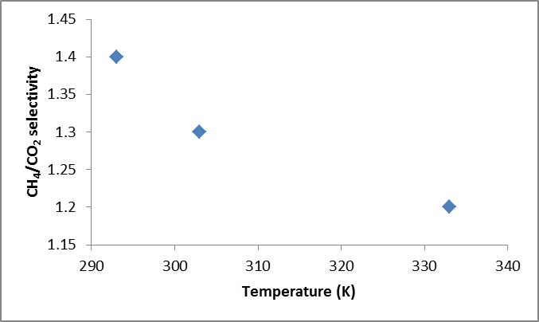
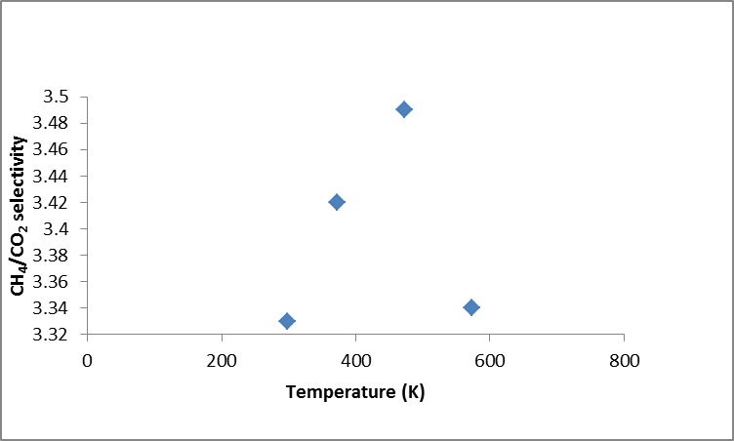
RESULTS AND DISCUSSION
Fig. 15: Effect of temperature on CH4/CO2 selectivity of silica membrane
Fig. 16: Effect of temperature on CH4/CO2 selectivity of zeolite membrane
CH4/CO2 selectivity decreases with increasing operating temperature in the silica membrane
CH₄/CO₂ obtained from the zeolite membrane is much higher than that of the silica membrane. The selectivity also increases with increase in temperature
At a higher temperature of about 500K the selectivity of the membrane to CH4 over CO2 falls to its room temperature value in the case of zeolite membrane.

Slide 15
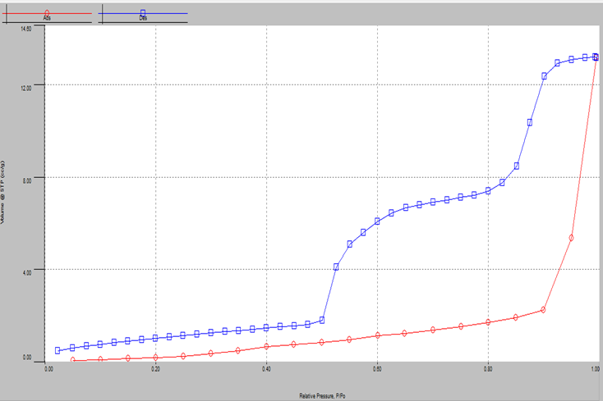
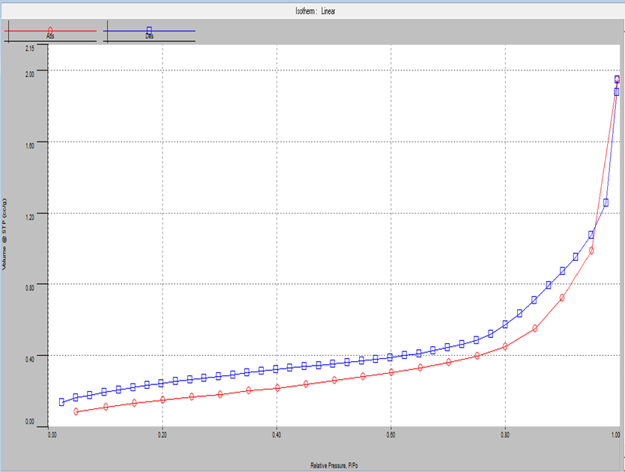
(a)
(b)
Fig. 17: Isotherm of silica (a) and zeolite (b) membranes
(a)
(b)
Table 1: Desorption summary of (a) silica membrane and (b) zeolite membrane
The hysteresis isotherms in Fig. 17 implies that both membranes are mesoporous and could undergo capillary condensation during hysteresis.
Table 1 shows the desorption summary of both membrane membrane.

Slide 16
CONCLUSION
The results obtained have shown that it is possible to use a mesoporous membrane to selectively remove carbon dioxide from methane to produce pipeline quality natural gas. The zeolite membrane has given better separation factor than the silica membrane.
FUTURE WORK
There is a need for further study of the transport mechanism of methane through the zeolite membrane since this is essential for the separation of other hydrocarbons that could be present as impurities.

Slide 17


