Slide 1
THE ADDITION OF PYRAZOLES TO CROTONALDEHYDE IN THE PRESENT OF WATER
Institute of Organic Chemistry, Scientific Technological Centre of Organic and Pharmaceutical Chemistry NAS RA
2nd European Organic Chemistry Congress
March 02-03, 2017 Amsterdam, Netherlands
Hasmik Khachatryan
Supervisor:
Sargis Hayotsyan

Slide 2
The reaction of pyrazoles with crotonaldehyde in the absence of catalyst
The synthesis of formylpropyl derivatives of pyrazoles (4-6) in the absence of catalyst and in neat conditions proceed with up to 85-90% yields in 8-16 hours.

Slide 3
The reaction of 3,5-dimethylpyrazole with croton aldehyde in an aqueous medium
Conditions:
Duration of the reaction is16 hours
The reaction is proceeded in present of water at 85-90ºC.

Slide 4
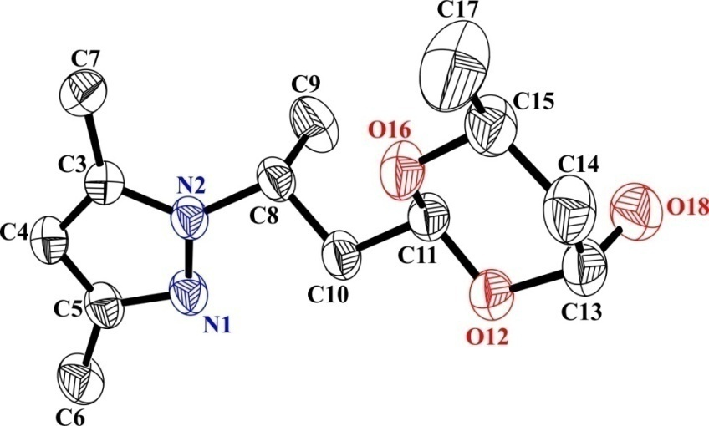
Single crystal structure of 2-(2-(3,5-dimethyl -1H-pyrazole -1-yl)propyl)-6-methyl -1,3-dioxan-4-ol
Conditions:
Enraf-Nonius Cad-4 diffractometer (graphite monochromator, Mo-Kα radiation, θ/2θ-scan)
The structure was solved by direct method and refined using SHELXTL software package
Hydrogen atoms are omitted for the clarity

Slide 5
Crystallographic data
Crystal Data
Compound | 7
Formula | C₁₃H₂₂N₂O₃
Formula Weight | 254.33
Crystal System | monoclinic
Space group | P2₁/c
a, b, c [Å] | 11.493(2), 14.748(3), 8.3173(17)
α, β, γ [deg.] | 90, 90.10(3), 90
V [Å³] | 1409.8(5)
Z | 4
D(calc) [g/cm³] | 1.198
μ(MoKα) [ mm⁻¹ ] | 0.085
F(000) | 552
Crystal Size [mm] | 0.36×0.30×0.25
Refinement
Nref, Npar | 4096, 168
R, wR2, S | 0.0774, 0.2486, 1.03
Weighting scheme | w=1/[σ²(Fo²)+(0.1200P)²+0,6782P], where P=(Fo²+2Fc²)/3

Slide 6
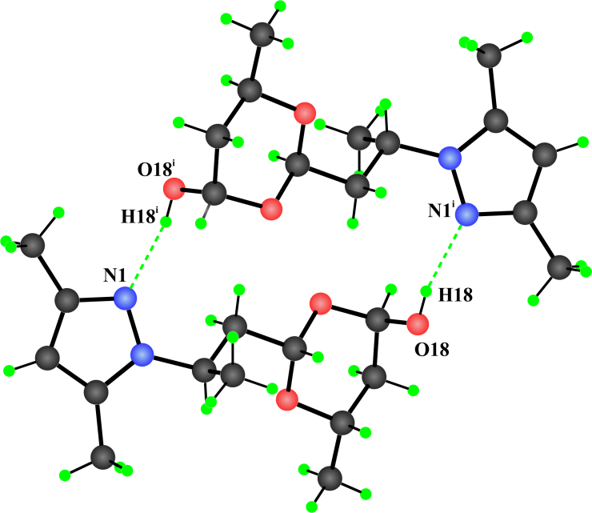
Single crystal structure of propyl)-6-methyl-1,3-dioxane-4-ol
The dimer compound of 2-(2-(3,5-dimethyl-1H-pyrazol-1-yl). Hydrogen bonds are shown by dotted lines. symmetry code (i = 2; -y; 1-z).
In 3D network these two conformers related by inversion center, are connected via intermolecular double hydrogen bonds: O18-H18…..N1^{i} and O18^{i}-H18^{i…..}N1, forming dimmers. Donor-acceptor bond lengths are 2.823(3)Å. The interactions between dimmers may be described mainly by van der Waals interactions.

Slide 7
The suggested mechanism of interaction

Slide 8
IR spectrum of the crystal
pyrazole ring
1550 cm⁻¹
OH
3100-3300 cm⁻¹

Slide 9
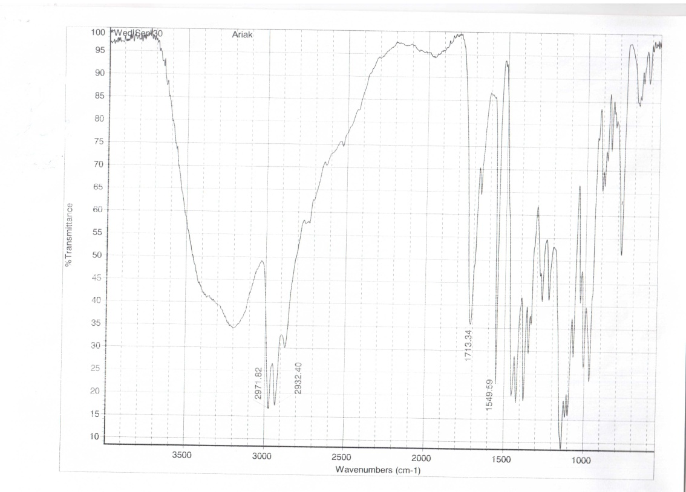
IR spectrum of the solution state
IR spectrum of the fused state

Slide 10
The existence of 2 compounds in equilibrium
¹H NMR analysis of compounds 7 and 8
doublet-doublet signals in formyl group at 9.61 ppm
singlet signals of OH groups at 4.40 ppm
signal from methyl group of the pyrazole ring at 1.23 ppm
signals from methyl substituents of the pyrazole rings between 2.11-2.21 ppm
signal from pyrazole ring at 5.84 ppm
signals from side chain methyl group of the pyrazole ring at 1.18 ppm, 1.32 ppm and 1.48 ppm as a doublet.

Slide 11
Conclusions
1
The synthesis of formylpropyl derivatives of pyrazoles by the reaction of pyrazoles with crotonaldehyde in the absence of catalyst and in neat conditions has been studied and the reactions proceed with up to 85-90% yields in 8-16 hours.
2
3
Based on the results of X-ray diffraction (XRD), IR and ¹H NMR one can suggest that 2-(2-(3,5-dimethyl-1H-pyrazol-1-yl)propyl)-6-methyl-1,3-dioxane-4-ol exists in equilibrium from 3-(3-(3,5-dimethyl-1H-pyrazol-1-yl)-1-hydroxybutoxy)butanal.
The reaction of 3,5-dimethylpyrazole with crotonaldehyde in an aqueous medium, leads to the formation 3,5-dimethylpyrazole of crystalline hemiacetal with 65 % yield.

Slide 12
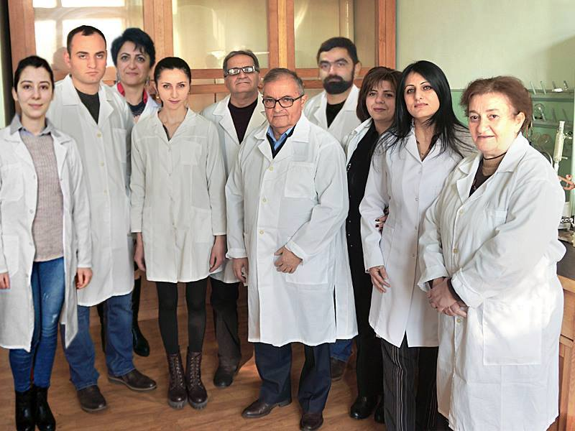
Acknowledgements
Prof. Hovhannes Attaryan
Group members
Molecular Structure Research Center of Scientific Technological Center of Organic and Pharmaceutical Chemistry NAS RA
Dr. H. Panosyan,
Dr. R. Tamazyan
Dr. A. Ayvazyan

Slide 13
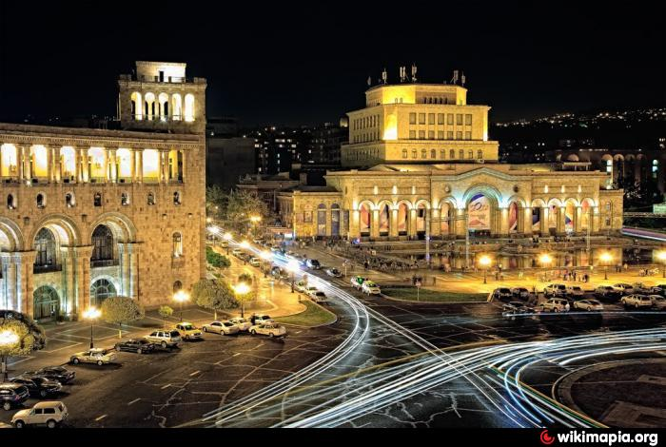
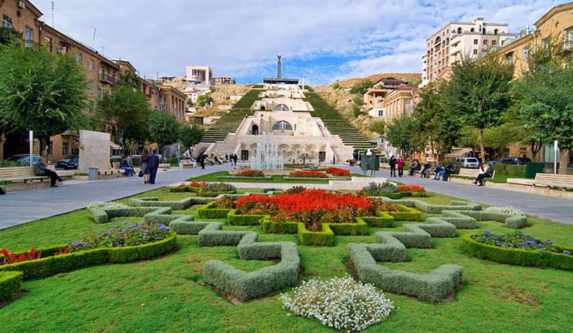
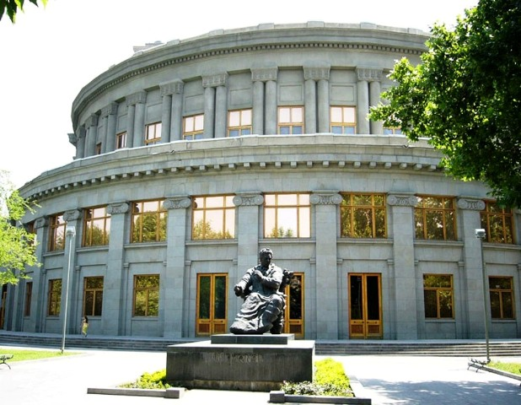
Historical Yerevan…
Kaskad
Republic square
Opera

