Slide 1
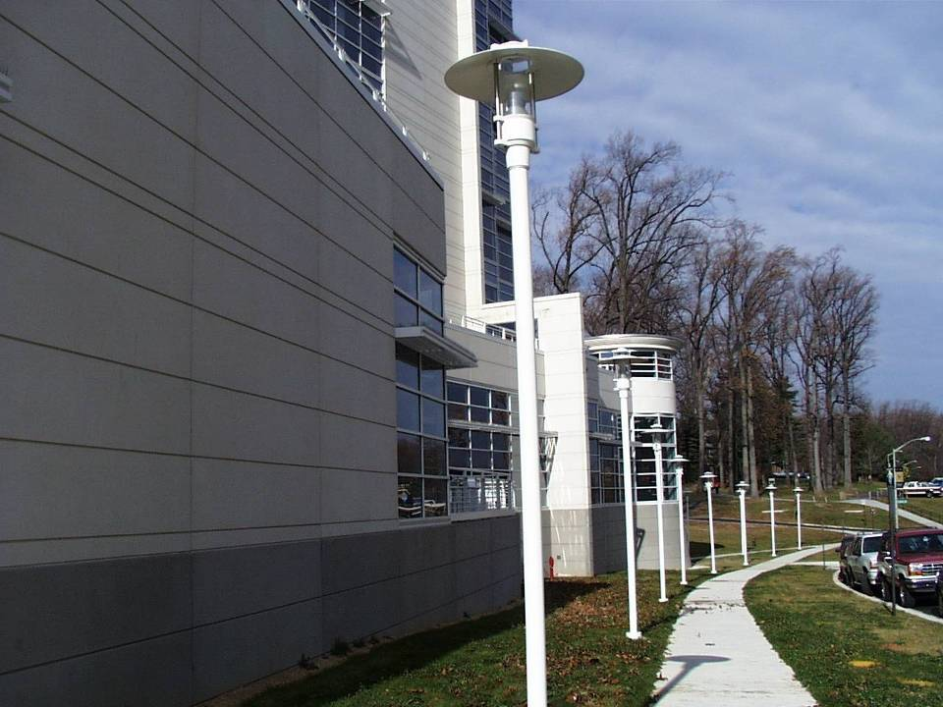
Application of Neutralization Fingerprinting in Antibody Epitope Prediction and Delineating Antibody Recognition in HIV-1 Sera
Gwo-Yu Chuang
Structural Bioinformatics Section
Vaccine Research Center/NIAID/NIH
September 25th, 2014

Slide 2
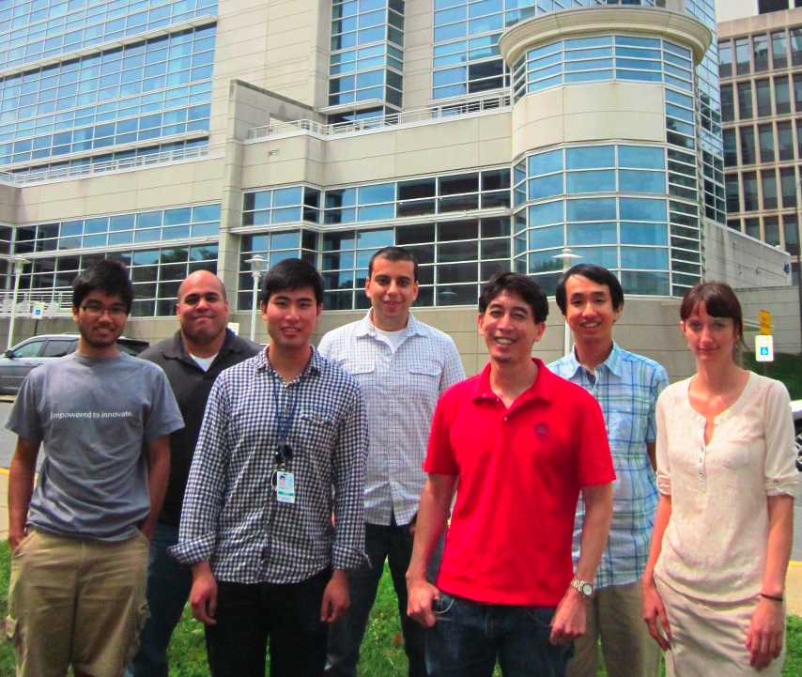
Who We Are
SBIS
Computational
Biology and
Structural
Bioinformatics
Ivelin Georgiev
Structure
Analysis
Serum Analysis/
Antibodyomics
Immunogen
Design
Peter Kwong
Vaccine
Design

Slide 3
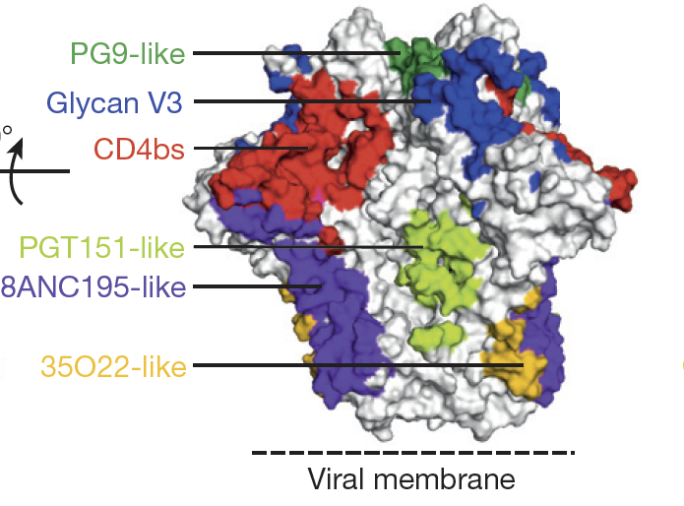
Major Epitopes Targeted by Broadly Neutralizing Antibodies On the HIV-1 Env Spike
MPER-like
Pancera et al. (2012) Nature (in press)

Slide 4
Goals
A fast and accurate method to predict HIV-1 antibody epitope in residue level
Understand resistance mutation
Facilitate optimization of neutralizing antibodies
Provide basis for epitope-based vaccine design
A fast and accurate method to delineate HIV-1 sera specificity
Isolation of new monoclonal antibodies that may be of therapeutic value
Elucidating immunodominant epitopes

Slide 5
Outline
Predicting antibody epitope in residue level using neutralization fingerprint
Predicting HIV-1 sera specificity using neutralization fingerprinting

Slide 6
Existing Methods for Epitope Prediction
Experimental:
Method | Accuracy | Efficiency
Crystallography | High | Low
NMR | High | Low
Cryo-EM | Medium | Medium
Alanine Scanning | Medium/High | Medium/Low
Pepscan | Medium/High | Medium/Low
Computational:
Method | Accuracy | Efficiency
Protein Docking | Low | High
Sequence and structure analysis | Low | High

Slide 7
Covariation Between Neutralization Potency and Sequence Variability
Basis: Altering amino acid of epitope residues is highly likely to affect neutralization
Amino acid
fingerprints
Neutralization
fingerprint
1
x
y
n
Strain 1
……
……
Strain 2
……
……
Strain 3
……
……
Strain 4
……
……
Strain 5
……
……
Strain 6
……
……
Different amino acid types
Different neutralization
potency levels
Chuang et al (2013), Journal of Virology

Slide 8
Covariation Between Neutralization Potency and Sequence Variability
Basis: Altering amino acid of epitope residues is highly likely to affect neutralization
Amino acid type
at position x
Neutralization
potency
Amino acid type
at position y
Neutralization
potency
Amino acid type at position x and neutralization potency have a high degree of mutual variation
=> Position x is likely at the epitope
Amino acid type at position y and neutralization potency have a low degree of mutual variation
=> Position y is not likely at the epitope
Different amino acid types
Different neutralization
potency levels
Chuang et al (2013), Journal of Virology

Slide 9
Epitope Prediction Based on Mutual Information Between Neutralization and Sequence Variability
Rank each antigen residue by the normalized mutual information between amino acid type and neutralization IC50
Mutual information calculation
Amino acid type
at position i
Neutralization
potency
x: amino acid types y: neutralization IC₅₀ values
(20 aa type plus gap) discretized as neutralizing (IC₅₀<50μg/mL)
and non-neutralizing (IC₅₀>=50μg/mL)
Chuang et al (2013), Journal of Virology

Slide 10
Incorporating Antigen Structural Information and Epitope Propensity Score
Antigen
Antigen
Mutual information calculation
Amino acid type
at position i
Neutralization
potency
+
Surface Accessibility
Spatial Localization of high scoring residues
Epitope propensity score (PS)
(Haste-Andersen et al. 2006 Protein Sci.)
Chuang et al (2013), Journal of Virology

Slide 11
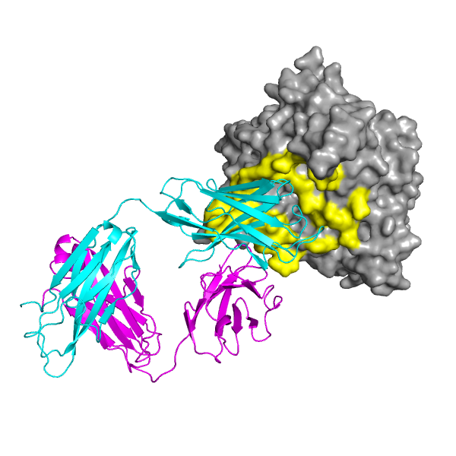
Test Cases – 19 HIV-1 antibodies
Viral Strains
Antibody | Site of Recognition
VRC01 | CD4-binding site
VRC-PG04 | CD4-binding site
b12 | CD4-binding site
b13 | CD4-binding site
F105 | CD4-binding site
NIH45-46 | CD4-binding site
3BNC117 | CD4-binding site
VRC-PG20 | CD4-binding site
VRC23 | CD4-binding site
CH103 | CD4-binding site
VRC03 | CD4-binding site
VRC06 | CD4-binding site
VRC-CH31 | CD4-binding site
17b | CD4i
10E8 | MPER
2F5 | MPER
4E10 | MPER
PG9 | V1/V2
PG16 | V1/V2
Antibodies
Neutralization panel (181 strains)
Antigen
Epitope defined by crystal structure
Antibody(Fab)
Antigen-antibody complex crystal structure
Chuang et al (2013), Journal of Virology
Likelihood of being an epitope residue: i > i+1 > i+2 >i+3

Slide 12
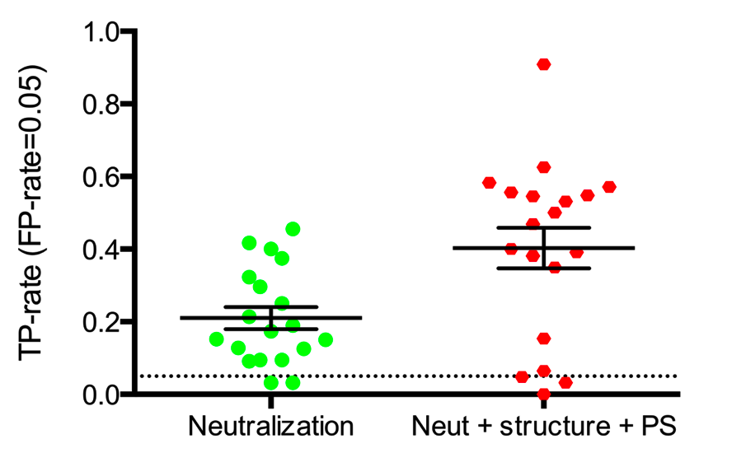
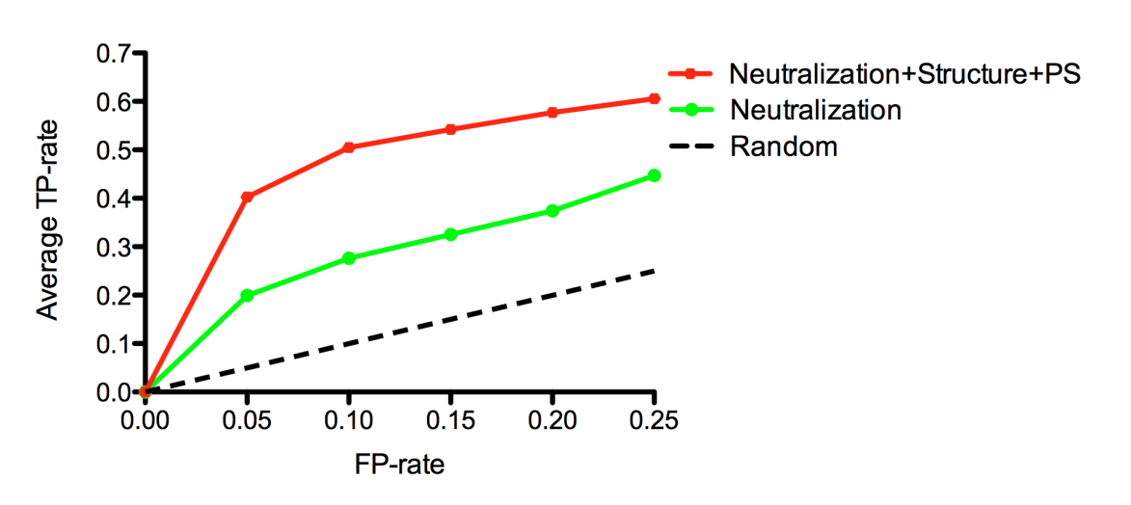
Neutralization-based Epitope Prediction Algorithms Give Good Prediction Accuracy
TP (True Positive): Number of correctly predicted epitope residues
FP (False Positive): Number of incorrectly predicted epitope residues
TP rate= TP/(Number of epitope residues)
FP rate= FP/(Number of non-epitope residues)
Chuang et al (2013), Journal of Virology
Likelihood of being an epitope residue: i > i+1 > i+2 >i+3

Slide 13
Case Study: Predicting the Epitope of HIV-1 Antibody 8ANC195
Isolated using a stabilized HIV-1 gp120 core (2CC) (Scheid et al. 2011, Science)
Does not possess characteristics of CD4bs- or CD4i-antibodies
No 8ANC195/gp120 complex structure available at the time of prediction

Slide 14
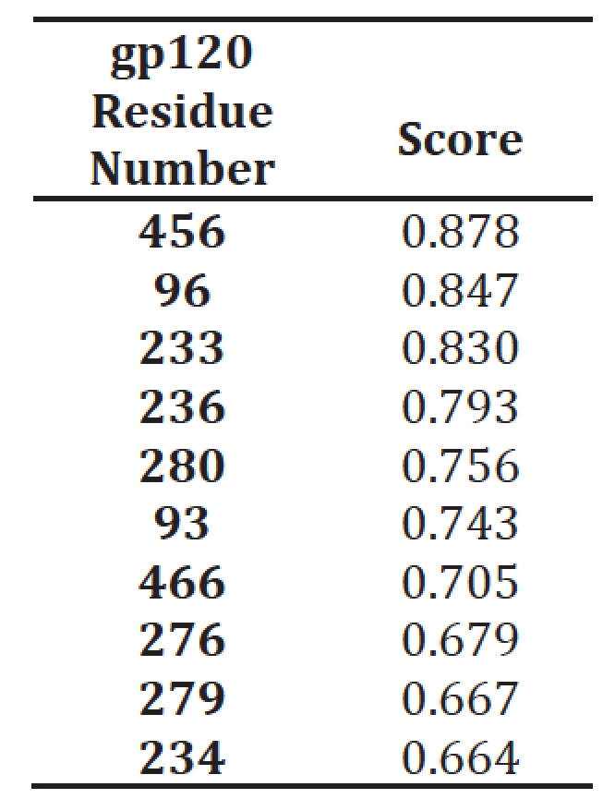
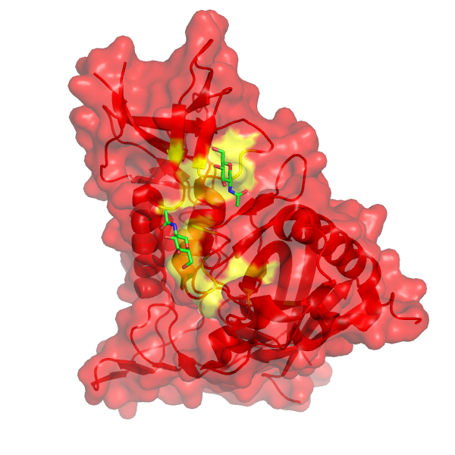
8ANC195 Epitope Prediction
Top 10 predicted epitope residues
N/C termini
HIV-1 gp120
Glycan 234
Top 10 predicted epitope residues
Glycan 276
CD4 binding site
- Three of the top ten predicted residues are part of two N-linked glycosylation sequons at gp120 residues 234 and 276, suggesting that 8ANC195 might binds to these two glycans
Chuang et al (2013), Journal of Virologyç

Slide 15
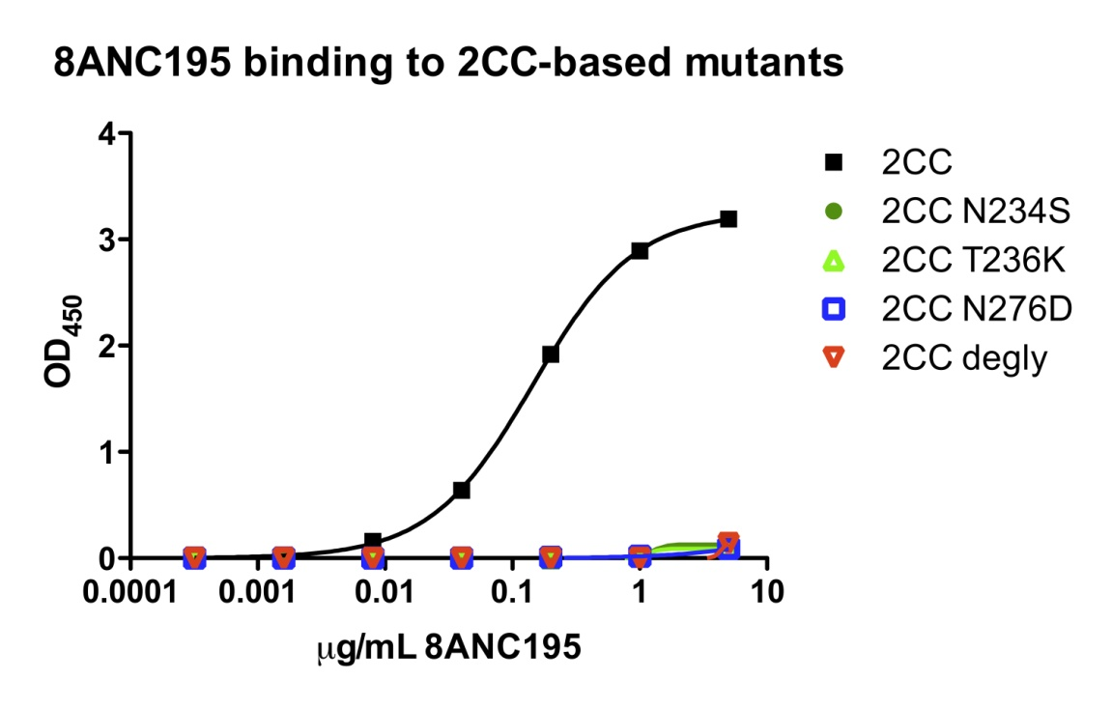
8ANC195 Binding/Neutralization is Affected by the Presence of N-linked Glycans at Residue 234 and 276
8ANC195 neutralization of 3337.V2.C6 pseudoviruses
8ANC195 binding to gp120 mutants
Mutations | Neutralization IC50 (μg/mL)
Wild type | 0.049
N234S | >50
T236K | >50
N276D | >50
Chuang et al (2013), Journal of Virology

Slide 16
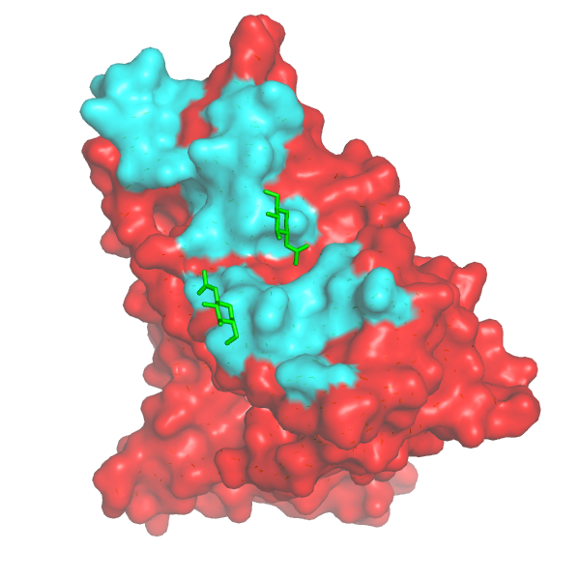
Predicted 8ANC195 Epitope Residues Highly Agree with Epitope Determined by Crystallography
N/C termini
HIV-1 gp120
8ANC195 epitope determined by crystal structure
Glycan 234
Glycan 234
Top 10 predicted epitope residues
Glycan 276
Glycan 276
PDB:4P9H
(Scharf et al (2014), Cell Reports)
5 of the top 10 predicted residues are part of the 8ANC195 epitope
Chuang et al (2013), Journal of Virology

Slide 17
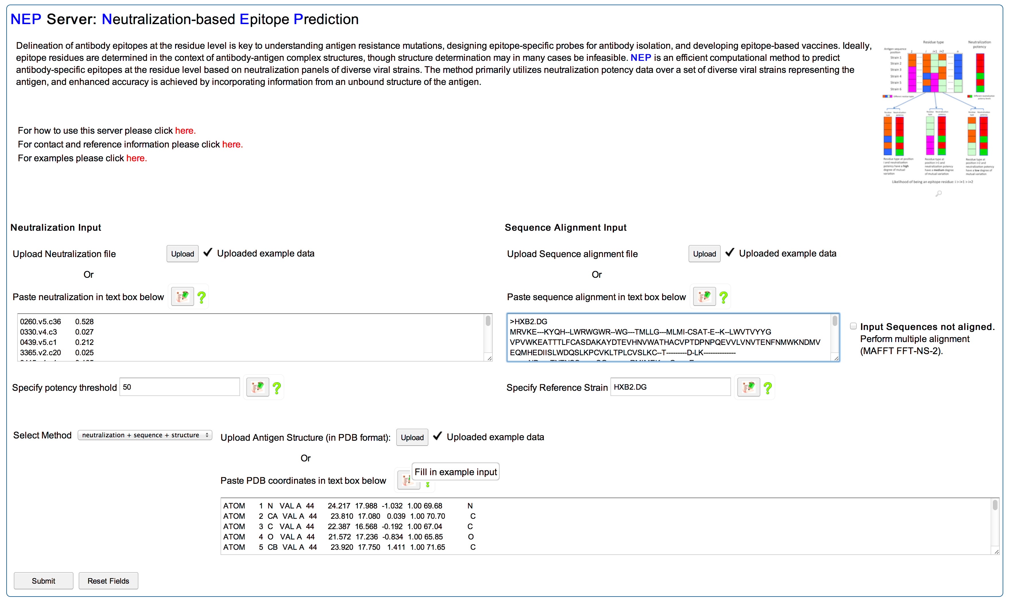
NEP: Neutralization-based Epitope Prediction Web-Server
Input: 1) Antibody neutralization data
2) Antigen sequence
3) Antigen structure (optional)
http://exon.niaid.nih.gov/nep
Chuang et al (2014), Nucleic Acids Research

Slide 18
Conclusions (I)
The neutralization-based algorithm is able to predict the epitope residues of HIV-1 antibodies with good accuracy and high efficiency
HIV-1 antibody 8ANC195 binds to N-linked glycans at gp120 position 234 and 276. This binding mode was not described at the time of the prediction
A web-based server (NEP) is available to the public to run neutralization-based epitope prediction
The method is applicable to other viruses with diverse strains (e.g. influenza)

Slide 19
Outline
Predicting antibody epitope in residue level using neutralization fingerprint
Predicting HIV-1 sera specificity using neutralization fingerprinting

Slide 20
Mapping HIV-1 Sera Specificity
Peptide Interference
Linear epitopes
Epitope Specific Probes
e.g. gp120 core
Knocking out specific sites
e.g N160K to knockout V1/V2 ab binding
Chimeric Viruses
e.g. grafting HIV-1 epitopes on SIV
Binley et al. (2009) Current Opinion in HIV and AIDS
.
Dey et al. (2009) Plos Pathogens

Slide 21
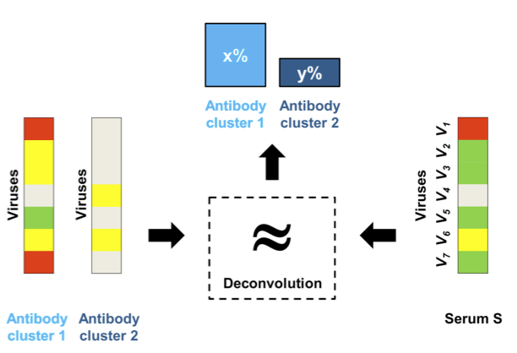
Identification of Serum Specificity by Deconvolution of Neutralization Fingerprints
10E8-like
PG9-like
Viruses
Viruses
VRC01
PG9
10E8
PGT128
Georgiev et al (2013), Science

Slide 22
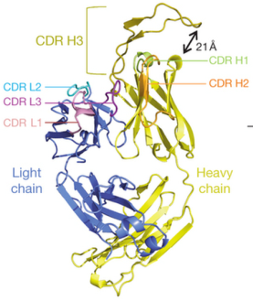
Predicted Sera Specificities Agree with Identified Neutralizing Antibodies
V1/V2 specific antibody VRC26 was identified
(Doria-Rose (2014), Nature)
Georgiev et al (2013), Science

Slide 23
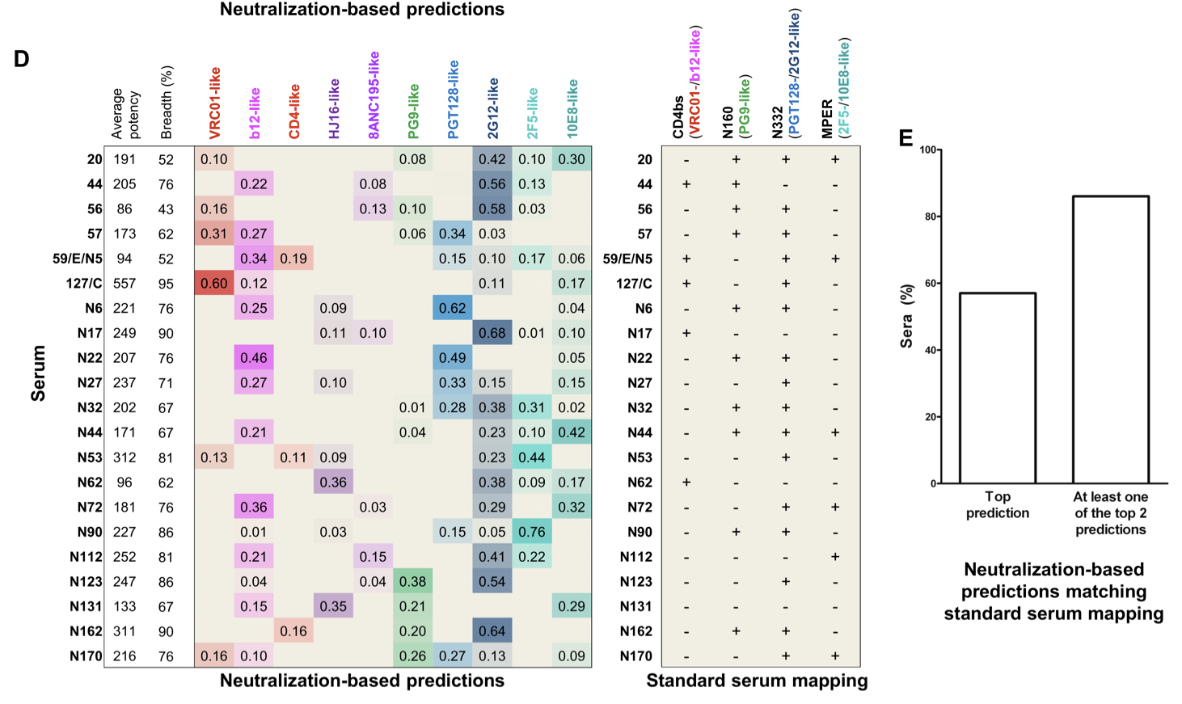
Predicted Sera Specificities Matched Standard Sera Mapping
Georgiev et al (2013), Science

Slide 24
Conclusions (II)
A new computational tool, based on neutralization fingerprints, was developed to predict HIV-1 sera specificities
The tool can aid the identification of new anti-HIV-1 broadly neutralizing antibody and understanding of the development of broadly neutralizing antibodies during the course of infection

Slide 25
Acknowledgments
Structural Bioinformatics Section
Peter Kwong
Ivelin Georgiev
BSL3 Core Virology Section
John Mascola
Nicole Doria-Rose
Ryan Staupe
Mark K. Louder
Stephen Schmidt
Krisha McKee
Sijy O’Dell
Structural Biology Section
Peter Kwong
Priyamvada Acharya
Jason Gorman
Young Do Kwon
Marie Pancera
Yongping Yang
Baoshan Zhang
Tongqing Zhou
Immunology Core Section
Robert Bailer
Office of Cyber Infrastructure and Computational Biology
David Liou

