Slide 1
Smart glasses – A new mobile tool for health care and education
Gunnar O Klein, M.D. Ph.D.
Professor of Informatics/eHealth in Örebro, Sweden
Valencia, 2015-07-29

Slide 2
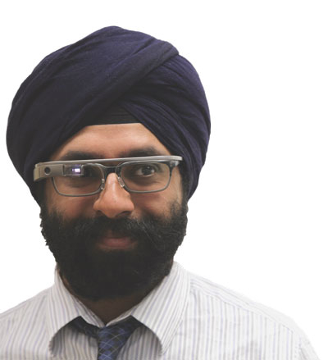
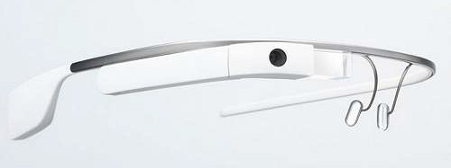
What is Google Glass ?
Dr Karandeep Singh
Harvard Medical School
• A communicator, handsfree telephone
• A camera and voice recorder/transmitter
• A display for reading short messages/texts images
• A voice input interface for steering applications from
local storage or internet sites

Slide 3
In press for the Medinfo 2015 conference of the International Medical Informatics Association
Smart Glasses – A new tool in medicine
Gunnar O Kleinª, Karandeep Singh^{b}, Johan von Heideken^{c,d}
ª Dept of Informatics, Örebro University, Örebro, Sweden
^{b} Dept of Biomedical Informatics, Harvard Medical School, Boston USA
^{c} Dept of Women’s and Children’s Health, Karolinska Institutet, Stockholm, Sweden
^{d} Department of Physical Therapy, Movement and Rehabilitation Sciences, Northeastern University, Boston USA

Slide 4
Method
A litterature search in December 2014 using Pubmed and Web of Science.
Fifty-nine abstracts were found and read. We included articles in the review if they: (1) included original data, and (2) were evaluating Google Glass in a clinical setting. Articles should be in English and of full length.
17 studies were found to meet the criteria

Slide 5
Brief History of the device
The Google Glass Explorer Edition became available in February of 2013 to individuals in the U.S. in a limited beta test. In April of 2013, Google released the first iteration of the development platform known as the Mirror API, followed by release of the Glass Development Kit in November of 2013, which allowed for the development of a number of Glass applications.
On January 15, Google announced that the production of the Glass prototype was stopped but Google remains committed to the development of the product.
While the Google Glass product is the most publicized, a number of start-ups and larger companies have also developed different types of smart glasses

Slide 6
Other smart glasses
The Google glass product is being redesigned and after January 2015 it is not available right now in July. Google has announced they will relaunch a new product but not when.
However other products are available and coming
One interesting is the VUZIX M100 smart glasses
They have teamed up with Octovis in their Telemedicine kit named ”Telle” which contains a bag for remote monitoring by a not so skilled person communicating to a physician at a remote location with a desktop application

Slide 7
The Telle kit
A tablet PC
Smart glass from Vuzix: Display, camera and audio
5 hours battery life
A digital stethoscope
A pulsoximeter that also records heart rate
The Physician desktop application

Slide 8
Table 1 – Different application areas described
Application area | Findings
Remote instruction of users wearing Glass | Beneficial use in cardiologist education [4] Orthopedic surgery training [5] Cancer surgery [6] Central venous access [7] Ultrasound interpretation [8] Diabetic limb assessment [9]
Documenting procedures | Autopsy documentation [10] Airway intubation [11]
Patient empowerment | Allergy patients getting access to information [12] Macula patients getting augumented vision [13]
Reading signal data | ECG assessment [14], Immunochromatography [15] Vital signs during radiological intervention [16]
Providing instructional films and simulation | Disaster medicine [17], Anatomy and palpation [18]

Slide 9
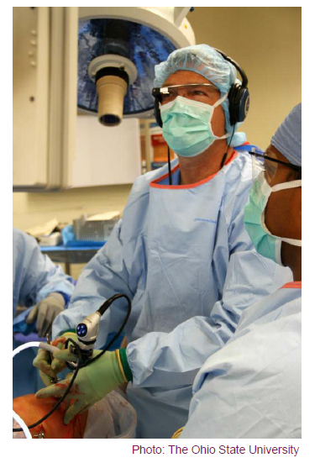
Glass in the operating room

Slide 10
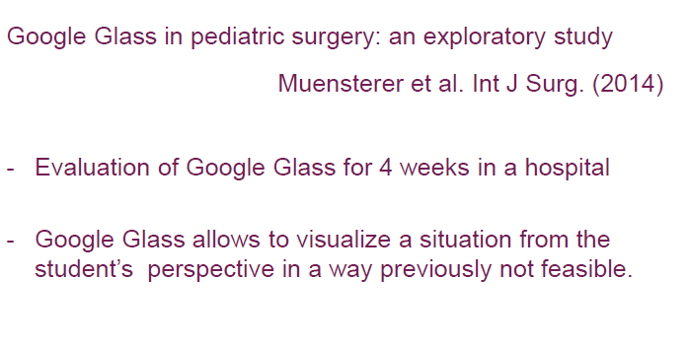

Slide 11
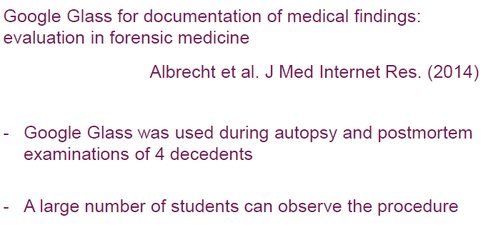

Slide 12
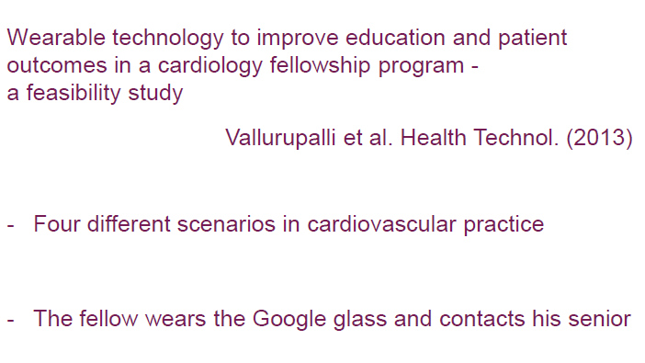

Slide 14
The study in Boston with Dr Singh
A smart glass based record is being developed
Patients that are the concern of a specific physician on a particular day or on a short list easily retrievable for review of essential facts on the glass display
The location system and time combined makes it possible to propose and display the relevant patient for retrieval
The physician documents based on a pre-defined structure where key words are displayed on the smart glass display
The physician has a task list of things to do which is displayed on the device

Slide 15
The patient as a user
A very advanced system for augmented reality where patients with severe macula degeneration and thus impaired vision where equipped with glasses with a very special purpose to enhance vision by providing more visual information to the peripheral field which was relatively unimpaired. The authors report promising results and seem determined to continue studies.
The other study reported is for patients with allergies who can benefit from the use of smart glasses by asking for the detailed content of consumer products when for instance doing grocery shopping.

Slide 16
The potential is great but unproven
There is are many potentially important applications where patients will use this technique both without the direct contact with health care and in treatment partnerships where they are reporting on their state to a remote health professional. The combination of an audio conferencing technique and the possibility of showing what they are doing including e.g. the state of a wound or other skin lesion is interesting.

Slide 17
Applications in education
This is an area where there should be more studies
Physicians at various stages may use glasses to communicate in real time to a remote supervisor where a specially challenging patient encounter may be done with the assistance as needed, e.g. during surgery
It is also a way of recording patient doctor interviews
An alternative approach is to put the glasses on a patient to record what the doctor in training is doing as seen from the perspective of the patient

Slide 18
Conclusions
Interesting opportunities with smart glasses in many areas.
Initial enthusiasm must be replaced by scientific evaluations
It is hardly a solution for all problems
The general use of smart glasses in society by patients and other citizens for health is one vision but not without many concerned opponents
Privacy issues are important
Whatch out for new product releases from Google and other companies

