Slide 1








What is an autonomy supportive environment in geriatric care services for healthcare professionals?
Guillaume Souesme
Ages in Life’s Psychology Laboratory
Tours
FRANCE
Notes:
1

Slide 2

Scientific context
State of the art
    Based on Self-Determination Theory (Ryan & Deci, 2000), autonomy support is one of key construct
    This notion has been widely studied in different domains (sport → Gaudreau et al., (2016) ; education → Reeve et al., (2004) ; work organisation → Gillet et al., (2012)) and in mainly in a quantitative manner
    In health context, the patient-physicians’ communication has been mainly studied (Murray et al., 2015)
    The autonomy support is a broader notion that integrates the perception of healthcare professionals.
Lack
    None studies have been conducted wilth healthcare professionals about « What elements might compose an autonomy-supportive environment? »
Interest & applications
    Use qualitative data for clarifying strategies and behaviours underlying an autonomy supportive environment
    Hypothetic application: older peoples’ stay is improved and re-hospitilization can be reduced

Slide 3
Autonomy support « the quality of being self-regulating »
Autonomy support is the interpersonal behaviour one person provides to involve and nurture another person’s internally locused, volitional intentions to act, such as when a teacher supports a student’s psychological needs (e.g., autonomy, competence, relatedness), interests, preferences, and values.
Reeve and Jang, 2006
Environment with autonomy support → Positive outcomes
Need satisfaction
Autonomy, competence & relatedness
Perceived autonomy support
Negative affects
Depressive symptoms & apathy
Souesme et al., 2016

Slide 4
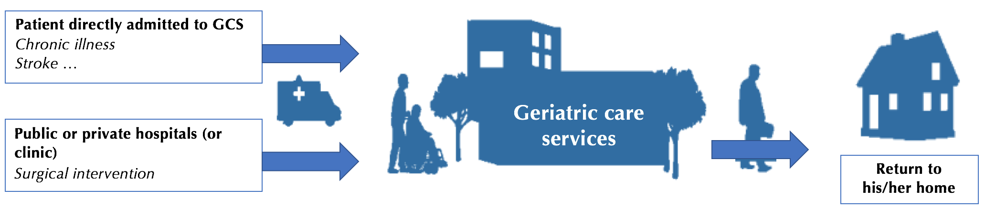
Geriatric care services « aged care services or transitional care »
Prevent or reduce the functional, physical, cognitive, psychological or social consequences of impairments and limitations in the capacity of patients and to promote their rehabilitation and reintegration
Coquelet and Valdelièvre (2011)
Institutional placement
Nursing home

Slide 5
Geriatric care services « aged care services or transitional care »
Population:
        53% over 70 years
Average length stay:
        35 days
Multidisciplinary professional team
« 3R rule » :
Re-education
Rehabilitation
Reintegration

Slide 6
Aims
The objectives of this research are to answer questions :
Do professionals understand what an autonomy supportive environment is?
Do professionals know what behaviours are associated with this environment?
What is the meaning of an autonomy supportive environment in geriatric care services for healthcare professionals?

Slide 7
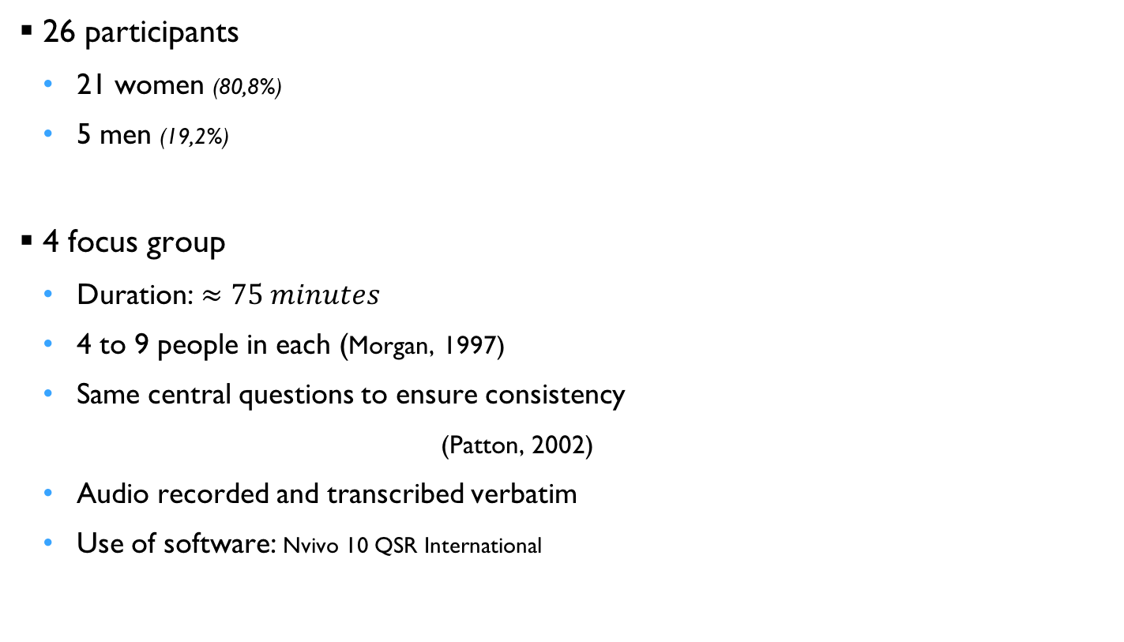
Material & Methods Use a qualitative manner to analyse data
CEO of GCS
Practitioners
Health executives / Services’ referent
Physiotherapist / Occupational therapist / Nutritrionist / Psychologist / Social worker
Nurse’s aids / Qualified hospital service employee’s
Nurses / Nursing student

Slide 8
Results What should we remember in all that?
Promote progress
Encourage them to express themselves
Establish a relationship of trust

Slide 9
Results What should we remember in all that?
Promote progress
Establish a relationship of trust
Encourage them to express themselves
Care plan
Goal
“We give an exact objective to reach. This, it is really attractive. It is the base.” (Physiotherapist)
“We put patients in front of reality, not just because it is fun to do it but only to allow them to move forward.” (Social worker)
3
Kindness
Respect
“It is important to respect the older adult, but also the person. Does he want to exchange or not? There are older people who want to keep their distance from you. This must be respected.” (Social worker)
2
“I personally think that it takes time. We are fortunate to have older people over a fairly long time. So, this helps to build a relationship little by little.” (Nurse)
“Sure, I see the difference when I do it or I do not do it. It is easy to create a link with older people. They know who we are, at least our name and our function.” (Nurse)
“To create a link, personally I explain why I am here in front of them.” (Physiotherapist)
Time
Welcome
1

Slide 10
Results What should we remember in all that?
Promote progress
Establish a relationship of trust
Encourage them to express themselves
Maintain suitable
distance to the other
“Calling each other “vous” allows a distinction from the other. It avoids misconduct while preserving the relationship.” (Occupational therapist)
4
Respect other in
his/her functioning
“It is important to take time to discuss with an older adult in order to know how he/she works at home, and to make a differential.” (Occupational therapist)
3
Enter into
dialogue
Listen
carefully
“Things have to be rephrased because it is important that older people express their anxiety and questioning.” (Physiotherapist)
“It is clear. Each individual, everyone needs a minimum of time that is dedicated to them to feel heard, understood, listened and supported.” (Physiotherapist)
2
Speak
Understand
1
“Take time to speak with them, because they have many things to release. It is not rare that some of them cry.” (Physician)

Slide 11
Results What should we remember in all that?
Promote progress
Establish a relationship of trust
Encourage them to express themselves
“We are seen as a resource person that can help them to make progress.” (Physiotherapist)
For every small difficulty we have gone through and have overcome, we try to go a bit further together.” (Physiotherapist)
Progress
Suggest
3
Comforting
Support
“There is non-stop encouragement, each time. It is true.” (Health executive)
“Encourage all small actions, this is important.” (Qualified hospital service employee)
2
Propose
Analyse
“We have a job to do around the loss of autonomy and, because the capacity is no longer the same as in the past, we must look together as to how the patient can rehabilitate himself in his daily life in a different way." (Psychologist)
1

Slide 12
Discussion
How interesting is it?
3 strategies and associated behaviours have been highlighted
Souesme and Ferrand, 2017 submitted
Establish a relationship of trust
Encourage them to express themselves
Promote progress

Slide 13
Limits
All of healthcare professionals interviewed seem to be agree (consensus)
But we need to
Collect patients’ point of view to distinguish differences and similarities
Understand institution’s policy:
    Autonomy support is only a link
      Healthcare professionals engagement and
      Multidisciplinary team promoted by GCS with patient centered care
Differenciate according to the role of each of the professionnals
    (hierarchical work organisation does not allow everyone to express themselves freely)

Slide 14
Outcomes
If healthcare
professionals
are engaged
put into practice that we saw previously
constitute “one single team” with patients
are in harmony with institutional policy
Limits
Autonomy support
Negative affects
Depressive symptoms & apathy
Need satisfaction
Autonomy, competence & relatedness
Internalization processes
Deci & Ryan, 2000
- Decrease rehospitalisation rate
Rise of well-being
- Better adherence to treatment
Increase engagement
Intrinsic motivation
Williams et al., 1998

Slide 15
References
Coquelet, F., & Valdelièvre, H. (2011, December 19). Les soins de suite et de réadaptation en 2008 : patientèle traitée et offre de soins. Dossier solidarité et santé n°23. Retrieved from http://www.drees.sante.gouv.fr/les-soins-de-suite-et-de-readaptation-en-2008-patientele-traitee-et-offre-de-soins,10231.html.
Deci, E. L., & Ryan, R. M. (2000). The « what » and « why » of goal pursuits: human needs and the self-determination of behavior. Psychological Inquiry, 11(4), 227-268.
Gaudreau, P., Morinville, A., Gareau, A., Verner-Filion, J., Green-Demers, I., & Franche, V (2016). Autonomy support from parents and coaches: synergistic or compensatory effects on sport-related outcomes of adolescent-athletes? Psychology of Sport and Exercice, 25, 89-99.
Gillet, N., Gagné, M., Sauvagère, S., & Fouquereau, E. (2012). The role of supervisor autonomy support, organizational support, and autonomous and controlled motivation in predicting employees’ satisfaction and turnover intentions. European Journal of Work and Organizational Psychology, 22(4), 450-460.
Morgan, D. L. (1997). Focus group research. London: Sage Publications Inc.
Murray, A., Hall, A. M., Williams, G. C., McDonough, S. M., Ntoumanis, N., Taylor, I. M., Jackson, B., Matthews, J., Hurley, D. A., & Lonsdale, C. (2015). Effects of a self-determination theory-based communication skills training program on physiotherapists’ psychological support fir their patients with chronic law back pain: a randomized controlled trial. Archives of Physical Medicine and Rehabilitation, 96(5), 809-816.
Patton, M. Q. (2002). Qualitative research and medication methods. Thousand Oaks, CA: Sage Publications Inc.
Reeve, J., & Jang, H. (2006). What teachers say and do to support students’ autonomy during a learning activity. Journal of Educational Psychology, 98(1), 209-218.
Reeve, J., Jang, H., Carrell, D., Jeon, S., & Barch, J. (2004). Enhancing students’ engagement by increasing teachers’ autonomy support. Motivation and Emotion, 28(2), 147-169.
Ryan, R., & Deci, E. (2000). Self-determination theory and the facilitation of intrinsic motivation, social development, and well-being. American Psychologist, 55(1), 68-78.
Souesme, G., Martinent, G., & Ferrand, C. (2016). Perceived autonomy support, psychological needs satisfaction, depressive symptoms and apathy in French hospitalized older people. Archives of Gerontology and Geriatrics, 65, 70-78.
Williams, G. C., Rodin, G. C., Ryan, R. M., Grolnick, W. S., & Deci, E. L. (1998). Autonomous regulation and long-term medication adherence in adult outpatients. Health Psychology, 17(3), 269-276.

Slide 16
Thank you for your attention
Contact:
guillaume.souesme@univ-tours.fr
Notes:
16

