Slide 1
About OMICS Group
OMICS Group International is an amalgamation of Open Access publications and worldwide international science conferences and events. Established in the year 2007 with the sole aim of making the information on Sciences and technology ‘Open Access’, OMICS Group publishes 400 online open access scholarly journals in all aspects of Science, Engineering, Management and Technology journals. OMICS Group has been instrumental in taking the knowledge on Science & technology to the doorsteps of ordinary men and women. Research Scholars, Students, Libraries, Educational Institutions, Research centers and the industry are main stakeholders that benefitted greatly from this knowledge dissemination. OMICS Group also organizes 300 International conferences annually across the globe, where knowledge transfer takes place through debates, round table discussions, poster presentations, workshops, symposia and exhibitions.

Slide 2
About OMICS Group Conferences
OMICS Group International is a pioneer and leading science event organizer, which publishes around 400 open access journals and conducts over 300 Medical, Clinical, Engineering, Life Sciences, Phrama scientific conferences all over the globe annually with the support of more than 1000 scientific associations and 30,000 editorial board members and 3.5 million followers to its credit.
OMICS Group has organized 500 conferences, workshops and national symposiums across the major cities including San Francisco, Las Vegas, San Antonio, Omaha, Orlando, Raleigh, Santa Clara, Chicago, Philadelphia, Baltimore, United Kingdom, Valencia, Dubai, Beijing, Hyderabad, Bengaluru and Mumbai.

Slide 3
黃耆六一湯之免疫調節評估
Immunomodulatory Effects of Huang Qi Liu Yi Tang
黃冠誠醫師
Assist. Prof. Guan-Cheng Huang M.D.
台灣。高雄。阮綜合醫院

Slide 4
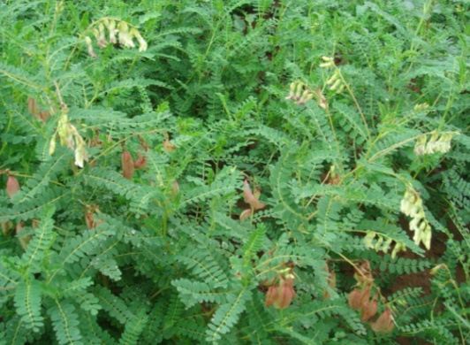
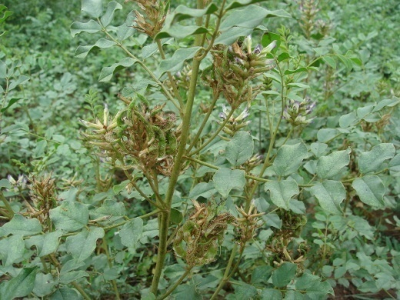
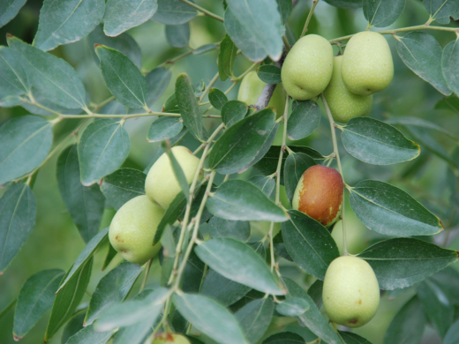
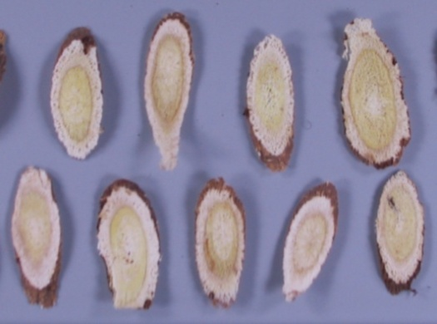
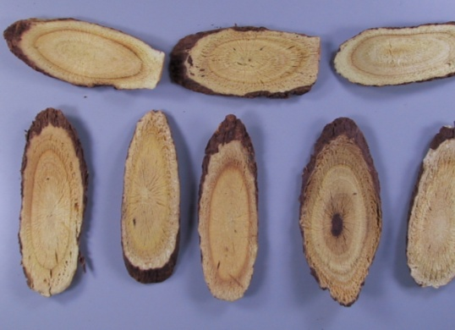
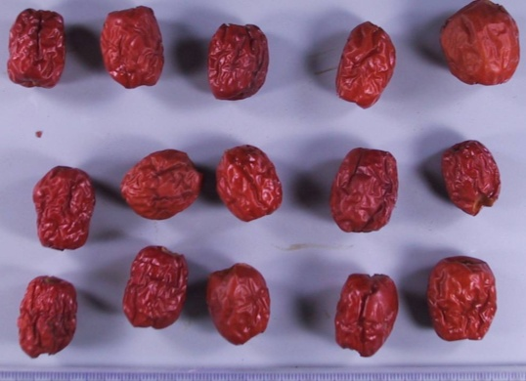
黃耆六一湯Huang Qi Liu Yi Tang (HQLYT)
出典：太平惠民和劑局方
組成：黃耆67.5,甘草11.25,大棗11.25克
效用：諸虛不足
Radix Astragali
Licorice
Jujube

Slide 5
治諸虛不足
增強免疫力
？

Slide 6

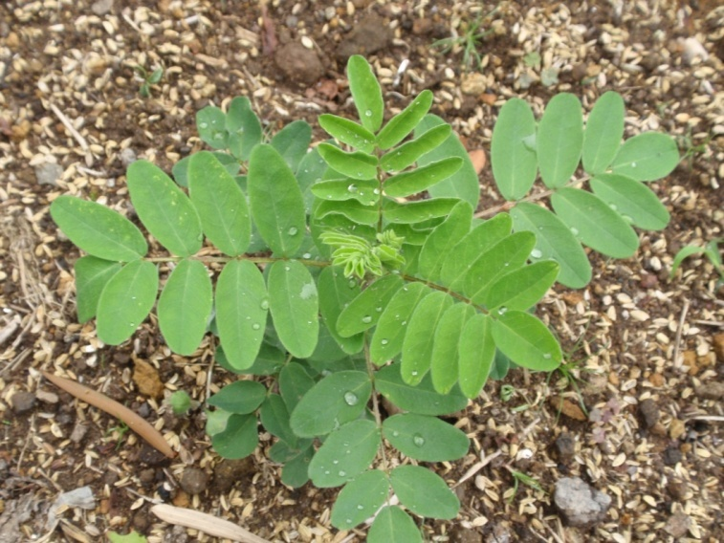
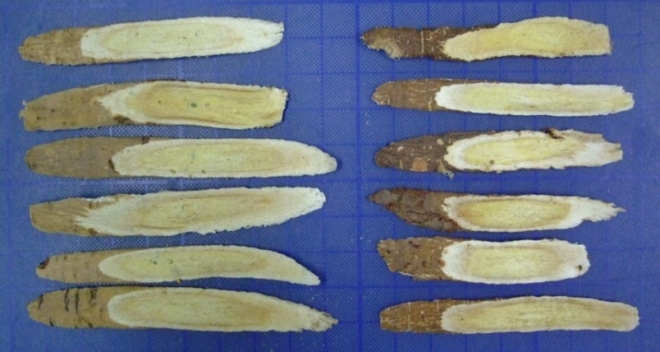
黃耆六一湯之主要藥材
黃耆
產地
  甘肅、陜西、蒙古、河北、山西等
性味
  甘，微溫
效用
  補氣升陽，益衛固表，托瘡生肌，利水消腫。
台灣習用品-晉耆
北耆

Slide 7
本草記載
神農本草經
  主癰疽，久敗瘡….小兒百病。
本經逢源
  能補五臟諸虛，….無汗則發，有汗則止，入肺而固表虛自汗，入脾而托已潰癰。
本草求真
  黃耆，入肺補氣，入表實衛，為補氣諸藥之最，是以有耆之稱。
本草備要
  黃耆“生血、生肌、排膿內托，瘡癰聖藥”。

Slide 8
黃耆之主要成分
7,3’-dihydroxy-4’-methoxyisoflavone 7-O- β -D-glucoside
7,3’-dihydroxy-4’-methoxyisoflavone
formononetin 7-O-β-D-glucoside
(6RR,11RR)-3-hydroxy-9,10-dimethoxypterocarpan 3-O-β-D-glucoside
7,2’-dihydroxy-3’,4’-dimethoxyisoflavan 7-O-β-D-glucoside

Slide 10
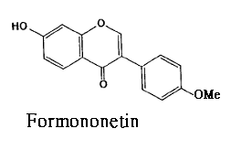
Quality Control of Hedysarum polybotrys extracts
晉耆質量控制
（Quality Control of Hedysarum polybotrys ）
Hedysarum polybotrys
Hot water (H)
MeOH (M)
H. polybotrys | Quality control
 | Yield (%) | Proanthocyanidinª(mg/g) | Formononetin^{b} (mg/g)
H | 33.70 | 2.60 | 13.45 ±1.79
M | 15.16 | 7.68 | 208.36 ±1.69
M-H | 14.41 | 3.75 | ND
M-EA | 0.75 | 36.14 | 5457.05 ± 174.02
Partition
H₂O layer
(M-H)
EtOAc layer
(M-EA)
ª Total proanthocyanidin was expressed as mg of catechin equivalents per g of extract.
^{b} Formononetin was a substance marker for H. polybotrys.

Slide 11
補氣藥
免疫系統
抑制發炎
免疫增強

Slide 12
免疫防禦系統
Nonspecific defenses |  | Nonspecific defenses (Immune system)
First line of defense | Second line of defense | Third line of defense
Skin Mucous membranes Secretions of skin and mucous membranes | Phagocytic white blood cells Defensive proteins The inflammatory response | Lymphocytes Antibodies
 | The lymphatic system

Slide 13
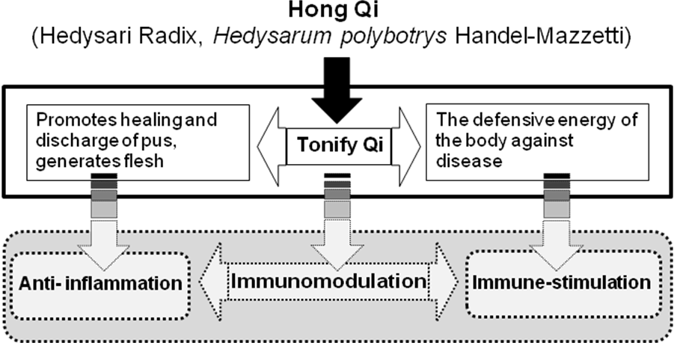
晉耆

Slide 14
Immunomodulatory Effects of Astragali Radix Extracts
Anti- inflammatory Effects
Immuno-stimulatory Effects

Slide 15

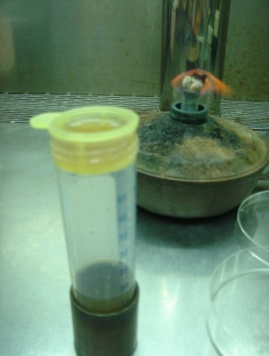
體外免疫調節實驗模式：In Vitro Splenocyte Model of the Immuno-modulation Effects Assay
The erythrocytes were lysed with 0.38% NH₄Cl-Tris buffer (pH 7.4), while the remaining cells were resuspended in RPMI-1640 with 10 μM Hepes, 10% FBS, 100 mg/l streptomycin, and 100 IU/ml penicillin.
Splenocytes were obtained by gentle disruption of the spleen of BaLb/c female mice and filtration via a 40-μm Nylon cell strainer.
Splenocyte Proliferation Assay
MTT assay
Natural Killer Cell Activity of Splenocytes in Vitro
YAC-1 cells were used as the target cells, while splenocytes were the effector cells.
LDH assay

Slide 16
晉耆萃取物刺激脾臟增生作用
（Effects of H. polybotrys Extracts on Splenocyte Proliferation）
Formononetin
*
*
*

Slide 17
晉耆M-EA萃取物使daunoblastina誘導的白血球低下症病鼠，白血球提升。（Rise in the WBC of M-EA Treated Daunoblastina-induced Leucopenia mice）
Blank group: Normal saline i.p. once on day 0, and sterile water orally administered to the mice once a day.
Control group: Daunoblastina 20 mg/kg, i.p. once on day 0, and then sterile water orally administered to the mice once a day.
Treated group: Daunoblastina 20 mg/kg, i.p. once on day 0, and the M-EA at 100 and 200 mg/kg orally administered to the mice once a day.

Slide 18
Immunomodulatory Effects of Astragali Radix Extracts
Anti- inflammatory Effects
Immuno-stimulatory Effects

Slide 19
發炎介質：Nitric Oxide & PGE₂
LPS, TNF-α, IL-1β, INF-γ
Arachidonic acid
Tyrosine kinase, NF-κB
COX-2
PGE₂
iNOS
L-Arginine
L-Citrulline + NO
Inflammation

Slide 20
體外抗發炎篩選平台
In Vitro, Anti-inflammation-assay Model
Cytotoxicity was observed by MTT assay
PGE₂ production was detected by EIA kit
COX-2
PGE₂
RAW 264.7
LPS
Inflammation
Tested Samples
iNOS
NO
iNOS and COX-2 protein expression was
detectedby Western blot analysis
NO production was detected by Griess reaction

Slide 21
晉耆M-EA萃取物抑制發炎介質作用
Anti-inflammation Effects of M-EA
M-EA extract showed more inhibition on Nitric oxide (NO) production and PGE₂ from LPS-stimulated RAW 264.7 cells than the other extracts, and the IC₅₀ was 55.75 μg/ml. However, the M-EA extract significantly stimulated proliferation of RAW 264.7 cells.

Slide 22
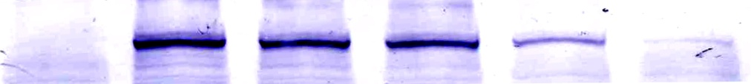
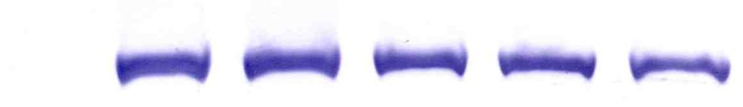
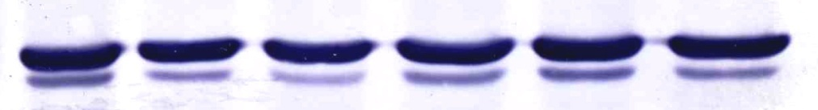
M-EA extract showed inhibition on iNOS and COX 2 expression from LPS-stimulated RAW 264.7 cells.
晉耆M-EA萃取物抑制INOS及COX-2蛋白表現作用
M-EA (μg/ml)
B C 25 50 100 200
iNOS
COX 2
GAPDH

Slide 23
晉耆M-EA萃取物可以降低sodium nitroprusside (SNP)誘導RAW 264.7 細胞之細胞毒性
M-EA could significantly prevent cytotoxicity effects from NO-induced RAW 264.7 cells and inhibit NO in a dose dependence manner.

Slide 24
晉耆M-EA萃取物可以降低sodium nitroprusside (SNP)誘導脾臟細胞之細胞毒性
M-EA could significantly prevent cytotoxicity effects from NO-induced splenocytes in a dose dependence manner.

Slide 25
小結
推測晉耆M-EA萃取物，可以透過清除NO自由基，而達到刺激脾臟細胞生長之功能。
於白血球低下症之病鼠中，可以加速白血球之提升。
晉耆M-EA萃取物，亦可以透過抑制iNOS及COX-2蛋白表現，而達到降低發炎介質（NO及PGE₂）之功效。
綜合上述，晉耆具有免疫調節之作用。因而推測以黃耆為主藥之黃耆六一湯應具有免疫調節之功能，繼而進行下列評估。

Slide 26
HQLYT免疫增強作用評估
Splenocyte modeimmuno-modulation effects l of the assay
  Splenocyte Proliferation Assay
  Natural Killer Cell Activity
  A murine model of cyclophosphamide-induced leucopenia

Slide 27
Mitogen:
Concanavalin A (ConA)
Phytohaemagglutinin (PHA)
Lipopolysaccharide (LPS)
非特異性免疫反應：脾臟細胞增殖
Con-A
PHA-P
Splenocytes
T cell
LPS
B cell
IL-2
Ig
Tc
Th
YAC-1
IL-2
NK cell

Slide 28
HQLYT刺激脾臟細胞增生結果
HQLYT與 LPS 合併處理後，細胞增生比Con A 及PHA明顯。
*
*
*
*
*
*
n=6, *p< 0.05, **p< 0.01

Slide 29
Radix Astragali
Licorice
12.78%
54.6%
*
*
*
Jujube
HQLYT
39%
*
*
87.8%
*
*
*
*

Slide 30
HQLYT more-strongly stimulated the proliferation effects of splenocytes than did Radix Astragali, licorice, and jujube used individually.
 | Enhanced proliferation percentage of splenocytes (%)
μg/ml | 12.5 |  | 3.9 | 7.5
HQLYT | 87.8
AR（黃耆） |  |  | 0 | 0
GR（甘草） |  |  | 38.0 | 54.6
ZF（大棗） |  |  | 17.3 | 24.7
 |  | Total | 55.3 | 79.3
AR, Radix Astragali; GR, licorice; ZF, jujube.

Slide 31
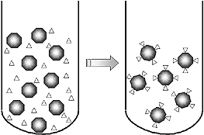
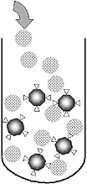
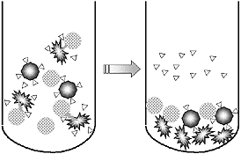
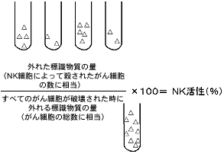
體外脾臟細胞中自然殺手細胞活性：Natural Killer Cell Activity of Splenocytes in Vitro
YAC-1細胞標定放射性物質
加入NK細胞至標地細胞
NK細胞殺死標地細胞
測量細胞外之放射線量
YAC-1 cells were used as the target cells, while splenocytes were the effector cells. Cytotoxic activity against YAC-1 cells was measured by the lactate dehydrogenase (LDH) release assay.

Slide 32
體內免疫調節實驗模式
HQLYT was orally administered to BaLb/c mice once a day for 14 days
The whole blood of hearts and spleens were obtained from BaLb/c mice killed by cervical dislocation under sterile conditions.
Serum of whole blood
Splenocytes
The IL-2 Assay
Natural Killer Cell Activity Assay

Slide 33
HQLYT 對 BaLb/c 小鼠之IL-2分泌影響
Effects of HQLYT on the IL-2 Assay in BaLb/c Mice
The amount of IL-2 in HQLYT-treated BaLb/c mice was higher than in the control group at 400, 800, and 1600 mg/kg but there was no significant dose dependence.
Each group contained three mice.

Slide 34
HQLYT對 BaLb/c 小鼠之自然殺手細胞之影響
Effects of HQLYT on Natural Killer Cell Activity of Splenocytes in Vivo
The effector cells (splenocytes from 400 mg/kg HQLYT-treated BaLb/c mice) were reacted with target cells (YAC-1). The cytotoxic activity of NK cells was enhanced by more than 50% at the ratios of the effector and target of 15:1, 20:1, and 25:1.
YAC-1 cells were used as the target cells, while splenocytes were the effector cells.
Cytotoxic activity against YAC-1 cells was measured by the lactate dehydrogenase (LDH) release assay.

Slide 35
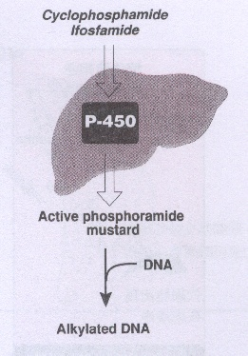

Cyclophosphamide誘導小鼠白血球低下症實驗模式： Murine Model of Cyclophosphamide-induced Leucopenia
BaLb/c mice were injected intraperitoneally (i.p.) with 100 mg cyclophosphamide /kg BW was administered once on day 0, and then 400 mg of HQLYT /kg BW was orally administered to mice once a day for 6 days in the treated group.
The white blood cells (WBC) levels of the whole blood were analyzed by an automatic multi-parameter blood cell counter (Sysmex KX-21N).
Whole blood was obtained from an eyehole vein of BaLb/c mice before treatment with HQLYT every day.
Days

Slide 36
HQLYT使白血球低下症之小鼠的白血球顯著上升
WBC count (10³/μl) | Blank group | Induced group | Treated group | _{P} value
0 day | 3.89 ± 1.33
1st day | 2.54 ± 0.65 | 2.02 ± 0.30 | 3.74 ± 1.22 | **
2nd day | 4.48 ± 0.68 | 2.04 ± 0.15 | 3.22 ± 1.39 | **
3rd day | 3.06 ± 0.53 | 2.08 ± 0.36 | 2.82 ± 1.03
4th day | 4.00 ± 1.02 | 2.32 ± 0.25 | 3.76 ± 1.69 | **
5th day | 4.38 ± 1.09 | 2.64 ± 0.19 | 3.93 ± 0.60 | **
Blank group: Normal saline i.p. once on day 0, and sterile water orally administered to the mice once a day for 6 days.
Induced group: Cyclophosphamide 100 mg/kg, i.p. once on day 0, and then sterile water orally administered to the mice once a day for 6 days.
Treated group: Cyclophosphamide 100 mg/kg, i.p. once on day 0, and the HQLYT at 400 mg/kg orally administered to the mice once a day for 6 days.
Each group contained five mice. MANOVA, **p < 0.01.

Slide 37
總結
黃耆六一湯可以預防daunorubicin誘導之毒性，並增強daunorubicin的抗癌作用，延長P388-CDF1擔癌鼠之存活率。
黃耆六一湯透過刺激IL-2釋放，活化NK細胞，及提升白血球水平，而達到輔助抗癌藥功效。
本研究之黃耆六一湯主藥材使用晉耆，具有免疫調節功能，其指標活性成分建議可以用formononetin。
綜合之，黃耆六一湯適合作為日常免疫提升之滋補湯劑。

Slide 38
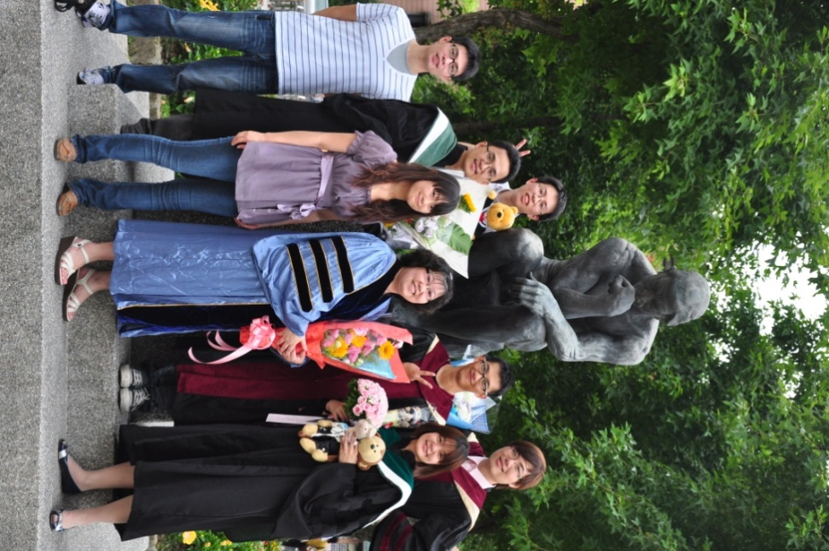
We are family…
We happily work together, because we have the same dream.
THANKS

Slide 39
Lets Meet again at Pharmacognosy-2015
3rd International Conference and Exhibition on Pharmacognosy, Phytochemistry and Natural Products
October 26-28, 2015 Hyderabad, India
Theme: Advanced trends for the future of Herbal Drugs and Products
Website: http://pharmacognosy-phytochemistry-natural-products.pharmaceuticalconferences.com/

