Slide 1
About OMICS Group
OMICS Group is an amalgamation of Open Access Publications and worldwide international science conferences and events. Established in the year 2007 with the sole aim of making the information on Sciences and technology ‘Open Access’, OMICS Group publishes 500 online open access scholarly journals in all aspects of Science, Engineering, Management and Technology journals. OMICS Group has been instrumental in taking the knowledge on Science & technology to the doorsteps of ordinary men and women. Research Scholars, Students, Libraries, Educational Institutions, Research centers and the industry are main stakeholders that benefitted greatly from this knowledge dissemination. OMICS Group also organizes 500 International conferences annually across the globe, where knowledge transfer takes place through debates, round table discussions, poster presentations, workshops, symposia and exhibitions.

Slide 2
OMICS International Conferences
OMICS International is a pioneer and leading science event organizer, which publishes around 500 open access journals and conducts over 500 Medical, Clinical, Engineering, Life Sciences, Pharma scientific conferences all over the globe annually with the support of more than 1000 scientific associations and 30,000 editorial board members and 3.5 million followers to its credit.
OMICS Group has organized 500 conferences, workshops and national symposiums across the major cities including San Francisco, Las Vegas, San Antonio, Omaha, Orlando, Raleigh, Santa Clara, Chicago, Philadelphia, Baltimore, United Kingdom, Valencia, Dubai, Beijing, Hyderabad, Bengaluru and Mumbai.

Slide 3
HELSINN BIREX PHARMACEUTICALS LTD
Inefficiencies in pharmacovigilance: what can we do now and what could be done in the future
Giovanni Furlan
EU QPPV Helsinn Birex

Slide 4
Disclaimer
The views and opinions expressed in the following PowerPoint slides are those of the individual presenter and should not be attributed to Helsinn, its directors, officers, employees or affiliates or any organization with which the presenter is employed or affiliated.
These PowerPoint slides are the intellectual property of the individual presenter and are protected under copyright laws. Used by permission. All rights reserved

Slide 5
What are we going to discuss ?
Do the pharmacovigilance regulations achieve their aim of protecting patient safety ?
Have they become cumbersome and complex ?
Do we have too many regulations, resulting in too much redundant effort that
has forced us in Drug Safety to spend more time doing busy work than actually
monitoring, evaluating, and analyzing safety information so to take adequate risk minimization measures ?
Did ICH achieve the aim of harmonizing regulations?

Slide 6
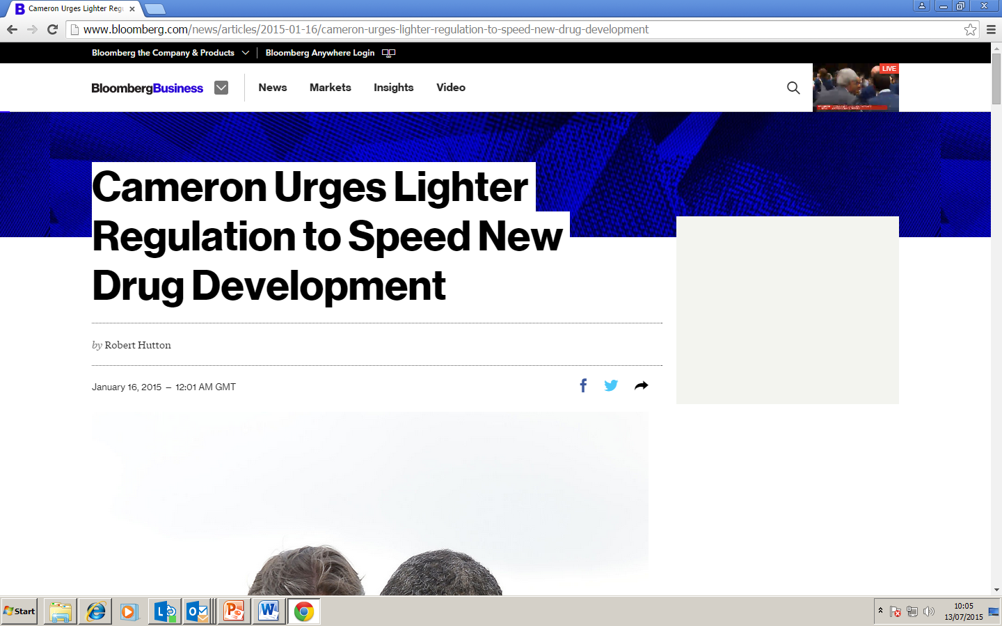
U.K. Prime Minister David Cameron will push for lighter regulations on the pharmaceutical industry in order to speed the path of new medicines to the market.
Cameron, who is in Washington to meet with President Barack Obama, sees the current process of developing and licensing new drugs as “abhorrently expensive and time consuming,” according to a statement from his office

Slide 7
Chinese regulations
PSURs are prepared in the old ICH format (R1).
Periodicity: every year since obtaining registration until renewal. Then every five years
Data collection period
Data collection for the Periodic Safety Update Report commence as of the day when the drug approval documents are obtained, and collected data shall be reported within 60 days after the data deadline. It is permitted to submit the Periodic Safety Update Report with the data’s international generation date as the collection commencement date, provided that, if the data deadline of the aforesaid report is earlier than that required in China, the data collected after the deadline of the report till the required deadline shall be supplemented and analyzed

Slide 8
Chinese ICSRs regulations
ICSRs originating in China
All adverse reactions occurred within 5 years from the date of authorization
Any new and/or serious adverse drug reactions occurred after 5-year period
Timelines:
Any new and/or serious adverse drug reaction within 15 days from first awareness
Death cases shall be reported immediately, other ADRs in 30 days
Follow-up information shall be timely
Death cases: investigation report in 15 days
All serious adverse reaction from outside China in 30 days

Slide 9
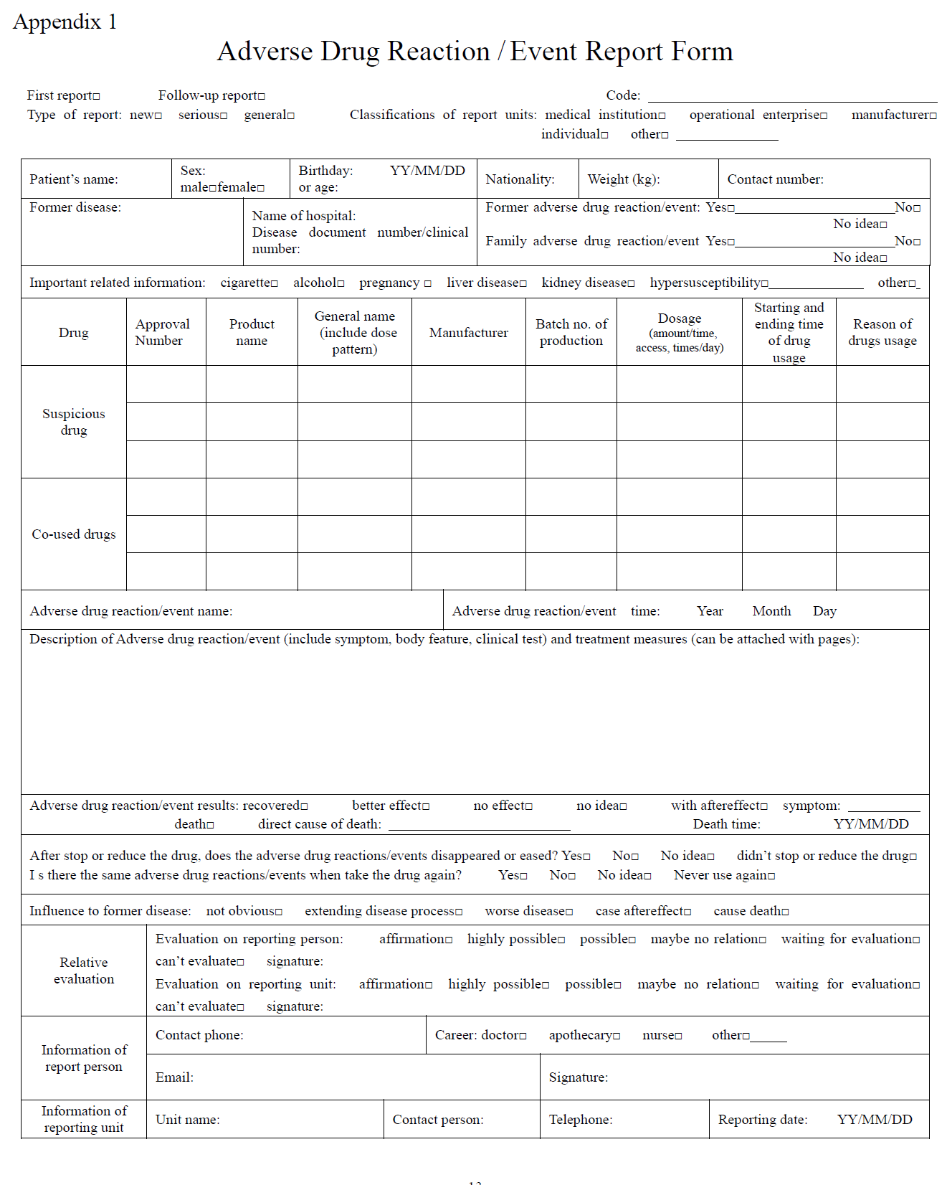

Slide 12
PSUR cover letter requires:
Main new safety information received in the reporting period
Patient exposure
Description of unlisted ADRs received during the reference period
No of fatal cases
Data on safety studies conducted during the reference period
Routine pharmacovigilance activities/actions related to newly received safety information described in the latest RMP
Minimization activities/actions related to new safety information described in the latest RMP
Summary tabulation of ICSRs included in the PSUR

Slide 13
Latin America requirements for non serious cases
Argentina: pregnancy associated with ADR: 7 calendar days
pregnancy not associated with ADR: 15 calendar days
Costa Rica: 10 working days
Ecuador: every two months
Panama: 15 calendar days
Peru: 10 working day
Chile: monthly

Slide 14
There is the need to harmonize PV requirements world wide
Which should be the reference standard ?
ICH ? EU legislation?
Which are the pros and cons of these standards?

Slide 15
Changes in EU pharmacovigilance legislation:
From Volume 9a (229 pages) to:
12 finalized GVPs + definitions, templates for RMP (60 pages) and PSUR, abbreviations, 3 GVPs still not final
9 «Other pharmacovigilance guidance» (final GVP annex III)
Guidance documents for submission of data to XEVMPD:
9 documents
Detailed guidance on the electronic submission of information on medicinal products for human use by marketing authorisation holders to the European Medicines Agency in accordance with Article 57(2), second subparagraph of Regulation (EC) No 726/2004
XEVPRM technical specifications, Chapter 3.I : 224 pages
References:
http://www.ema.europa.eu/ema/index.jsp?curl=pages/regulation/document_listing/document_listing_000345.jsp&mid=WC0b01ac058058f32c
http://www.ema.europa.eu/ema/index.jsp?curl=pages/regulation/document_listing/document_listing_000336.jsp&mid=WC0b01ac05804d8b2b&jsenabled=true

Slide 16
Changes in ICH guidelines
ICH E2B R3:
166 page implementation guide + 8 appendices - “old” E2B R2 was 29 pages
ICH E2C (new vs old version) grew from 10 to 19 chapters
Purpose of new EU legislation
Impact of the new legislation on marketing-authorisation holders
Marketing-authorisation applicants and holders are impacted by the legislation in a number of key areas. The legislation aims to:
make roles and responsibilities clear;
minimise duplication of effort;
free up resources by rationalising and simplifying periodic safety update reports (PSURs) and adverse-drug-reaction (ADR) reporting;
establish a clear legal framework for post-authorisation monitoring.

Slide 17
Redundancies are recognized (EMA/CHMP/ICH/544553/1998)

Slide 18
Redundancies have not been resolved
16 out 40 sections in common between PBRER and DSUR; 3 with RMP
Periodicity is not the same:
Annually for DSUR
PBRER: Every 6 months after placing on the EU market for 2 years; once a year for 2 years; every 3 years. (depending on EU RD list)
RMP: at the request of an authority; when important milestone is reached; new information can change the benefit-risk balance of the product
No modular approach is possible
PADER: quarterly for first 2 years, then annually

Slide 19
Redundancies
Renewals
No PSUR is required, but addendum to clinical overview (in practice a PBRER in a different format with benefit evaluation and benefit-risk balance sections)
Clinical Expert Statement (with confirmation that there are no new data that can change the benefit-risk balance)
Signal detection:
The marketing authorisation holder:
shall monitor the data in EudraVigilance to the extent of their accessibility. The frequency of the monitoring should be at least once monthly and shall be proportionate to the identified risk, the potential risk and the need for additional information
How many monthly signal detection reports for acetylsalicylic acid will be prepared ?

Slide 20
Documents addressing signals, risks, benefit-risk balance (post marketing)
Safety information for referrals
PBRER
RMP
PSUR
Signal detection reports
PADER
Addendum to clinical overview
More complicated overlapping documents = more time =
additional costs

Slide 21
Clinical trials regulation 536/2014
Protocol (Annex I section d, 17)
The protocol shall at least include:
A summary of findings from non-clinical studies that potentially have clinical significance and from other clinical trials that are relevant to the clinical trial
A summary of the known and potential risks and benefits including an evaluation of the anticipated benefits and risks
Investigator’s Brochure (Annex I section e, 27)
The information in the IB…..enables a clinician or investigator to understand it and make an unbiased benefit-risk assessment of the appropriateness of the clinical trial

Slide 22
Clinical trials regulation 536/2014
Investigational medicinal product dossier –IMPD- (Annex I, G)
SCOPE: The IMPD shall give information on the quality of any investigational medicinal
product…and data from non-clinical studies and from its clinical use
The IMPD shall also contain summaries of non-clinical pharmacology and toxicology data (point 41)
Overall risk and benefit assessment (point 48): This section shall provide a brief integrated summary that critically analyses the non-clinical and clinical data in relation to the potential risks and benefits of the investigational medicinal product……unless the information is already provided in the protocol. In the latter case, it shall cross-reference to the relevant section of the protocol
DSUR (Art 43)
…as usual

Slide 23
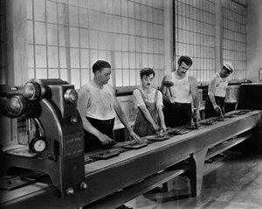
Redundancies from clinical trial regulations
Four documents with benefit-risk information for clinical trials:
IB is updated at least annually
DSUR is prepared annually
IMPD and protocol ? Will they need to be updated annually?

Slide 24
Documents addressing signals, risks, benefit-risk
Safety information for referrals
PBRER
DSUR
RMP
PSUR
Signal detection reports
PADER
Addendum to clinical overview
IB
Protocol
IMPD

Slide 25
What is the impact of redundant regulatory requirements on the quality of the work ?
…and on the pharma sector in general?

Slide 26
In pharma industry we see: - No new antibiotics being developed - Focus is on orphan drug development (costs less to develop), cancer, monoclonal antibodies (biogenerics are more difficult to register, innovator has longer market exclusivity) - Drug shortages
What happens when costs increase but revenues don’t increase?
In pharmacovigilance:
Work outsourced at lowest possible cost (low cost = low quality ?)
Work done by under qualified personnel
Number of employees does not increase in a proportionate way to workload = work exceeds staff capacity
Copy and paste exercises
Is this in the best interests of patient safety ?

Slide 27
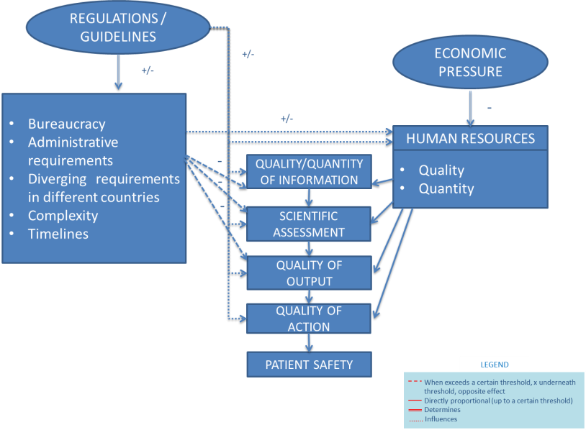
Interactions between components playing a role in pharmacovigilance quality

Slide 28
Any ideas on how simplify aggregate reports?
Do we need all of them?

Slide 29
What are aggregate reports/pharmacovigilance about ?
What is known about a medicinal product (e.g. mechanism of action, patient exposure, action taken by regulatory authorities/MAH, which studies have been conducted, effect of products of the same class, metabolism)
What is not know about a product (e.g. in populations subgroups -safety/efficacy-)
Main risks (known and unknown)
Efficacy (known and unknown)
New safety information received during the reference period (risk characteristics, signals, benefits)
How are risks minimized
What has to be done to collect information on the unknowns
Benefit-risk evaluation

Slide 30
An “old” proposal
1 Introduction
2 World-wide Market Authorization Status
3 Inventory of Ongoing/Completed Safety Studies*
4 Changes to RSI*
5 Regulatory Actions Taken for Safety Reasons**
6.1 Patient Exposure** 6.2 Limitations of Human Safety Database
7 Drug Risks Currently Under Evaluation 7.1 General Introduction (describe how the risk was identified and by whom) 7.2 Sources of Evidence 7.2.1 Spontaneous Reports 7.2.2 Company Sponsored/Supported Interventional Studies 7.2.3 Company Sponsored/Supported non-Interventional Studies 7.2.4 Literature 7.2.5.Other Sources 7.3 Risk Characterization and Evaluation 7.3.1 Risk Factors and sub-Populations at Risk 7.3.2 Risk Severity/Seriousness and Frequency 7.3.3 Biological Plausibility 7.3.4 Clinical Plausibility (evidence strength and consistency) 7.3.5 Risk Impact on Compliance and Benefit-Risk Balance 7.3.6 Actions Taken and further actions that could be taken
8 Summary of resolved drug risks
* during the reference period
** cumulative and during the reference period
Reference: Drug Safety 2012; 35(8):615-622

Slide 31
Drug Safety Master file: benefits
No duplication
No inconsistencies between documents
One single assessment from authorities = no diverging assessments
Harmonization between documents, internationally
More resources for scientific assessment of safety data, collecting data, risk minimization activities

Slide 32
Is there anything the industry can do to simplify clinical and PV operations?
Why do we use separate clinical and PV databases?
Is there any benefit in having 2 separate databases?

Slide 33
Inefficiencies originating from separate clinical and safety databases
Clinical and safety run their operations independently and use separate databases with different data standards: CDASH (Clinical Data Acquisition Standards Harmonization) and E2B
Duplicate data entry of SAEs and/or QC
Different coding dictionaries or different versions of the same dictionary
Reconciliation
Maintenance and validation of two separate databases
Drug safety does not immediately have access to all safety data originating from clinical trials (i.e. lab data/clinical exams, non-serious adverse events). More difficult to prepare:
IBs
DSURs
Signal detection reports

Slide 34
Inefficiencies originating from separate clinical and safety databases
Duplicate queries to Investigators
If EDC is implemented: drug safety may not be aware of SUSARs
Less accurate signal validation and evaluation
Increased costs (two data repositories, more time, more personnel)
Why two different standards ?
They have been developed independently
CDASH is an industry convention for accommodating SDTM FDA requirements , ICH is global
Clinical Data Interchange Standards Consortium (CDISC):
Mapped E2B (R2) with CDASH

Slide 35
Can operations be improved?
The differences between CDASH and E2B R2 are a matter of conventions, not driven by different scientific requirements.
Examples
E2B is more granular than CDASH
Dates for reporting information are not captured from the reporter (E2B – first awareness date) but extracted from the EDC (each entry has a date).
CDASH employs letters for field labelling (e.g. AESDTH), while E2B alphanumeric with no relation to data type (A.1.5.2)
Reference: Current drug safety 2013, 8(1): 56-62
With release of new E2B R3 mapping needs to be re-done
HL7 needs to be accommodated
New standard to be developed

Slide 36
One data repository for all study data
E2B XML file
ICSR
EDC
Safety
Module
SQL Data Retrievals
PSUR
Trial Site
Key Data
Unify
SQL Data Retrievals
DSUR
Clinical
Module
SQL Data Retrievals
CRTs
XML
SDTM
CDASH
SDTM
SAS datasets
Internationally recognised data standard
ADaM
Internationally recognised safety report

Slide 37
Potential benefits
No duplicate data processing
Same coding dictionary
No reconciliation
Reduced cost: one database instead of two, less time, less personnel
Drug Safety has access to all clinical safety data:
Easier preparation of aggregate reports
Reduced time and cost for preparing aggregate reports
Better signal validation and evaluation
Safety and clinical become aware of SUSARs at the same time

Slide 38
Challenges
Clinical and drug safety departments will need to be restructured
Closer cooperation between departments
Development of one single standard (unified database)
For each study, define which database fields are relevant (for safety data)

Slide 39
Systems Approach
A system should not be the result of the development of its single components in isolation without taking into account the relationships among all socio-technical components
(i.e. the interactions between all stakeholders, components and factors – drug safety employees, environmental pressures, regulatory authorities, processes, etc.)
1994: US Army Blackhawk helicopter was shot down in north Iraq by friendly fire
System evaluation of the accident revealed multiple redundant layers of control
Many overlapping responsibilities and departments involved
Departments were using different communication codes and wave lengths
Complication, redundancy, overlap does not prevent failure
More is not better, it can be worse
Reference: Nancy G. Leveson. Engineering a Safety world. The MIT Press

Slide 40
ACRES (Alliance for Clinical Research Excellence and Safety)
A multi-sector alliance of like-minded people and organizations working collaboratively to build shared Global System for Clinical Research Excellence
Foster more effective and efficient ethical and regulatory oversight through standardization, innovation, collaboration and stakeholder engagement
Working on unified database project to make it reality

Slide 41
Questions ? Any ideas ?

Slide 42
Let us meet again..
We welcome you all to our future conferences of OMICS International
5th International Conference & Exhibition on Pharmacovigilance & Clinical Trials
On
September 19 - 21, 2016 at Vienna, Austria http://pharmacovigilance.pharmaceuticalconferences.com/

