Slide 1
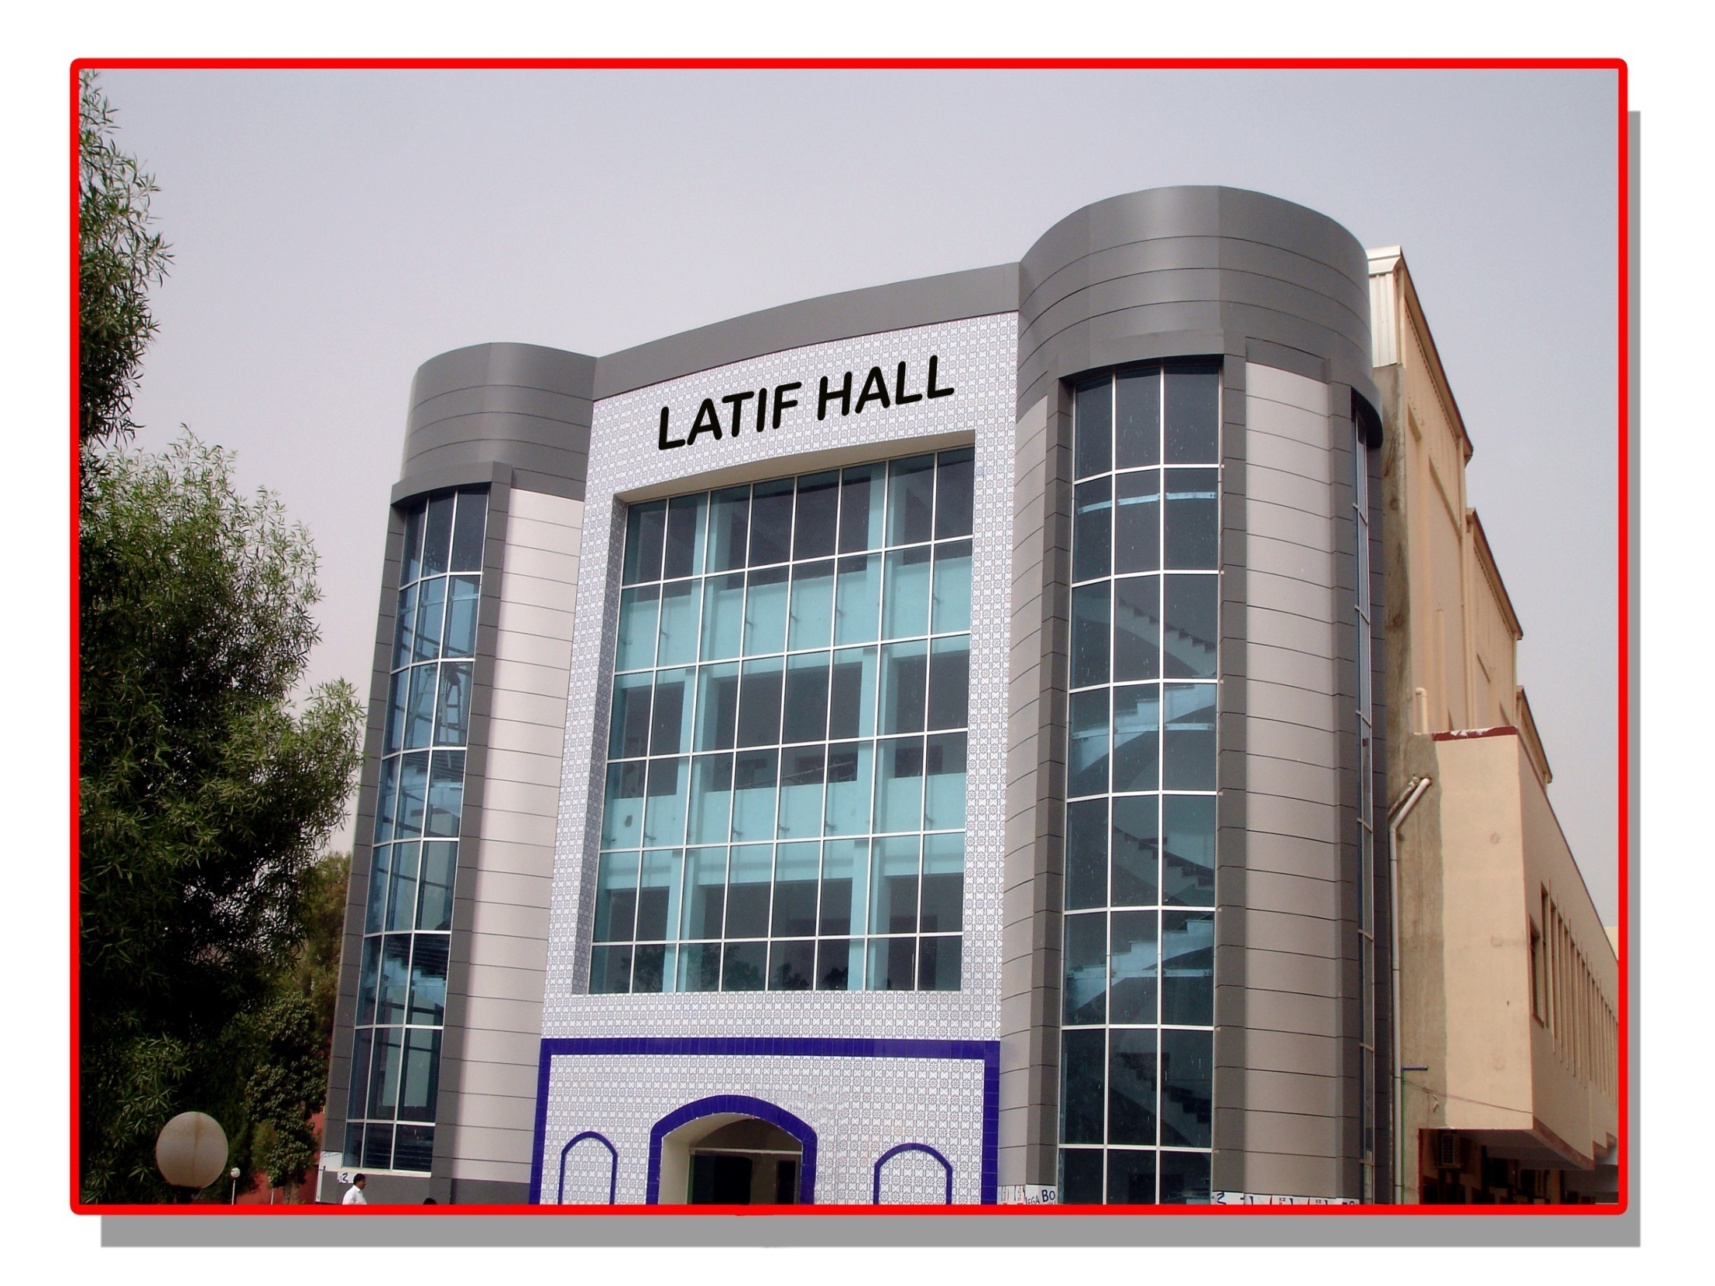

Effects of Calcium Antagonists on Insulin Release
Prof. Mashori Ghulam Rasool, Pakistan
Peoples University of Medical & Health Sciences For Women, Pakistan.

Slide 2
Introduction
Cardiovascular diseases are the main cause of death in many countries and pose health problems not only in the developed countries, but also in the developing countries (WHO, 2015).
Peoples University of Medical & Health Sciences For Women, Pakistan.
http://www.who.int/mediacentre/factsheets/fs317/en/)

Slide 3
Introduction
Antihypertensive treatment has reduced the incidence of stroke, heart failure and renal failure. However the incidence of coronary heart disease (CHD) is not reduced to the same degree (Wang et. el. 2005) (Europian Society of Cardiology 2014)
Peoples University of Medical & Health Sciences For Women, Pakistan.
(Wang JG, Staessen JA, Franklin SS, Fagard R, Gueyffier F. Systolic and diastolic blood pressure lowering as determinants of cardiovascular outcome. Hypertension. 2005;45:907–913.)
http://www.escardio.org/The-ESC/Press-Office/Press-releases/Last-5-years/Antihypertensive-therapy-reduces-CV-events-strokes-and-mortality-in-older-adult

Slide 4
Introduction
The main goal in the treatment of Hypertension is to reduce the risk of future cardiovascular morbidity and early death. (Vadera et. el. 2011). Cardiovascular diseases may be related not only to the elevated blood pressure, but also to the other risk factors, including the increase in plasma glucose (Davidson JA, 2009)
Peoples University of Medical & Health Sciences For Women, Pakistan.
1: Vadera R. Does antihypertensive drug therapy decrease morbidity or mortality in patients with a hypertensive emergency? Ann Emerg Med. 2011 Jan;57(1):64-5. doi: 10.1016/j.annemergmed.2010.05.021.
2: Davidson JA, Parkin CG. Is hyperglycemia a causal factor in cardiovascular disease? Does proving this relationship really matter? Yes. Diabetes Care. 2009 Nov;32 Suppl 2:S331-3. doi: 10.2337/dc09-S333. Review.
.

Slide 5
Introduction
Treatment of hypertension in most instances is prolonged and often for life. Therefore it is always necessary to identify antihypertensive drugs such as the Calcium Antagonists, which are needed to reduce blood pressure, that may potentially cause deterioration in GI (Jeff Hughes,2007).
Peoples University of Medical & Health Sciences For Women, Pakistan.
Do calcium antagonists contribute to gastro-oesophageal reflux disease and concomitant noncardiac chest pain? British Journal of Clinical Pharmacology, 2007 July 64(1): 83-89.

Slide 6
Introduction
Several agents advocated as first line drugs in the stepwise antihypertensive therapy have been known to cause carbohydrate intolerance and this has been implicated as a major risk factor in the development of CHD (Suter et. al 1995).
Peoples University of Medical & Health Sciences For Women, Pakistan.
Suter PM, Vetter W. Metabolic effects of antihypertensive drugs. J Hypertens Suppl. 1995 Dec;13(4):S11-7.

Slide 7
Introduction
In the 1990’s individualized therapy in the treatment of Hypertension has also been advocated (Ogihara et al 1990), whereby new groups of antihypertensive drugs, such as the Calcium Antagonists may be used as first line therapy (Burnier et al, 2009).
Peoples University of Medical & Health Sciences For Women, Pakistan.
1. Ogihara T, Mikami H. [Pathogenesis and treatment of hypertension]. Rinsho Byori. 1990 May;38(5):559-62. Review. Japanese. :
2. Burnier M, Pruijm M, Wuerzner G. Treatment of essential hypertension with calcium channel blockers: what is the place of lercanidipine? Expert Opin Drug Metab Toxicol. 2009 Aug;5(8):981-7. Review.

Slide 8
Objective
The study relates to evaluate and compare the effects of a number of calcium antagonists of dihydropyridine class on insulin release in rat isolated pancreas.
Peoples University of Medical & Health Sciences For Women, Pakistan.

Slide 9
Method
Loubatieres et. al. (1972)
Male Albino Rats 250-300gm, fasted for over night
Pancreas isolated using phenobarbitone
Perfused with low glucose (60mg/100ml) in Krebs Solution
3-conc. of each drug in Krebs Solution chosen
10X below Therapeutic Conc.
Therapeutic Conc.
10x above Therapeutic Conc.
5 samples collected (Low Glucose Conc.)
20 samples collected (High Glucose Conc.--- 300mg/100ml)
Samples stored and frozen at -20⁰C then Analyzed by using RIA (Coat-A-Count Kit)

Slide 10
Method
The concentrations chosen for the drugs were based on the peak serum/ plasma concentration achieved in human with a single therapeutic dose.
The Concs. of drugs used are shown in Table-I
Peoples University of Medical & Health Sciences For Women, Pakistan.

Slide 11
Table-I: Concentration of Calcium Antagonists used in the Study
Calcium Antagonist | 1/10 Peak Plasma Concentration | Peak Plasma Concentration | 10x Peak Plasma Concentration
Isradipine | 1ng | 10ng | 100ng
Nicardipine | 20ng | 200ng | 2µg
Amlodipine | 0.5ng | 5ng | 50ng
Peoples University of Medical & Health Sciences For Women, Pakistan.

Slide 12
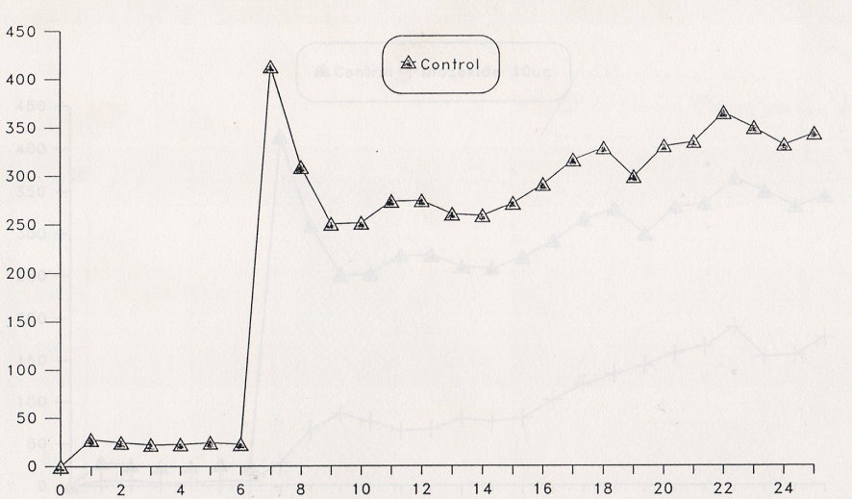
Effects of low (0-5) and high glucose perfusion (6-25 min) on insulin release in normal isolated rat pancreas.
Immuno-reactive Insulin (µlU/minute)
Time in minutes

Slide 13
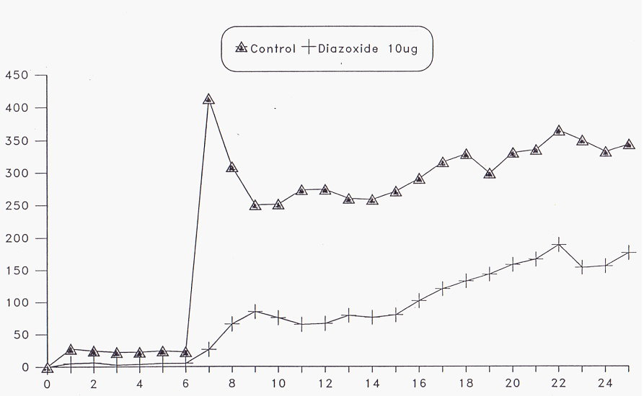
Effect of Diazoxide (10µg/ml) on insulin release (µlU/min) in low and high glucose perfusion in isolated rat pancreas (n=6)
Immuno-reactive Insulin (µlU/minute)
Time in minutes

Slide 14
Method
Effect of Glucose on Insulin Release is Biphasic Response.
Diazoxide a known insulin suppressant drug used as a positive control at a dose 10µg/ml shows inhibition of insulin release approximately by 50% (Howell et al. 1968, Henquin et al. 1982, Bergsten et al. 1988, Garrino et al. 1989 etc.)
Peoples University of Medical & Health Sciences For Women, Pakistan.

Slide 15
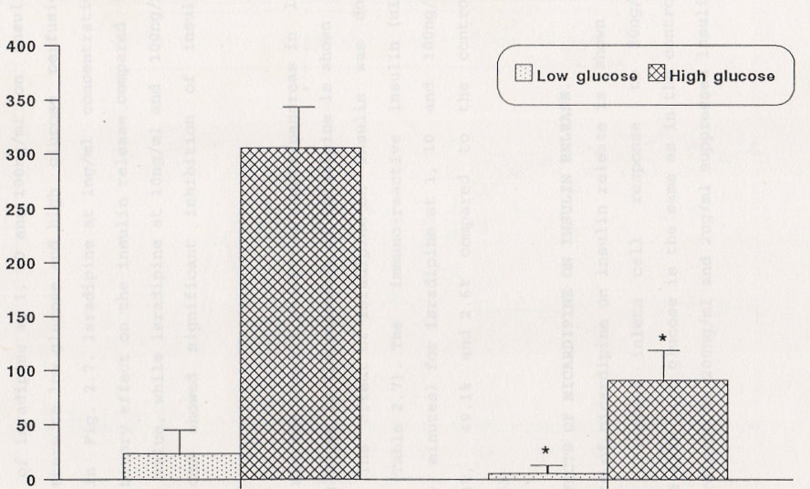
Effect of Diazoxide (10µg/ml) on average insulin/min/pancreas (mean± sem) in low and high glucose perfusion in isolated rat pancreas (n=6) (*P<0.05).
Immuno-reactive Insulin (µU/minute)
Control
Diazoxide
(10µg/ml)

Slide 16
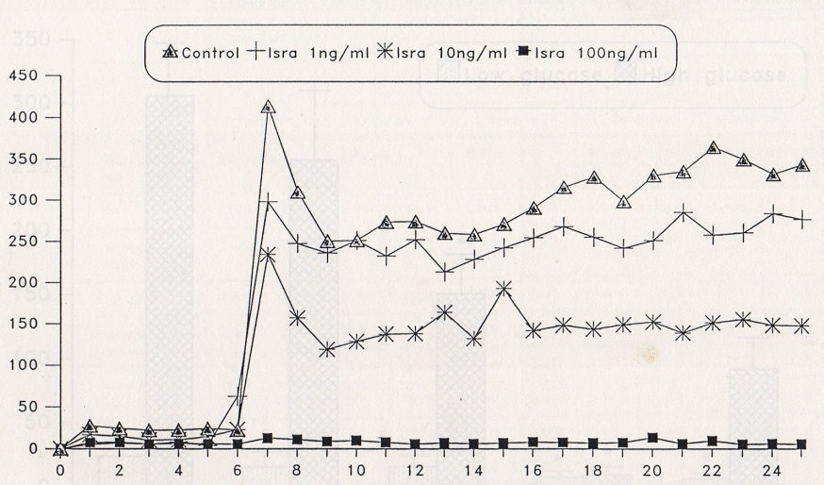
Effects of Isradipine (1ng/ml, 10ng/ml & 100ng/ml) on insulin release (µlU/min) in low and high glucose perfusion in isolated rat pancreas (n=6).
Immuno-reactive Insµlin (ulU/minute)
Time in minutes

Slide 17
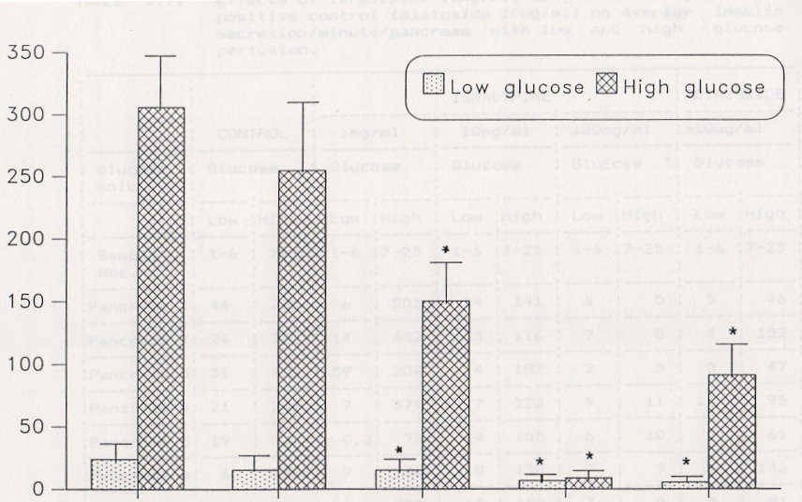
Effects of Isradipine (1ng/ml, 10ng/ml & 100ng/ml) on average insulin/min/pancreas (mean ± sem) in low and high perfusion in isolated rat pancreas (n=6). (*P<0.05)
Immuno-reactive Insulin (µlU/minute)
Control
Isr 1ng/ml
Isr 10ng/ml
Isr 100ng/ml
Diaz 10µg/ml

Slide 18
Effects of Isradipine on Insulin Release
At 1ng/ml there were no significant effect.
At 10ng/ml and 100ng/ml there was significant inhibition of insulin release.
Inhibition was dose dependent.
Peoples University of Medical & Health Sciences For Women, Pakistan.

Slide 19
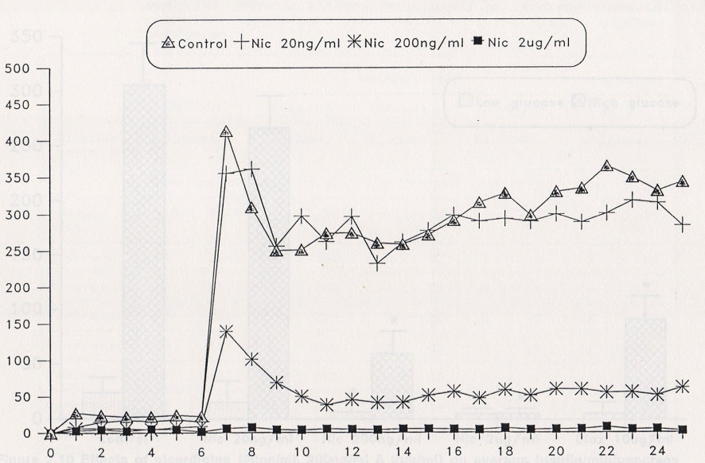
Effects of Nicardipine (20ng/ml, 200ng/ml, & 2µg/ml) on insulin release (µlU/min) in low and high glucose perfusion in isolated rat pancreas. (n=6)
Immuno-reactive Insulin (µlU/minute)
Time in minutes

Slide 20
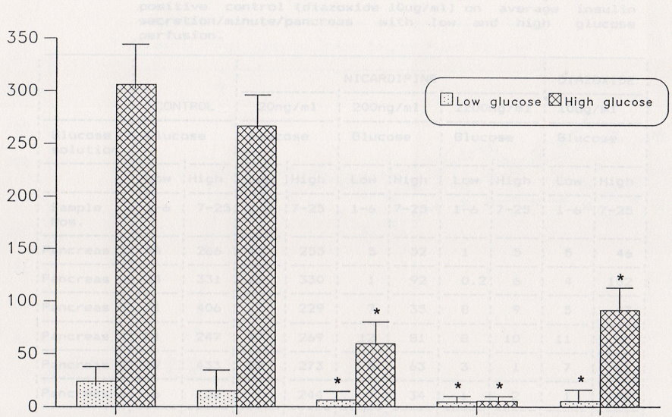
Effects of Nicardipine (20ng/ml, 200ng/ml, & 2ug/ml) on average insulin/min/pancreas (mean ± sem) in low and high glucose perfusion in isolated rat pancreas (n=6). (*P<0.05)
Immuno-reactive Insulin (µlU/minute)
Control
Nic 20ng/ml
Nic 200ng/ml
Nic 2ug/ml
Diz 10µg/ml

Slide 21
Effects of Nicardipine on Insulin Release
At 20ng/ml there was no significant effect.
At 200ng/ml and 2µg/ml there were significant inhibition of insulin release.
Inhibition was dose dependent.
Peoples University of Medical & Health Sciences For Women, Pakistan.

Slide 22
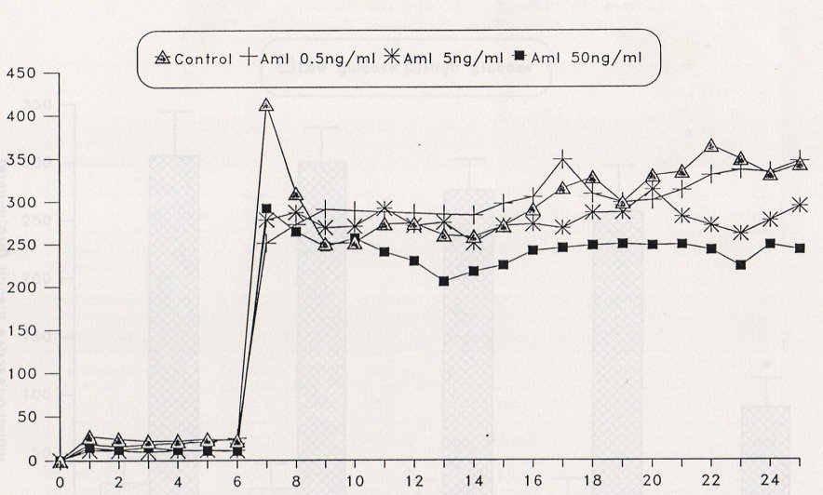
Effects of Amlodipine (0.5ng/ml, 5ng/ml & 50ng/ml) on insulin release (µlU/min) in low and high glucose perfusion in isolated pancreas (n=6).
Immuno-reactive Insulin (µlU/minute)
Time in minutes

Slide 23
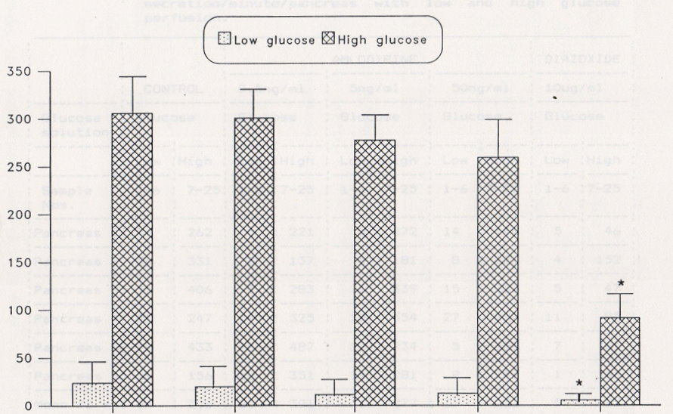
Effects of Amlodipine (0.5ng/ml, 5ng/ml & 50ng/ml) on average insulin/min/pancreas (mean ± sem) in low and high glucose perfusion in isolated rat pancreas (n=6). (*P<0.05)
Immuno-reactive Insulin (µlU/minute)
Control
Aml 0.5ng/ml
Aml 5.0ng/ml
Aml 50ng/ml
Diaz 10µg/ml

Slide 24
Effects of Amlodipine on Insulin Release
At 0.5ng/ml, 5ng/ml, and 50ng/ml, there were no significant inhibition on insulin release.
Peoples University of Medical & Health Sciences For Women, Pakistan.

Slide 25
Conclusion
Different Calcium antagonists have varying effects on insulin release at equivalent therapeutic doses.
Peoples University of Medical & Health Sciences For Women, Pakistan.

Slide 26
The End

