Slide 1
Knowledge, Attitudes, and Practices Regarding Cervical Cancer and Screening
Dr Ghufran Jassim
MBBS,MD, MSc, PhD

Slide 2
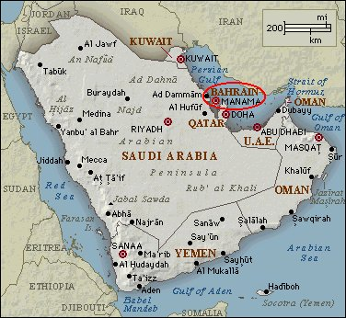
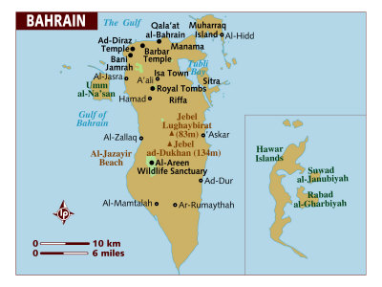
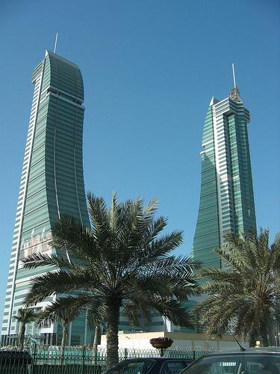
Bahrain
Population 1,234,571
Area 760 km² .

Slide 3
Introduction
Cervical cancer is one of the most common cancers among women, with 80% of the cases occurring in developing countries.
Cervical cancer is largely preventable by effective screening programs.
In Bahrain, all public health care centres provide screening services free of charge for nationals.
The objective of this study was to explore the knowledge, attitudes, and practices of women attending primary care health centres for cervical cancer screening.

Slide 4
Significance
considering the significant impact of cervical screening,
the low coverage of cervical screening, and absence of a population-based screening program,
as well as not including the HPV vaccine in the national vaccination schedule,
Knowledge and attitudes assessment of cervical cancer screening and the HPV vaccine is an important determinant for cervical cancer screening acceptance and use.

Slide 5
Methods
a cross-sectional study of 300 women attending primary health care centres in Bahrain.
We used a validated tool comprised of 45 items to collect data through face-to-face interviews between December 2015 and February 2016.
First, all five health governorates were included as our sample strata.
Then, one health centre was selected at random from all the health centres belonging to each health governorate.
Finally, systematic sampling was adopted by selecting every 5th woman attending the health centre for any reason

Slide 6
Results
Socio-demographic
Variable | Mean (SD)
Age | 37.24 (11.89)
Parity | 2.31 (2.09)
Duration of marriage | 14.95 (10.99)

Slide 7
Results

Slide 8
Results

Slide 9
Results
Knowledge items | Yes | No | DK
1.Have you ever heard about the Pap smear? | 194 (64.7) | 106 (35.3)
2.Pap smear is not able to detect precancerous cells before manifestations of its symptoms | 49 (16.3) | 70 (23.3) | 181 (60.3)
3.If someone is having a normal Pap smear, she does not need Pap smears in the future | 39 (13.0) | 124 (41.3) | 137 (45.7)
4.Pap smear is a non-invasive method | 117 (59.0) | 9 (3.0) | 114 (38.0)

Slide 10
Attitudes /Practice items | Yes | No | DK
1.Have you ever had a Pap smear done? | 1221 (40.7) | 155 (51.7) | 23 (7.7)
2.If you were single, would you go for screening test? | 69 (23.0) | 173 (57.7) | 58 (19.3)
3.If male doctor performed the test, would you feel embarrassed? | 250 (83.3) | 42 (14.0) | 8 (2.7)
4.Are you discouraged from screening for cervical cancer by your partner or others? | 28 (9.3) | 208 (69.3) | 64 (21.3)
5.Pap smear is unnecessary if there are no signs and symptoms | 59 (19.7) | 188 (62.7) | 53 (17.7)
6.I am afraid that something wrong will be detected if I go for Pap smear | 79 (26.3) | 150 (50.0) | 71 (23.7)
7.Would you take HPV vaccine? | 245 (81.8) | 55 (18.2)
8.Would you allow your children to be vaccinated against HPV? | 273 (90.9) | 27 (9.1)

Slide 11
Association between knowledge, attitude, practice and independent variables
Variable | Pearson chi square | p-value | df
Knowledge: Have you heard of the Pap smear
Marital status | 45.943 | 0.000 | 3
Educational level | 3.325 | 0.505 | 4
Employment | 2.629 | 0.269 | 2
Practice: Have you ever had a Pap smear done
Marital status | 52.883 | 0.000 | 3
Educational level | 6.738 | 0.565 | 4
Employment | 3.132 | 0.536 | 2
Attitude: A Pap smear is unnecessary if the patient has no signs or symptoms
Marital status | 14.623 | 0.023 | 3
Educational level | 15.718 | 0.047 | 4
Employment | 9.153 | 0.057 | 2

Slide 12
Discussion
This low level of uptake and knowledge is far less than that reported in developed countries, although the data were at least a decade older.
Considering the religious and conservative aspects of this culture, the majority of participants expressed their feeling of embarrassment if examined by a male doctor, and had been denied screening if single.
Few participants were discouraged from cervical screening by their partner or friends, however, this study failed to determine the reasons for this finding

Slide 13
Discussion
Knowledge, attitudes and practices was not influenced by education or employment but by marital status.
the majority reported positive attitudes towards HPV vaccine and were happy to either take the vaccine themselves or allow their children to be vaccinated
This information should encourage health policy officials to promote the HPV vaccine as it resolves the dispute presented in previous studies about parental perception of the HPV vaccine encouraging premarital sexual behaviour

Slide 14
Conclusion
Participants demonstrated a wide range of knowledge and attitudes towards cervical cancer screening.
However, the majority demonstrated a positive attitude towards the HPV vaccine.
This study shows the need to establish a sustainable awareness campaign concerning the prevention of cervical cancer, and further emphasizes the importance of a nationwide population-based screening program across primary health care centres.

Slide 15
Thank you

