Slide 1
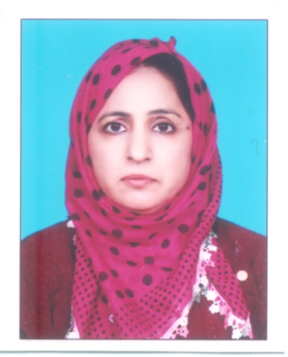
Ghazala Rubi
B.Sc, M.Sc,
F.I.B.M.S;
MPhil (Mol.Bio)
PhD (Human Genetics & Mol.Bio)

Slide 2
Personal Information
Personal Detail
Name : Ghazala Rubi
email rubighazala@yahoo.com
Nationality : Pakistani
Place of Birth : Lahore, Pakistan
Marital Status : Married

Slide 3
Profession
FULL-TIME EMPLOYMENT
1995- 1997 Clinical Microbiologist at Shaukat Khanum, Memorial Cancer Hospital and Research Centre Lahore, Pakistan.
1997-2008 Clinical Senior Molecular Biologist (head of the PCR diagnosis) at Chughtais Lahore Lab, Ammar Medical Complex, 8-Jail Road, Lahore. Pakistan.
2008-2013 Senior teaching & Research faculty at University of Health sciences Lahore.
2013-todate Molcular Pathologist at Agha Khan university Hospital, Pakistan

Slide 4
HONOURS
Got an award for presenting a paper in a conference for an outstanding research AWARD at International Conference of Hepatology in Avari Hotel Lahore 30-31st Jan, 2011.
Academic Roll of Honor from Government College, Lahore.
Elected Secretary of Biological Society of Government College, Lahore.
Fellow of Institute of Biomedical Sciences of UK (FIBMS)
Visiting teacher at Institute of Biotechnology and Biochemistry, University of the Punjab, Lahore Pakistan.
Award for a scholar at the University of Health Sciences Lahore Pakistan.
Active presenter at CME (continued Medical education) in Pakistan.
Achieved 3rd prize in paper presentation in 37th Annual conference of PAP, Dec, 2013.
Won an excellent award in paper presentation in 12th international congress on Ageing in Hyderabad India, 2014.
Abstract accepted for an international conference in MEMBS, Dubai, sept,2014.

Slide 5
Training & Courses
15 Day course on Malariology and Control NIMRT Lahore (November 1992).
Course on Molecular Genetics, Molecular Biology of Prokaryotes, Eukaryotes and plant, NCEMB from February 13-July 31, 1993.
Computer Programs of DOS, Lotus 123, Word 5, Word 5.5, WinWord, FoxPro etc., NCEMB (February 15-April, 1993).
PCR for clinical diagnosis, School of Biological Sciences, University of Surrey, UK. (November 96-May, 1997).
Clinical investigations for bacterial and viral infections. Royal Free Hospital, London, UK (April 1997).
Molecular development course (Jan-Mar 1997) School of Biological Sciences University of Surrey, UK.
Molecular genetics course (Jan-Mar 1997) School of Biological Sciences University of Surrey, UK.
Molecular biological course on gene sequencing (25th Sept to 30th Sept 2000) held at Agha Khan University, Hospital Karachi, Pakistan.
Training on HLA tissue typing in transplant patients (July 2003).
Training on REAL TIME PCR for HCV and Genotyping patients in Italy from 9th May to 13th May 2005.
24 weeks 1st April 2010-30th Sept 2010, course on Molecular Biology at University of Health Sciences Lahore.
National Course on Human Genetics 6th March, 2011-30th April 2010, at University of Health Sciences Lahore.
Two months training/course in Pathology, virology, bacteriology, Genetics, chemical pathology and Molecular Pathology, and CAP quality control in pathology, 1st Jan – 28th February, 2013.

Slide 6
Research interests:
1) Molecular Diagnostics
HCV qualitative & HCV Quantitative
HCV Genotyping
IL 28B GenePolymorphism
HBV Qualitative & Quantitative
HBV Genotyping
MTB Diagnosis from all body fluids
CMV Diagnostics
Dengue Diagnosis

Slide 7
HLA Tissue Typing
HLA tissue typing by PCR diagnosis for Transplant Purpose.
HLA tissue typing for donor and recipient
Matching of donors and recipients
Description of results to patients and clinicians
CME in hospitals for education purpose

Slide 8
HCV
My special interest with HCV RNA and patients suffering with this virus.
How did they acquire and sufferings?
Treatment and viral load coordination
Genotype description
Help those patients to reach clinicians
Kind of therapy and quality testing

Slide 9
Response to therapy
My research included
data of different communities getting the HCV infection.
Response of therapy
Not responded to the therapy
Realpsers after therapy

Slide 10
Ageing
How we are corelating ageing with current infections
Ageing of HCV RNA in different age groups
How our ecology is effecting this process
Written two grants on it

Slide 11
HCV and Diabetes
Mostly patients of HCV acquired diabetes Mellitus after therapy
Trying to get grant on it to work on these two projects

Slide 13
What testing should be done?
Anti HCV
Qualitative PCR
PCR
Quantitative PCR
HCV Genotyping
IL28B

Slide 15
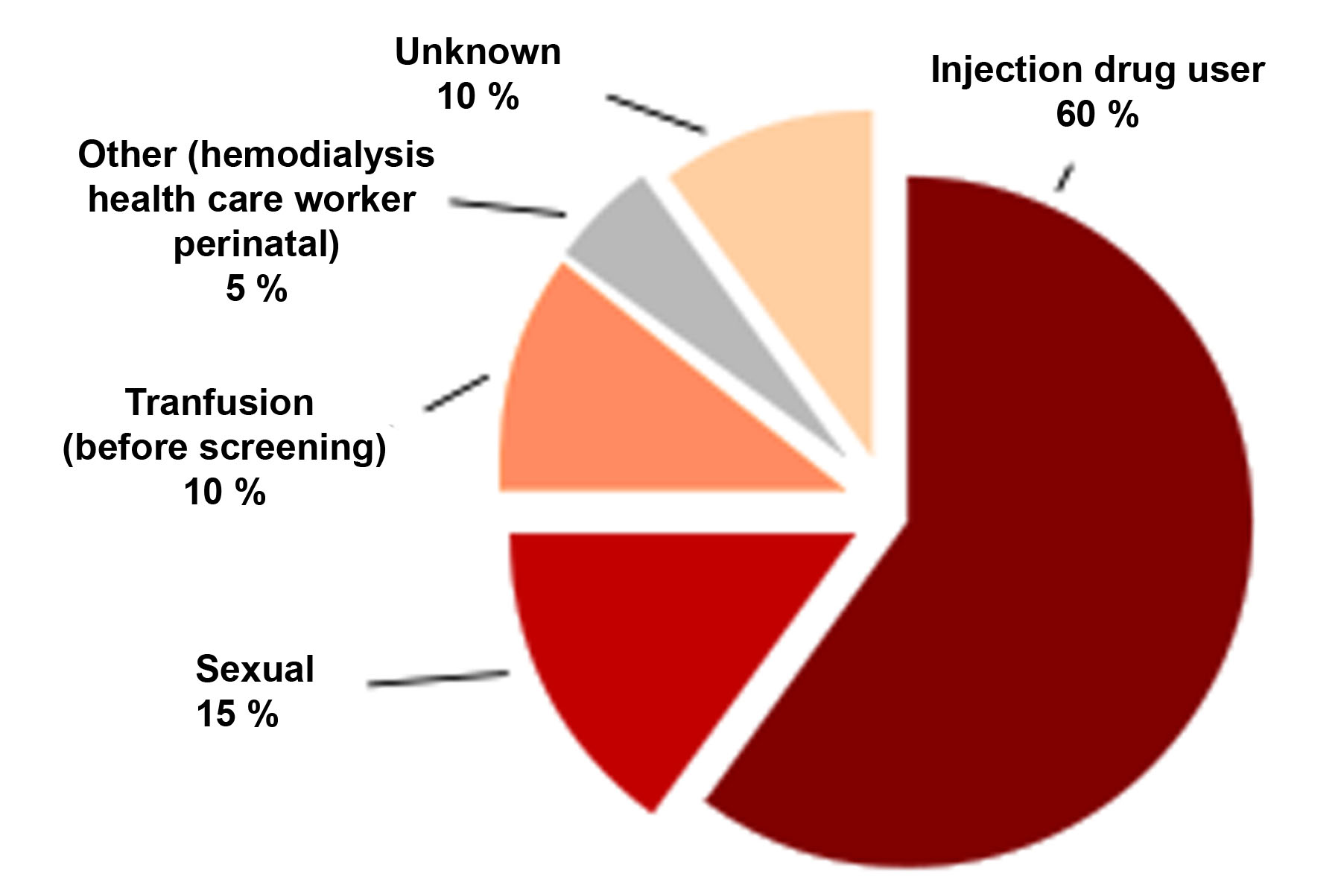
% age of HCV modes of infection

Slide 16
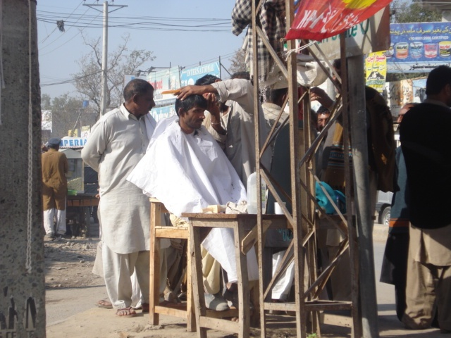

Slide 18
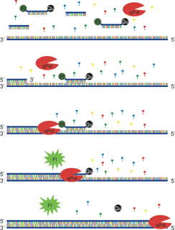
Real Time PCR

Slide 19
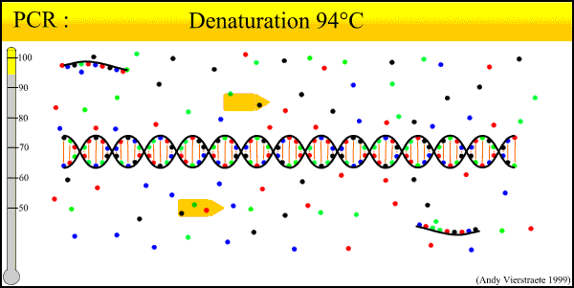
(last update : 20-08-1999)
.
How does PCR work?
Denaturation
Aneeling
Extention
The cycle of denaturing and synthesizing new DNA is repeated as many as 30 or 40 times, leading to more than one billion exact copies of the original DNA segment.
It is directed by a machine called a thermocycler, which is programmed to alter the temperature of the reaction every few minutes to allow DNA denaturing and synthesis.

Slide 21
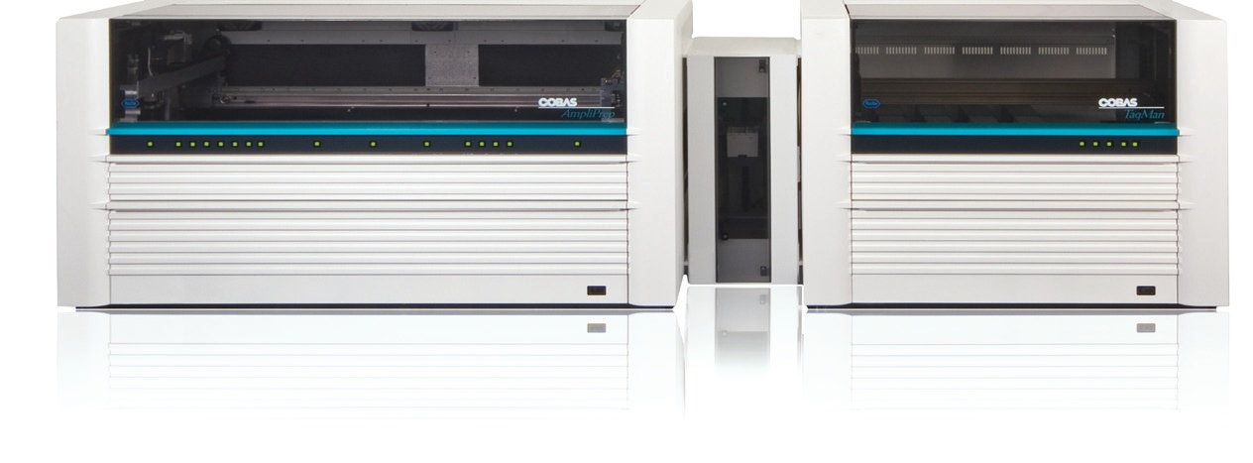
Ampliprep &TaqMan® System

Slide 22
Qualitative HCV PCR
3 Steps
Extraction…………………………………..(Ampliprep)
Reverse Transcription, cDNA……..(Taq Man 96)
Amplification & Detection…………..(Taq Man 96)

Slide 23
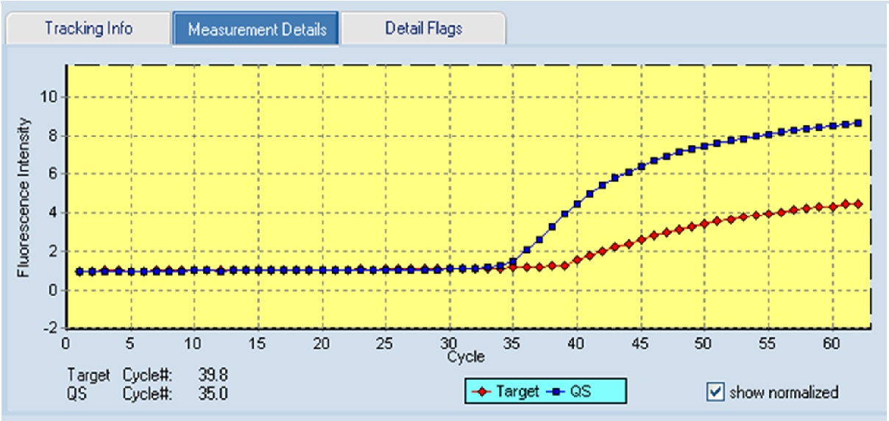
Results Interpretation by graph

Slide 24
Genotypes of HCV
The ability of the virus to mutate has resulted in the existence of
11 different genetic variations of HCV.
These variations are known as ‘genotypes’.
Numbered from 1 - 12.
These genotypes also have sub-types.
The different genotypes are often, but not exclusively, related to different parts of the world.

Slide 25
Genotype distribution
Genotypes 1, 2 and 3 have a worldwide distribution.
Types 1a and 1b are the most common, accounting for about 60% of global infections.
They predominate in Northern Europe and North America and in Southern and Eastern Europe and Japan.
Genotype 2 is less frequently represented than type 1.
Genotype 3 is endemic in south-east Asia.
Genotype 4 is principally found in the Middle East, Egypt, and central Africa.
Type 5 is almost exclusively found in South Africa. Genotypes 6 in China.

Slide 26
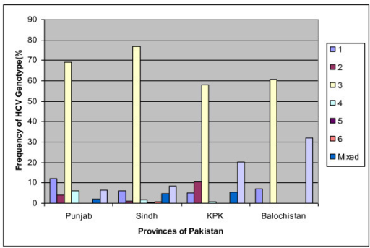
HCV Genotype distribution in Pakistan

Slide 27
Genetic Variability
Implications in HCV infection
Pathogenesis
Therapy
Prevention

Slide 28
Genetic Heterogeneity of
Hepatitis C Virus
Genotypes
Subgenotypes
Isolates
Quasispecies

Slide 29
Genotype Assays
Different assays are used to determine genotype
Molecular Methods (Genotyping)
Direct sequence analysis
Reverse Hybridization
RT PCR with genotype specific probes

Slide 30
Serological Methods (Serotyping)
Competitive ELISA
Most genotype assays use amplification of virus
sequences by PCR.
Assays for determining genotypes and serotypes are
commonly employed in research settings

Slide 31
IL 28B gene polymorphism
IL28B (Interleukin 28B; interferon lambda3) genetic variations found on the human interferon gene on chromosome 19.
These variations may be a predictor regarding the effectiveness of interferon treatments for HCV.
There are 3 variations of the IL 28B genotypes:
CC,
CT
TT.
Patients with the CC allele have the best response to current treatments, people with CT and TT alleles have improved responses with the addition of the new DAAs. ERVR and achievement of virological milestones are still considered to be the best predictors for SVR.

Slide 32
It is important to remember…
IL28B is a blood test
Just because you do not have the gene type does not mean you will not be cured of hepatitis C
some people who do not have this type can still be cured of hepatitis C
The CC genotype is different from what we usually call a genotype. HCV genotypes are strains of hepatitis C that are numbered 1, 2, 3, 4, 5 and 6 such as HCV genotype 1

Slide 33
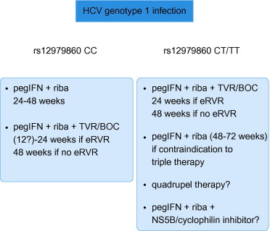
Possible treatment algorithms for chronic HCV genotype 1 infected patients according toIL28Balleles

Slide 34
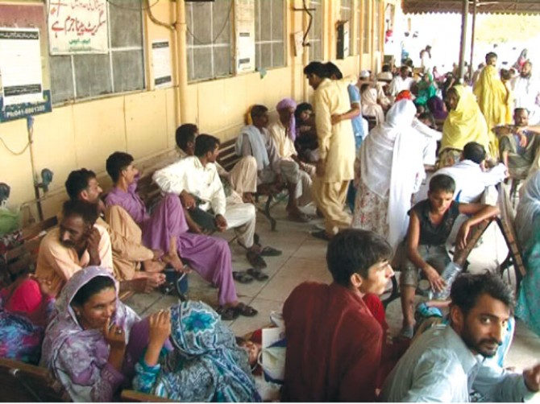

Slide 35
Vote of credit

Slide 36
Challenge?
Keen to do more research on Genetic Susceptibility of HCV RNA
To do research on NS5B target region
Why all patients could not get treated?
Want to do cohort study from different regions of the world to establish a proper guide line for the patients and clinicians.

Slide 37
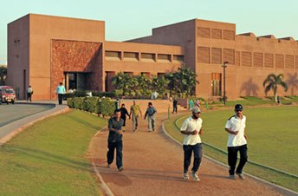
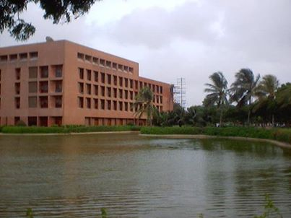
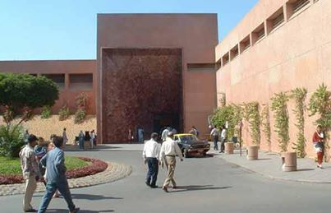
Agha Khan University Hospital

