Slide 1
Vitamin D: Should a regular dose be part in immunomodulation of regulatory T cells in immunomediated diseases?
Gerlies Treiber, Barbara Prietl, Thomas Pieber
Department for Endocrinology and Metabolism
Medical University Graz
3rd Immunology Summit, Baltimore, 30. September 2014

Slide 2
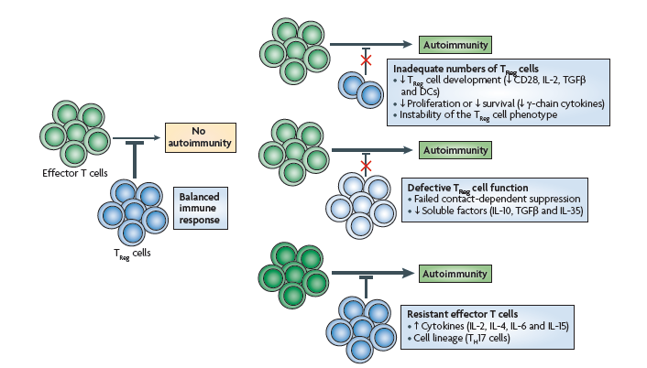
The role of regulatory T-cells in autoimmunity
Buckner, Nat Rev Immunol, 2010

Slide 3
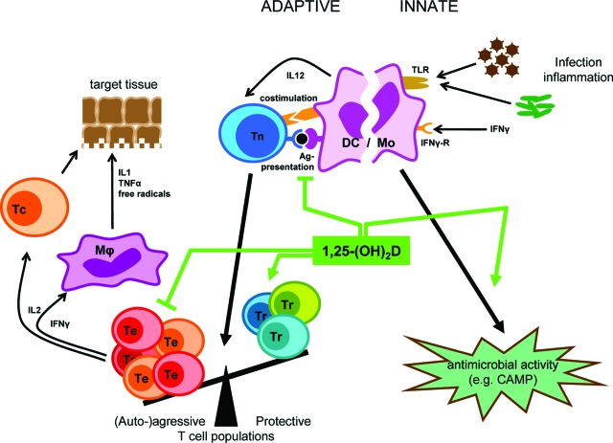
Effects of Vitamin D in the immune system
Treg
Bouillon, Endocrine Reviews, 2008
Notes:
Figure 9. From: Vitamin D and Human Health: Lessons from Vitamin D Receptor Null Mice.
Overview of the pharmacological effects of 1,25-(OH)₂D in the immune system. 1,25-(OH)₂D inhibits the surface expression of MHC II-complexed antigen and of costimulatory molecules, as well as the production of the cytokine IL-12 in APCs (such as DC), thereby shifting the polarization of T cells from an (auto-)aggressive effector (Te) toward a protective or regulatory (Tr) phenotype. 1,25-(OH)₂D exerts its immunomodulatory effects also directly on the level of T cells. Together, these immunomodulatory effects of 1,25-(OH)₂D onto players of the adaptive immune system can lead to the protection of target tissues in autoimmune diseases and transplantation. In the innate immune system on the other hand, 1,25-(OH)₂D strengthens the antimicrobial function of monocytes and macrophages, for example through enhanced expression of the CAMP, eventually leading to better clearance of pathogenic microorganisms.
Roger Bouillon, et al. Endocr Rev. 2008 October;29(6):726-776.

Slide 4
Vitamin D supplementation and regulatory T cells in healthy humans
Pilot study | 1x 140.000 IU Cholecalciferol
n | 50
Age (yrs) | 31±8
Females (%) | 64
BMI (kg/m²) | 23.3±4.3
Prietl B, Pilz S et al IMAJ 2010

Slide 5
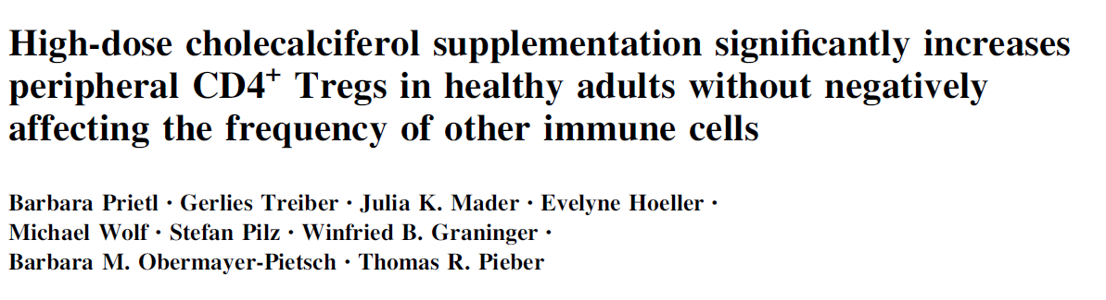
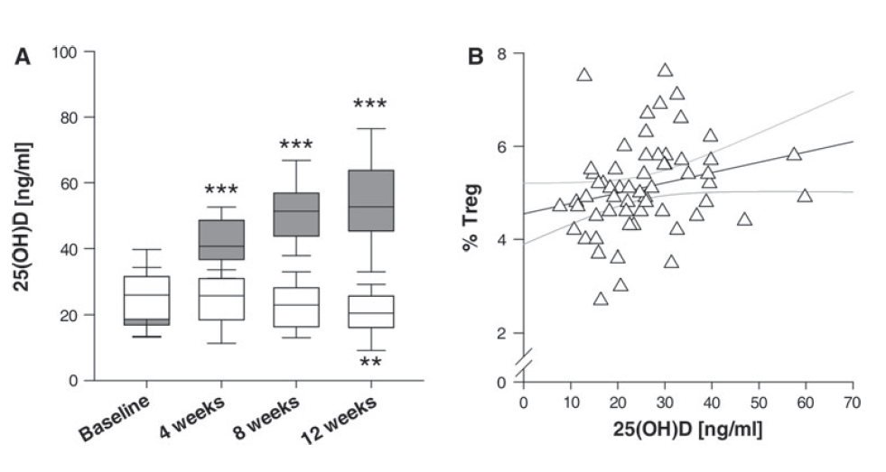
140.000 IU Vit D3
Baseline
r=0.339
p=0.009
Prietl B, Treiber G et al Eur J Nutr 2014

Slide 6
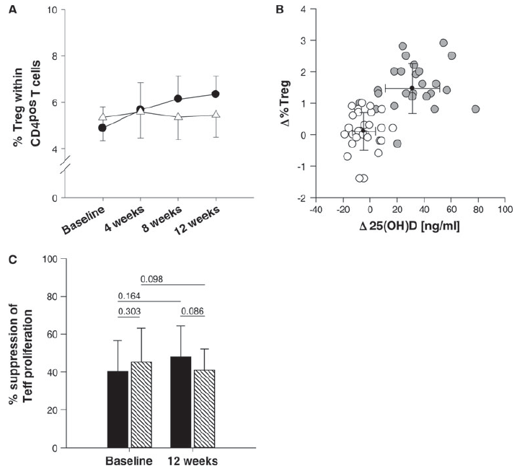
<0.001
<0.001
0.018
r=0.640
p<0.001
Significant increase in
% Treg in CD4^{pos} T cells
Unchanged Treg suppression function in healthy humans
Other immune cells not effected
No treatment related side effects
Prietl B, Treiber G et al Eur J Nutr 2014

Slide 7
Regulatory T cells in Typ 1 Diabetes
T1D: no global deficiency in Treg cell numbers , but functional capacity like suppression of Treg cells is impaired. (reviewed in Bruckner Nat Immun 2010)
    Targeting the Treg population directly in vivo to increase frequency and/or function of Treg
Analog of active form of vitamin D (1,25(OH)₂D₃) increased CD4⁺CD25⁺Treg in pancreatic lymph nodes in NOD mice. (Gregori 2002)
VitD3 increased CD4⁺CD25⁺FoxP3⁺ T cells in pancreatic lymph nodes and reduced diabetes development in NOD mice. (Takiishi Diabetes 2014)
2000 IU VitD3 increased regulatory CD4⁺CD25⁺FoxP3⁺ T cells and slower decline of residual ß-cell function in new onset T1D. (Gabbay APDM 2012)
Notes:
Tregs central role in maintenance of immune tolerance. Current evidence does not indicate a global deficiency in Treg cell numbers in T1D but does not rule out a focal defiency in Treg cell compartment. Several studies show suppression of Treg cells is impared in type 1 diabetes (reviewed in Bruckner Nat Immun 2010)
Suppressive activity of CD4?CD25? cells. The pro- found reduction of IL-2–producing cells in the pancreatic lymph nodes of Ro 26-2198–treated NOD mice was paral- leled by the strongly decreased proliferative response to insolubilized anti-TCR mAb. Pancreatic lymph node CD4? cells from 20-week-old Ro 26-2198–treated NOD mice proliferated 4 times less than age-matched controls and 10 times less than cells from 8-week-old mice (Fig. 5B)

Slide 8
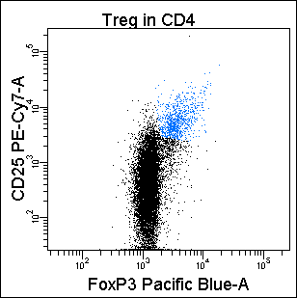
RCT: Vit D3 in patients with T1D
30 Patients with new-onset T1D (<12 weeks)
Intervention 12 month:
  oral therapy of cholecalciferol (70IU/kg bodyweight/day)
  or placebo
Immunologic Assessment at month 0, 3, 6 and 12:
  Immune phenotyping: FACS-analysis
    CD4^{pos}CD25^{hi}Foxp3^{pos} CD127^{dim} Treg
    Th-Subtypes (Th1, Th2, Th17)
    DC , B-cells, NK, NKT-cells
  functional tests: FACS sorted Treg and Teff
    ex vivo suppression co-cultures (⦋³H⦌-thymidine incorporation)
    Apoptosis (AnnexinV/7-AAD)
Notes:
(age 15 [10-16], 77% male) with

Slide 9
RCT: Vit D3 in T1D
Treiber G et al in preperation

Slide 10
RCT: Vit D3 in T1D
No significant effect on the frequency of other peripheral immune cells
  Th1 /Th2 / Th17 cells
  B cells
  Cells from the innate immune system

Slide 11
RCT: Vit D3 in T1D
p=0.078
p=n.s.
p=0.004

Slide 12
Treg origin: Thymus and Gut associated lymphoid tissue
GALT
Li L et al Clin Immun 2011
Notes:
Treg kommen einerseits aus dem Thymus und erfahren dann eine “post-thymic differentiation” und werden zu Effector/memory Treg die dann in die versch Tissues auswandern; Auf der anderen Seite werden Treg auch im Gut-associated lymphoid tissue induziert (aus effector Tc oder naiven Treg) – diese wandern ebenfalls ins Blut, werden zu memory Tregs und gehen in die versch tissues
Original Text zur Fig :
Post-thymic differentiation of Treg cells. The majority of Treg cells at birth are naïve cells and express high levels of CD62L, CCR7 and the gut homing receptor α4β7 allowing them to migrate into secondary lymphoid organs and gut-associated lymphoid tissues where naive Treg cells encounter self-antigens and commensal microbes. Subsequently, Treg cells express diverse homing receptors, which render them capable of migrating to specific tissues and organs. For instance, expression of CCR4 is required for migration to skin, lung and other inflamed tissues; T-bet-dependent expression of CXCR3 is important for localization of Treg cells to inflamed liver; Treg cells expressing CCR6 are able to migrate to Th17 cell-mediated inflammatory sites. Upon recognition of antigen Treg cells, like conventional naïve T cells, lose their naïve phenotype and become effector- or memory-like cells expressing distinct sur- face markers. Thus, post-thymic differentiation of Treg cells occurs through a sequence of events that involve antigen recognition, migration and functional maturation, which eventually determine the specific function and fate of Treg cells.
Li L.; Molecular and functional heterogeneity of T regulatory cells; Clinical Immunology; 2011

Slide 13
GALT: interface for maintenace of immune homostasis
T1D: Increased intestinal permeability precedes clinical onset of type 1 diabetes. (Bosi Diabetologia 2006)
Cow milk, early cereal exposure and enterovirus infection riskfactors for islet autoimmunity. (Lempainen DMRR 2012)
T1D: reduced regulatory Foxp3⁺T cells in duodenal biopsies (Badami Diabetes 2011)
IBD: Decreased frequency of CD4⁺Foxp3⁺ Treg in PBMC and increased Foxp3⁺ cells in inflamed mucosa (Wang JDD 2011). Increased apoptosis of regulatory T lymphocytes in peripheral blood and in mucosa. (Veltkamp C Gut 2011)
  Vit D3 effect on Treg in gastrointestinal mucosa in humans unknown

Slide 14
Vit D3 effect on Treg in gastrointestinal mucosa in humans
Screening
16 healthy volunteers
Safety
Follow-up
Gastro
Gastro
Colo
Colo
4 weeks
4 weeks
BL V2/V3 V4 V5/V6 V7
Cholecalciferol
blood
blood
biopsy
70IU/kg BW/d
Loading dose
blood
biopsy

Slide 15
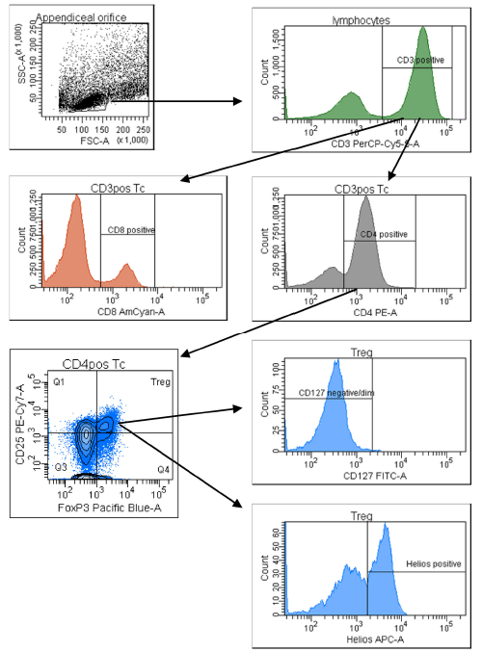
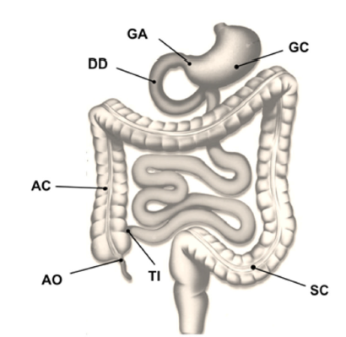
Biopsy regions
systematic assessment of upper and lower GI tract
healthy humans | 16
Age (yrs) | 25±4
Females (%) | 44
BMI (kg/m²) | 23±3
Gating strategy
FACS analyses

Slide 16
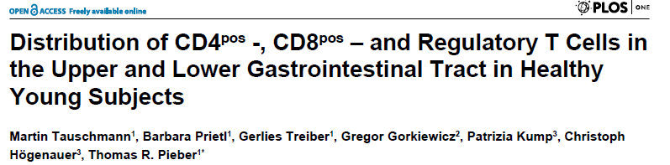
CD3^{pos} (% of lymphocytes)
Treg (% of CD4^{pos} T cells)
CD8^{pos} (% of CD3^{pos} T cells)
CD4^{pos} (% of CD3^{pos} T cells)
regions
regions
regions
regions
Plos one 2013

Slide 17
Vit D3: on blood Treg
peripheral blood

Slide 18
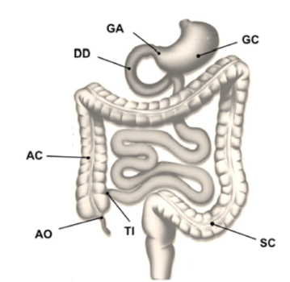
Vit D3 on GI CD4⁺ and CD8⁺

Slide 19

Vit D3 on GI Treg
Baseline
8 weeks Vit D3

Slide 20
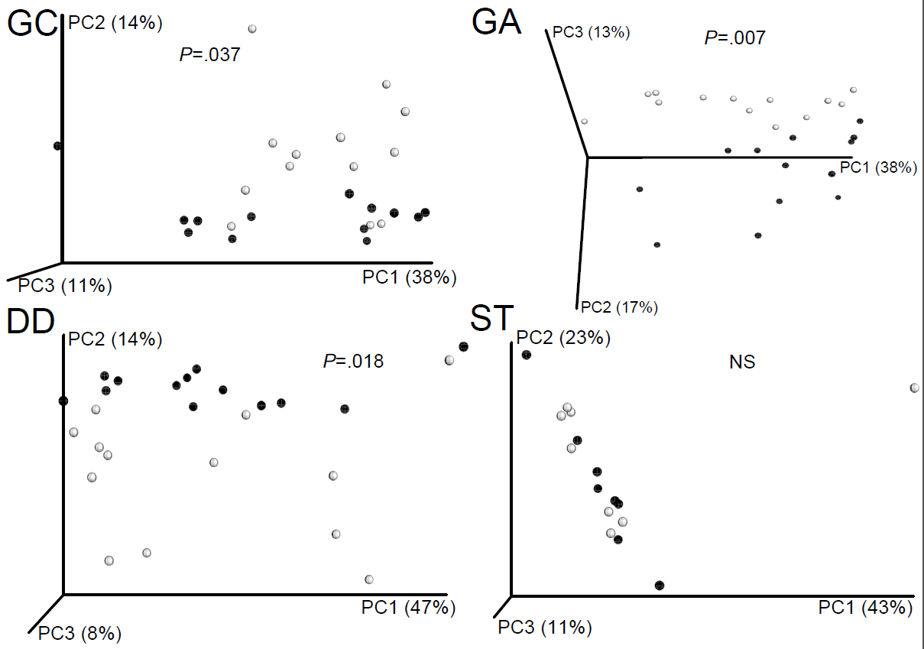
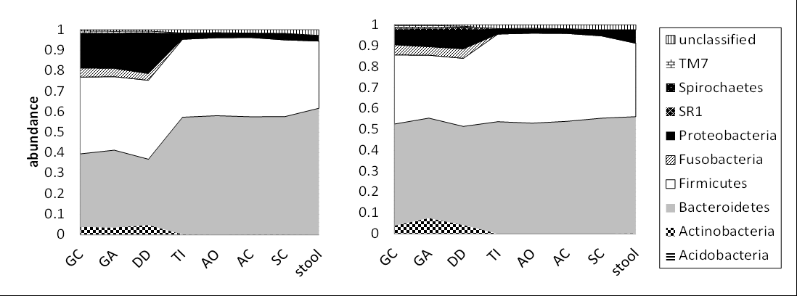
Vit D3 and Mikrobiom
Vit D alters upper GI community structure
Reduction of Proteobacteria
Increase of richness in upper GI
before
8 wks

Slide 21
Summary and Conclusion
Vitamin D3 – Cholecalciferol - increases peripheral regulatory T cells in healthy humans
Impaired suppressive capacity in type 1 diabetes improved with Cholecalciferol supplementation along with preservation of fasting C-peptide
8 weeks of VitD3 did not alter total number of Treg in gastrointestinal mucosa in healthy humans but showed an distinct pattern in Helios⁺ Treg compartment
Vitamin D3 elevates CD8^{pos} cytotoxic T cell numbers, accompanied by modulation of the gut microbiome with marked reduction of Gammaproteobacteria
  Potential as adjunctive immunomodulatory therapy of immunomediated diseases like T1D in combination with other future immune therapies

Slide 22




Acknowledgements
  Barbara Prietl
  Evelyne Höller
  Verena Pfeifer
  Christine Neuper
  Silvia Leitgeb
  Anja Ribitsch
All our study participants
Team Diabetes Clinics
ADPP Network
Research support
  EASD and EFSD
  Martin Tauschmann
  Minar Bashir
  Christoph Högenauer
  Patrizia Kump
  Gregor Gorkiewicz
  Stefan Pilz
CD4⁺
T cell
Thank you!

