Slide 1
Gamma-aminobutyric acid (GABA) treatment blocks inflammatory pathways and promotes survival and proliferation of pancreatic beta cells
Gérald J. Prud’homme, MD, FRCPC
Keenan Research Centre for Biomedical Science,
St. Michael’s Hospital, Toronto.
Department of Laboratory Medicine and Pathobiology, University of Toronto.
Email: prudhommeg@smh.ca

Slide 2
Limitations of current therapies of diabetes
Do not prevent or reverse type 1 diabetes (no cure).
Minimal or no improvement in the survival of pancreatic beta cells (type 1 or 2).
Do not induce replacement or regeneration of beta cells (type 1 or 2).

Slide 3
EFFECTS NEEDED TO CURE TYPE 1 DIABETES
Stop the autoimmune (inflammatory) reaction that kills beta cells.
Increase the resistance of beta cells to injury.
Stimulate the regeneration of beta cells, or replace these cells.
Research aspect: human beta cells are different from mouse. Drugs must work on human cells.

Slide 4
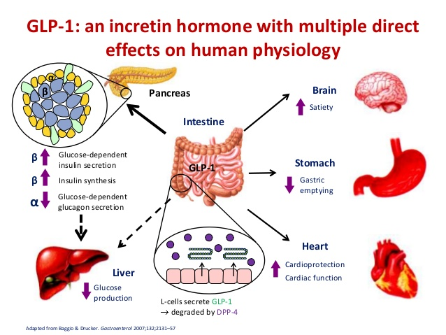

Slide 5
GLP-1 receptor agonists
Effective in the treatment of type 2 diabetes
Several drugs available or under investigation: exenatide [Byetta], liraglutide, dulaglutide, etc.
Not effective in type 1 diabetes (lack anti-inflammatory and regenerative capacity).

Slide 6
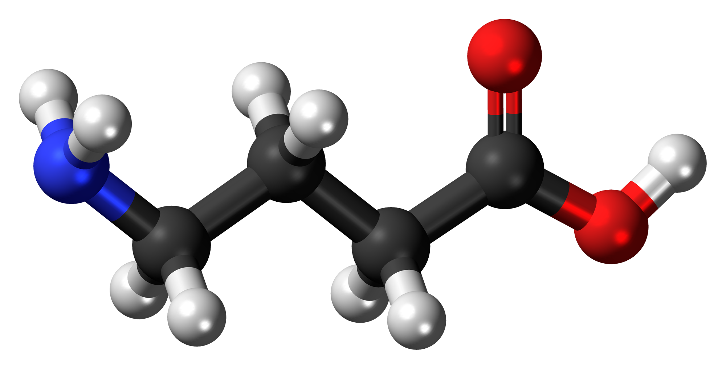
GABA
Gamma-aminobutyric acid

Slide 7
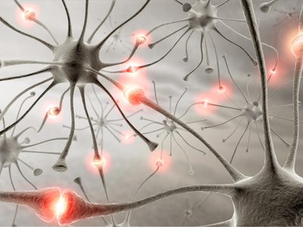
GABA is an inhibitory neurotransmitter in the brain, but also present in the pancreas

Slide 8
GABA
Brain:
Major inhibitory neurotransmitter.
Islets:
Inhibits α cells, but stimulates β cells.
Immune system:
Inhibits lymphocytes and macrophages

Slide 9
GABA RECEPTORS
Type A (GABA-A receptor):
Fast acting ligand-gated chloride channel (many variants).
Blocked by picrotoxin.
Type B (GABA-B receptor):
Slow acting G-protein coupled receptor.
Blocked by saclofen.
Neurons and islet cells: Express both receptors.
Lymphocytes: Type A only.

Slide 10
GABA suppresses proliferation of human T cells (anti-CD3 antibody)

Slide 11
Immunotherapeutic effects of GABA in T1D
Strain/model Immune effects Disease course
NOD(prediabetic) Th1 cells↓, IFN-γ↓ prevented diabetes IL-12↓, Treg↑ (insulitis↓)
NOD (diabetic) reversed transiently
NOD-TCR8.3 CTL response↓ prevented (insulitis↓)
CD1 mice IL-1↓, TNF-α↓ reversed diabetes
(low dose STZ, IL-12↓, IFN-γ↓ (insulitis↓, β-cell diabetic) regeneration)
Reviewed in: Prud’homme et al. Autoimmunity reviews, 2015, 14:1048-56.

Slide 12
Inhibition of NF-kB in Mouse T cells
(anti-CD3/CD28 stimulated)

Slide 13
GABA suppresses activation of NF-kB in
human islets through GABA-A receptors

Slide 14
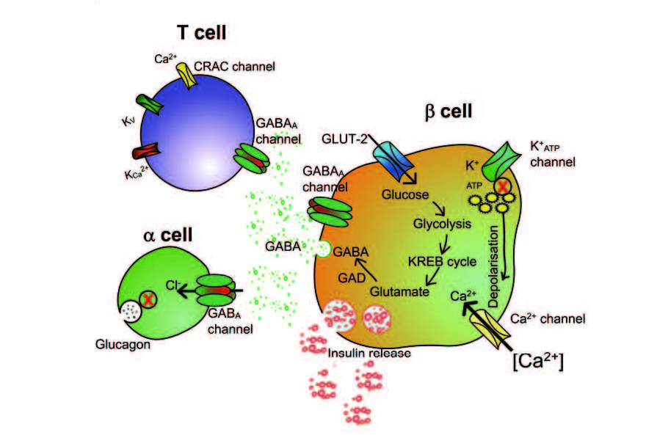
GABA BLOCKS AUTOIMMUNE REACTION AGAINST BETA CELLS

Slide 15
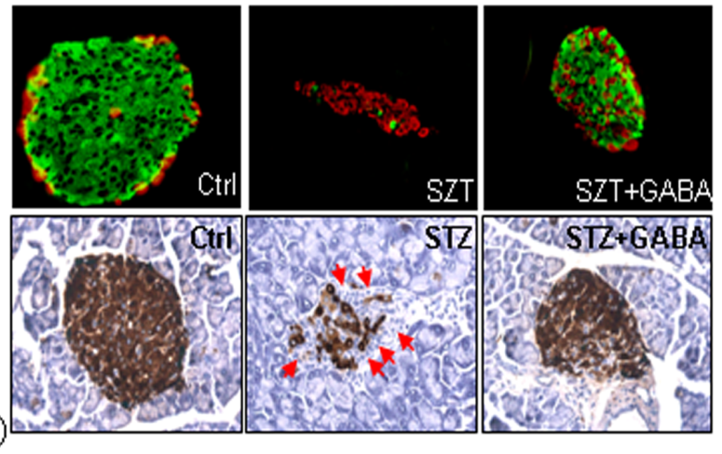
GABA induces beta-cell regeneration

Slide 16
Mouse:
GABA prevents β-cell death, stimulates β-cell proliferation, increases insulin secretion, and promotes β-cell regeneration.
GABA exerts anti-inflammatory and immunosuppressive effects.
Humans: Similar to mouse??

Slide 17
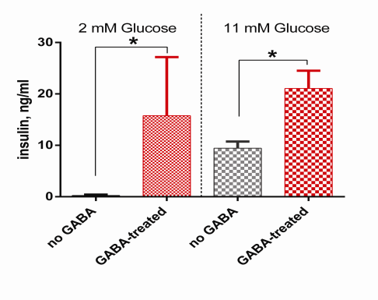
GABA stimulates insulin secretion

Slide 18
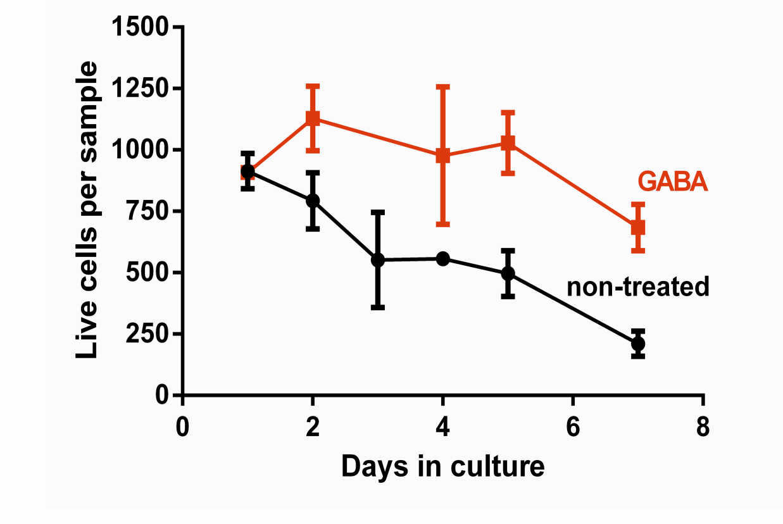
Human beta cells in culture

Slide 19
GABA and Liraglutide (GLP-1R agonist) ameliorate human beta-cell survival
(24 h in vitro; additive effect)

Slide 20
Non-treated islets
Ki67 -red
DAPI - green
merge

Slide 21

Islets treated with 100 μM GABA
Ki67 -red
DAPI - green
merge

Slide 22
Ki67 staining,
See images below

Slide 23
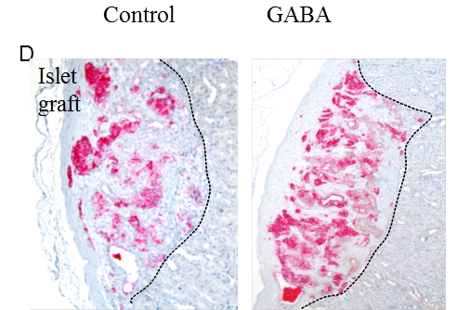
Human islets transplanted into immunodeficient mice: GABA stimulates growth (regeneration) of beta cells

Slide 24
HYPOTHESES
Combined therapy with GABA and a DPP-4 inhibitor (DPP4-I) will improve protection of human beta cells against injury/apoptosis and induce regeneration.
A completely oral therapy will be effective, which is a major clinical advantage.

Slide 25
GABA AND GLP-1 WORK TOGETHER
Our most recent data show that GABA and GLP-1 are more effective when administered together.
Improved beta-cell survival and regeneration.
Effective on human beta cells.
Completely oral therapy protects against diabetes in experimental model.

Slide 26
Streptozotocin-induced diabetes (MDSD)
GABA AND DPP-4I collaborate to increase beta-cell mass. Red = insulin; green = glucagon; blue = DAPI. Treatment with combined drugs was superior to induce proliferation (Ki-67+ cells) and reduce apoptosis (Tunel assay); data not shown.

Slide 27
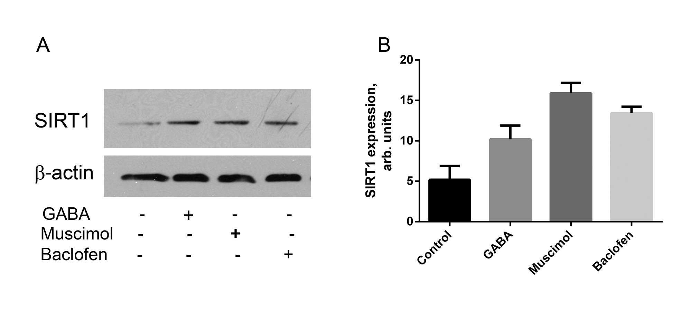
GABA and GABAergic drugs (agonistic) increase SIRT1 expression in INS-1 beta-cell line

Slide 28
GABA increases Klotho (alpha-Klotho)
In humans Klotho normally declines with age, and is abnormally low in diabetic patients (type 1 and 2).
Klotho KO mice have multi-system disease and accelerated aging.
Klotho has multiple protective effects on beta cells. Importantly, it inhibits NF-kB activation and exerts anti-apoptotic effect.

Slide 29
Structure of α-Klotho
ADAM10,
ADAM17
BACE1
ADAM10,
ADAM17,
BACE1
N-
KL1
KL2
-C
Truncated soluble Klotho 65 kD
Secreted Klotho (alternative splicing)
70 kD
Soluble
Klotho ~130 kD
Membrane-bound klotho binds FGFR1 and facilitates binding of FGF23 to this receptor.
Soluble klotho acts as a hormone with the receptors yet to be characterized.
KL1 and KL2 domains structurally resemble glucosidase, but their enzymatic activity
is questionable.

Slide 30
Binding partners of α-klotho
FGF23,
FGFR1
IGF-1
TGF-βRII
Wnt family members
?
Cell proliferation
Caspase-3 cleavage
Apoptosis
α-klotho shedding
(activation of mTOR)
IGF-1 tyrosine kinase
FOXO (antagonizes
suppression by IGF-1)
MnSOD expression
Suppression of pancreatic
cancer
Prevents binding
of TGFβ1 to
TGF-βRII
Inhibits EMT
Inhibits accelerated senescence
Suppresses tumor development
Multiple effects mediated by non-described receptors

Slide 31
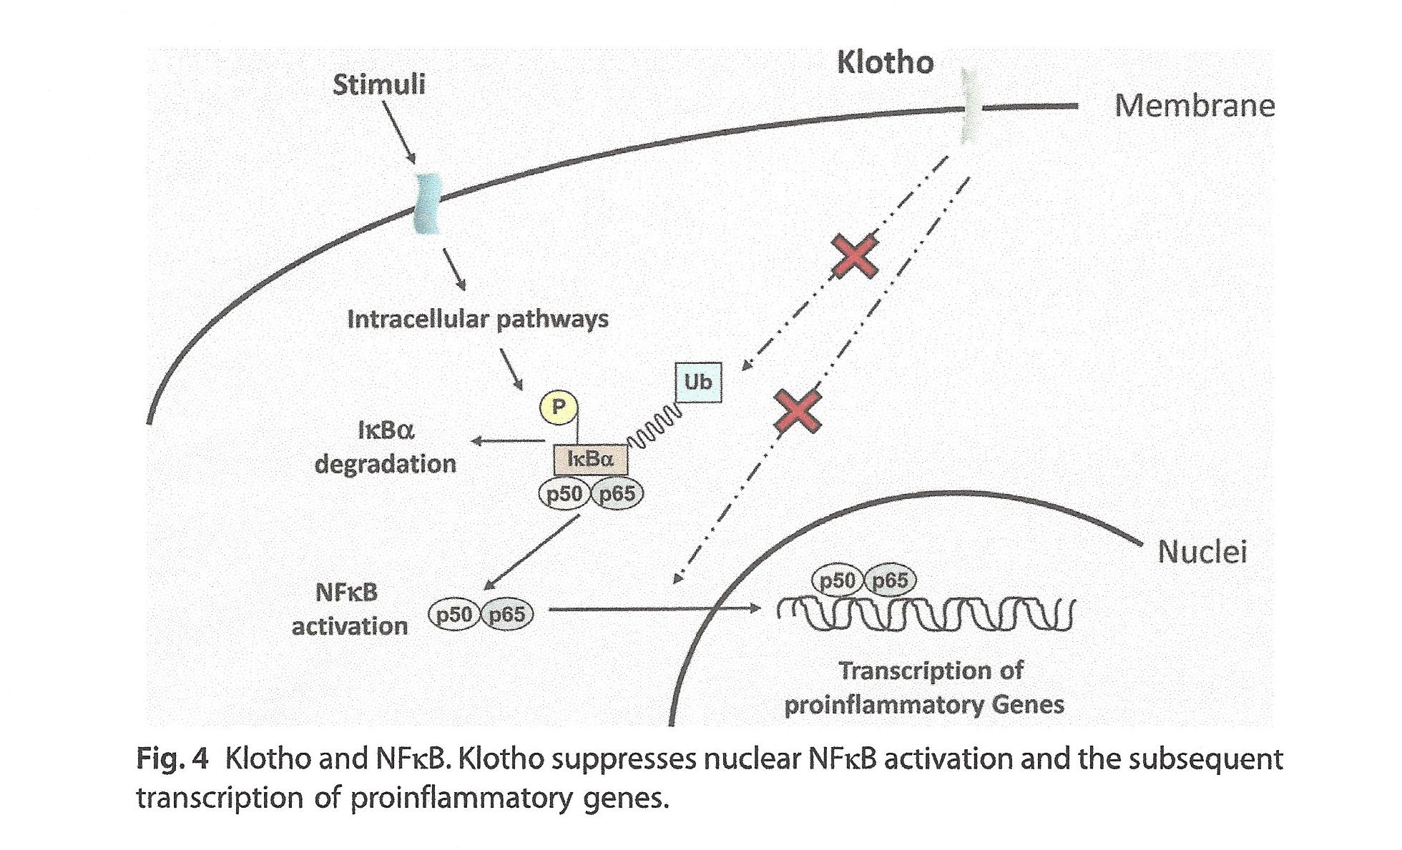
KLOTHO INHIBITS NF-κB ACTIVATION
Buendia et al., Vitamins and Hormones, 2016, 101: 119-147

Slide 32
Schematic representation of the Klotho participating in intracellular signaling pathways. Klotho protein is involved in several intracellular signaling pathways that are essential for the regulation of many cellular processes, including aging and senescence.
From: M. Sopjani et al. Klotho and Intracellular Signaling
Current Molecular Medicine, 2015, Vol. 15, No. 1 33

Slide 37
Klotho knockdown
Recombinant Klotho Cell viability

Slide 38
Klotho knockdown
GABA
Cell viability

Slide 39
Effects of Klotho/our preliminary data:
Klotho is expressed by rat (INS-1) and human pancreatic cells (donor islets).
Cultured islet cells actively release soluble Klotho.
The level of circulating Klotho in mouse serum is severely decreased during STZ-induced diabetes. GABA, but not Liraglutide, restores it.
Ability of GABA to increase the survival of beta cells under stress depends on the expression of Klotho.

Slide 40



GABA in food and beverages:
It is a safe natural compound

Slide 41

GABA INCREASES GROWTH HORMONE

Slide 42
SUMMARY: GABA has key effects against diabetes
(studies performed with human cells)
1) It prevents beta-cell injury and death.
2) It promotes the regeneration of beta cells.
3) It suppresses immune cells that cause autoimmunity and beta-cell loss.
4) It increases SIRT1 and Klotho, which suppress NF-κB activation and exert protective effects on beta cells.
G. Prud’homme, Q. Wang and colleagues (PNAS 2011; Transplantation 2013; Diabetes 2014; BBRC 2014; Frontiers Pharmacology 2015, 2017)

Slide 43
Future Goals
Clinical development of a new treatment for type 1 and 2 diabetes: GABA therapy, with or without GLP-1.
Determine whether GABA therapy has a role in the treatment of other chronic diseases.

Slide 44
Research Team
Dr. Gérald Prud’homme
Dr. Qinghua Wang
Dr. Tianru Jin
Dr. Yelena Glinka
Dr. Wenjuan Liu
Ms. Merve Kurt
Funding
Juvenile Diabetes Research Foundation (JDRF) International

