Slide 1
GEORGIA TORRES PhD (CSCS)
Effect of exercise intervention programmes on anthropometric, physiological and cardio-metabolic parameters of persons with and without metabolic syndrome.

Slide 2
THE STUDY Effect of exercise intervention programmes on anthropometric, physiological and cardio-metabolic parameters of persons with and without metabolic syndrome.
Study compared the effects on the components of the MetS of an exercise programme that uses blood lactate transition thresholds (anaerobic threshold (AT)) to the same measurements obtained in an exercise programme (not using AT) appearing in the literature.
The main aim of the study was to design an exercise programme that optimised exercise responses and may thus improve metabolic characteristics in individuals with MetS.

Slide 3
THE STUDY
The intention of using at?
To individualise the exercise programme and optimise the improvements in metabolic characteristics.

Slide 4
METHODS
Only Males (25 – 55 yrs old) were used in this study
Individuals with CVD, pulmonary disease and Type 1 diabetes were not included
Ten subjects with MetS exercised
using the walking programme of Leon et al (1979) (Group: MetSL).
Ten subjects with MetS exercised using velocity at AT to set training intensities (Group: MetSV).
Ten subjects without MetS exercised using velocity at AT to set training intensities (Group: Non-MetSV).

Slide 5
DIAGNOSIS
The presence of any 3 of the 5 criteria denoted below constituted a diagnosis of MetS:
(Alberti, 2009).
1
Waist circumference (≥94 cm);
2
triglycerides (≥1.7 mmol/L) or drug treatment for high triglycerides;
3
HDL-cholesterol (<1.0 mmol/L) or drug treatment for reduced HDL-cholesterol;
4
elevated blood pressure (≥130/85) or on anti-hypertensive drug treatment;
5
elevated fasting glucose (≥5.6mmol/L) or drug treatment for glucose intolerance.

Slide 6
ANTHROPOMETRIC PARAMETERS
HEIGHT
Waist circumference (taken as the greatest reading around the girth, midway between lateral lower ribs and the iliac crests).
WEIGHT
BMI

Slide 7
PHYSIOLOGICAL PARAMETERS
Blood pressure: Sitting position; an average taken of two readings.
Peak VO2 and heart rate were measured using the Cortex, Biophysik, Metalyzer 3b CPX on-line system.
A BLTT test and ECG were performed at the same time.

Slide 8
CARDIO-METABOLIC PARAMETERS
Blood serum concentrations of:
Triglycerides; HDL; LDL and total cholesterol.
An oral glucose tolerance test (OGTT): Fasting state; administering a 75 g glucose load.
Fasting, 30 minute and two-hour glucose and insulin levels.
The HOMA-IR (Matthews et al, 1985)

Slide 9
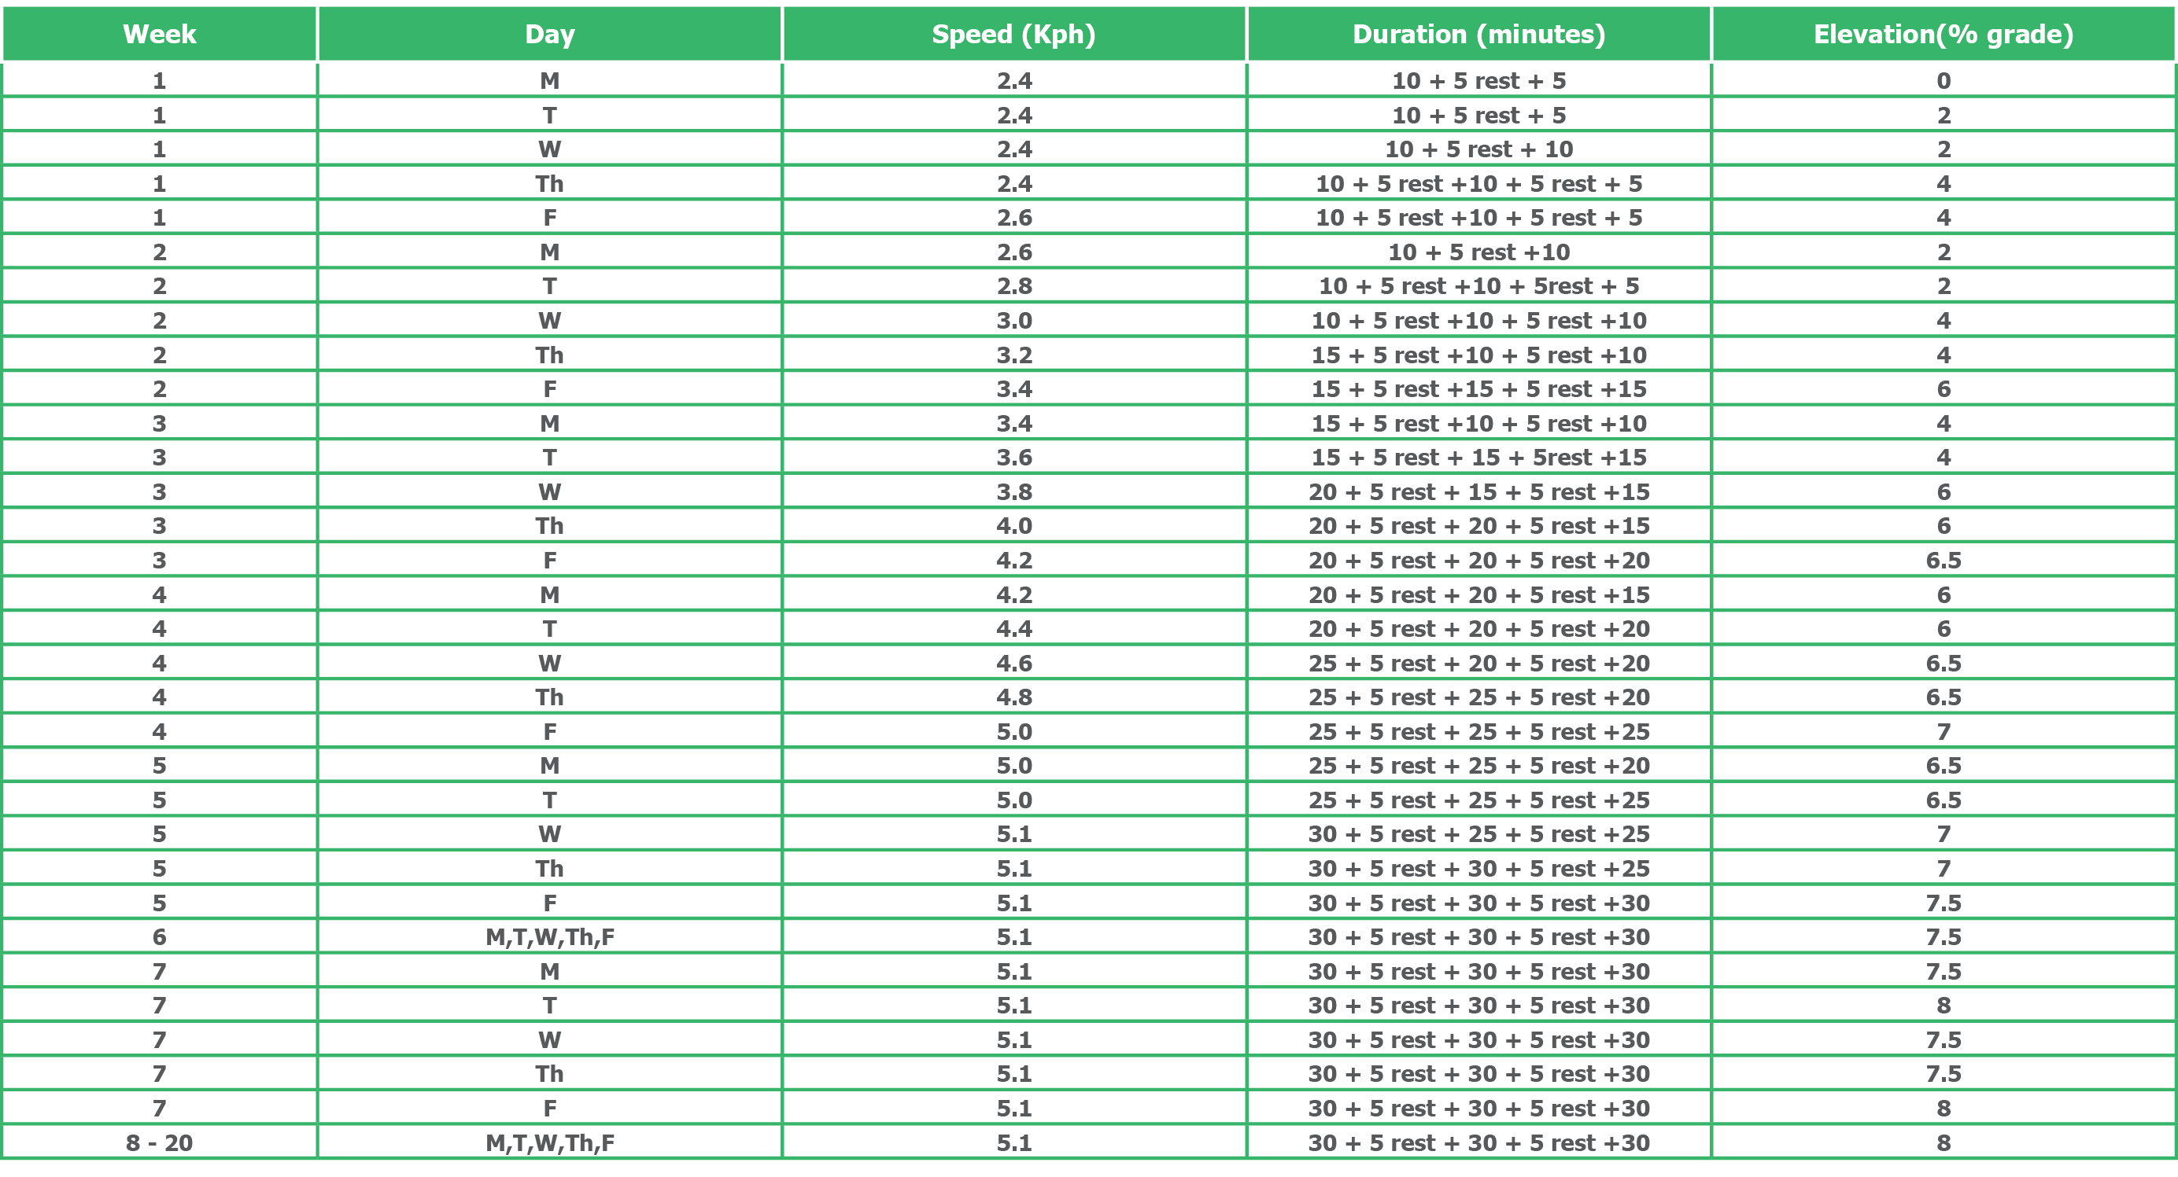
TRAINING PROGRAMMES:
Leon et al (1979): for METSL Group
The training programme for groups using AT to set training intensity

Slide 10
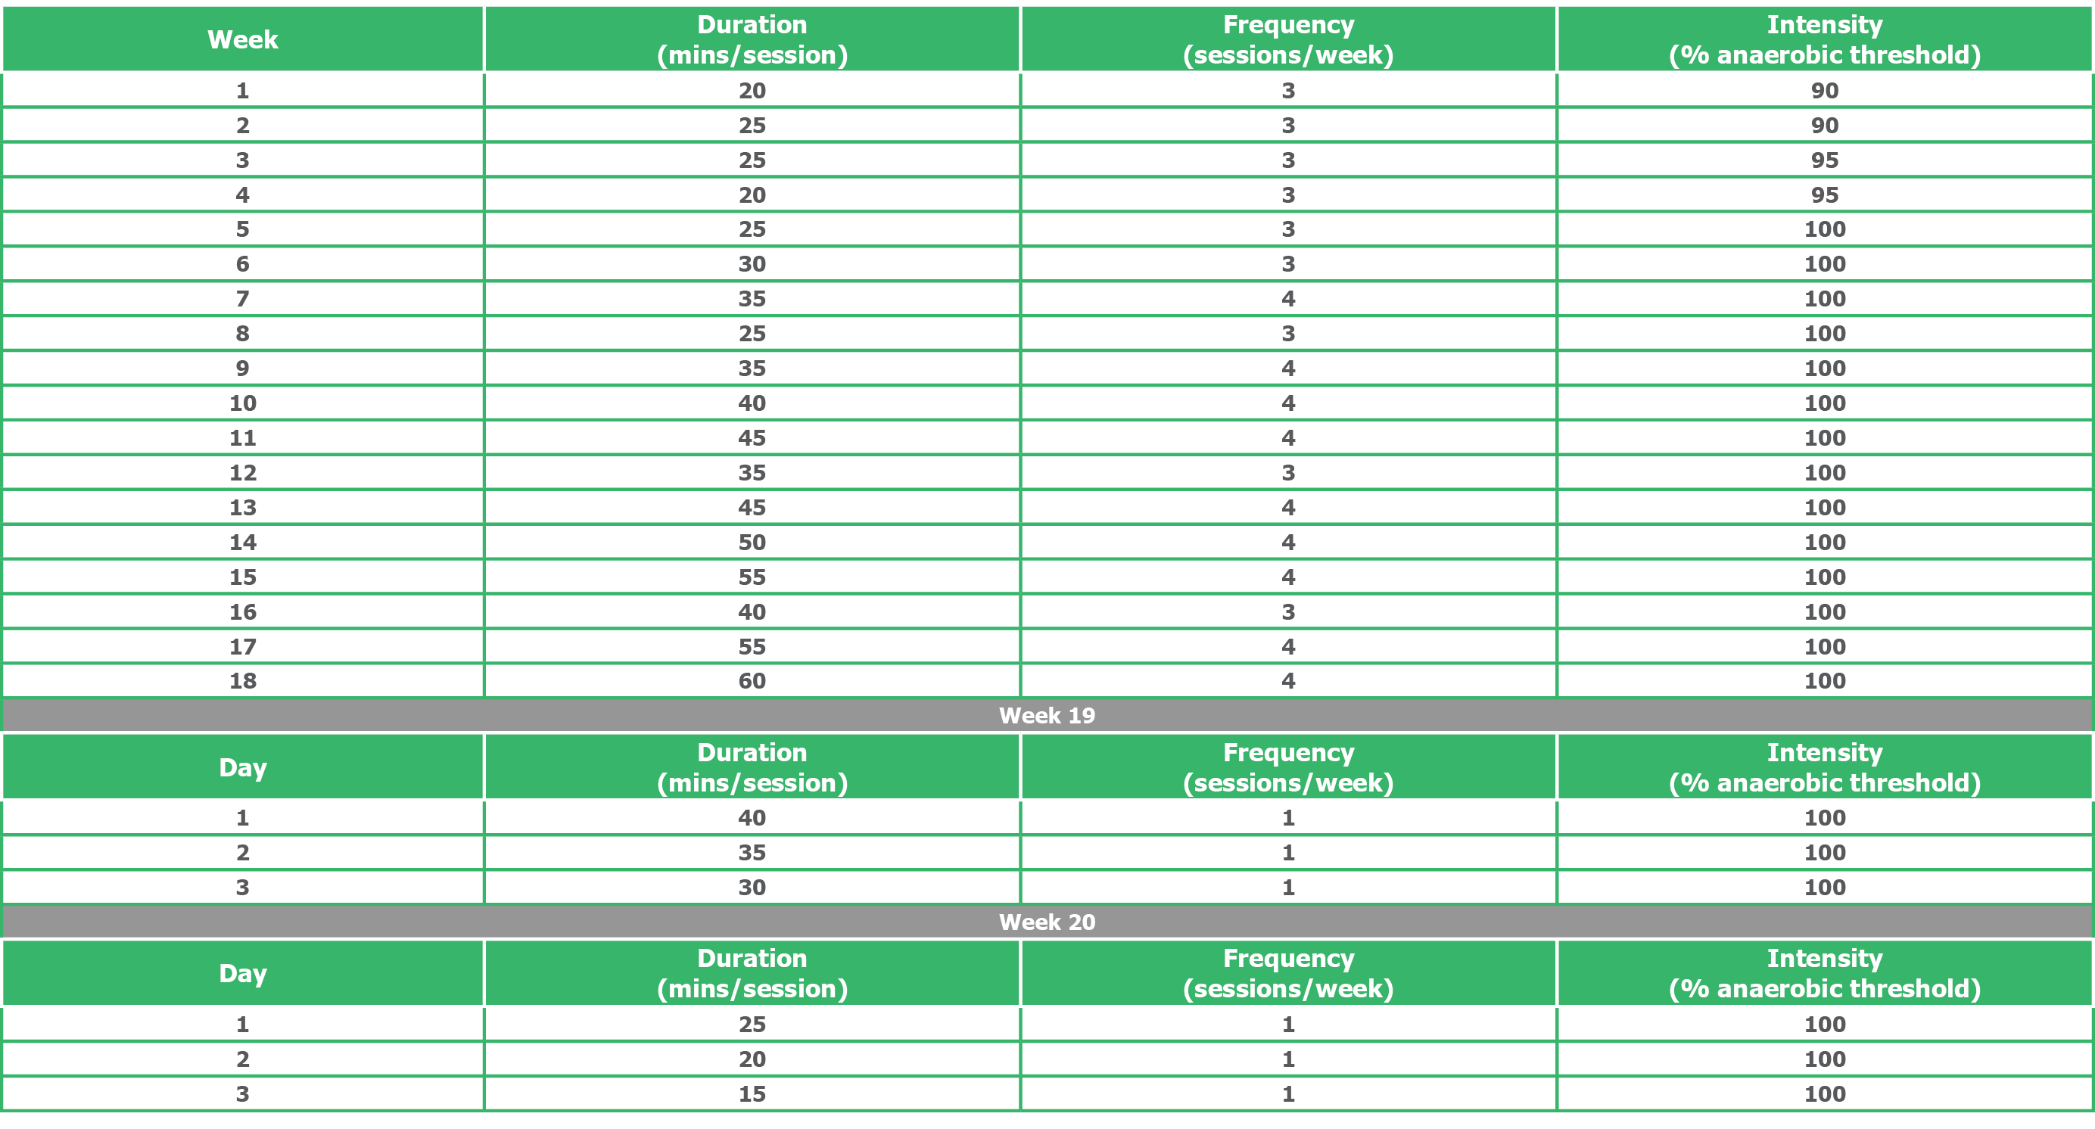
TRAINING PROGRAMMES: For MetSV and non-MetSV groups – using AT
The training programme for groups using AT to set training intensity

Slide 11
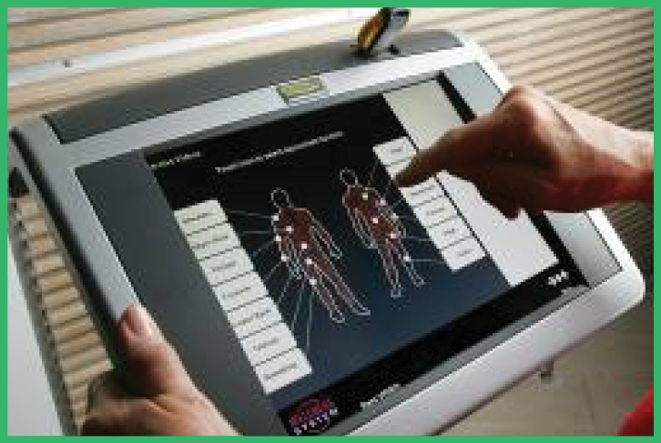
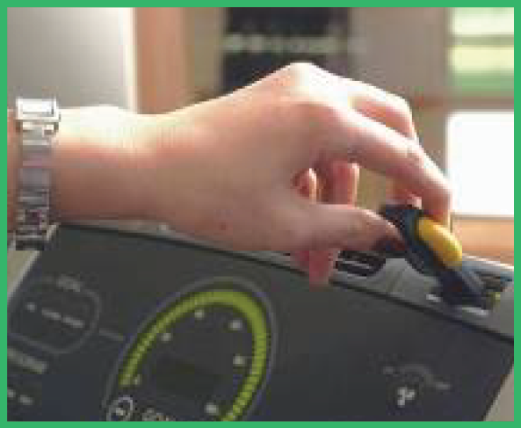
HOW TECHNOGYM WELLNESS SYSTEM WORKS…
Assessments and training prescription
Step 1: load key
Step 3: unload results
Step 2: insert key

Slide 12
MEDICATIONS AND NUTRITIONAL ANALYSIS
No participants used any confounding medications (eg. Statins; Glucophage).
All participants were given a standardised nutrition programme in an attempt to get a similar energy intake across the 3 groups.
The Willett food frequency questionnaire (Lee, 1996) in combination with a 24 hour eating record for 3 days were used to monitor the energy intake.
Nutritional records were analysed for caloric content using the site www.nal.usda.gov/fnic/foodcomp/search.

Slide 13
STATISTICAL ANALYSIS
Data distribution: Shapiro-Wilk’s W test: Variables significantly skewed were log transformed to normality.
Intra-group comparisons: Student’s t-test for paired values obtained at week 0 and week 12; and at week 0 and week 20.
Dunnett’s test was used for analysis of the multiple comparisons at weeks 4, 8, 12, 16 and 20 with week 0.
Inter-group comparisons: ANOVA. Confounding variables - ANCOVA analysis was performed adjusting for the confounding variable + post hoc analysis (Tukey HSD test).
A level of P< 0.05 was set as statistically significant.

Slide 14
STUDY PARTICIPANTS
Baseline physical and biochemical characteristics of study participants
Data reported as median (IQR) or mean ± SD
*p<0.05, **p<0.005 vs Non-MetSV; †p<0.05 vs MetSV; aMetSV and MetSL groups were combined and compared with Non-MetS V group

Slide 15
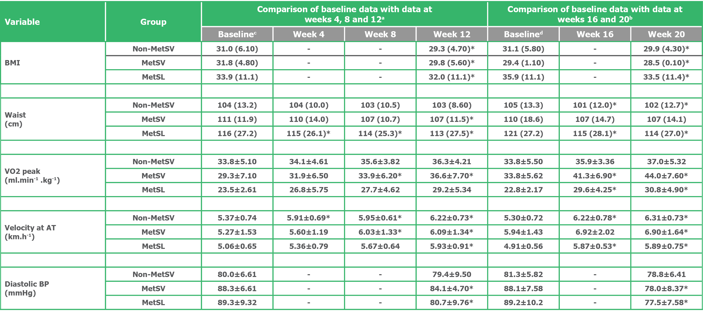
INTRA-GROUP RESULTS (SIGNIFICANT CHANGES ONLY)
Changes in physical, physiological and metabolic parameters at weeks 4, 8, 12, 16 and 20 for Non-MetSV, MetSV and MetSL groups

Slide 16
INTRA-GROUP RESULTS (SIGNIFICANT CHANGES ONLY)
Data given as mean ± SD or median (interquartile range); Non-MetSV=subjects without metabolic syndrome training at AT; MetSV= subjects with metabolic syndrome training at AT; MetSL= subjects with metabolic syndrome training with walking programme; ªn for Non-MetSV, MetSV and MetSL groups are 9, 9 and 7, respectively; ^{b}n for Non-MetSV, MetSV and MetSL groups are 8, 5 and 6, respectively; ^{c}these values used in Dunnett’s against weeks 4, 8 and 12; ^{d}these values used in Dunnett’s test against weeks 16 and 20; *p<0.05 vs baseline

Slide 17
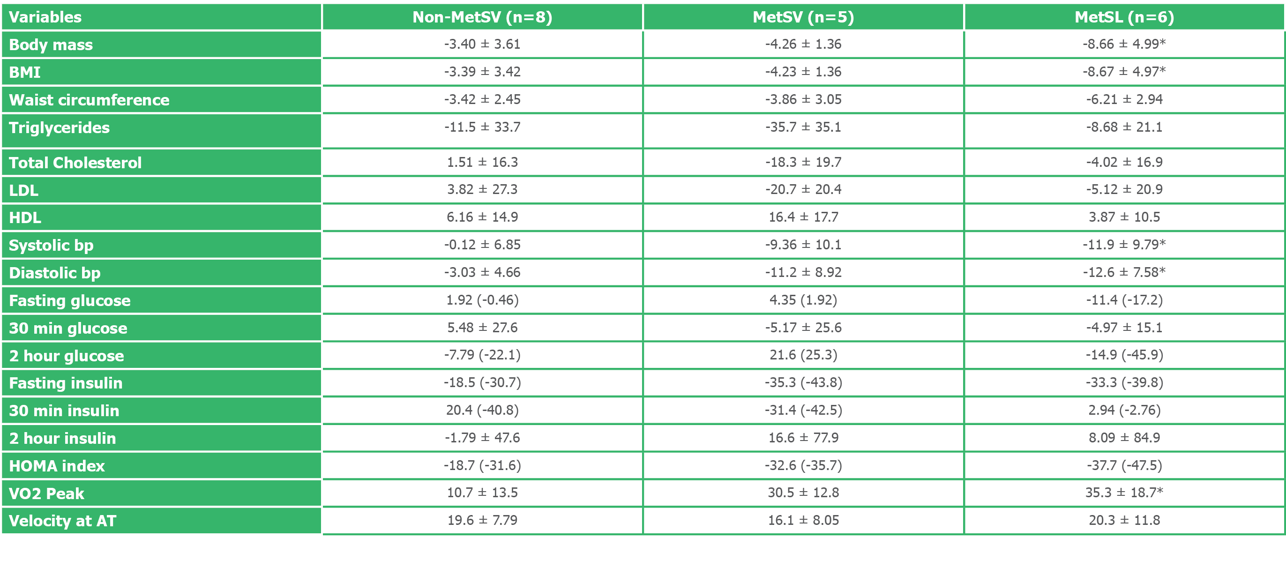
INTER-GROUP COMPARISONS:
Comparison of week 0 vs week 20, percent change data across the three subject groups.
Data reported as a mean ± SD or median (IQR); Non-MetSV=subjects without metabolic syndrome training at AT; MetSV= subjects with metabolic syndrome training at AT; MetSL= subjects with metabolic syndrome training with walking programme; *p<0.05 vs Non-MetSV

Slide 18
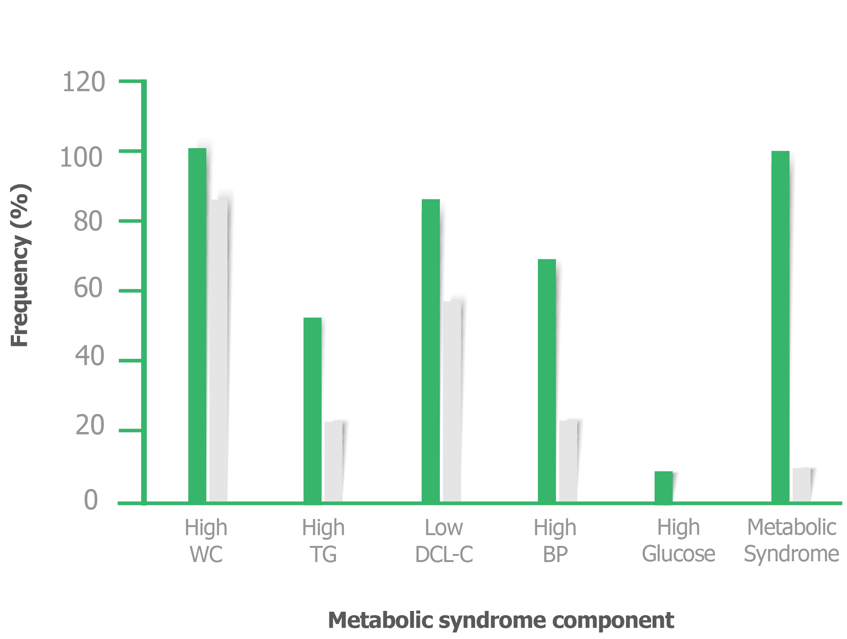
INCIDENCE OF MetS AND MetS COMPONENTS: MetSV GROUP

Slide 19
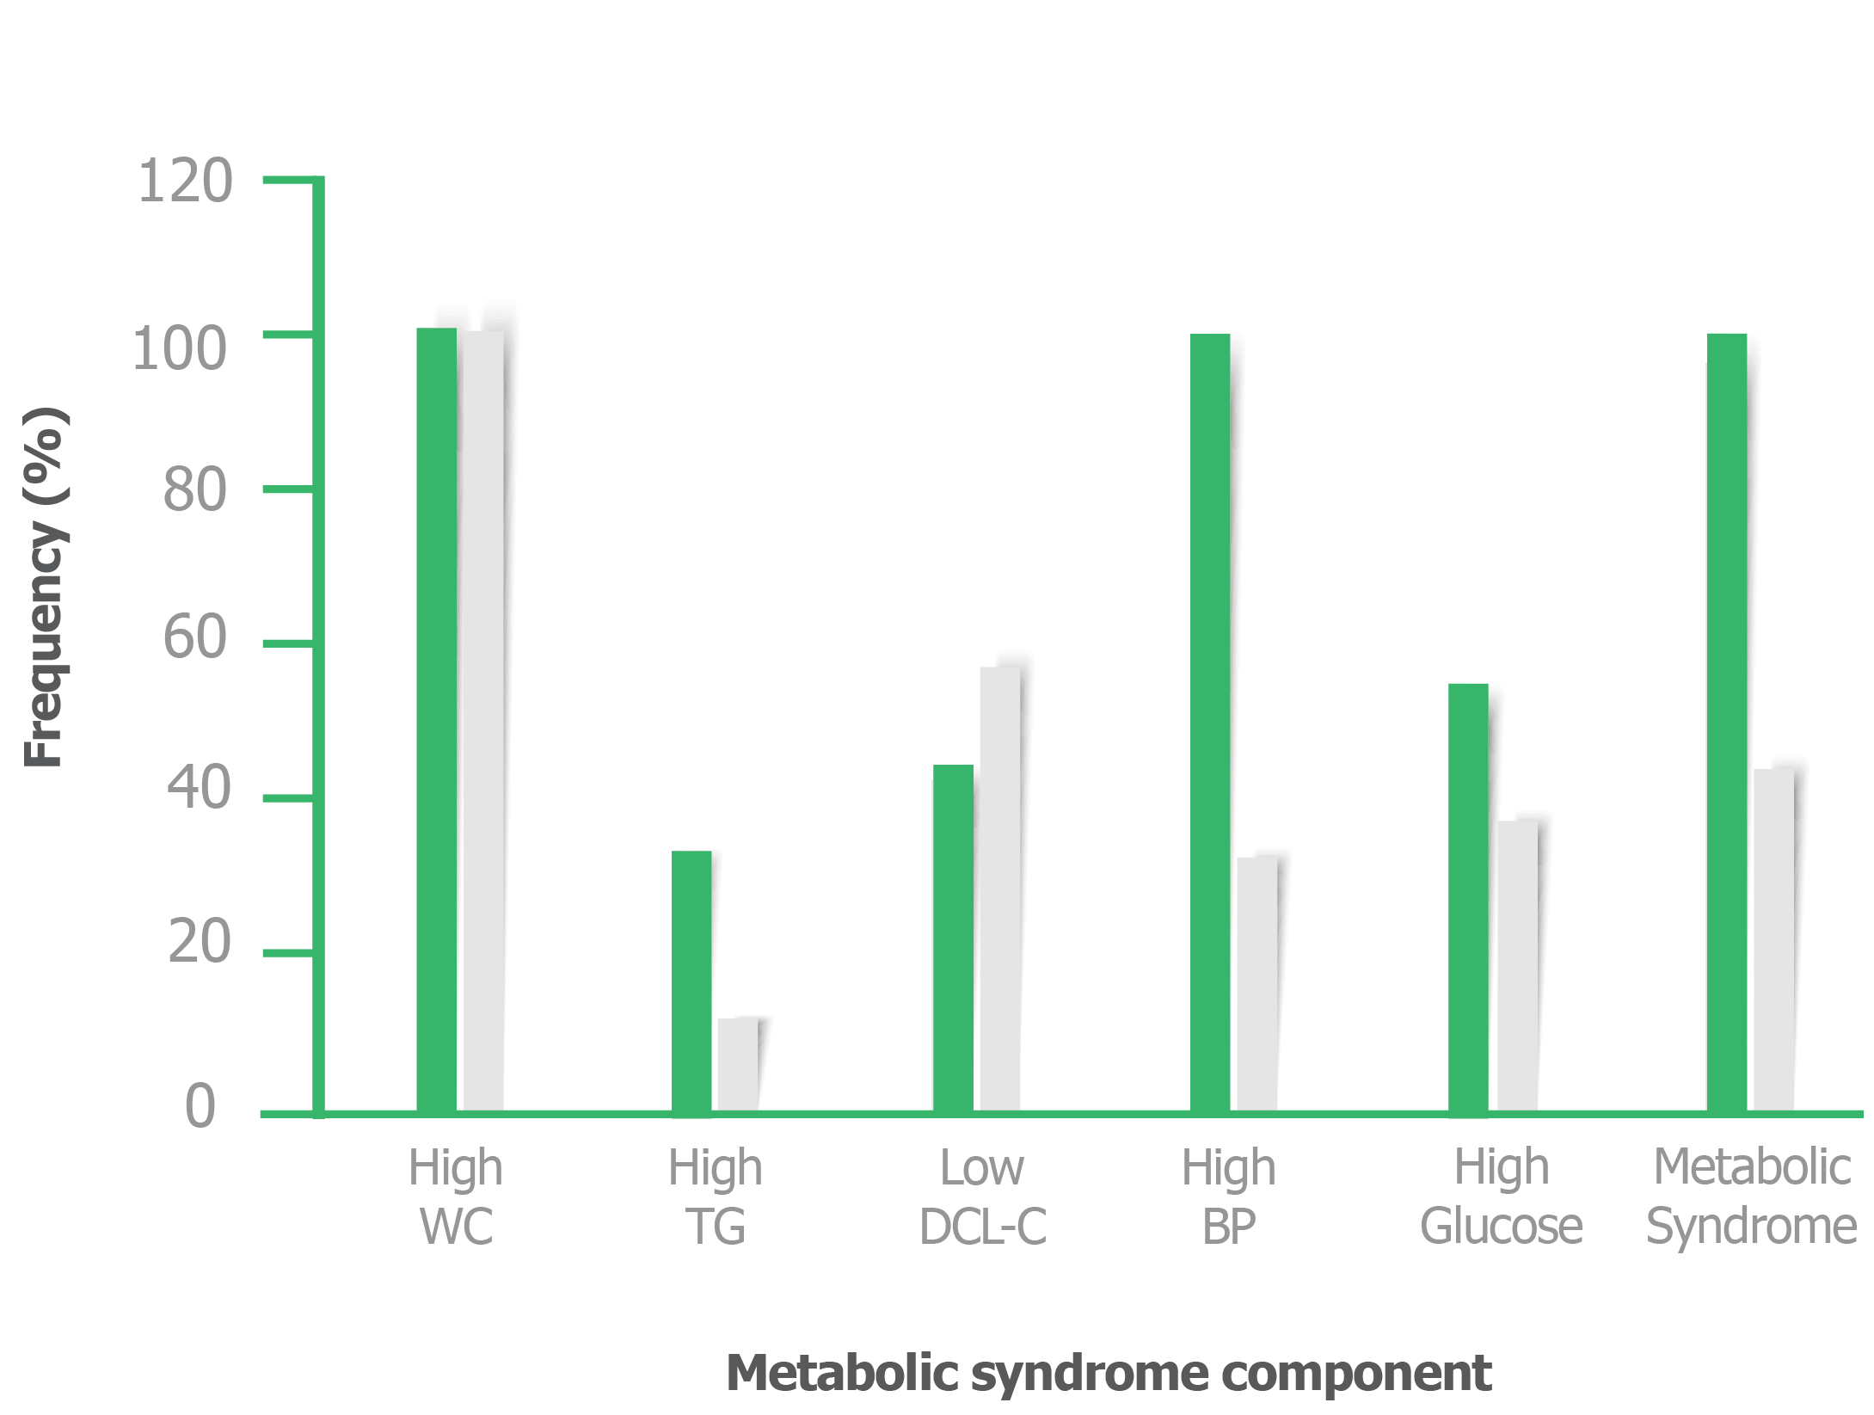
INCIDENCE OF MetS AND MetS COMPONENTS: MetSV GROUP

Slide 20
NUTRITIONAL INTAKE & EXERCISE EXPENDITURE ANALYSIS
No significant changes in total dietary caloric intake were noted within each group during the 20 weeks of the study.
Total dietary caloric intake did not differ across the three groups at baseline, week 8 or week 20.
The MetSL group expended 3994 ± 1089 kcal/wk
The MetSV and Non-MetSV groups expended 1238 ± 173 kcal/wk (p<0.005 vs MetSL) and 1110 ± 280 kcal/wk (p<0.005 vs MetSL) respectively.
The Non-MetSV and MetSV groups did not significantly differ in exercise energy expenditure.

Slide 21
DISCUSSION
Both training programmes used in this study showed favourable training responses in physical, physiological and bio-chemical parameters.
There was no significant difference in the % change of weight, BMI, waist circumference, blood pressure, peak oxygen consumption, velocity at AT across the two different training groups (MetSV and MetSL).
This indicates that the training programme utilising AT had a similar effect on these variables with persons with MetS as the training programme not using AT.

Slide 22
DISCUSSION
YET, the training programme using AT achieved these improvement at a third of the exercise energy expenditure of the training programme not using AT.
The study also found a dose-response with respect to weight loss.
At 19 kcal.kg⁻¹.wk⁻¹ and 36 kcal.kg⁻¹.wk⁻¹ energy expenditure for the MetSV and MetSL groups respectively, the weight loss was 4.3% and 8.7% respectively at week 20.

Slide 23
DISCUSSION
Biochemical/metabolic parameters
The training group with MetS that used AT was the only group to show significant, positive changes in metabolic parameters (fasting insulin and HOMA).
Thus, insulin sensitivity may have been positively influenced by the training programme using AT to set intensity.
More specific tests and a greater number of subjects would be needed to confirm this result.

Slide 24
INSULIN SENSITIVITY
Speculated: Exercise training at the AT may improve insulin sensitivity due to increases in Glut-4 transports related to an increase in the demand for glucose when training at the AT.
This speculation is based on the finding: Exercise increases the Glut-4 isoform of the glucose transporter which in turn results in a more rapid glucose uptake (Holloszy, 2008).
This speculation will need to be addressed with further research.

Slide 25
CONCLUSIONS
An endurance exercise programme using AT to set intensity is effective in eliciting favourable responses in individuals diagnosed with MetS.
The programme is as effective as the walking programme (not using AT), yet it is more time-efficient.
Similar results were achieved with both training programmes but the program using AT elicited the responses with a reduced exercise frequency and intensity.
Programme using AT improved insulin sensitivity which was not affected by the walking programme.

Slide 26
CONCLUSIONS
The training programme using AT indicated a reversal of disease and at a lower exercise energy expenditure than that of a training programme not using AT.
Exercise was an effective medicine in reversing MetS

Slide 27
LIMITATIONS
All subjects were white males, and thus it cannot be assumed that the results will be the same for other ethnic groups and/or females.
Small sample sizes - low numbers in each group.
Despite this limitation we were able to pick up significant trends in the data.
No non-exercising control group and a group without MetS that undertook the Leon et al, exercise programme - (These groups were originally included in the study, yet had to be removed due to financial constraints).
The nutritional intervention was not performed intensively.

Slide 28
ACKNOWLEDGEMENTS

