Slide 1
About OMICS Group
OMICS Group International is an amalgamation of Open Access publications and worldwide international science conferences and events. Established in the year 2007 with the sole aim of making the information on Sciences and technology ‘Open Access’, OMICS Group publishes 400 online open access scholarly journals in all aspects of Science, Engineering, Management and Technology journals. OMICS Group has been instrumental in taking the knowledge on Science & technology to the doorsteps of ordinary men and women. Research Scholars, Students, Libraries, Educational Institutions, Research centers and the industry are main stakeholders that benefitted greatly from this knowledge dissemination. OMICS Group also organizes 300 International conferences annually across the globe, where knowledge transfer takes place through debates, round table discussions, poster presentations, workshops, symposia and exhibitions.

Slide 2
About OMICS Group Conferences
OMICS Group International is a pioneer and leading science event organizer, which publishes around 400 open access journals and conducts over 300 Medical, Clinical, Engineering, Life Sciences, Phrama scientific conferences all over the globe annually with the support of more than 1000 scientific associations and 30,000 editorial board members and 3.5 million followers to its credit.
OMICS Group has organized 500 conferences, workshops and national symposiums across the major cities including San Francisco, Las Vegas, San Antonio, Omaha, Orlando, Raleigh, Santa Clara, Chicago, Philadelphia, Baltimore, United Kingdom, Valencia, Dubai, Beijing, Hyderabad, Bengaluru and Mumbai.

Slide 3
Novel Concepts for the Application of Rapid DNA Technology as a Sentinel Event Prophylactic in the Criminal Justice System
George W. Adams, M.A.
October 6, 2014 San Antonio, Texas
1/18
Notes:
Last year (2009), despite the global recession, the Digital Universe set a record. It grew by 62% to nearly 800,000 petabytes. A petabyte is a million gigabytes. 1 gigabit equals about 20,000 pages. This year, the Digital Universe is expected to grow almost as fast to 1.2 million petabytes, or 1.2 zettabytes. This explosive growth means that by 2010, our Digital Universe will be 44 times as big as it was in 2009. Our stack of DVDs would now reach halfway to Mars.

Slide 4
In Pursuit of Truth and Justice
Truth, like gold, is to be obtained not by its
growth, but by washing away from it
all that is not gold.
Lev Nikolayevich Tolstoy(1828-1910)
2/18

Slide 5
Is a Prophylactic Needed?
20-25% of Innocence Project cases successfully litigated included false confessions
(Jenson, J.K. (2014) The Dilemma and Debate over Confession Evidence Strategies. J forensic Res Crim Stud 1:1-10)
“Beatrice Six” defendants who confessed to murder in 1989 were exonerated when DNA evidence identified another suspect not associated with defendants – a 42 USC Sec. 1983 claim filed against investigating parties
(No. 11-2882 US Court of Appeals 8th Circuit)
National Registry of Exonerations shows 1,409 exonerations as of August 12, 2014
(https://www.law.umich.edu/special/exoneration/Pages/browse.aspx )
3/18

Slide 6
Objectives
Describe sentinel events as related to the criminal justice system and understand the prophylactic utility of rapid DNA technology (RDT)
An understanding of RDT deployment
Understand “probable cause” and “evidentiary” applications
Understand the RDT / CODIS inter-face of the Arizona Department of Public Safety (AZDPS) Type Model with auxiliary local DNA database.
Understand liability exposure in the investigative process
4/18

Slide 7
What are Sentinel Events?
Joint Commission on Accreditation of Hospital Organizations (JACHO): A sentinel event is an unexpected occurrence involving death or serious physical or psychological injury, or the risk thereof.
(http://www.jointcommission.org/sentinel_event.aspx)
National Institute of Justice (NIJ): A sentinel event is a significant negative outcome that: signals underlying weaknesses in the system or process; is likely the result of compound errors; may provide, if properly analyzed and addressed, important keys to strengthening the system and preventing future adverse events or outcomes.
(http://nij.gov/topics/justice-system/Pages/sentinel-events.aspx)
5/18

Slide 8
CJS Examples of Sentinel Events
Wrongful conviction or near-miss* for when accused of a criminal act
Labeling of an individual when questioned by investigators relative a criminal case
Inaccurate eye-witnesses testimony
False statements from informants, victims or witnesses
Over-reaching forensic subject matter expert testimony
Exoneration outcomes: liability risk for criminal justice personnel and agencies
* Tried – found not guilty
6/18

Slide 9
Rapid DNA Technology (RDT)
You might think of RDT as a lab in a box
Currently, there are two types of RDT equipment available to U.S. law enforcement and laboratories:
1) General Electric - DNAscan
2) IntegenX – RapidHit 200
Provides agencies the ability to produce results in under ninety-minutes or collection to result in < 2 hours
RDT may deployed in nearly in a number of situations
Potential to provide near real time access to DNA typing expertise via automation
7/18

Slide 10
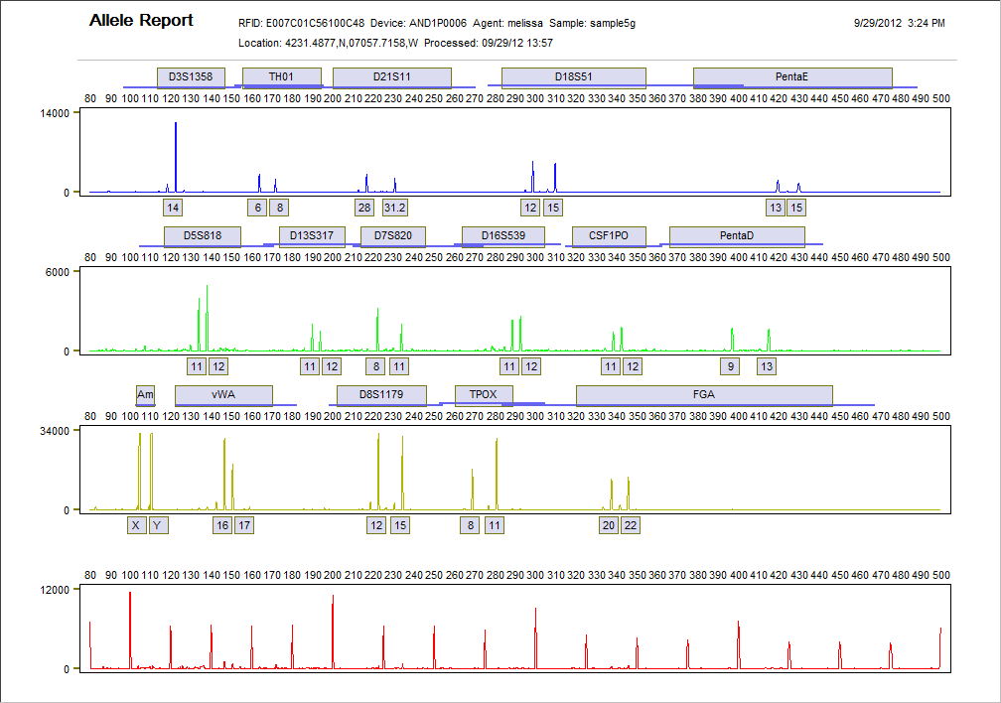
DNA Profile: GWA < 85 Minutes
Equipment Used -
DNAscan, Courtesy
GE Healthcare
8/18

Slide 11
AZDPS Deployment Type Model
Offender
POND
LDIS/SDIS
LAW ENFORCEMENT
Forensic
Pond
LEA/LAB
POND
LAB
CODIS
Law
Enforcement
RDT
Suspect
Pond
9/18

Slide 12
Probable Cause & RDT
Probable Cause: evidence that gives someone a reason to think a crime has been committed or is in process.
If an individual is implicated in a criminal act, an officer has reasonable suspicion to investigate. Rapid DNA technology may be a viable strategy to establish probable cause under such circumstances when a unknown crime scene DNA evidence is available or the investigator has reasonable suspicion that a criminal relationship may exist between parties.
10/18

Slide 13
DNA Sample Collection
Most situations will require voluntary consent. Therefore, law enforcement personnel will have to exercise restraint and not collect by coercion.
Materials that are discarded may be used – no expectation of privacy
(State v. Christian, Court of Appeals of Iowa, No. 04-0900 8/23/06 @ http://www.denverda.org/dna/Surreptitious_Collection_and_Abandoned_DNA_Cases.htm )
11/18

Slide 14
Excluded / Not Excluded
If the results of the RDT analysis exclude the individual, probable cause may not exist to continue the investigation saving the agency valuable investigative resources and the individual the stress of being labeled as a person of interest in a criminal investigation.
If the results do not exclude, a warrant may be in order to secure an evidentiary DNA sample to be processed according to agency policy and protocols.
12/18

Slide 15
Wilson v. Lawrence County (2001)
There is no countervailing equally important governmental interest that would excuse the appellants from fulfilling their responsibility to investigate these leads when faced with an involuntary confession and no reliable corroborating evidence. Therefore, the proper standard to judge whether the officers' conduct violates due process is recklessness.
(United States Court of Appeals, Eighth Circuit No. 00-2828 - 260 F.3d 946 )
13/18

Slide 16
Notable Settlements in the Press
Exonerated Ohio man wins civil rights suit, $13.2M - spent 13 years in prison for a murder that DNA testing later proved he did not commit
(http://www.wkyt.com/home/headlines/Exonerated-Ohio-man-wins-civil-rights-suit-132M-196694571.html?site=mobile )
5 Exonerated in Central Park Jogger Case Agree to Settle Suit for $40 Million : DNA and other evidence implicated another man a convicted rapist and murderer who confessed to acting alone.
(http://www.nytimes.com/2014/06/20/nyregion/5-exonerated-in-central-park-jogger-case-are-to-settle-suit-for-40-million.html?_r=0 )
14/18

Slide 17
Thoughts to Consider
“Any problem is best solved by preventing it from occurring”
(Thayer, L. 2010. Leaders and Leadership: Searching for Wisdom in All the Right Places. E-book p.38 of 870 )
“We cannot solve our problems with the same thinking we used when we created them” – Albert Einstein
http://www.brainyquote.com/quotes/quotes/a/alberteins121993.html#jD6YMvjDB0lxDeFt.99
15/18

Slide 18
RDT as a Prophylactic for Sentinel Events
False confessions are exposed
Labeling exposure for the innocent is reduced or eliminated
Eyewitness testimony may be corroborated
Testimony of witnesses and informants may be corroborated or dismissed
Investigative resources may be more focused and efficient
Liability exposure for investigators, prosecutors and jurisdictions may be greatly reduced.
16/18

Slide 19
Questions
George W. Adams, M.A.
NamUs Director (Financial Operations)
University of North Texas Health Science Center
3500 Camp Bowie Blvd. – CBH 650
Fort Worth, Texas 76107
g.w.adams@unthsc.edu
817-735-5451
Presenter is solely responsible for presentation content.
17/18

Slide 20
18/18

Slide 21
Let Us Meet Again
We welcome you all to our future conferences of OMICS Group International
Please Visit: www.omicsgroup.com
www.conferenceseries.com

