Slide 1
Marine Biotechnology
George Schroeder MD., M.S., FACEP, FAAUCM
Clinical Assistant Professor of Emergency Medicine
University of Central Florida
College of Medicine
Orlando, Florida, USA
American Academy of Urgent Care Medicine
Chairman-International Urgent Care Medicine Committee
Executive Council & Senior Medical Editor –
Journal of the American Academy of Urgent Care Medicine

Slide 2
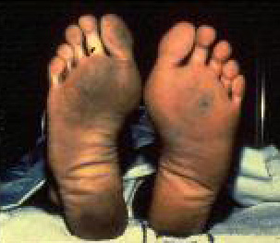
Emergency Medical Management of Scorpionfish, Stonefish and Lionfish Envenomation

Slide 3
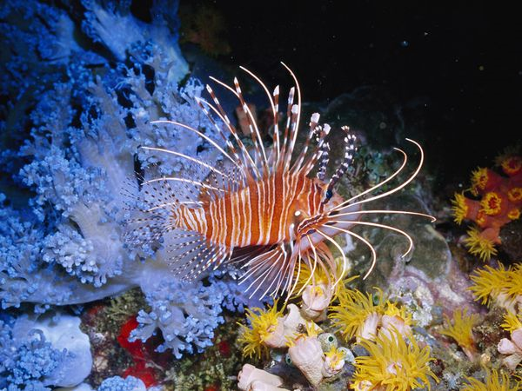
LIONFISH - (Pterosis Species)

Slide 4
Red Lionfish

Slide 5
Lionfish Distribution

Slide 6
Lionfish & Stonefish

Slide 7
Stonefish (Synanceia verrucosa)

Slide 8
Stonefish
Family: Synanceiidae
Genus: Synanceia
Species: Synanceia alula, Synanceia horrid, Synanceia nana, Synanceia platyrhyncha, and Synanceia verrucosa
Length: Up to 50 cm
Weight: nearly 5 pounds or 2400 grams
Diet: Carnivorous, primarily small fishes and shrimps
Life Span: 5 to 10 years
Nature: Venomous, dangerous and even fatal to humans
Habitat: Coral reef, near and about rocks, mud or sand in tidal inlets
Range: Coastal regions of Indo-Pacific oceans and northern Australian waters

Slide 9
Stonefish Marine Toxins
The venom of a stonefish is made of a mixture of proteins, like the haemolytic stonustoxin, the proteinaceous verrucotoxin and the cardioactive cardioleputin.
Its glands have neurotoxins at the base of its needle-like dorsal fin spines, 13 of them. The stonefish emits toxins when it feels threatened or is disturbed.
Depending on the depth of the penetration of its poisonous spines, the poison takes less than 1- 2 hours to kill a human being after driving him into severe pain, tissue death and paralysis.

Slide 10
Four Marine Toxins
1. Primary Toxin = antigenic heat-labile protein
2. Acetylcholine = a neurotransmitter
3. Neuromuscular Toxins
4. Low Molecular weight non-proteinaceous icthyotoxin

Slide 11
Scorpionfish (Scorpaena Species)

Slide 12
Scorpion Fish rank 2nd only to Stingrays in total number of estimated envenomations.
50,000 cases annually
Climate change
Change in environmental
Oceanic conditions
Distribution of these
venomous species of fish

Slide 13
California Scorpionfish Also known as Sculpin, Scorpaena guttata Rock fish shape – red in deeper water, brown in shallow water 12 – 17 inches long, depth range 30m – 183m Habitat = shallow rocky areas, often in caves & crevices Heat labile toxin delivered through dorsal spines

Slide 14
Brazilian Scorpionfish
Scorpaena plumieri, Scorpaena brasiliensis
Venom is lethal (LD50) in mouse 0.28 mg/kg, i.v.
Displays 3 activities –
1. Hemorrhagic
2. Hemolytic
3. Proteolytic
Endothelial Barrier Dysfunction, microvascular hypermeability & CV effects = change in BP + HR

Slide 15
Scorpionfish Venom
Potent hemolytic toxin (Sp-CTx-121 kDa)
Scorpaena plumieri venom
Isolated from an Atlantic Scorpionfish
Mass Spectrometry: AA sequences in Sp-CTx shared by other piscine hemolytic toxins
Hemolytic activity of Sp-CTx on rabbit RBC’s attenuated by osmotic protectants (PEG Polymers), and molecules larger than 6 nm in diameter inhibited cell lysis = Sp-CTx maybe pore-forming protein

Slide 16
Scorpionfish near coral formation

Slide 17
Clinical Manifestations
Intense pain at site of contact
Edema, Erythema, occasional skin Necrosis
Adenopathy
Nausea, vomiting, diarrhea
Neuromuscular effects
Agitation, malaise, sweating
Cardiovascular – tachycardia & arrhythmias

Slide 18
Inflammatory & Vasoactive Effects of Marine Toxins & Venoms

Slide 19
Symptoms & Signs- Local
Intense pain -site of puncture on patient’s extremity.
Erythema and edema also due to initial histamine-like allergic reaction to proteinaceous ichthyotoxin from Lionfish, Scorpionfish, Devil Firefish & Stonefish
Surrounding rings of bluish cyanotic tissue due to potent, potentially fatal Stonefish envenomation
Vesicle formation, especially in softer connective tissue and skin of hands, along with warmth which may spread to entire affected limb
Thereafter – rapid tissue Sloughing, - Cellulitis
Surrounding hypesthesia

Slide 20
Systemic Effects
Nausea
Muscle weakness
Dyspnea
Hypotension

Slide 21
Stonefish Envenomation
Bradycardia
Syncope
Cardiogenic Shock
Congestive heart failure
Pulmonary Edema

Slide 22
Differential Diagnosis
Decompression Sickness
Anaphylaxis
Serum Sickness
Echinoderm envenomations
Stingray envenomations
Urticarial eruptions
Dysbarism
Sea snake envenomations
Spider bite

Slide 23
Imaging
Soft tissue Radiographs with double marker
Ultrasound
CT Scanning & MRI imaging

Slide 24
Emergency Management & Therapeutic Modalities
1. Pre-hospital Emergency Management-
Proper diagnosis
Gentle removal of visible spines with gloved hands
Direct pressure to control bleeding
Adequate Analgesia
Anti-emetic if necessary – for nausea
Also – prompt recognition of serious potentially life-threatening systemic symptoms and signs, followed by immediate CPR
Treatment of Anaphylaxis

Slide 25
Referral
2. Appropriate Triage-
Level 3 & 4 UCM Clinics ought to transfer to higher level of care, after initial stabilization and Tetanus Prophylaxis
Level 1 & 2 UCM Clinics may initiate primary care including – parenteral analgesia, antiemetic, I.V. fluids if necessary, antibiotics – only if indicated , wound debridement, Antihistamines, Corticosteroids

Slide 26
Immediate Treatment
3. Hot Water Immersion Technique:
Continuous immersion in non-scalding hot water of affected region of body (up to max 114 degree F, or 45 degree C) and up to 20 minutes, should inactivate heat-labile venom in Lionfish, Scorpionfish and devil fish. Pain relief in 97% of patients

Slide 27
4.Local, Regional Analgesic & Sedation
Tordol
Opiate analgesics – parenteral only in the absence of hypotension
Bupivacaine – as local and / or regional block anesthesia for long-acting analgesia. Increases electrical excitation threshold slowing nerve impulse propagation, reduces action potential and prevents generation and conduction of nerve impulses.
Lorazepam or Midazolam – for procedural sedation as needed.
Intravenous fluids for hypotension.

Slide 28
Stonefish Antivenom
IM / IV administration of hyperimmunized equine (Australian CSL) Antiserum
With: pre-treatment subcutaneous epinephrine parenteral antihistamine, corticosteroid
for Intravenous Use: careful dilution – slow administration of:
- 1 ampoule (2000 U) for every 1-2 punctures
- 3 ampoules for more than 4 punctures
Dilution: 50-100 mls – isotonic NaCl – slowly over 20 minutes on calibrated infusion pump.
Wound debridement, irrigation and anti-sepsis
Possible admission to hospital, possibly ICU

Slide 29
“If we can’t BEAT them, let’s EAT them”
NOAA: 2007 promoted a Lionfish cookbook
FDA: Discouraged this campaign –
However, from tests conducted on more than 200 Lionfish, more than 25% exceed federal levels of ciguatera fish toxin; or more than 0.1 parts per billion. Nevertheless, other reports have dismissed these findings as “negligible and not clinically significant”.

Slide 30
Conclusion
Moreover, rapidly evolving climate change and disruption of the delicate ocean Biome and fragile ecosystems necessitate growing awareness of this escalating biomedical challenge, with dire environmental consequences.
http://nas.er.usgs.gov/sitingreport.aspx
Tracking and Cataloging Non-native Invasive Marine Species.
Proactive conservation measures to protect delicate marine ecosystems.

Slide 31
Sea Orbiter

