Slide 1
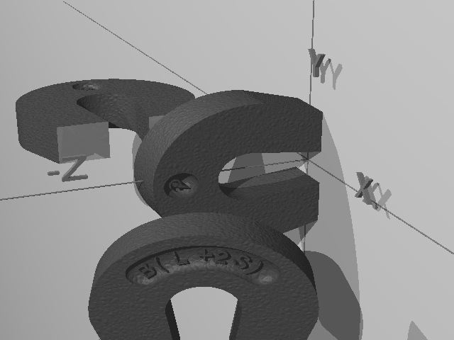
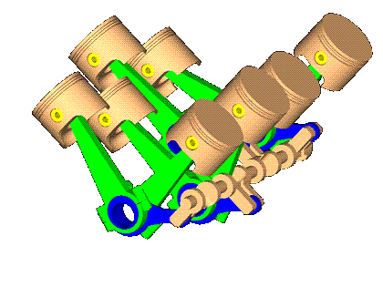


Thermodynamic Aspects of Magnetic Molecules
G. Lefkidis
Department of Physics and Research Center OPTIMAS, Kaiserslautern University of Technology,
Box 3049, 67653 Kaiserslautern, Germany
San Francisco, Dec 1, 2014

Slide 2
Outlook
Introduction
  Hamiltonian
  Basics of quantum thermodynamics
Understanding QTD
  Z system
  Doublet harmonic oscillator
Results
  Otto cycle and magnetism
  Diesel cycle and magnetism
Summary

Slide 3
Outlook
Introduction
  Hamiltonian
  Basics of quantum thermodynamics
Understanding QTD
  Z system
  Doublet harmonic oscillator
Results
  Otto cycle and magnetism
  Diesel cycle and magnetism
Summary

Slide 4
Degrees of Freedom in the Hamiltonian
electronic
correlations
SOC
static B-field
phonons
laser
temperature

Slide 5
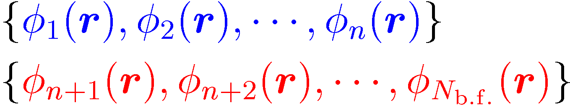
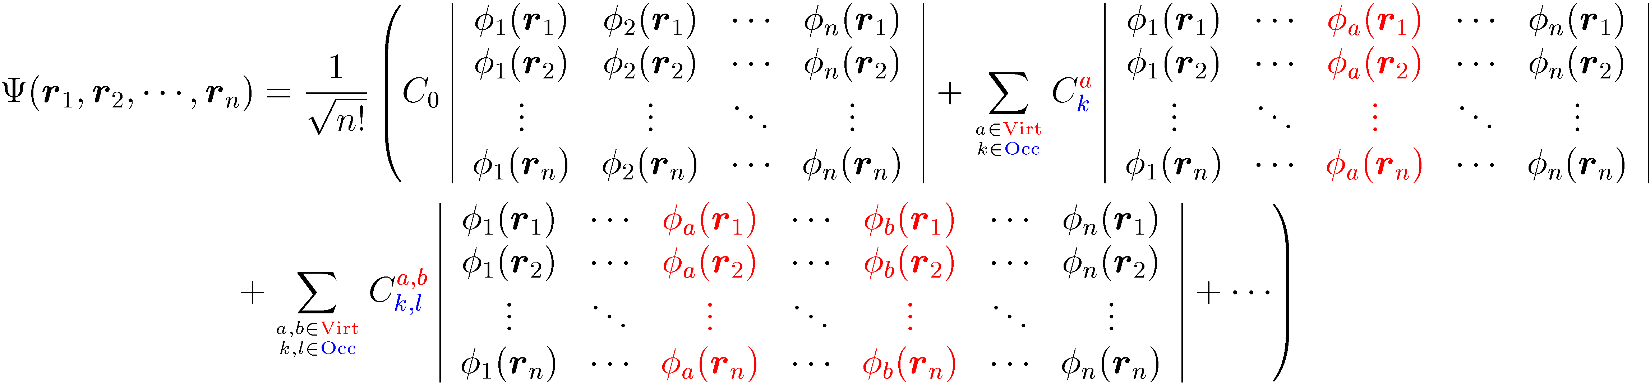
Electronic Correlations in the Hamiltonian
occupied
virtual
Configuration interaction or coupled cluster expansion
Slater-rules → $ρ_{i,j}→〈\hat{O}〉$ & Mulliken analysis (localization)

Slide 6
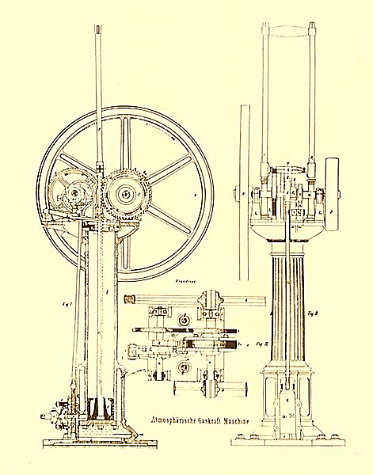
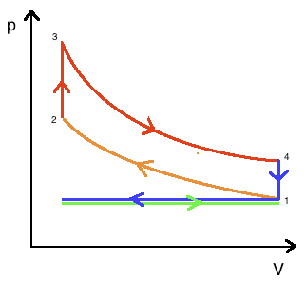
Otto Cycle
Eugenio Barsanti and Felice Matteucci
patented around 1854-1857
Alphonse Beau de Rochas
patented 1861
Nicolaus Otto
built 1863
1→2 isentropic compression
2→3 isochoric heating
3→4 isentropic expansion
4→1 isochoric cooling (exhaust +intake)

Slide 7
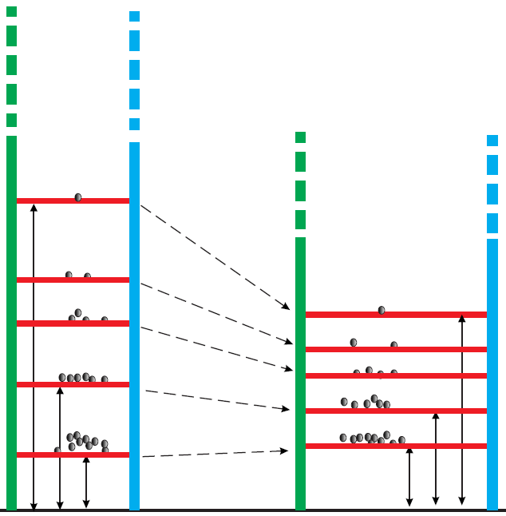
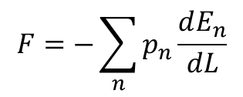

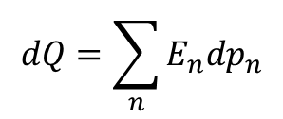
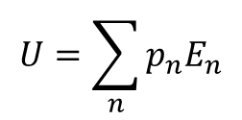
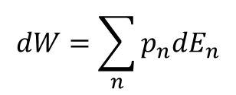

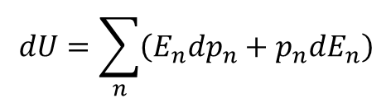

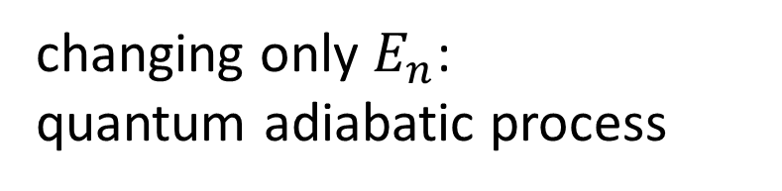

Basics of Quantum Thermodynamics
$$U=\sum_{n}{p_{n}E_{n}}$$
quantum first law of thermodynamics
$$dU=\sum_{n}{\left(E_{n}dp_{n}+p_{n}dE_{n}\right)}$$
quantum levels:
internal energy
$$\left\{E_{n}\right\}$$
$$→\left\{E_{n}^{′}\right\}$$
occupations:
$$\left\{p_{n}\right\}$$
$$dW=\sum_{n}{p_{n}dE_{n}}$$
work
heat
$$dQ=\sum_{n}{E_{n}dp_{n}}$$
volume
$L$ (1D system)
$$F=−\sum_{n}{p_{n}\frac{dE_{n}}{dL}}$$
pressure
changing only $E_{n}$:
quantum adiabatic process
H. T. Quan, Y.-X. Liu, C. P. Sun, and F. Nori, Phys. Rev. B 76, 031105 (2007)

Slide 8

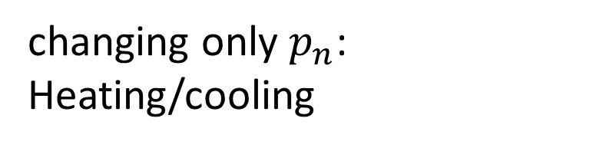
Basics of Quantum Thermodynamics
$$U=\sum_{n}{p_{n}E_{n}}$$
quantum first law of thermodynamics
$$dU=\sum_{n}{\left(E_{n}dp_{n}+p_{n}dE_{n}\right)}$$
quantum levels:
internal energy
$$\left\{E_{n}\right\}$$
occupations:
$$\left\{p_{n}\right\}$$
$$→\left\{p_{n}^{′}\right\}$$
$$dW=\sum_{n}{p_{n}dE_{n}}$$
work
heat
$$dQ=\sum_{n}{E_{n}dp_{n}}$$
volume
$L$ (1D system)
$$F=−\sum_{n}{p_{n}\frac{dE_{n}}{dL}}$$
pressure
changing only $p_{n}$:
Heating/cooling
H. T. Quan, Y.-X. Liu, C. P. Sun, and F. Nori, Phys. Rev. B 76, 031105 (2007)

Slide 9
Outlook
Introduction
  Hamiltonian
  Basics of quantum thermodynamics
Understanding QTD
  Z system
  Doublet harmonic oscillator
Results
  Otto cycle and magnetism
  Diesel cycle and magnetism
Summary

Slide 10

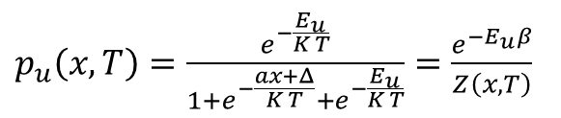







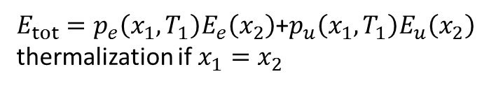

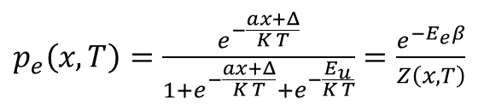
Z System
$p_{u}\left(x,T\right)=\frac{e^{−\frac{E_{u}}{K T}}}{1+e^{−\frac{ax+Δ}{K T}}+e^{−\frac{E_{u}}{K T}}}=\frac{e^{−E_{u}β}}{Z\left(x,T\right)}$
$$|u〉$$
$$E_{u}$$
$$E$$
$$|e〉$$
$$E_{e}=ax+Δ$$
$p_{e}\left(x,T\right)=\frac{e^{−\frac{ax+Δ}{K T}}}{1+e^{−\frac{ax+Δ}{K T}}+e^{−\frac{E_{u}}{K T}}}$ $=\frac{e^{−E_{e}β}}{Z\left(x,T\right)}$
$$|g〉$$
$$E_{g}=0$$
$$x$$
$p_{g}\left(x,T\right)=\frac{1}{1+e^{−\frac{ax+Δ}{K T}}+e^{−\frac{E_{u}}{K T}}}$ $=\frac{1}{Z\left(x,T\right)}$
$E_{tot}=p_{e}\left(x_{1},T_{1}\right)E_{e}\left(x_{2}\right)$+$p_{u}\left(x_{1},T_{1}\right)E_{u}\left(x_{2}\right)$
thermalization if $x_{1}=x_{2}$

Slide 11
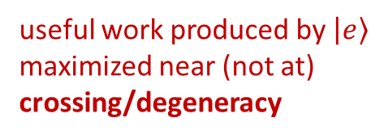
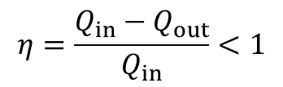
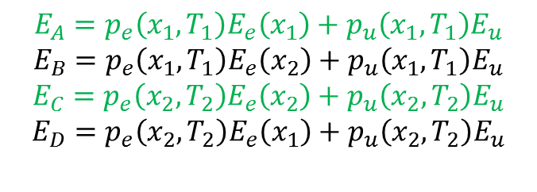
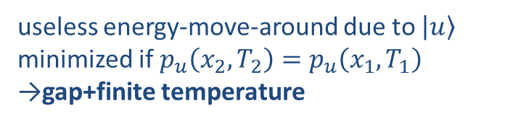
Z System
D
C
$$E_{u}$$
$$|u〉$$
$$E$$
$$|e〉$$
$$E_{e}=ax+Δ$$
$$η=\frac{Q_{in}−Q_{out}}{Q_{in}}<1$$
$$|g〉$$
$$E_{g}=0$$
A
B
$$x$$
$$E_{A}=p_{e}\left(x_{1},T_{1}\right)E_{e}\left(x_{1}\right)+p_{u}\left(x_{1},T_{1}\right)E_{u}$$
$$E_{B}=p_{e}\left(x_{1},T_{1}\right)E_{e}\left(x_{2}\right)+p_{u}\left(x_{1},T_{1}\right)E_{u}$$
$$E_{C}=p_{e}\left(x_{2},T_{2}\right)E_{e}\left(x_{2}\right)+p_{u}\left(x_{2},T_{2}\right)E_{u}$$
$$E_{D}=p_{e}\left(x_{2},T_{2}\right)E_{e}\left(x_{1}\right)+p_{u}\left(x_{2},T_{2}\right)E_{u}$$
$$Q_{in}=\left[p_{e}\left(x_{2},T_{2}\right)−p_{e}\left(x_{1},T_{1}\right)\right]E_{e}\left(x_{2}\right)+\left[p_{u}\left(x_{2},T_{2}\right)−p_{u}\left(x_{1},T_{1}\right)\right]E_{u}$$
$$Q_{out}=\left[p_{e}\left(x_{2},T_{2}\right)−p_{e}\left(x_{1},T_{1}\right)\right]E_{e}\left(x_{1}\right)+\left[p_{u}\left(x_{2},T_{2}\right)−p_{u}\left(x_{1},T_{1}\right)\right]E_{u}$$
useful work produced by $|e〉$
maximized near (not at)
crossing/degeneracy
useless energy-move-around due to $|u〉$
minimized if$p_{u}\left(x_{2},T_{2}\right)=p_{u}\left(x_{1},T_{1}\right)$
→gap+finite temperature

Slide 12
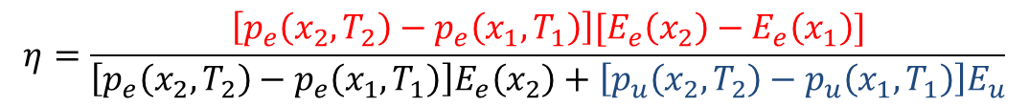


Z System
D
C
$$E_{u}$$
$$|u〉$$
$$E$$
$$|e〉$$
$$E_{e}=ax+Δ$$
$$η=\frac{Q_{in}−Q_{out}}{Q_{in}}<1$$
$$|g〉$$
$$E_{g}=0$$
A
B
$$x$$
$$η=\frac{\left[p_{e}\left(x_{2},T_{2}\right)−p_{e}\left(x_{1},T_{1}\right)\right][E_{e}\left(x_{2}\right)−E_{e}\left(x_{1}\right)]}{\left[p_{e}\left(x_{2},T_{2}\right)−p_{e}\left(x_{1},T_{1}\right)\right]E_{e}\left(x_{2}\right)+\left[p_{u}\left(x_{2},T_{2}\right)−p_{u}\left(x_{1},T_{1}\right)\right]E_{u}}$$
$$T_{1}→0$$
$$T_{1}→0$$
For $T_{1}→0$ and very small $ΔT$ we get $η→1$ but very little
energy conversion per cycle. At room temperature we get $η→0.3$

Slide 13
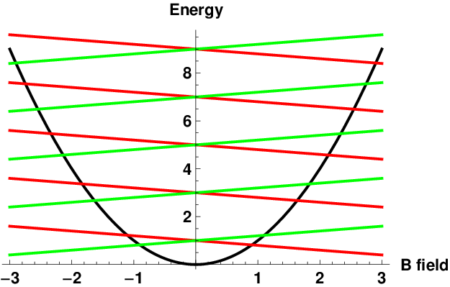
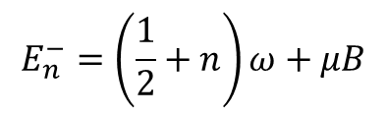
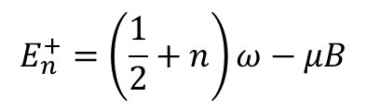
Doublet Harmonic Oscillator
$$E_{n}^{−}=\left(\frac{1}{2}+n\right)ω+μB$$
Spin up
$$E_{n}^{+}=\left(\frac{1}{2}+n\right)ω−μB$$
Spin down
$$Z=\sum_{n=1}^{∞}{\text{exp}\left(−\frac{E_{n}^{+}}{KT}\right)}+\sum_{n=1}^{∞}{\text{exp}\left(−\frac{E_{n}^{−}}{KT}\right)}=\text{exp}\left(−\frac{ω}{KT}\right)\cosh\left(\frac{μB}{KT}\right)\operatorname{csch}\left(\frac{ω}{2KT}\right)$$
$$E=\frac{1}{Z}\left\{\sum_{n=1}^{∞}{E_{n}^{+}\text{exp}\left(−\frac{E_{n}^{+}}{KT}\right)}+\sum_{n=1}^{∞}{E_{n}^{−}\text{exp}\left(−\frac{E_{n}^{−}}{KT}\right)}\right\}=ω+\frac{ω}{2}\coth\left(\frac{ω}{2KT}\right)−μB\tanh\left(\frac{μB}{KT}\right)$$
C. D. Dong, G. Lefkidis and W. Hübner, Phys. Rev. B 88, 214421 (2013)

Slide 14
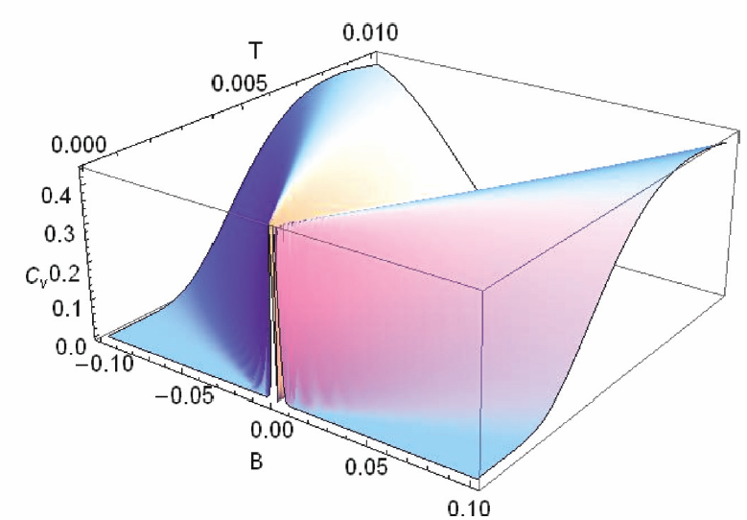
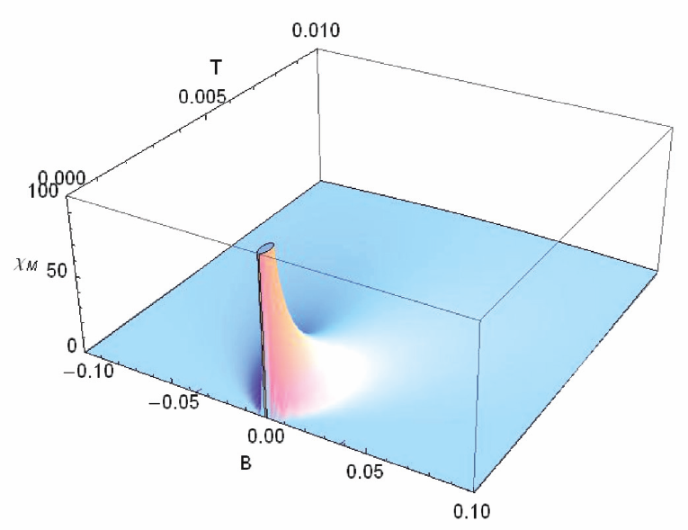
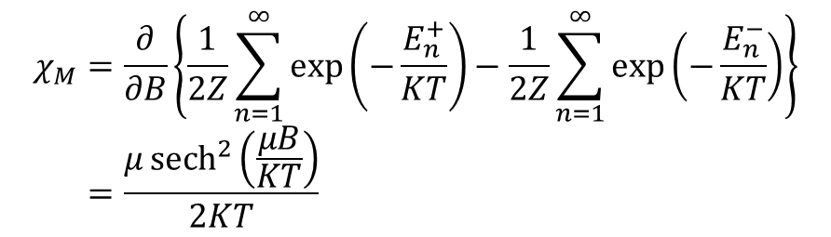
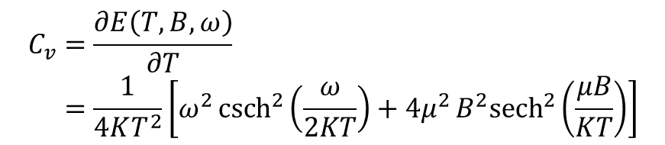
Doublet Harmonic Oscillator
Heat capacity
$$C_{v}=\frac{∂E\left(T,B,ω\right)}{∂T} \\ =\frac{1}{4KT^{2}}\left[ω^{2}{csch}^{2}\left(\frac{ω}{2KT}\right)+4μ^{2}B^{2}{sech}^{2}\left(\frac{μB}{KT}\right)\right]$$
Magnetic susceptibility
$$χ_{M}=\frac{∂}{∂B}\left\{\frac{1}{2Z}\sum_{n=1}^{∞}{\text{exp}\left(−\frac{E_{n}^{+}}{KT}\right)}−\frac{1}{2Z}\sum_{n=1}^{∞}{\text{exp}\left(−\frac{E_{n}^{−}}{KT}\right)}\right\} \\ =\frac{μ{sech}^{2}\left(\frac{μB}{KT}\right)}{2KT}$$
C. D. Dong, G. Lefkidis and W. Hübner, Phys. Rev. B 88, 214421 (2013)

Slide 15
Outlook
Introduction
  Hamiltonian
  Basics of quantum thermodynamics
Understanding QTD
  Z system
  Doublet harmonic oscillator
Results
  Otto cycle and magnetism
  Diesel cycle and magnetism
Summary

Slide 16
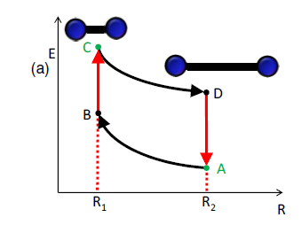
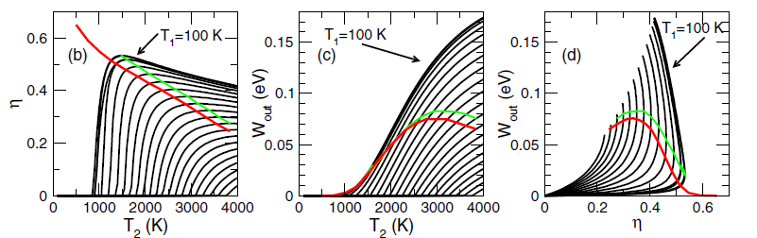
Otto Cycle on Ni₂: Efficiency and Work Output
Magnetism increases output power at maximum efficiency
Magnetism increases work output
W. Hübner, G. Lefkidis, C. D. Dong, D. Chaudhuri, L. Chotorlishvili, and J. Berakdar
Phys. Rev. B 90, 024401 (2014)

Slide 17
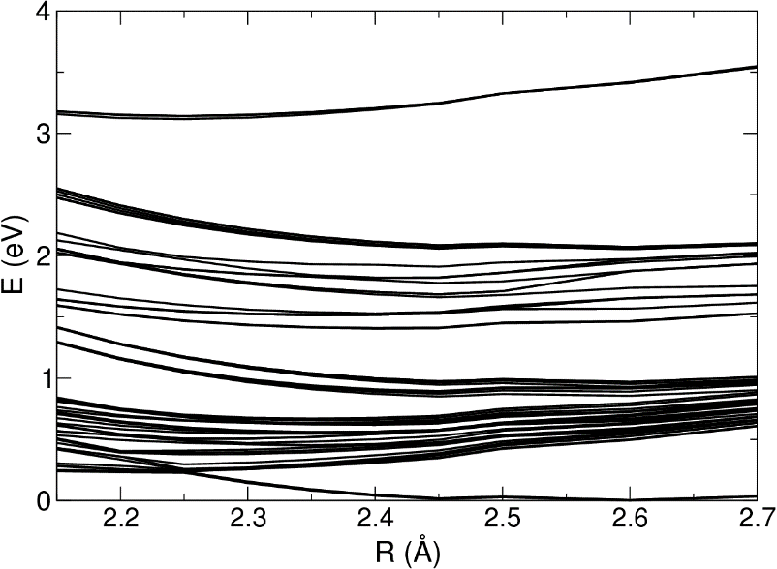
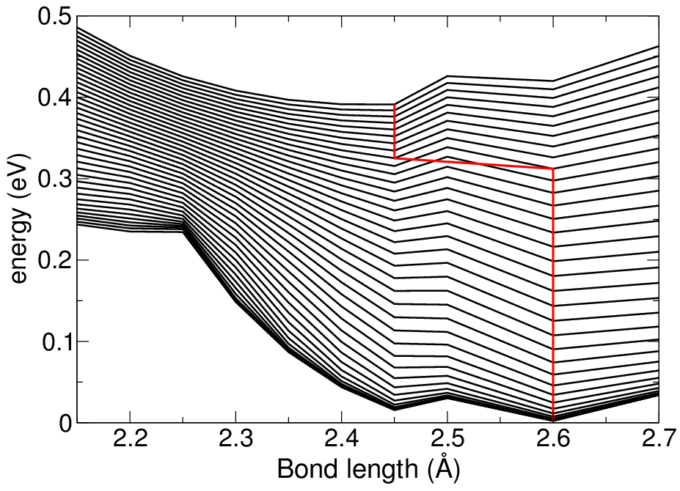
Otto Cycle on Ni₂: Equilibrium Distance
Only molecules can both expand and compress spontaneously!
W. Hübner, G. Lefkidis, C. D. Dong, D. Chaudhuri, L. Chotorlishvili, and J. Berakdar
Phys. Rev. B 90, 024401 (2014)

Slide 18
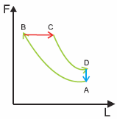
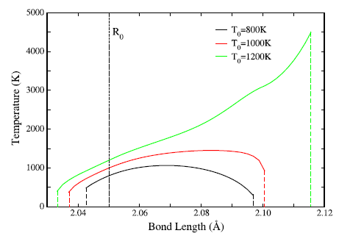
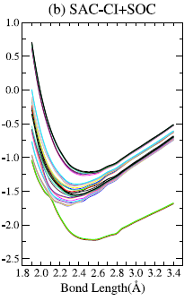
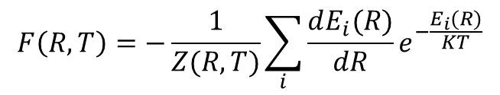
Diesel Cycle on Ni₂: Isobaric Process in Ni₂
Isobaric ranges
$$F\left(R,T\right)=−\frac{1}{Z(R,T)}\sum_{i}{\frac{dE_{i}(R)}{dR}e^{−\frac{E_{i}(R)}{KT}}}$$
Non-equilibrium, non-thermalized states!
C. D. Dong, G. Lefkidis and W. Hübner, J. Supercond. Nov. Magn. 26, 1589 (2013)

Slide 19
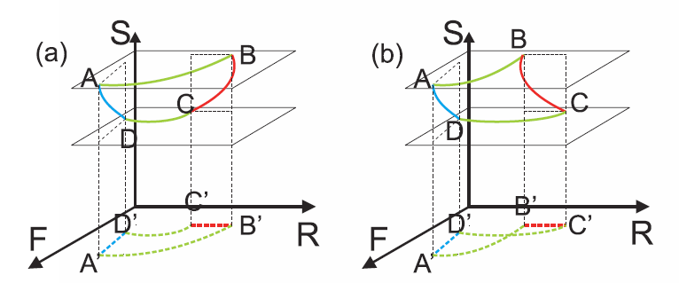
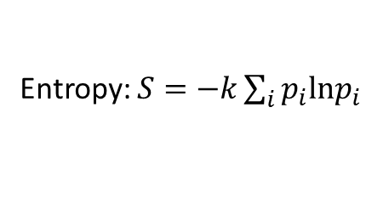
Entropy and Quantum Thermodynamics
Entropy: $S=−k\sum_{i}{p_{i}\text{ln}p_{i}}$
Crossings of lines in PV diagrams due to additional degrees of freedom
Even larger configuration space for magnetic molecules
C. D. Dong, G. Lefkidis and W. Hübner, Phys. Rev. B 88, 214421 (2013)

Slide 20
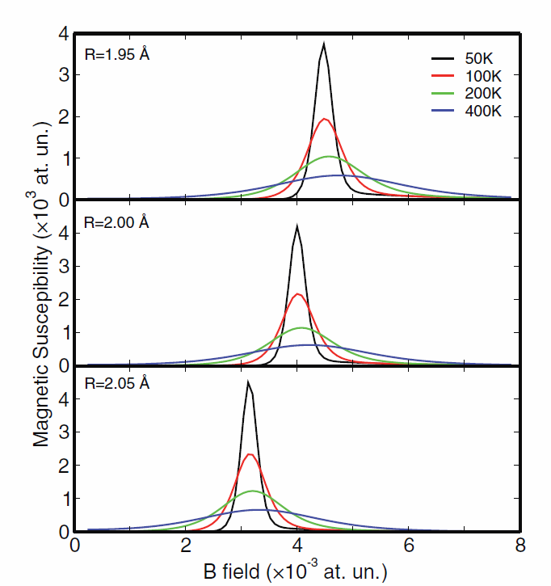
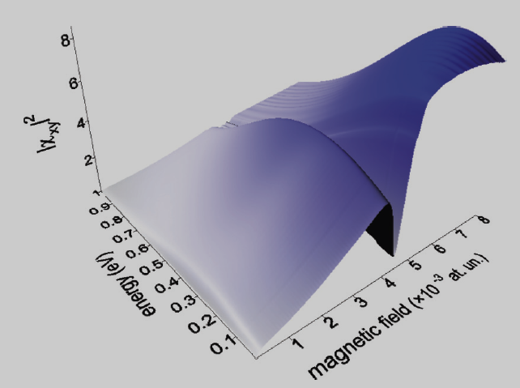
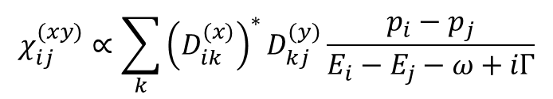
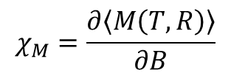
Heat Capacity and Magnetic Susceptibility of Ni₂
$$χ_{ij}^{(xy)}∝\sum_{k}{{\left(D_{ik}^{(x)}\right)}^{∗}D_{kj}^{(y)}\frac{p_{i}−p_{j}}{E_{i}−E_{j}−ω+iΓ}}$$
$$χ_{M}=\frac{∂\left\langle M\left(T,R\right)\right\rangle }{∂B}$$
Singularities indicate level crossings.
C. D. Dong, G. Lefkidis and W. Hübner, Phys. Rev. B 88, 214421 (2013)

Slide 21
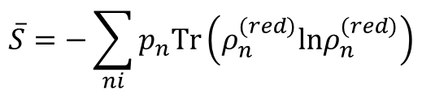
Heat Capacity and Magnetic Susceptibility of Ni₂
Magnetic susceptibility at 100 K
Heat capacity
Magnetic susceptibility at 400 K
Von-Neumann entropy
$$\overline{S}=−\sum_{ni}{p_{n}\text{Tr}\left(ρ_{n}^{(red)}\text{ln}ρ_{n}^{(red)}\right)}$$
C. D. Dong, G. Lefkidis and W. Hübner, Phys. Rev. B 88, 214421 (2013)

Slide 22
Summary
QTD: Effects of energy discretization (in particular level crossings)
Electronic temperature – non thermalized states
Quantum Otto Cycle – effects of magnetism
Isobaric process – Quantum Diesel Cycle

Slide 23
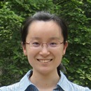
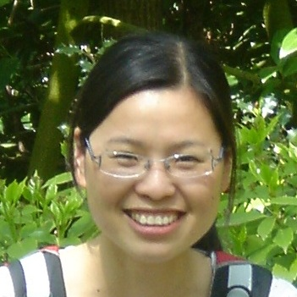
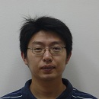
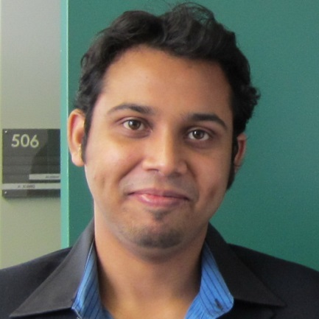
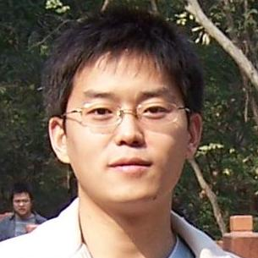
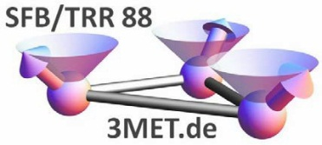

Acknowledgements
Wei Jin (Xi’an)
Hongping Xiang (Northridge)
Chuanding Dong
Debapriya Chaudhuri
Chun Li (Xi‘an)

