Slide 1
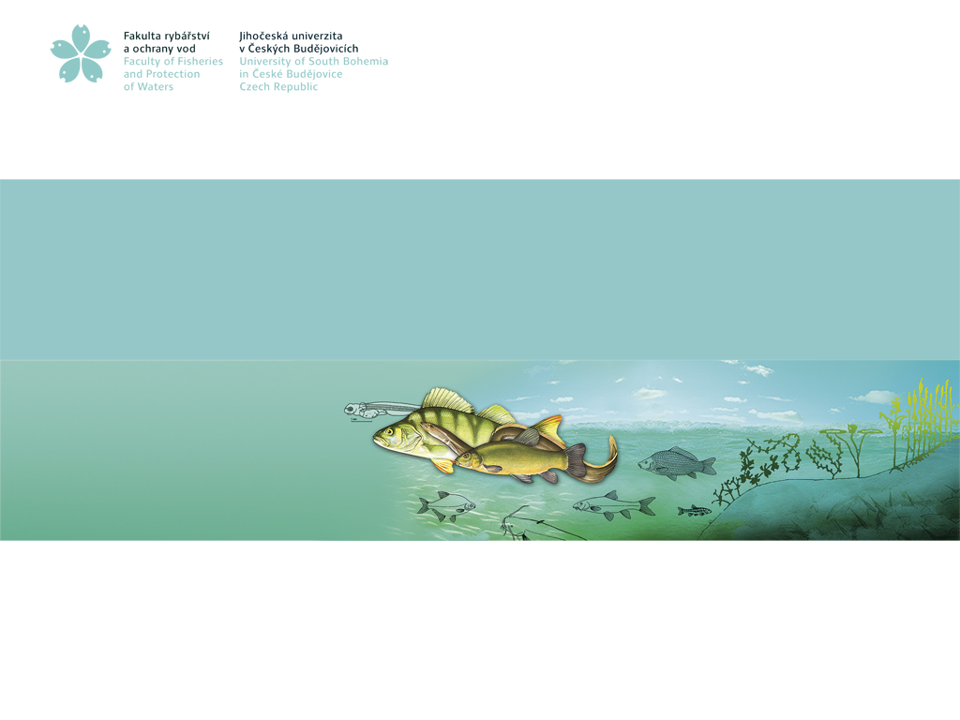
IN VITRO EFFECT OF BISPHENOL A ON DNA INTEGRITY AND INTRACELLULAR SIGNALING IN STURGEON (ACIPENSER RUTHENUS) SPERM
Ievgeniia Gazo*,
Pavla Linhartova,
Anna Shaliutina-Kolešová,
Jacky Cosson
University of South Bohemia in České Budějovice, Faculty of Fisheries and Protection of Waters, South Bohemian Research Center of Aquaculture and Biodiversity of Hydrocenoses, Zátiší 728/II, 389 25 Vodňany, Czech Republic
www.frov.jcu.cz

Slide 2
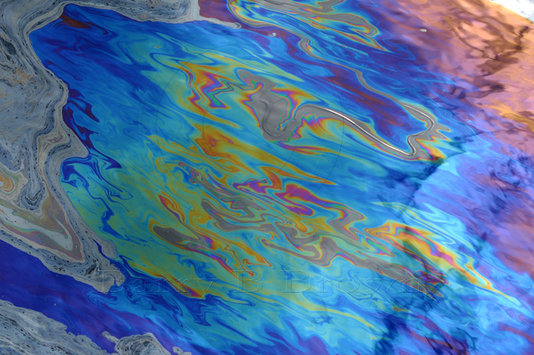
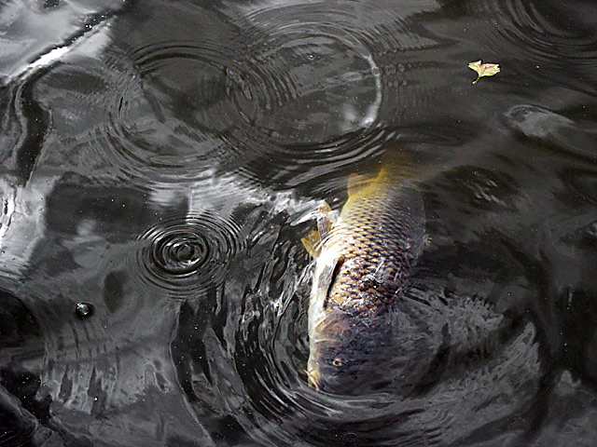
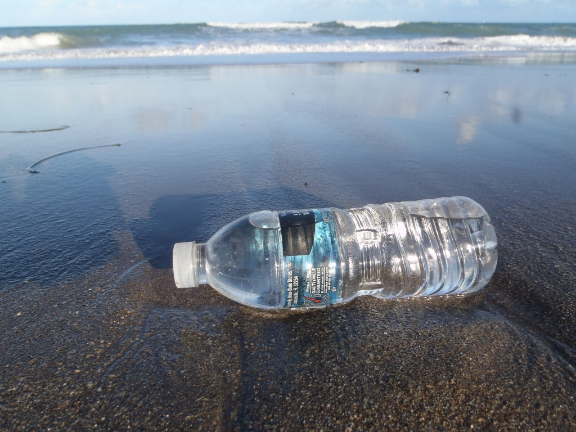
Agricultural runoff and other polutants can affect aquatic organisms by disrupting endocrine system and impairing gamete performance.
Plastic in water is a source of numerous xenobiotic compounds, such as Bisphenol A
Concentration of BPA in surface waters varies significantly from 0.1 µg/L to 2 mg/L.

Slide 3
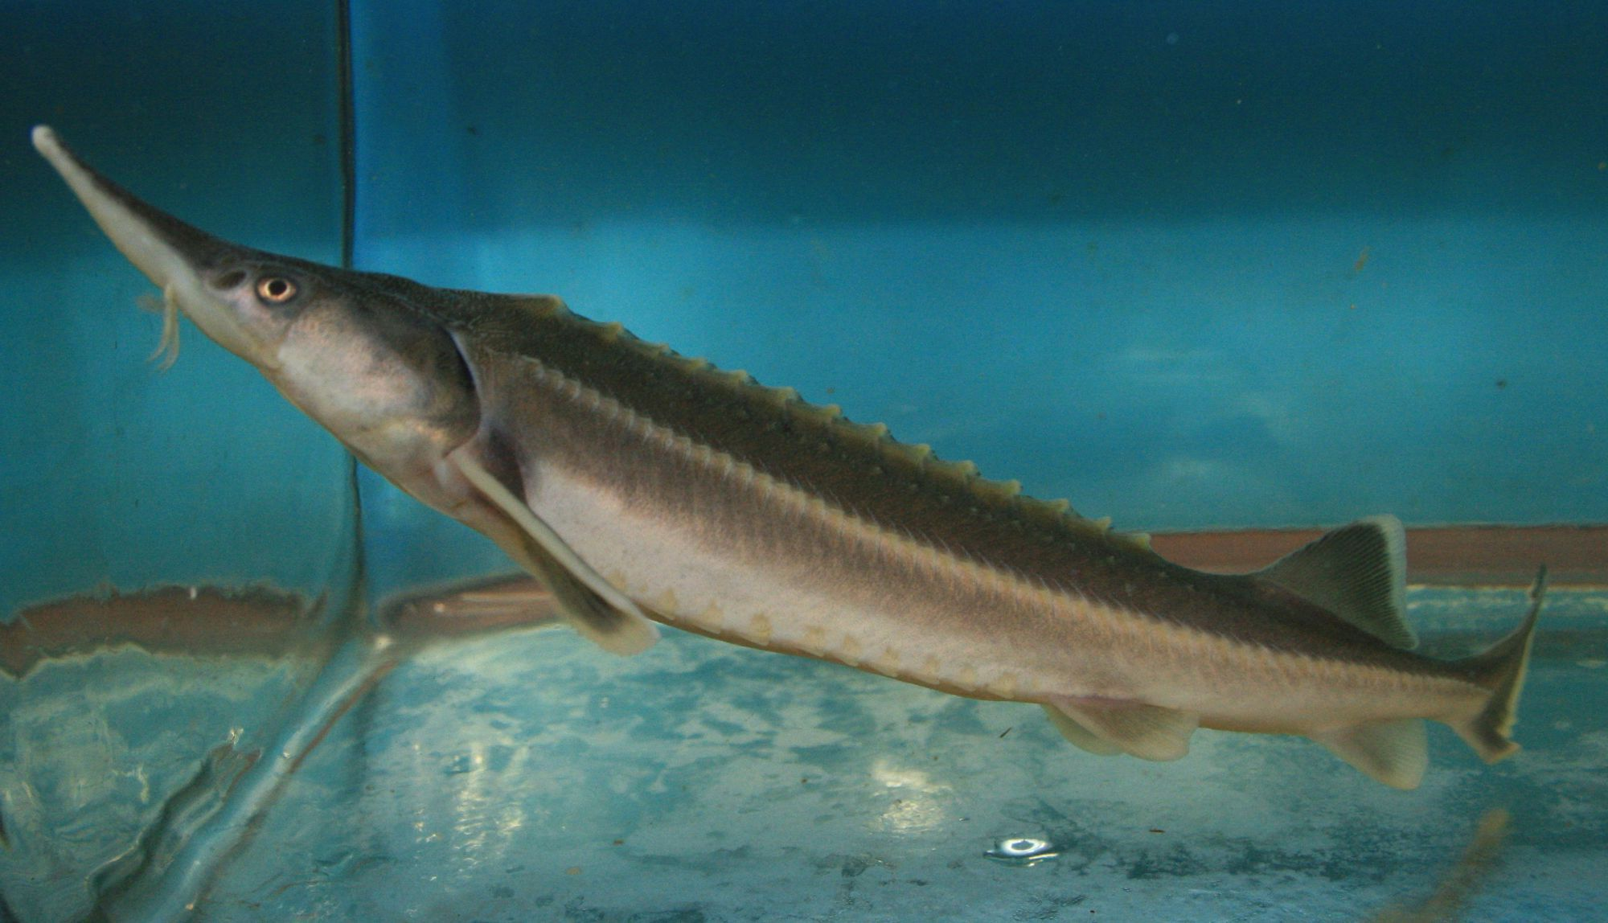
The effect of xenobiotics on fish spermatozoa
Gametes of externally fertilizing fish after spawning are particularly susceptible to the effect of xenobiotics due to lack of antioxidant protection
How does bisphenol A (BPA) affect sperm motility, DNA integrity and protein phosphorylation pattern?
Sturgeon spermatozoa were incubated with Bisphenol A at concentrations 0.1, 1, 5, 10 µM for 1 hour.
Small sturgeon or sterlet (Acipenser ruthenus)

Slide 4
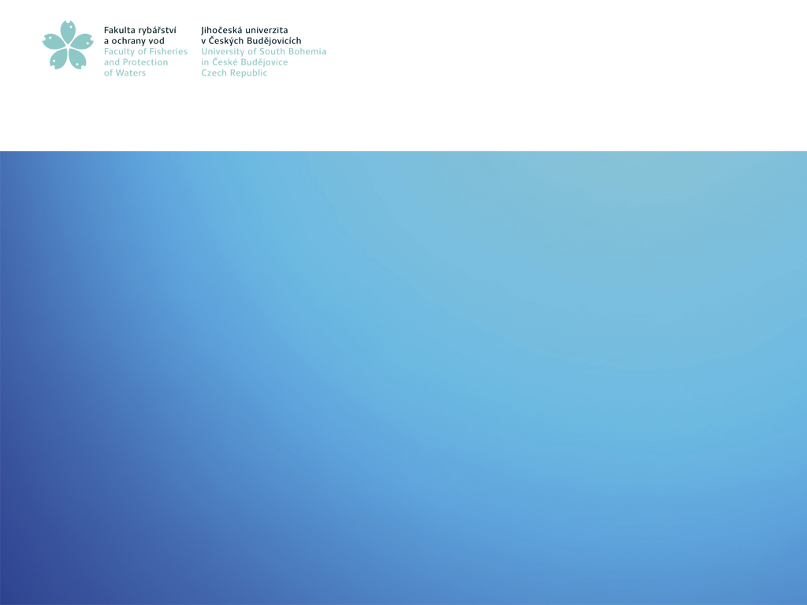
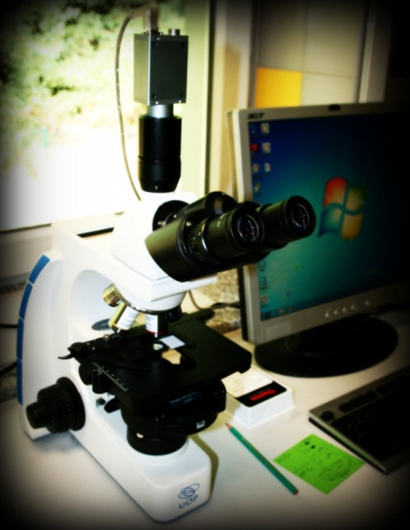
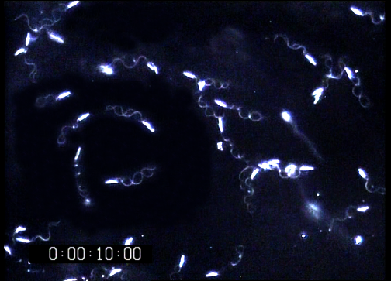
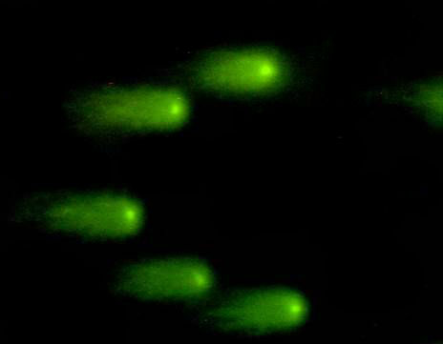
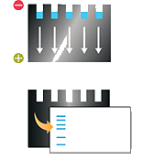
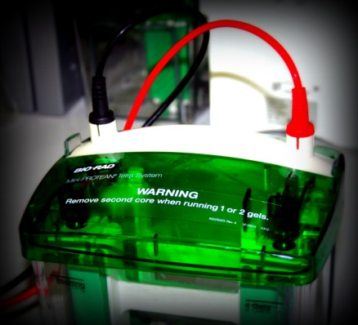
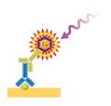
METHODS
Motility analysis
% Motile cells
Comet assay
% DNA in comet tail
Anti-phosphoserine and anti-(Ser) PKC substrate antibodies
Western blotting
HRP-conjugated goat anti-rabbit antibody

Slide 5
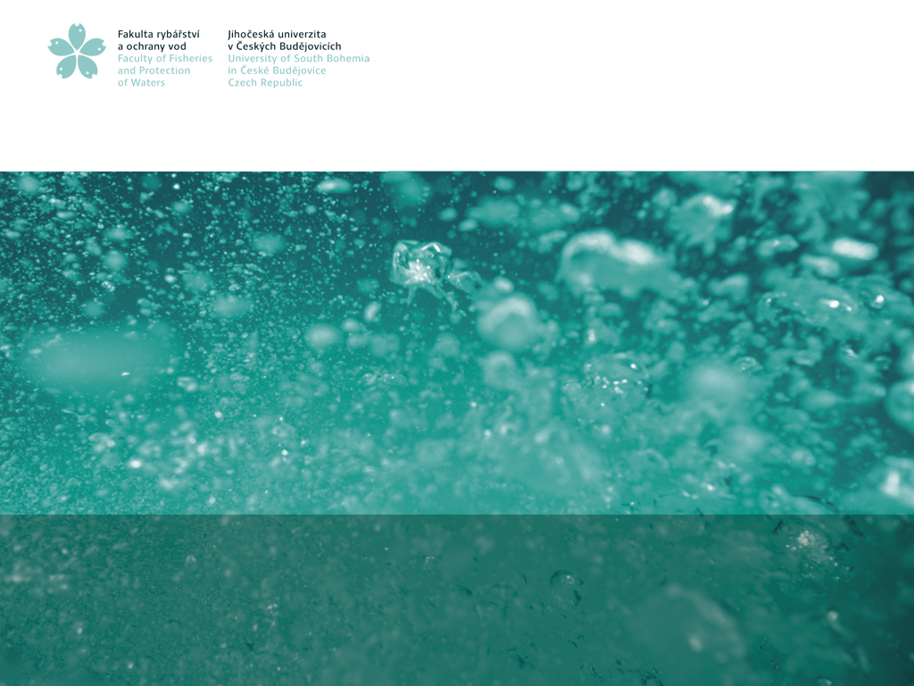
RESULTS
Sperm motility
The percentage of motile spermatozoa was determined in 15 s after triggering sperm motility by activating medium

Slide 6
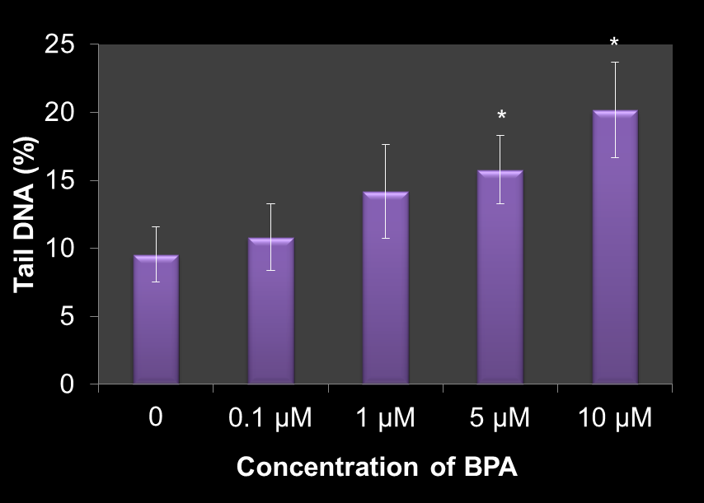
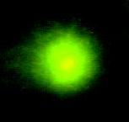
RESULTS
DNA integrity
Influence of BPA on DNA fragmentation in A. ruthenus spermatozoa measured by Comet assay as a percentage of DNA in the tail

Slide 7
RESULTS
Intracellular signaling
Phosphorylation of protein kinase C (PKC) substrate
Phosphorylation on serine residue
(kDa)
C
0.1
1
10
C
0.1
1
10
250
150
100
80
60
50

Slide 8
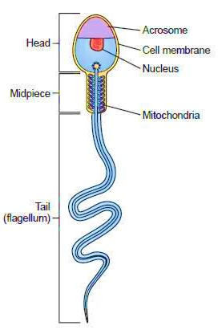
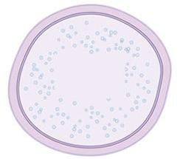
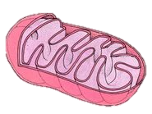
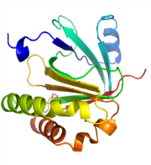
The effect of EDCs on fish sperm motility, DNA integrity, oxidative stress indices and ATP content
Endocrine Disruptor (BPA)
Nuclear receptor
DNA
Membrane receptor
Kinases
Phosphatases
Cell nucleus
Intracellular signaling
Proteins
ROS
Mitochondria
Lipid membranes
Hulák et al., 2013. In vitro effects of bisphenol A on the quality parameters, oxidative stress, DNA integrity and adenosine triphosphate content in sterlet (Acipenser ruthenus) spermatozoa. Comp. Biochem. Physiol. C Toxicol. Pharmacol. 158(2): 64-71.

Slide 9
CONCLUSIONS
Even at low doses (down to 1 µm) BPA could decrease sturgeon sperm motility, induce DNA fragmentation and change the pattern of protein phosphorylation.
Decreased sperm motility represents one of the adverse effects of water pollutants, which can affect individual fertility and, hence, poses problems for the whole fish population. Additionaly, the damaged DNA from spermatozoa could be transmitted to the offspring, and cause the negative effects in development.
The high sensitivity of sterlet spermatozoa toward the presence of xenobiotics makes them a promising model for studying effects of water pollution on reproduction of aquatic organisms. On the other hand, current results also emphasize the threat of water pollution for wild population of sturgeons.

Slide 10
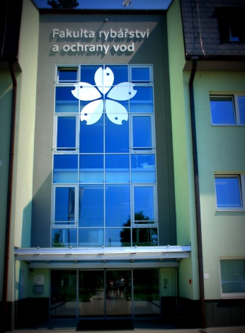
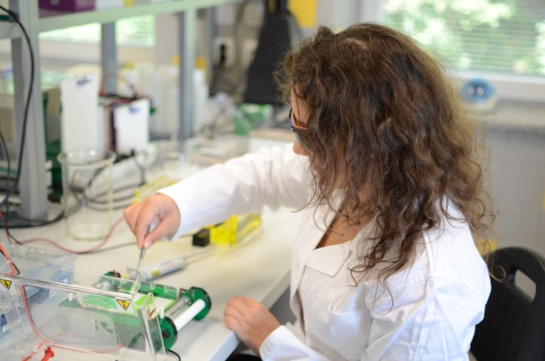
ACKNOWLEDGEMENTS
Research Institute of Fish Culture and Hydrobiology, especially Laboratory of Molecular, Cellular and Quantitative Genetics and Laboratory of Reproductive Physiology
Projects:
CZ.1.05/2.1.00/01.0024, NPU LO1205, COST (LD14119), GAČR P502/11/0090, GAČR 523/08/0824, GAČR 15-12034S and GAJU 046/2010/Z

Slide 11
Thank you for attention!

