Slide 1
About OMICS Group
OMICS Group International is an amalgamation of Open Access publications and worldwide international science conferences and events. Established in the year 2007 with the sole aim of making the information on Sciences and technology ‘Open Access’, OMICS Group publishes 400 online open access scholarly journals in all aspects of Science, Engineering, Management and Technology journals. OMICS Group has been instrumental in taking the knowledge on Science & technology to the doorsteps of ordinary men and women. Research Scholars, Students, Libraries, Educational Institutions, Research centers and the industry are main stakeholders that benefitted greatly from this knowledge dissemination. OMICS Group also organizes 300 International conferences annually across the globe, where knowledge transfer takes place through debates, round table discussions, poster presentations, workshops, symposia and exhibitions.

Slide 2
About OMICS Group Conferences
OMICS Group International is a pioneer and leading science event organizer, which publishes around 400 open access journals and conducts over 300 Medical, Clinical, Engineering, Life Sciences, Phrama scientific conferences all over the globe annually with the support of more than 1000 scientific associations and 30,000 editorial board members and 3.5 million followers to its credit.
OMICS Group has organized 500 conferences, workshops and national symposiums across the major cities including San Francisco, Las Vegas, San Antonio, Omaha, Orlando, Raleigh, Santa Clara, Chicago, Philadelphia, Baltimore, United Kingdom, Valencia, Dubai, Beijing, Hyderabad, Bengaluru and Mumbai.

Slide 3
Production and regulation of functional amyloid curli fimbriae by Shiga toxin-producing Escherichia coli.
Gaylen Uhlich, DVM, PhD, ACVM
Eastern Regional Research Center,
USDA Agricultural Research Service, Wyndmoor, PA

Slide 4
Shiga Toxin-Producing E. coli (STEC)
Food borne; Ruminant reservoir
Associated with HC and HUS in humans
Produce Shiga-like toxin(s) (I, II, variants) – encoded on lambdoid prophage
Serotype 0157:H7 & Serogroups O111, O103, O121, O26, O45, O145, O113
Attachment and persistence factors
Reservoir (ruminants), lairage
Food and manufacturing surfaces
Human host and disease

Slide 5
Why are curli important in STEC-associated food safety?
Host - 37°C
Curli deletion results in marked reductions in adhesion to Caco-2 cells at 37 °C (Rosser et al., 2008, Infect. Immun. 76:5598-5607).
.
Deletion of curli/cellulose genes significantly reduced adhesion to HT-29 colonic cells at 37 °C (Saldaña et al., 2009, Environ. Microbiol. 11:992- 1006).
Curli-expressing serotype O157:H7 variants were more invasive for HeLa and HEp-2 cells, and more virulent in a mouse model than their non-curliated parents (Uhlich et al., 2002, Infect. Immun. 70:395-399).
Environment - 30°C
Strong correlation between biofilm formation and curli expression of in serotype O157:H7 (Tafarello et al., 2011, Appl. Environ. Microbiol. 77:2201-2208).
In serotype O157:H7 robust biofilm formation was dependent on curli expression; in non-O157 STEC, cellulose and curli both affect biofilm formation (Uhlich, et al., 2014, FEMS Microbiol. Lett. 354:133-141).
Curli expression has a critical role in STEC biofilm formation and resistance to sanitizers (Wang et al., 2012, J. Food Protect. 75:1418-1428).

Slide 6
Biofilm
Multicellular behavior on surfaces characterized by expression of curli fibers and polysaccharides, such as cellulose, that encase bacteria in a protective matrix

Slide 7
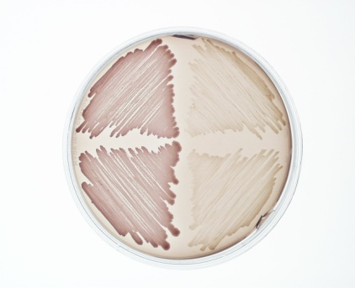
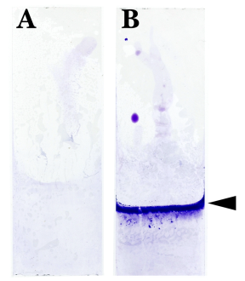
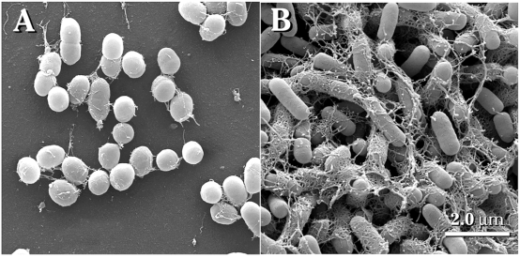
Measuring Curli / Biofilm in the Lab
Curli
Biofilm
Congo red Indicator Plates
Crystal Violet Staining
Electron Microscopy

Slide 8
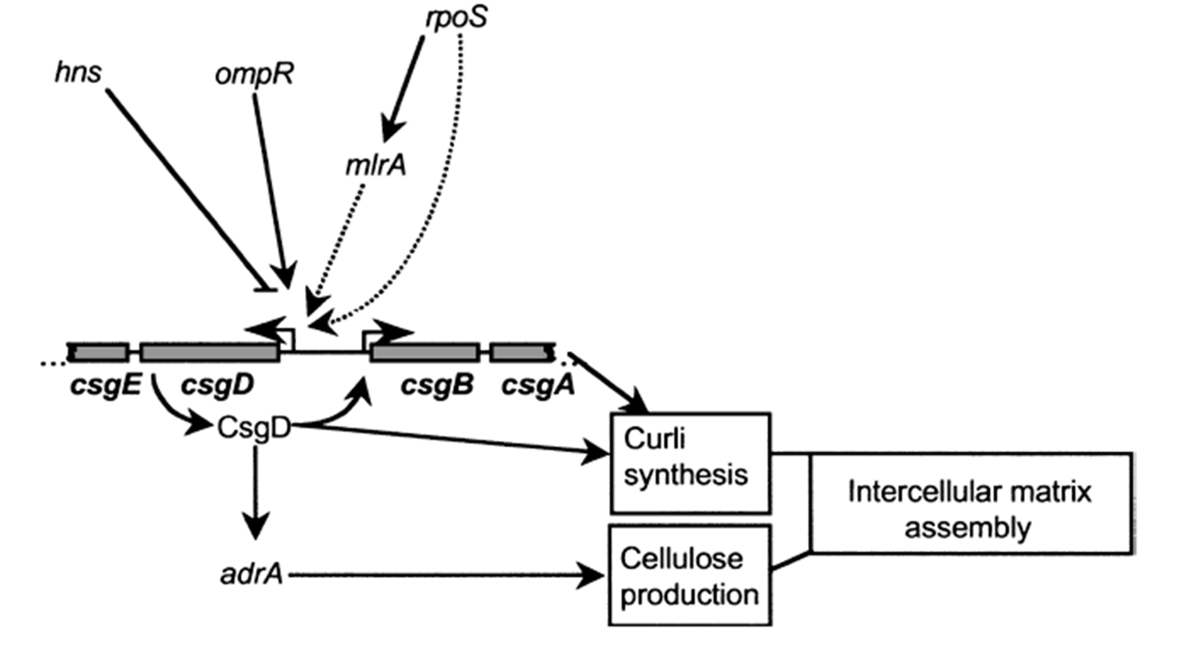

Slide 9
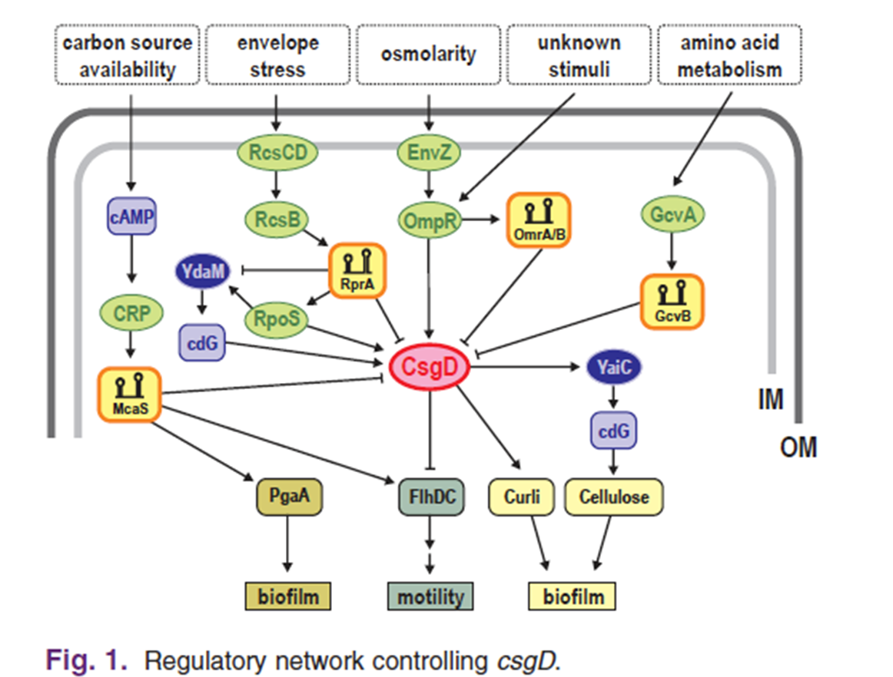

Slide 10
CsgD regulation
Sigma factors (2): RpoS, RpoD
Protein transcription factors:
two-component systems (4): EnvZ/OmpR, RstB/A, RcsC/B, CpxA/R
single-component systems (2): MlrA, Crp
DNA-bending nucleoid proteins (2): IHF, H-NS
Small proteins affecting RpoS (3): Crl, IraP, FliZ
Small regulatory RNAs (sRNA) (5): OmrA, OmrB, RprA, GcvB, McaS
GGDEF/EAL proteins controlling c-di-GMP (6): YdaM/YciR, YeaP YegE/YhjH, YhdA

Slide 12
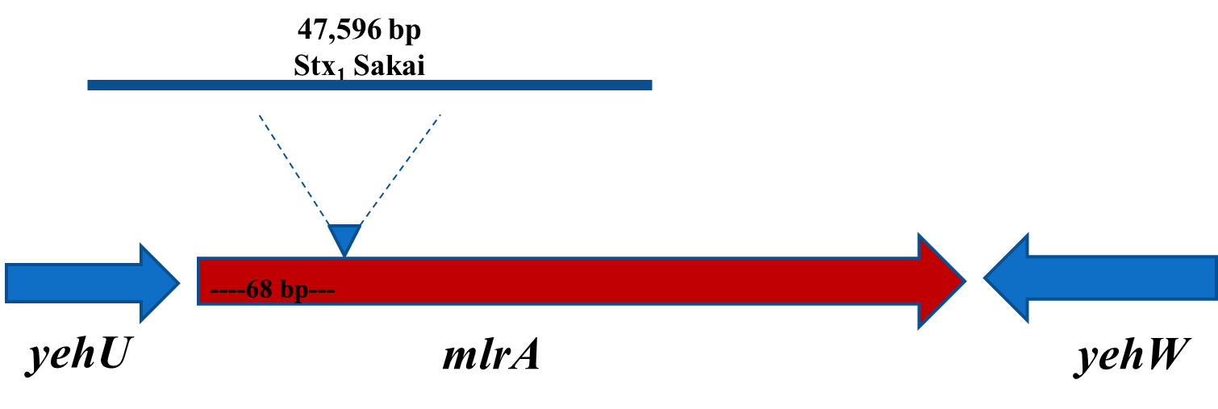
mlrA encodes a prophage insertion site

Slide 13
Survey of O157:H7 clinical isolates
Serotype O157:H7 – biofilm barriers
>96% carried a prophage (± stx₁) insertion in mlrA
Non-O157:H7 STEC – biofilm barriers
<22% carry prophage insertions in mlrA

Slide 14
MlrA complementation
phage
rpoS
WT
+mlrA

Slide 15
PA20-R2R: mlrA restored
R2R
PA20
30°C 37°C

Slide 16
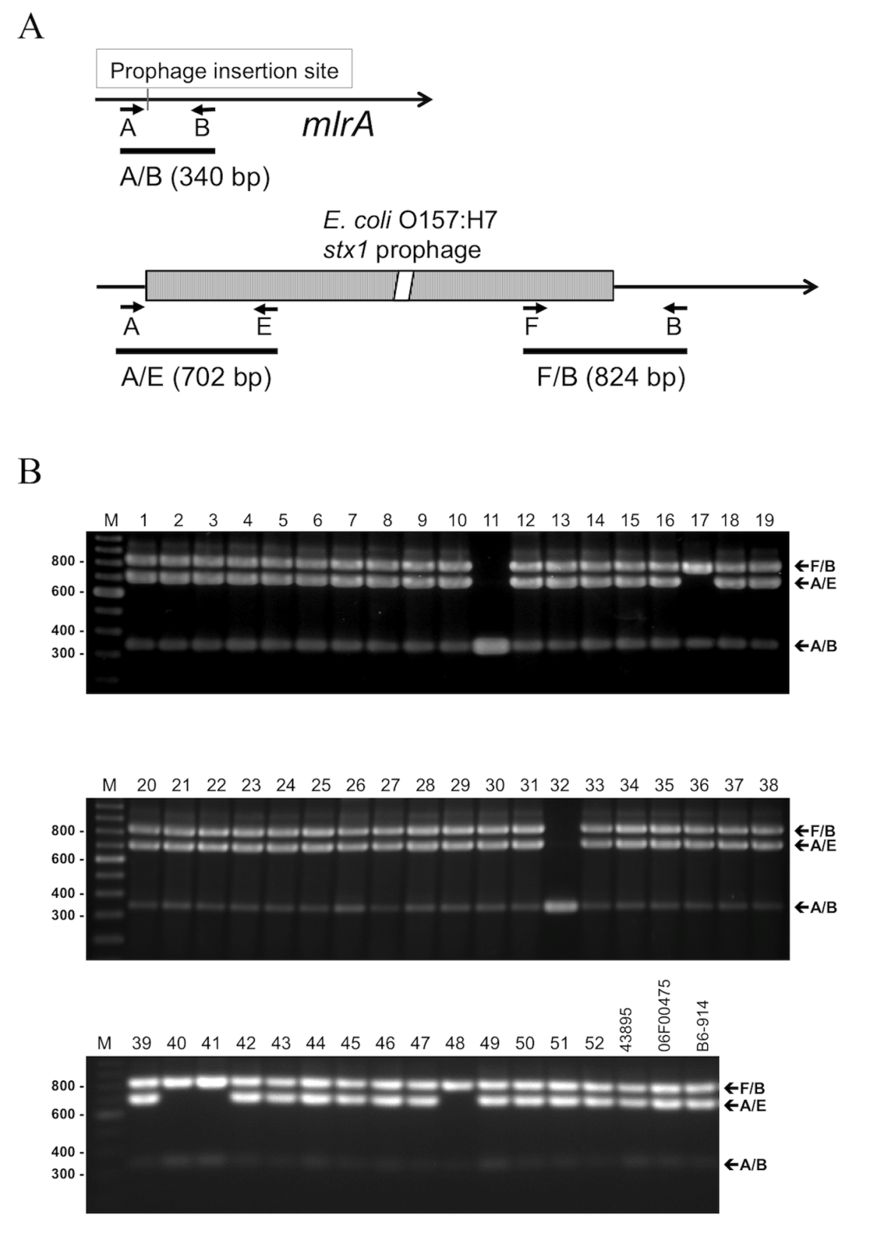

Slide 17
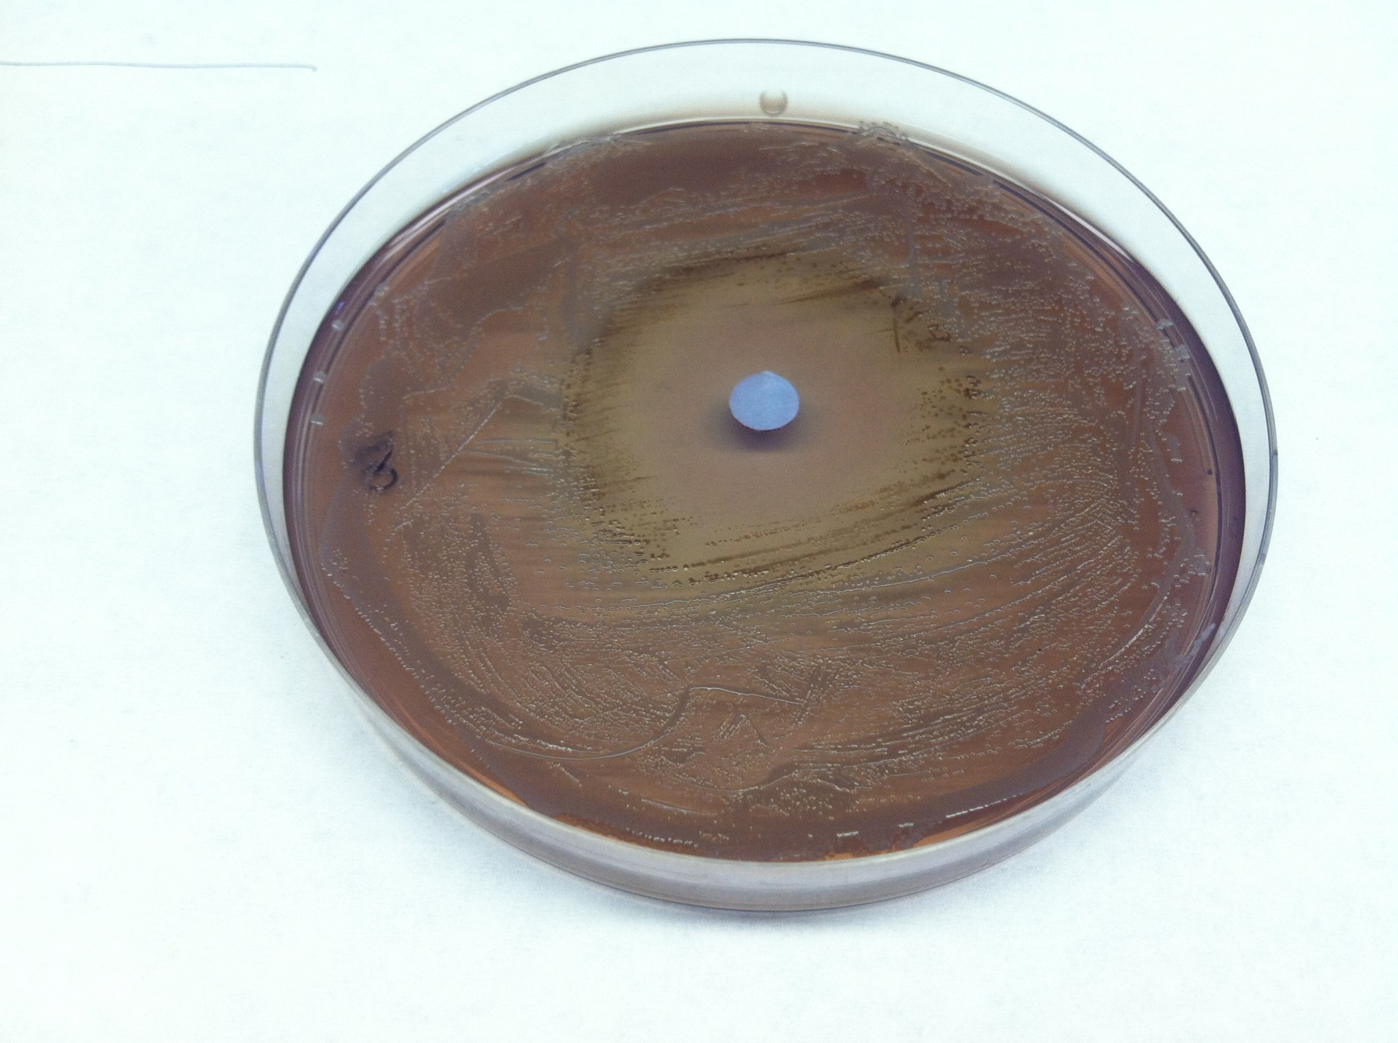
inner
outer

Slide 18
SMX/TM increases ancestral mlrA
PA20 O I
933 O I
PA6 O I
PA8 O I
20 xis
O I
20 intV
O I
20 3’J O I

Slide 19
qRT-PCR
 | PA20 |  | PA20 control
 | inner | Outer | inner | outer
% AB | 21.80 | 3.48 | 5.41 | 2.75
I/O (% AB) | 6.26 |  | 1.97

Slide 20
SMX/TM stimulates biofilm formation

Slide 21
PA20 expression studies
Ancestral mlrA (primers A/B): CT = 36.9
Distal mlrA (primers 3’ to prophage): CT = 26.5
93% of mlrA coding sequence is 3’ to the prophage

Slide 22
Distal mlrA encodes potential truncated proteins

Slide 23
Cloning
T1, T2, T3 coding region
GST fusion protein
Histidine Tag fusion protein
5’ RACE Transcripts 1 and 2
pSE380 - inducible lacZ promoter w/o RBS
Native protein

Slide 24
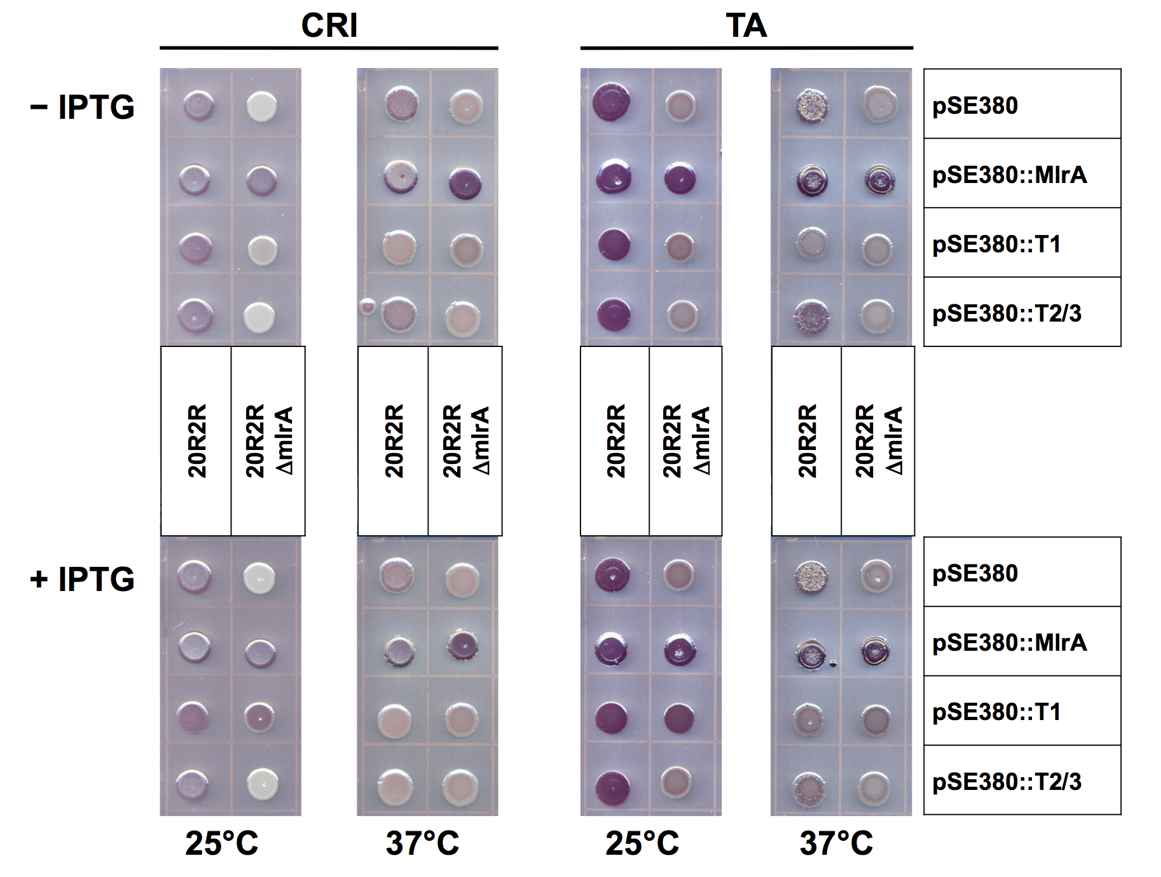
Truncated MlrA proteins regulate CR affinity

Slide 25
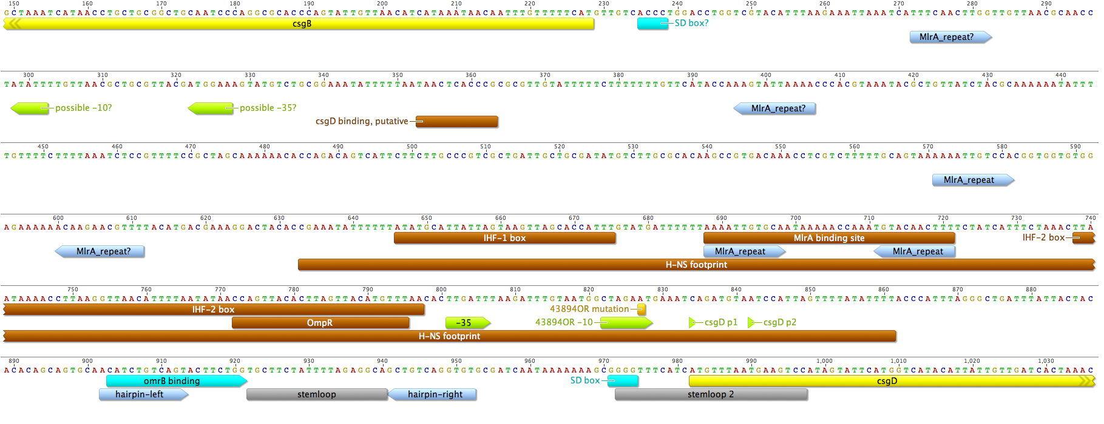
DNA binding assays: MlrA and Truncates with the csgD promoter
GST proteins captured on magnetic beads + plasmid cloned target sequences IGS1 and IGS2 (95 nt each)
Detection by RT-PCR: bound target/input target x 100 = % bound by protein

Slide 26
MlrA, but not the truncated proteins, bind the csgD promoter

Slide 27
C-di-GMP
Second messenger signaling molecule
Controlled by diguanylate cyclase (DGC) and phosphodiesterase (PDE) pairs – 29 proteins in E. coli
Temporal expression or functional sequestration gives specificity

Slide 28
YdaM/YciR & YegE/YhjH control CsgD by affecting MlrA
Two DGC/PDE pairs (control modules) control csgD transciption by affecting mlrA:
YegE (DCG) / YhjH (PDE) - ↑csgD, ↓motility
YdaM (DCG) / YciR (PDE) - ↑csgD
The control modules function in a cascade, connected by the bi-functional trigger enzyme, yciR
YdaM, YciR and MlrA all bind to each other using multiple domain contacts
YciR inhibitory role is due to direct contact and that inhibition is antagonized by c-di-GMP from module 1
YdaM activation of MlrA is by direct interaction
Lindenberg et al., The EMBO Journal (2013) 32, 2001–2014

Slide 29
Conclusions
Curli deficiencies result from prophage insertions in mlrA in serotype O157:H7
SMX/TM will increase ancestral mlrA to levels sufficient for biofilm formation
Transcripts encoding truncated mlrA proteins are expressed from the distal prophage / mlrA
Truncated mlrA products can modulate CR phenotypes
Truncated products do not bind the csgD promoter and may rely on protein contacts

Slide 30
Acknowledgments
Chen-Yi Chen
Christopher Hofmann
Bryan Cottrell
Ly Nguyen
Terence Strobaugh
John Phillips
George Paoli
Peter Irwin

Slide 31
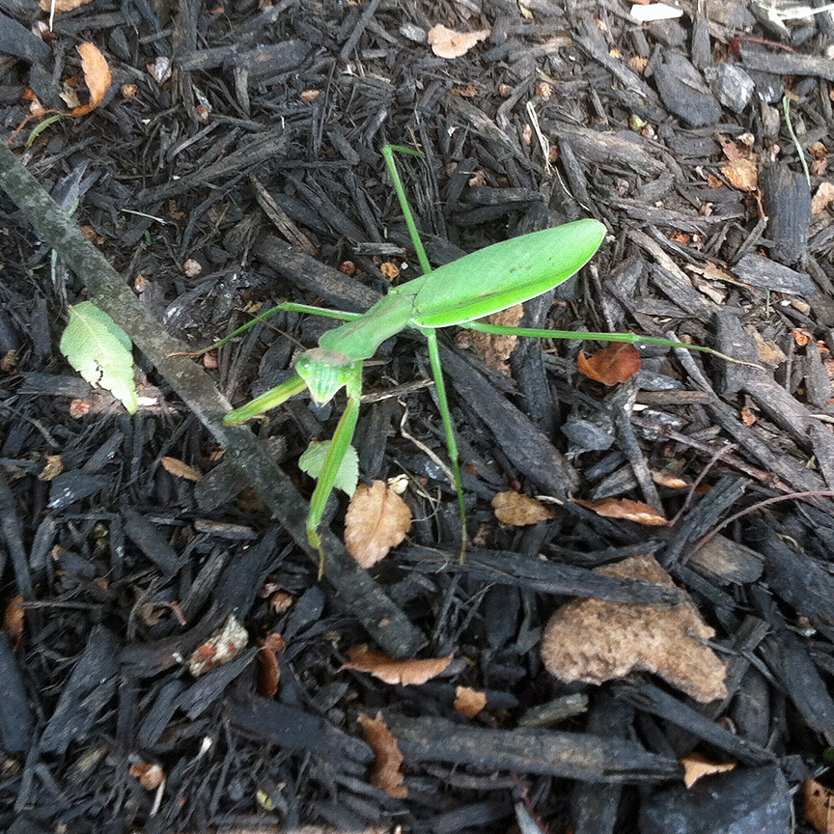
Questions?

Slide 32
Let Us Meet Again
We welcome you all to our future conferences of OMICS Group International
Please Visit: www.omicsgroup.com
www.conferenceseries.com

