Slide 1
Breast Cancer in young age is an independent prognostic indicator in Assamese women
Gayatri Gogoi MD
Assistant Professor
Deptt of Pathology
Assam Medical College
, Dibrugarh, Assam, India
- gayatrigogoi303@gmail.com.

Slide 2
Co authors
MONDITA BORGOHAIN,MD
HIRANYA SAIKIA, ,PhD
PROGNAN SAIKIA, MD
RAM KANTA HAZARIKA, MD
^{Affiliations:}
I,III,IV Professors, Department of Pathology &
II Associate professor, Department of Biostatistics
Acknowledgement: Dr S A Fazal, Associate Professor, Department of Surgery
Assam Medical College and Hospital ,
Dibrugarh, Assam, India

Slide 3
Background
Breast Cancer diagnosis at young age is an independent negative prognostic factor is a controversial issue.
However many studies indicate that breast cancer in young women have unique clinicopathological characteristics than in the elderly .A disturbing trend in India is gradually more and more young women are suffering from breast cancer
--------------------------------------------------------------------
Agrup M, Stäl O, Olsen K, Winren S (2000). C-erbB-2 Over expression and survival in early onset breast cancer. Breast
Cancer Res Treat, 63, 23-9

Slide 4
Background:Breast cancer in Assamese women
Hospital cancer registry data from two large centers of North eastern states of India namely Assam, showed incidence of 48% women belonged to younger than 40 years which constitute largest young breast cancer group affected women in India.
Approximately 3.7%–7.5% of the total number of breast cancer patients diagnosed each year in the US [1, 2] and Western Europe [3–5] are younger than 40 years. So incidence of younger Assamese women affected in India is 6 to 12 times higher than US and western Europe
---------------------------------------------------------------------------------
C. K. Anders, R. Johnson, J. Litton, M. Phillips, and A. Bleyer, “Breast cancer before age 40 years,” Seminars in Oncology, vol. 36, no. 3, pp. 237–249, 2009. ·
D. P. Winchester, “Breast cancer in young women,” Surgical Clinics of North America, vol. 76, no. 2, pp. 279–287, 1996.

Slide 5
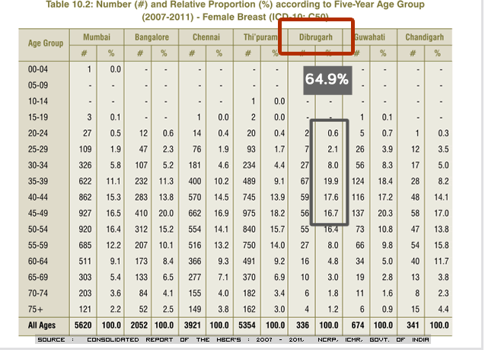

Slide 6
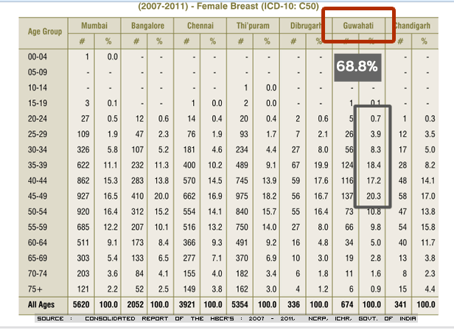

Slide 7
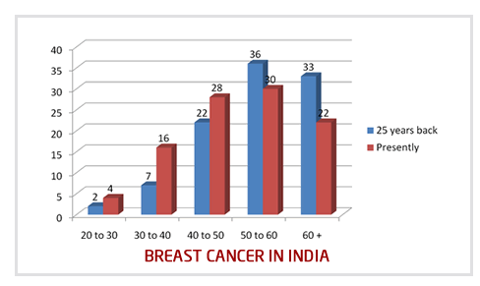
Age shift: Breast cancer now more common in 30's and 40's

Slide 8
Background: survival issue
, The over all 5 year survival for breast cancer has increased from 75% in 1970's to almost 89% presently USA. This means that, out of every 100 women with breast cancer in the US, 89 women are likely to survive for atleast 5 years.
There are barely any similar statistics for India available, but a rough estimate from the PBCR and HBCCR reports is that, this figure is not even more than 60%.
The most important reason is stated as being lack of awareness about breast cancer and screening of the same; more than 50% patients of breast cancer present in stages 3 and 4, and outcome is not as good as earlier stages.

Slide 9
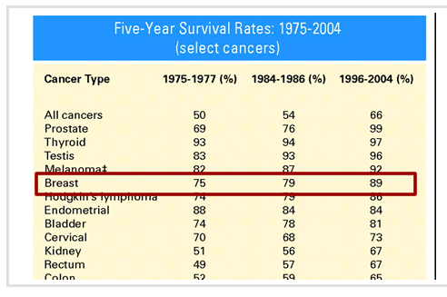
published by ASCO (American Society of Clinical Oncology) in 2009 on 5 year survival

Slide 10
background
Many retrospective series and subset analyses of larger randomized trials have shown that young patients with BC have a poorer prognosis compared to older age at diagnosis.Women of ≤40 years tend to have more triple-negative and fewer luminal A and B breast cancers tumors of higher grade, more extensive intraductal component, more lymphovascular invasion, more likely ER negative tumors and more often BRCA-1 or -2 germline mutations .
- However some studies performed in Asia and Africa did not find a different prognosis of younger BC patients compared to the older counterparts suggest that regional differences may exist concerning the biology and prognosis of young-------------------------------------------------------------------------------
M. A. Bollet, B. Sigal-Zafrani, V. Mazeau et al., “Age remains the first prognostic factor for loco-regional breast cancer recurrence in young (<40 years) women treated with breast conserving surgery first,” Radiotherapy and Oncology, vol. 82, no. 3, pp. 272–280, 2007
T. Aryandono, Harijadi, and Soeripto, “Breast cancer in young women: prognostic factors and clinicopathological features,” Asian Pacific Journal of Cancer Prevention, vol. 7, no. 3, pp. 451–454, 2006.

Slide 11

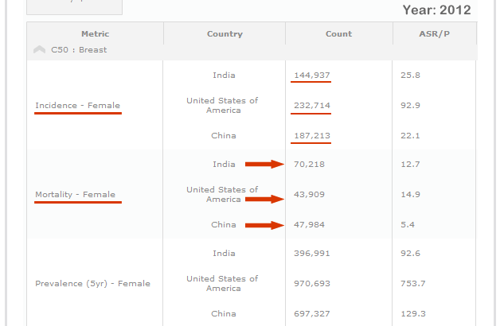

Slide 12
Global comparison of mortality
United States, for the year 2012:
232,714 women were newly detected wth breast cancer and 43,909 women died .
So roughly for every 5 or 6 women newly diagnosed with BC, one lady is dying
China, for the year 2012:
187,213 women were newly detected with breast cancer and 47,984 women died
. So roughly, in China, for every 4 women newly diagnosed with BC one lady is dying of it.
India, for the year 2012:
144,937 women were newly detected with breast cancer and 70,218 women died of breast cancer
So roughly, in India, for every 2 women newly diagnosed with BC one lady is dying

Slide 13
Background
So more studies are needed why Indian women 1 out of 2 die due to BC according to latest WHO 2012 survival report in a background of BC average age in Indian Population is less than 50 years and its prognostic factors.
Detailed data about prognostic factors and treatment outcome in breast cancer are scarce in India and Asia continent as a whole
-------------------------------------------------------------------------
S. Aebi, S. Gelber, M. Castiglione-Gertsch et al., “Is chemotherapy alone adequate for young women with oestrogen-receptor-positive breast cancer?” The Lancet, vol. 355, no. 9218, pp. 1869–1874, 2000

Slide 14
Aims and Objective
The purpose of this study was to characterize the breast cancer of Assamese women by studying the clinico pathological parameters of operable Breast cancer with curative intend of this tertiary care hospital in Assam, North Eastern part of India.
Compare the data between >44 years of age groups to <45 years, at time of diagnosis and assess their prognosis with Disease free survival analysis
To understand whether young age alone is one of the poor prognostic factor

Slide 15
Declarations
Ethical clearance from Institutional Ethical Committee for Human subject: Yes
Conflicts of interest: None

Slide 16
Materials and Methods[I]
Study was done by both acquiring retrospective data for period of 2009 and 2010 from Department of Pathology, the prospectively recruiting breast cancer cases attending from January 2011 to December, 2013 , at Assam Medical College of India.
Eligibility criteria: Histologically confirmed cases of invasive BC and surgical treatment with lumpectomy surgery or mastectomy with curative intents.
Patients admitted for palliative surgery were excluded from the analysis.

Slide 17
Materials and Methods[II]
Women with operable breast cancer were assessed clinically and pathologically.
Gross Tumor details including size, H & E stained slides were examined by two pathologists independently for general histological diagnosis besides ascertaining invasiveness of tumor
histological type Lymph node metastasis , Mitotic figure counts and Modified BRG grading, Lymphovascular invasion prior to IHC staining. Also representative tumor area were selected at the same time
ER, PR, Her2neu expression, and Ki67 proliferation were evaluated by IHC
--------------------------------------------------------------------------.
. Bloom HJG, Richardson WW. Histologic Grading and Prognosis in BC, Br J Cancer. 1957

Slide 18
Materials and Methods[III]
Staging procedures included were complete history and physical examination, laboratory assessments, and diagnostic bilateral mammogram.
Where indicated, ultrasonography of the breast and abdomen, chest radiograph, and radionuclide bone scan were performed.
Selected patients received magnetic resonance imaging (MRI) of the breast, computerized tomography (CT).

Slide 19
Materials and Methods[IV]:Treatment
Treatment consisted of modified radical mastectomy or lumpectomy treatment and radiation therapy.
Adjuvant chemotherapy with cyclophosphamide, methothrexate and 5- fluorouracil (CMF) or adriamycin and cyclophosphamide (AC), and hormonal therapy with tamoxifen were given as indicated.
The patients were followed up in 3-6 months prospectively for Disease free survival[DFS], recurrence or distant metastasis and death.

Slide 20
Materials and Methods[V]
The inclusion of prospective data was closed in December 2013.
Clinicopathological variables, were compared with those for operable breast cancers of women <44 and aged > 45 years.
Breast cancer was classified according to the International Union Against Cancer (UICC),
Clinical pathological staging followed according to the American Joint Committee on Cancer (AJCC, 6th edition).

Slide 21
Materials and Methods[VI]
Sections with a thickness of four μm were cut from Formalin fixed paraffin embedded blocks and used for IHC.
The clones of antibodies SP1, Y85, CB11 and SP 6 were used to evaluate the ER-a, PR, Her2neu status and Ki67 fraction.
The Allred scoring system was used to assess the ER and PR status. In summary, a total Allred score was obtained by the summation of proportion score and intensity score .
A total score of 2 or more was considered as positive; scores 0 and 1 were considered negative
-----------------------------------------------------------------------------
D. C. Allred, J. M. Harvey, M. Berardo, and G. M. Clark, “Prognostic and predictive factors in breast cancer by immunohistochemical analysis,” Modern Pathology, vol. 11, no. 2, pp. 155–168, 1998

Slide 22
Materials and Methods[VII]
Her2 neu scoring was done according to ASCO guidelines as 0, 1+, 2+,3+, only 3+ was taken for treatment by transtuzumab.
Though various authors used different criteria for counting in various malignancies but purpose of breast, it was counted like mitosis counting formula of BRG, so that it is easily comparable to mitotic count and can be analyzed effectively (Trihia H et al, 2003).
-------------------------------------------------------------------------- M. Elizabeth H. Hammond; Daniel F. Hayes; Mitch Dowsett; American Society of Clinical Oncology/College of American Pathologists Guideline Recommendations for Immunohistochemical Testing of Estrogen and Progesterone Receptors in Breast Cancer, Arch Pathol Lab Med. 2010;134:907–922.

Slide 23
Statistical analysis
The Chi square -test was used to test for statistically significant different proportions of clinicopathological features and treatment-related factors of patients ≤45 years versus >44 years by using SPSS software. P value less than 0.005 was considered statistically significant.

Slide 24
Results and observation
A total of 543 cases were evaluated
Study included 209 women diagnosed with BC under the age of 44 and women over 45 years were 334.
Mean age of BC was 38 years in younger and 52 years in older group with a mean age difference is 14 years.
Family history of breast cancer or ovarian cancer in blood relatives are slightly higher[10%] in younger age group than elder age group[7%] which is not statistically significant

Slide 25
Table -1 : Comparison of clinicoPathological characteristics of Patients > 44 years and <45 years at diagnosis
Characteristic > 44 < 45 P value
Age
Mean [SD] 38.01 [ 3.79] 52.11[5.71]
Median [Range] 38[27-44] 51[45-70]
Menopausal status
Premenopausal 193 55 < 0.00
Postmenopausal 16 279
Family history NS
No cancer in blood relatives 124 220
Other than breast in at least 54 67
one blood relative
Other than breast cancer in 39
at least one first degree relative
Breast cancer or ovarian cancer in 21 24
at least one blood relative
Breast cancer or ovarian cancer 15 14
in at least one first degree relative
Unknown 10 23
Histology NS
IDC 164 228
Non IDC 45 106
----------------------------------------------------------------------------------------------------------------------------------------------
NS-not significant

Slide 26
Family history not significant
Family history of breast cancer or ovarian cancer in blood relatives are slightly higher[10%] in younger age group than elder age group[7%] which is not statistically significant

Slide 27
Table -1 : Comparison of clinicoPathological characteristics of Patients > 44 years and <45 at diagnosis
Charactertics > 44 < 45 P value
T stage <0.00
T0 Nil Nil
T1 43 44
T2 122 140
T3 24 118
T4 20 32
Tx Nil Nil
--------------------------------------------------------------------------------------------------------------------
N stage < 0.00
N0 46 133
N1 45 67
N2 64 65
N3 54 69
Nx Nil Nil
-------------------------------------------------------------------------------------------------------------------
M stage NS
M0 77 102
M1 110 204
Mx 22 28

Slide 28
Results
When comparing Tumour sizes, T stages in >44 age groups have higher degree of T2 tumour [58%] than <45 age groups[41%]
But <45 age group women had more T3 tumour -35% in contrast to 11% in younger.
Younger counterpart presented without axillary node 22% vs 39% in other.It means young women presented more frequently[78%] with positive nodes
Whereas younger group were presented at diagnosis without metastasis in 41% women and older group with 33%.

Slide 29
Table -1 : Comparison of clinicoPathological characteristics of Patients > 44 years and <45 at diagnosis
Charactertics > 44 < 45 P value
AJCCStage NS
I 49 40
II 115 154
III 32 123
Unknown 13 25
----------------------------------------------------------------------------------------------------------------------------------
BR Grading <0.00
G1 22 71
G2 53 117
G3 134 146
Gx NIL NIL
Lymphovascular invasion(LV) NS
LV0 93 168
LV1 65 104
Unknown 51 62
Type of surgery
Lumpectomy 35 56
MRM 174 278

Slide 30
Results
In AJCC staging 58% of grade II tumours were seen younger counterpart whereas in older, common presentation at time of diagnosis was 51 % Grade III tumours. It didn’t show any statistically significant relationship
Comparing Bloom Richardson Histologic Grade , younger Assamese women were more frequently presented with a tumour with higher grade which accounts to 64% than 43% in older group. It showed a statistically significant relationship with P value less than 0.001
Lymphovascular invasion though marginally higher in younger women but it had no significant relation

Slide 31
Table -1 : Comparison of clinicoPathological characteristics of Patients > 44 years and <45 at diagnosis
Charactertics > 44 < 45 P value
Estrogen receptor(ER) status <0.00
ER negative 94 62
ER Positive 39 155
Unknown 76 117
------------------------------------------------------------------------------------------------------------------
Progesterone receptor (PR) status <0.00
PR negative 97 57
PR positive 36 160
Unknown 76 117
-----------------------------------------------------------------------------------------------------------------
Her2neu status NS
Her2neu negative 106 174
Her2neu positive 27 91
Unknown 76 117
NS=not significant

Slide 32
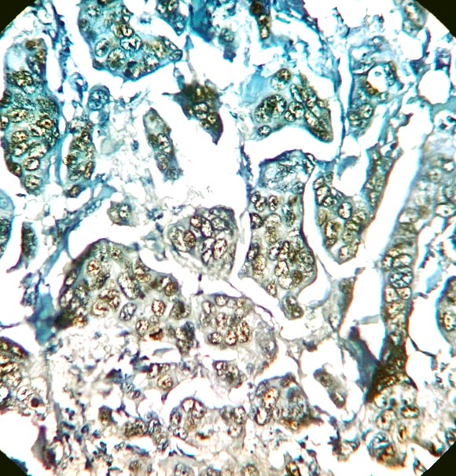
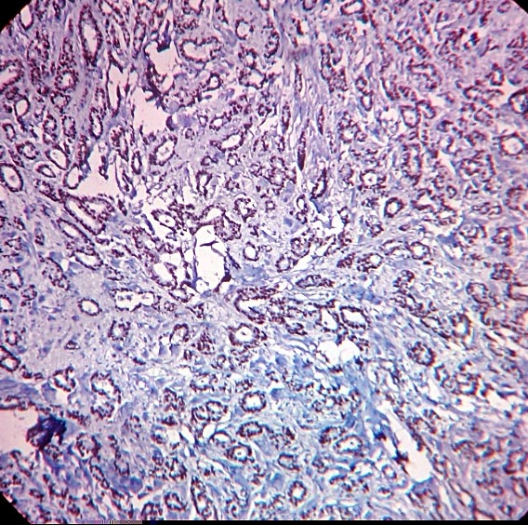
ER+, Allred score 8/8
Luminal A: tubululobular histology

Slide 33
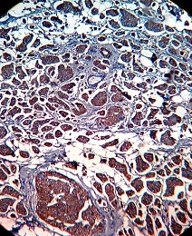
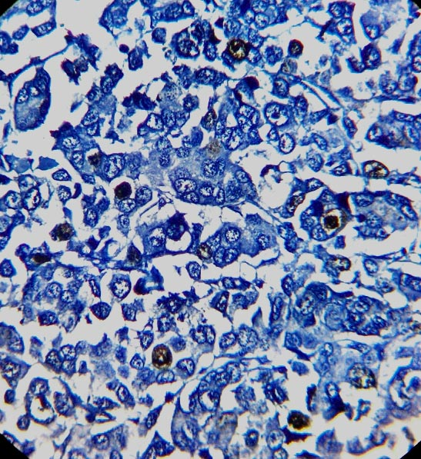
Her2 neu-3+
Ki67 high expression

Slide 34
Results and interpretations
IHC analysis for ER and PR showed very low ER and PR expression in young age[28%, 27%] group which is a complete opposite in elder group with higher expression 73%. It indicated a significant statistical correlation with P value less than 0.001
Her2 neu status was similar in both the group s[19%, 20%]
Ki67 expression for degree of proliferation showed high grades are more frequent[57%] in younger age group whereas for elder group moderate grade of proliferation is common[53%]

Slide 35
Table -1 : Comparison of clinicoPathological characteristics of Patients > 44 years and <45 at diagnosis
Charactertics > 44 < 45 P value
Tumor subtype <0.001
Luminal A 19 110
Luminal B 22 40
Her2 overexpressing 25 39
Triple negative 67 28
Unknown 76 117
Adjuvant Chemotherapy
Yes 163 212
NO 46 132
Adjuvant Tamoxifen
Yes 64 [30%] 207[61%]
No 145 [ 70%] 127 [39%]
DFS[2 yrs] 174[83%] 304[91%]
------------------------------------------------------------------------------------------------------------------------- ----
Disease free survival=DFS

Slide 36
Results and interpretations
While analyzing tumour subtypes elder age group had 51% Luminal A whereas Younger women only 12%.
Younger women tumours were belonged to triple negative type in 50% which is far above the level of 12% in other group.Tumour types correlation showed a statistically significant relationship.
Women age <44 were treated more frequently with chemotherapy[78%] than >45 age group where this group received Tamoxifen more commonly 61% in contrast to 30% in other group.
When compared for disease free survival [DFS]of two years younger women recorded more disease related events than with 83% than elder counterpart with 91%.

Slide 37
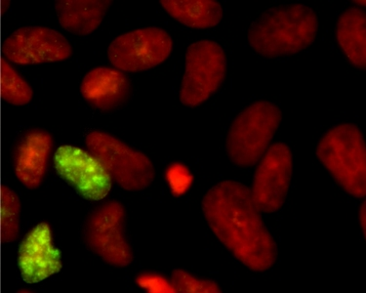

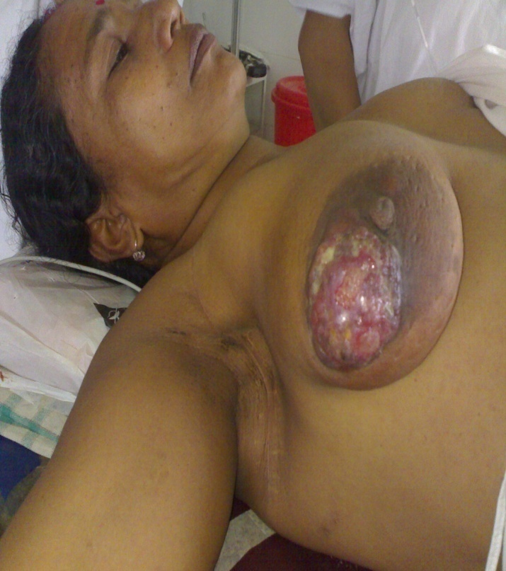

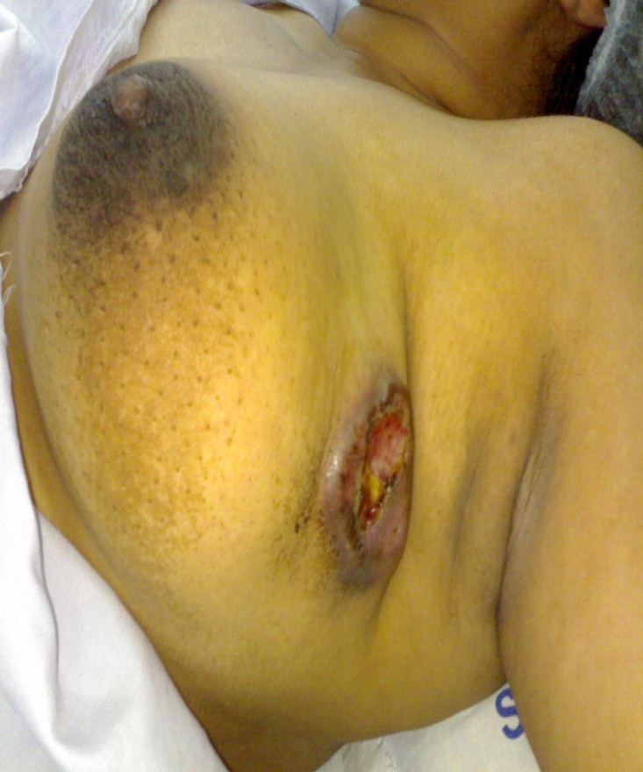
Young Assamese women <44 years
1

Slide 38
Discussion & observation[I]
A total of 543 Assamese Indian women diagnosed with BC was analyzed, but some of women could not be evaluated in some parameters or others clinically, histopathologically Immunohistochemically or completely followed up due to certain limitations specially in retrospective cases.
Our study showed 38% affected in <44 years age group with median range of 27-44 years which were mostly premenopausal excepting a few. This is very comparable to the data of Hospital Based Tumour Registry of this region.
BC in younger age found to be many times higher in Assamese Indian than American Women and European Women.

Slide 39
Discussion[II]
But the mean age of >45 year category was only 52 years. Which means overall scenario of breast cancer is common among young Assamese and Indian Women which is similar to study , Saxena et al 2005. and Gogoi et al.2012
Understanding the average menopausal age of study population, cases were divided as <44 and >45, our study showed 90% cases attained menopause by 45 years.
-------------------------------------------------------------------- Saxena et al. Clinico-morphological patterns of breast cancer including family history in a New Delhi hospital, India-A cross-sectional study, World Journal of Surgical Oncology 2005, 3:67

Slide 40
Discussion & OBSERVATIONS[III]
Our study did not reveal any significant family history of breast or ovarian cancer in blood relatives with 10% than 7% in other similar to studies like Rudat et al 2012.
When observing the data of both younger and elder, commonest size of tumour at the time of diagnosis T2 [2-5 cm in size] 58% and 41% respectively .
------------------------------------------------------------------
T. Aryandono, Harijadi, and Soeripto, “Breast cancer in young women: prognostic factors and clinicopathological features,” Asian Pacific Journal of Cancer Prevention, vol. 7, no. 3, pp. 451–454, 2006

Slide 41
Discussion[III]
Our data showed that young age is an independent prognostic factor of breast cancer patients similar to study, Rudat et al 2012
Breast cancer in young age under 44 years old mostly belonged to T2 stage , higher positive Axillary lymph node, higher grade, which is similar to findings of Sundquist et al[2001] and Aryandono et al,2006.
Similarity was found in Sundquist ’s study that the proportion of grade 3 tumors decreased with age (Sundquist et al. in contrast to Aryandono et al,2006 study without this significance.
-----------------------------------------------------------------------------------
Sundquist M, Thorestenson S, Brenden L, Wingren S, Nordenskjold
B (2001). Incidence and prognosis in early onset breast cancer.The Breast, 11, 30-5.

Slide 43
Discussion
It showed that tumor in young age had high proliferation activity which was studied by Ki67 expression pattern which also validate findings of Gogoi et al 2014 from same tertiary care centre .
Our findings in younger group showed lower ER positive tumours[27%] than >45 age group with 73% which is comparable with papers in the literature (Sidoni et al.,2003; Daidone et al., 2003) that usually older women with breast cancer has higher positivity of ER & PR.
This group of young patients is not likely response to hormonal treatment or manipulation and they belonged to TNBC or Her2 over expressed category

Slide 44
G3 tumours decrease with age

Slide 45
Her2 expression in various studies
younger age older age
Agrup et al 27%
Rudrigues et al. 48% 28%
Aryndono et al 74% 55%
Our study 20% 19%

Slide 46
Discussion
Her2 expression was 20% in younger women which was almost similar to elderly with group 19% expression . it was observed that this group of patient associated with other poor prognostic factors.
While looking at lympho vascular invasion in tumour, it did not reveal any significant trend between two categories.
In both the groups equal women underwent lumpectomy[16%] and MRM[84%]
As young women were mostly negative for ER and PR, and also large numbers of them were node positive so they were given adjuvant chemotherapy[77%]
.
Adjuvant chemotherapy was given along with tamoxifen to >45 group also as good numbers of then were belonged to node positive category.

Slide 48
Discussion
As this is a ongoing study, 5 year survival outcome are yet to be completed, we have of 2 years data of DFS which showed 83% in younger group than 91% of older group
. So this trend is definitely showing a poorer prognosis to younger women category
The breast cancer in young women< 44 showed more aggressive phenotype than >45, although the later group usually diagnosed in more advanced stage, AJCC stage in 41%.

Slide 51
Discussion
.
It was observed that BC in young women showed higher proliferation rate than elderly group, also they had lower positivity for ER &PR with higher TNBC.
They received adjuvant chemotherapy more commonly than tamoxifen.
The recurrence ,metastasis and death were still higher in young than elderly patients. It seemed that BC in young and older women has different biologic behaviour, and further research is needed.

Slide 54
Younger age women prognostic factors which could be of more taken into consideration is TNBC and high proliferation fraction in tumour cells.
Higher proliferation of tumours likely to be linked to age and hence poorer survival.

Slide 55
Discussion
But when strongest prognostic factors like nodes and metastasis are considered, they were no significant difference between two groups.
Still taking that background, two years disease free survival was taking a poorer outcome in compared to >45 group of Assamese women.
So young age itself is a independent prognostic indicator over and above standard predictive and prognostic criteria.
This is a ongoing study, 5 years survival outcome will complete 2018.

Slide 56
Conclusion & future perspective
Patients ≤44 years exhibited more often triple negative and less frequently luminal A tumors compared to patients >45 years.
Moreover in general , BC is frequent in much young age group in Assamese Indian women, poor survival may not be only due to presentation in advanced stage, likely contribution of poor survival due to young age factor which determines disease aggression which was observed in the study

Slide 57
Future perspective
One project funded by Indian council of Medical Research is going on study of types of breast cancer on Assamese women with special emphasis on TNBC
Another ICMR approved project is about to begin on germline mutation spectra on BRCA mutation 1 and BRCA 2 genes in multi ethnic breast cancer patients from North eastern India based on sequencing.

Slide 58
This world is moved not only by the mighty shoves of the heroes but also by the aggregates of the tiny pushes of each honest worker.
– Hellen Killer

Slide 59

THANK YOU

Slide 60
Sunita Saxena, Bharat Rekhi, Anju Bansal, Ashok Bagga, Chintamani, and Nandagudi S Murthy Clinico-morphological patterns of breast cancer including family history in a New Delhi hospital, India-A cross-sectional study, World Journal of Surgical Oncology 2005, 3:67
M. Elizabeth H. Hammond; Daniel F. Hayes; Mitch Dowsett; American Society of Clinical Oncology/College of American Pathologists Guideline Recommendations for Immunohistochemical Testing of Estrogen and Progesterone Receptors in Breast Cancer, Arch Pathol Lab Med. 2010;134:907–922.

