Slide 1
Origin of breast cancer metastasis
Gaspar Banfalvi
University of Debrecen
Department of Biotechnology

Slide 2
Aim
Abdominal organs are frequent targets of cancer cell invasion, but less known for their metastatic potential to other organs, particularly to breast.
Our aim was to follow the common steps of abdominal tumor cell progression in rats upon i.p. administration, subrenal or subhepatic implantation of solid tumor and leukemia cells and mimicking their migration with inorganic colloidal particles.
2

Slide 3
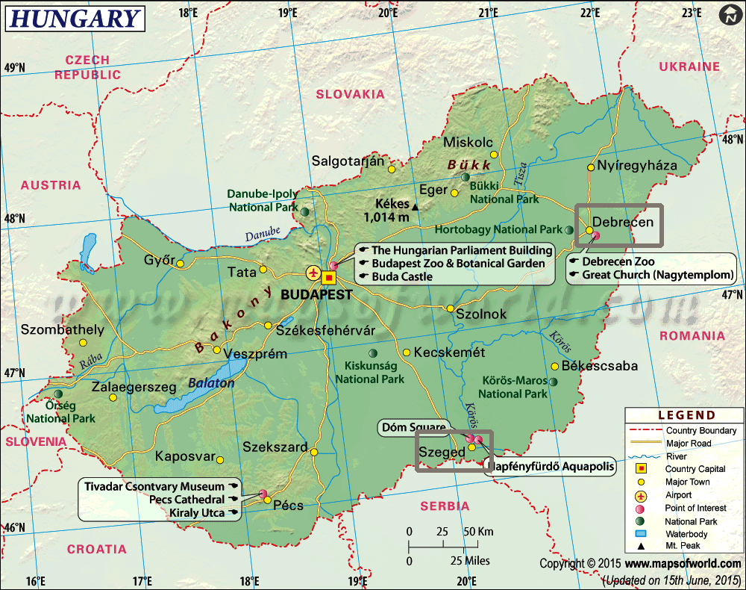
The work was started at the Univerity of Szeged and continued at the University of Debrecen
3

Slide 4
Tumor diagnostics – Szeged University : chloride, colloid, and macroaggregate prepared in 1970
Conclusion: after i.v. administration
In-chloride: acidic solution, circulated with blood
could be used in small quantities (0.1-0.2 ml)
(but not recommended)
In-colloid: accumulated in the liver (recommended and used)
In-Fe-macroaggregate: caused microembolization in the lungs of rats (the particle size was unreliable and large particles coukd cause death, thus it could not be used in human diagnostics (counterindicated)
3

Slide 5
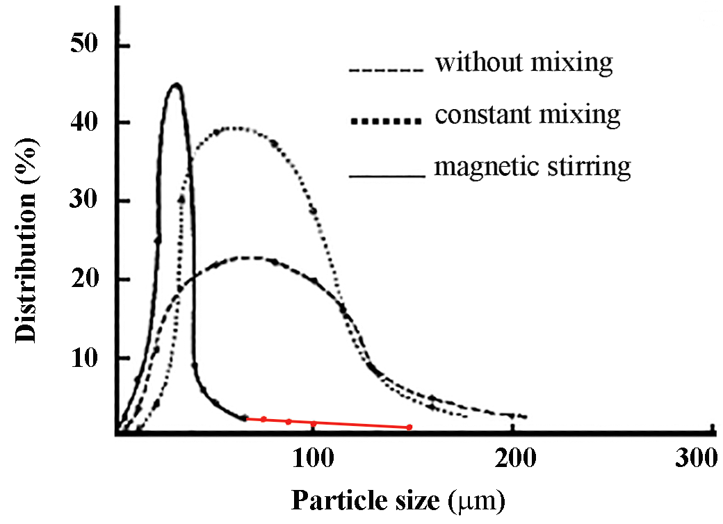
macroaggregate formation
(not to be used)
(not to be used)
(not to be used)
……… life threatening particle size
4

Slide 6
Organ distribution of i.v. administered ^{113m}In-colloid particles in rats
Liver 85-90 % (Kupffer cells)
Spleen 3-5 %
Bone marrow 5-10 %
Primary lymphoid organs:
- bone marrow, and the thymus
Secondary lymphoid organs:
- lymph nodes, tonsils, spleen, and
- "MALT" (mucosa- associated lymphoid tissue, Kupffer cells of
the liver, microglia of the central nervous system
Reticuloendothelial system (RES) = Mononuclear phagocytic system and lymphoreticular system
5

Slide 7
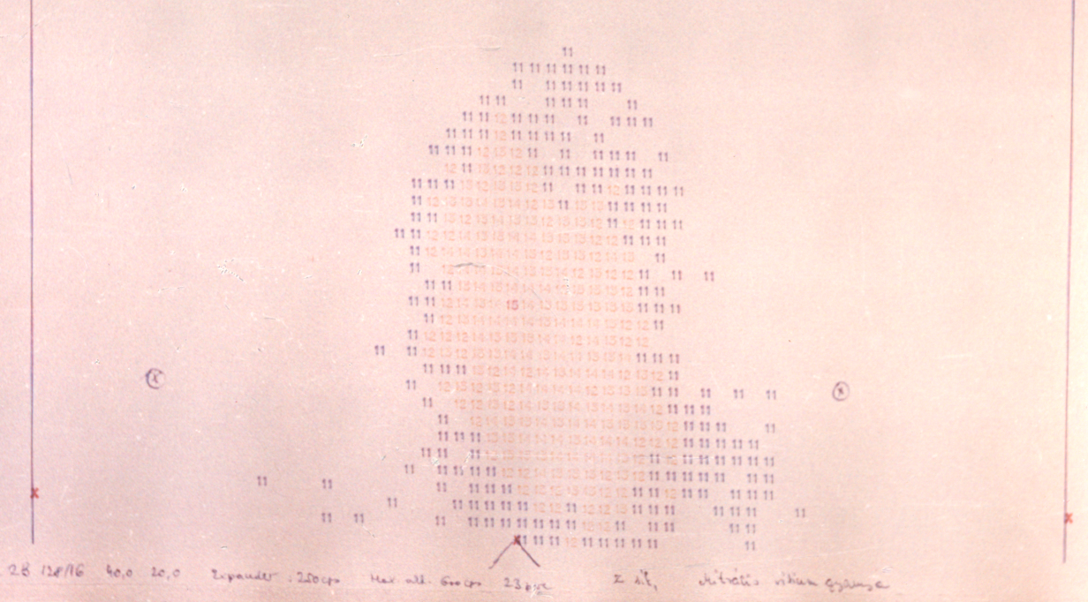
Heart scintigraphy with ^{113m}InCl₃ solution
Banfalvi, G. Production of ¹ ^{13m}In-preparations suitable for diagnosis
PhD dissertation , 1971, University of Szeged, 1st Department of Medicine
6

Slide 8
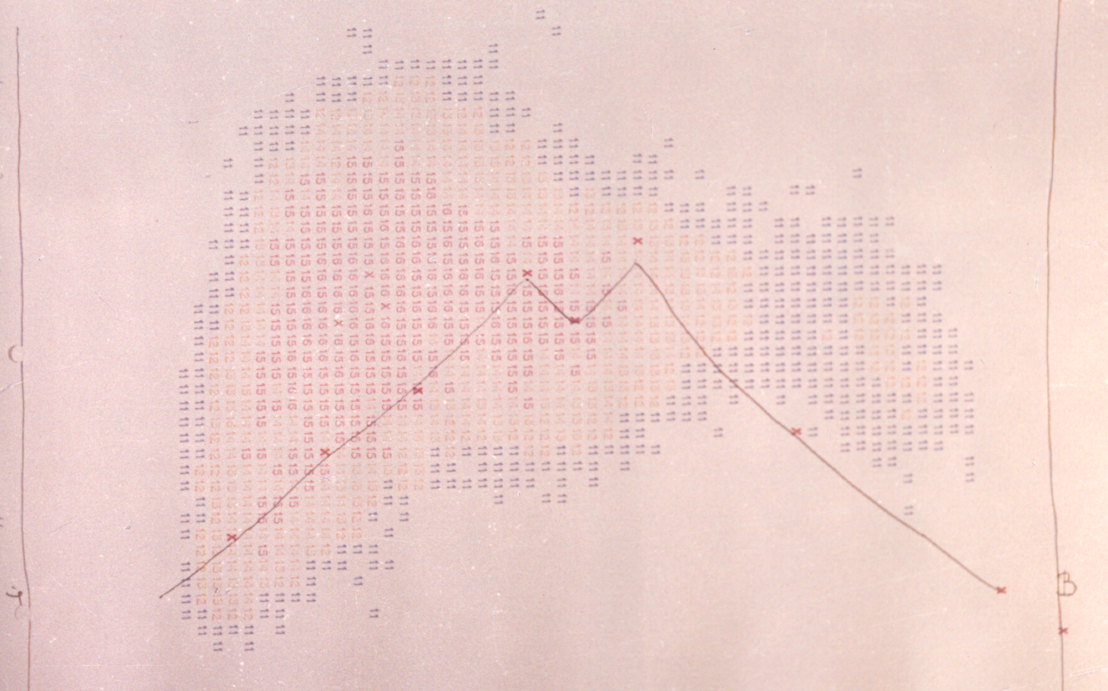
Normal liver scintigram
Bánfalvi , G. Banfalvi, G. Production of ¹ ^{13m}In-colloid suitable for liver scintigraphy
PhD dissertation, 1971 Szeged, Department of Internal Medicine
7

Slide 9
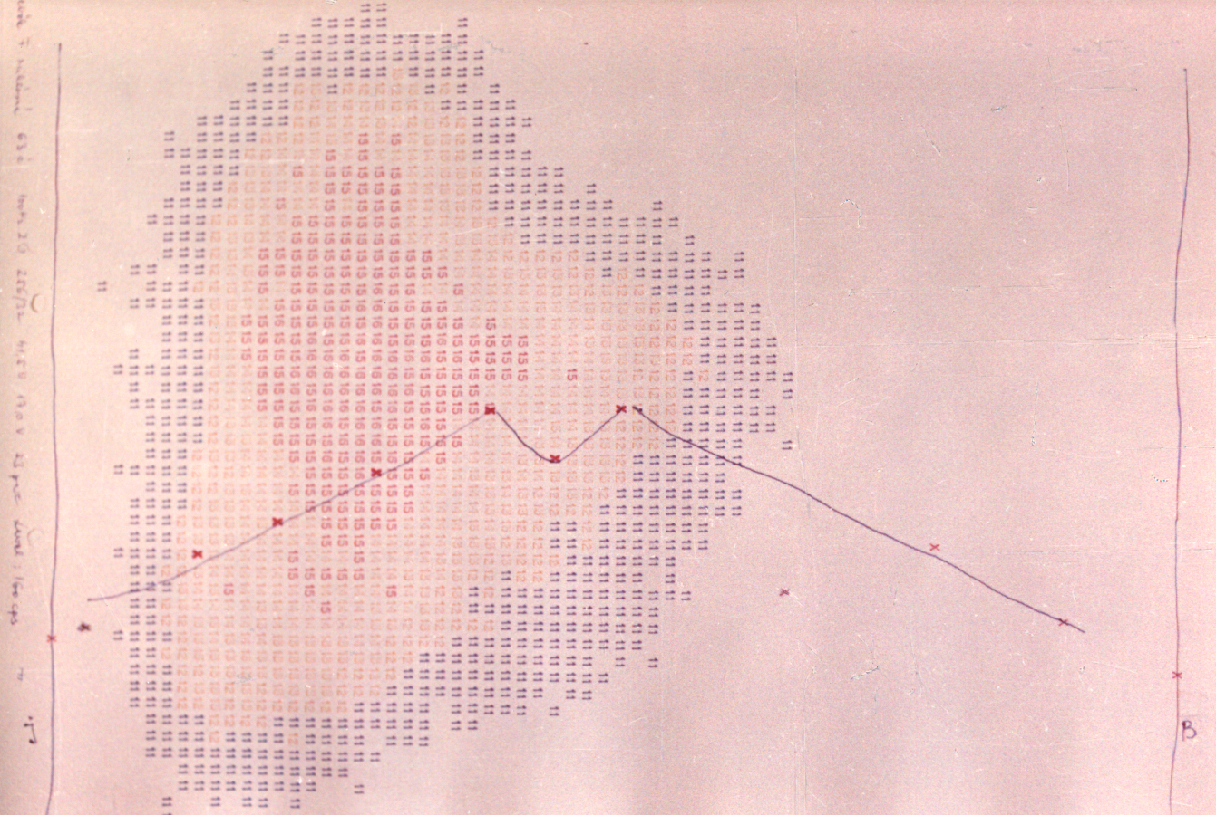
Hepatomegaly
8

Slide 10
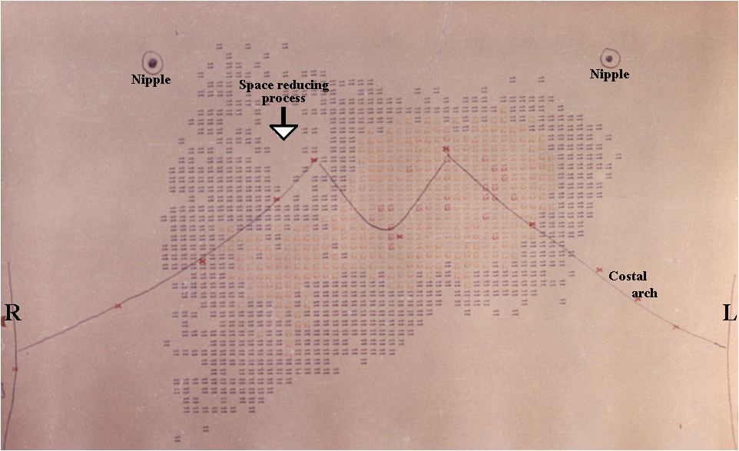
Tumor in the liver
Human liver scintigraphy using ¹¹³In-colloid. In the upper right corner of the liver there was no colloid accumulation indicative of an abnormal process. Medical University, Szeged.
Ist Department of Internal Medicine (¹¹³In-colloid prepared by G. Banfalvi in 1970).
9

Slide 11
Colloid (nano) particles in the organism: Similar to ultrafine particles, nanoparticles are sized between 1 and 100 nanometers Colloid particles are between 1 nm and 10 micrometers - viruses, - bacteria, - yeast cells, - cancer cells (cancer cells often are different in their sizes and shapes) - cell remnants, - carbon particles (e.g. India ink) - thin fibrous crystals of asbestos Foerign particles are attacked by white blood cells: - granulocytes, - monocytes, - lymhocytes) Debrecen cancer cells >
10

Slide 12
Tumor biology in Debrecen Primer cells, cell culture, cell line
Clinical isolate Part of tumor Sliced tumor Elastase digestion Cell culture
(melanoma) (2x2x2 mm)
Melanoma obtained from Department of Dermatology
Tumor cell line: Melanoma Debreceniensis (Me/De) (2008)
Establishment of He/De, Ne/De, My1/De, My2/De, Me/De cell lines
11

Slide 13
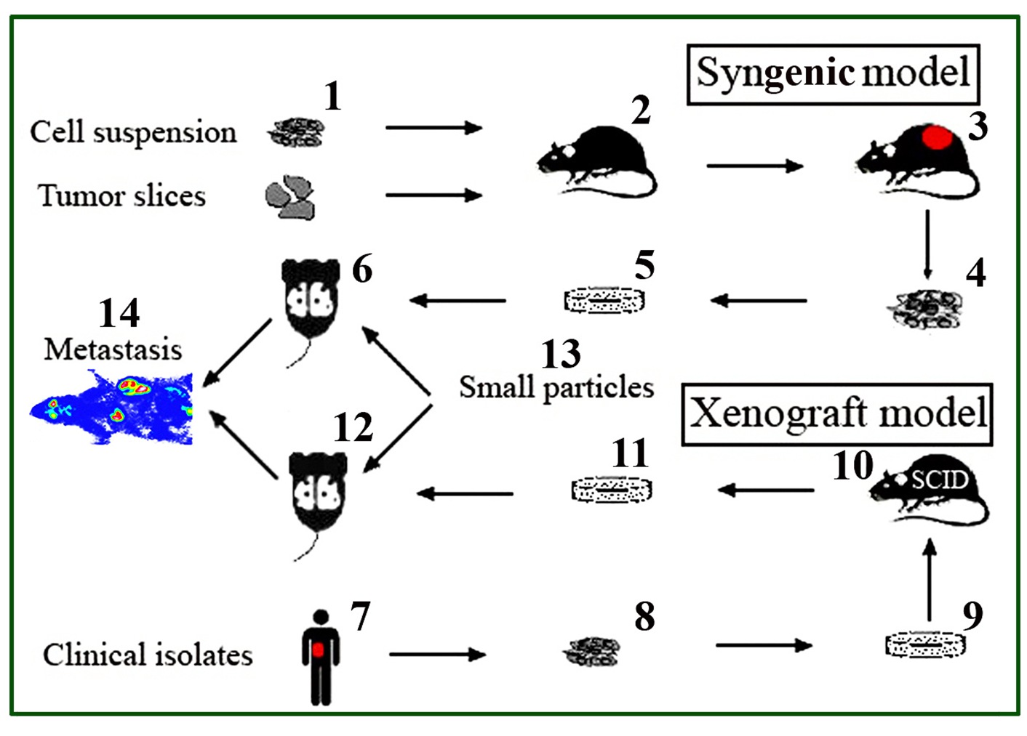
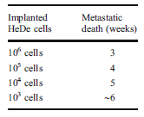
Syngenic and xenograft tumor models
Timing of metastasis formation :
In model experiments we have used healthy mice and mice suffering in Severe Combined Immuno-deficiency (SCID) characterized by the inability to sustain an appropriate immune response against the tumor cell lines implanted. Tumor cell lines obtained from human tumors (liver, spleen, lung, kidney): implanted under the kidney capsule. Due to the absence of T and B lymphocytes tumor cells grow in SCID mice. Nanoparticles carrying the specific antitumor agent will be targeted to the sites of tumor growth. The comparison of syngenic model with the xenograft model in itself is expected to reveal the advantage of the presence of lymphocytes in supporting chemotherapy
12

Slide 14
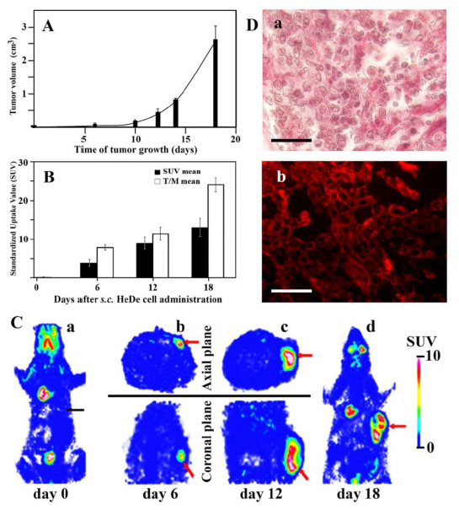
Local tumor formation upon administration of tumor cells by:
subcutaneous (s.c.)
injection
Trencsenyi G, Marian T, Bako F, Emri M, Nagy G, Kertai P, Banfalvi G. Metastatic hepatocarcinoma He/De tumor model in rat. J. Cancer. 5(7), 548-558 (2014).
13

Slide 15
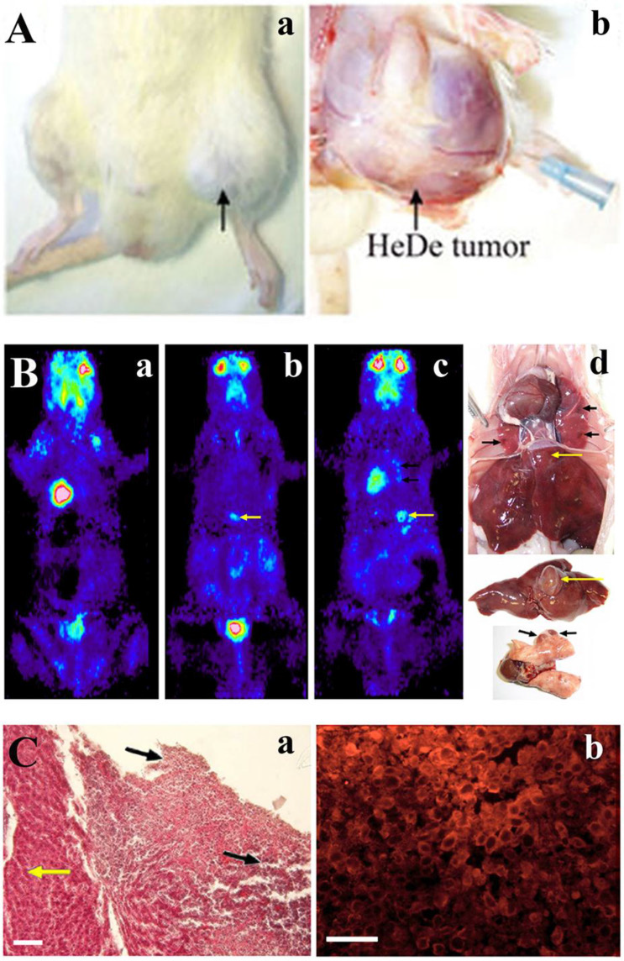
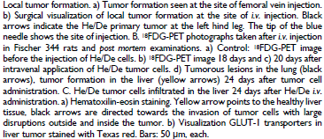
Local tumor growth:
intravenous (i.v.) administration
A
B
Trencsenyi G, Marian T, Bako F, Emri M, Nagy G, Kertai P, Banfalvi G. Metastatic hepatocarcinoma He/De tumor model in rat. J. Cancer. 5(7), 548-558 (2014).
14

Slide 16
Subrenal rat implantation model He/De, Ne/De, Me/De, My1/De, My2/De hepatocarcinoma, nephroblastoma, melanoma , myeloid leukemia, myeloid leukemia
PTN
Trencsenyi G, Nagy G, Kahlik B, Kertai P, Kiss A, Banfalvi G. Lymphoid metastasis of rat My2/De leukemia.
Leukemia Res. 38, 586-593 (2014).
15

Slide 17
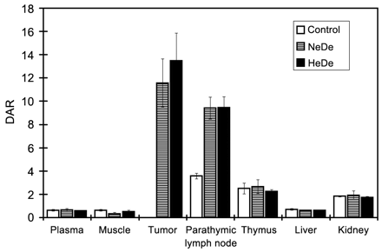
Tissue distribution of radioactivity after i.v. administration of ¹⁸FDG in Ne/De or He/De tumor-bearing rats
Metabolism:
high in primary tumors and
in PTNs
low in other tissues
Metastatic potential of Ne/De and He/De cells, plasma, muscle, tumor, parathymic lymph nodes, thymus, liver and kidney expressed as DAR (differential absorption ratio).
Trencsenyi G., Kertai P., Bako F., Hunyadi J.,Marian T., Hargitai Z., Pocsi I., Muranyi E., Hornyak L. and Banfalvi G. Renal capsule - Parathymic lymph node complex: A new in vivo metastatic model in rats. Anticancer Res. 29(6):2121-2126 (2009)
16

Slide 18
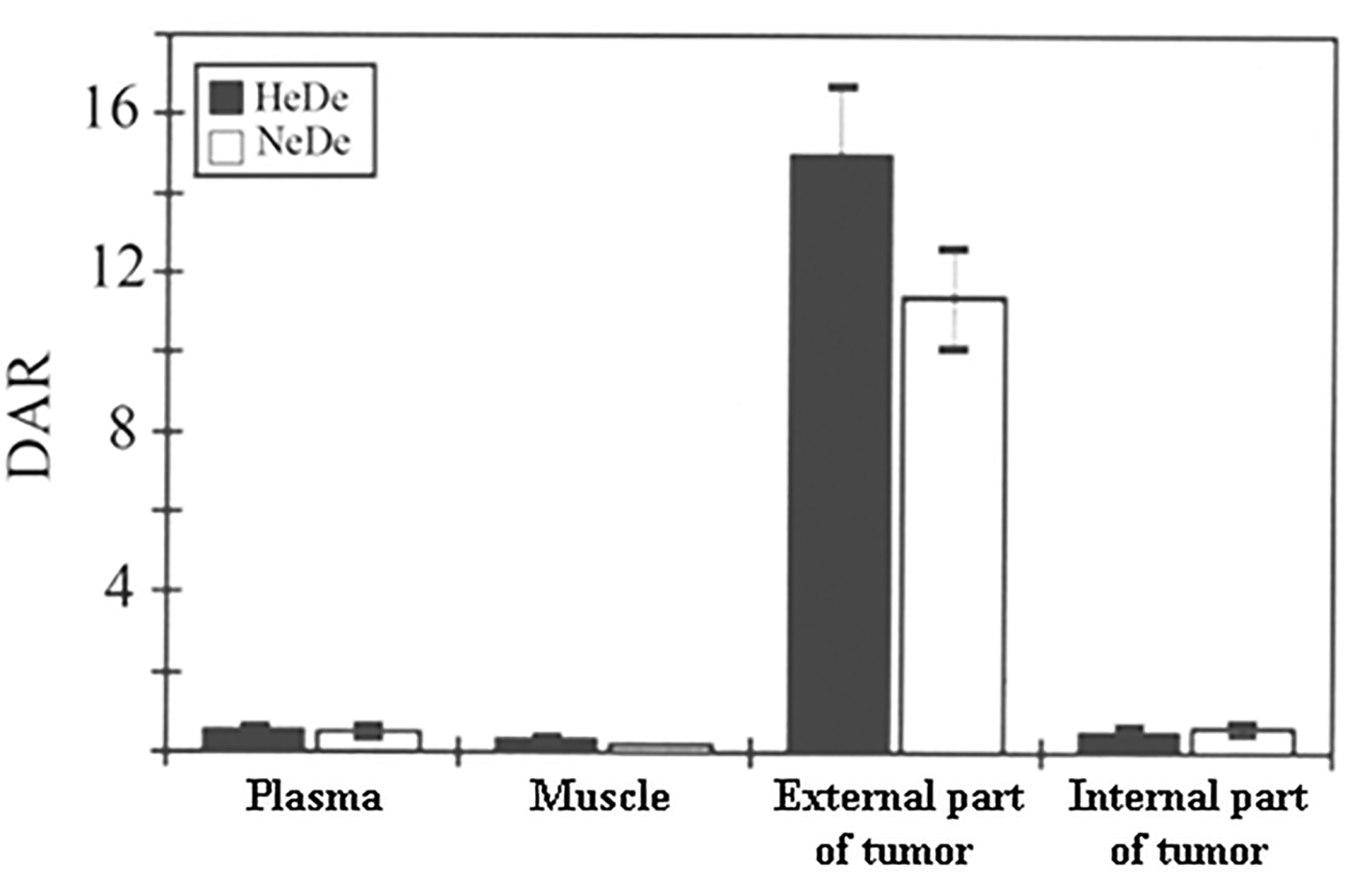
Tissue distribution of ¹⁸FDG in the inner and outer part of the tumor
Metabolism:
high in external part of
primary tumors
low at inner part of tumors
Outward tumor growth and inward necrosis of HeDe and NeDe tumors expressed as DAR (differential absorption ratio).
Trencsenyi G., Kertai P., Bako F., Hunyadi J.,Marian T., Hargitai Z., Pocsi I., Muranyi E., Hornyak L. and Banfalvi G. Renal capsule - Parathymic lymph node complex: A new in vivo metastatic model in rats. Anticancer Res. 29(6):2121-2126 (2009)
17

Slide 19
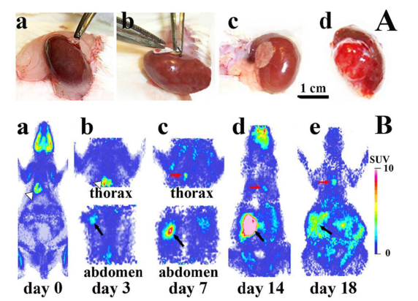
Subrenal implantation of tumor cells
Trencsenyi G, Marian T, Bako F, Emri M, Nagy G, Kertai P, Banfalvi G. Metastatic hepatocarcinoma He/De tumor model in rat. J. Cancer. 5(7), 548-558 (2014).
18

Slide 20
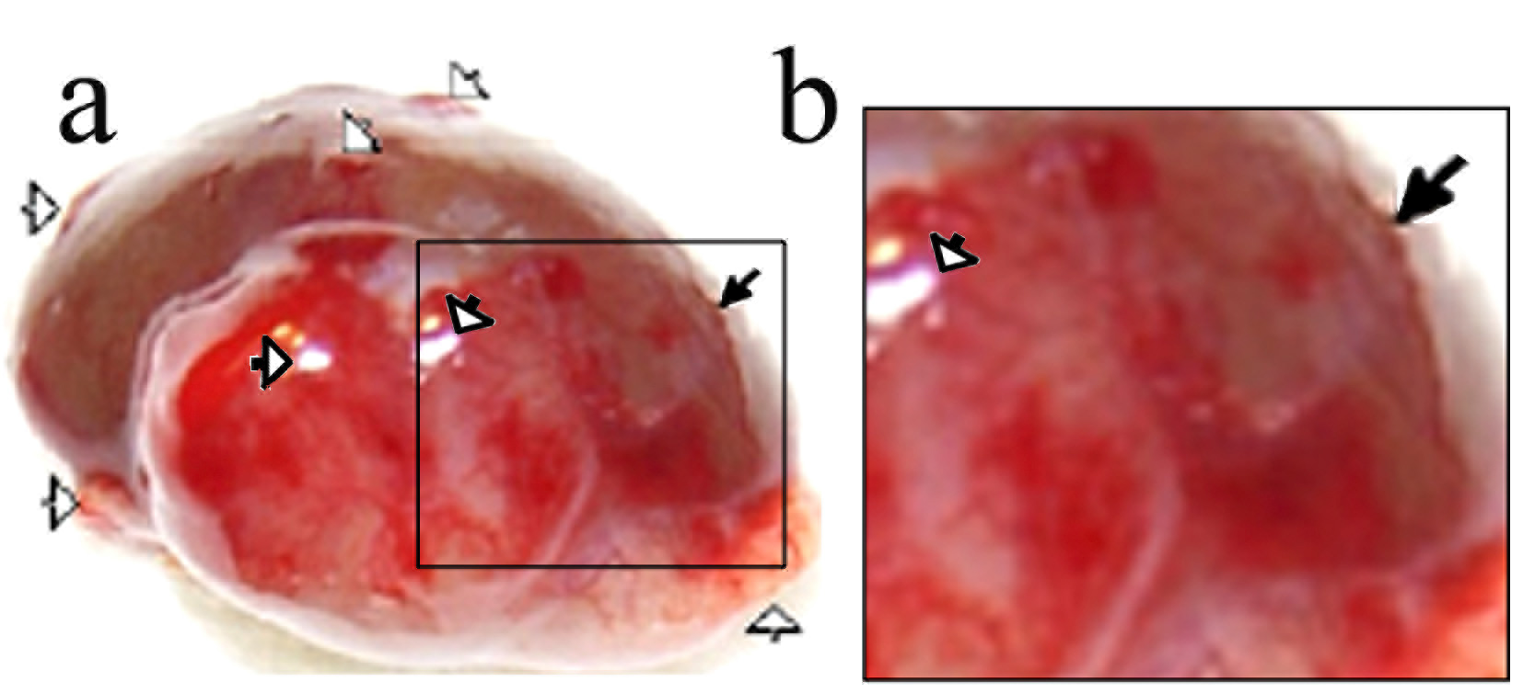
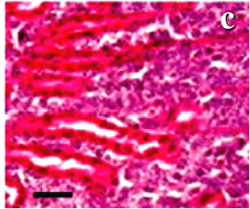
Lagging angiogenesis during tumor formation (after subrenal implantation of HeDe cells)
Tumor growth outward with disruption of capillaries, blood and tumor cells pour out through the disruptions.
Trencsenyi G., Kertai P., Bako F., Hunyadi J.,Marian T., Hargitai Z., Pocsi I., Muranyi E., Hornyak L. and Banfalvi G. Renal capsule - Parathymic lymph node complex: A new in vivo metastatic model in rats. Anticancer Res. 29(6):2121-2126 (2009)
19

Slide 21
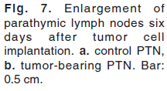
Subrenal implantation of nephroblastoma (NeDe) cells Enlargement of parathymic lymph node (PTN)
Rozsa D, Trencsenyi G, Kertai P, Marian T, Nagy G, Banfalvi G.: Lymphatic spread of mesenchymal renal tumor to metastatic parathymic lymph nodes. Histol. Histopathol. 24:1367-1379 (2009).
20

Slide 22
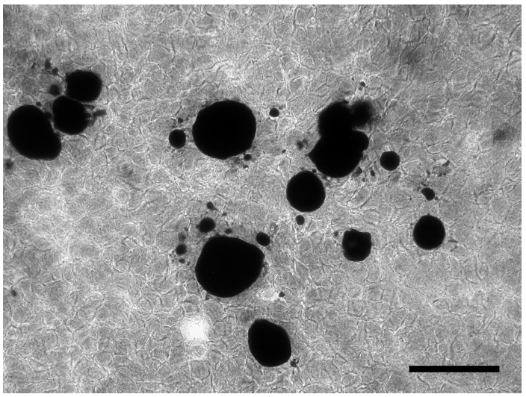
Lipid formation in NeDe primary tumor
Rozsa D, Trencsenyi G, Kertai P, Marian T, Nagy G, Banfalvi G.: Lymphatic spread of mesenchymal renal tumor to metastatic parathymic lymph nodes. Histol. Histopathol. 24:1367-1379 (2009).
21

Slide 23
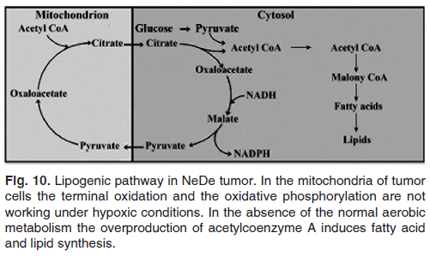
Lipogenesis in NeDe tumor
Rozsa D, Trencsenyi G, Kertai P, Marian T, Nagy G, Banfalvi G.: Lymphatic spread of mesenchymal renal tumor to metastatic parathymic lymph nodes. Histol. Histopathol. 24:1367-1379 (2009).
22

Slide 24
Metastasis in parathymic lymph nodes caused by nephroblastoma (NeDe) cell implantation
Elevated peripheral pressure in abdominal kidney tumor
produces an increased amount of fluid accumulating in the peritoneal cavity.
(Uroperitoneum subsequent to kidney, ureter, bladder, or urethra rupture also cause an increased amount of effusion in the abdomen. Pleural neoplastic effusions are known to occur frequently (Ultmann JE: CA: Cancer J Clin 1962,12:42–50).
c and d) Rat mesenchymal renal tumor cells (Ne/De) transplanted under the kidney capsule of F344 rats pour through the disruptions of blood vessels into the retroperitoneum and
d) cross the diaphragm and appear in the PTNs
Rozsa D, Trencsenyi G, Kertai P, Marian T, Nagy G, Banfalvi G.: Lymphatic spread of mesenchymal renal tumor to metastatic parathymic lymph nodes. Histol. Histopathol. 24:1367-1379 (2009).
23

Slide 25
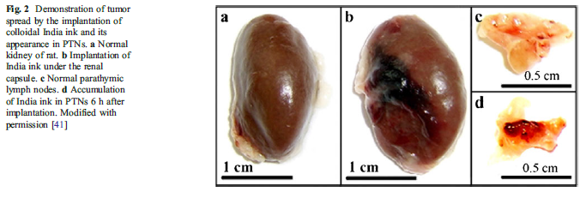
Mimicking metastatic spread by India ink implantation in rats
Banfalvi G. Metastatic view of breast cancer. Cancer Metast. Rev. 31:815–822 (2012)
24

Slide 26
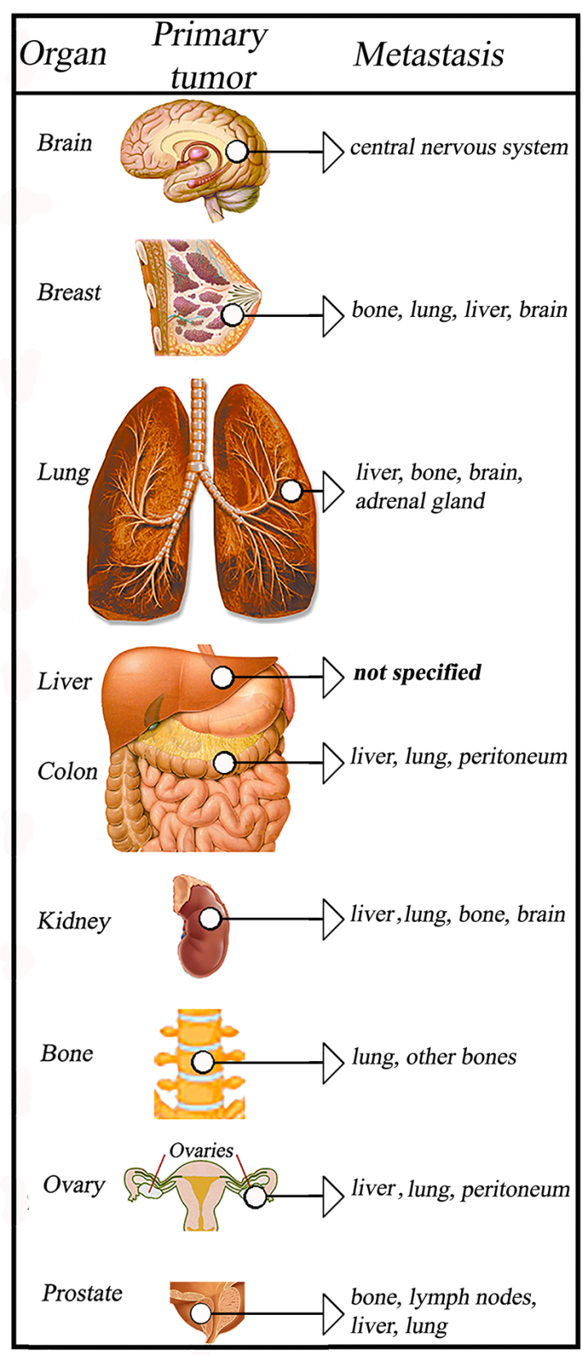
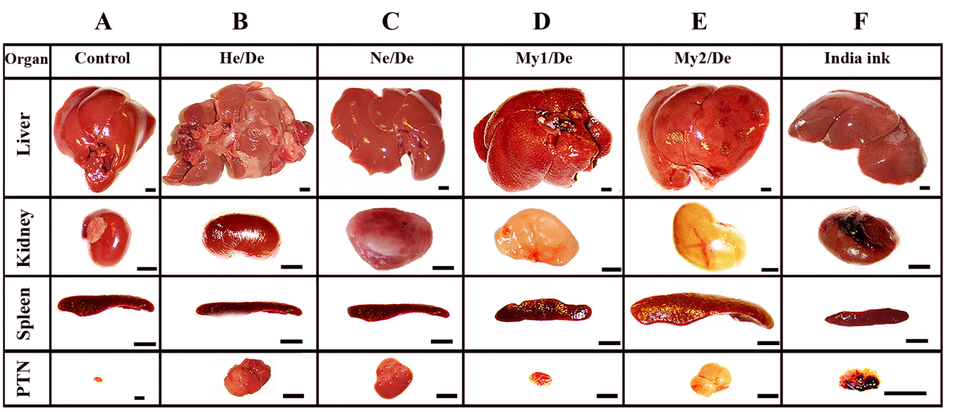
Spread of metastasis
from organs to other organs primarily
to the liver (well known)
from abdominal (peritoneal, retroperitoneal) tumors to parathymic lymph nodes (not well understood)
Metastasis: abdominal primary tumor thoracal (PTN)
mammary lymph nodes
25

Slide 27
Metastatic spread of primary tumor to thoracal and parathymic lymph nodes in rat
Banfalvi G. Role of parathymic lymph nodes in metastatic tumor development. Cancer Metastasis Rev (2012) 31:89–97.
26

Slide 28
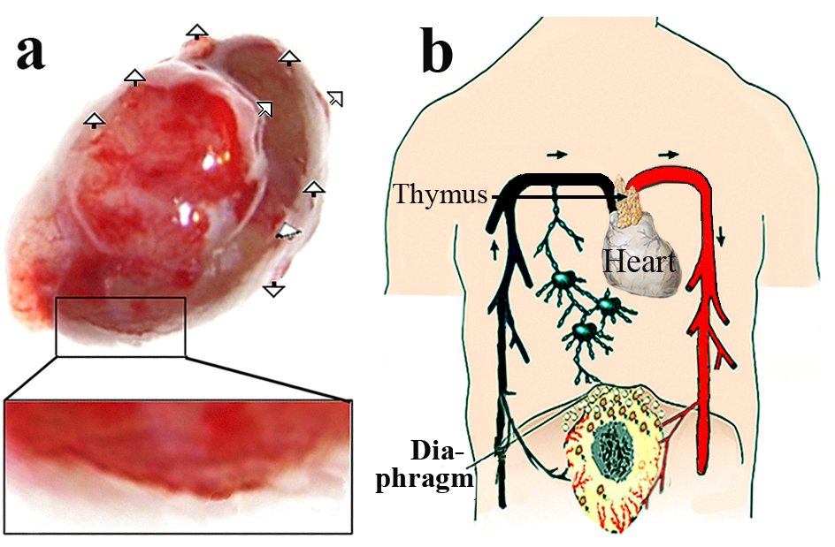
Similar human metastatic spread of abdominal tumors to inner mammary lymph nodes
i) Disruptions in the abdominal primary tumor (arrows in a)
ii) Release of tumor cells through gastrointestinal bleeding of the primary tumor and their appearance in the abdominal space (a)
iii) Migration of tumor cells by pass the hiatuses of the diaphragm (b)
iv) Tumor cells exhaust the defense capacity of the parathymic organ
v) Unchecked tumor cells migrate from the inferior to the superior thoracal lymph nodes and drain to the vascular system (b).
Banfalvi G. Role of parathymic lymph nodes in metastatic tumor development. Cancer Metast. Rev. 31(1-2): 89-97 (2012).
27

Slide 29
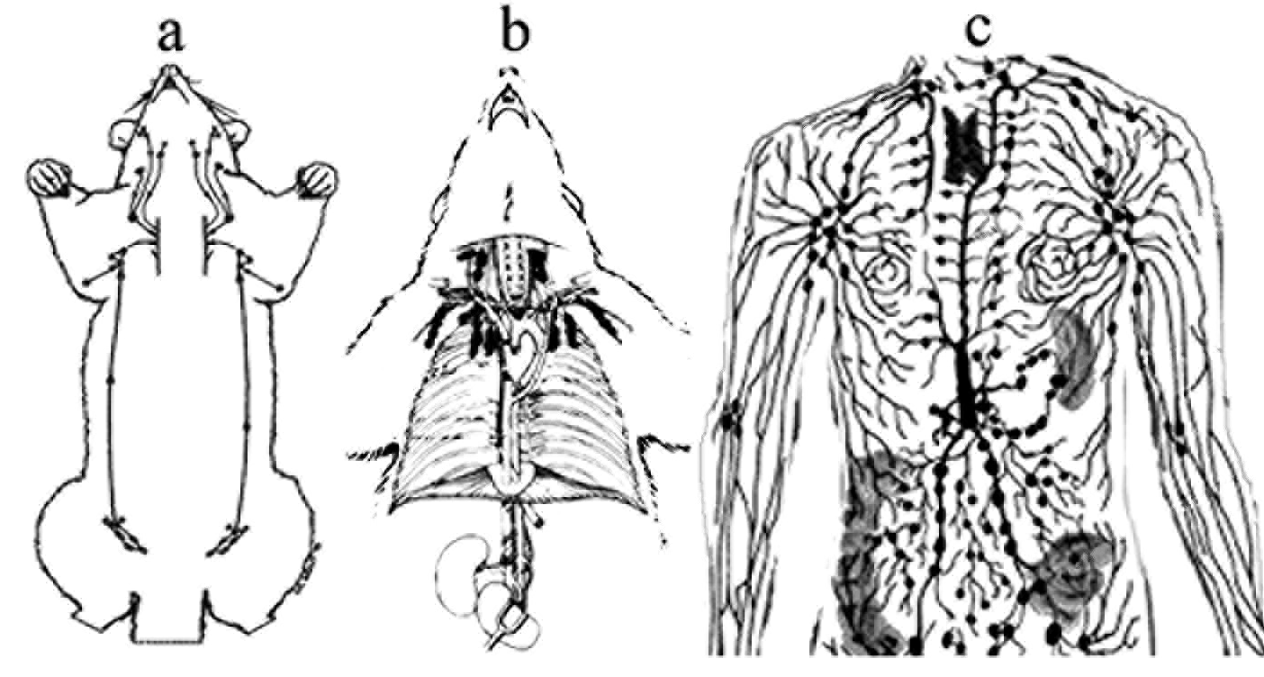
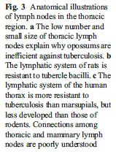
Anatomical illustration of lymph nodes in the thoracic region
Opossum Rat Human
Banfalvi G. Metastatic view of breast cancer. Cancer Metast. Rev. 31:815–822 (2012)
28

Slide 30
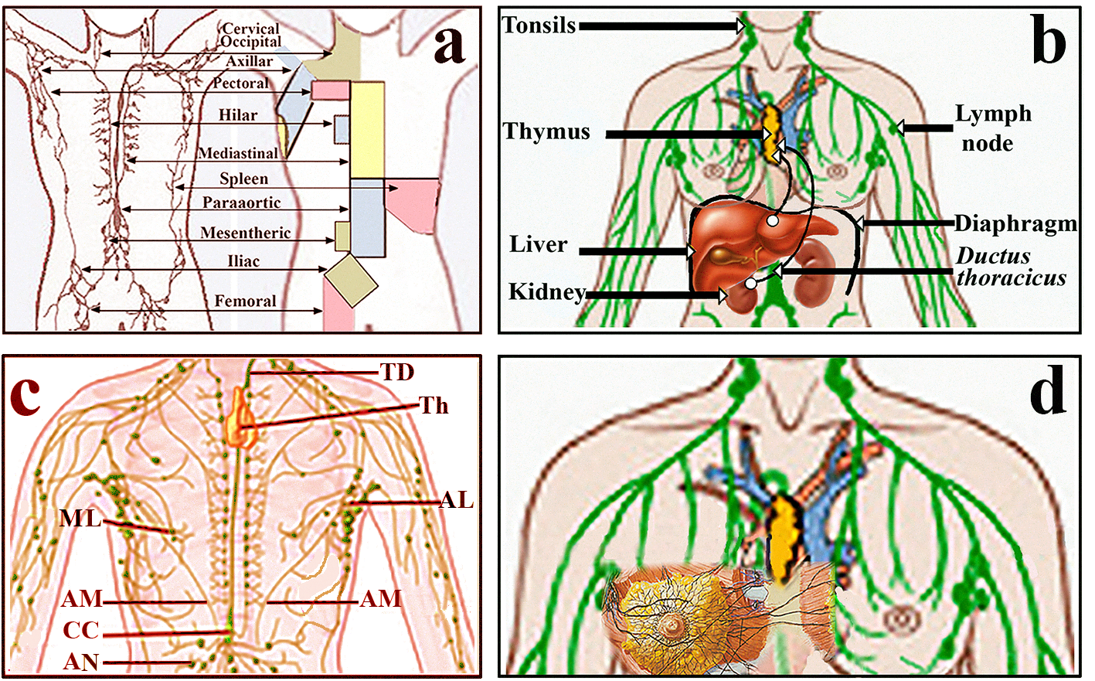
Metastatic spread of abdominal tumors to mammary lymph nodes
29
Banfalvi G. Metastatic view of breast cancer. Cancer Metast. Rev. 31:815–822 (2012)

Slide 31
What did others find?
- High radiotracer glucose analogue uptake in PTNs is in correlation with the inflammatory activity in the liver (1).
After intraperitoneal administration of oncolytic measles virus-infected cells, the dia-phragmatic stomata, thoracic lymphatic vessels, and parathymic lymph nodes contained numerous measles-infected cells (2).
9–45% axillary lymph node tumors drain to the internal mammary lymph nodes (IMLN) (3-6).
In almost all patients the internal mammary lymph node tumor is a forerunner of a metastatic disease (7).
Handley and Thackray concluded that the internal mammary glands may often be invaded before carcinoma has reached the axilla . Their clinical evidence indicates a relatively high incidence (~ 25%) of scondary spread to the breast (8).
There is a direct anatomical connection between abdominal and mammary lymph nodes (9).
Friedrich-Rust et al. Am J Roentgenol 2007,188:758-764.
Peng et al. Human Gene Ther 2003,14:1565-1577
Uren et al. World J Surg 2001, 25:789-793.
4. Bird et al. Ann Surg Oncol 2001, 8:234-240.
5. van der Ent et al. Ann Surg 2001, 234:79-84.
Lamonica et al. Clin Nucl Med 2003, 28:558-64.
Cranenbroek et al. Breat Cancer Treat 2005, 89:271-275.
Handley and Thackray Brit J Cancer 1947, 1:15–20.
Gray Anatomy(1901 edn).
30

Slide 32
Summary
The migration of abdominal tumor cells can be summarized as:
implanted tumor cells cause primary tumors and peripheral disruptions of primary tumors,
tumor cells are shedded into the abdominal cavity,
released tumor cells cross the stomata of the diaphragm,
tumor cells accumulate in thoracal, primarily in parathymic (rodent), inner mammary (human) lymph nodes,
after exhausting the defense capacity of parathymic lymph nodes, metastatic migration continues in the superior lymph node chain before the thoracic duct returns chyle to the vascular system,
colloidal carbon particles mimic faithfully the migration of tumor cells.
31

Slide 33
Conclusions
• The study of abdominal tumor spread to mammary lymph nodes has been neglected earlier due to the belief that mammary tumors are not metastases.
• The metastatic spread of tumor cells released from abdominal primary tumors to PTNs was found by using different cell lines including solid rat liver (He/De), kidney (Ne/De) and leukemia (My1/De, My2/De) cell lines.
• Why human parathymic lymph nodes have not been investigated earlier ? Answer: they were investigated but were known as inner mammary lymph nodes (not to be confused with intra-mammary lymph nodes).
• The significance of potential spread of metastasis from the most often occuring abdominal primary tumors to mammary lymph nodes is emphasized. The spread of abdominal tumors cells to mammary lymph nodes provides a new explanation to the origin of breast metastasis and alternative for prevention.
32

Slide 34
For more information see: Banfalvi G. Homeostasis – Tumor – Metastasis . Springer, New York, 2013. ISBN 978-94-007-7334-9
http://link.springer.com/book/10.1007/978-94-007-7335-6/page/1
Gmail: gaspar.banfalvi@gmail.com
33

Slide 35
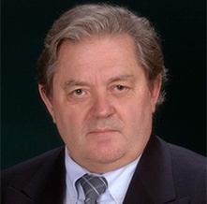
Acknowledgements to
Students:
A B
NP
VR
HP
HT
Nagy, Gábor PhD
Trencsényi ,György PhD
Rőszer ,Tamá,s, PhD Ulm
Ujvárosi , Kinga, PhD
Pintér ,Gábor
Gácsi, Mariann PhD
Szepessy, Edit PhD, MD
Buzder ,Tímea PhD
Rehak Marian PhD
Professors:
• Kertai, Pál, DE
• Hunyadi, János, DE
• Alexei Basnakian, Little Rock
• Németh, Péter, Pécs
• Varda Rotter, Weizmann Intézet
• Henry Paulus, Harvard
• Hans Tanke, Leiden
• Tuneko Okazaki, Nagoya
† Edward Wood, Leeds
• Pócsi, István, head of department
KP
HJ
Technical contribution:
Somogyi, Csilla
Farkas, Erzsébet
Laza, Diána
Sárvári, Anitta
Bakó, Fruzsina
Balogh, Enikő
Pócsi, Imre
Turáni ,Melinda
Tánczos, Bence
Király, Gábor
Tálas, László
Pinczés, Gyula
Kukoricza, Krisztina
Jákim, Judit
Fidrus, Eszter
Vörös, Orsolya
TO
34

Slide 36
Thank you for your attention!

