Slide 1

NEPAL IS ALSO KNOWN AS

Slide 2
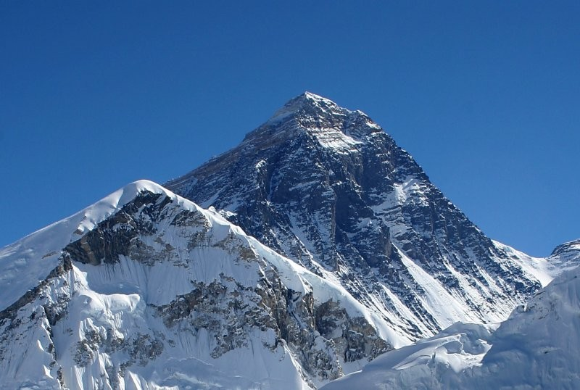
The country of Mount Everest

Slide 3
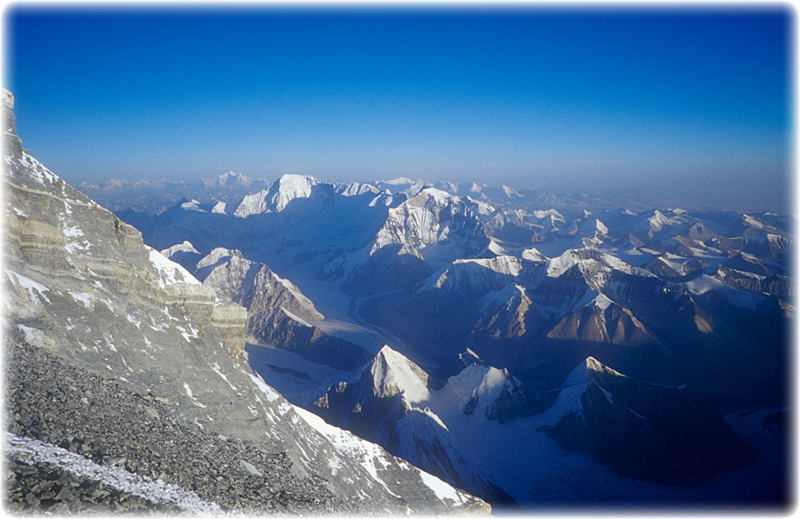
LAND OF HIMALAYAS: 8 OUT OF 10 WORLDS HIGHEST PEAKS ARE IN NEPAL

Slide 4
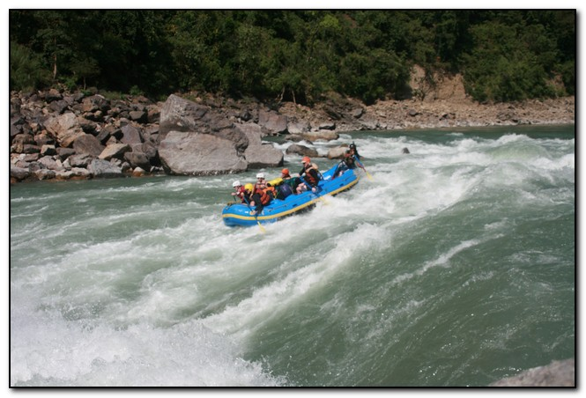
2nd RICHEST COUNTRY IN WATER RESOURCES

Slide 5

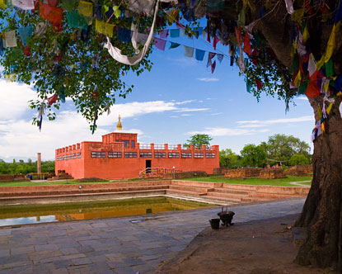
The Birth place of Gautam Buddha; Light Of Asia

Slide 6

The country of Great Warriors: Gorkhas

Slide 7
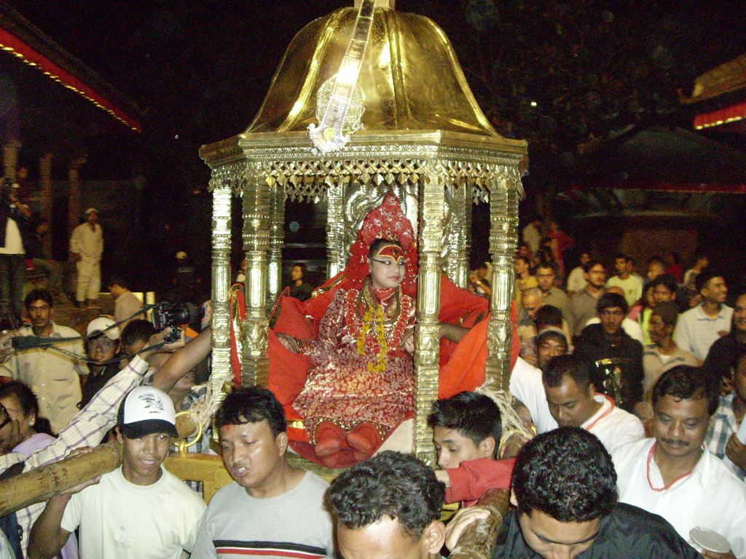
The Land of Kumari; The Living Goddess

Slide 8
Where is Nepal?

Slide 9
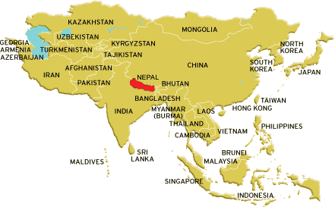
Latitude and longitude 28°00' N and 84°00' E
Nepal is a landlocked country in South Asia, bordered by India on 3 sides and by China on the north.

Slide 10
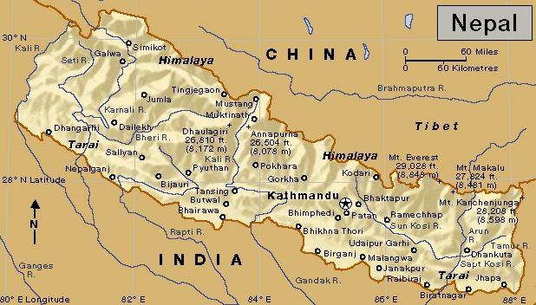
It has an area of 147,181 square kilometers (54,363 square miles), a border of 2,926 kilometers (1,818 miles)- 93rd on size ranking.
Government sources estimate a population of 28,618,668 (2010).

Slide 11
CULTURE AND HERITAGE

Slide 12
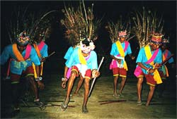
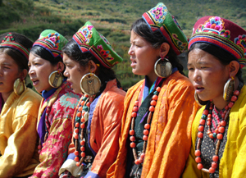

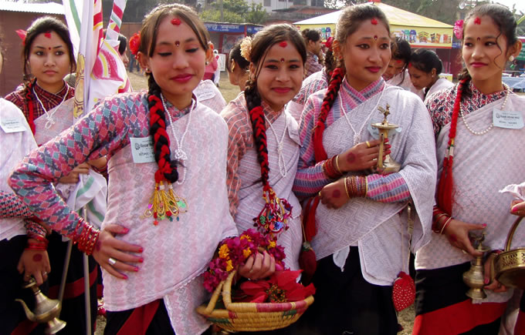
A Tharu dance
Himalayan Sherpa females (Sherpinis)
A hilly region wedding ceremony
A Newari jatra

Slide 13
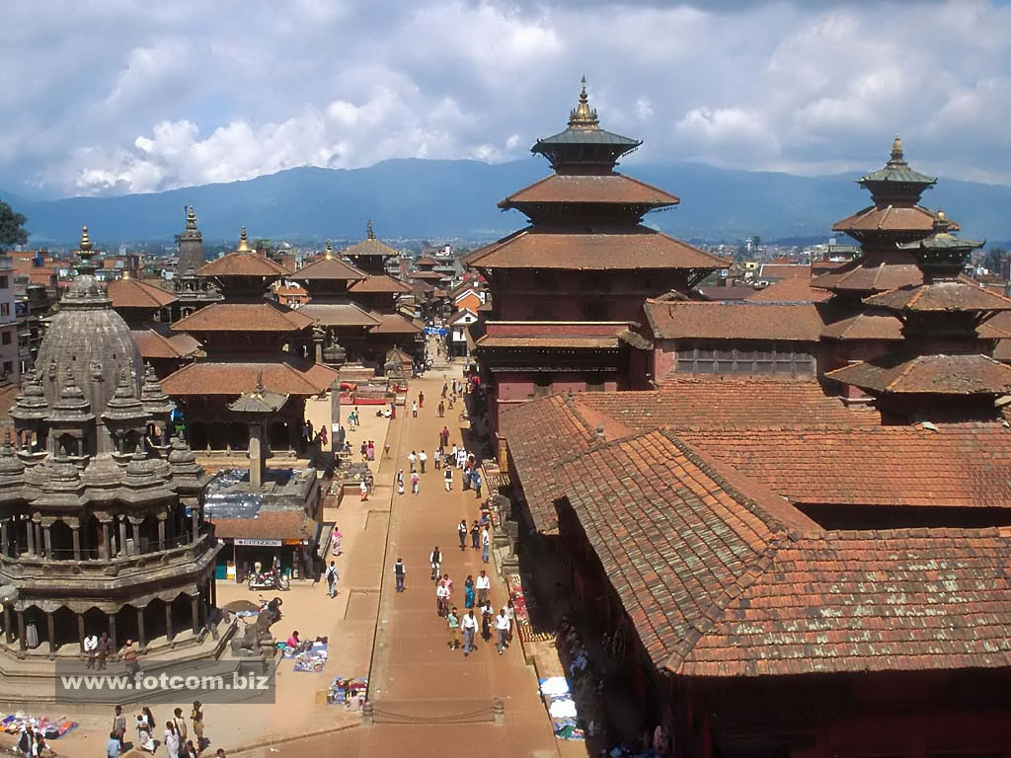
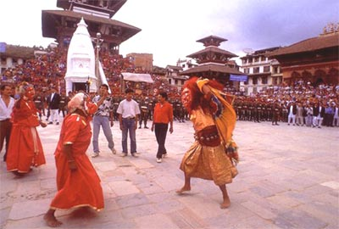
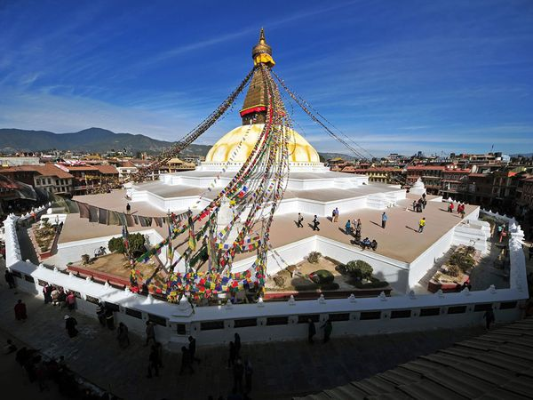
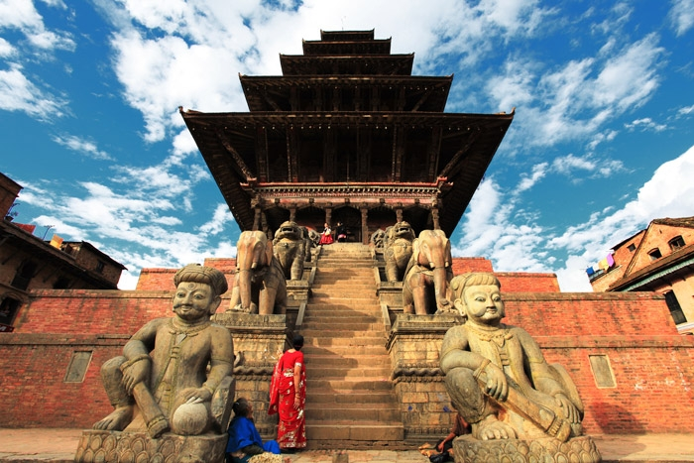
Patan Durbar square
Indrajatra in Kathmandu
Boudhanath Stupa
The 5 storeyed Nyatapola in Bhaktapur

Slide 14
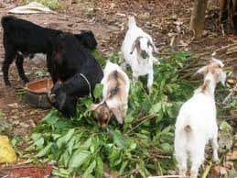
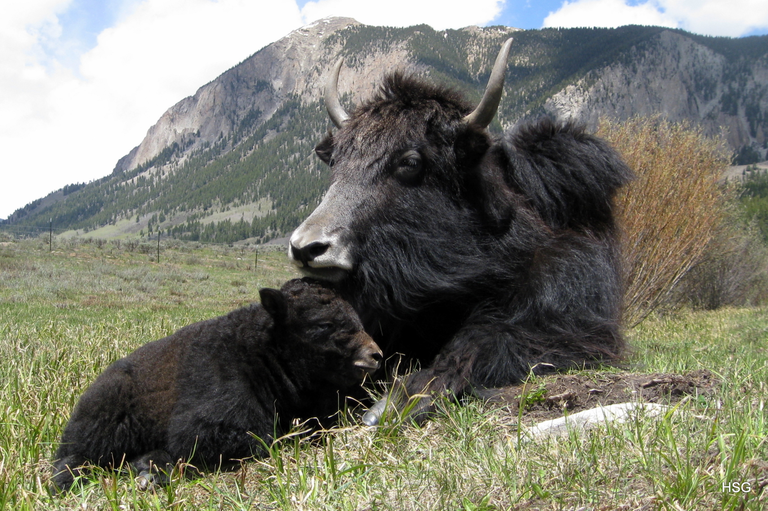
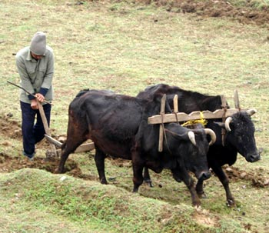
Livestock

Slide 15
A serological study in response to people at occupational risk of rabies virus exposure in Nepal
Dr. Ganesh Raj Pant,
Faculty of Animal Science, Veterinary Science and Fisheries,
Agriculture and Forestry University, Chitwan, Nepal
Email: pantganesh@hotmail.com
Telephone: + 9779843639444

Slide 16
Outline of Presentation
Introduction
Human Rabies and vaccine in Nepal
Animal Rabies and vaccine in Nepal
Study
Objective
Methodology
Discussion
Conclusion

Slide 17
Human rabies in Nepal
Rabies is endemic throughout the country and cases may occur in any season.
100-200 person die from rabies every year, mostly following dog bite (EDCD, 2010).
Incidences reported in all age group and children are at high risk.
Dogs have 92.2% and other animal such as cat, monkey, jackal and mongoose has 7.8% role in transmission rabies
Arctic lineage was detected from human rabies virus
(Pant et al., 2011).

Slide 18
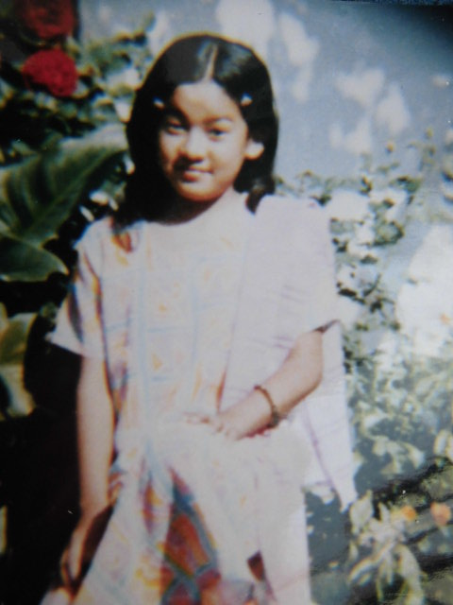
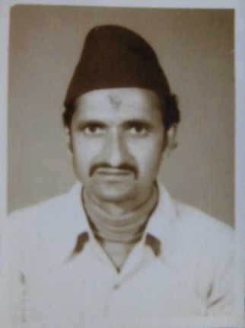
Cases of Rabies
12 yr school girl
53 yr health worker

Slide 19
Human Vaccination
35, 000 people get post exposure vaccination every year.
DOHS expends US$ 1.5 million per year to buy rabies vaccine for post exposure treatment (EDCD, 2010).
334,737 doses of cell culture vaccine were purchased by health authority from July 2011 to June 2012 for free post exposure vaccination (EDCD, 2012)

Slide 20
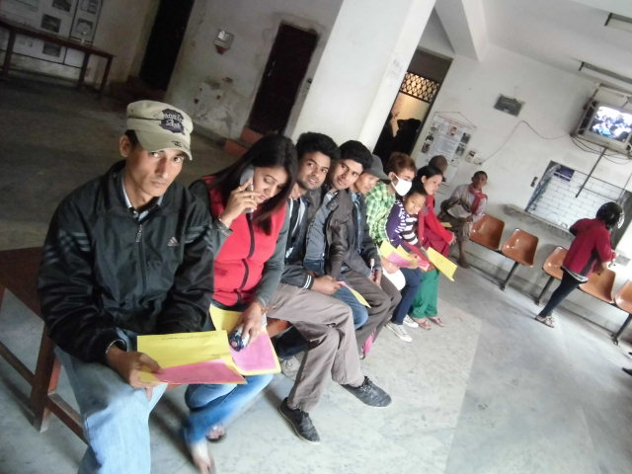
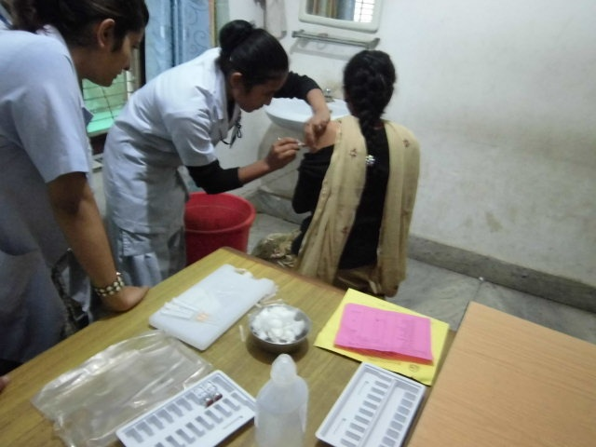
Post-exposure rabies vaccination
Teku hospital for infectious diseases, Kathmandu, Nepal, 2013
People in queue for vaccination
Nurses injecting vaccine

Slide 21
Rabies in animals
Prevalence of rabies was found 25.63% in dog, 35.29% in cattle, 28.57% in buffalo, 9.66% in goat and 0.84% in pig.
Out breaks of rabies occurred throughout the year. Numbers of outbreaks were highest (36) in June and lowest (9) in September.
Rabies has been reported in 44 districts (Out of 75) and numbers of outbreaks were highest (19) in Kanchanpur and highest cases were in Kailali (65) (Pant, 2014).

Slide 22
Rabies in Animal
Rabies has been confirmed in dogs, cats, buffaloes, cattle, goats, sheep and mongoose.
In 2014, 34 clinical samples were submitted to CVL for laboratory test and 16 were positive (CVL, 2014)
A total of 88 outbreaks and 210 animal deaths reported in 2014 (VEC, 2014)
Arctic and Indian subcontinent lineages in Nepal (Pant et al., 2013)

Slide 23
CVL has Rapid antigen detection and FAT facilities.
Laboratory facility in Nepal

Slide 24
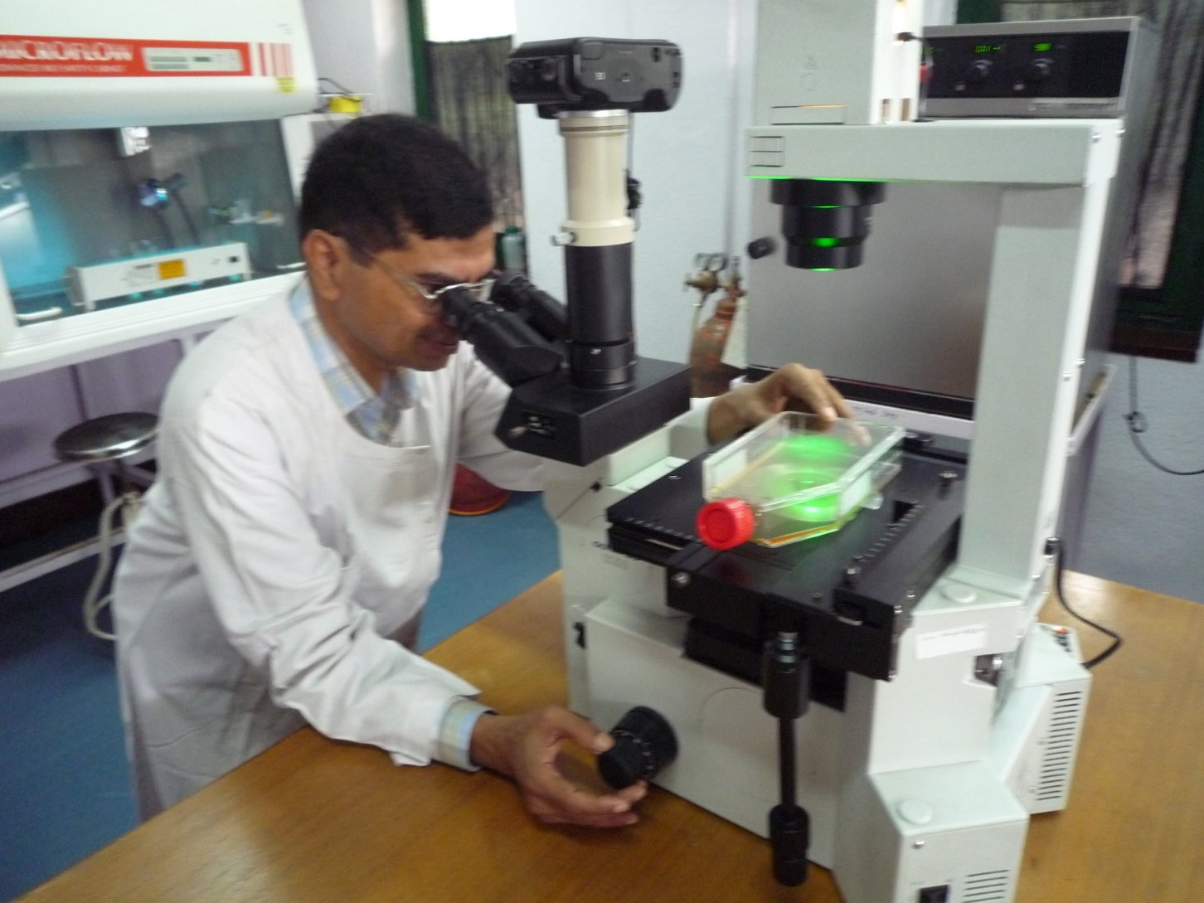
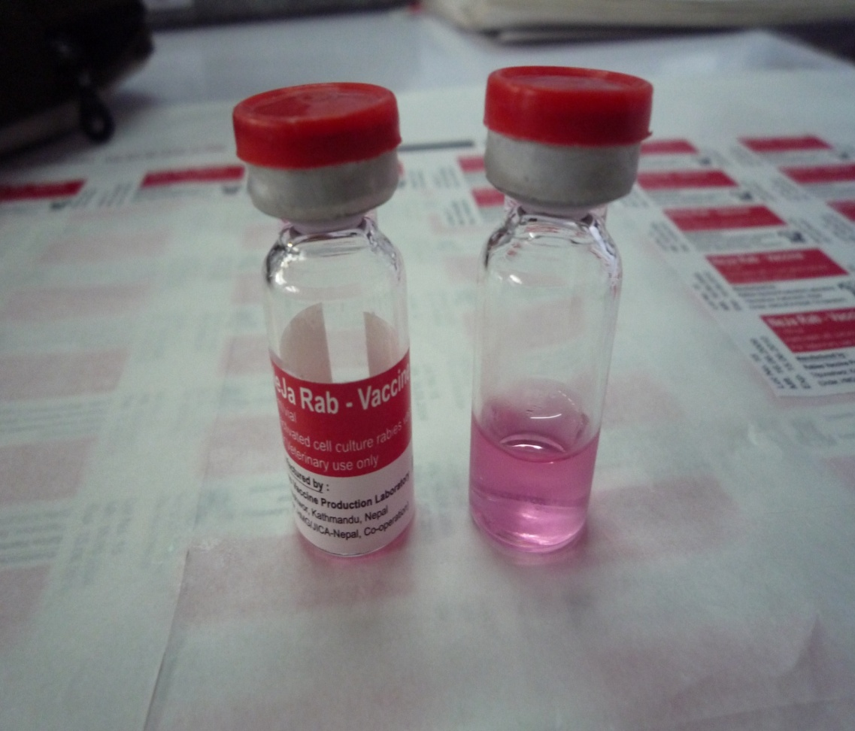
Laboratory facility in Nepal
RVPL produces 50,000 doses of cell culture rabies vaccine (NeJaRab) for animal annually.

Slide 25
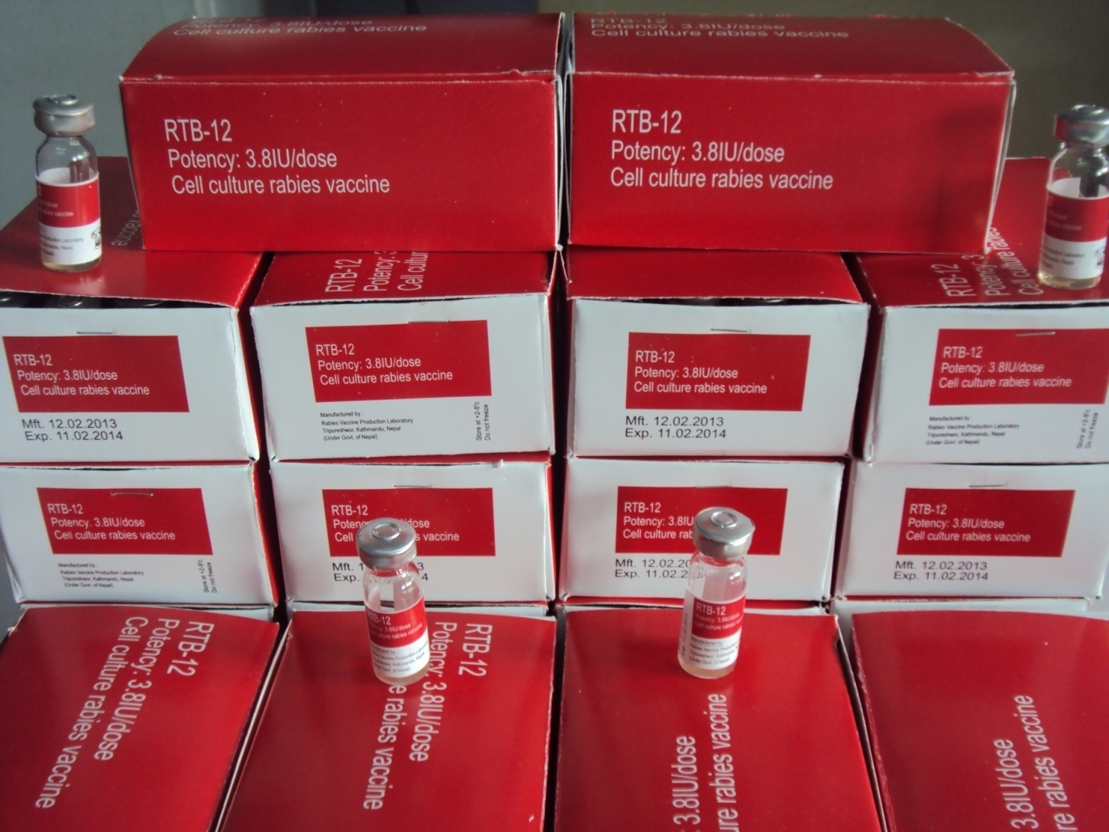
Laboratory facility in Nepal
RVPL produced cell culture rabies vaccine for human use with 3.8IU/dose potency in 2012

Slide 26
Objective of Study
To know the antibody titer against rabies virus in occupational risk group of people.

Slide 27
Methodology
A total 44 serum samples were collected out of which
21 samples were collected from medical professionals (working at Teku Infectious Hospital, Kathmandu) and,
23 were collected from veterinary professionals (working at Central Veterinary Hospital and Rabies Vaccine Production Laboratory, Kathmandu)

Slide 28
Cont……
Among the 44 samples, 4 were collected from unvaccinated persons.
The other 40 people sampled were vaccinated.
All samples were subjected to the Rabies Fluorescent Focus Inhibition Test (WHO Laboratory Techniques in Rabies, 1996) at CDC, USA .

Slide 29
Result
The antibody level of 7 person was found to be less than the WHO recommended titer of 0.5 IU/ml.
Highest titer was 3396 and lowest titer was 0.043IU/ml

Slide 30
Discussion
Six medical professionals and one veterinary professional had a low rabies virus neutralizing antibody titer.
The 4 samples collected from unvaccinated persons, and 3 collected from vaccinated persons (7.5%) had a titer below 0.5 IU/ml.
15.9% of tested group were at risk.

Slide 31
Conclusion
The study showed that medical and veterinary professionals who are responsible to nurse or handle rabies patients, rabid animals or rabies virus are still at higher risk.
This signifies the importance of recommendation for regular serological testing of occupationally at risk individuals and injecting rabies vaccine booster dose if necessary.

Slide 32
Acknowledgement
Dr. Ashutosh Wadhwa and Dr. Todd Smith, CDC, USA
Rabies vaccine production laboratory, Kathmandu
Central veterinary laboratory, Kathmandu
Central veterinary hospital, Kathmandu
Sukraraj tropical hospital, Teku, Kathmandu
The university of Liverpool, UK
Organizer of Euro vaccine 2015

Slide 33
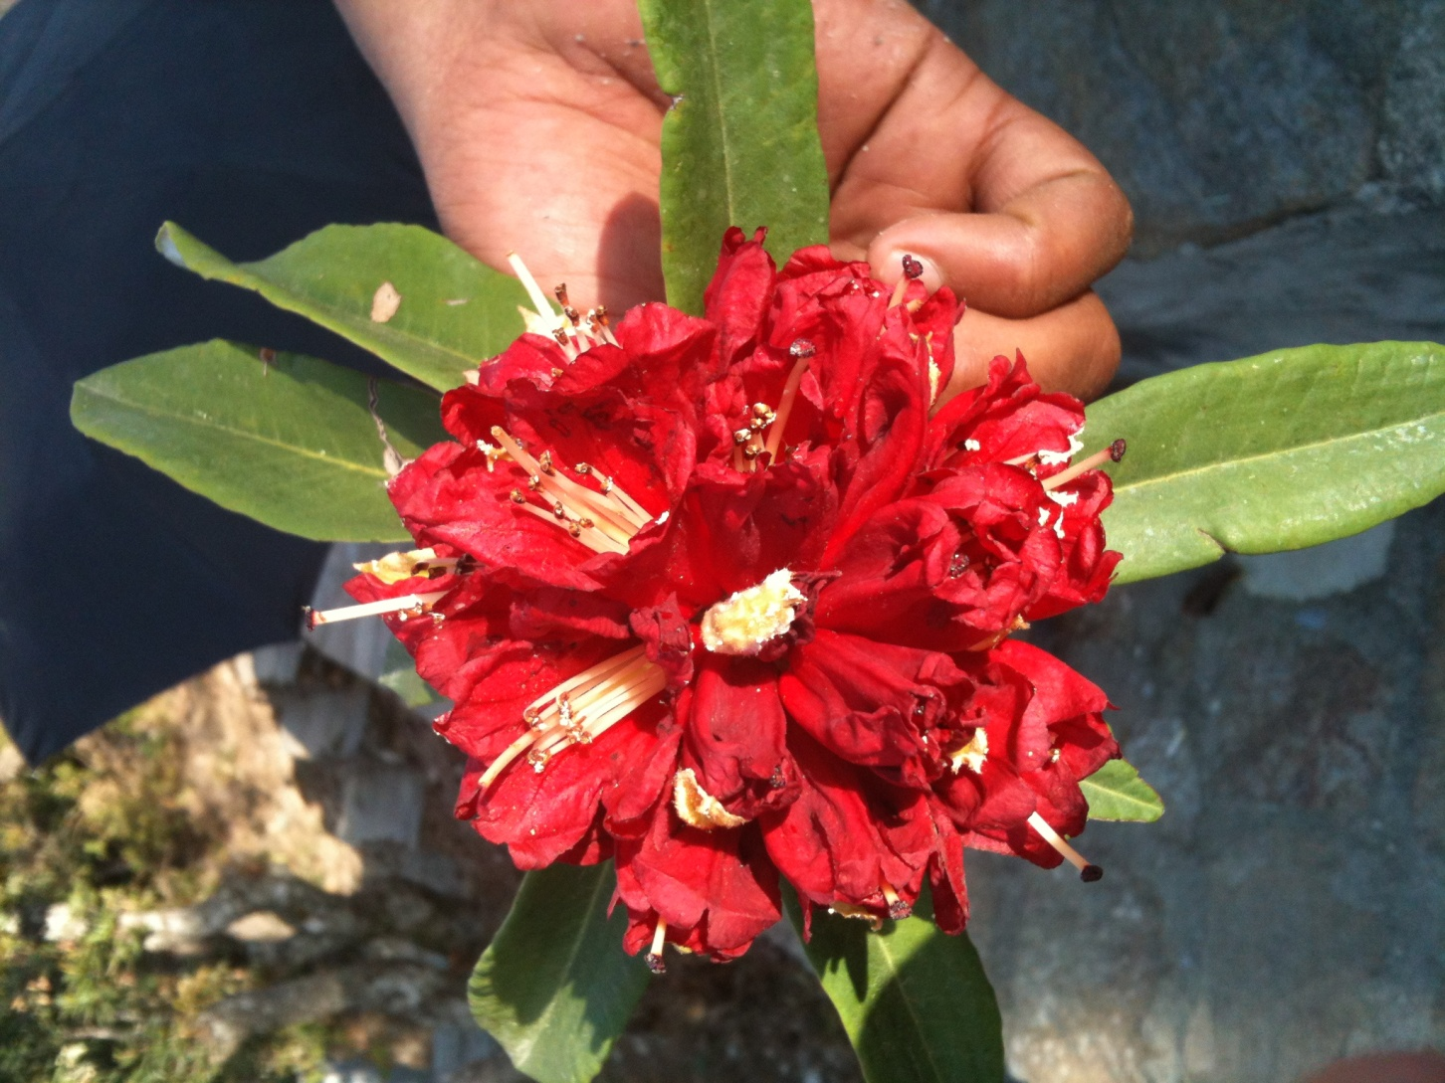
Thank you
Rhododendron

