Slide 1
Conversion of Processed Citrus Wastes into Nutritional Components
Gamal A. El-Sharnouby1*, Salah M. Aleid2 and Mutlag M. Al-Otaibi1
1 Department of Food and Nutrition Sciences, College of Agricultural
& Food Sciences, King Faisal University, Saudi Arabia
2 Date Palm Research Center of Excellence, King Faisal University, Saudi Arabia

Slide 2
CONVERSION OF PROCESSED CITRUS WASTES INTO NUTRITIONAL COMPONENTS
Project From :
Deanship of Scientific Research, King Faisal University , Saudi Arabia

Slide 3
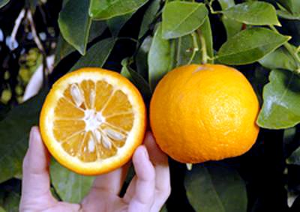
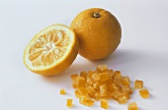
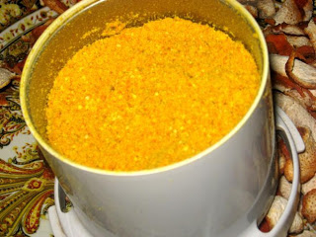
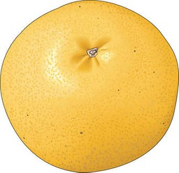
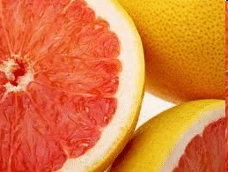

Slide 4
INTRODUCTION

Slide 5
INTRODUCTION
Orange is commonly consumed in world. About 50 % of the processed oranges turned out in the form of orange peels. It is almost consumed as fresh, on the other hand , some factories are using sour orange (Citrus aurantium) in processing in juice and jam. However the outer layer usually called , flavedo in comparison with the inner layer of the peels usually called albedo contains considerable amounts of the natural carottenoids. Such pigments are widely utilized as natural colorants in foods [Tolba,2002 Zhou et. al. 2009 and Khoo et. al. 2011].

Slide 6
Such pigments are widely utilized as natural colorants in foods (Francis 1995, Deli et. al. 2001, Breithaupt et. al. 2004, Tolba 2002, Zhou et. al. 2009 and Khoo et. al. 2011).

Slide 7
The color is one of the most important factors affecting quality and palatability of the foods among different consumers (Khoo et. al. 2011).
Therefore, food quality and flavor are closely associated with color. So, liking or disliking a food is conditioned by its color, attractive foods are sought out as pleasure giving, while unattractive foods avoided as undesirable (Badr 2006).

Slide 8
Today a large number of industrially produced foods such as beverages, dairy products, confectionery margarine, pasta etc.., which contain beta carotene as a colorant and as a nutrient.

Slide 9
Colors may be added to foods for several reasons, which can be summarized as follows:
- To reinforce colors already present in food but less
intense than the consumer would expect.
- To ensure uniformity of food color from batch to
batch.
- To restore the original appearance of food that its
color has been affected by processing.
- To coloring certain foods such as sugar confectionery,
ice Cream and soft drink, which would be virtually
colorless.

Slide 10
There are three types of colors , which used as food colorants:
1- Synthetic colors:
Do not occur in nature and are produced by chemical synthesis. (e.g.sunset yellow, carmoisine and tartrazine).
2- Nature – identical colors :
Manufactured by chemical synthesis to be identical chemically to colorants found in nature. (e.g. β- carotene, riboflavin and canthaxanthin).
3- Natural colorants:
Organic colorants that are derived from natural edible sources using recognized food preparation methods. (e.g. anthocyanins and carotenoids) (Naviglio et. al., 2008).

Slide 11
Many studies have also been carried out on color substances from industrial food wastes .

Slide 12
Breithaupt [14] reported that, there is a wide variety of carotenoid analysis methods, but the most used are high pressure liquid chromatography (HPLC) and thin layer chromatography TLC. HPLC gives more detailed results, TLC is reliable, inexpensive, portable and readily carried out by nontechnical operators and, thus, often preferred.
Francis and Isaksen (1995) separated carotenoid of some different sources including paprika by thin-layer chromatography on silica layers using petroleum ether containing tert-butanal or tret-pentanol. They found that, this system gave chromatograms with improved separation of oxygenated carotenoids compared with acetone -petroleum ether system.

Slide 13
The total carotenoid content of the ripe fruits was about 1.3g/100g of dry weight, of which capsanthin constituted 37%, zeaxanthin was 8%, cucurbitaxanthin was 7%, capsorubin constituted 3.2% and β-carotene accounted for 9%. They also found that, the remainder was composed of capsanthin 5,6-epoxide, capsanthin 3, 6-epoxide, 5, 6 diepikarpoxanthin, violxanthin, antheraxanthin, β-cryptoxanthin, and several cis isomers and furanoid oxides.

Slide 14
Different factors affecting stability of carotenoids.
Many researchers found that:
carotenoids were stable in alkaline solution pH value 9 and were not affected by high temperatures up to 100 °C for 15 min.
Carotenoids were very sensitive to light and oxygen.

Slide 15
Chantaro and Chiewchan (2008) separated antioxidant from carrot and beetroot pulp wastes and used for value addition in food formulations.
Hanaa et al. (2006) used the natural colors of carrots to improve the color of cake.
The results of organoleptic evaluation indicated that the highest palatability of panelists for cake was achieved by increasing the concentration of the natural carotenoids.

Slide 16
AIM OF THE WORK

Slide 17
THIS RESEARCH WAS AIMED TO STUDY THE FOLLOWING MAIN POINTS:
Extraction, determination and identification of natural
colorants from different citrus wastes (citrus peel)
2. Factors affecting the stability of extracted pigments.
3. Using specific carriers for the extracted pigments.
4. Study the possibility of using produced pigments in
manufacturing of food product (Jelly).

Slide 18
MATERIALS AND METHODS
Materials
Citrus waste (Citrus peels): Two species of citrus from local market in Al-Ahsa Government were use.
Sour orange (Citrus aurantium)
Grape fruit (Citrus paradisi)

Slide 19
Methods: Sample preparation: The outer layer called flavedo of two mature citrus varieties i.e. Sour orange and Grapefruit were prepared as method described by Chantaro et. Al. (2008). Each sample was divided into three parts; the first part was treated with 0.1% of α-tocopherol (w/w) as natural antioxidant. The second part was treated with 0.1% butylated hydroxy toluene (BHT,w/w) as artificialm antioxidant.The third part was untreated sample as control.

Slide 20
The samples were dried in oven at 45 ºC for 72 hour and ground into fine powders in an electric grinder Shea 2006).

Slide 21
Extraction of natural pigments:
Colorants were extracted from citrus samples according to the technique described by (Chantaro et. al., 2008).
Identification of natural pigments:
Carotenoid pigments extracted from citrus samples were identified by (TLC) and high-performance liquid chromatography (HPLC) apparatus (Hewlett packard series 1050) according to the method reported by (Mathauss, 2002)

Slide 22
Stability of pigments:
Effect of pH:
Effect of oxidation:
The adsorption of concentrated pigments on solid supports.
Jelly preparation:

Slide 23
Sensory evaluation of Jelly:
Samples of jelly were subjected to organoleptic evaluation by panelists according to (Gadallah 2002 and Kang et. al. 2007). Panelists were asked to evaluate color, taste, clarity, texture, grayness, bleeding, and overall acceptability.

Slide 24
Statistical analysis:
Results were given as means ± standard deviation of three independent determinations (n=3). One way analysis of variance (ANOVA) was used to test of significance comparison between means were tasted by Duncan’s multiple range test. Differences were considered to be significant at p < 0.05 according to [18]. All statistical analyses were performed using SAS (9.3) [Shea 2002].

Slide 25
Table (1): Formulation of jelly sample.
Weight (%) | Ingredients
53.88 44.00 2.00 0.20 0.02 by different ratios | Water Sucrose Gelatin Citric acid Synthetic flavor Natural yellow pigment

Slide 27
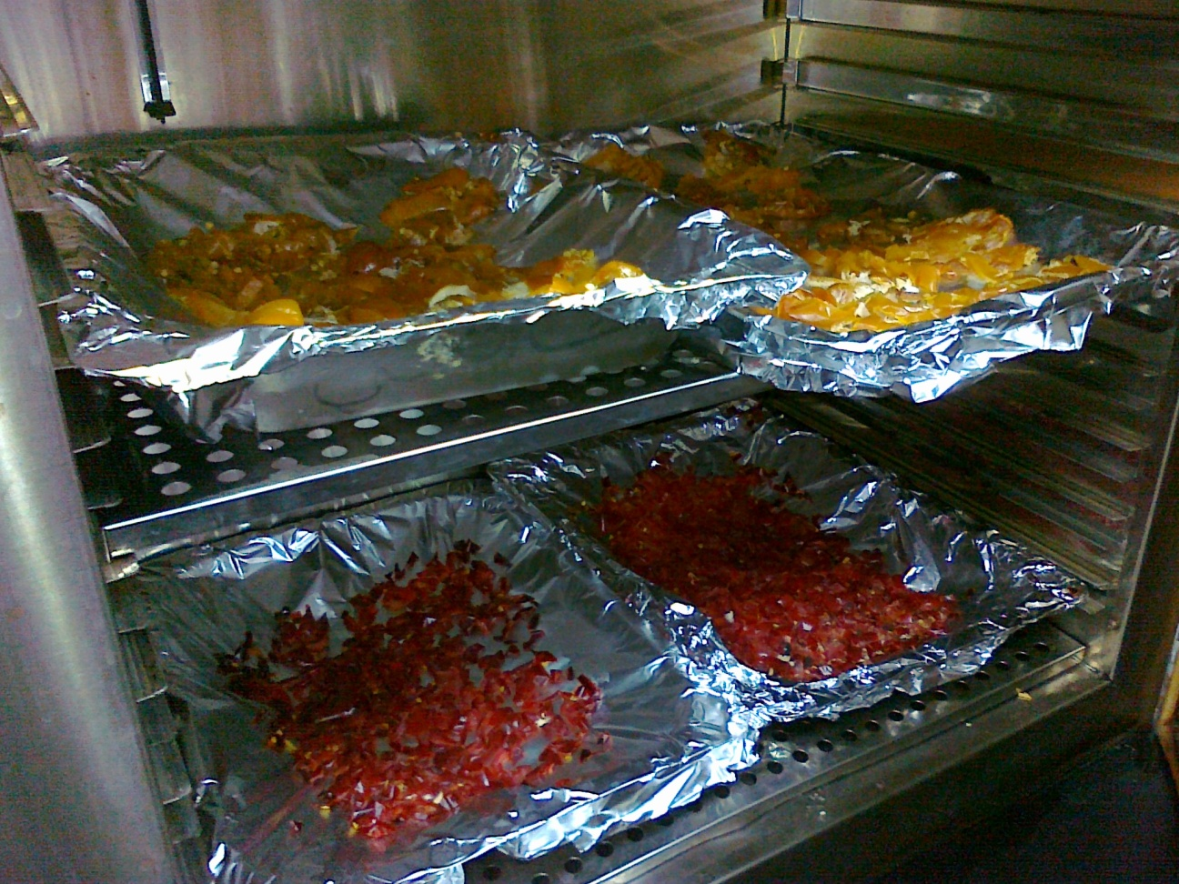
Dried

Slide 28
Grinding

Slide 29
Powder

Slide 30
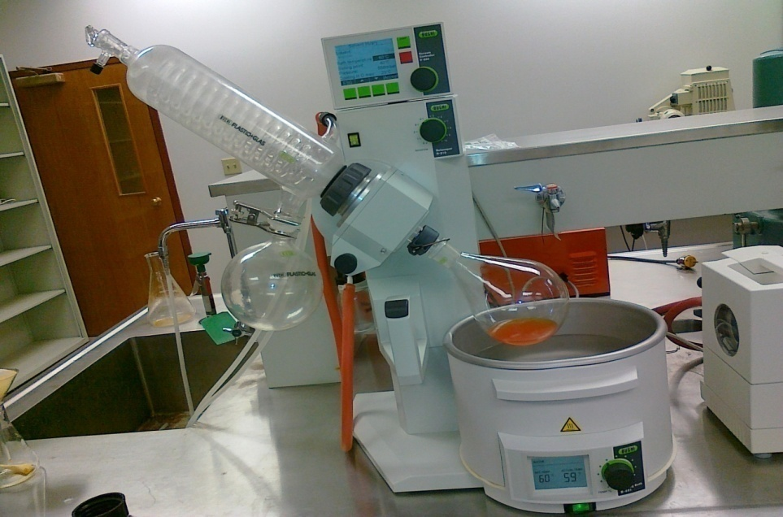
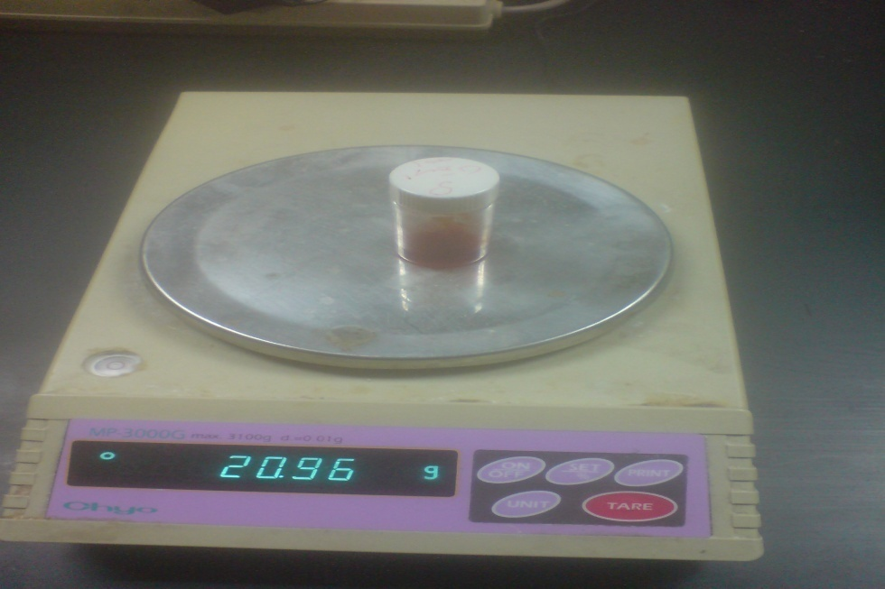
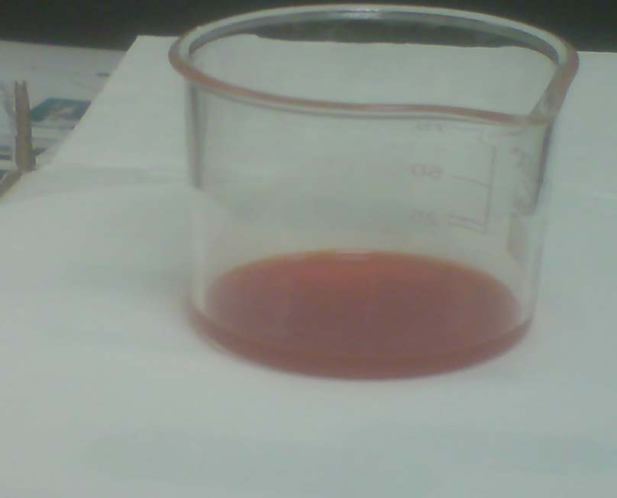
EXTRACTION

Slide 31
Pigment powders

Slide 32
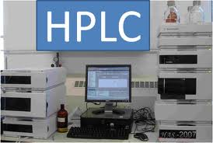
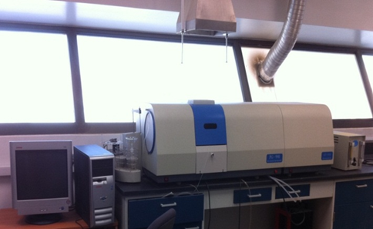
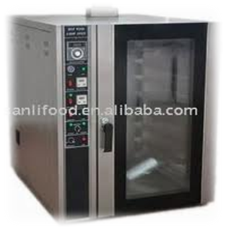
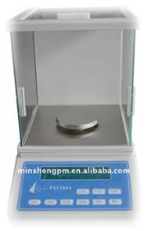

Slide 33
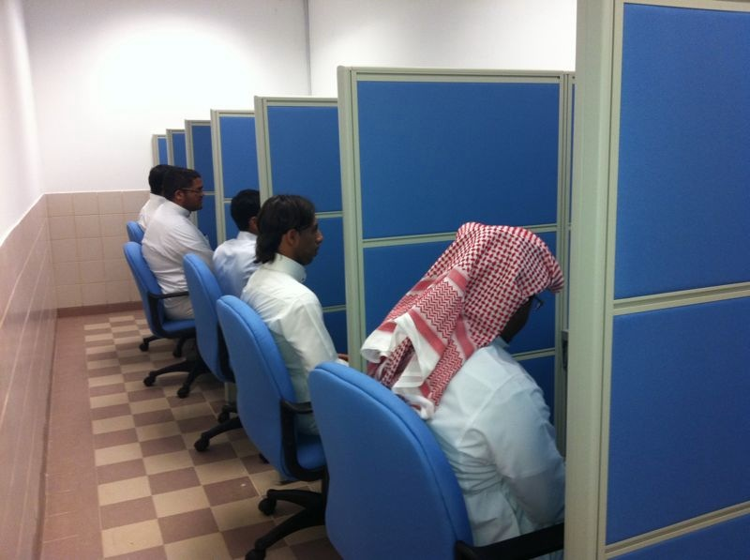
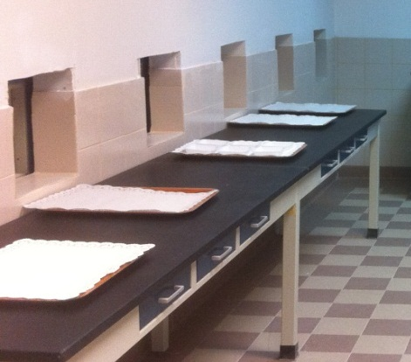
- Sensory Evaluation
- Statistically Analysis
(SAS software ver. 6.11.SAS Institute, Cary, NC )

Slide 34
RESULTS AND DISCUSSION

Slide 35
Table (2): Effect of some solvents on extraction of pigments (mg/L)
Citrus peels | Solvents | Chlorophyll A | Chlorophyll B | Total carotenoids
Sour orange | Ethyl acetate Acetone 85% Petroleum ether n.hexane Ethanol 90% | 0.15 0.15 0.06 0.11 0.02 | 0.12 0.12 0.29 0.03 0.31 | 5.65 4.63 4.56 4.45 3.22
Grape fruit | Ethyl acetate Acetone 85% Petroleum ether n.hexane Ethanol 90% | 0.08 0.17 0.23 0.14 0.08 | 0.03 0.11 0.02 0.23 0.18 | 1.42 1.26 1.10 0.62 0.61

Slide 36
Ethyl acetate is the best solvent followed by Aceton 85 %

Slide 37
Table (3): Identification of carotenoid pigments of Sour orange and G. fruits
Type of Citrus peels | Identified carotenoids | %
Sour orange | Antheraxanthin | 39.22
 | Zeaxanthin | 26.40
 | Cryptoxanthin | 5.53
 | Unidentified | 0.53
 | Unidentified | 0.71
 | Lutein | 5.76
 | Canthaxanthin | 5.20
 | Capsanthin | 4.88
 | β-Carotene | 9.20
Grape fruit | Antheraxanthin | 36.76
 | Zeaxanthin | 25.66
 | Violaxanthin | 6.30
 | Lutein | 9.41
 | Cryptoxanthin | 7.75
 | β-Carotene | 8.75

Slide 38
Table (4): The effect of pH value on the stability of carotenoids extracted from Sour orange and Grape fruit
PH value | Sour Orange Peels |  | Grape Fruit Peels
 | Retention % | Degradation % | Retention % | Degradation %
2 | 45.36 | 54.32 | 39.53 | 60.63
3 | 55.02 | 45.33 | 52.66 | 47.12
4 | 71.33 | 28.36 | 70.12 | 29.87
5 | 82.25 | 17.82 | 80.54 | 19.32
6 | 93.31 | 6.11 | 96.51 | 3.56
7 | 97.13 | 2.77 | 96.43 | 3.45
8 | 86.54 | 13.16 | 78.21 | 22.32
9 | 79.36 | 20.11 | 77.76 | 22.21

Slide 39
Table (5): Effect of oxygen on the stability of carotenoids extracted
from Sour orange and Grape fruit .
Citrus peels | Exposure to air for 4 h |  | Under nitrogen gas for 4 h
 | Retained % | Degradation % | Retained % | Degradation %
Sour orange (Control) | 90.36 | 9.44 | 99.88 | 0.02
Sour orange (α.tocopherol) | 99.10 | 0.80 | 100 | 0.00
Sour orange (BHT) | 98.87 | 0.13 | 100 | 0.00
Grape fruit (Control) | 88.83 | 11.17 | 99.84 | 0.06
Grape fruit (α.tocopherol) | 93.22 | 6.68 | 100 | 0.00
Grape fruit (BHT) | 93.11 | 6.79 | 100 | 0.00

Slide 40
Alpha-tocopherol as antioxidant was relatively more stable than butylated hydroxy toluene (BHT)

Slide 41
Table (6): Color concentration (mg/100gm carrier) of extracted carotenoids from Sour orange and Grape fruits with different carriers at different ratios (w/w).
Pigment/carrier (w/w) | Applied carriers
 | Lactose | Starch | Flour | Dextrin | Arabic gum
 | Sour orange mg/100gm
1:1 | 1650 | 960 | 856 | 794 | 82.28
2:1 | 1940 | 1258 | 880 | 894 | 127.76
3:1 | 2260 | 1696 | 1260 | 1350 | 435.25
4:1 | 2520 | 2092 | 1448 | 1478 | 623.9
 | Grape fruit mg/100gm
1:1 | 350 | 378 | 372 | 314 | 84.8
2:1 | 708 | 760 | 688 | 566 | 122.4
3:1 | 1000 | 1136 | 982 | 728 | 163.8
4:1 | 1490 | 1240 | 1036 | 936 | 195.2

Slide 42
Lactose is the best one as carrier

Slide 43
Table (7): Sensory evaluation of prepared jelly by adding extracted carotenoids from Sour orange peels.
Treatments | Color | Clarity | Flavor | Taste | Texture | Shape | Over all acceptability
1 | 17.75ª | 12.62ª | 7.62a | 7.45 ª | 11.50^{b} | 7.91^{b} | 16.83ª
2 | 17.66 ª | 13.12ª | 7.83ª | 8.00 ª | 12.71ª | 8.62ª | 17.41ª
3 | 17.05^{ab} | 12.04ª | 7.52ª | 7.73^{ab} | 11.70^{b} | 7.54^{b} | 16.08^{ab}
4 | 16.16^{b} | 9.66^{c} | 7.62ª | 7.16^{c} | 10.5^{c} | 6.66^{d} | 13.58^{c}
Means in the same column with different letters are significantly different (P < 0.05):
1, Jelly + synthetic yellow color (control).
2, jelly + 0.0066 % carotenoids.
3, jelly + 0.0133 % carotenoids.
4, jelly + 0.0266 % carotenoids.

Slide 44
Conclusion
Sour orange considered as a good source of carotenoids comparing to Grape fruit.
Ethyl acetate was the most efficient solvent in extracting natural pigments from Sour orange , while, that of Grape fruit were ethyl alcohol.
The highest carotenoid extracted from Sour orange was 97.13 at pH 7.0, while, the highest for the carotenoid extracted from Grape fruit was 96.43.
Using nitrogen gas had losses approximately in carotenoid content for all studied samples either treated or untreated with antioxidants.

Slide 45
5- The antioxidant treatments (either by a-tocopherol or BHT) were relatively enhanced the carotenoids stability, but the highest effect was observed for the Sour orange .
6- Lactose was the best carrier for the dispersion of Sour orange carotenoid, while, starch was more effective adsorpant coated carriers for pigments extracted from Grape fruit.
7- Regarding to the overall acceptability of jelly samples, it could be showed that, slight insignificant reduction in overall acceptability was achieved for jelly sample prepared with the first addition ratio. However, addition of 0.0066 % led to insignificant increase in recorded color value comparing to control.

Slide 46
ACKNOWLEDGMENT
The authors acknowledge gratefully the Deanship of Scientific Research, King Faisal University, Saudi Arabia for its financial, material and moral support for this project.

Slide 47
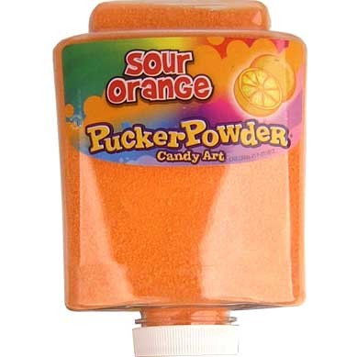

Slide 48
Thank You

