Slide 1
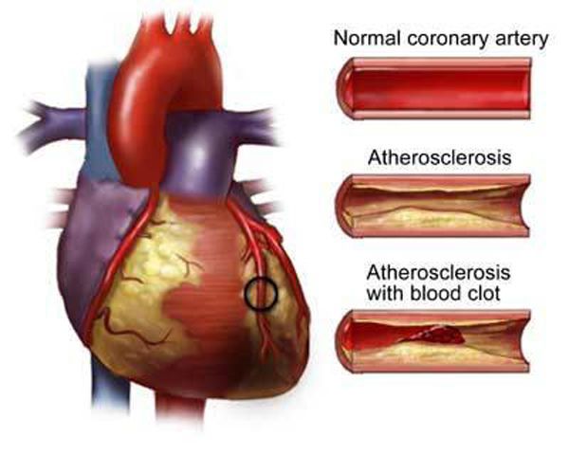
GENETIC MARKERS OF CORONARY ARTERY DISEASE RISK
GALYA ATANASOVA MD, PhD
DOMINIC JAMES

Slide 2
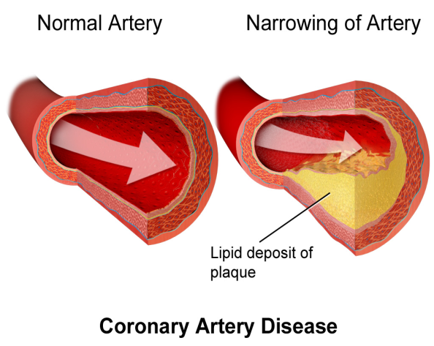
Overview
In the present study we analyzed the impact of a genetic variant in CYP2C8 on coronary artery disease (CAD) in the Bulgarian population. We conducted a case-control study to determine whether the common genetic variation rs890293 (CYP2J2*7) in the CYP2J2 gene was associated with the risk of CAD.

Slide 3
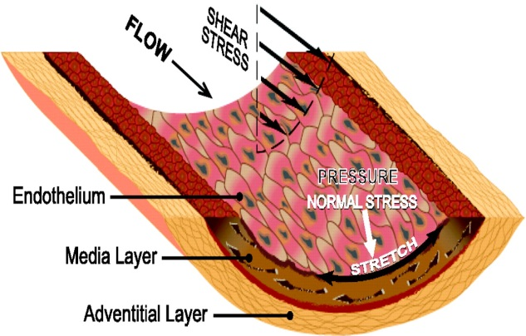
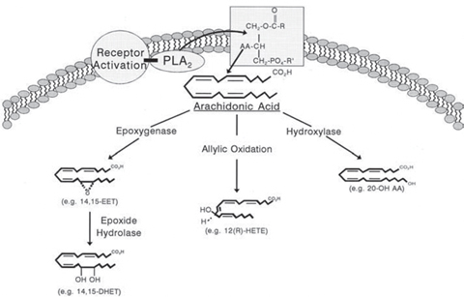
Introduction
Cytochrome P450 2C8 is a polymorphic enzyme responsible for the biosynthesis of vasoactive substances from arachidonic acid.
Cytochrome P450 (CYP) 2J2 is expressed in the vascular endothelium
and it metabolizes arachidonic acid to biologically active epoxyeicosatrienoic acids (EETs).

Slide 4
Methods
We analyzed 99 patients with CAD and 377 controls for a potential correlation of the CYP2J2 polymorphism G-50T. 96 of these 99 patients were tested for the presence of polymorphisms CYP2C8.

Slide 5
To evaluate the genotypes of the samples real time PCR with predesigned TaqMan SNP Genotyping Assays (Applied Biosystem) for rs890293 was used.
The deviation of allele polymorphism was CYP2J2*7 and CYP2C8*3 respectively according to Hardy-Weinberg equilibrium. The frequency of the T allele was calculated too via the χ² test.

Slide 6
Results
The main dichotomous and nondichotomous and clinical characteristics of the study group are shown in table 1 and table 2.
Table 1. Dichotomous clinical characteristics of the group
Characteristic | Number | Percentage
Men | 60 | 60.61
Women | 39 | 39.39
Smokers | 44 | 44.44
Hereditary | 40 | 40.40
Hypertension | 92 | 92.93
Type 1 diabetes | 2 | 2.02
Type 2 diabetes | 25 | 25.25

Slide 7
Table 2. Nondichotomous clinical characteristics of the group.
Characteristic | Average | Average deviation
BMI [kg/m²] | 27.98 | 5.13
Triglyceride levels [mmol/l] | 2.13 | 0.77
Cholesterol levels [mmol/l] | 5.90 | 0.98
HDL [mmol/l] | 1.42 | 0.62

Slide 8
The frequency of genotypes of the T allele CYP2J2*7 and CYP2C8*3 is shown in tables 3 and 4.
Table 3. The frequency of genotypes of the T allele in CYP2J2 * 7.
Alleles | Group with coronary artery disease- 99 |  | Control group - 377 |  | Total – 476
 | Number | Percentage | Number | Percentage | Number | Percentage
TT | 2 | 2.02 | 2 | 0.53 | 4 | 0.84
TG | 12 | 12.12 | 39 | 11.57 | 51 | 10.71
TT or TG | 14 | 14.14 | 41 | 12.10 | 55 | 11.55
GG | 85 | 85.86 | 336 | 87.90 | 421 | 88.45
Frequency | 0.0808 | 8.08 | 0.057 | 5.7 | 0.062 | 6.2
р-value | 0.0670 |  | 0.4586 |  | 0.0868

Slide 9
In the group of people with MI, the percentage of these T-allele is slightly greater than in the control group - 14.14% respectively versus 12.10% of patients with T-allele (Table 3). The frequency of presence of the T-allele was also greater in the group with infarction (8.08%) than in the control group (5.7%).

Slide 10
The obtained p-value for the statistical significance of the hypothesis (relating to the distribution of the T-allele in CYP2J2 * 7), taking into account Hardy-Weinberg Equilibrium, is greater than 0.05 and therefore for all groups of this hypothesis cannot be rejected.

Slide 11
Table 4. The frequency of genotypes of CYP2C8 * 3.
Alleles | Group with coronary artery disease - 96 |  | Control group - 363 |  | Total – 459
 | Number | Percentage | Number | Percentage | Number | Percentage
TT | 2 | 2.08 | 3 | 0.83 | 5 | 0.84
TG | 26 | 27.08 | 67 | 18.46 | 93 | 10.71
TT or TG | 28 | 29.16 | 70 | 19.29 | 98 | 11.55
GG | 68 | 70.84 | 293 | 80.71 | 361 | 88.45
Frequency | 0.1562 | 15.62 | 0.1006 | 10.06 | 0.1122 | 11.22
р-value | 0.7901 |  | 0.6974 |  | 0.7153

Slide 12
The resulting p-values for both polymorphism (for CYP2C8 * 3, p = 0.7901 and p = 0.0670 CYP2J2*7) indicates that the distribution of T allele CYP2C8*3 with high probability lies closer to Hardy Weinberg Equilibrium than in the CYP2J2 * 7 gene (tables 3, 4).
An analysis of the connection between gender and the likelihood of CAD among polymorphisms in the CYP2J2 * 7 and CYP2C8 * 3 is made. The results are shown in table 5 and table 6.

Slide 13
Table 5. Association of the T-allele CYP2J2 * 7 with CAD.
The obtained p-value is р=0.3656 which show that the hypothesis of no association can not be rejected. The odds ratio (OR) for polymorphism in the CYP2J2 * 7 is 1.35 with CI=0.7034÷2.5900. The results show that there is not evidence for association between the T-allele and CAD.
CAD Т- allele | Yes | No | Total
Yes | 14 | 41 | 55
No | 85 | 336 | 421
Total | 99 | 377 | 476

Slide 14
Table 6. Association of the T-allele CYP2C8 * 3 with CAD.
The obtained p-value is р=0.0356 which show that the hypothesis of no association have to be rejected. The chances for people with T-allele polymorphism in the CYP2C8 * 3, CAD occur on average 1.7 times higher than those who did not carry this allele. CI of OR (1.0334÷2.8746) with 95% probability. CI indicated that it could be argued with a 95% probability that the presence of T allele in CYP2C8 * 3 increases the risk of CAD.
CAD Т- allele | Yes | No | Total
Yes | 28 | 70 | 98
No | 68 | 293 | 361
Total | 96 | 363 | 459

Slide 15
An analysis of the connection between gender and the likelihood of CAD among the carriers of the T allele polymorphisms in the CYP2J2 * 7 and CYP2C8 * 3 is made. The results are shown in table 7 and table 8.
The obtained p-value and OR are p=0.8005 and OR=1.1719 with CI=0.3423÷4.011. The analysis shows that gender is not a risk factor for CAD among T allele CYP2J2 * 7 carriers.

Slide 16
Table 7. Association between gender and CAD among carriers of the T allele in the CYP2J2 * 7.
type 2 diabetes Т- allele | Yes | No | Total
Yes | 2 | 12 | 14
No | 23 | 62 | 85
Total | 25 | 74 | 99
Table 8. Association between gender and CAD among carriers of the T allele in CYP2C8 * 3
type 2 diabetes Т- allele | Yes | No | Total
Yes | 5 | 23 | 28
No | 17 | 51 | 68
Total | 22 | 74 | 96
The analysis shows that gender is not a CAD risk factor among T allele CYP2C8 * 3 carriers.

Slide 17
Analyzed is the relationship between gender and the likelihood of CAD among participants without T-allele polymorphisms in the CYP2J2*7 and CYP2C8*3. The results are shown in table 9 and table 10.
Table 9. Association between hereditary and CAD among carriers of the T allele in the CYP2J2 * 7.
hereditary Т- allele | Yes | No | Total
Yes | 8 | 6 | 14
No | 32 | 53 | 85
Total | 40 | 59 | 99
The obtained statistical parameters are p=0.1091 and OR=1.4917 with CI=0.9130÷2.4374. The obtained values shows that it is unlikely that gender is a risk factor for CAD among T allele CYP2J2 * 7 carriers.

Slide 18
Table 10. Association between gender and CAD among participants without T-allele in CYP2C8 * 3.
hereditary Т- allele | Yes | No | Total
Yes | 10 | 18 | 28
No | 28 | 40 | 68
Total | 38 | 58 | 96
The obtained statistical parameters are p=0.1547 and OR=1.4781 with CI=0.8612÷2.5369. The obtained values shows that it is unlikely sex to influence on CAD chances among T allele CYP2C8 * 3 carriers.

Slide 19
Table 11 and Table 12 shows the results of the association between the presence of the T allele and smoking respectively CYP2J2 * 7 and CYP2C8 * 3.
Table 11. Association between the T allele in the CYP2J2 * 7 and smoking in the group with CAD.
The obtained statistical parameters are p=0.4780 and OR=0.6553 with CI=0.2027÷2.1187. The obtained values shows that there isn’t association between smoking and CAD among T allele CYP2J2 * 7 carriers.
Smoker Т- allele | Yes | No | Total
Yes | 5 | 9 | 14
No | 39 | 46 | 85
Total | 44 | 55 | 99

Slide 20
Table 12. Association between the T - allele in CYP2C8 * 3 and smoking group with CAD.
The obtained p-value is p=0.0441 and consequently there is statistical significant association between smoking and CAD among T allele CYP2C8 * 3 carriers. The odds ratio is 2.4965 with CI 1.0125÷6.1555. The results indicate that the chances for CAD are 2.5 times greater to smokers.
Smoker Т- allele | Yes | No | Total
Yes | 17 | 11 | 28
No | 26 | 42 | 68
Total | 43 | 53 | 96

Slide 21
Fig 1. ANOVA test of men height for groups with and without T-allele in CYP2C8 * 3.

Slide 22
Conclusions
The analysis of results shows that polymorphism CYP2C8 * 3 is more important for the occurrence of CAD compared with CYP2J2 * 7 in the study. Demonstrates a statistically significant association between the presence of the T-allele in CYP2C8 * 3 and smoking group with CAD (OR = 2.4965, CI = 1.0125÷6.1555). The risk for CAD is 2.5 times greater for smokers.
The one-way ANOVA test showed a difference in average height only for men with and without T allele in CYP2C8*3 (p=0. 0272 and F-statistic F=5.1314).

Slide 23
THANK YOU

