Slide 1
EFFECT OF DIFFERENT LEVELS OF GOAT MILK, SOY MILK AND COW MILK ON CHEMICAL COMPOSITION OF RASOGOLLA
Gajendra K. Londhe
Dy. Director Research (AHDS)
V.N.M.K.V., Parbhani (MS)

Slide 2
Introduction
Chhana is a base material
  sandesh, rasogolla, cham-cham, rajbhog, chhana murki, chhana podo etc.
  4% milk is converted chhana.
Bengali sweets – West Bengal & other Eastern parts
Rasogolla is most popular – indigenous milk sweets
Rasogollas are marble white balls, spongy and chewy body and smooth texture – served in sugar syrup
Cow milk is prefered

Slide 3
Importance of goat milk
Increasing demand
  goat milk cheeses and yoghurt is increasing in developed countries
  Increasing levels of disposable incomes
  People with cow milk allergy & gastro-intestinal ailments
Goat milk is dominant - Capric, caprylic acids and MCT
Beneficial for human health – cardiovascular conditions
MCT – unique metabolic ability
Goat milk exceeds cow milk in
    MCT : 46%
    MUFA : 16%
    PUFA : 25%

Slide 4
Importance of soymilk
Soymilk is inexpensive source of protein and calorie
  WHO (1996) recommended soymilk as a supplement of bovine milk & nutritionally comparable with mother’s milk
  Soy milk and its products do not contain cholesterol - major cause of coronary heart disease
  Free from lactose – lactose intolerance
Potential health benefits of soy foods
  Cancer prevension, cardiovascular disease, osteoporosis and lowering cholesterol

Slide 5
Objectives
Optimization of different levels of goat milk and soy milk on the basis of cow milk for preparation of rasogolla using RSM.
Selection of best finished product on the basis of sensory evaluation for further studies.
Chemical composition of rasogolla prepared from different levels of goat milk and soy milk on the basis of cow milk.

Slide 6
Materials and methods
Preparation of soymilk
Soybean seeds
Blanching
(2 min using pressure cooker)
Soaking in cold water
Grinding
Slurry
Admixed with water
(1:8 ratio)
Straining
(double-layered muslin cloth)
Soymilk
(Chauhan et al, 2003)

Slide 7
Preparation of rasogolla
Goat milk Cow milk Soy milk
Mixing
Heating (70°C)
Coagulation (1% calcium lactate solution at 70°C)
Straining whey removal
Hanging of chant
Kneading (5% Maida)
Rolling (app. 6-10 g)
Cooking
(boiling in 60 per cent sugar syrup for 15-20 minutes)
Soaking (40 per cent sugar syrup at 60°C)
Cooling (room temperature)
Serving

Slide 8
Table 1. Average chemical composition of different milks used for preparation of rasogolla
Constituents (%) | Cow milk | Goat milk | Soy milk
Moisture | 87.72 | 86.38 | 89.28
Total Solids | 12.28 | 13.62 | 10.72
SNF | 8.78 | 9.12 | 8.80
Fat | 3.50 | 4.50 | 1.84
Total Protein | 3.15 | 4.24 | 5.43
Total Carbohydrates | 4.86 | 4.12 | 2.80
Ash | 0.78 | 0.84 | 0.74

Slide 9
Response Surface Methodology
RSM was used to estimate the effect of goat milk & soy milk on the basis of cow milk on sensory attributes. STATE EASE Design Expert Software (version 8.0.4.1). Central Composite Rotatable Design, face centered with two factors & 5 center points was used.
Quadratic Model used to describe the response variables is as
Y = b˳+b₁X₁+b₂X₂+b₃X₁²+b₄X₂²+b₅X₁X₂
Y = response (dependent variable)
X₁ = level of goat milk (independent variable)
X₂ = level of soy milk (independent variable)
b˳,b₁,b₂,b₃,b₄ & b₅= response model coeficient
Table 2. Experimental variables, their coded level and decoded (actual values)
-1 0 +1
Goat milk- A 20 40 60
Soy milk- B 10 20 30
Standard order | Goat milk (%) | Soy milk (%)
1 | 20 | 10
2 | 60 | 10
3 | 20 | 30
4 | 60 | 30
5 | 11.71 | 20
6 | 68.28 | 20
7 | 40 | 5.85
8 | 40 | 34.14
9 | 40 | 20
10 | 40 | 20
11 | 40 | 20
12 | 40 | 20
13 | 40 | 20

Slide 10
Table 3. Effect of goat milk and soymilk on sensory attributes of rasogolla
Results
Standard order | Goat milk (%) | Soy milk (%) | Flavour | Body & Texture | Mouthfeel | Colour & Appearance | Overall Acceptability
1 | 20 | 10 | 8.0 | 8.0 | 8.0 | 8.0 | 8.0
2 | 60 | 10 | 8.0 | 9.0 | 8.0 | 8.0 | 8.0
3 | 20 | 30 | 6.5 | 6.0 | 6.0 | 7.0 | 6.5
4 | 60 | 30 | 7.0 | 7.0 | 6.5 | 7.0 | 7.0
5 | 11.71 | 20 | 6.0 | 6.0 | 7.0 | 7.5 | 6.5
6 | 68.28 | 20 | 7.5 | 7.0 | 7.5 | 8.0 | 7.5
7 | 40 | 5.85 | 8.0 | 8.5 | 8.0 | 8.0 | 8.0
8 | 40 | 34.14 | 6.0 | 6.0 | 6.0 | 6.5 | 6.0
9 | 40 | 20 | 8.5 | 9.0 | 8.5 | 8.0 | 8.5
10 | 40 | 20 | 9.0 | 8.5 | 8.0 | 7.5 | 8.0
11 | 40 | 20 | 9.0 | 8.5 | 8.0 | 8.0 | 8.0
12 | 40 | 20 | 8.5 | 9.0 | 8.5 | 7.5 | 8.5
13 | 40 | 20 | 8.5 | 9.0 | 8.0 | 8.0 | 8.5

Slide 11
Optimization of levels of variables using RSM
Suitable levels of goat milk & soymilk – verification of sensory status
Design Expert Software –Optimization command
Table 4. Goals for level of goat milk and soymilk on the basis of cow milk and
sensory score targeted to predict the optimal combinations.
Name |  | Goal set | Lower limit | Upper limit
Factor | Goat milk (%) | In range | 20 | 60
 | Soy milk (%) | In range | 10 | 30
Response | Flavour | Maximize | 6.0 | 9.0
 | Body & Texture | Maximize | 6.0 | 9.0
 | Mouthfeel | Maximize | 6.0 | 8.5
 | Colour & Appearance | Maximize | 6.5 | 8.0
 | Overall Acceptability | Maximize | 6.0 | 8.5

Slide 12
Contd…
Design Expert Software suggested formulation on the basis of sensory evaluation
42.52% goat milk & 14.54% soymilk
  Predicted sensory score
Flavour | Body & text. | Mouthfeel | Colour & app. | Overall Accp.
8.66 | 8.51 | 8.35 | 8.01 | 8.41
Table 5. Verification of predicted sensory quality of optimized rosogolla
Parameter | Predicted score | Actual score* | Calculated ‘t’ value
Flavour | 8.66 | 8.82 | 1.38
Body and texture | 8.51 | 8.71 | 1.12
Mouthfeel | 8.35 | 8.55 | 1.12
Colour and appearance | 8.01 | 8.23 | 1.90
Overall acceptability | 8.41 | 8.99 | 1.66
*Average of triplicate experiments;
Table t0.05 is 4.30

Slide 13
Table 6. Effect of goat milk and soymilk & cow milk on chemical composition of rasogolla
Standard order | Goat milk (%) | Soy milk (%) | Moisture (%) | T.S (%) | Fat (%) | Total Protein (%) | Total Carbohydrates (%) | Ash (%)
1 | 20 | 10 | 52.17 | 47.83 | 5.20 | 8.40 | 33.42 | 0.81
2 | 60 | 10 | 50.48 | 49.52 | 6.12 | 9.21 | 32.36 | 0.83
3 | 20 | 30 | 52.56 | 47.44 | 5.11 | 9.68 | 31.86 | 0.79
4 | 60 | 30 | 51.71 | 48.29 | 5.92 | 8.99 | 32.54 | 0.84
5 | 11.71 | 20 | 52.68 | 47.32 | 5.00 | 8.87 | 32.64 | 0.80
6 | 68.28 | 20 | 50.99 | 49.01 | 6.34 | 9.81 | 31.98 | 0.88
7 | 40 | 5.85 | 52.05 | 47.95 | 6.46 | 8.55 | 32.09 | 0.85
8 | 40 | 34.14 | 52.53 | 47.47 | 5.89 | 9.35 | 31.41 | 0.82
9 | 40 | 20 | 52.39 | 47.61 | 5.62 | 9.63 | 31.53 | 0.83
10 | 40 | 20 | 52.39 | 47.61 | 5.63 | 9.62 | 31.52 | 0.84
11 | 40 | 20 | 52.39 | 47.61 | 5.62 | 9.63 | 31.52 | 0.84
12 | 40 | 20 | 52.39 | 47.61 | 5.63 | 9.62 | 31.53 | 0.83
13 | 40 | 20 | 52.40 | 47.60 | 5.62 | 9.63 | 31.52 | 0.83

Slide 14
Table 7. Coefficient of full second order polynominal model for coded chemical composition to different levels of goat milk, soymilk & cow milk in rasogolla
Factor | Moisture (%) | T.S (%) | Fat (%) | Total Protein (%) | Total Carbohydrates (%) | Ash (%)
Intercept | 52.39 | 47.60 | 5.62 | 9.62 | 31.52 | 0.83
A- Goat milk | -0.61** | 0.61** | 0.45** | 0.18* | -0.16 | 0.02**
B- Soy milk | 0.28** | -0.61** | -0.13 | 0.27** | -0.29* | -0.006
A² | -0.36** | 0.36** | -0.06 | -0.16* | 0.52** | -0.002
B² | -0.13 | 0.13 | 0.19* | -0.35** | 0.24 | -0.004
AB | 0.21 | -0.21 | -0.02 | -0.37** | 0.43* | 0.007
R² | 0.93 | 0.93 | 0.88 | 0.92 | 0.86 | 0.79
Adeq Precision | 12.16 | 12.16 | 11.51 | 11.89 | 8.38 | 7.80
Model‘F’ value | 20.23 | 20.23 | 11.27 | 17.27 | 8.92 | 5.35
**P˂ 0.01, *P ˂ 0.05

Slide 15
Fig.3 Response surface relating to moisture as influenced by levels of goat milk, soymilk & cow milk for rasogolla

Slide 16
Fig.4 Response surface relating to total solids as influenced by levels of goat milk, soymilk & cow milk for rasogolla

Slide 17
Fig.5 Response surface relating to fat as influenced by levels of goat milk, soymilk & cow milk for rasogolla

Slide 18
Fig. 6 Response surface relating to total protein as influenced by levels of goat milk, soymilk & cow milk for rasogolla

Slide 19
Fig. 7 Response surface relating to total carbobydrate as influenced by levels of goat milk, soymilk & cow milk for rasogolla

Slide 20
Fig. 8 Response surface relating to ash as influenced by levels of goat milk, soymilk & cow milk for rasogolla

Slide 21
Response Surface Equation for Chemical Parameters
Moisture = 52.39 - 0.61 A + 0.28 B + 0.21 A B - 0.36 A² + 0.13 B²
Total Solids = 47.60 + 0.61 A - 0.28 B - 0.21 A B + 0.36 A² + 0.13 B²
Fat = 5.62 + 0.45 A - 0.13 B - 0.027 A B - 0.060 A² + 0.19 B²
Total Protein = 9.62 + 0.18 A + 0.27 B - 0.37 A B - 0.16 A² - 0.35 B²
Total Carbohydrates = 31.52 - 0.16 A - 0.29 B + 0.43 A B + 0.52 A² + 0.24 B²
Ash = 0.83 + 0.022 A - 0.0065 B + 0.007 A B - 0.002 A² - 0.004 B²

Slide 22
Chemical composition of rasogolla with optimized levels of goat milk, soy milk & cow milk on sensory basis
Final formulation on the basis of cow milk
Goat milk : 42.52 %
Soy milk : 14.54 %
Table 8. Comparison of optimized rasogolla with cow milk rasogolla
Constituents (%) | Cow milk | Optimized
Moisture | 51.10 | 52.43
Total Solids | 48.90 | 47.54
Fat | 5.78 | 5.65
Total Protein | 5.04 | 9.59
Total Carbohydrate | 37.09 | 31.49
Ash | 0.90 | 0.84

Slide 23
Conclusion
Incorporation of goat milk and soy milk in cow milk is feasible for preparation of good quality rasogolla
Incorporation of 42.52 % goat milk and 14.54% soy milk is best on the basis of sensory evaluation.
Incorporation of goat milk and soy milk increases the protein & yield of product.
Reduces the cost of product.
Value added health benefit product could be prepared using this combination.

Slide 24
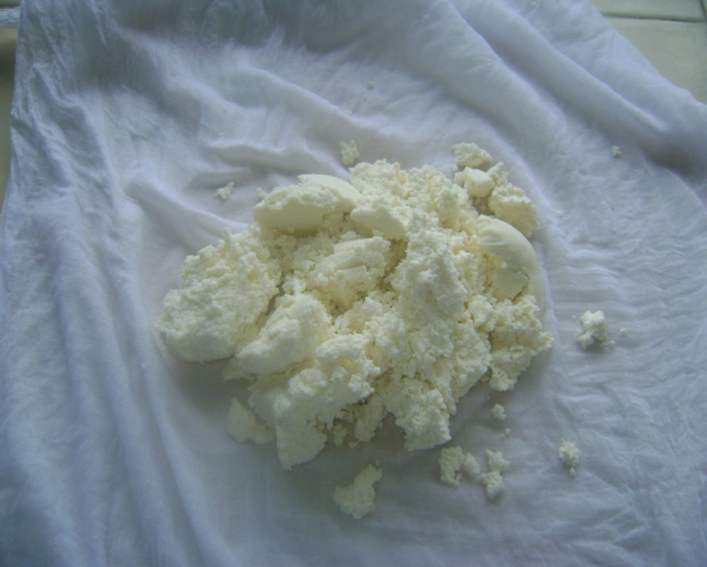
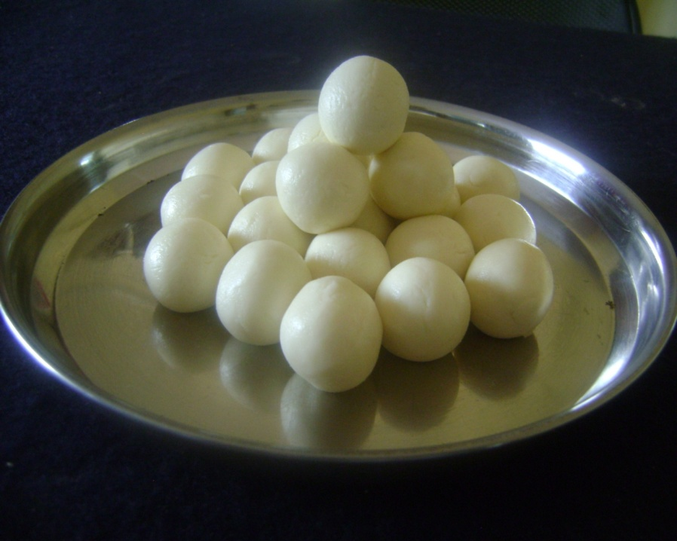
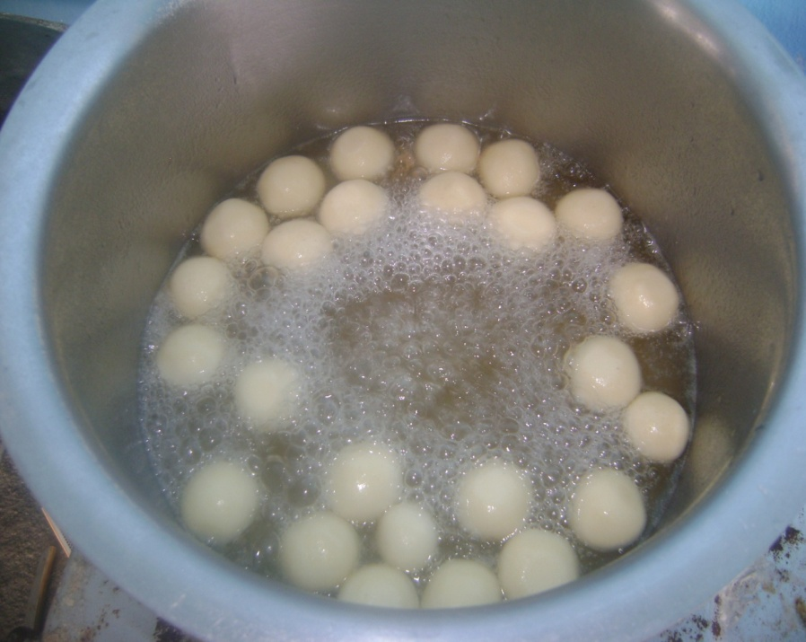
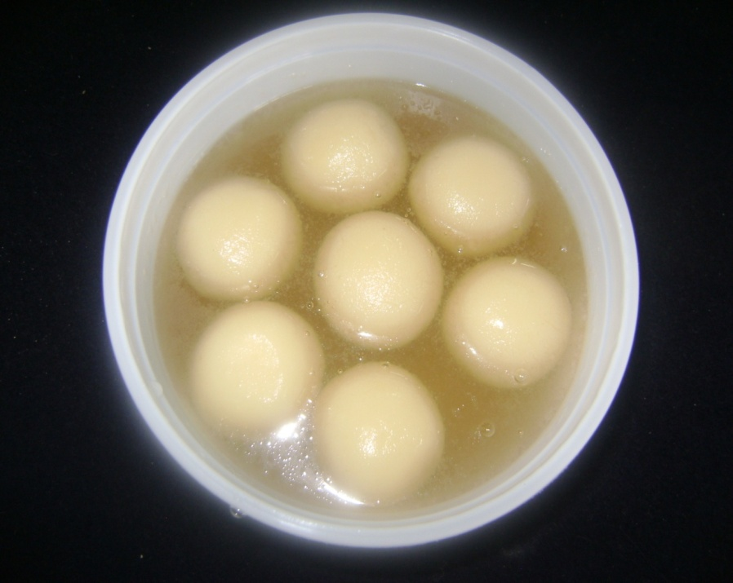

Slide 25
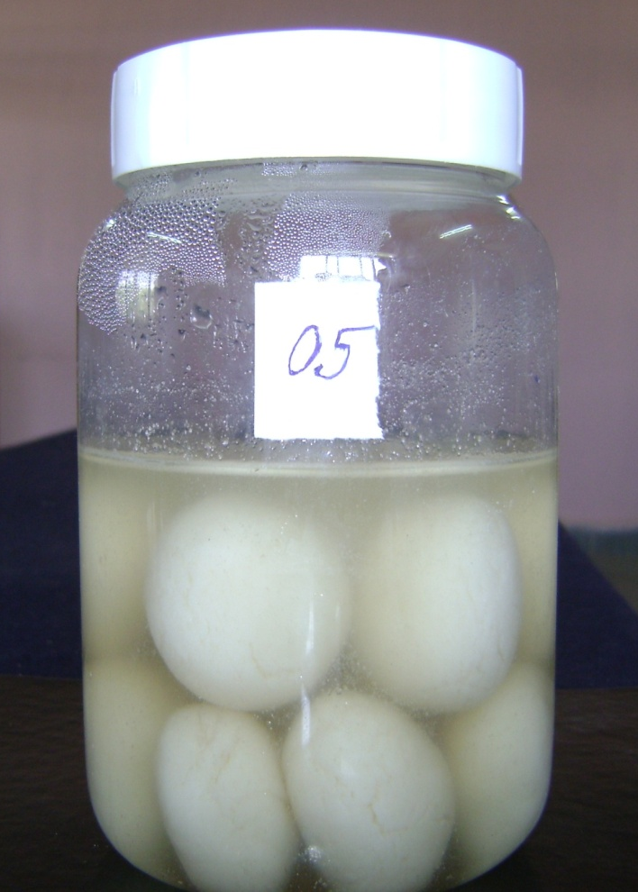

Slide 26

THANK YOU

Slide 27
Fatty acid profile of goat milk vs cow milk
Goat milk Cow milk Difference (%) for goat milk
C4:0 butyric 0.13 0.11
C6:0 caproic 0.09 0.06
C8:0 caprylic 0.10 0.04
C10:0 capric 0.26 0.08
C12:0 lauric 0.12 0.09
C14:0 myristic 0.32 0.34
C16:0 palmitic 0.91 0.88
C18:0 stearic 0.44 0.40
C6-14 total MCT 0.89 0.61 +46
C4-18 total SAFA 2.67 2.08 +28
C16:1 palmitoleic 0.08 0.08
C18:1 oleic 0.98 0.84
C16:1-22:1 total MUFA 1.11 0.96 +16
C18:2 linoleic 0.11 0.08
C18:3 linolenic 0.04 0.05
C18:2-18:3 total PUFA 0.15 0.12 +25
ª MCT: medium chain triglycerides; SAFA: saturated fatty acids;
MUFA: monounsaturated fatty acids; PUFA: polyunsaturated fatty acids.

Slide 28
Table 14. Cost structure of rasogolla prepared from cow milk and optimized rasogolla (cow milk + goat milk + soy milk)
Sr. No. | Particulars | Rate (Rs.) | Cow milk rasogolla |  | Optimized rasogolla
 |  |  | Quantity | Amount (Rs.) | Quantity | Amount (Rs.)
1 | Cow milk (ml) | 32.00/lit. | 1000 | 32.00 | 1000 | 32.00
2 | Goat milk (ml) | 41.00/lit. | -- | -- | 425 | 17.50
3 | Soy milk (ml) | 6.00/lit. | -- | -- | 145 | 1.00
4 | Chhana obtained (gm.) | -- | 200 | -- | 320 | --
5 | Sugar (60% syrup) (gm.) | 30.00/kg | 300 | 9.00 | 360 | 10.80
6 | Electric charges (Unit) | 7.00/Unit | 01 | 7.00 | 01 | 7.00
7 | Labour (hr.) | 15.00/hr. | -- | 3.20 | -- | 3.20
8 | Miscellaneous | -- | -- | 1.00 | -- | 1.00
9 | Rasogolla obtained (gm.) | -- | 270 | -- | 425 | --
10 | Total cost of rasogolla | -- | -- | 52.00 | -- | 62.50
11 | Cost of drained weight rasogolla/kg. | -- | -- | 192.60 | -- | 147.05
12 | Cost including packaging charges | 5.00/Tin | -- | 197.60 | -- | 152.05

Slide 29
Fig. 19 Cost structure of cow milk rasogolla with optimized rasogolla

