Slide 1
AML with t(8;16) shows unique clinical, morphological and cytogenetic features
Gabriela Gheorghe, MD
Children’s Hospital Wisconsin,
Medical College of wisconsin

Slide 2
INTRODUCTION
t(8;16) (p11.2;p13.3) is a recurrent, myeloid-specific cytogenetic abnormality detectable on routine cytogenetic karyotypic analysis.
Rare (0.7% of AML) but comprises 6.5% of AML of the M4/M5 FAB subtype.
Initially described in pediatric leukemias and is the second most common recurrent cytogenetic abnormality in rare cases of congenital leukemia.
Aggressive and often therapy-related with frequent resistance to standard chemotherapy, similar to AML with MLL rearrangements (though, outcome may even be inferior).

Slide 3
Acute Myeloid Leukaemia and Related Precursor Neoplasms (WHO)
Acute myeloid leukaemia with recurrent genetic abnormalities
Acute myeloid leukaemia with myelodysplasia-related changes
Therapy-related myeloid neoplasms
Acute myeloid leukaemia, not otherwise specified
Myeloid sarcoma
Myeloid proliferations related to Down syndrome
Blastic plasmacytoid dendritic cell neoplasm

Slide 4
AML with balanced translocations/inversions (WHO 2008 classification)
Acute myeloid leukaemia with t(8;21)(q22;q22); RUNX1·RUNX1T1
Acute myeloid leukaemia with inv(16)(p13.1q22) or t(16;16)(p13.1;q22); CBFB·MYH11
Acute promyelocytic leukemia with t(15;17)(q22;q12); PML-RARA
Acute myeloid leukaemIa with t(9;11)(p22;q23); MLLT3·MLL
Acute myeloid leukaemia with t(6;9)(p23;q34); DEK-NUP214
Acute myeloid leukaemia with inv(3)(q21q26.2) or t(3;3)(q2/;q26.2); RPN/·EVI1
Acute myeloid leukaemia (megakaryoblastic) with t(1;22)(p13;q13); RBMI15-MKL1

Slide 5
Pie chart based on 246 patients analyzed for the presence of mutations in the NPM1 and CEBPA genes, FLT3-ITD, FLT3-TKD and MLL-PTD. Each sector indicates the percentage of patients harboring one or more of the aforementioned mutations. WT indicates patients with only wild-type alleles of the genes testing.
From Mrozek et al* and adapted from Dohne et al**
*Mrózek K et al. Bloomfield CD. Blood. 2007 Jan 15;109(2):431-48. Epub 2006 Sep 7. Review.
Mutant nucleophosmin (NPM1) predicts favorable prognosis in younger adults with acute myeloid leukemia and normal cytogenetics: interaction with other gene mutations.
**Döhner K et al, Blood. 2005 Dec 1;106(12):3740-6.

Slide 6
AML with t (8;16)
Initially reported as a malignant histiocytosis (Schouten et al), AML with t(8;16) commonly shows blast hemophagocytosis, DIC, and extramedullary infiltration
Often a monocytoid leukemia but difficult to classify based on unusual cytochemical staining (parallel MPO/NSE positivity in blasts).
Thought to be an initiating event in leukemogenesis and fuses MYST3 (8p11), which encodes for a histone acetyltransferase, to CREBBP (16p13), which encodes for a transcriptional co-activator and acetyltransferase, generating a novel fusion protein that inhibits RUNX1 regulated transcription, leading to differentiation block.
Variant translocations related to t(8;16) include t(10;16)(q22;p13), t(8;22)(p11;q13), inv(8)(p11q13), t(8;20)(p11;q13) and show similar features, including blast erythrophagocytosis.
Although >100 cases of t(8;16) have been reported, infants and children are underrepresented in recent studies

Slide 7
TABLE 1. Patient Characteristics/CHW,DenverCH
 | Age | Sex | WBC | Sites | Subtype | Immunophenotype‡ | Karyotype | DIC , Hemophago-cytosis | Outcome
1 | 5y | F | 18,600/ul | Bone marrow, peripheral blood | De novo FAB M5a | CD34-, CD117-, MPO+, NSE+ CD4+, CD56+, TdT-, CD163- | 46,XX,der(7)t(6;7)(q15;q31),t(8;16)(p11.2;p13.3)[14]/46,XY[6] | Minimal blast hemophagocytosis | Alive, 19 months s/p transplant
2 | 8y | F |  | Bone marrow, peripheral blood | Therapy-related FAB M5b | CD34-, CD117?, MPO-, NSE+ CD2+, CD19+, TdT- | 46,XX,t(5;10)(p15.3;q24),del(7)(q31),t(8;16)(p11.2;p13),inv(17)(p13q23)[16]/ 46,XX, t(1;15)(q21;q24),t(5;10)(p15.3;q24),t(6;7)(q27;p15),t(8;16)(p11.2;p13),t(13;17) (q14;p13)[1]/ 46,XY[3] | None | DOD, <1 year following diagnosis
3 | 1m | M | 381,000/ul | Peripheral blood, skin, CSF | De novo FAB M4 | CD34-, CD117-, MPO+, NSE+ CD56(dim+), TdT(dim+) | 46,XY,t(8;16)(p11.2;p13.3)[inc2]/46,XY[2] | DIC | Alive, 19 months s/p reinduction and URD cord blood transplant
4 | 14y | F | 171,000/ul | Peripheral blood, bone marrow | De novo FAB M4 | CD34-, CD56+, CD15+, CD4+ | t(8;16)(p11.2;p13.3) nuc ish(5’KAT6A, 3’ KAT6A)x2 (5’KAT6A sep 3’ KAT6Ax1)[25/100] | DIC hemophagocytosis | DOD, 2 months after bone marrow transplant
5* | 20m | M |  | Skin | Therapy-related | No flow | t(8;16)(p11.2;p13.3) by FISH | Hemophago cytosis | Alive 1 year after bone marrow transplant
*Early therapy-related myeloid sarcoma and deletion of 9q22.32 to q31.1. Brickler MM, Basel DG, Gheorghe G, Margolis DM, Kelly ME, Ehrhardt MJ. Pediatr Blood Cancer. 2014 Sep;61(9)

Slide 8
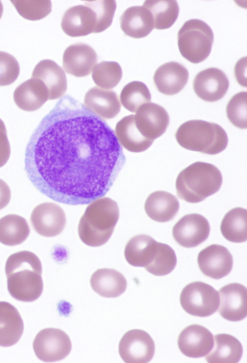
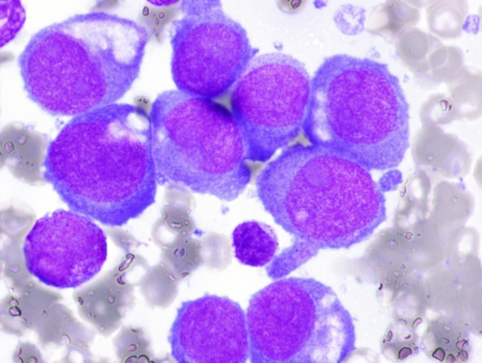
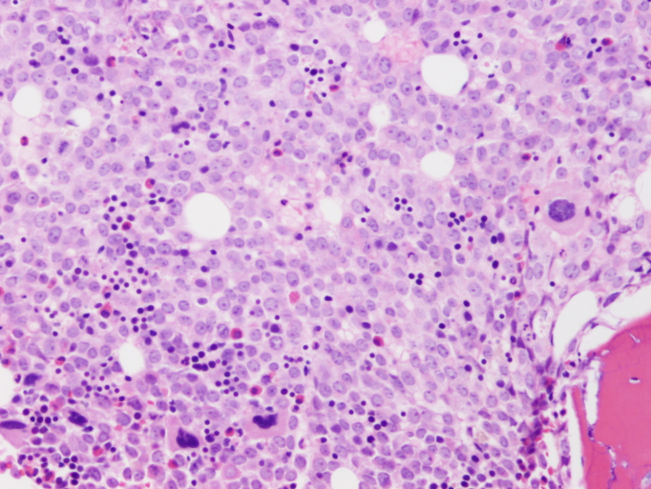
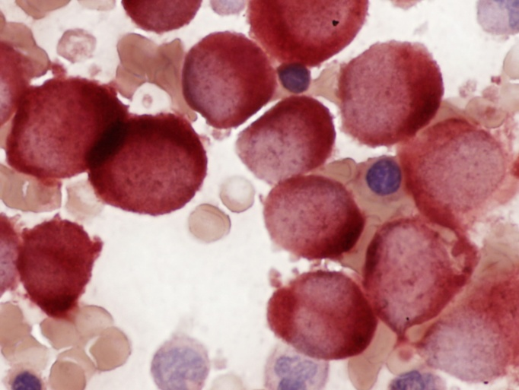
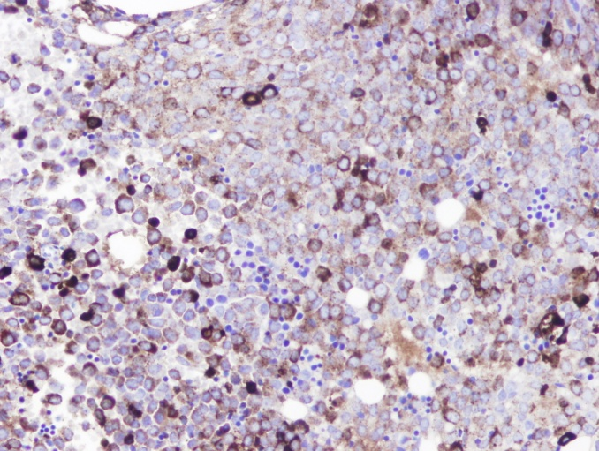
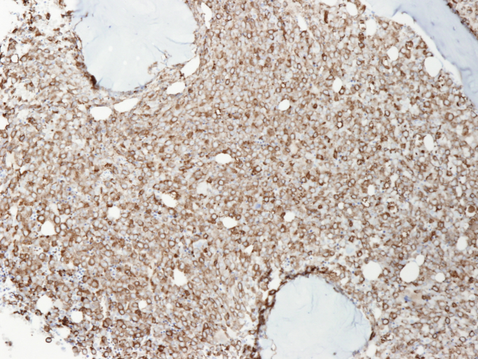
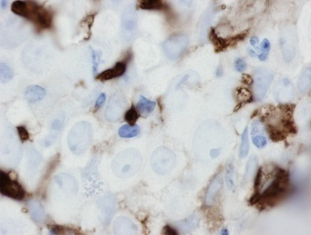
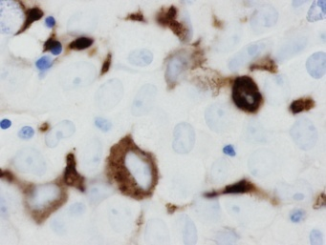
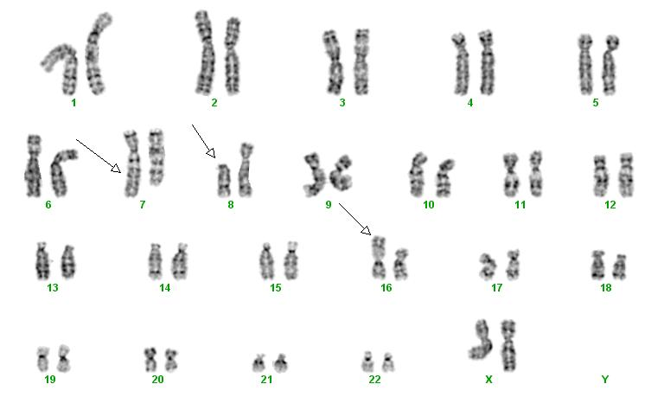
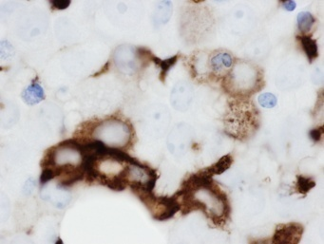
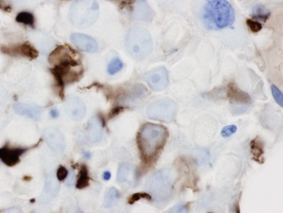
A
B
C
D
E
F
α-naphthyl acetate esterase
myeloperoxidase
CD68-PGM1
G
CD163
Case 1

Slide 10
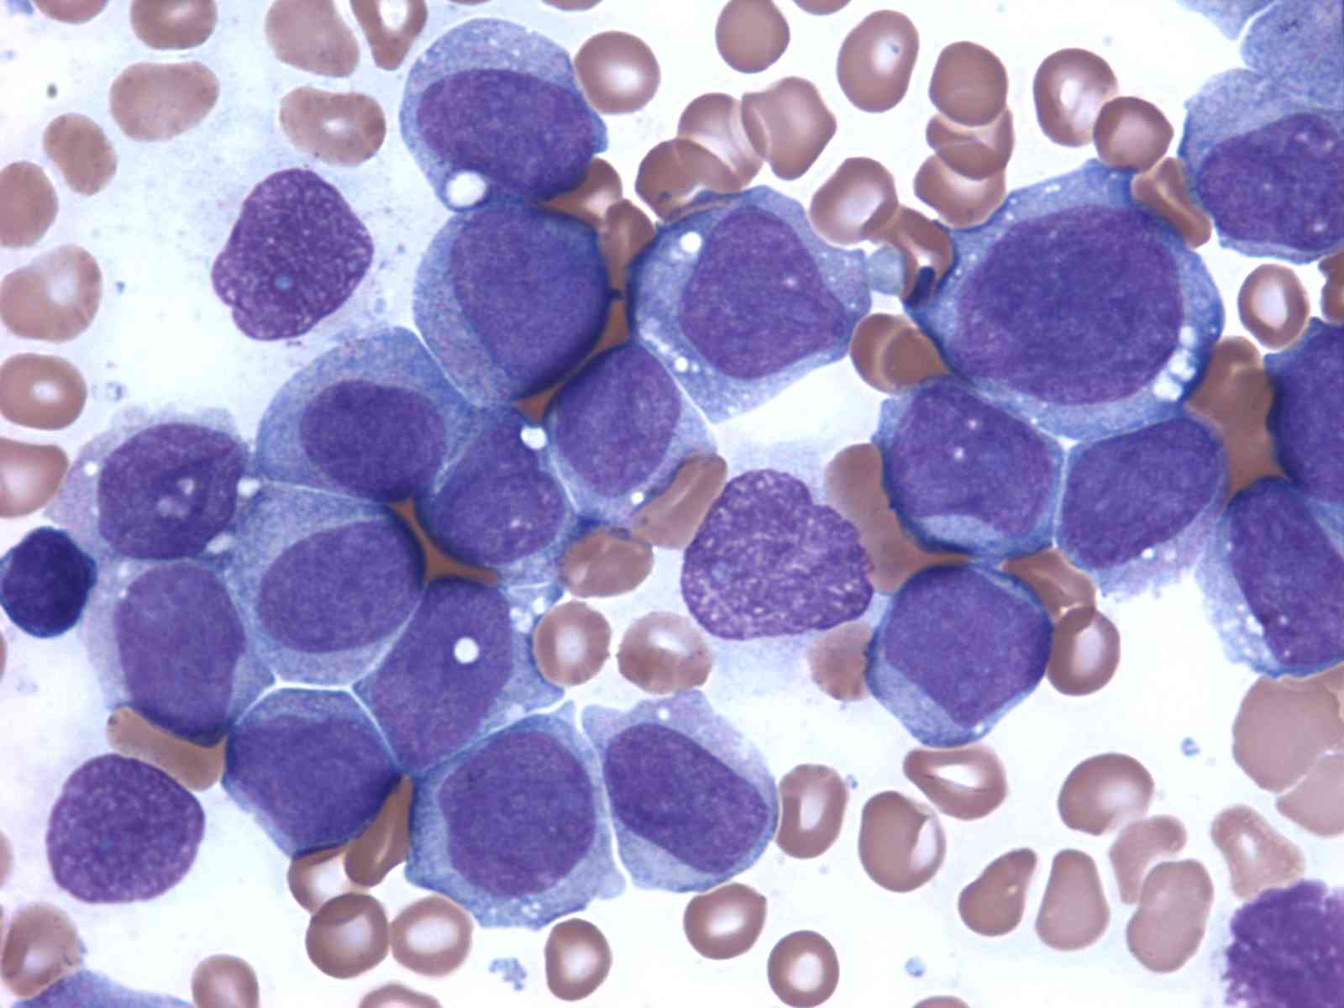
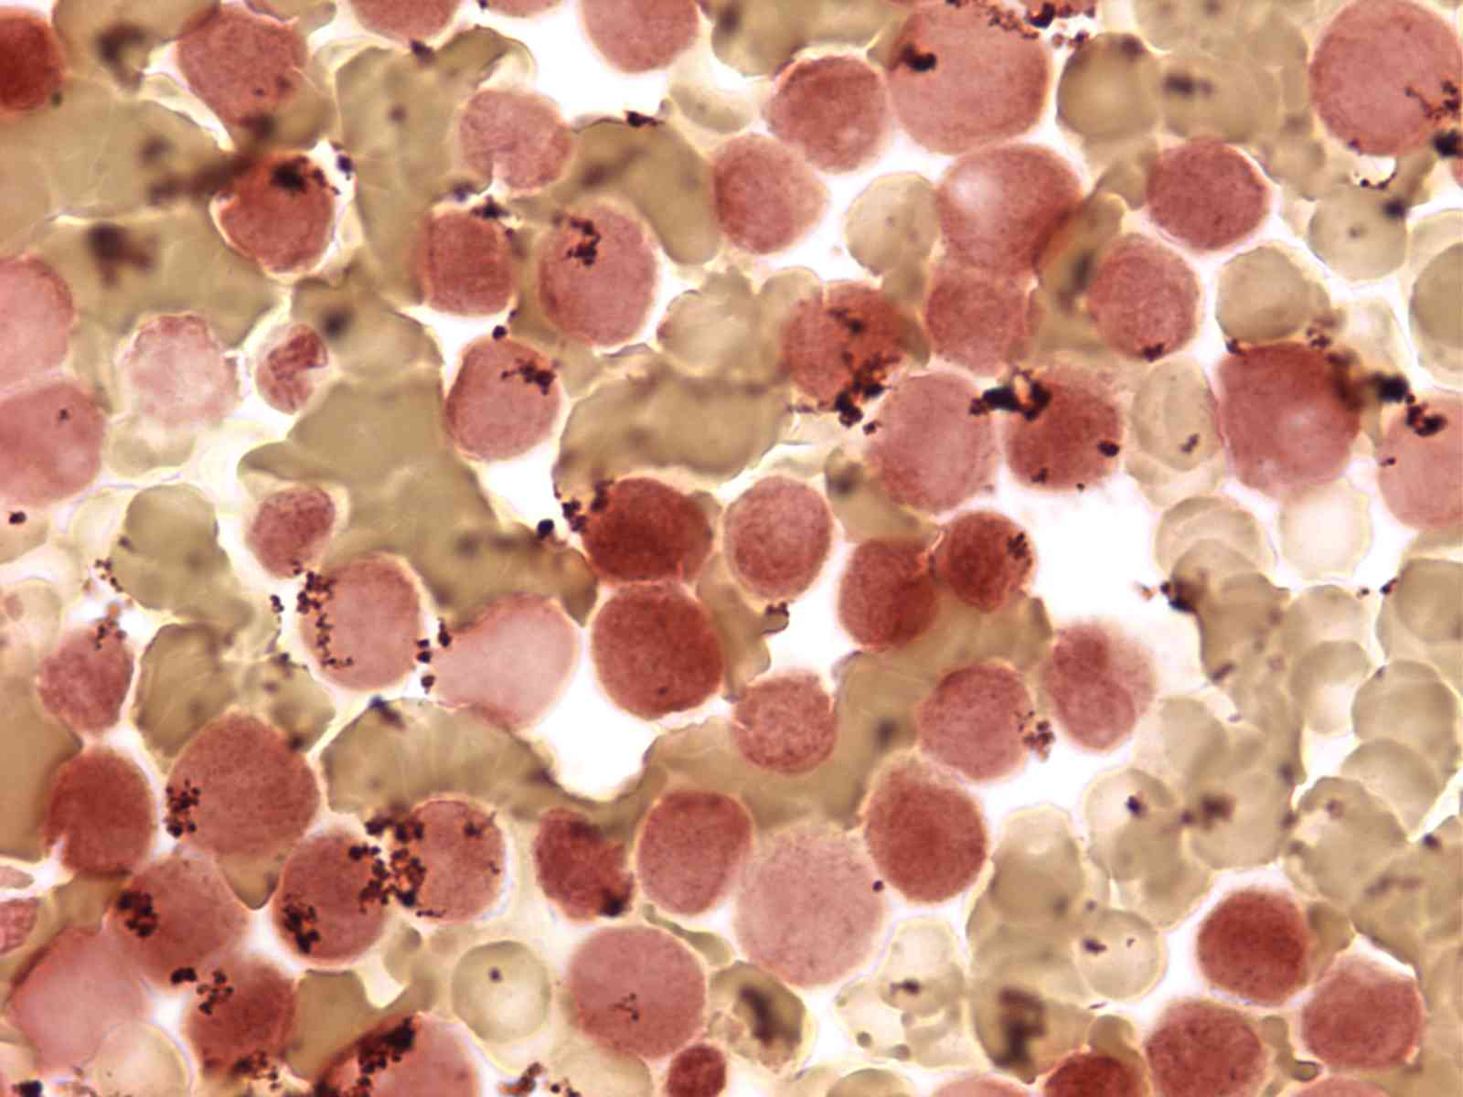
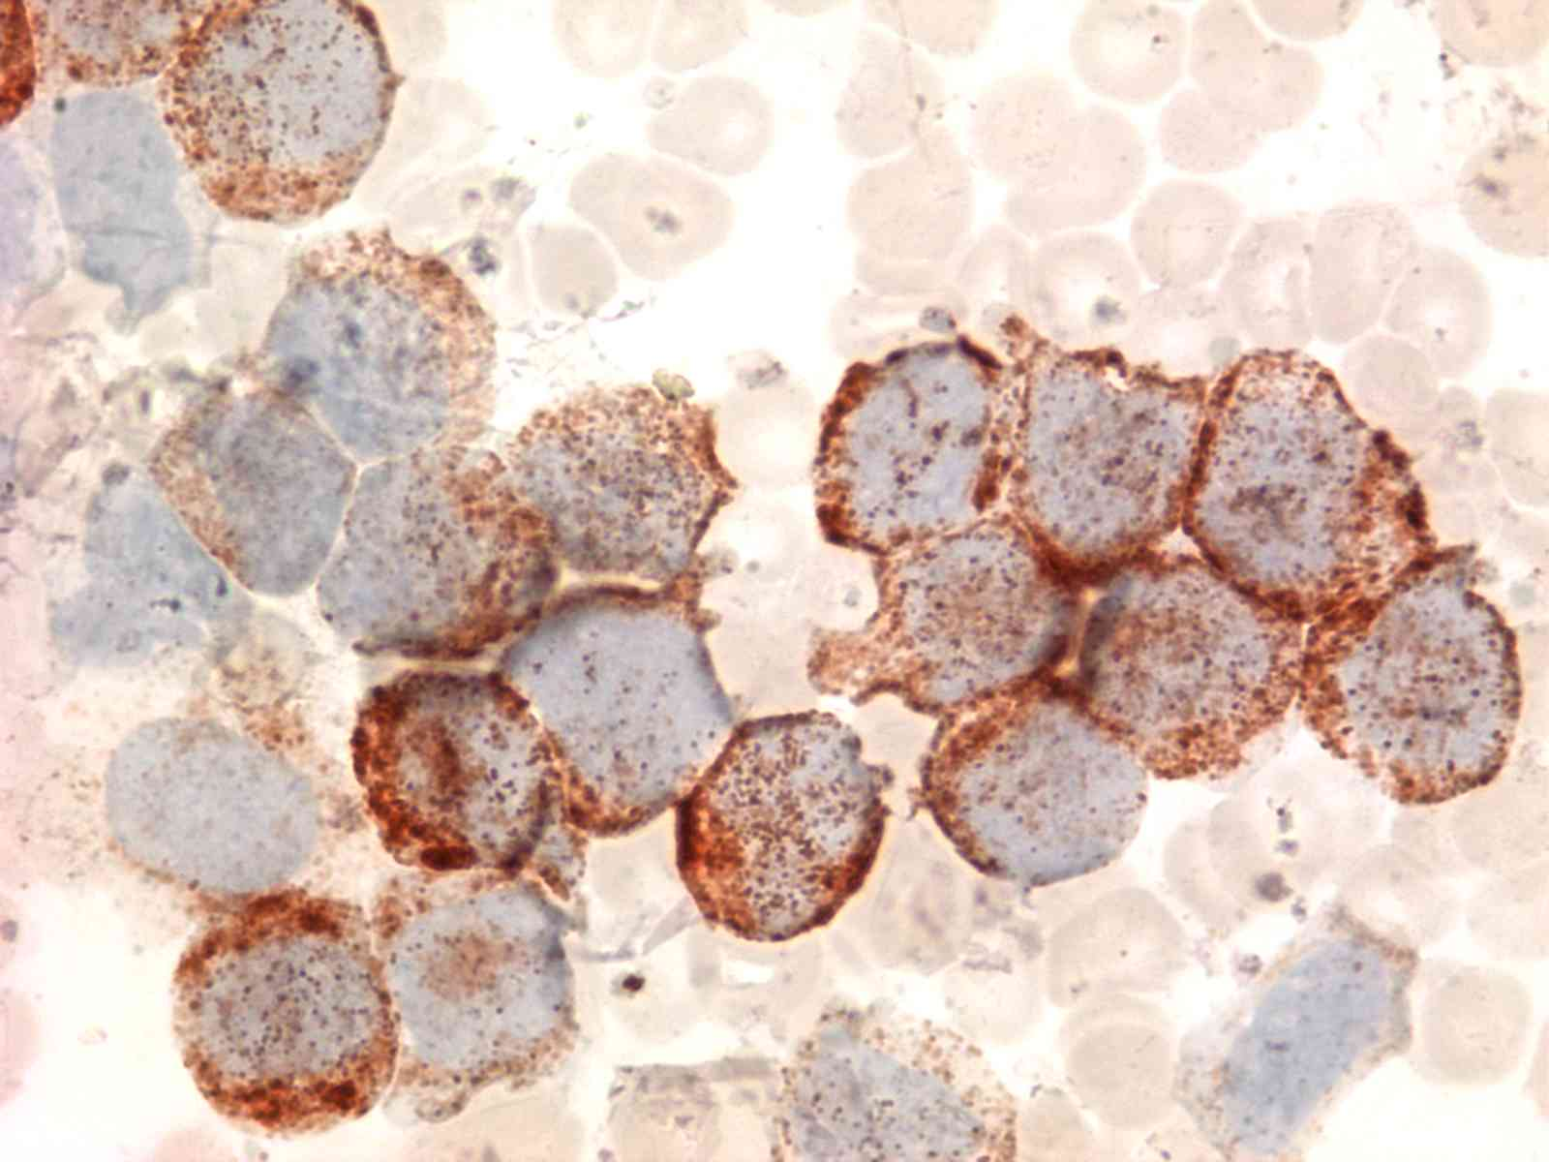
A
B
peripheral blood
Non-specific esterase
C
myeloperoxidase
Case 3

Slide 11
14 yo with ho leukemia
14 yo with respiratory failure, cytopenia
History of leukemia with t (8;16), 2 months s/p transplant
Transfusion reaction (Trali) vs relapsed leukemia
DIC: fulminant course
Case 4

Slide 12
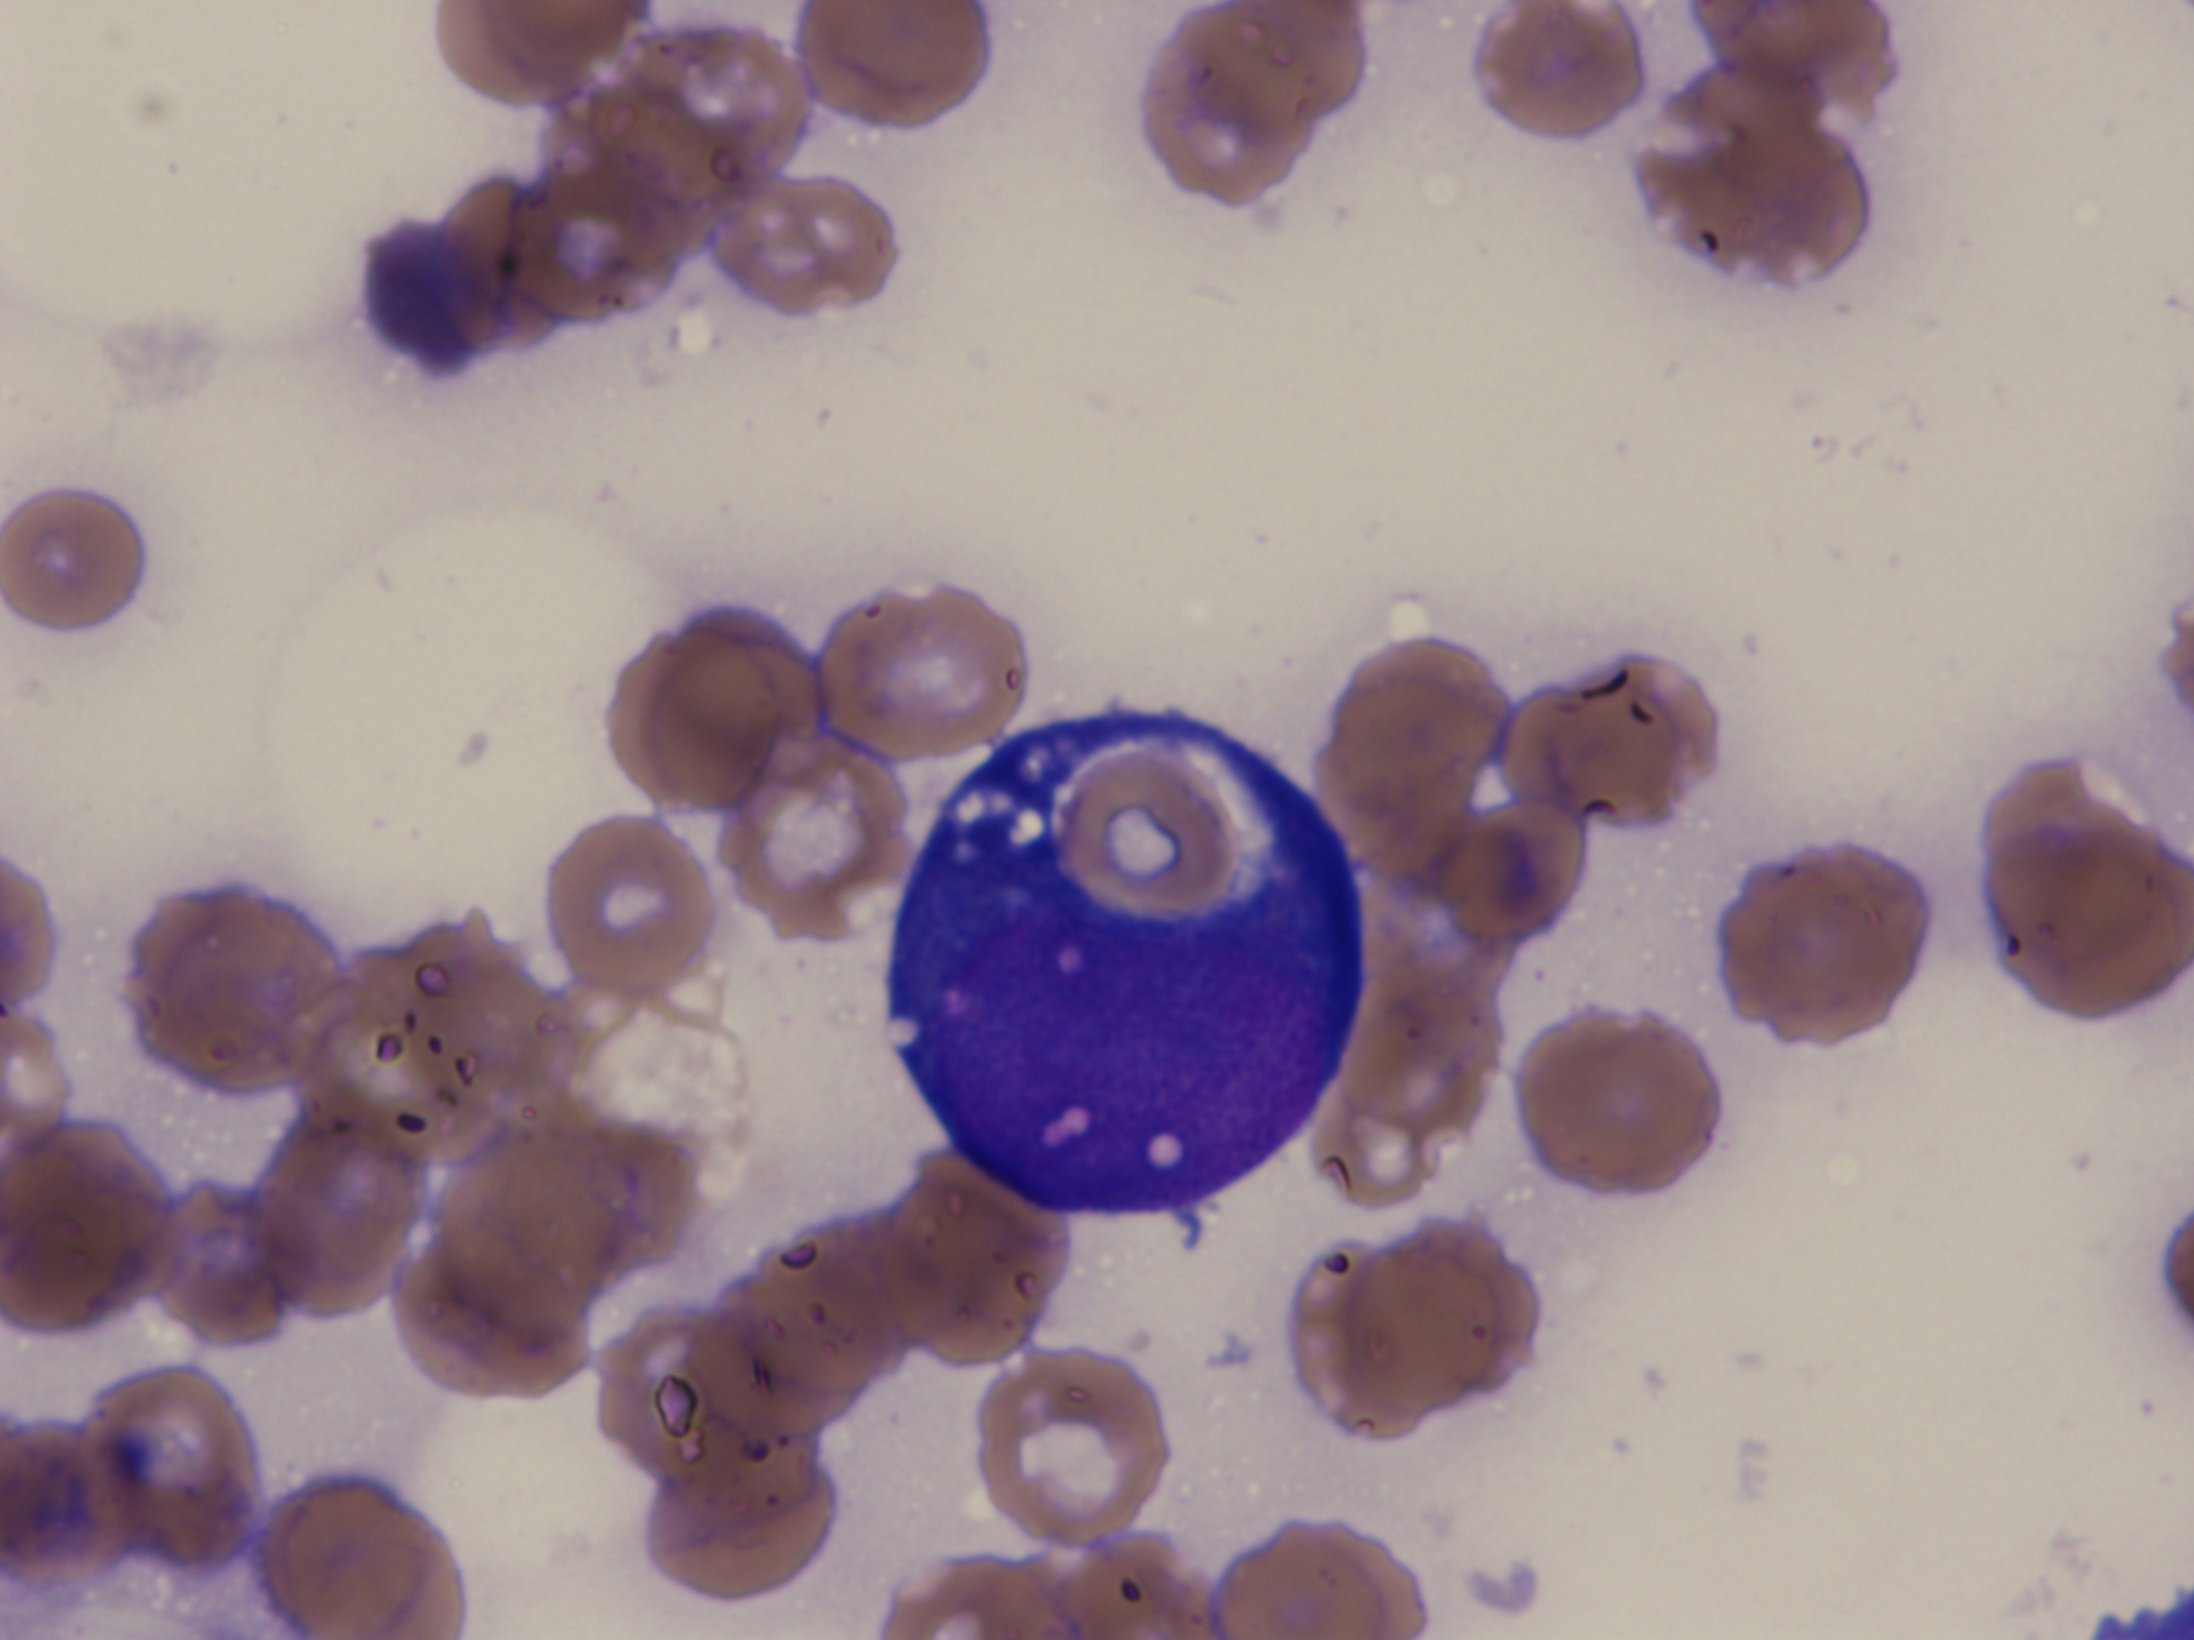
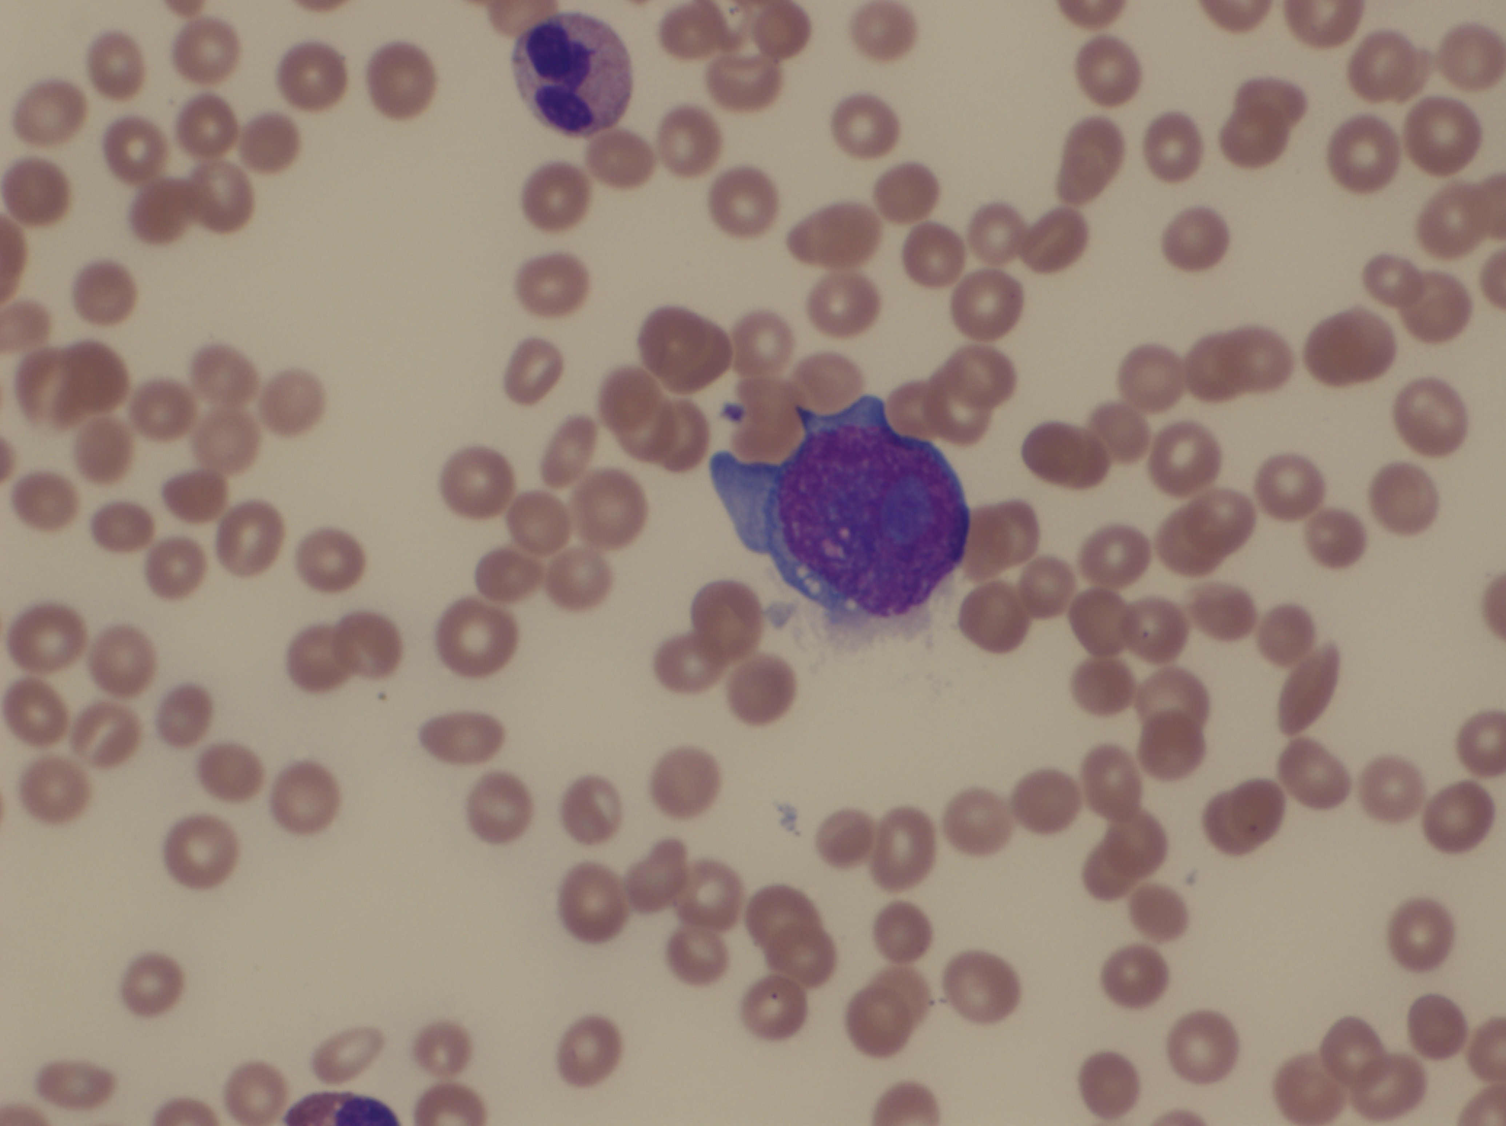
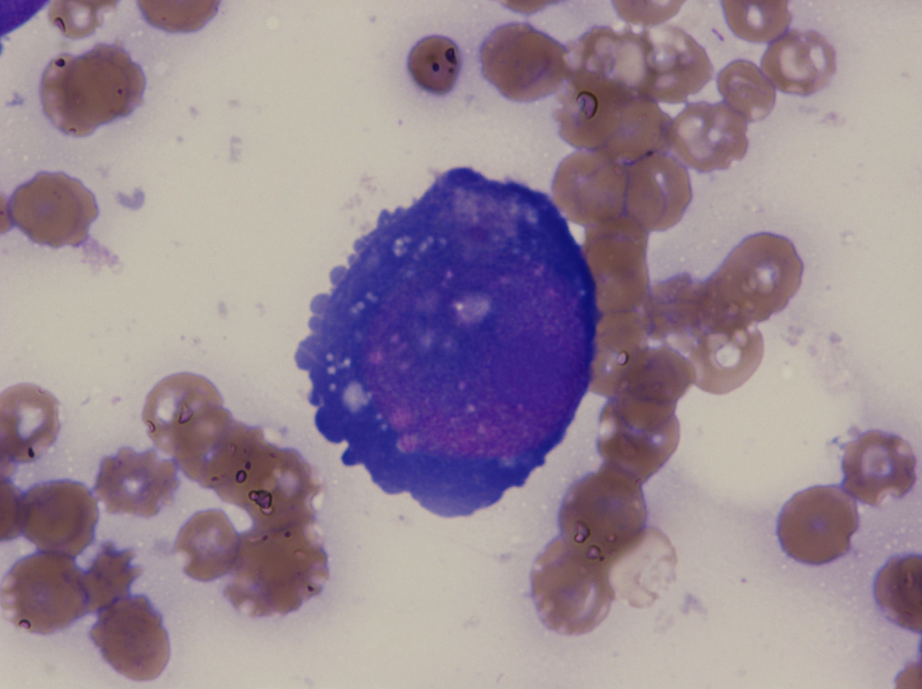

Slide 13
20 mo ho neuroblastoma..
20 month old male with 5 week history of growing papules on posterior scalp
Non-tender, Firm
History of stage 4 neuroblastoma
Diagnosed at 13 months of age
Received 8 cycles chemotherapy Cyclophosphamide, Etoposide, Carboplatin, Doxorubicin
Case 5
Notes:
This is a now 2 year old male who presented at 20 months of age with a 5 week history of growing, firm, nontender papules on his posterior scalp. He has a history of stage 4 neuroblastoma, diagnosed at 13 months of age. His primary neuroblastoma did not have any cutaneous involvement.

Slide 14
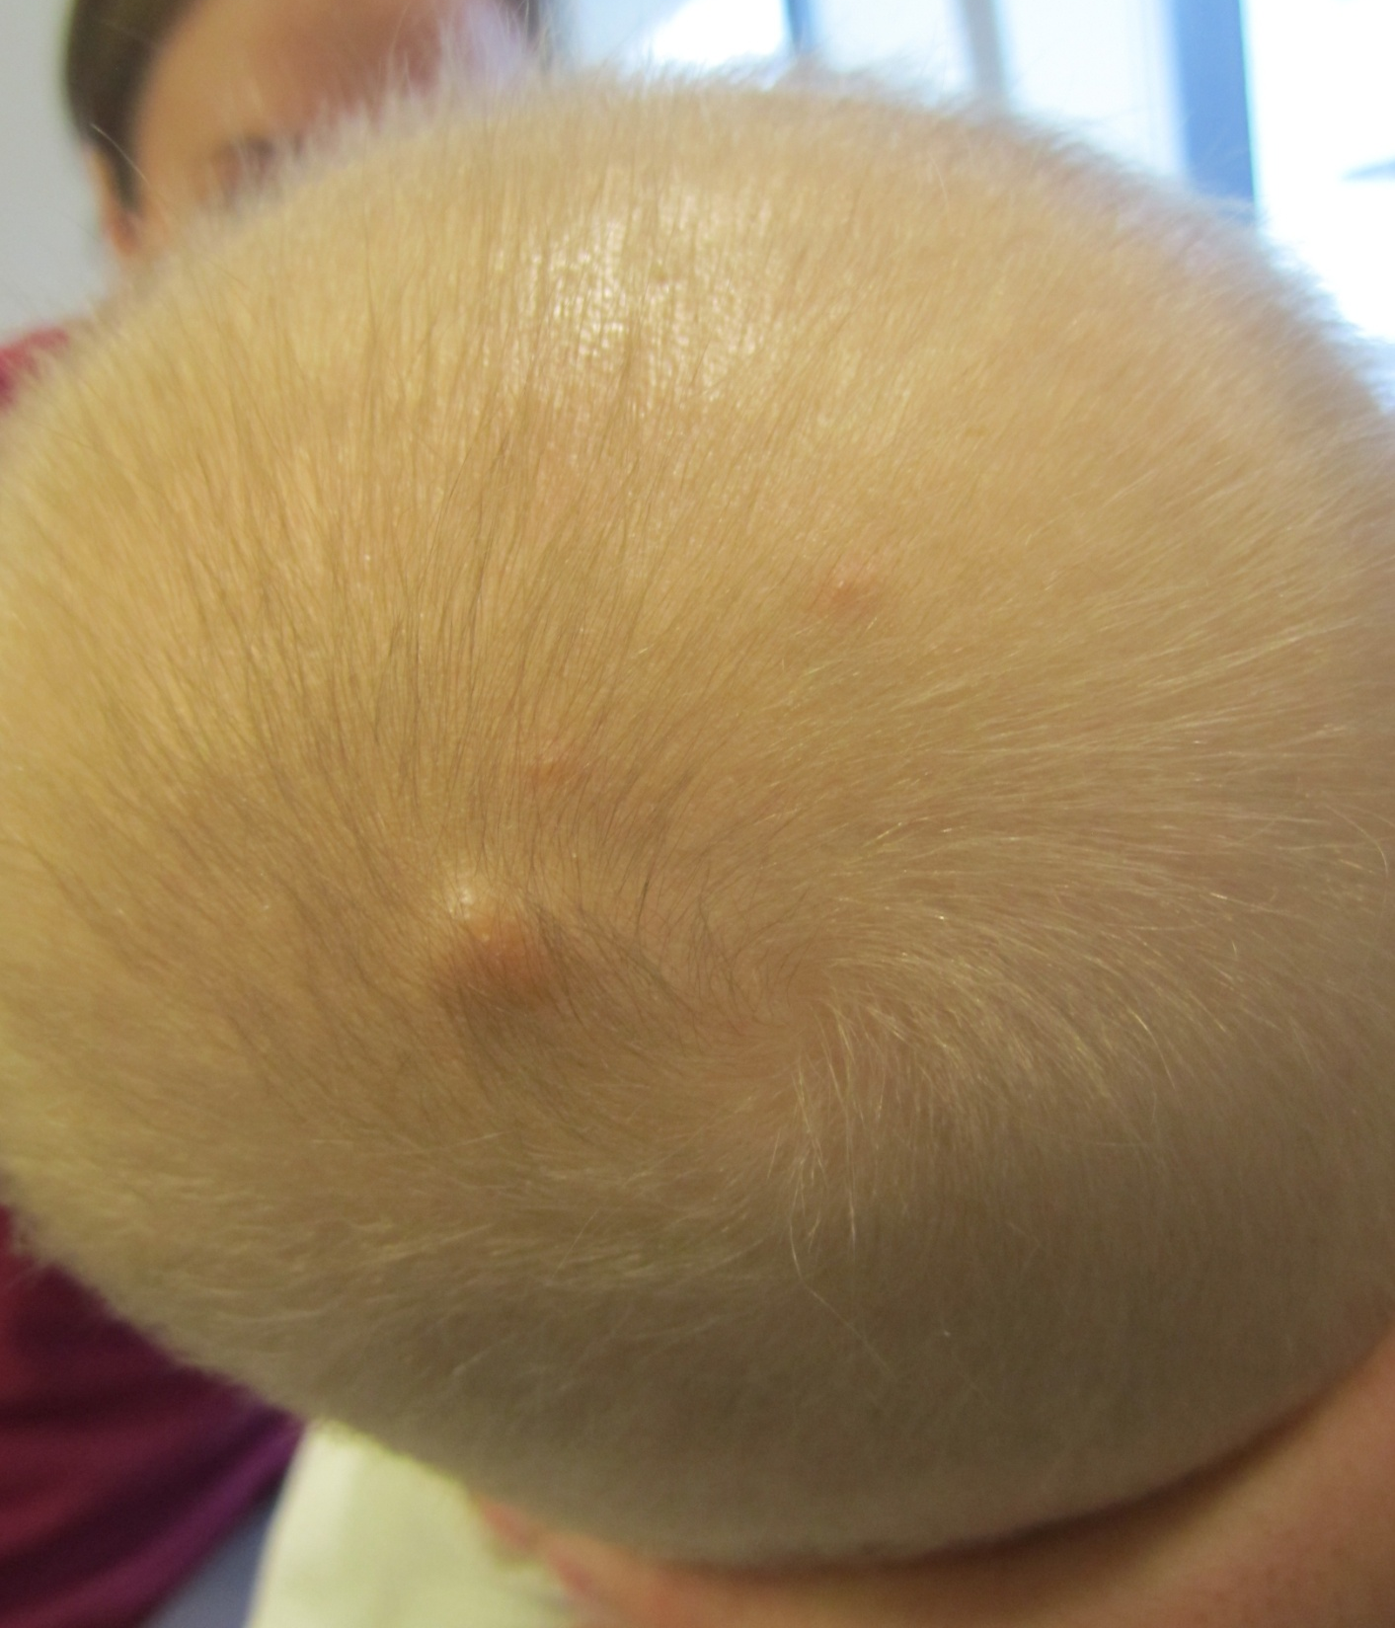
Notes:
On physical exam, he is a thin, healthy appearing boy with a solitary 5 x 6 mm very firm, indurated, mobile pink to violaceous papule on the vertex of his scalp. There are two similar, smaller papules on the vertex. No cervical lymphadenopathy.

Slide 15
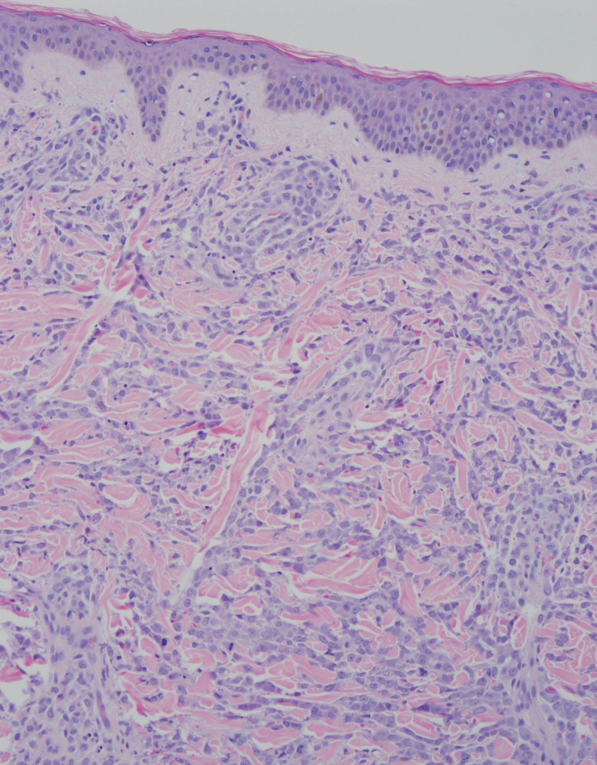
Notes:
At higher power magnification of the specimen, viewing the epidermis and upper portion of the dermis, you can see variable-sized lymphocytes throughout. There is some single-stranding, of the lymphocytes amidst bundles of collagen, as well as a few present in the epidermis.

Slide 16
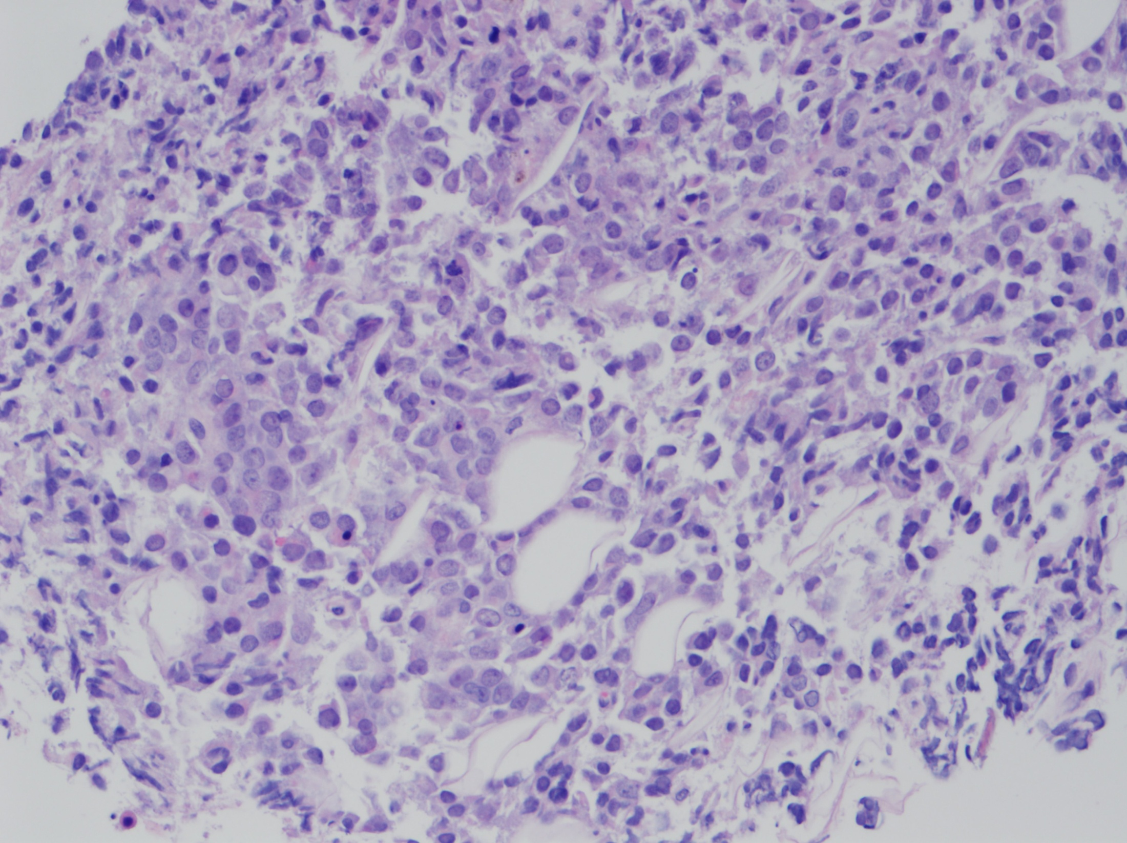
Notes:
At higher power in the deeper dermis and subcutaneous fat, you can see many variable-sized lymphocytes. There are lymphocytes with dense chromatin and others with fine chromatin, and visible nucleoli. There are a few mitoses present.

Slide 17
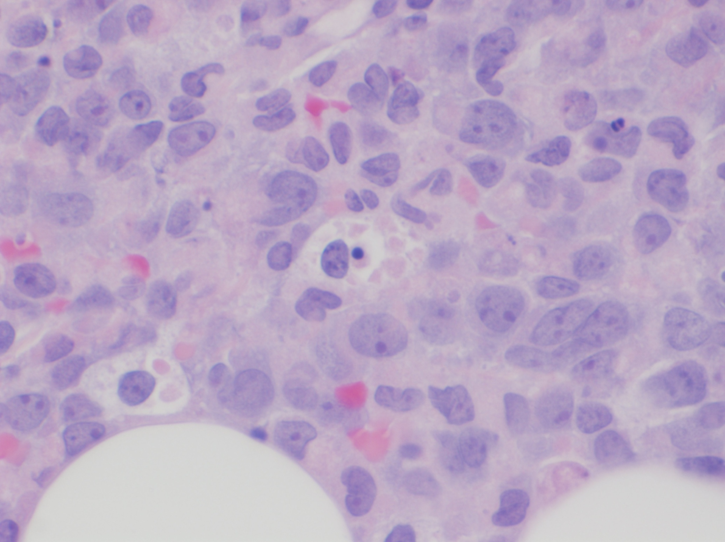
Notes:
There is a more magnified view that demonstrates prominent nucleoli, fine chromatin and variable sized lymphocytes. In the center of the slide is hemophagocytosis of a nucleated red blood cell. You can also see some mitotic figures
There is no evidence of emperipolesis, which is the presence of an intact cell within the cytoplasm of a cell.

Slide 18
Extramedullary AML
Myeloid sarcoma
positive for CD68-KP1, CD43, CD33, Lysozyme, Myeloperoxidase (MPO), CD45
Also known as:
Extramedullary acute myeloid leukemia (AML).
Chloroma
A t(8:16) translocation was present in tumor cells analyzed by FISH
Fuses MOZ (monocytic leukemia zinc finger) to CREB-binding protein
Found in de novo and therapy-related AML
Notes:
The H&E and the stains were consistent with myeloid sarcoma, also known as extramedullary acute myeloid leukemia or chloroma.
Cytogenetic evaluation of the specimens demonstrated a t(8;16) translocation, confirmed to be present in 67% of tumor cells analyzed by fluorescent in situ hybridization (FISH). The t(8:16) fuses MOZ (monocytic leukemia zinc finger), an acetyltransferase, to the CREB-binding protein, and has been reported in both de novo and therapy-related AML.

Slide 19
Myeloid Sarcoma
Tumors of myeloid origin occurring at extramedullary locations
Typically occur in the setting of overt bone marrow involvement
Treatment is chemotherapy
Local recurrence or frank leukemia typically develops within several months without treatment
Notes:
Myeloid sarcomas are tumors of myeloid origin, that occur at extramedullary sites. They typically are seen with overt bone marrow involvement, but they can be the only identifiable sign of disease. If left untreated, local recurrence or frank leukemia can develop within several months.

Slide 20
Discussion
Neuroblastoma can have cutaneous metastases
Pathology confirmed isolated cutaneous myeloid sarcoma, occurring on therapy
Our patient remains in remission ~1y post-HCT
Notes:
This is case was very interesting to us, as we expected a diagnosis of Neuroblastoma, which can have cutaneous mets. However, it showed myeloid sarcoma – with cutaneous findings only. Interestingly, they appeared at the end of his chemo for his neuroblastoma. As therapy-related AML is a known side effect of chemo, and that MS can be a harbinger for systemic involvement, the combination is unique. We do not know if his large chromosomal deletion plays a part in the development of the myeloid sarcoma. He is status post transplant and is doing well.

Slide 21
Discussion
Acute myeloid leukemia with t(8;16)(p11.2;p13.3) is not yet a distinct entity in the WHO 2008 Classification
An aggressive course is typical, but evidence for disseminated intravascular coagulation and hemophagocytosis must be sought
Pediatric AML with t(8;16) is underrepresented in recent literature but shows similar features to adult cases
Diagnostic pearls include:
Monocytic/monoblastic differentiation with cytoplasmic vacuolization2,3
MPO/NSE dual positivity – how to classify?
CD34-/CD117- blasts that often show CD56 and may rarely have dim TdT expression
The 8p11 fusion gene, MYST3 (MOZ), is involved in both de novo and therapy-related cases1,2 and may be crucial in the understanding of leukemogenesis, which could provide therapeutic targets
With further investigation, AML with t(8;16)(p11.2;p13.3) may meet criteria to stand alone as a distinct diagnostic entity

Slide 22
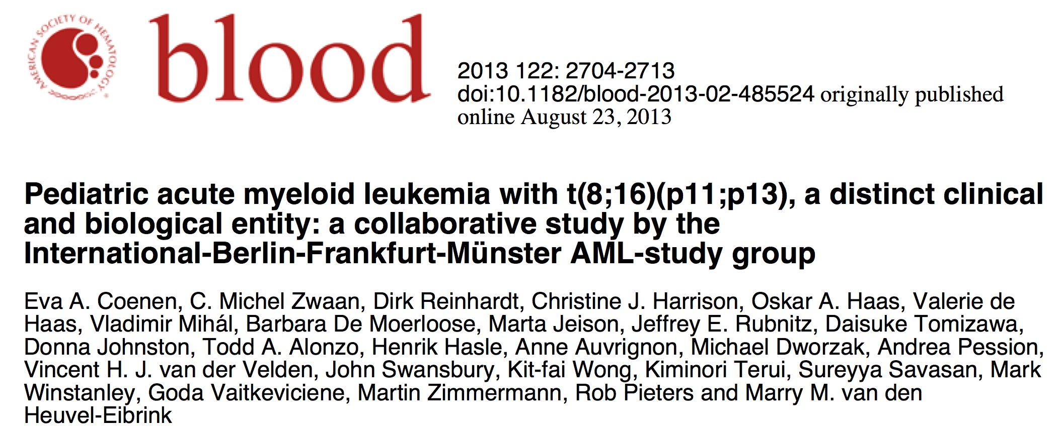

Slide 23
Findings
62 pediatric patients from 18 countries (median age: 1.2 years), 2 therapy related
7 congenital cases showed spontaneous resolution but 4 relapsed eventually
extramedullary disease: 66%
CNS involvement: 15%
DIC: 39%

Slide 24
Conclusion
t(8;16)(p11.2;p13.3) or 8p11.2 MYST3 rearrangements are recurrent cytogenetic abnormalities in acute myeloid leukemia and may best be distinct in the WHO classification
An aggressive clinical course is typical (including DIC)
Pediatric AML with t(8;16) is underrepresented but may present as a congenital leukemia
Spontaneous remissions common but clinical follow up very important

Slide 25
References
Haferlach T et al. AML with translocation t(8;16)(p11;p13) demonstrates unique cytomorphological, cytogenetic, molecular, and prognostic features. Leukemia 2009;23:934-943.
Gervais C, Murati A, Helias C, et al. Acute myeloid leukaemia with 8p11 (MYST3) rearrangement: an integrated cytologic, cytogenetic and molecular study by the groupe francophone de cytogenetique hematologique. Leukemia 2008;22:1567-1575.
Stark B, Resnitzky P, Jeison M, et al. A distinct subtype of M4/M5 acute myeloblastic leukemia (AML) associated with t(8:16)(p11:p13), in a patient with the variant t(8:19)(p11:q13)--case report and review of the literature. Leuk Res 1995;19:367-379.
Bakst R, Tallman M, Douer D, Yahalom, J. How I treat extramedullary acute myeloid leukemia. Blood (2011) 118 (14): 3785-3793
Bhatta, S et al. Therapy-related myeloid sarcoma with an NPM1 mutation. Leukemia & Lymphoma (2010). 51 (11): 2130-2131
Classen C et al. Spontaneous complete and sustained remission of a rearrangement CBP (16p13)-positive disseminated congenital myelosarcoma. Ann Hematol (2005), 84: 274-275.
Gervais C et al. Acute myeloid leukaemia with 8p11 (MYST3) reaarangement: an intergrated cytologic, cytogenetic and molecular study by the groupe francophone de cytogenetique hematologique. Leukemia (2008) 22: 1567-1575.
Quensel B, et al. Therapy-related acute myeloid leukemia with t(8;21), inv(16), and t(8;16): A report on 25 cases and review of the literature. J of Clinical Oncology (1993) 11 (12): 2370-2379.
Reinhardt D, Creutzig U. Isolated Myelosarcoma in Children – Update and Review. Leukemia & Lymphoma (2002). 43(3): 565-574.

Slide 27
Acute myeloid leukaemia with 8p11 (MYST3) rearrangement: an integrated cytologic, cytogenetic and molecular study by the groupe francophone de cytogenetique hematologique
C Gervais1,18, A Murati2,18, C Helias1, S Struski1, A Eischen1, E Lippert3, I Tigaud4, D Penther5, C Bastard5, F Mugneret6, B Poppe7,F Speleman7, P Talmant8, J VanDen Akker9, L Baranger10, C Barin11, I Luquet12, N Nadal13, F Nguyen-Khac14, O Maarek15, C Herens16, D Sainty2, G Flandrin17, D Birnbaum2, M-J Mozziconacci2 and M Lessard11Laboratoire d’He´matologie, CHU de Hautepierre, Strasbourg, France; 2Institut Paoli-Calmettes, Centre

Slide 32
The 2008 revision of the World Health Organization (WHO) classification of myeloid neoplasms and acute leukemia: rationale and important changes
James W. Vardiman,¹ Jüergen Thiele,² Daniel A. Arber,³ Richard D. Brunning,⁴ Michael J. Borowitz,⁵ Anna Porwit,⁶ Nancy Lee Harris,⁷ Michelle M. Le Beau,⁸ Eva Hellström-Lindberg,⁹ Ayalew Tefferi,¹⁰ and Clara D. Bloomfield¹¹
¹Department of Pathology, University of Chicago, IL; ²Institute of Pathology, University of Cologne, Cologne, Germany; ³Department of Pathology, Stanford University Medical Center, CA; ⁴Department of Laboratory Medicine and Pathology, University of Minnesota, Minneapolis; ⁵Department of Pathology and Oncology, Johns Hopkins Medical Institutions, Baltimore, MD; ⁶Department of Pathology, Karolinska University Hospital, Stockholm, Sweden; ⁷Department of Pathology, Massachusetts General Hospital and Harvard Medical School, Boston; ⁸Section of Hematology/Oncology, University of Chicago, IL; ⁹Department of Medicine, Karolinska University Hospital, Stockholm, Sweden; ¹⁰Division of Hematology, Mayo Clinic, Rochester, MN; and ¹¹Comprehensive Cancer Center, The Ohio State University, Columbus
BLOOD, 30 JULY 2009 VOLUME 114, NUMBER 5

Slide 33
References
Bakst R, Tallman M, Douer D, Yahalom, J. How I treat extramedullary acute myeloid leukemia. Blood (2011) 118 (14): 3785-3793
Bhatta, S et al. Therapy-related myeloid sarcoma with an NPM1 mutation. Leukemia & Lymphoma (2010). 51 (11): 2130-2131
Classen C et al. Spontaneous complete and sustained remission of a rearrangement CBP (16p13)-positive disseminated congenital myelosarcoma. Ann Hematol (2005), 84: 274-275.
Gervais C et al. Acute myeloid leukaemia with 8p11 (MYST3) reaarangement: an intergrated cytologic, cytogenetic and molecular study by the groupe francophone de cytogenetique hematologique. Leukemia (2008) 22: 1567-1575.
Quensel B, et al. Therapy-related acute myeloid leukemia with t(8;21), inv(16), and t(8;16): A report on 25 cases and review of the literature. J of Clinical Oncology (1993) 11 (12): 2370-2379.
Reinhardt D, Creutzig U. Isolated Myelosarcoma in Children – Update and Review. Leukemia & Lymphoma (2002). 43(3): 565-574.
Notes:
He was born term. He was noted to have gross speech and motor delays.
Jays deletion is further telomeric to PTCH1 and FANC genes but there is still overlap of the area of interest, meaning, it does not include the PTCH1 gene, which is responsible for Gorlin’s syndrome. 9q22.32 q31.1
The deleted region does not specifically include any gene which has been previously highlighted as a tumor predisposition gene but this is a large deletion and of the 98 open reading frames, only 33 are identified genes with OMIM entries.
Loss of function of TGFBR1 has been described in the context of myeloid malignancies and has been the target of therapy in some malignancies with proven abnormal TGFB function.

