Slide 1
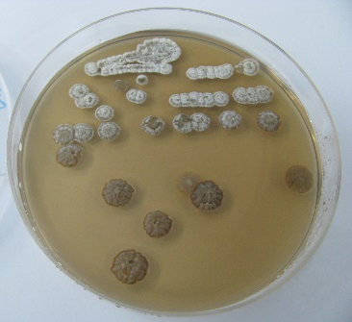
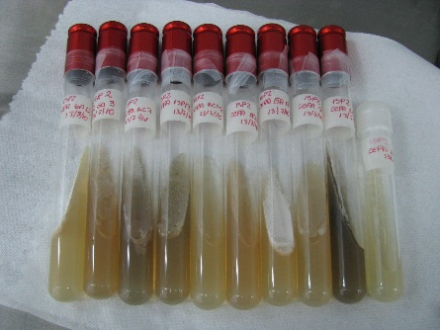
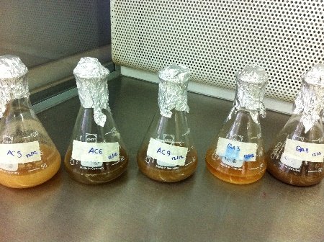
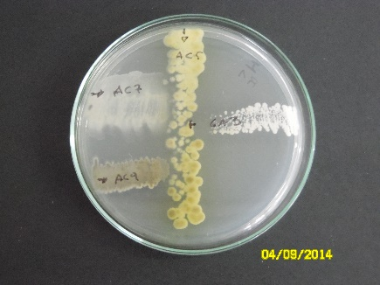
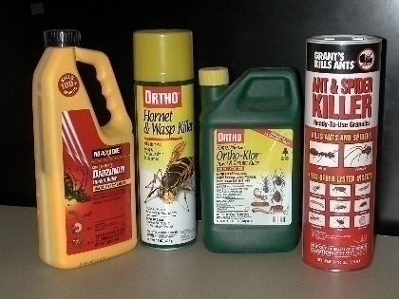
“Selection of an actinobacteria consortium for enhancing diazinon degradation” Briceño Gabriela., Schalchli Heidi., Palma Graciela., Diez M. Cristina. Universidad de La Frontera, Box 54-D, Chile

Slide 2
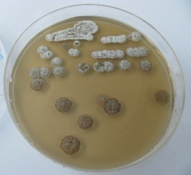
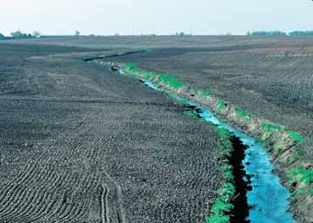
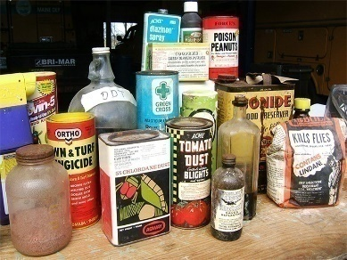
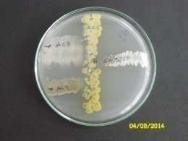
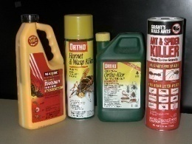
Introduction
Pesticides are a very important group of environmental pollutants used in intensive agriculture for protection against diseases and pests.
Pesticide Residues
Pesticide wastewater
Treatment
Notes:
1.- However, pesticide residues caused by improper handling of these compounds can be found in soil and water, in the form of pesticide wastewaters and as obsolete pesticides.
2.- Considering the toxicity and danger of these compounds, early detection, detoxification and decontamination of polluted environment or pesticide wastes are essential.
3.- Find efficient treatment systems for pesticides has been a preoccupation in the area of science and engineering and also for our research group.

Slide 3
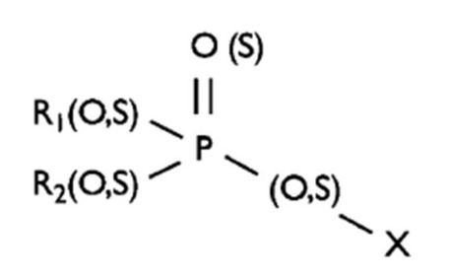
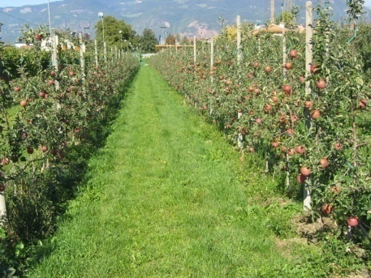
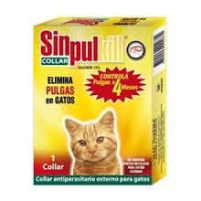
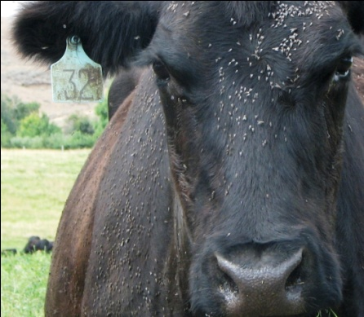
Introduction
Organophosphorus pesticides (OPs)
Diazinon
(O,O-diethyl-O-[2-isopropyl-4-methyl -6-pyrimidinyl] phosphorothioate)
OPs are:
The most widely used pesticide worldwide
Inhibitors of the enzyme acetylcholinesterase
Moderate to high toxicity
Carcinogenic and mutagenic
Contaminants of soil and water
Notes:
1.- A pesticide groups that has received considerable attention are organophosphates because these compounds are generally characterized…
2.- Diazinon is an insecticide widely used in agriculture, livestock and also in dogs and cats.

Slide 4
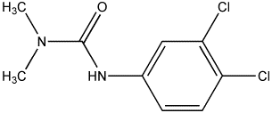
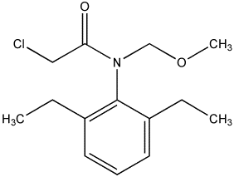
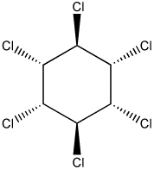
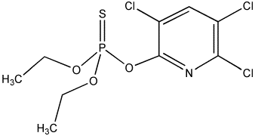
Introduction
Actinobacteria or Actinomycete
Physiologial and biochemical characteristic
Medicine
Bioremediation
Pesticide degradation
Agriculture
Environmental Science
Notes:
1.- Currently, promising methods for pesticide detoxification is by using microorganisms.
2.- The actinobacteria are recognized in medicine for the production of antibiotics , in agriculture for the production of compounds with bio-pesticides and bio-fertilizers properties, and in the environmental science for the ability to degrade various contaminant compounds, including pesticides of different chemical classes.
3.- Moreover, actinobacteria supporting adverse environmental conditions, they present an easy colonization, among others, therefore, these microorganisms are considered to be used in decontamination system.
4.- Now, the use of microbial consortia could support enhanced pesticide degradation because different metabolic pathways could act.
5.- Therefore the objective of this study is:

Slide 5
Objective
To select an actinobacteria consortium to enhance the diazinon degradation

Slide 6
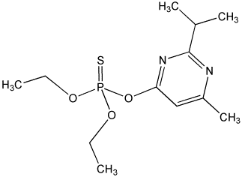
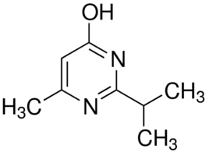
Materials and Methods (1)
Organophosphorus-degrading actinobacteria identified as Streptomyces sp. strains AC5, AC6, AC7, AC9, GA3, GA11, ISP4 and ISP13 were used
1
Diazinon (O,O-diethyl-O-[2-isopropyl-4-methyl -6-pyrimidinyl] phosphorothioate)
2
2-isopropyl-6-methyl-4-pyrimidinol (IMHP)
3
Notes:
1.- Organophosphorus-degrading actinobacteria identified as Streptomyces strains menchon dear were used.
2.- On the other hand, diazinon and their main metabolit IMHP.

Slide 7
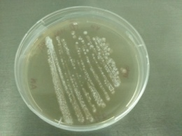
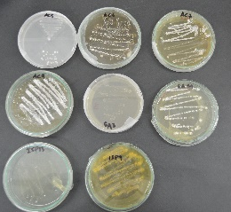
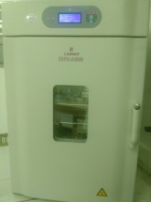
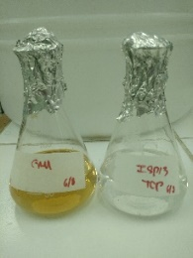
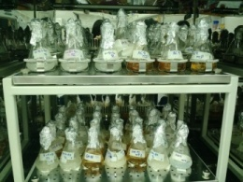
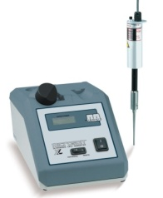
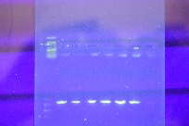
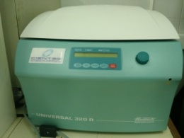
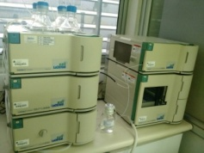
Materials and Methods (2)
Study with single culture
Study with mixed culture
Spore
Antagonism assay
Biomass (dry weight)
Pre-incubation in liquid culture medium
Strains Selection
Protein
SDS-PAGE
50 mg l⁻¹ Diazinon degradation
50 mg l⁻¹ Diazinon as only carbon source
Diazinon and IMHP concentration
Centrifugation
Diazinon concentration
Notes:
1.- For the study with individual strains, spore were inoculated in a rich medium, then biomass was used to evaluate diazinon removal added in minimal medium at 50 mg/l concentration as only carbon source.
2.- After incubation for 96 hours, biomass, protein and residual diazinon were analyzed.
3.- With these results, the strains were selected to make different combinations of mixed cultures.
4.- An antagonism assay was performed between the different strains and then the diazinon removal. After incubation for 96 hoursrs, biomass growth, diazinon removal and IMHP production were analyzed.

Slide 8
Results and discussion
Figure 1. Diazinon removal from liquid medium by pure cultures of Streptomyces spp. strains AC5, AC6, AC7, AC9, GA3, GA11, ISP4 and ISP13 after 96 h of incubation. The error bars represent the standard error of the means of three replicates. The values with different letters indicate significant differences (p ≤ 0.05, Tuckey test).
Notes:
1.- Diazinon removal by single actinobacteria is choon in this figure.
2.- It can be seen that 10 to 30% of diazinon was removed.
3.- The highest diazinon removal was exhibited by the strains AC9, GA11 and ISP13, which reached values close to 30 %.
4.- While, the lowest removal was observed for the strains AC6, AC7 and GA3.

Slide 9
Results and discussion
Figure 2. Initial biomass and final biomass of Streptomyces spp. strains AC5, AC6, AC7, AC9, GA3, GA11, ISP4 and ISP13 after 96 h of incubation. The errors bars represent the standard error of the means of three replicates.
Notes:
1.- Respect to biomass growth, six of the eight strains were able to grow with diazinon which could be used as a carbon and energy source

Slide 10
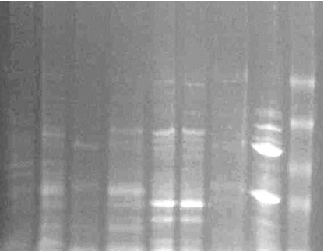
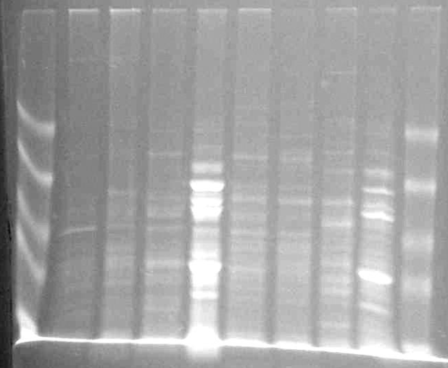
Results and discussion
AC5
AC6
AC7
AC9
GA3
GA11
ISP4
ISP13
A B A B A B A B C
A B A B A B A B C
69
78
63
65
65
65
68
69
58
63
59
60
43
43
42
42
42
39
39
39
39
33
35
37
34
33
30
30
Figure 3. Denaturing PAGE analysis of proteins from Streptomyces spp. strains AC5, AC6, AC7, AC9, GA3, GA11, ISP4 and ISP13. The cells were cultured in MM medium with 50 mg l⁻¹ diazinon. Lane A, without diazinon; lane B, with diazinon and lane C, molecular weight marker. The new protein bands or prominent bands are indicated by the arrows.
Notes:
1.- The proteine profile of the cell-free extracts showed increased intensity an more proteine bands in the lane that represent the strains cultivates with diazinon.
2.- So, diazinon induces enzymes in the actinobacteria strains. Exceptions were observed for strains AC7 and ISP4 that showed similar profile that observed in the absence of diazinon.
3.- The molecular weights were between 34-78 kilodalton, that could correspond to a phosphotriesterase that can degrade organophosphorus compounds.
4.- With these results the strains AC5, AC6, AC9, GA11 and ISP13 were selected.

Slide 11
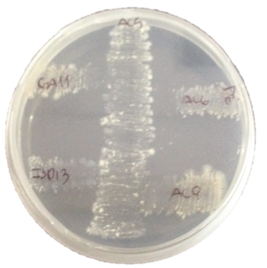
Results and discussion
AC5
AC9
GA11
AC6
GA11
AC6
ISP13
ISP13
AC9
AC6
GA11
Figure 4. Antagonism assay among: (a) Streptomyces spp. strains AC5, AC6, AC9, GA11 and ISP13, (b) Streptomyces spp. strains AC6, AC9, GA11 and ISP13, (c) Streptomyces spp. strains AC6, GA11 and ISP13, and (d) Streptomyces spp. strains GA11 and ISP13.
ISP13
GA11
ISP13
Notes:
1.- The antagonism assay showed that strains AC6 was the only one that showed a slight growth decrease when faced with strains AC5
2.- Howover, in general .no inhibitory effects for others strains was observed

Slide 12
Results and discussion
Mixed cultures
Five strains
26- AC5+AC6+ AC9+GA11+ISP13
Four strains
25- AC9+AC6+GA11+ISP13
24- AC5+AC6+GA11+ISP13
23- AC5+AC6+AC9+ISP13
22- AC5+AC6+ AC9+GA11
21- AC5+AC9+GA11+ISP13
Three strains
20- GA11+AC9+AC6
19- GA11+ISP13+AC6
18- AC9+ISP13+AC6
17- AC9+GA11+ISP13
16- AC5+GA11+AC6
15- AC5+AC6+ISP13
14- AC5+GA11+ISP13
13- AC5+AC9+ISP13
12- AC5+AC9+AC6
11- AC5+AC9+GA11
Two strains
10- GA11+ISP13
9- AC6+ISP13
8- AC6+GA11
7- AC9+ISP13
6- AC9+GA11
5- AC9+AC6
4- AC5+ISP13
3- AC5+AC9
2- AC5+GA11
1- AC5+AC6
Figure 5. Diazinon removal by mixed cultures of Streptomyces. The mixed cultures were formed with two, three, four and five strains. The error bars represent the standard error of the means of three replicates. The values with different letters indicate significant differences (p ≤ 0.05, Tuckey test).
Notes:
1.- In this study, 26 different combinations were tested to obtain and select a mixed culture with higher diazinon removal capacity.
2.- The results showed increased diazinon removal when mixed cultures of actinobacteria were assayed.
3.- The combination of two strains resulted in an average degradation of 34%, 48% was observed for the cultures formed by three strains, the combination of four strains showed an average degradation of 59% and the combination five strains showed 28% diazinon removal.
4.- According to these results, the selected actinobacteria combination were Streptomyces spp. strains AC5, AC9, GA11 and ISP13.

Slide 13
Results and discussion
Table 1. IMHP production by mixed cultures of actinobacteria
Mixed culture | IMHP production (mg l⁻¹)
Two strains
1- AC5+AC6 | 0.361 ± 0.010 d
2- AC5+GA11 | 0.242 ± 0.001 d
3- AC5+AC9 | 0.176 ± 0.027 d
4- AC5+ISP13 | 0.170 ± 0.023 d
5- AC9+AC6 | 0.258 ± 0.028 d
6- AC9+GA11 | 0.256 ± 0.013 d
7- AC9+ISP13 | 0.232 ± 0.009 d
8- AC6+GA11 | 0.341 ± 0.013 d
9- AC6+ISP13 | 0.216 ± 0.002 d
10- GA11+ISP13 | 0.239 ± 0.007 d
Three strains
11- AC5+AC9+GA11 | 0.160 ± 0.008 d
12- AC5+AC9+AC6 | 4.057 ± 0.012 a
13- AC5+AC9+ISP13 | 1.758 ± 0.088 c
14- AC5+GA11+ISP13 | 0.172 ± 0.010 d
15- AC5+AC6+ISP13 | 0.195 ± 0.008 d
16- AC5+GA11+AC6 | 0.193 ± 0.008 d
17- AC9+GA11+ISP13 | 0.207 ± 0.002 d
18- AC9+ISP13+AC6 | 0.211 ± 0.016 d
19- GA11+ISP13+AC6 | 3.774 ± 0.102 a
20- GA11+AC9+AC6 | 3.954 ± 0.107 a
Mixed culture | IMHP production (mg l⁻¹)
Four strains
21- AC5+AC9+GA11+ISP13 | 0.380 ± 0.027 d
22- AC5+AC6+AC9+GA11 | 0.253 ± 0.013 d
23- AC5+AC6+AC9+ISP13 | 1.587 ± 0.137 c
24- AC5+AC6+GA11+ISP13 | 0.315 ± 0.027 d
25- AC9+AC6+GA11+ISP13 | 2.196 ± 0.136bc
Five strains
26- AC5+AC9+GA11+ISP4+ISP13 | 2.196 ± 0.001 d
Notes:
1.- The concentrations of IMHP were between 0.160 to 4.057 mg l⁻¹
2.- The highest IMHP production was mainly observed when a combination of three, four or five strains was used.
3.- IMHP is reported to be the major diazinon metabolite found in compost, soil and water and is characterized as a less toxic compound compared to its parent compound.

Slide 14
Results and discussion
Figure 6. Concentration of diazinon and IMHP, and microbial growth of the mixed culture of actinobacteria formed by the Streptomyces spp. strains AC5, AC9, GA11 and ISP13. The error bars represent the standard error of the means of three replicates.
Notes:
1.- The results showed that approximately 50% of diazinon is degraded within 24 h of incubation, and a duplication of the biomass was observed after 48 h.
2.- After this time, diazinon removal continued, with a residual concentration close to 15 mg l⁻¹, and IMHP appeared at a concentration of 3.057 mg l⁻¹ after 72 h of incubation. However, IMHP decreased over time.

Slide 15
Conclusion
Mixed cultures of Streptomyces spp. increase the diazinon removal
Diazinon-degrading enzymes are expressed by some strains of Streptomyces
Diazinon is used as an only carbon source for growth by studied Streptomyces
Formation of the diazinon metabolite 2-isopropyl-6-methyl-4-pyrimidinol was observed

Slide 16
Acknowledge
The authors acknowledge the financial support of:
FONDECYT Initiation Project (Nº 11130716)
CONICYT/MINCYT Program of Scientific International Cooperation (PCCI140056)
CONICYT International Networking between Research Centres (REDES140053)
CONICYT/FONDAP Project (Nº 15130015).

Slide 17
Thank you!
Danke sehr!

