Slide 1
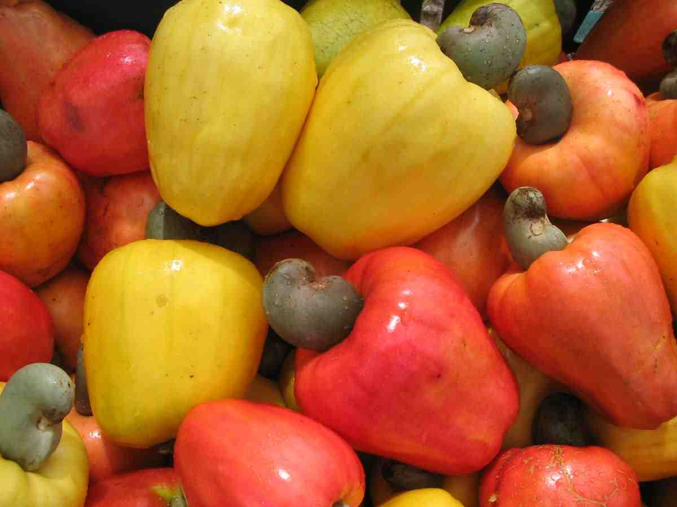
NEW VISTAS IN CASHEW BREEDING
Saroj, P.L., Mohana, G.S.*, Adiga, J.D. and Eradasappa, E
Directorate of Cashew Research, Puttur-574202, Karnataka
www.cashew.res.in
mohangs2007@gmail.com

Slide 2
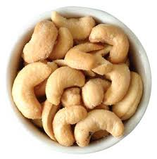
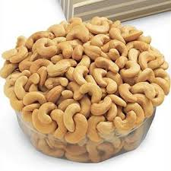
Eat cashew without fear of cholesterol !!
Delicious snack food. Free from cholesterol. Fat rich in unsaturated fatty acid - helps in reducing the blood cholesterol.
Proteins (21%), carbohydrates (22%), fat (47%), minerals and vitamins. All the essential amino acids
The cashew apple - sugars, amino acids, tannin, ascorbic acid (Vitamin C) and crude fibre. Very rich in ascorbic acid (240 mg/100g). Phenols, tannin and flavonols present could serve as natural antioxidants.

Slide 3
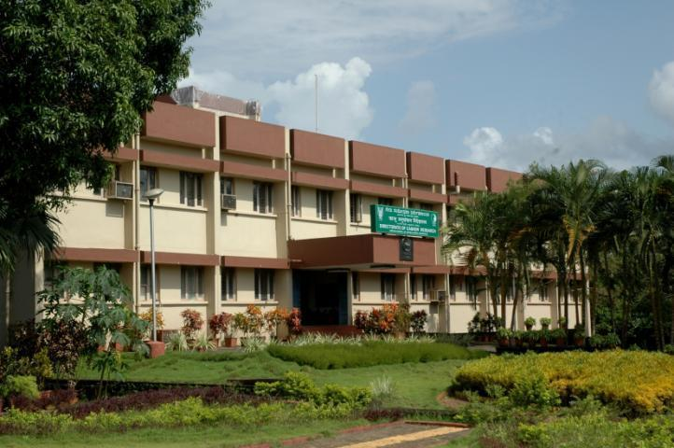
ICAR -Directorate of cashew Research, Puttur,
Karnataka, India

Slide 4
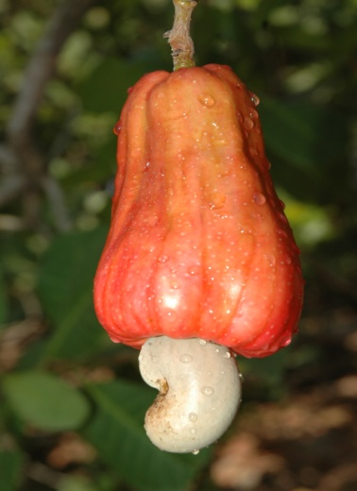
Mandate
To conduct mission oriented research for improving productivity and quality with special reference to export.
To serve as National repository for cashew germplasm and a clearing house for research information on cashew.
To act as a centre for training on research methodologies and technology updating of cashew and to coordinate national research projects.
To provide consultancy on CPT.
To generate quality planting material.
To collaborate with national and international agencies.

Slide 5
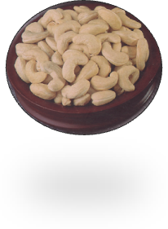
About Cashew
Brazil is the native of cashew.
Introduced into India during 16th century.
India made cashew a commodity of International trade and acclaim.
Cultivated in east coast, west coast regions and also to some extent in plains region and NEH region.
Export earnings by export of cashew kernels: Rs. 2906 Crores (2009-10), Rs. 2598 Crores (2010-11) and Rs. 4390 Crores (2011-12) and 4067 crores (2012-13) .

Slide 6
About Cashew (contd.)
Processing capacity in India : 13-14 lakh tonnes.
Import of RCN : 6-7 lakh tonnes.
India exports over 1.0 lakh cashew kernels to over 65 countries of the world.
The major countries that import Indian cashew are United States of America, Netherlands, United Kingdom, United Arab Emirates, Japan, France, Saudi Arabia, Spain, Russia, Germany, Canada and Greece.

Slide 7
Journey of Cashew Research
Research on cashew was first initiated in the early 1950s.
In 1971, ICAR also sanctioned All India Coordinated Spices and Cashew Improvement Project (AICS and CIP) with its Headquarters located at CPCRI, Kasaragod, India
NRCC- Established in 1986
National Research Centre was upgraded and renamed by ICAR in 2009 under XI Plan as Directorate of Cashew Research (DCR).

Slide 8
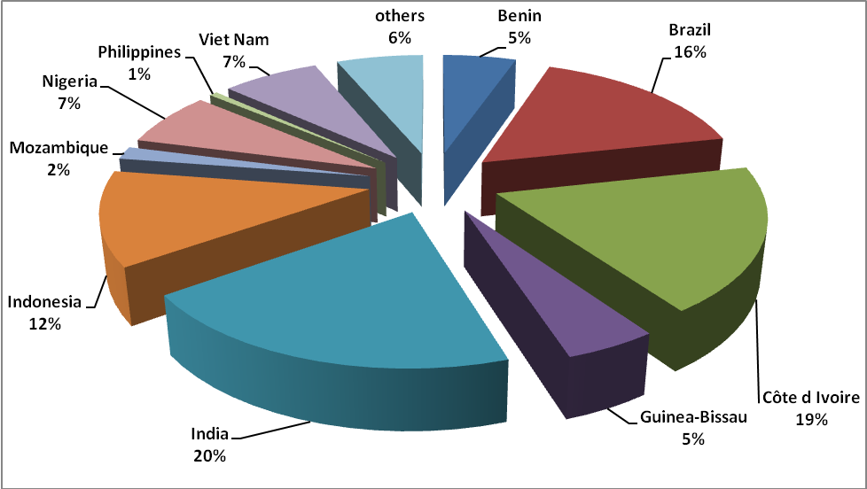
Per cent distribution of cashew area in different countries

Slide 9
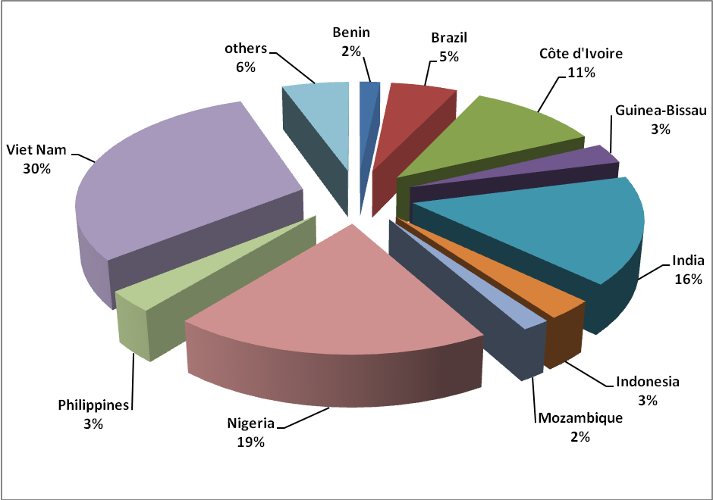
Per cent distribution of cashew production in different countries

Slide 10
Cashew statistics in India during 2012-13
State | Area (000 ha) | Production (000 MT) | Productivity (kg/ha)
Kerala | 84.88 | 76.96 | 898
Karnataka | 121.88 | 68.64 | 588
Goa | 57.47 | 29.95 | 540
Maharashtra | 184.20 | 224.64 | 1040
Tamil Nadu | 136.42 | 62.40 | 469
Andhra Pradesh | 183.95 | 118.14 | 646
Odisha | 163.91 | 99.84 | 679
West Bengal | 11.00 | 12.06 | 1096
Chhattisgarh | 13.50 | 15.60 | 1560
Jharkhand | 11.50 | 4.64 | 336
Tripura | 4.10 | 5.72 | 1427
Meghalaya | 8.50 | 9.36 | 1001
Assam | 0.90 | 0.52 | 505
TOTAL | 982.21 | 728.47 | 772
Source : DCCD, Kochi

Slide 11
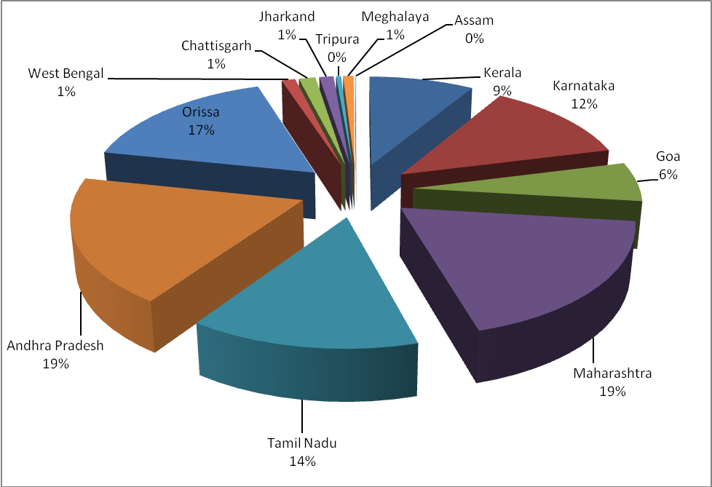
Per cent distribution of cashew area in different states (2012-13)

Slide 12
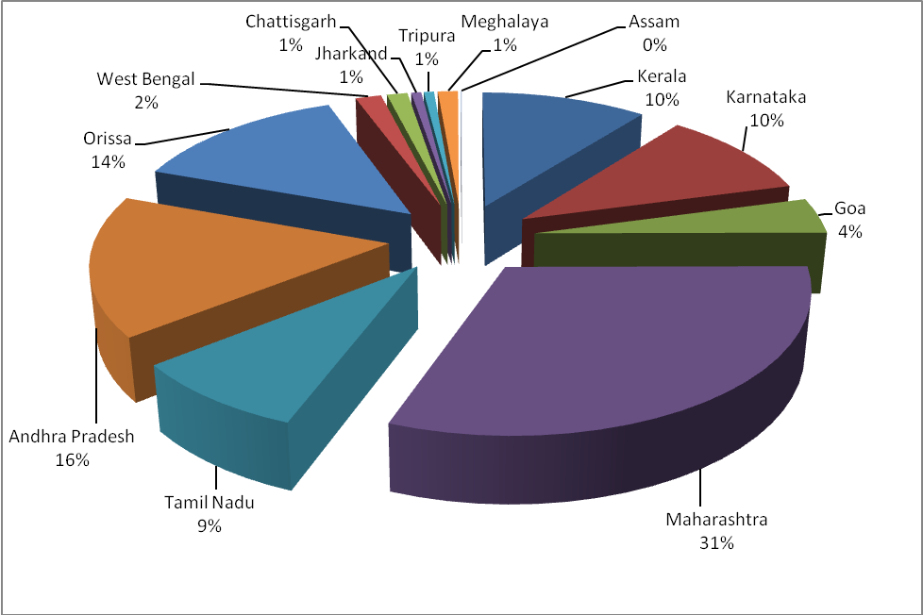
Per cent distribution of cashew production in different states during 2012-13

Slide 13
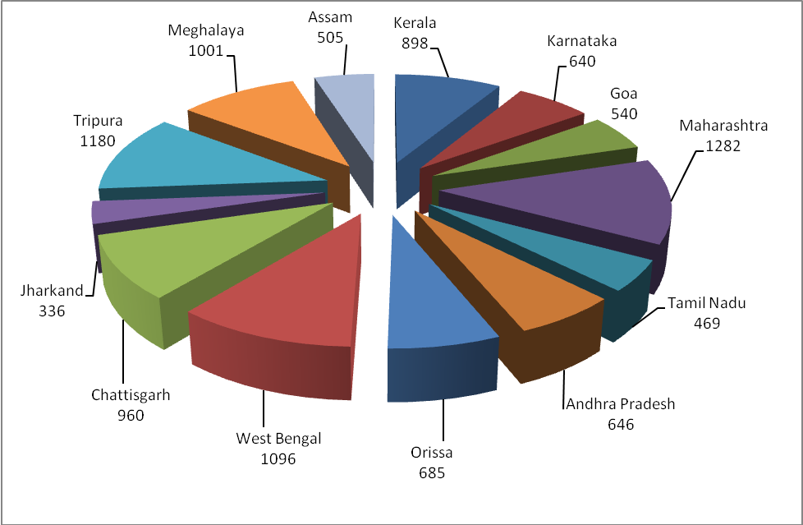
Productivity of cashew (kg/ha ) in different states in India (2012-13)

Slide 14
Trend in Area, Production and Productivity of Cashew

Slide 15
Cashew varieties released in India
Centre | No. of varieties released | Variety
East Coast
Bapatla | 7 | BPP-1 to BPP-6 and BPP-8
Vridhachalam | 4 | VRI-1, VRI-2, VRI-3 and VRI (Cw) 5
Bhubaneswar | 1 | Bhubaneswar-1
Jhargram | 2 | Jhargram-1, Jhargram-2
West Coast
Vengurla | 7 | Vengurla-1 to Vengurla-7
Goa | 2 | Goa-1 and Goa-2
Madakkathara | 8 | Anakkayam-1, Madak-1 (BLA-39-4), Madak-2 (NDR-2-1), K-22-1, Kanaka, Dhana, Priyanka and Amrutha
Ullal | 5 | Ullal-1, Ullal-2, Ullal-3, Ullal-4, UN-50
DCR Puttur | 3 | NRCC Selection-1, NRCC Selection-2 and Bhaskara
Chattisgarh | 1 | Indira Kaju
Chintamani | 2 | Chintamani-1 and Chintamani-2
Total | 42

Slide 16
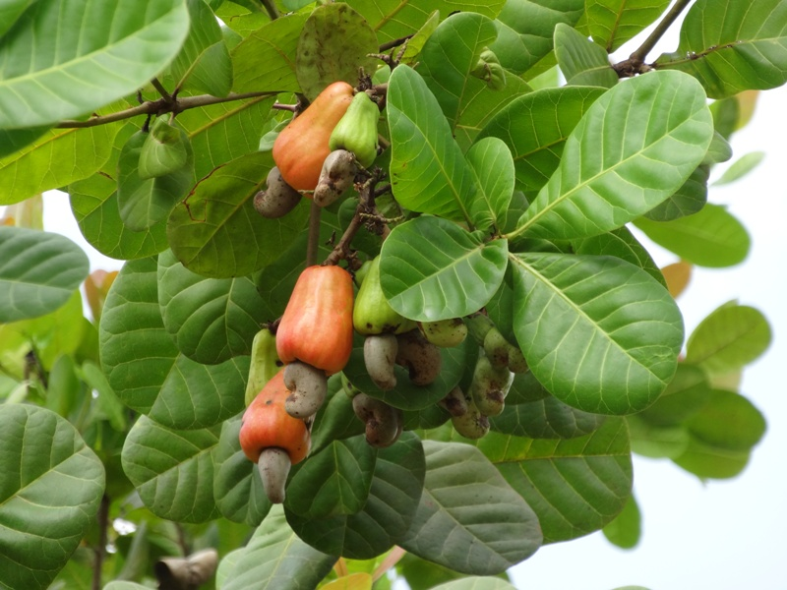
Bhaskara

Slide 17
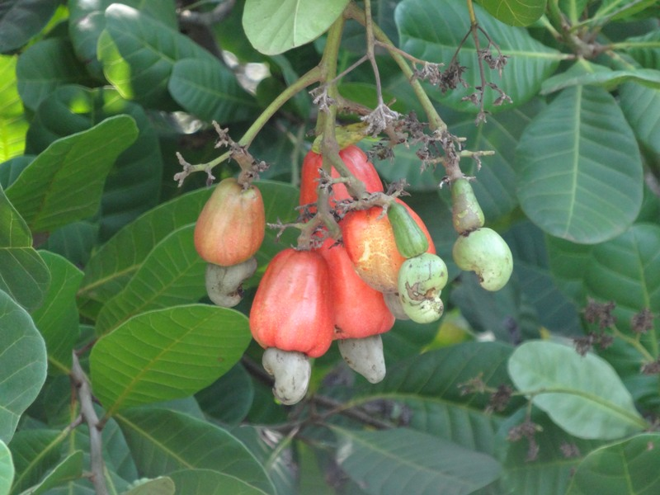
Madakkatara-2

Slide 18
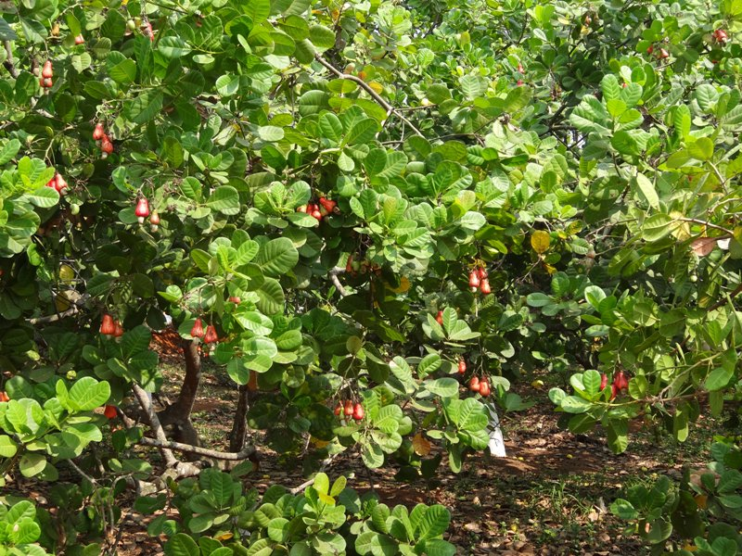
Vengurla-4

Slide 19
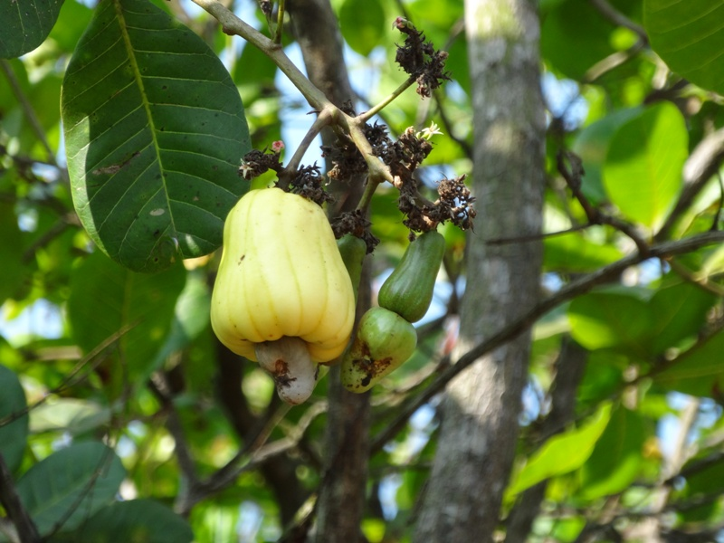
Kanaka

Slide 20
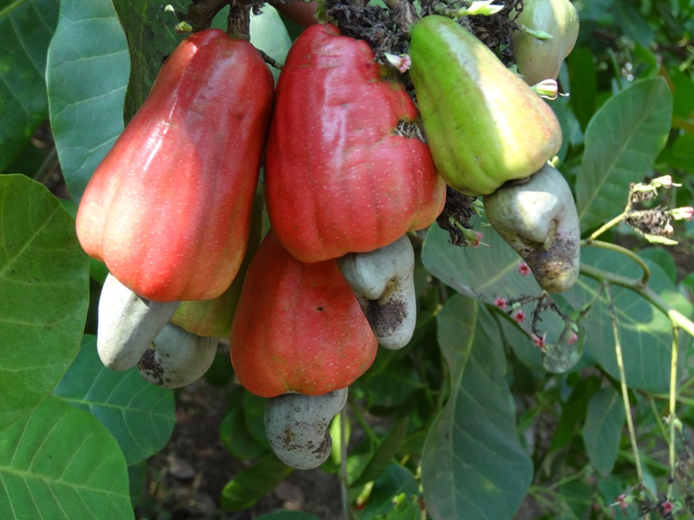
Ullal-3

Slide 21
Varieties developed by DCR, Puttur
Parameters |  | NRCC Selection-1 | NRCC Selection-2 | Bhaskara
Year of release |  | 1998 | 1998 | 2006
Yield (t/ha) | : | 1.5 | 1.5 | 1.6
Nut size | : | Medium (7.6 g) | Medium to bold (9.2 g) | Medium (7.4 g)
Cashew apple | : | Big (70-80 g) | Medium (50-60 g) | Medium (50-60 g)
Season of flowering | : | Mid – Late season | Early season | Mid season
Shelling % | : | High (28.8%) | High (28.6%) | High (30.6%)
Kernel protein (%) | : | 24.20 | 25.60 | 29.91
Kernel weight (g) | : | 2.20 g | 2.63 g | 2.2 g
Kernel grade |  | W-210 | W-210 | W-240

Slide 22
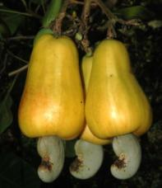
Varieties developed by DCR, Puttur
NRCC Sel-1

Slide 23
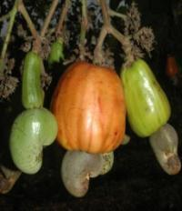
Varieties developed by DCR, Puttur
NRCC Sel-2

Slide 24
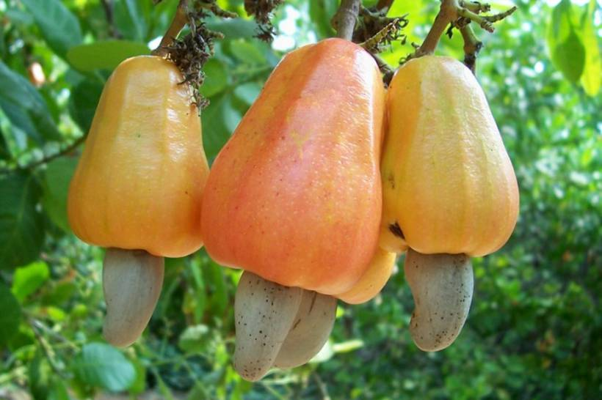
Varieties developed by DCR, Puttur
Bhaskara

Slide 25
Cashew germplasm in India
State | At NCFGB | At AICRP centers | Total
Andaman & Nicobar Islands | 10 | -- | 10
Andhra Pradesh | 103 | 48 | 151
Arunachal Pradesh | 2 | -- | 2
Assam | 3 | -- | 3
Chattisgarh | 1 | 61 | 62
Goa | 45 | -- | 45
Karnataka | 128 | 128 | 256
Kerala | 72 | 181 | 253
Maharashtra | 45 | 297 | 342
Manipur | 1 | -- | 1
Meghalaya | 11 | -- | 11
Mizoram | 1 | -- | 1
Orissa | 21 | 97 | 118
Tamil Nadu | 46 | 200 | 246
Tripura | 3 | -- | 3
West Bengal | 14 | 92 | 106
Exotic | 22 | -- | 22
Total | 528 | 1104 | 1632

Slide 26
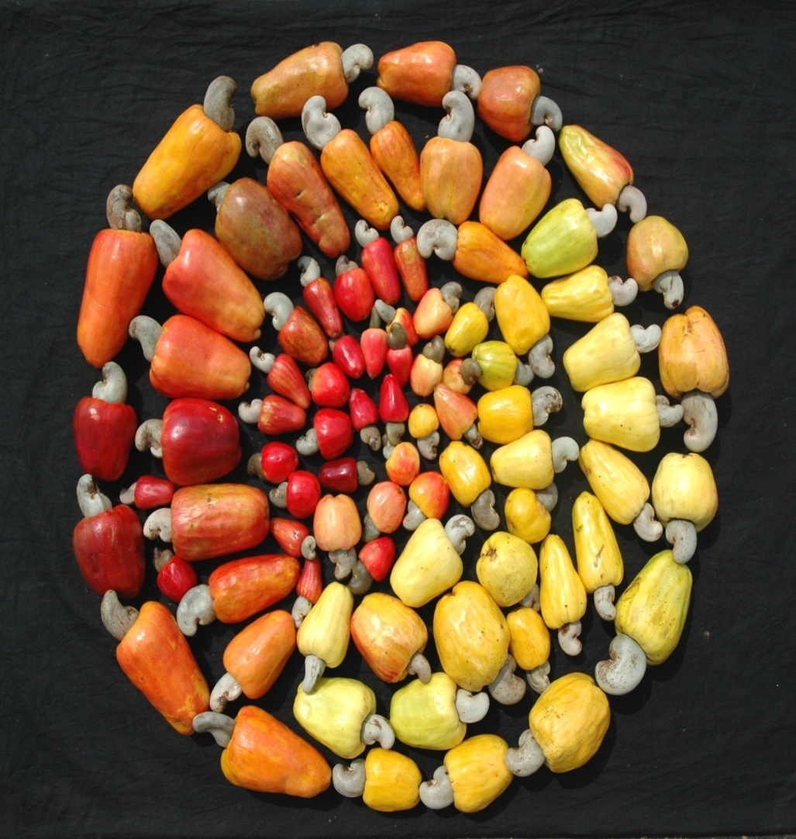
Variability in Cashew Apple

Slide 27
Reasons for low productivity in cashew
Old and senile plantations
Non descript genotypes
Marginal lands
Priority for cashew
Fluctuating market prices

Slide 28
Breeding Objectives
High yield
Dwarf and semi compact types
Short flowering duration
High sex ratio
Bold/Medium nut size
High shelling percentage
Resistance to TMB and CSRB
Cashew apple
CNSL content

Slide 29
Current Cashew Breeding Strategies
Development of dwarf and semi-compact hybrids for high density planting system
Development of hybrids with high yield and bold/medium nut size
Introgression of characters from wild species for pest resistance breeding
Marker Assisted Selection for economic traits
Breeding for cashew apple

Slide 30
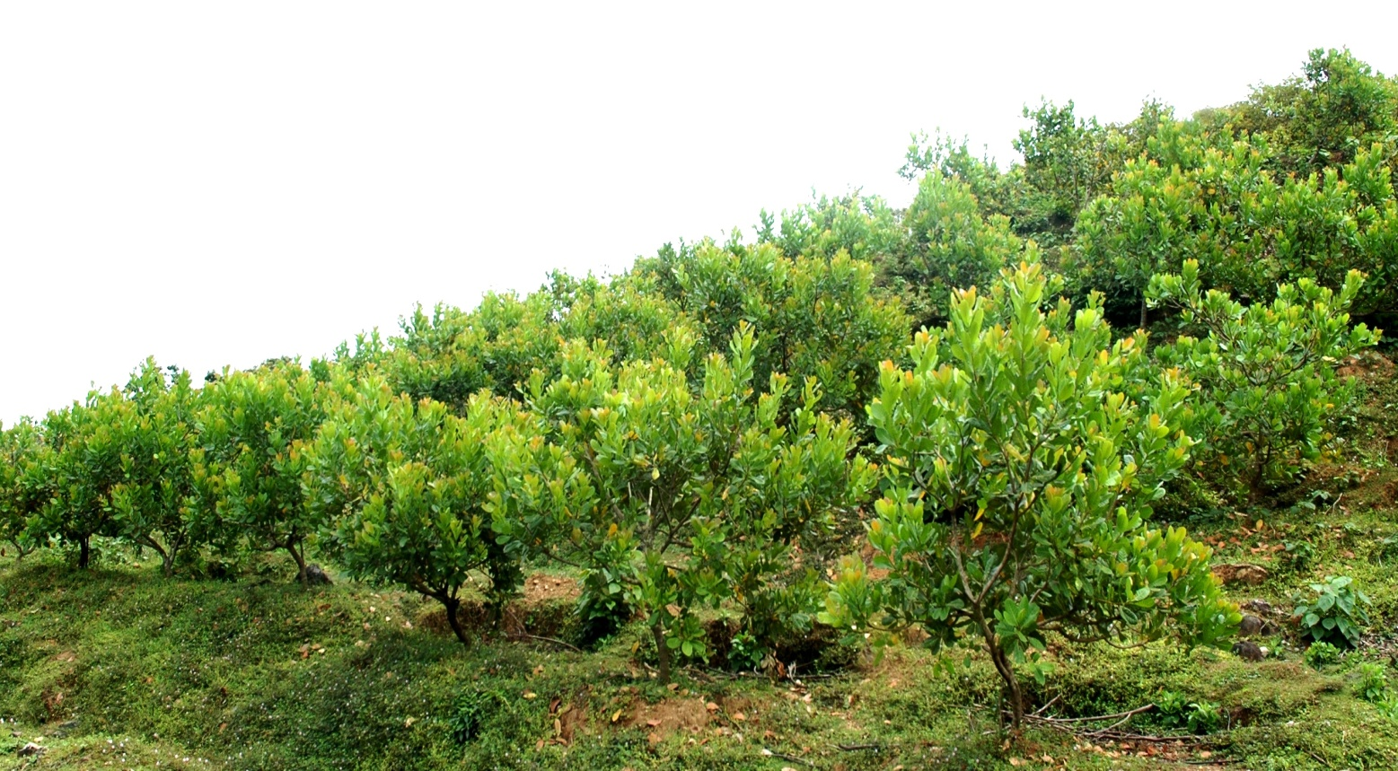
High Density Planting in Cashew
High Density Planting
Closer planting at 4m x 4m (625 plants/ha) or 5m x 4m (500 plants/ha) or 5m x 5m (400 plants/ha) increases yield 2-3 fold that normal spacing 8m x 8m (156 plants/ha).
Regular pruning every year/ thinning tree population after 11 years is required .
This method is more suitable for soils with low fertility.

Slide 31
Development of dwarf and compact hybrids
A total of 253 hybrids obtained from crossing NRCC Sel-2, Bhaskara and Ullal-3 as female parents and Taliparamba-1, Brazil dwarf and Kodippady-2 as male parents are under evaluation.
Some of the hybrids are showing the signs of reduced vigour , semi compact canopy and precocious bearing.

Slide 32
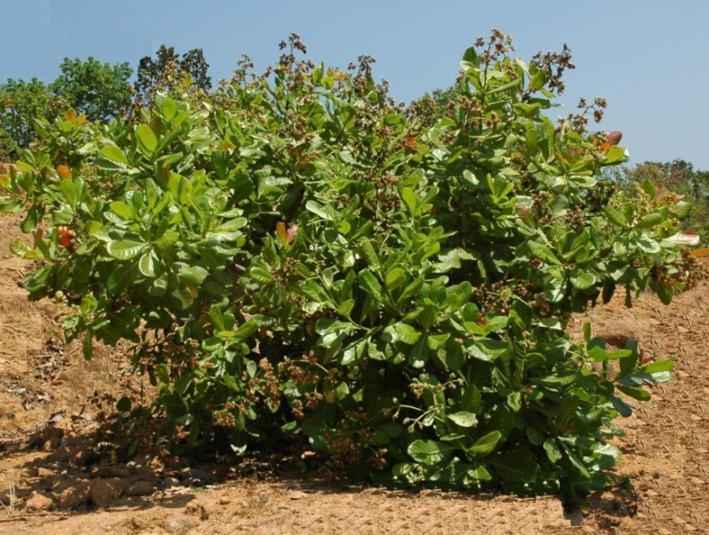
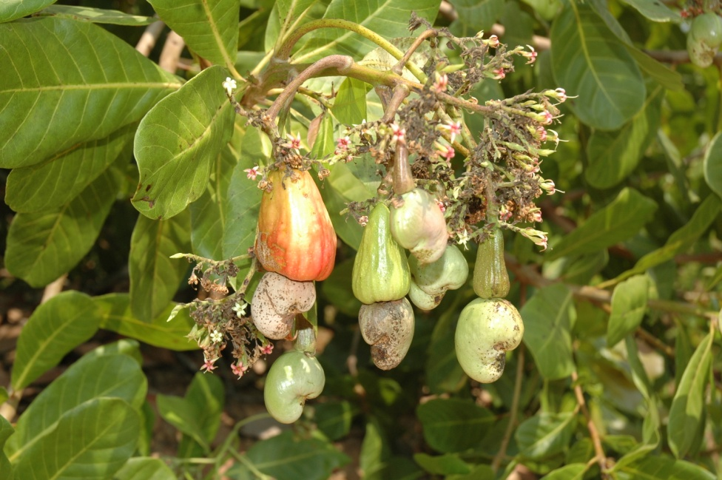
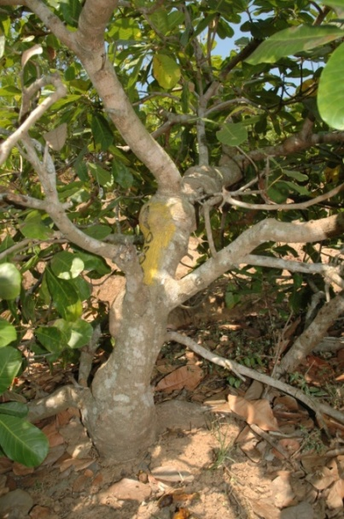
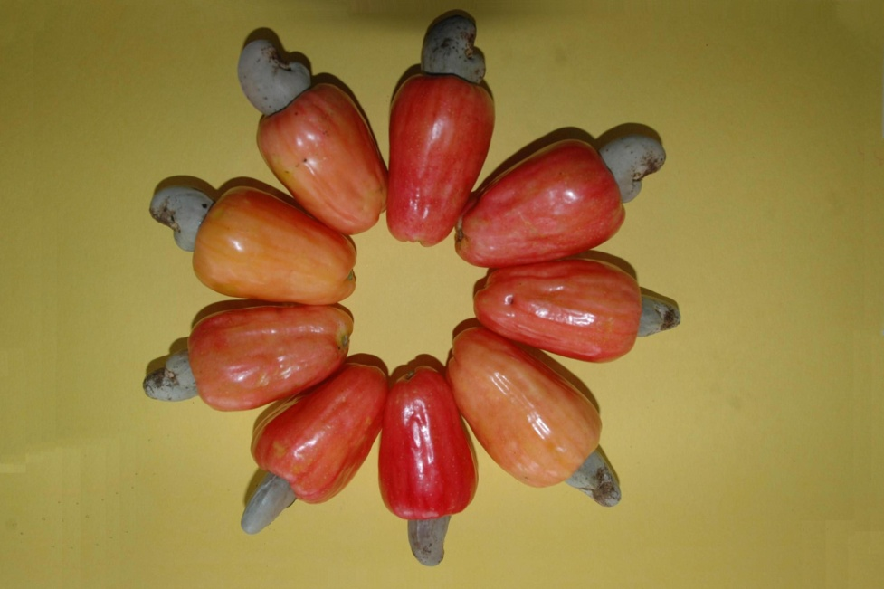
Brazil dwarf (NRC-492)

Slide 33
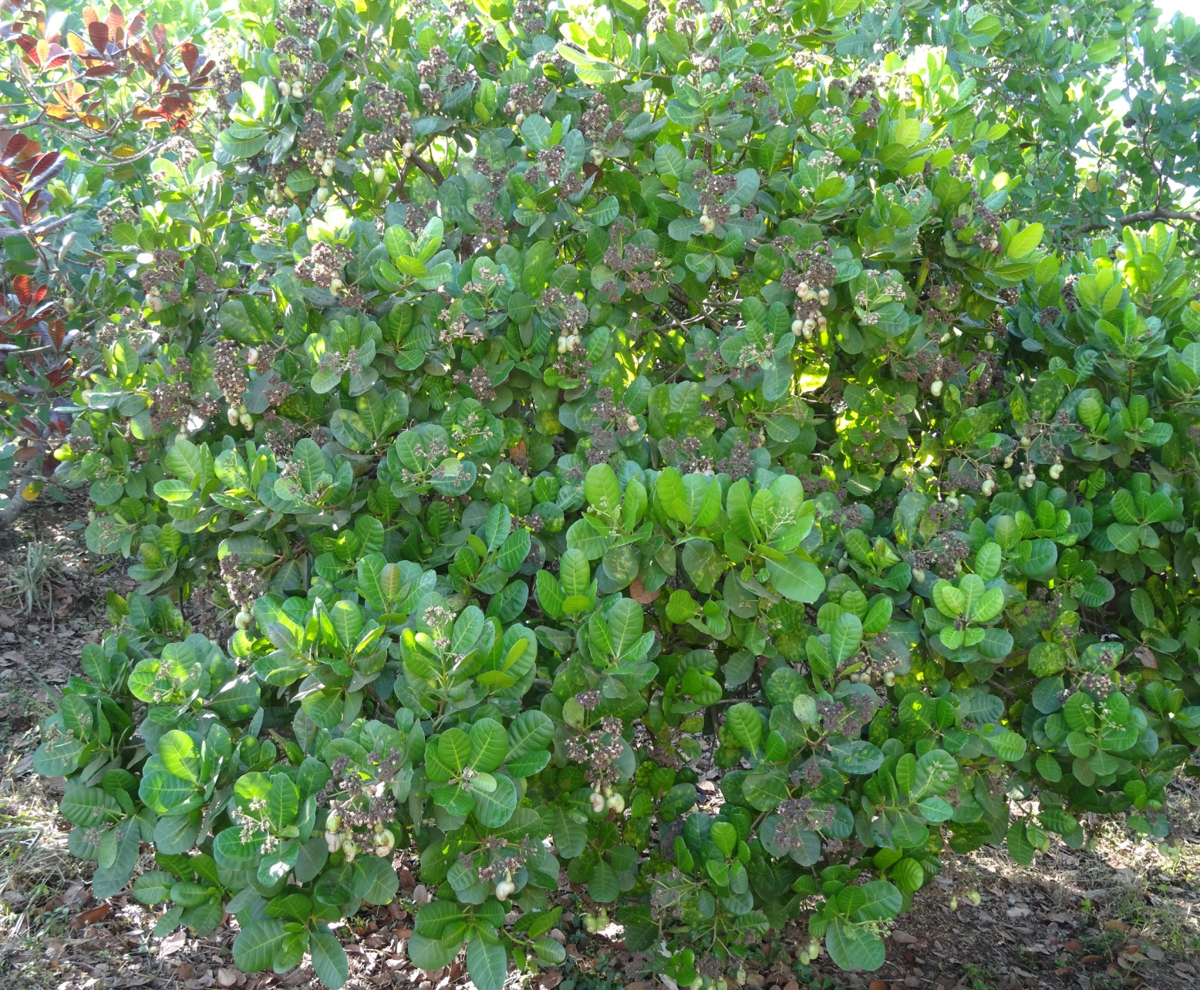
Taliparamba

Slide 34
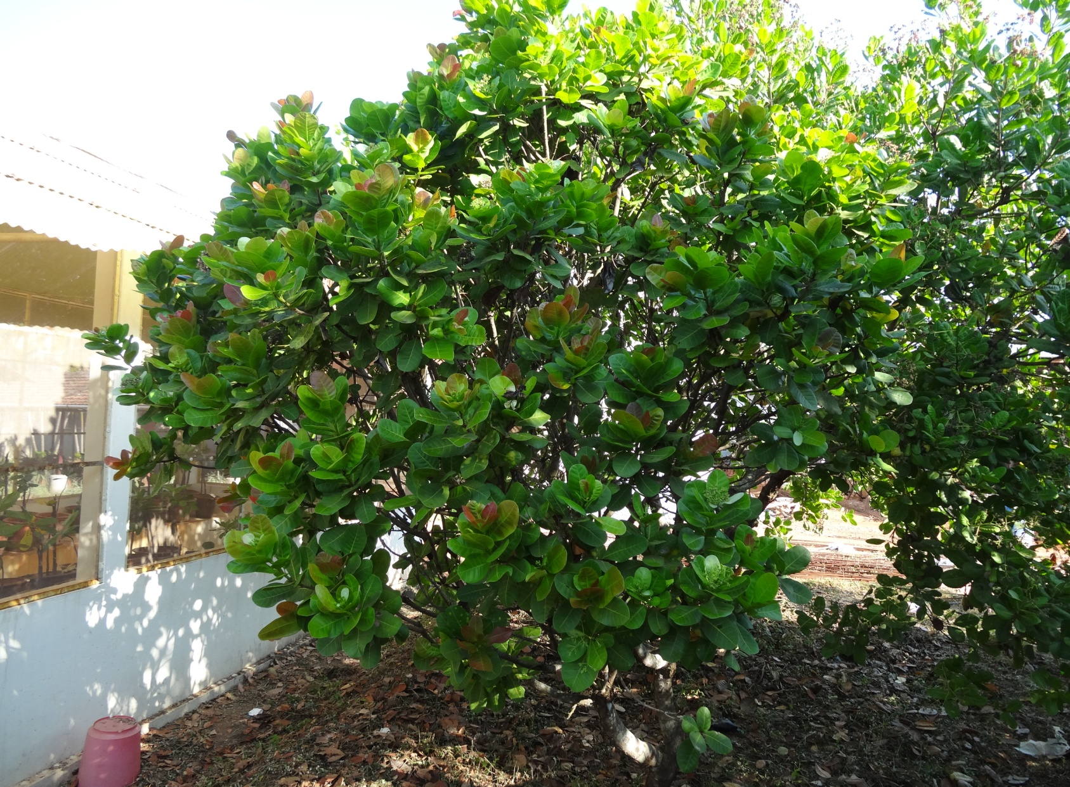
Kodippady

Slide 35
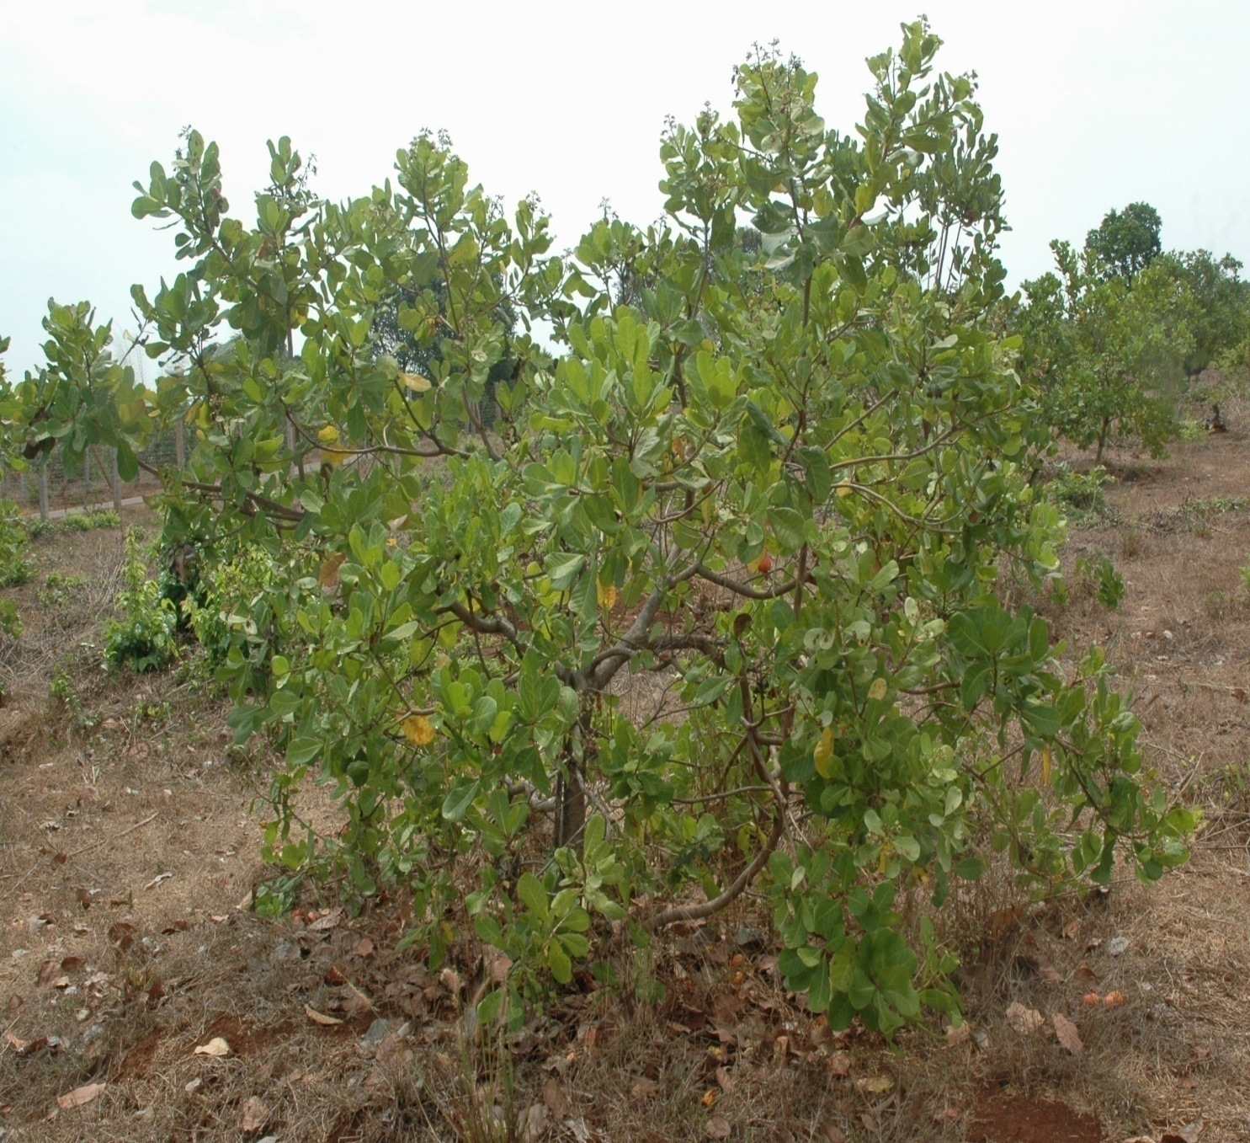
A hybrid plant; Cross combination Bhaskara x brazil Dwarf

Slide 36
Hybridization 2013-14
S.No. | Cross |  |  | No. of nuts sown | No. of seedlings germinated | No. of seedlings planted | % Germination | % Mortality (Numbers)
1 | Vengurle-4 | x | NRC-492 | 204 | 177 | 177 | 86.76 | 2.26 (4)
2 | Vengurle-4 | x | Taliparamba-1 | 150 | 134 | 134 | 89.33 | 1.49 (2)
3 | Priyanka | x | NRC-492 | 90 | 70 | 70 | 77.78 | 2.86 (2)
4 | Priyanka | x | Taliparamba-1 | 22 | 10 | 10 | 45.45 | 0
5 | Dhana | x | NRC-492 | 62 | 61 | 61 | 98.39 | 0
6 | Dhana | x | Taliparamba-1 | 78 | 75 | 75 | 96.15 | 0
7 | Madakkathara-2 | x | NRC-492 | 170 | 151 | 150 | 88.82 | 0.67 (1)
8 | Madakkathara-2 | x | Taliparamba-1 | 129 | 62 | 62 | 48.06 | 0
9 | NRC-492 | x | Vengurle-4 | 16 | 10 | 10 | 62.50 | 0
10 | Taliparamba-1 | x | Vengurle-4 | 7 | 7 | 7 | 100.00 | 0
11 | NRC-492 | x | Priyanka | 30 | 13 | 13 | 43.33 | 0
12 | Taliparamba-1 | x | Priyanka | 11 | 8 | 8 | 72.73 | 0
13 | NRC-492 | x | Dhana | 16 | 12 | 12 | 75.00 | 0
14 | Taliparamba-1 | x | Dhana | 8 | 4 | 4 | 50.00 | 0
15 | NRC-492 | x | Madakkathara-2 | 15 | 10 | 10 | 66.67 | 0
16 | Taliparamba-1 | x | Madakkathara-2 | 2 | 0 | 0 | 0 | 0
 |  |  | Total | 1010 | 804 | 803 | 0-100 | 0-2.86
 |  |  |  |  |  | Range
 |  |  |  |  |  | Mean | 68.81 | 0.36
 |  |  |  |  |  | SE | 6.65 | 0.18
 |  |  |  |  |  | CV | 38.69 | 195.8

Slide 37
Variability for seedling parameters in direct and reciprocal crosses observed at 80 days
S.No | Cross | Girth (cm) |  |  |  | Plant height (cm)
 |  | Range | M | SE | CV | Range | M | SE | CV
1 | Vengurle-4 x NRC-492 | 0.3-1.1 | 0.77 | 0.01 | 20.1 | 9.0-37.0 | 24.72 | 0.40 | 21.4
2 | Vengurle-4 x Taliparamba-1 | 0.4-0.9 | 0.68 | 0.01 | 17.1 | 14.0-38.5 | 27.75 | 0.45 | 18.1
3 | Priyanka x NRC-492 | 0.4-1.1 | 0.86 | 0.01 | 13.9 | 11.0-52.0 | 39.24 | 0.85 | 18.8
4 | Priyanka x Taliparamba-1 | 0.4-1.1 | 0.77 | 0.08 | 32.4 | 15.0-40.0 | 29.15 | 2.38 | 25.8
5 | Dhana x NRC-492 | 0.5-1.0 | 0.74 | 0.04 | 15.3 | 23.5-39.5 | 32.11 | 0.45 | 11.0
6 | Dhana xTaliparamba-1 | 0.5-1.0 | 0.74 | 0.13 | 15.7 | 17.0-43.0 | 31.74 | 0.57 | 15.6
7 | Madakkathara-2 x NRC-492 | 0.2-1.1 | 0.70 | 0.01 | 24.8 | 8.5-38 | 25.80 | 0.48 | 22.8
8 | Madakkathara-2 x Taliparamba-1 | 0.3-1.0 | 0.73 | 0.02 | 18.7 | 9.0-37.5 | 27.09 | 0.80 | 23.3
9 | NRC-492 x Vengurle-4 | 0.4-0.8 | 0.62 | 0.04 | 21.2 | 13.0-33.0 | 25.70 | 1.70 | 20.9
10 | Taliparamba-1 x Vengurle-4 | 0.6-1.0 | 0.76 | 0.06 | 19.9 | 21.0-31.0 | 27.71 | 1.30 | 12.4
11 | NRC-492 x Priyanka | 0.5-0.8 | 0.59 | 0.03 | 16.2 | 21.5-33.0 | 26.77 | 0.92 | 12.4
12 | Taliparamba-1 x Priyanka | 0.7-0.9 | 0.77 | 0.04 | 13.4 | 28.0-43.5 | 33.50 | 2.07 | 17.5
13 | NRC-492 x Dhana | 0.5-0.8 | 0.61 | 0.03 | 16.3 | 14.0-37.0 | 26.67 | 1.71 | 22.2
14 | Taliparamba-1 x Dhana | 0.7-0.9 | 0.75 | 0.05 | 13.3 | 20.0-30.0 | 24.25 | 2.17 | 17.9
15 | NRC-492 x Madakkathara-2 | 0.4-0.8 | 0.63 | 0.05 | 23.7 | 10.5-29.0 | 21.65 | 2.46 | 36.0

Slide 38
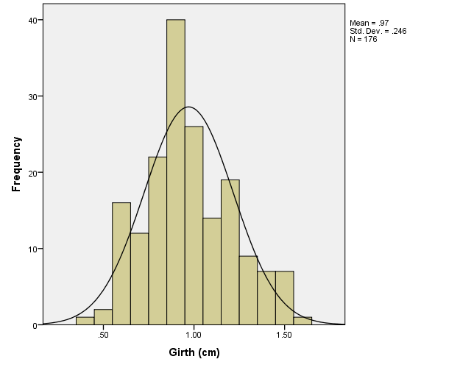
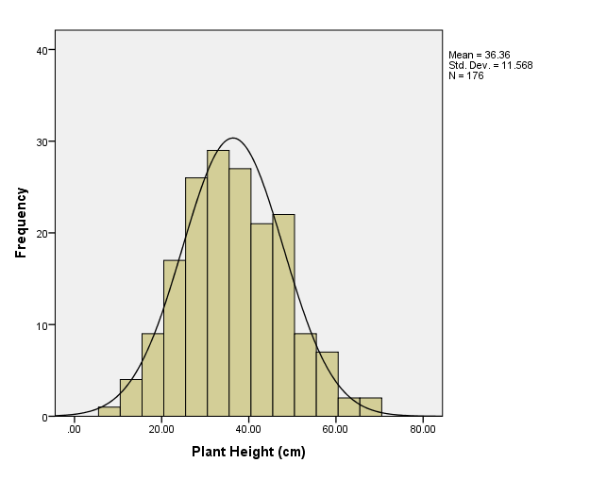
Vengurle-4 x NRC-492
Skewness:0.33, appx.sym
Kurtosis: -0.30, platykurtic
Skewness:0.23, appx.sym
Kurtosis: -0.30, platykurtic

Slide 39
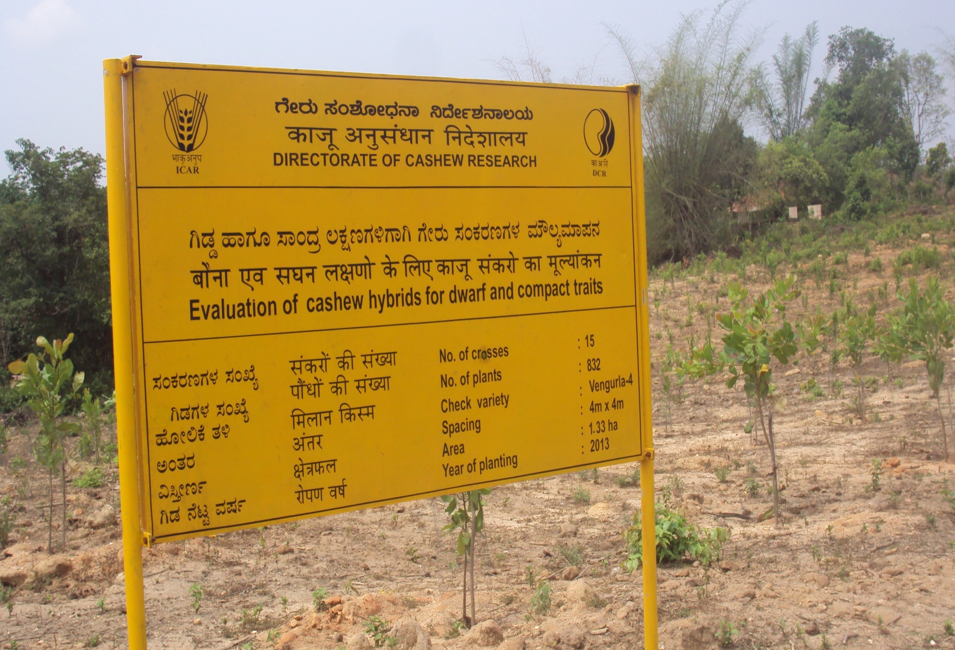
Hybrid seedlings planted in the field at Shantigodu

Slide 40
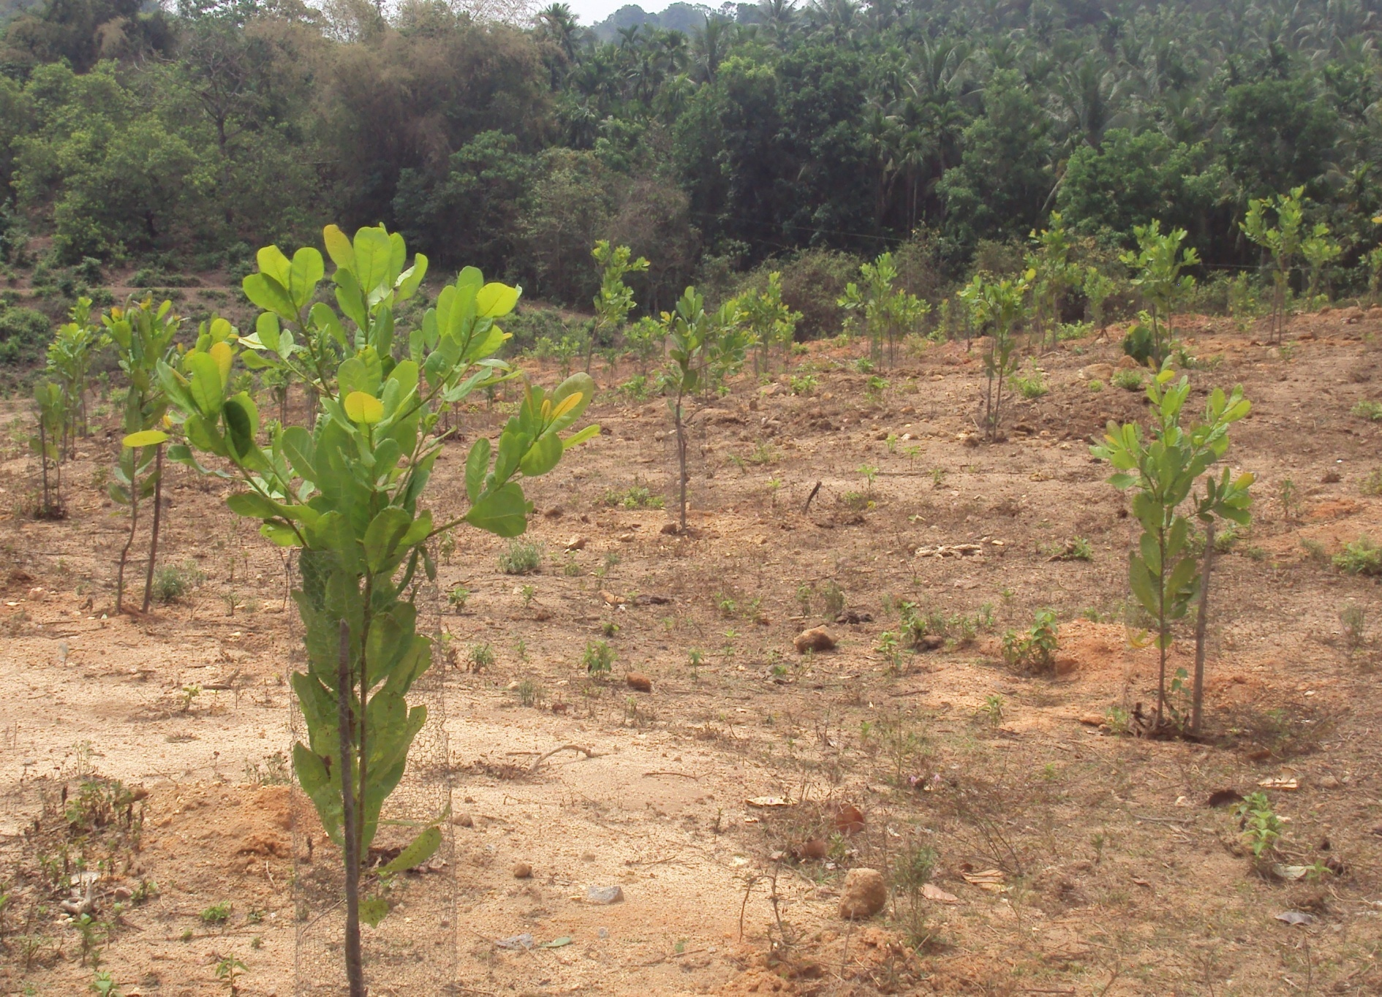
Courtesy:Dr.Mohana, G.S
Hybrid seedlings

Slide 41
Characteristics of promising hybrids
Hybrid | Cross combination | Annual yield in 7th harvest(kg/tree) | Cumulative yield for 7 harvests(kg/tree) | Av. Yield of seven harvests (kg/tree) | Mean nut weight (g) | Mean kernel weight (g) | Shelling (%)
H-43 | NRCC Sel-2 x Bhuthnath-II | 5.20 | 35.33 | 5.04 | 12.33 | 3.33 | 27.00
H-66 | NRCC Sel-2 x Bhuthnath-II | 6.25 | 34.61 | 4.94 | 10.30 | 2.90 | 28.15
H-68 | NRCC Sel-2 x Bhuthnath-II | 6.55 | 35.55 | 5.07 | 11.42 | 3.28 | 28.75
H-125 | NRCC Sel-2 x Bhedasi | 5.95 | 37.60 | 5.37 | 12.75 | 3.40 | 26.66
H-126 | NRCC Sel-2 x Bhedasi | 5.70 | 34.39 | 4.91 | 10.83 | 3.33 | 30.76
NRCC Sel-2 (check) | - | 1.78 | 23.17 | 3.31 | 9.2 | 2.63 | 28.60
Bhuthnath- II(parent) | - | - | 6.1(over six harvests) | 1.02 | 9.2 | 2.80 | 30.43
Bhedasi (parent) | - | - | 5.21(over six harvests) | 0.87 | 10.00 | 3.0 | 30.00
Table 1: Performance of promising hybrids in un replicated trial

Slide 42
Apple characteristics of promising hybrids
Sl. No | Tree No. | Apple colour | Apple weight(g) | TSS (Brix) | Juice (%)
1. | 43 | Orange Red ( 33B) | 100 | 13.00 | 81
2. | 66 | Orange Red ( 33B) | 110 | 13.00 | 80
3. | 68 | Orange Red ( 33B) | 108 | 12.50 | 70
4. | 125 | Orange Red ( 33B) | 105 | 14.00 | 70
5. | 126 | Orange Red ( 33B) | 102 | 13.00 | 72
6. | NRCC Sel-2(check) | Orange Red ( 33B) | 95 | 14.00 | 60
7. | Bhuthnath-2(parent) | Yellow Orange(23A) | 55 | 12.00 | 65
8. | Bhedasi(parent) | Yellow(13A) | 90 | 13.00 | 75

Slide 43
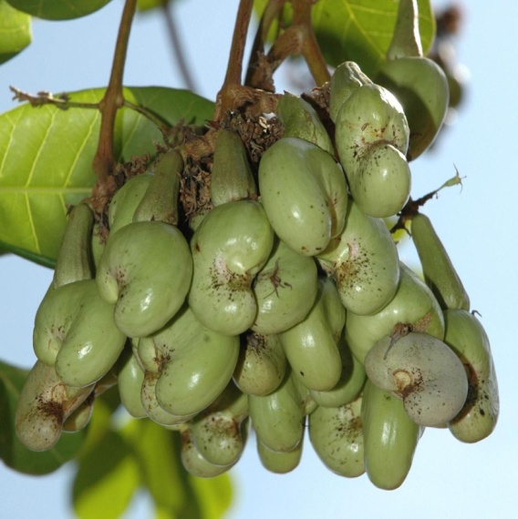
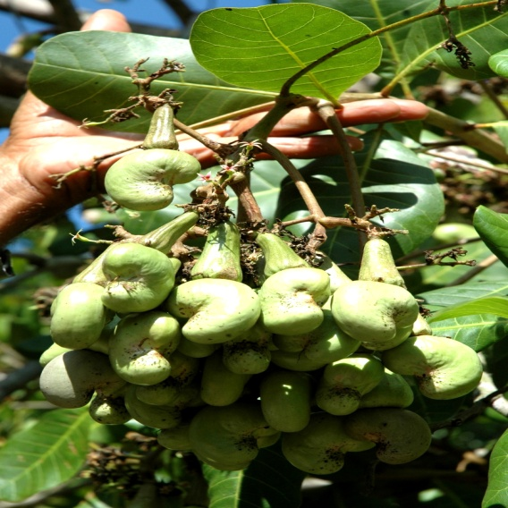
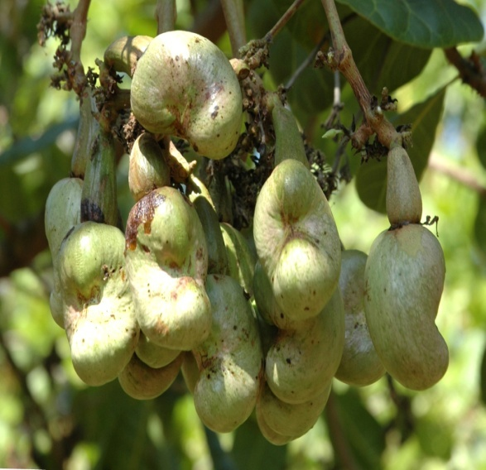
PROMISING HYBRIDS UNDER EVALUATION
Cross combinations of NRCC Selection-2, Bhuthnath and Bhedasi

Slide 44
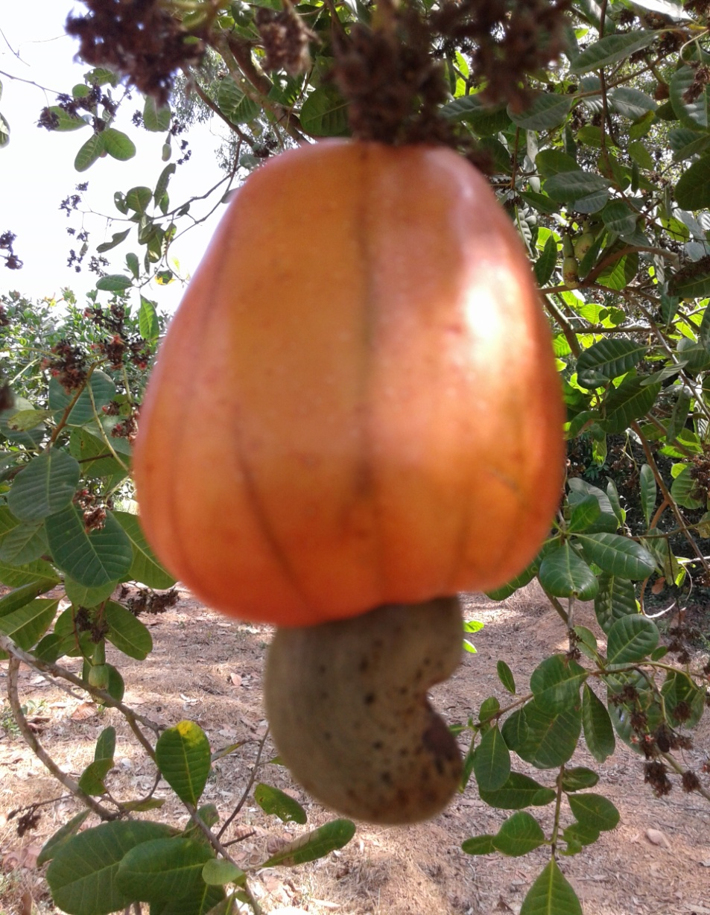
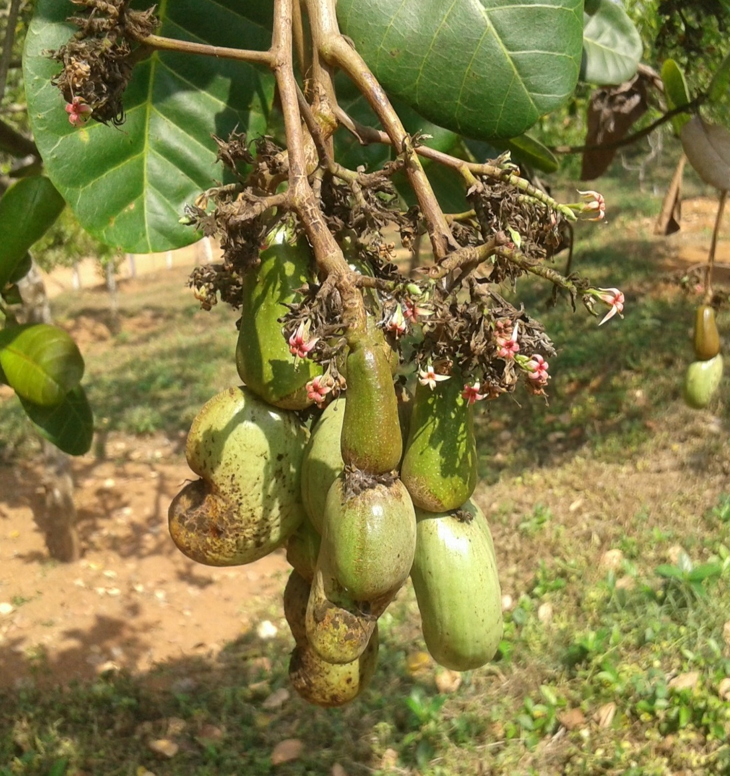
H-66
H-68

Slide 45
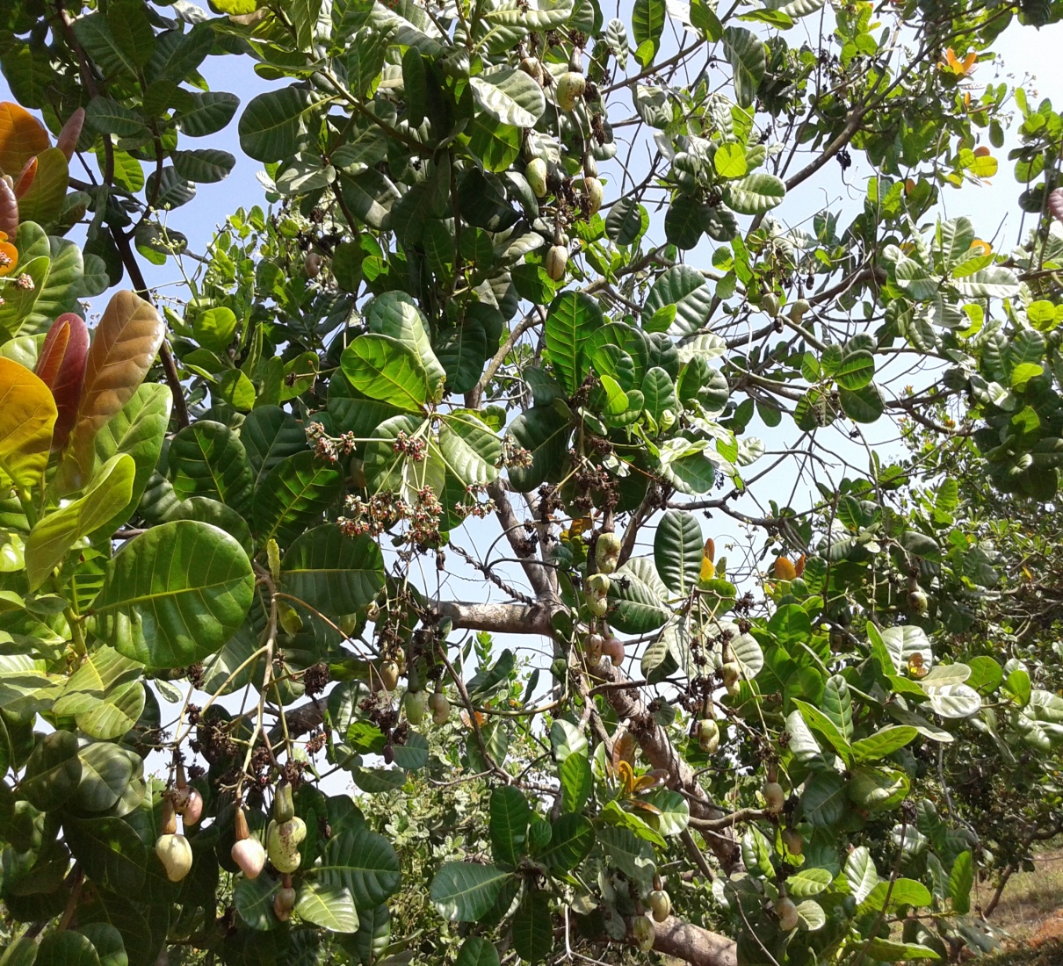
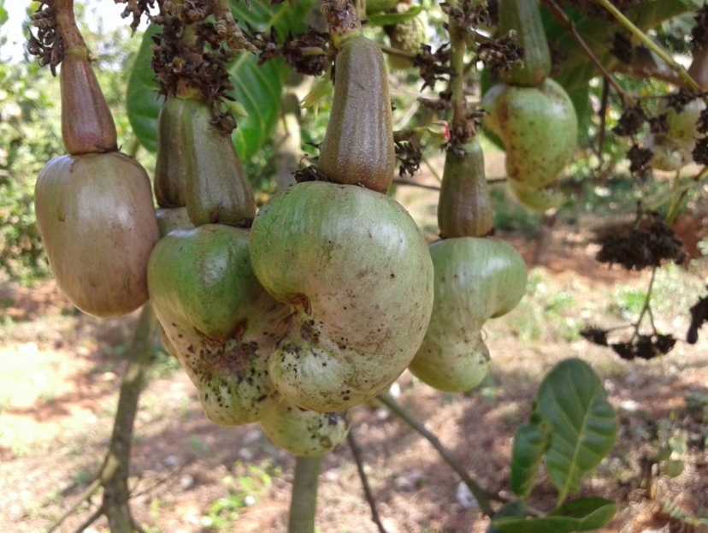
H-125

Slide 46
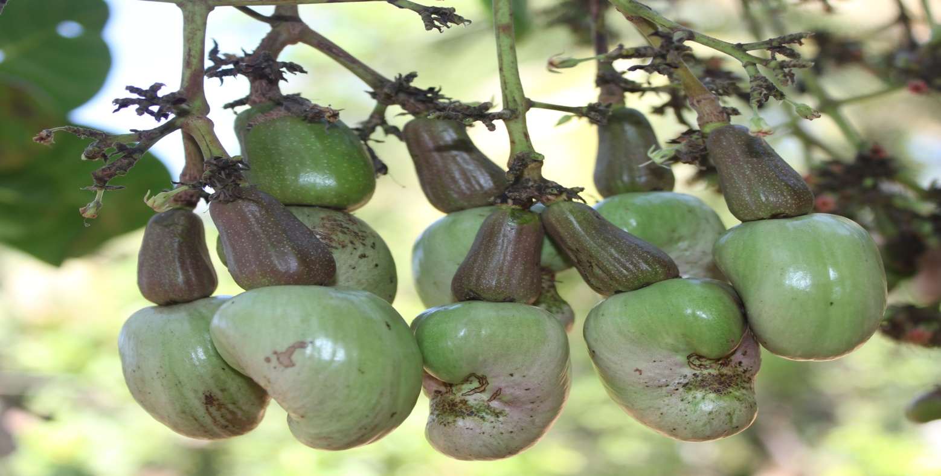
H-126

Slide 47
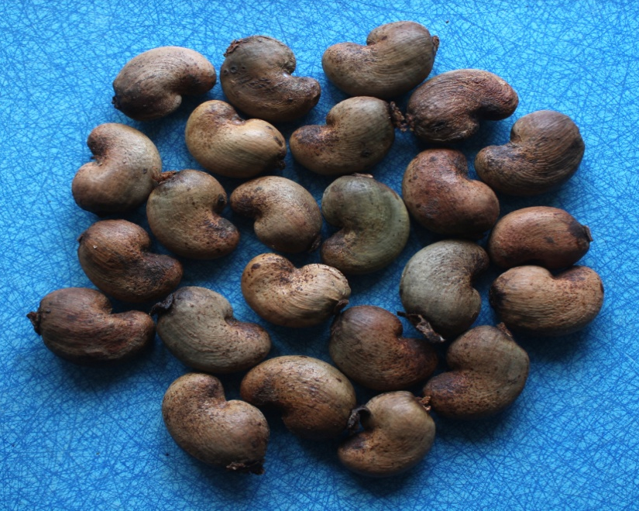
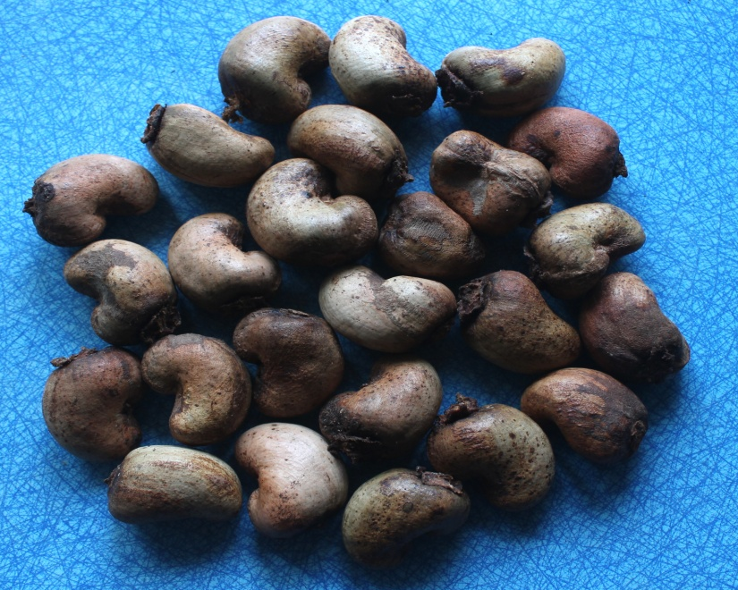
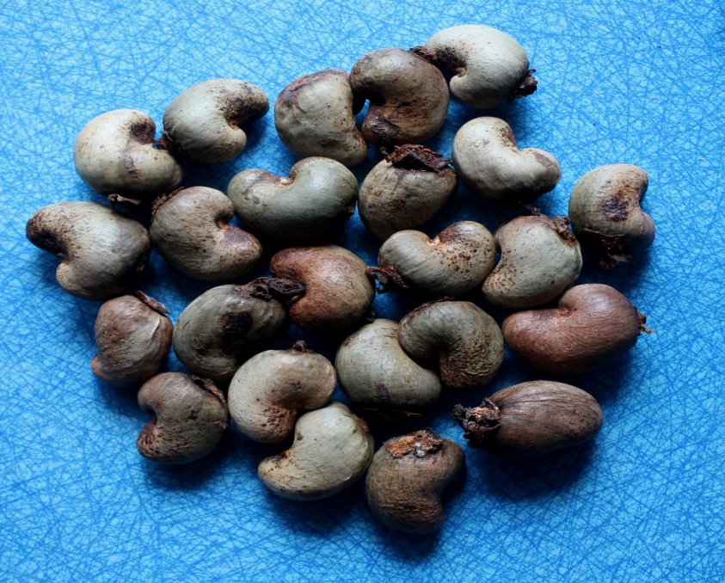
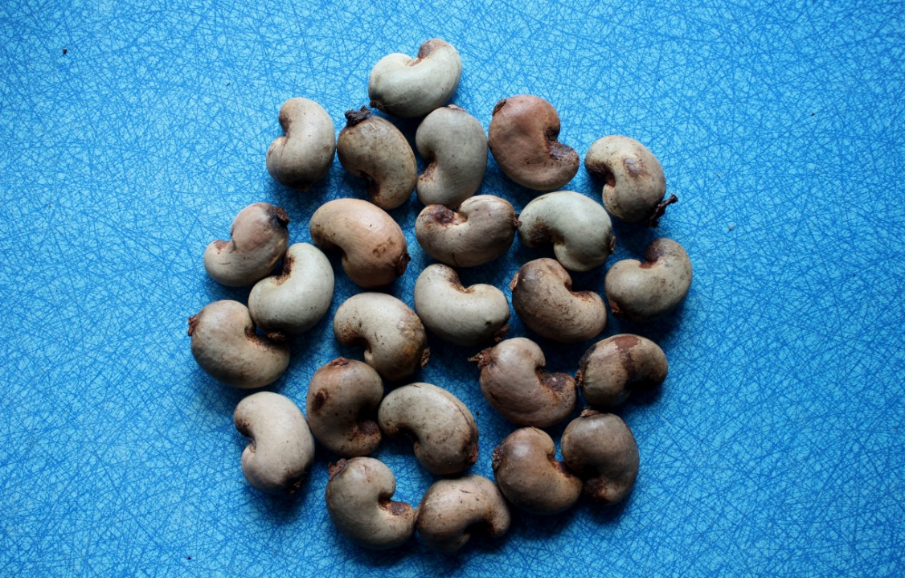
H-68
H-125
Sel-2
Bhaskara

Slide 48
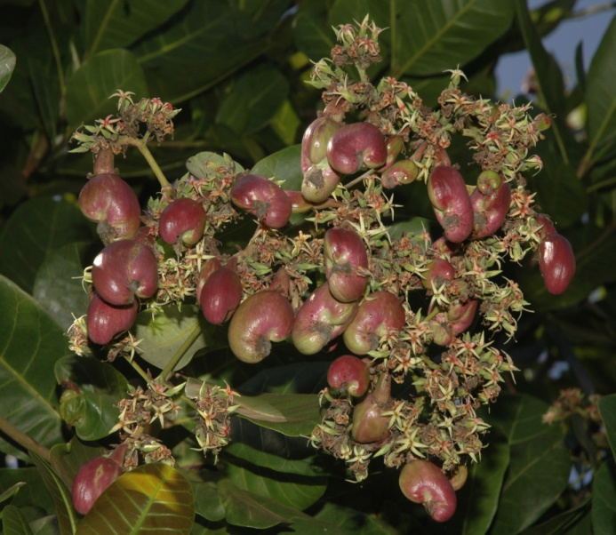
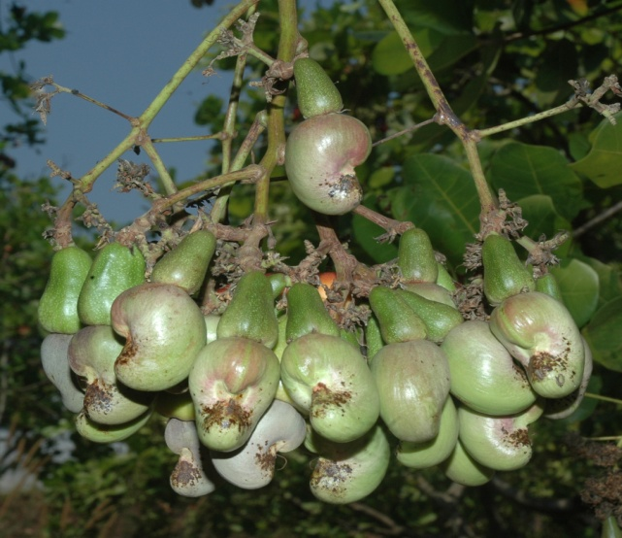
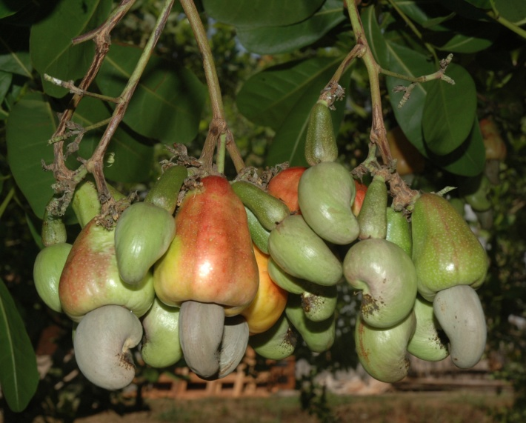
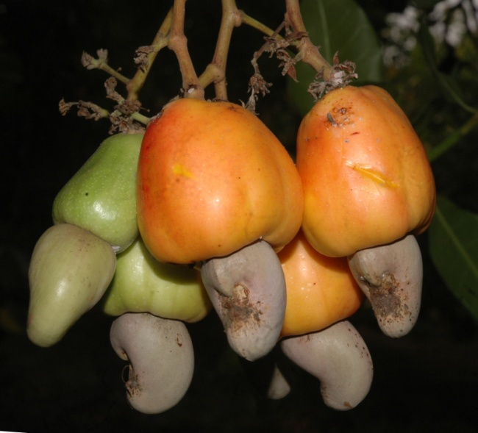
Promising germplasm under evaluation

Slide 49
Hybridization with wild species
Sl.No. | Female parent | Male parent
1. | Ullal-1 | A. microcarpum
2. | Ullal-3 | A. microcarpum
3. | V-4 | A. microcarpum
4. | Bhaskara | A. microcarpum
5. | Ullal-1 | A. othonianum
6. | A. microcarpum | Bhaskara
7. | A.microcarpum | V-4
8. | A.microcarpum | Ullal-3

Slide 50
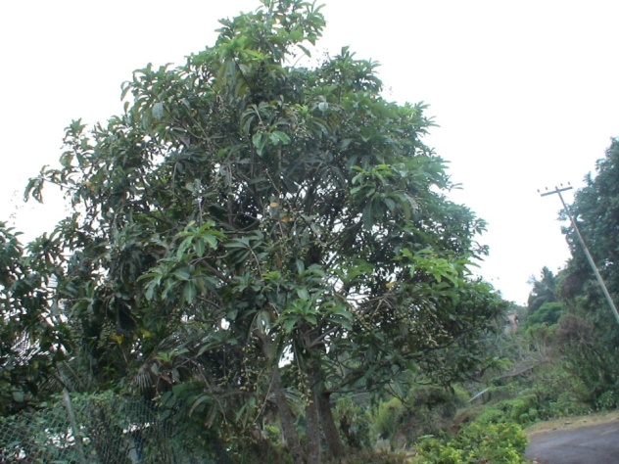
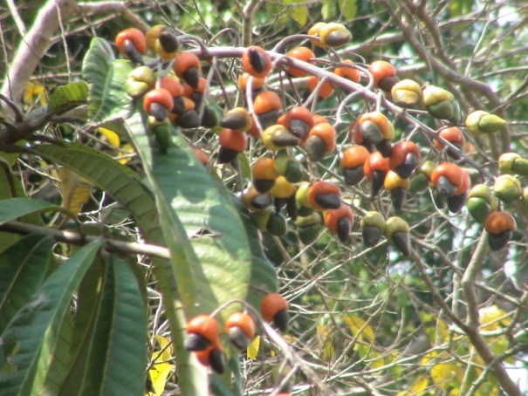
Wild / Weedy Species
Jungly caju (Semecarpus pranaui)
Fruit bunch of jungly caju

Slide 51
Seedling Selection in Cashew
Cross pollinated crop- offers ample scope for exploring diversity among seedling progenies.
An attempt - identify ideal plant from seedling progenies of popular cultivars.
Seedling progenies of NRCC Sel-2, Vengurla-4, VRI-3, Bhaskara, VTH-174, and VTH-30/4.
Some of the progenies - precocity , boldnut and higher yield. (VTH-30/4- 6.9 kg)

Slide 52
Variability for growth parameters and yield in seedling progenies of varieties (16 seedlings /variety)
Trait | Statistic | NRCC Sel-2 | Vengurle-4 | VRI-3 | Bhaskara | VTH-174 | VTH-30/4
Height (m) | Range | 3.25-6.45 | 4.00-7.45 | 3.50-7.10 | 3.75-8.90 | 5.10-7.25 | 4.10-7.25
 | Mean | 4.80 | 5.21 | 4.76 | 5.80 | 6.05 | 5.43
 | SEm ± | 0.21 | 0.30 | 0.21 | 0.39 | 0.15 | 0.24
 | CV % | 17.71 | 23.03 | 17.44 | 26.72 | 10.25 | 18.05
Tree spread (m) | Range | 3.50-7.62 | 3.25-9.72 | 3.22-7.80 | 3.87-8.95 | 4.62-8.9 | 3.62-9.25
 | Mean | 5.04 | 5.89 | 5.33 | 5.81 | 6.67 | 6.23
 | SEm ± | 0.26 | 0.41 | 0.25 | 0.33 | 0.26 | 0.37
 | CV % | 20.83 | 27.84 | 18.57 | 23.06 | 15.44 | 23.43
Yield (kg) | Range | 1.45-2.54 | 1.20-2.98 | 0.94-4.41 | 0.56-3.38 | 0.50-3.05 | 1.02-6.90
 | Mean | 1.85 | 1.82 | 2.46 | 1.95 | 1.75 | 2.04
 | SEm ± | 0.08 | 0.12 | 0.21 | 0.11 | 0.13 | 0.34
 | CV % | 17.84 | 25.27 | 34.15 | 23.08 | 29.14 | 66.18

Slide 53



Tree-480(VTH30/4)- 6.9 kg yield

Slide 54
Backcross breeding
Material | Details
Hybrid (F1) | Ullal- 3 x Brazil Dwarf Bhaskara x Brazil Dwarf
Backcrosses (2) | (Ullal- 3 x Brazil Dwarf ) x Ullal-3 (Bhaskara x Brazil Dwarf ) x Bhaskara

Slide 55



Back crossed hybrid seedlings in nursery
SOWING
1.5 MONTHS OLD
3 MONTHS OLD

Slide 56
Backcross breeding
Material | Details
Hybrid (F1) | Ullal- 3 x Brazil Dwarf Bhaskara x Brazil Dwarf
Backcrosses (2) | (Ullal- 3 x Brazil Dwarf ) x Ullal-3 (Bhaskara x Brazil Dwarf ) x Bhaskara

Slide 57

SSR polymorphism in parents (SSR-8)
Marker Assisted Selection for Economic Traits

Slide 58

SSR profile in F1 population- CS-3

Slide 59
Cluster of 31 accessions Based on SSR markers of cashew

Slide 60

SSR amplification with pistachio primer (Ps23)

Slide 61

Cluster ing 48 accessions. based on SSR markers from other species
NRC 447 and 493 are highly divergent
NRC 482 and NRC 495- Highly similar
Average similarity = 0.52
Modertate diversity among accessions

Slide 62

Breeding for cashew apple
13 accessions have been planted in 2014

Slide 63

Challenges
Development of varieties resistant to CSRB and TMB
Varieties suitable for moderate cold climate
Breaking the yield barrier

Slide 64

THANK YOU
THANK YOU

