Slide 1
2nd International conference on Animal Dairy Science
Assessment of genetic variability in Marwari breed of Indian meat goat using Microsatellite DNA
SPEAKER : PROF. G. C. GAHLOT
RAJASTHAN UNIVERSITY OF VETERINARY & ANIMAL SCIENCE, BIKANER (RAJASTHAN), INDIA
Notes:
1

Slide 2
Goat Population overview
one goat to approximately 1.17 sheep in the world (FAOSTAT, 2013).
The largest number of goats is observed in Asia, followed by Africa, representing about 59.4% and 35.0%, summing up to 94.4% out of the total number of the world, respectively.
The ratios of goat to sheep in Africa, Central America and Asia are approximately equal, indicating the considerable importance of goat populations in these parts of the world, especially to the poor and landless peasants.
The total number of goats in the world increased by 146% of the total number (1005.6 million) encountered in 1990. Number of goats in the world has been increasing since 1990 by about 1% to 4% each year. During the same period, cattle number increased by 5%, while that of sheep decreased by 10%, reflecting the emergence of goats as a major livestock species.

Slide 3
Table1:Numbers of goats in the top ten countries, the ratio of goats to sheep & their percentages from the total number in the world (FAOSTAT, 2013)
Country | Number (Million) |  | Ratio |  | Percentage of world total (%)
 | Goats | Sheep | Goat | Sheep | Goats | Sheep
China | 182.89 | 185.00 | 1 | 1.01 | 18.19 | 15.77
India | 162.00 | 75.50 | 1 | 0.47 | 16.11 | 6.437
Pakistan | 64.90 | 28.80 | 1 | 0.44 | 6.454 | 2.456
Nigeria | 58.25 | 39.00 | 1 | 0.67 | 5.793 | 3.325
Bangladesh | 55.60 | 19.00 | 1 | 0.34 | 5.529 | 1.62
Sudan | 44.00 | 52.50 | 1 | 1.19 | 4.375 | 4.476
Kenya | 30.00 | 18.50 | 1 | 0.62 | 2.983 | 1.577
Ethiopia | 25.00 | 26.50 | 1 | 1.06 | 2.486 | 2.259
Iran | 22.10 | 50.22 | 1 | 2.27 | 2.198 | 4.282
Mali | 19.12 | 13.73 | 1 | 0.72 | 1.901 | 1.171
World | 1005.6 | 1172.83 | 1 | 1.17

Slide 4
Table 2: Number of goats in the India during the period from
1970 to 2013 (FAOSTAT, 2013)
Numbers (Million)
YEAR

Slide 5
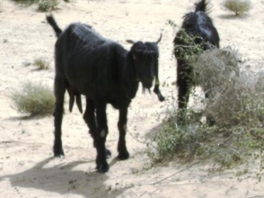
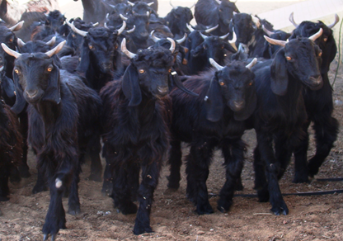

Slide 6
INDIAN GOAT POPULATION DISTRIBUTION
Temperate Region
Gaddi, Changthangi, Chegu & Shingari
North-Western Region
Jamunapari, Beetal
GOAT
BREED
Southern Region
Osmanabadi, Malabari, Sangamneri
Western Region
Sirohi, Barbari, Kutchi,, Mehasana, Zalawadi Surti & Marwari
Eastern Region
Bengal, Ganjam, Assam Hill & Jakharana
Assessment of genetic variability in Marwari breed of Indian meat goat using microsatellite DNA

Slide 7
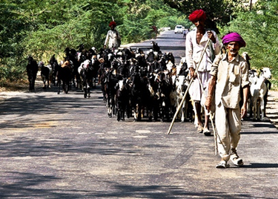
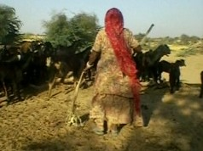
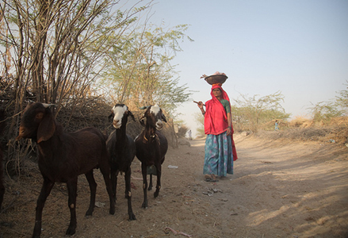
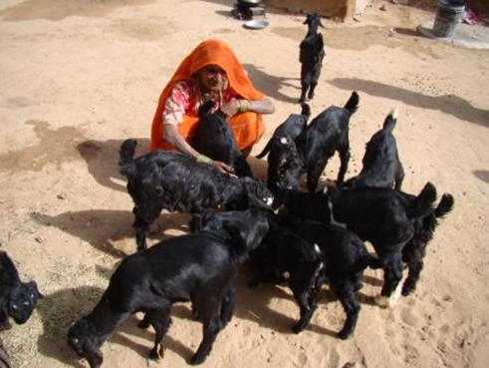
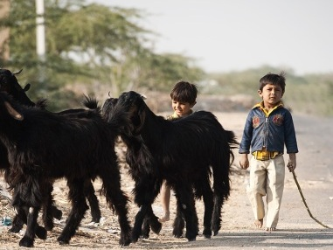
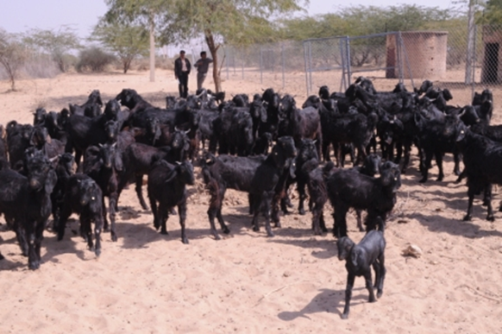
Journey for survival and co-existence--- Looking beyond Boundaries
Children normally herd goats, while their day-to-day management and the care of young stock usually fall to women.
Women, children and old men together contributed 77-92% of labor requirements in goat rearing. Women alone contributed 32-55% to it (census of India, 2010

Slide 8
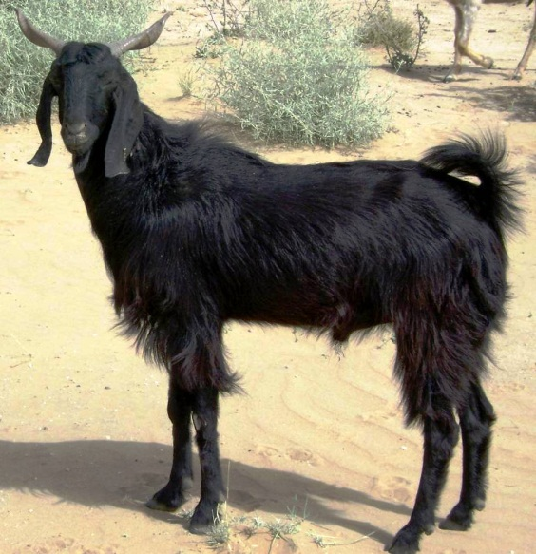
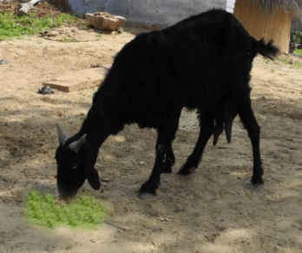
Marwari Breed Characters
Home Tract : Bikaner, Jodhpur, Jaisalmer, Barmer, Pali and Nagour districts.
Utility : Meat and Milk
Morphology : Medium sized body, predominantly black with long hairs occasionally white or brown patches.
Hair : Lustrous hair grows with 11 to 12 cm per annum.
Horns: 8.60 to 12.20 cm long, twisted, pointed and directed upwards and backwards
Ears : 12.58 to19.13 cm long hanging downwards.
Body dimensions
Height : 60-80 cm Length : 40-67 cm
Hearth girth: 68-80 cm Pouch girth: 70-88 cm
Adult Wt. : Male:40-45 kg Female:35-40 Kg
Milk yield : 84±5.7 kg to 113±7.0 kg
Twinning : 15-20 %

Slide 9
OBJECTIVE: To account of the existing within-breed genetic
variability in Marwari goat
Materials and methods
Blood samples were randomly collected from 146 genetically unrelated animals of Marwari goat from different villages of Bikaner districts of Rajasthan in line with MoDAD recommendations (FAO, 1998).
Genomic DNA was extracted from whole blood using proteinase K digestion followed by standard phenol–chloroform extraction procedure at room temperature (Sambrook et al., 2001) with few modifications.
PCR-based microsatellite DNA typing using standard protocol.
All extracted samples were confirmed through horizontal electrophoresis on 0.8% agarose gel containing ethidium bromide
Microsatellite markers: A panel of 15 microsatellite markers were selected from the list recommended by International Society for Animal Genetics (ISAG) and FAO’s (DAD-IS) for Caprine.

Slide 10
Table 3 : A panel of 15 microsatellite markers used in the study
Locus | Primer sequence | Type of repeat | Size range | Chromosome No. | Annealing Temp. (in°C)
ETH-152 | TACTCGTAGGGCAGGCTGCCTG GAGACCTCAGGGTTGGTGATCAG | (CA)₁₇ | 92-122 | 05 | 56.0
ETH-225 | GATCACCTTGCCACTATTTCCT ACATGACAGCCAAGCTGCTACT | (CA)₁₈ | 146-160 | 14 | 54.0
ILSTS-005 | GGAAGCAATGAAATCTATAGCC TGTTCTGTGAGTTTGTAAGC | (nn)₃₉ | 174-190 | 10 | 52.8
ILSTS-011 | GCT TGC TAC ATG GAA AGT GC CTA AAA TGC AGA GCC CTA CC | (CA)₁₁ | 167-173 | 14 | 54.0
ILSTS-019 | AAGGGACCTCATGTAGAAGC ACTTTTGGACCCTGTAGTGC | (TG)₁₀ | 142-162 | Ann | 53.7
ILSTS-022 | AGTCTGAAGGCCTGAGAACC CTTACAGTCCTTGGGGTTGC | (GT)₂₁ | 186-202 | Ann | 55.0
ILSTS-028 | TCC AGA TTT TGT ACC AGA CC GTC ATG TCA TAC CTT TGA GC | (CA)₇ | 132-150 | 11 | 50.4
ILSTS-030 | CTGCAGTTCTGCATATGTGG CTTAGACAACAGGGGTTTGG | (CA)₁₃ | 159-179 | 2 | 54.0
ILSTS-033 | TATTAGAGTGGCTCAGTGCC ATGCAGACAGTTTTAGAGGG | (CA)₁₂ | 151-187 | 12 | 54.6
ILSTS-034 | AAGGGTCTAAGTCCACTGGC GACCTGGTTTAGCAGAGAGC | (GT)₂₉ | 153-185 | 5 | 51.0
ILSTS-044 | AGTCACCCAAAAGTAACTGG ACA TGT TGT ATT CCA AGT GC | (GT)₂₀ | 142-170 | Ann | 50.0
ILSTS-058 | GCCTTACTACCATTTCCAGC CATCCTGACTTTGGCTGTGG | (GT)₁₅ | 136-188 | 17 | 54.0
ILSTS-059 | GCTGAACAATGTGATATGTTCAGG GGGACAATACTGTCTTAGATGCTGC | (CA)₄(GT)₂ | 105-135 | 13 | 55.0
ILSTS-065 | GCTGCAAAGAGTTGAACACC AACTATTACAGGAGGCTCCC | (CA)₂₂ | 105-135 | 24 | 53.7
ILSTS-087 | AGC AGA CAT GAT GAC TCA GC CTG CCT CTT TTC TTG AGA GC | (CA)₁₄ | 110-120 | 28 | 50.0

Slide 11
PCR-amplified products were resolved on 6% urea–PAGE denaturing sequencing gel at 75 W (Sequi Gen GT apparatus. Bio-Rad, Hercules, USA) and visualized by silver staining (Bassam et al. 1991). Allele sizes were estimated using a 100-bp ladder (Invitrogen Life Technologies, Carlsbad, USA). Genotype of each individual animal at 25 different loci was recorded by direct counting.

Slide 12
Analysis of molecular data
Genotype of each individual animal was determined and recorded from the silver-stained gels for each microsatellite locus.
Different measures of within-breed genetic variations, namely number of alleles, allele frequencies, effective number of alleles (ne), observed heterozygosity (Ho), expected heterozygosity (He), were estimated to evaluate variability at DNA level.
Polymorphism information content (PIC) for each locus was calculated according to Botstein et al. (1980).

Slide 13
RESULTS
A total of 74 alleles were contributed by Marwari goat across all 15 microsatellite loci.
The number of alleles per locus varied from two (ILSTS-087) to 9 (ILSTS-058) alleles, with a mean of 4.93 whereas the effective number of allele varied from 1.35 (ILSTS-005) to 3.129 (ILSTS011) with a mean of 2.36.
The effective number of allele is lesser than observed number at all the loci. ­­­­­­­­­­­­­
Allelic sizes ranged from 125 bp (ILSTS-028 and ILSTS-033) to 650 bp (ILSTS-011 and ILSTS-019).
The expected heterozygosity ranged from 0.240 (locus ILSTS-005) to 0.681 (locus ILSTS-011), with an average value of 0.544.

Slide 14
The observed heterozygosity (Ho) ranged from 0.1428 (locus ILSTS-087) to 0.9285 (locus ILSTS-034), with an average value of 0.5485 indicates substantial and very good number of heterozygotes, in the population.
The highest polymorphic information content (PIC) value (1.1886) was observed at ILSTS-044 locus and least (0.0768) at ILSTS-065 locus for Marwari goat. Reasonably high PIC values observed for most of the marker with an average of (0.78096) are indicative of the usefulness of microsatellites biodiversity evaluation in this breed.

Slide 15
Table 4: Number and size of the alleles, heterozygosity and PIC in Marwari goat.
Microsatellite Marker | No. of Allele |  | Allele size(bp) | Heterozygosity |  | PIC
 | A_{o} | A_{e} |  | H_{o} | H_{(Exp)}
ETH-152 | 4 | 2.515 | 150-200 | 0.4285 | 0.603 | 1.1306
ETH-225 | 5 | 2.755 | 140-200 | 0.500 | 0.637 | 1.1448
ILSTS-005 | 3 | 1.315 | 175-350 | 0.2857 | 0.240 | 0.6425
ILSTS-011 | 7 | 3.129 | 350-650 | 0.5714 | 0.681 | 0.9385
ILSTS-019 | 5 | 2.932 | 145-650 | 0.7857 | 0.660 | 1.2057
ILSTS-022 | 4 | 2.143 | 200-350 | 0.5714 | 0.534 | 0.1065
ILSTS-028 | 4 | 1.44 | 125-245 | 0.4285 | 0.305 | 0.8264
ILSTS-030 | 6 | 2.853 | 150-310 | 0.6428 | 0.650 | 1.1608
ILSTS-033 | 4 | 2.939 | 125-175 | 0.514 | 0.655 | 0.1862
ILSTS-034 | 6 | 2.68 | 200-250 | 0.9285 | 0.627 | 1.1759
ILSTS-044 | 5 | 2.995 | 150-550 | 0.6428 | 0.666 | 1.1886
ILSTS-058 | 9 | 2.652 | 175-550 | 0.714 | 0.623 | 0.1279
ILSTS-059 | 5 | 1.988 | 150-250 | 0.7857 | 0.497 | 1.1534
ILSTS-065 | 5 | 2.099 | 145-550 | 0.2857 | 0.524 | 0.0768
ILSTS-087 | 2 | 1.34 | 150-200 | 0.1428 | 0.254 | 0.6498
Average | 4.93 | 2.385 |  | 0.5485 | 0.544 | 0.78096

Slide 16
Conclusions
Based on the PIC values, the microsatellite primers used in the present study are proved to be highly polymorphic in nature and hence can be well utilized for molecular characterization of goat germplasm.
The PIC values are suggestive of high polymorphic nature of the microsatellite loci analysed.
The PIC values observed in the present study is indicative of the fact that the markers used are highly informative for characterization of Marwari goat diversity.
The significant level of variability in this population reflects that the Marwari population contains a valuable genetic diversity. Hence, this population could provide a valuable source of genetic material that may be used for meeting the demands of future breeding programmes.

Slide 17
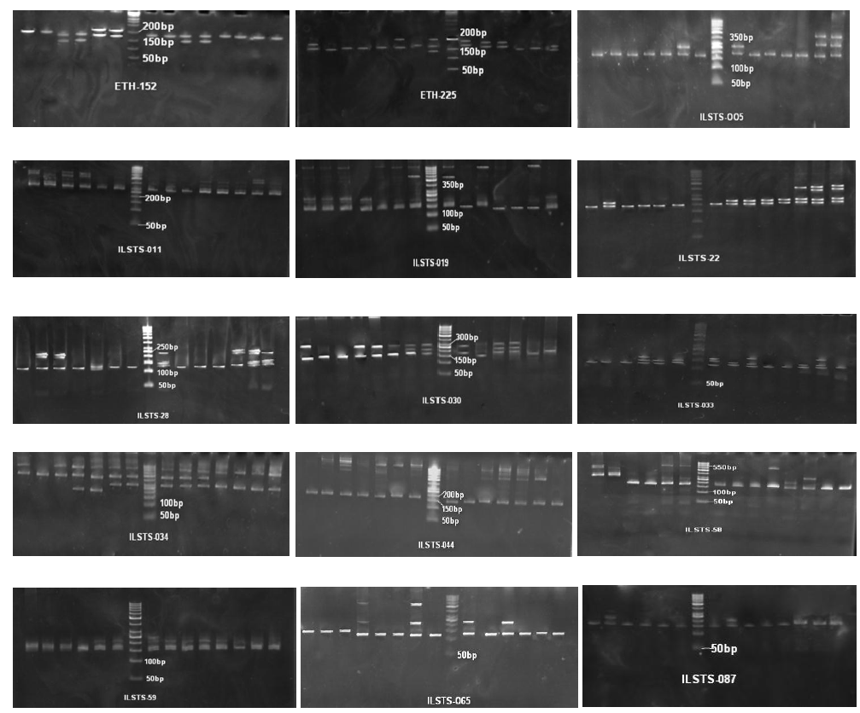
Allelic profile across the 15 microsatellite markers in Marwari goat on PAGE

Slide 18
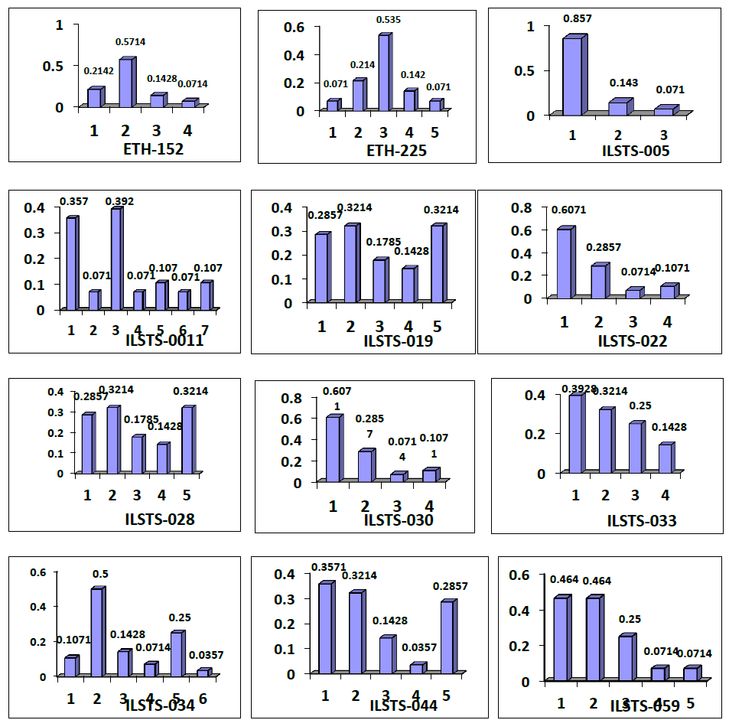
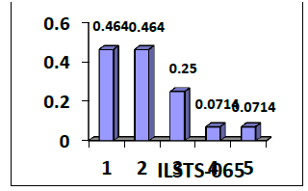
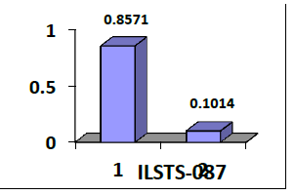
Figure :
Allelic frequency distribution across the 15 microsatellite
markers in Marwari Goats.

Slide 19
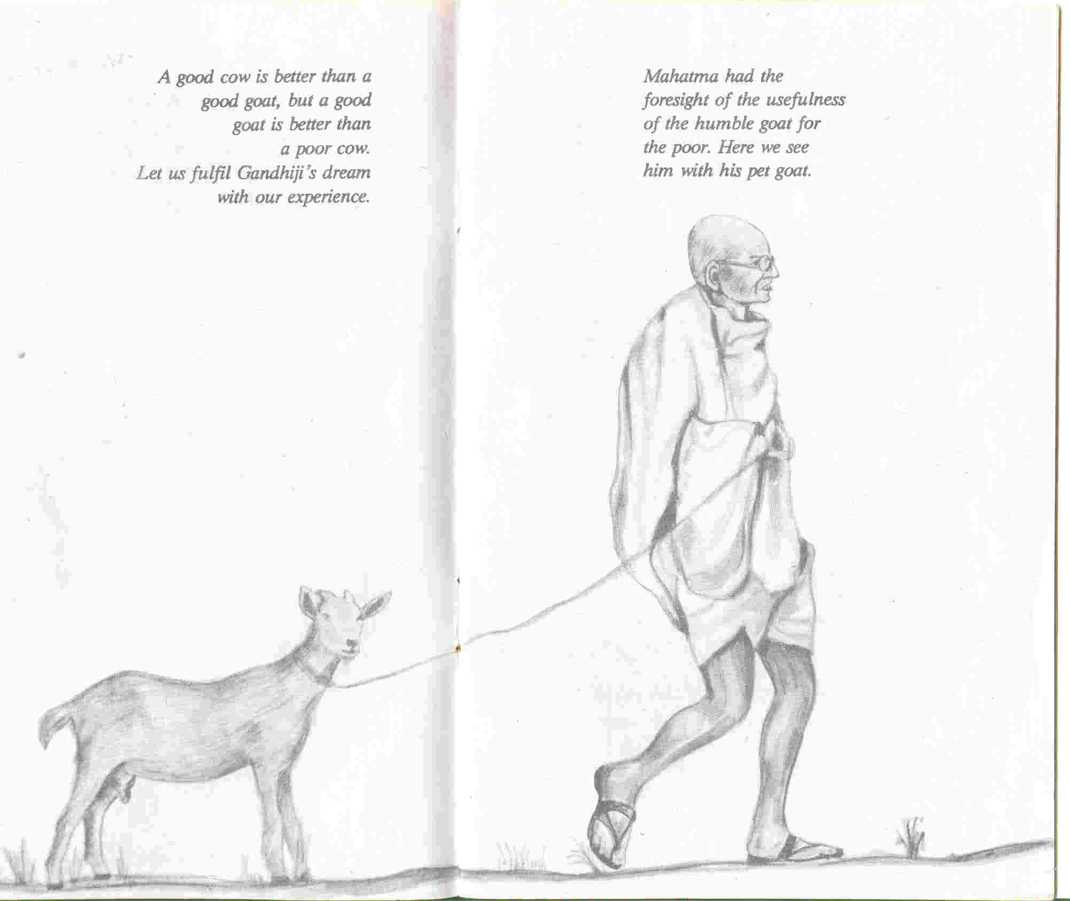
Thank You!

