Slide 1
CLINICAL MANAGEMENT OF
SOYA BEAN ASSOCIATED
ALKALINE INDIGESTION
IN A BULLOCK – A CASE REPORT
DR. G. AMBICA
ASSISTANT PROFESSOR
DEPT. OF VETERINARY MEDICINE
COLLEGE OF VETERINARY SCIENCE
KORUTLA-505 326
KARIMNAGAR DISTRICT, TELANGANA.

Slide 2
Soybean (US) or soya bean (UK) is a species of legume native to East Asia, widely grown for its edible bean which has numerous uses.
The plant is classed as an oilseed rather than a pulse by the UN Food and Agricultural Organization (FAO).
Soybean Scientific classification:
Kingdom : Plantae
Order : Fabales
Family : Fabaceae
Subfamily : Faboideae
Genus : Glycine
Species : G. max

Slide 3
PARTICULARS OF OWNER & ANIMAL
Case No. 77 Date: 12-07-2014
Owner Particulars: Linganna,
Ragavpet Villaga, Korutla Mandal Karimnagar district, Telangana.
Animal Particulars:
Species : Bovine Breed : ND
Sex : Male (Bullock) Age : 10 years
Colour : White

Slide 4
HISTORY
Bullock has brought to the Teaching Veterinary Clinical Complex, College of Veterinary Science, Korutla with the history of adlib soya bean intake 4 days back.
Owner has reported that it has taken more than 5 k.g of soya bean seeds. Then onwards it is dull, not taking feed and not voiding faeces.
Owner has taken the bullock to near by Veterinary hospital for 2 days but there was no improvement. There bullock was treated with rumentorics and B-complex injections.

Slide 5
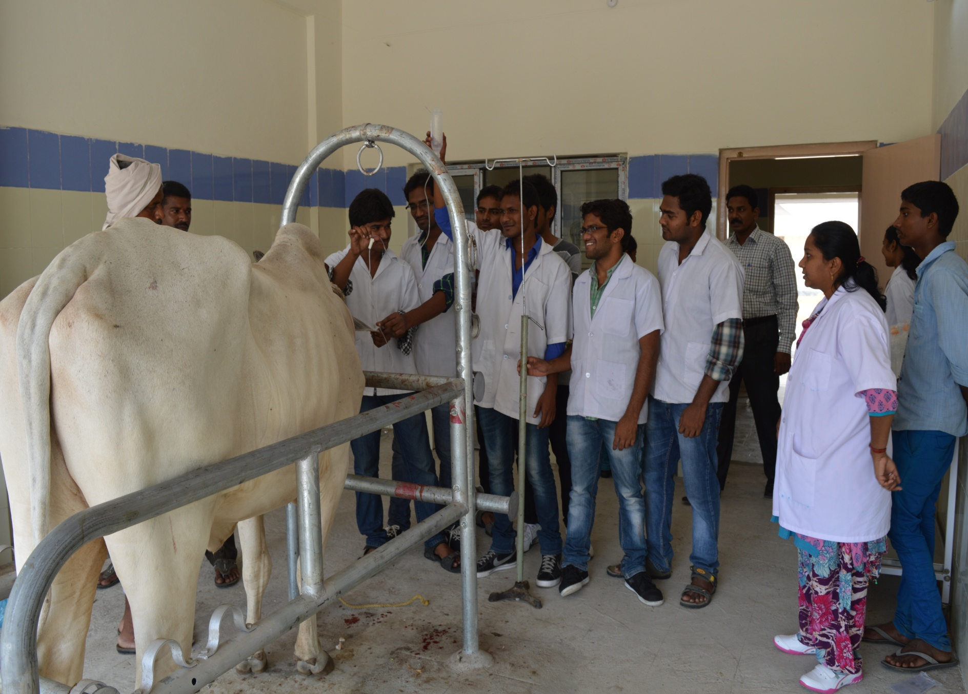

Slide 6
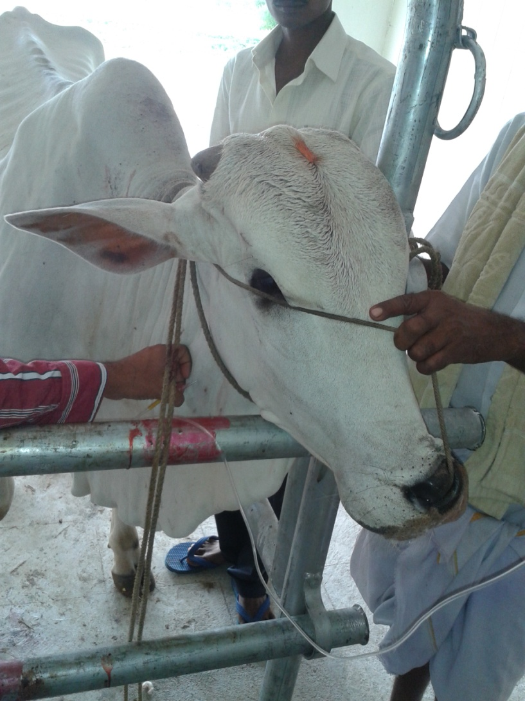

Slide 7
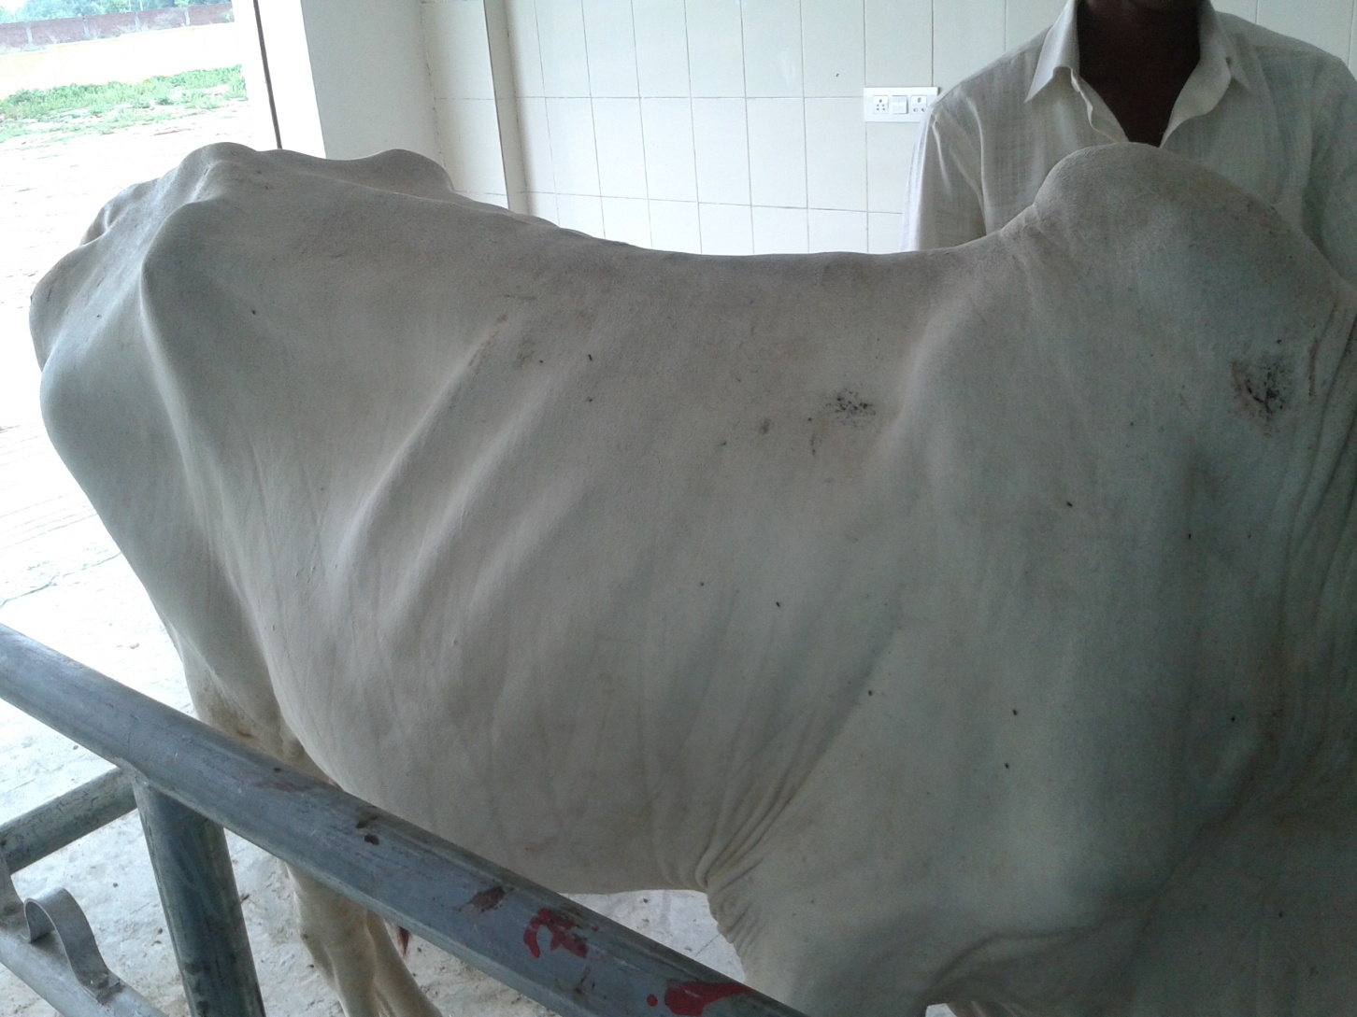

Slide 8
  Physical examination:
    General body condition : Lean
    Demeanor : Dull, Depressed and very weak
  Fetid mouth odor
  Profuse frothy salivation
  Mild dyspnea
  Animal is severely dehydrated with prominent sunken eye balls and with skin tenting time more than 10 seconds at upper lid region.

Slide 9
CLINCAL EXAMINATION
Detailed clinical examination has revealed,
Temp : 96.6 ⁰F
Pulse : 93/ minute
Heart rate : 58 beats/ minute
Resp. rate : 35/ minute
C.M.M. : Slight pale & dry
B.M.M. : Normal but dry
    Rumen motility: Complete atony of the rumen with mild tympany,

Slide 10
  We have collected dung, urine, blood
  Faecal sample is negative for parasitic ova
  Peripheral blood smear is negative for haemoprotozoans
  In serum increased BUN levels was noticed
  Urine examination:
    Colour : Normal
    Odour : Slight pungent

Slide 11
Rumen fluid examination
  We could able to aspirate 1 ml of rumen fluid with 16 G needle fitted to 20 ml syringe, after proper sterilization of the collecting site(mid Left paralumbar fossa) and did rumen fluid examination. While poking the needle itself there was pungent odour.
RUMEN FLUID OBSERVATIONS:
Colour : dark brown
Consistency : Watery
Odour : foul and putrid
pH : 8.5
Microscopic examination has reveled all dead protozoa

Slide 12
TREATMENT
We have removed the dung manually as much as possible.
Animal was treated with the following medication
  Inj. DNS 900 mL i.v
  Inj. RL 450 mL i.v
  Inj. Histanil 20 mL i.m
  Inj. Intamox 3375 mg i.v
  Inj. Belamyl 20 mL i.m
Drenched Magsulf orally by mixing 50 g of magsulf powder in 2L of water.
Advised owner to drench tamarind water (around 1/4th kg of tamarind mixed in 2L of water which act as acidifier).

Slide 13
Treatment with i.v fluids and antibiotics was repeated for two more days, where as antihistamines and supportive treatment with Belamyl was continued for 5 days.
Rumentas bolus @ 4 daily for 3 days were advised for 5 days after voiding the dung.
Bullock started started taking green grass from 4th day onwards and was recovered fully in 10 days.

Slide 14
THANK YOU

