Slide 1
The HIV epidemic in Heilongjiang province of China
Fuxiang Wang
Department of Infectious Diseases, Fourth Afﬁliated Hospital of Harbin Medical University ,China
E-mail:wangfuxiang999@163.com
Mobile Tel:13845101378

Slide 2
Content
The HIV epidemic in the world and China
The HIV epidemic in Heilongjiang province of China
Subtype and sequence analysis of HIV-1 strains in Heilongjiang Province
Notes:
The size of the HIV genome is similar to that of other retroviruses but it is more complex. There is no oncogene but there are extra open reading frames which do code for protein. In all 15 proteins are encoded in HIV and they are made because antibodies to them can be found in patients. These extra open reading frames are not typical of retroviruses such as RSV. These extra open reading frames give a clue to the complex lifestyle of HIV. Note that some of them are encoded in two or more exons so there will have to be multiple splice events to make the final RNA. Could these be a site for intervention in the replication of the virus?

Slide 3
The HIV epidemic in the world

Slide 4
Global estimates for adults and children  2012

Slide 5
The HIV epidemic in China

Slide 6
At the end of 2011, the cumulative number of reported people living with HIV(PLHIV) stood at close to 445,000 cases.
Epidemic estimates show that at the end of 2011, a total of 780,000 people were living with HIV in China, accounting for 0.058% of the total population. China therefore remains a low-prevalence country.
Notes:
The size of the HIV genome is similar to that of other retroviruses but it is more complex. There is no oncogene but there are extra open reading frames which do code for protein. In all 15 proteins are encoded in HIV and they are made because antibodies to them can be found in patients. These extra open reading frames are not typical of retroviruses such as RSV. These extra open reading frames give a clue to the complex lifestyle of HIV. Note that some of them are encoded in two or more exons so there will have to be multiple splice events to make the final RNA. Could these be a site for intervention in the replication of the virus?

Slide 7
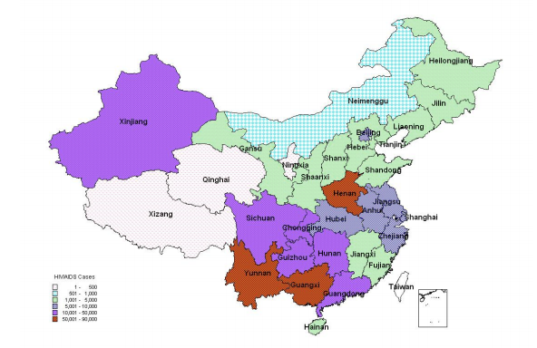
Fig 1.Geographical distribution of cumulative reported HIV/AIDS cases (as of 31st December 2011)

Slide 8
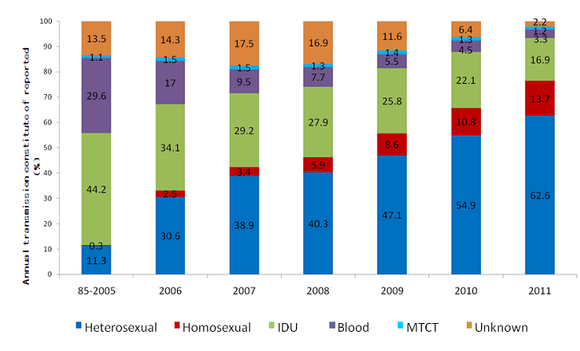
Fig 2.Breakdown of newly reported cases of HIV in past years

Slide 9
The HIV epidemic in Heilongjiang province of China

Slide 10
Fig 3.Geographical distribution of cumulative reported HIV/AIDS cases (as of 31st December 2011)

Slide 11
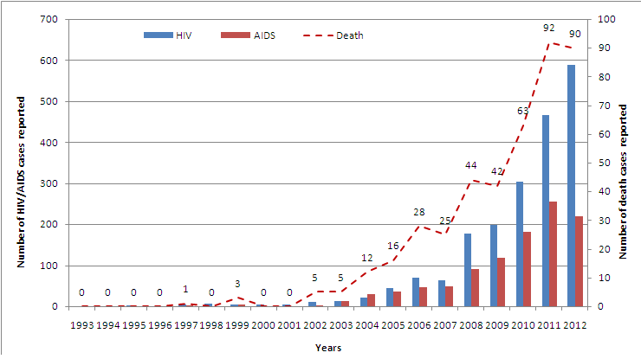
Figure 3. The number of reported HIV/AIDS and deaths annually in Heilongjiang province from 1993 when the ﬁrst HIV was detected to 2012

Slide 12
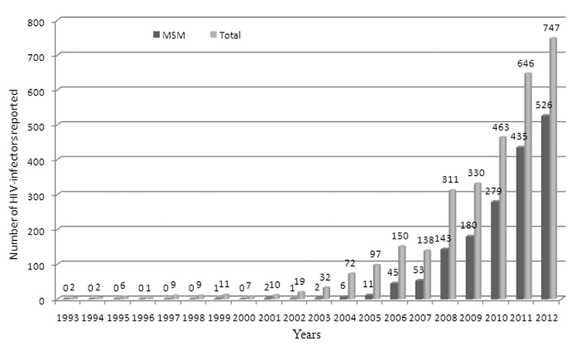
Figure 4. The number of HIV-infections through homosexual contact and the total number of reported HIV cases annually in Heilongjiang province (1993-2012).

Slide 13
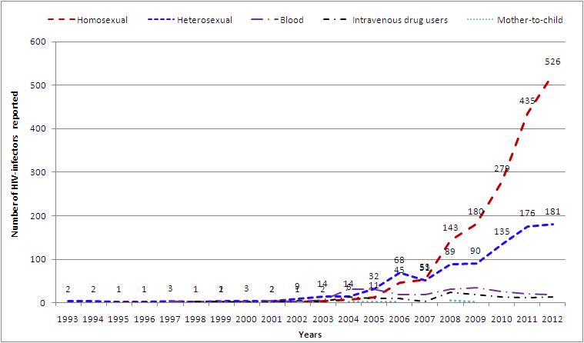
Figure 5. The distribution of HIV transmitted routes in Heilongjiang province (1993-2012).

Slide 14
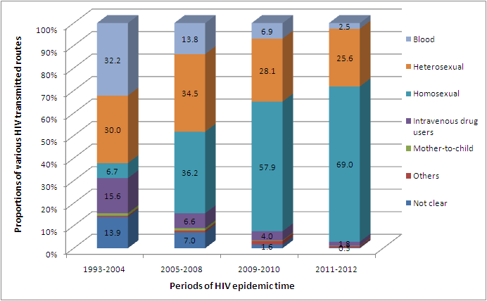
Figure 6. The proportion of various routes of HIV transmission in Heilongjiang province
during four time periods:1993-2004; 2005-2008; 2009-2010; and 2011-2012.

Slide 15
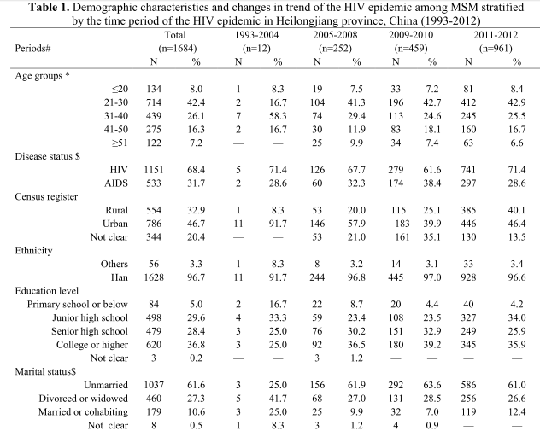
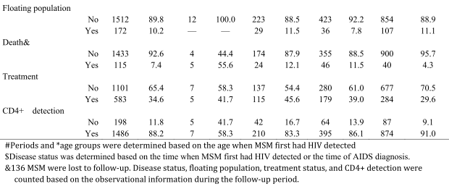

Slide 16
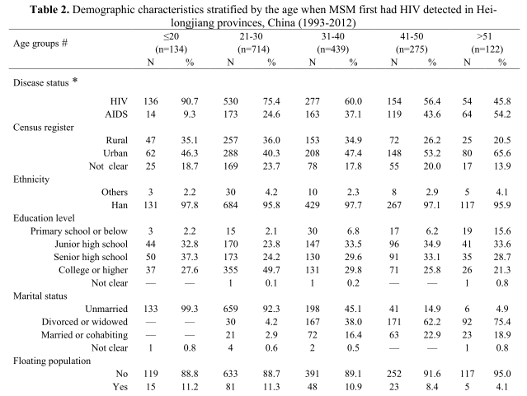

Slide 17
Subtype and sequence analysis of HIV-1 strains in Heilongjiang Province

Slide 18
The subtype of 19 HIV-1 seropositive individuals in Heilongjiang Province is B’, and it is introduced from He’nan Province.
(WANG Fu-xiang, ZHOU Hui, LING Hong, etc. Subtype and sequence analysis of HIV-1 strains in Heilongjiang Province . Chin Med J 2007;120(22):2006-2010.)

Slide 19
There are 12 B subtypes, 3 CRF07_BC subtypes,1 CRF01_AE subtype among16 HIV-1-positive inmates from prisons in Heilongjiang Province.
(Sheng-Yuan Liu,Fang-Fang Zeng,Guo-Feng Huang,Hui Zhou,Yan-Mei Shi,Hong Ling,Fu-Xiang Wang,Bin-You Wang,and Jin Zhou. Analysis of Human Immunodeﬁciency Virus Type 1 nef Gene Sequences among Inmates from Prisons in China. AIDS Res Hum Retroviruses. 2009 ;25(5):525-9.)

Slide 20
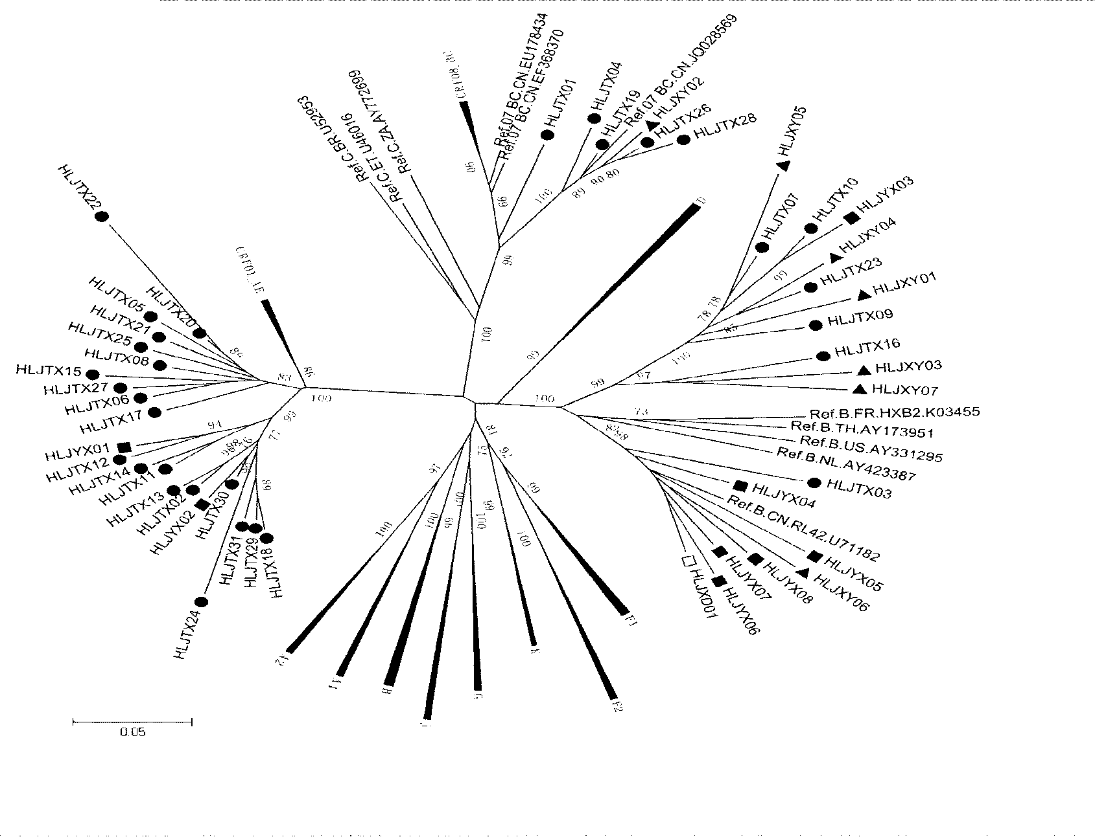
FIG 8 . Phylogenetic analysis of the V3-V4 region of the env gene in HIV-1 strains from infections in Harbin city.

Slide 21
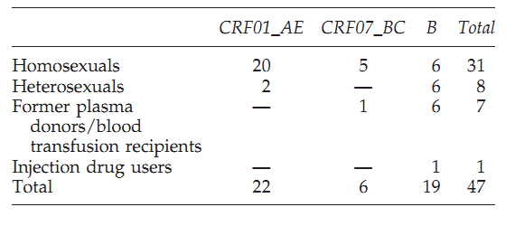
Table 3. Distribution of HIV-1 Subtypes Identiﬁed Based on the V3-V4
Region of the env Gene in Each Risk Group

Slide 22
Conclusion
The HIV/AIDS epidemic has been continuing to increase in Heilongjiang province, and has shown explosive growth after 2008;MSM have made a tremendous contribution to the incidence of HIV infections. Homosexual contact has become the dominant route of HIV transmission. Urgent intervention needs to target this population, especially those ≤30 years of age, unmarried, a high educational background, and urban MSM.
Notes:
The size of the HIV genome is similar to that of other retroviruses but it is more complex. There is no oncogene but there are extra open reading frames which do code for protein. In all 15 proteins are encoded in HIV and they are made because antibodies to them can be found in patients. These extra open reading frames are not typical of retroviruses such as RSV. These extra open reading frames give a clue to the complex lifestyle of HIV. Note that some of them are encoded in two or more exons so there will have to be multiple splice events to make the final RNA. Could these be a site for intervention in the replication of the virus?

Slide 23
Conclusion
Our study showed that CRF01_AE was the dominant strain circulating in MSM. However, other than the MSM population, subtypes of B were the principal strains in Heilongjiang province
Notes:
The size of the HIV genome is similar to that of other retroviruses but it is more complex. There is no oncogene but there are extra open reading frames which do code for protein. In all 15 proteins are encoded in HIV and they are made because antibodies to them can be found in patients. These extra open reading frames are not typical of retroviruses such as RSV. These extra open reading frames give a clue to the complex lifestyle of HIV. Note that some of them are encoded in two or more exons so there will have to be multiple splice events to make the final RNA. Could these be a site for intervention in the replication of the virus?

Slide 24
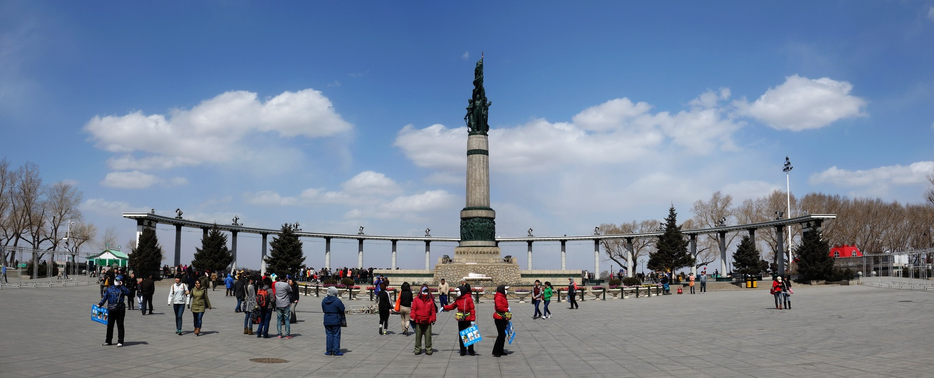
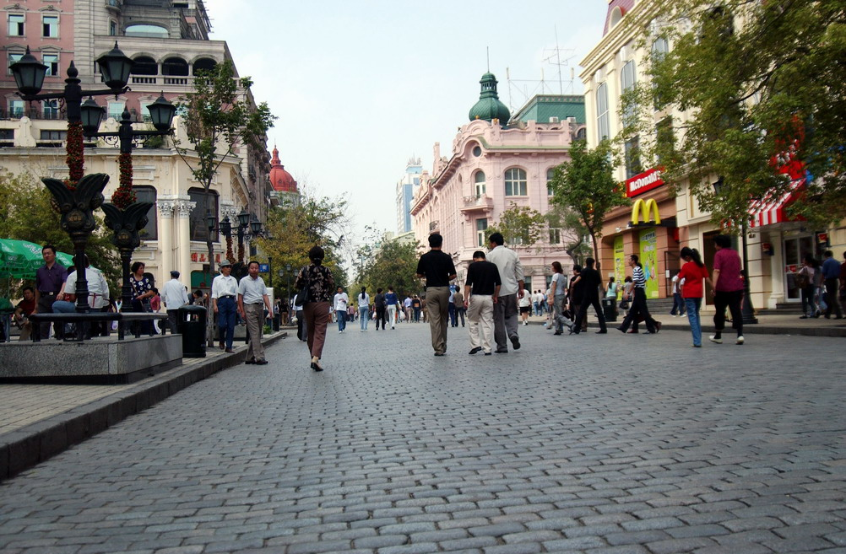
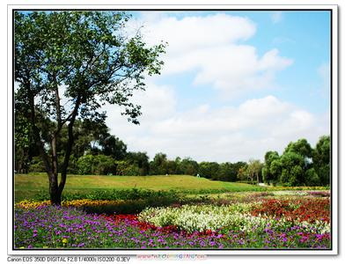
Notes:
The size of the HIV genome is similar to that of other retroviruses but it is more complex. There is no oncogene but there are extra open reading frames which do code for protein. In all 15 proteins are encoded in HIV and they are made because antibodies to them can be found in patients. These extra open reading frames are not typical of retroviruses such as RSV. These extra open reading frames give a clue to the complex lifestyle of HIV. Note that some of them are encoded in two or more exons so there will have to be multiple splice events to make the final RNA. Could these be a site for intervention in the replication of the virus?

Slide 25
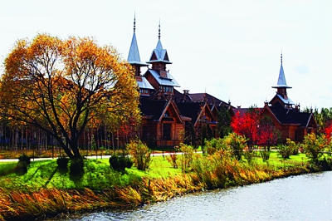
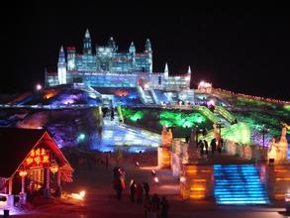
Conclusion
Notes:
The size of the HIV genome is similar to that of other retroviruses but it is more complex. There is no oncogene but there are extra open reading frames which do code for protein. In all 15 proteins are encoded in HIV and they are made because antibodies to them can be found in patients. These extra open reading frames are not typical of retroviruses such as RSV. These extra open reading frames give a clue to the complex lifestyle of HIV. Note that some of them are encoded in two or more exons so there will have to be multiple splice events to make the final RNA. Could these be a site for intervention in the replication of the virus?

Slide 26
Thank you！

