Slide 1
Abortion Pathology
Dr. Fred Williams III, DVM, DACVP
Assistant Professor
Veterinary Medical Diagnostic Laboratory
University of Missouri
E-mail: williamsfre@missouri.edu

Slide 2
Defining Terms
Abortion: Expulsion of the fetus before full development; may be alive or dead
Stillbirth: Expulsion of a dead fetus at full gestational development
Determination of term in bovines?
Embryonic death vs. Fetal death: Occurs earlier in the gestational period
May appear as infertility

Slide 3
Frequency of good Dx on abortion cases?
Confounding factors
Loss of agent
In utero autolysis
Loss of placenta
Genetic causes
Toxic causes
Other non-infectious causes
In 814 abortions, a specific cause was identified in 29.5%
Anderson, Blanchard, Barr. A survey of causes of bovine abortion occurring in the San Joaquin Valley, CA. Journal of Veterinary Diagnostic Investigation. 1990 Oct; 2(4):283-7
In 1,784 abortions, etiologic Dx was made in 44%
Kirkbride CA. Diagnoses in 1,784 ovine abortions and stillbirths. Journal of Veterinary Diagnostic Investigation. 1993 Jul; 5(3):398-402

Slide 4
Species variation
Sheep/goats no diagnosis in approximately 55%
Pigs 1/3 of cases have a diagnosis
Equine occur 10-15%, with 16% idiopathic
Typically in 1st 40 days or late in term
Shoulder joints of late term fetus for hemarthrosis/fractures

Slide 5
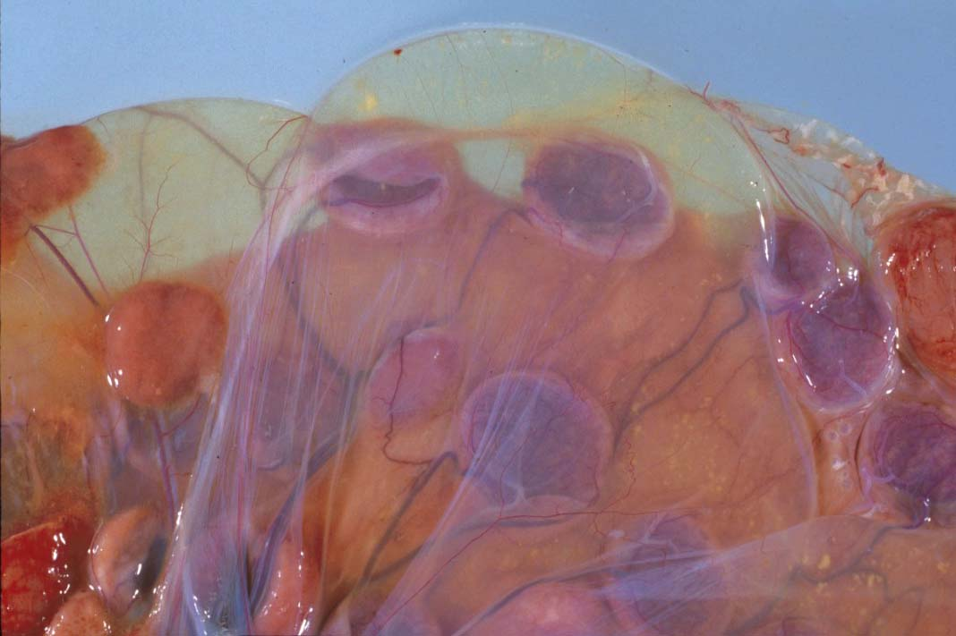
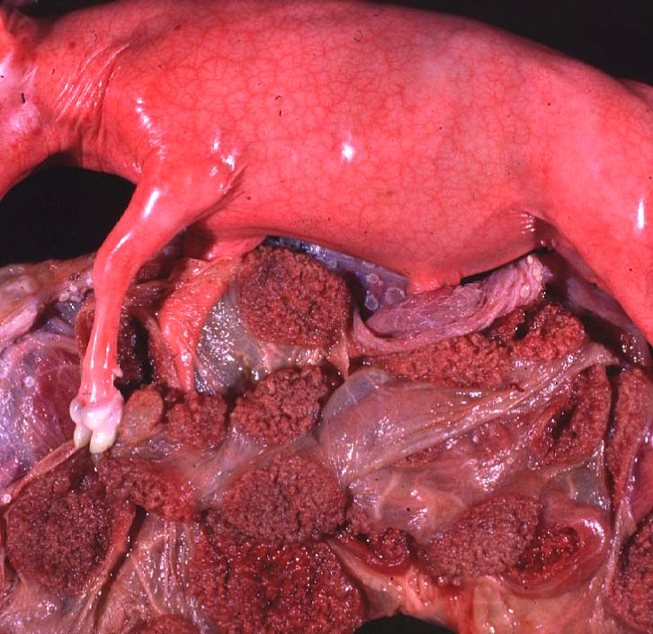
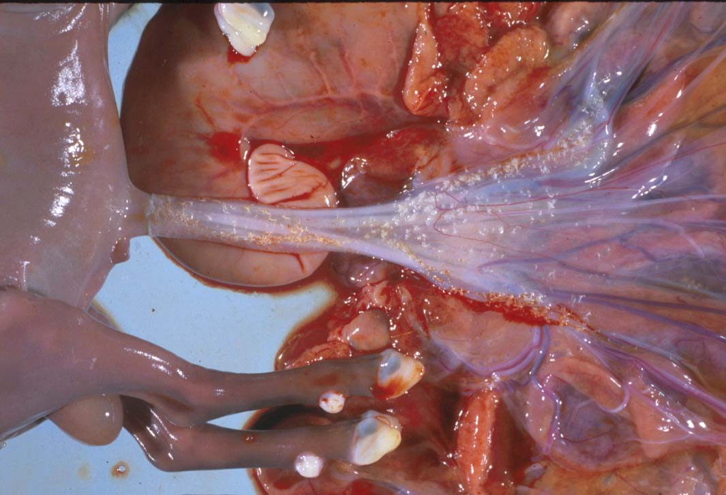

Slide 6
Maceration vs. Mummification
Maceration: putrefactive destruction of the fetus; assoc’d with endometritis
Fetid odor
Bacterial etiologies
Emphysema
Mummification: retained fetus, progressively dehydrated; virtually sterile => no lytic organisms
Viral or non-infectious etiologies
May be held indefinitely
Parvovirus (porcines) => vary among piglets

Slide 7
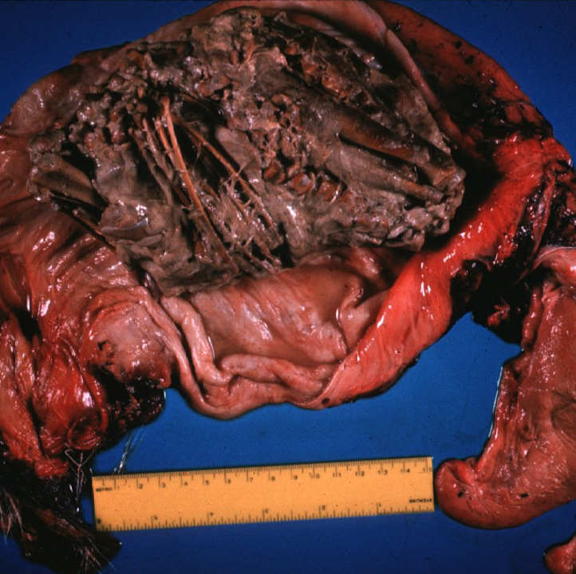
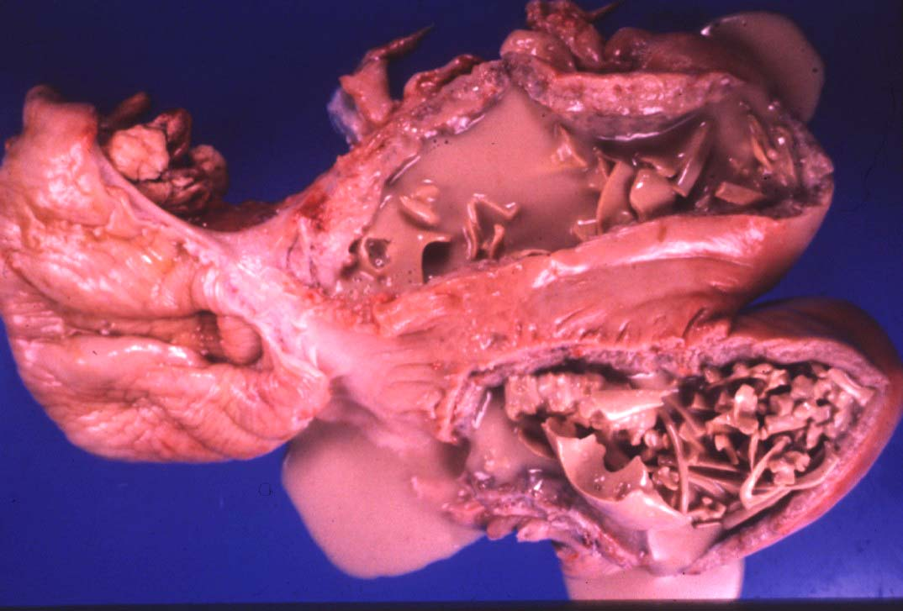
Maceration => “Chewed up”

Slide 8
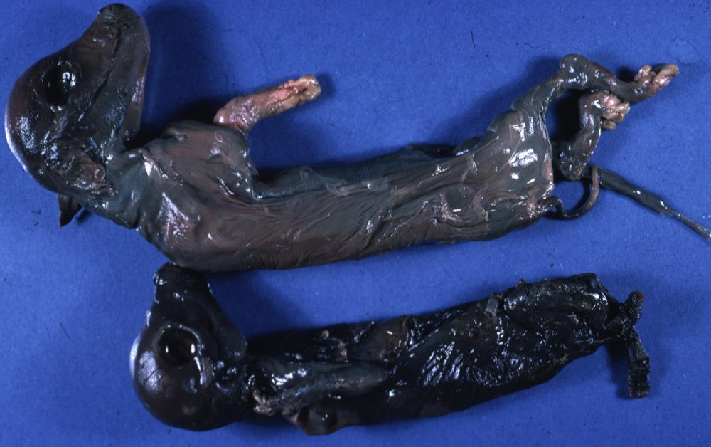
Mummification => “Dried up”

Slide 9
Twinning
MC a problem in the mare
Assoc’d with Freemartinism

Slide 10
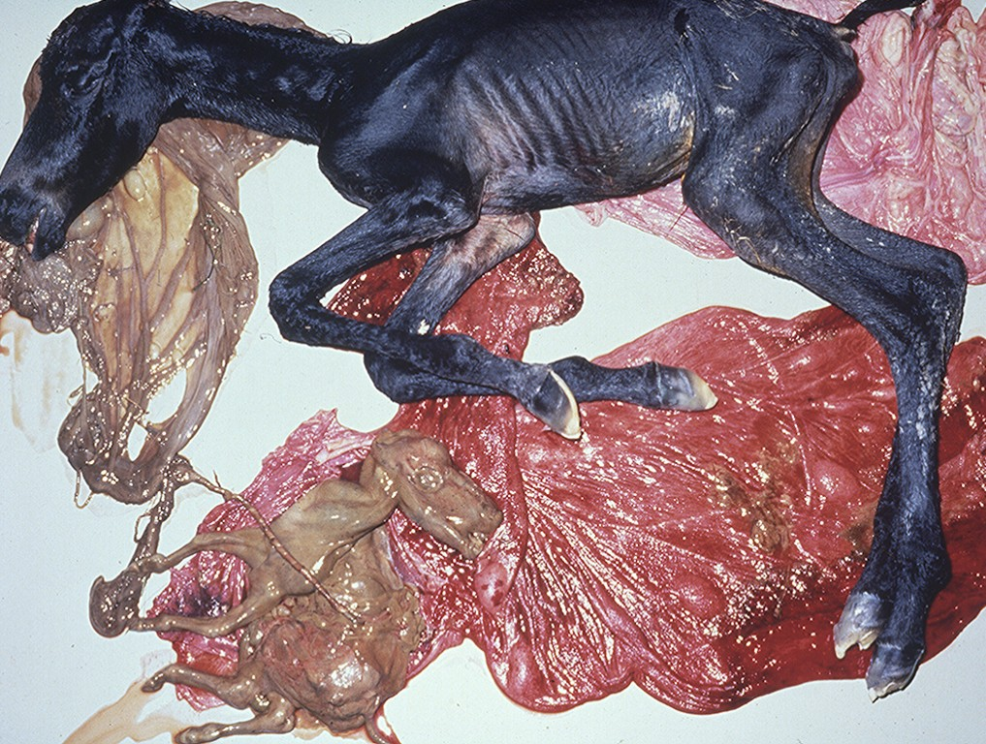

Slide 11
Bacterial Causes
Can be nearly anything that infects the uterus and/or placenta
Salmonella, Pasteurella, Haemophilus, Streptococcus, E. coli, T. pyogenes, etc.
Lesions are non-specific
Suppurative placentitis
Suppurative bronchopneumonia, fetal
Septicemia, fetal
Fetal abomasal fluid is critical

Slide 12
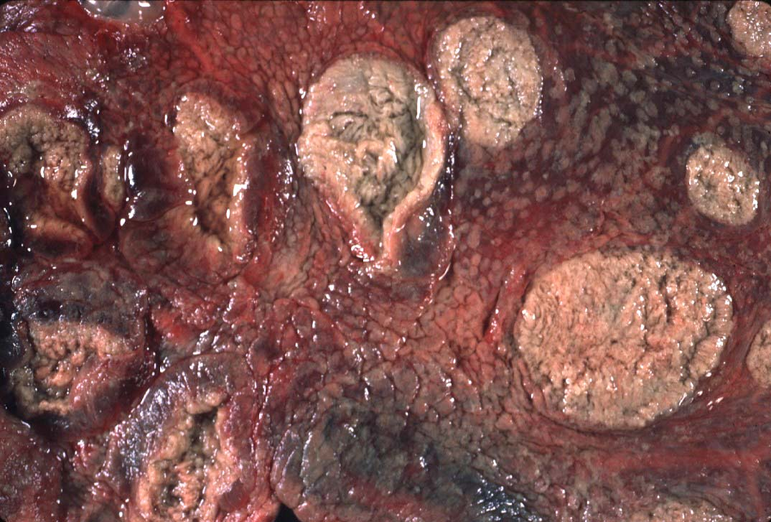

Slide 13
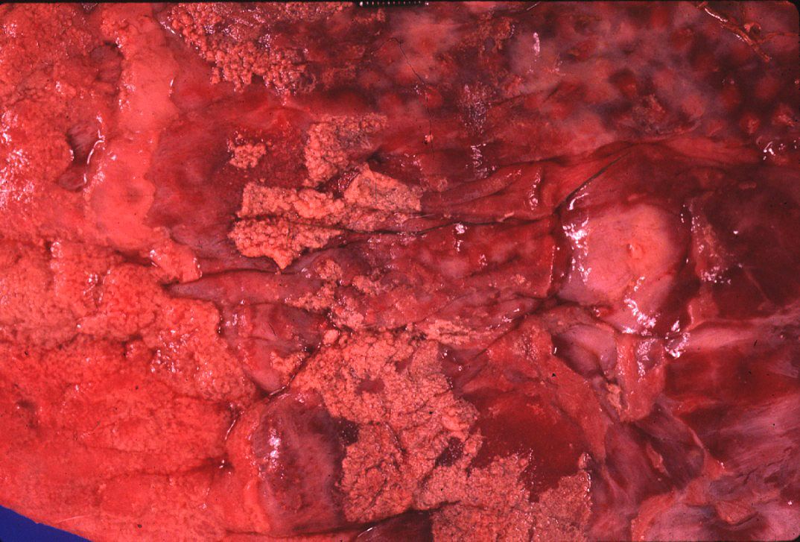
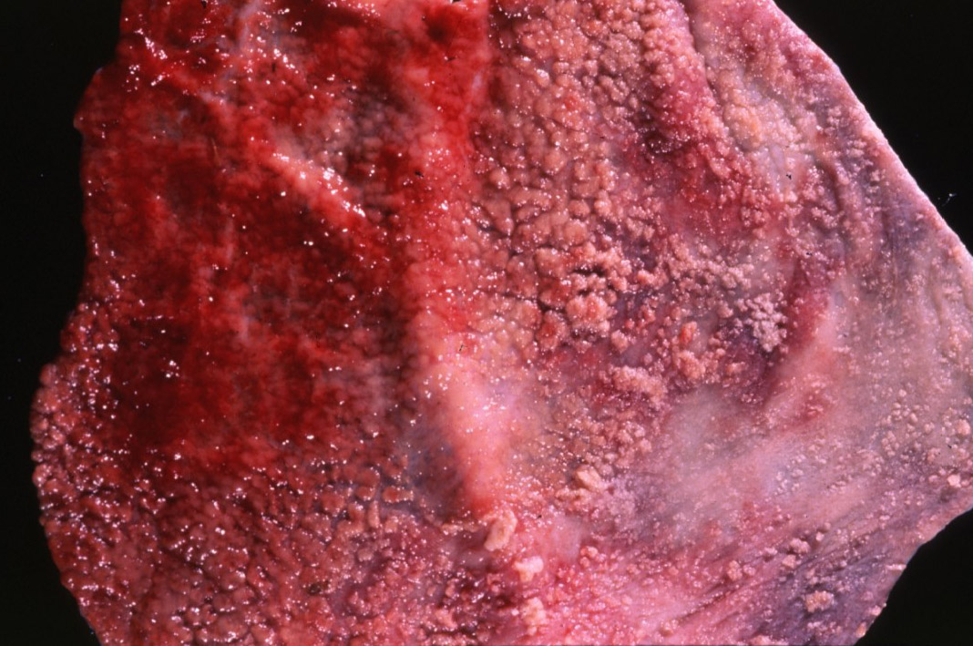
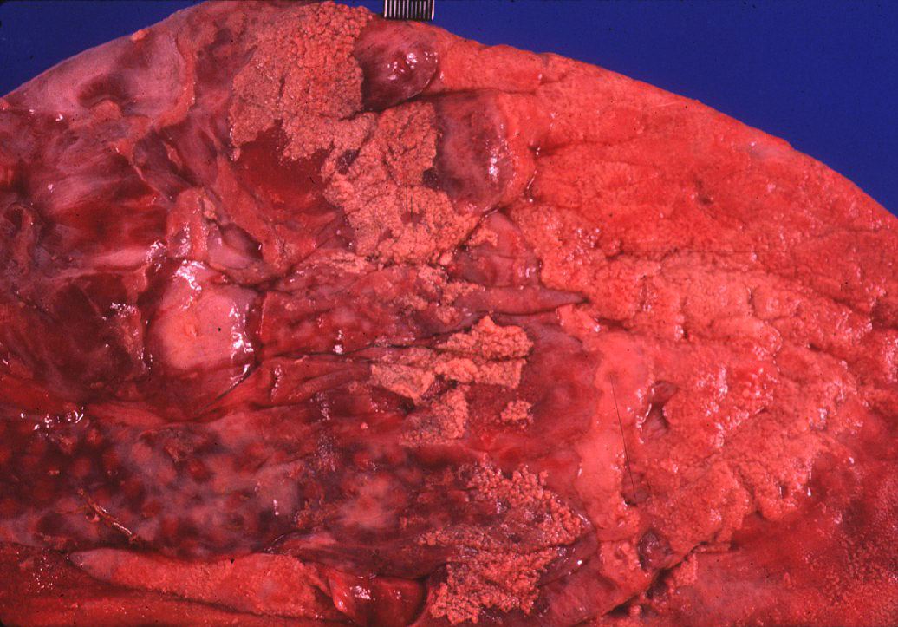
Fibrinous Placentitis

Slide 14
Side by side comparison
Normal
Inflamed

Slide 15
Campylobacter
Campylobacter fetus var. venerealis
Bovine
Venereally transmitted from prepuce/penis
ED or early fetal death => irregular estrus
Increased resistance
Campylobacter fetus subsp. fetus and jejuni
Ovine => develop metritis => death
Late term abortions => abortion storms
Hepatic necrosis, fetus

Slide 16
Brucella => ZOONOTIC!!!
Brucella abortus
Bovine => ingestion => systemic
May infect trophoblast cells
Brucella canis
Ingestion or venereal => head/neck lymphadenitis
Fetus: endocarditis, pneumonia, hepatitis
Brucella ovis / melitensis (goats)
Venereal
Shed in milk
Brucella suis
Lesions in bone/joints
Does not require pregnancy => endometritis

Slide 17
Coxiella burnetti => ZOONOTIC!!!
Q-fever in humans
Ovines and Caprines, goats MC
Ingestion or inhalation
Shed in vaginal discharge or milk, Giemsa stain
Intercotyledonary chorioallantois
Thick yellow, covered with exudate
Chlamydophila abortus (ovine)
Late term abortion, fetal autolysis
Oral transmission
Immune to re-infection
Intercotyledonary chorioallantois

Slide 18
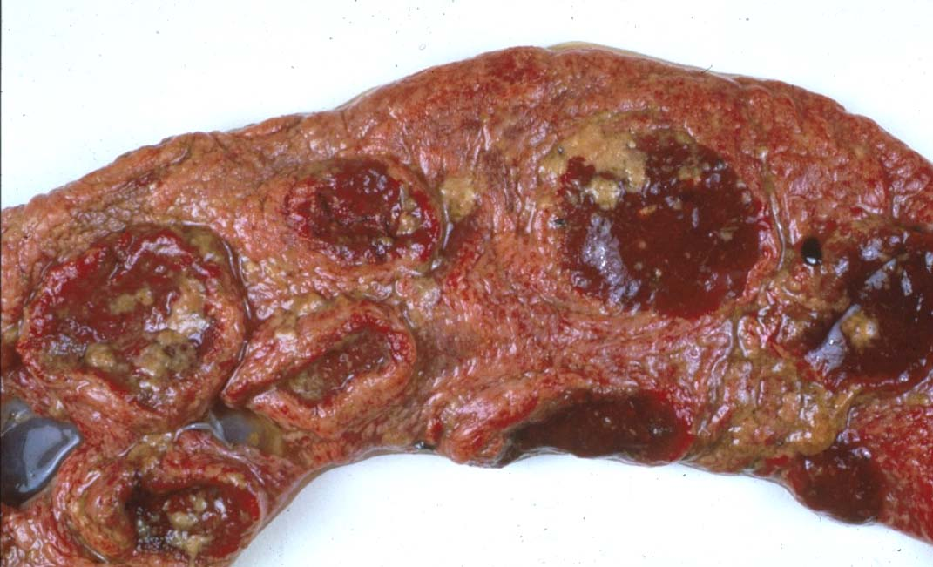
Intercotyledonary Chorioallantois

Slide 19
Leptospira => ZOONOTIC!!!
Largely bovine and porcine
L. interrogans serovar hardjo and serovar pomona
Often no c/s => localize in the kidneys
Abortion weeks after septicemic phase, in last trimester
Placental edema with fetal ascites and peritonitis
Advanced fetal autolysis
Flexispira rappini
Similar to Campylobacter, liver necrosis, Giemsa +
Foothill abortion
In CA and adjacent states
Cows new to the territory
Lesion
Petechiation of conjunctiva and tongue

Slide 20
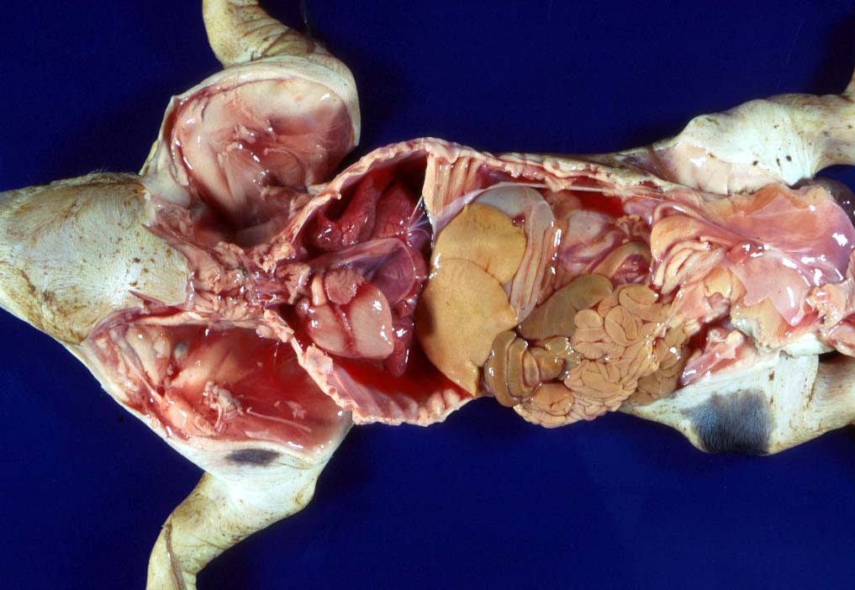
Leptospirosis

Slide 21
Listeria monocytogenes => ZOONOTIC
Bovine, ovine, and caprine
Last trimester
Lesions
Suppurative hepatitis
Fibrin in body cavities
Suppurative placentitis
Lesion in the fetus/calf?

Slide 22
Viral Causes
Multiple etiologies
“Herpesvirus hates babies!”
Fetal mummification
Developmental anomalies
Akabane and Cache Valley (Bunyaviridae)
Ovines and other ruminants
Nervous malformation
Arthrogryposis
Bluetongue (orbiviridae) => Summer/Early Fall
MC in ovine
Nervous malformation: encephalitis and retinitis
Arthrogryposis
Exposed prior to day 100, may clear the virus => neg PCR

Slide 23
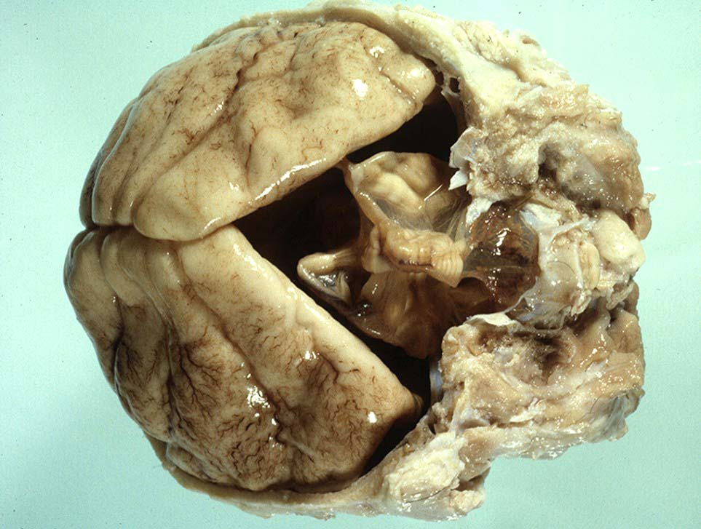

Slide 24
Equine

Slide 25
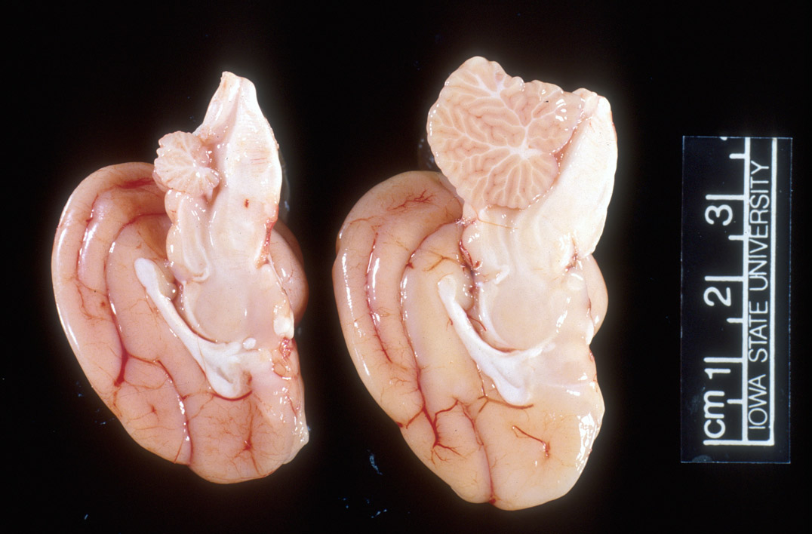
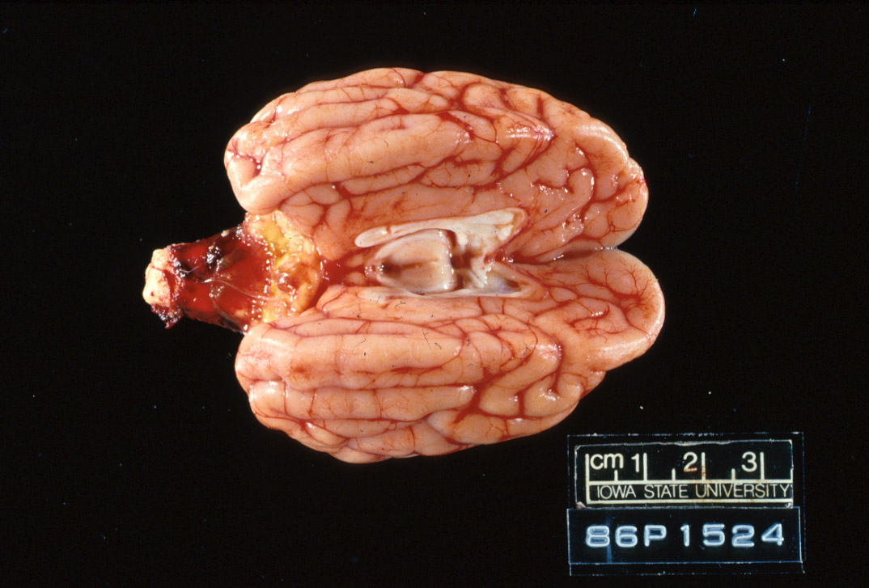
Feline

Slide 26
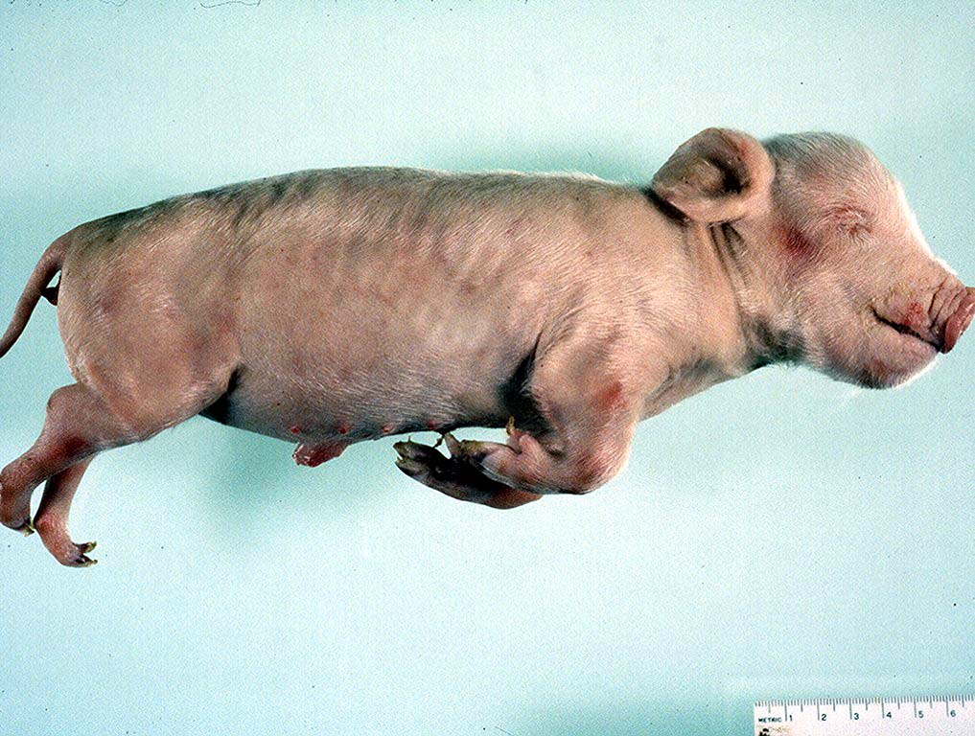
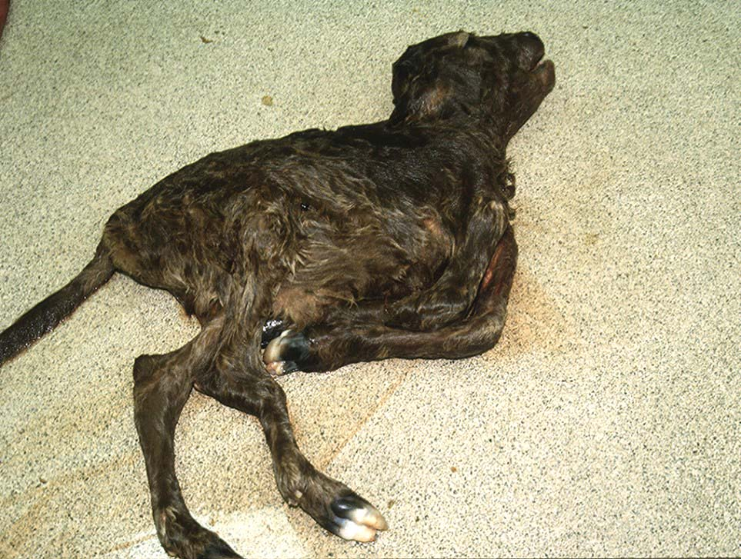
Arthrogryposis

Slide 27
Herpesvirus
Lymphoid necrosis spleen/thymus
Hepatic necrosis, multifocal
Pulmonary necrosis, multifocal (equine)
Fibrin plaques in lung & trachea => characteristic
Pestivirus
BVD (bov); Border Dz (ovi); Hog Cholera (por)
Fetal death or malformation
Persistently infected BVD calves, day 120
Persistently infected kids, b/f day 60-80
“Hairy Shakers” => sheep, thick haircoat, pigmented
Targets oligodendrocytes => hypomyelinogenesis

Slide 28
SMEDI (78% in pigs)
Porcine parvovirus (environmental)
Embryonic and early fetal loss
Mummification
PRRS (Arteriveridae), 60% of porcine abortions
Hemorrhage in umbilical cords
Affects 50% of fetuses in litter
Interstitial pneumonia in live littermates
Porcine Circovirus => myocardium and lymphoid
CSF/Pseudorabies => Feral pig reservoir
Sow Infertility Syndrome (Virus X)

Slide 29
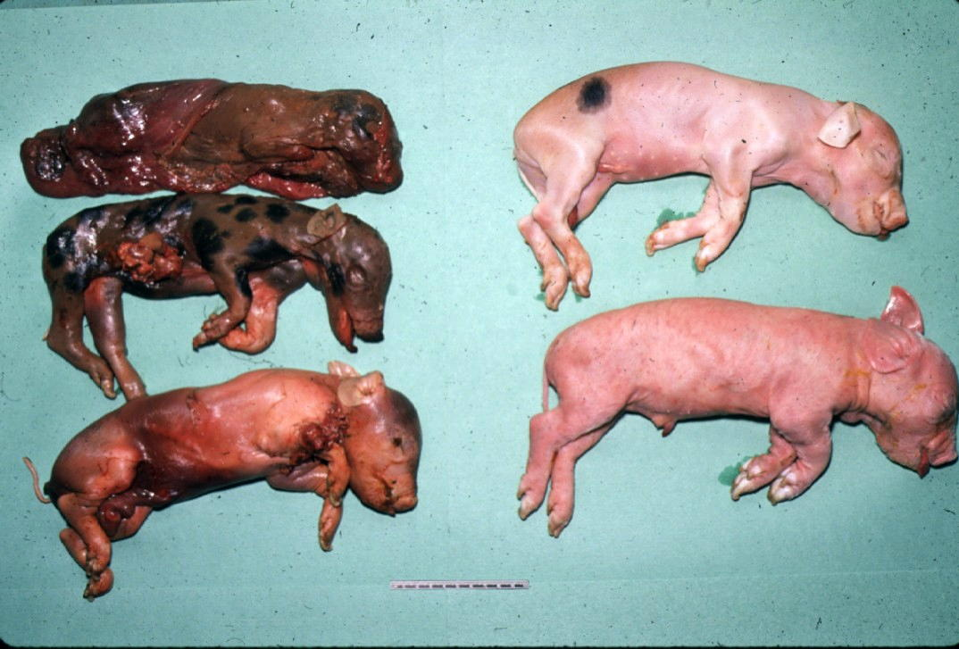
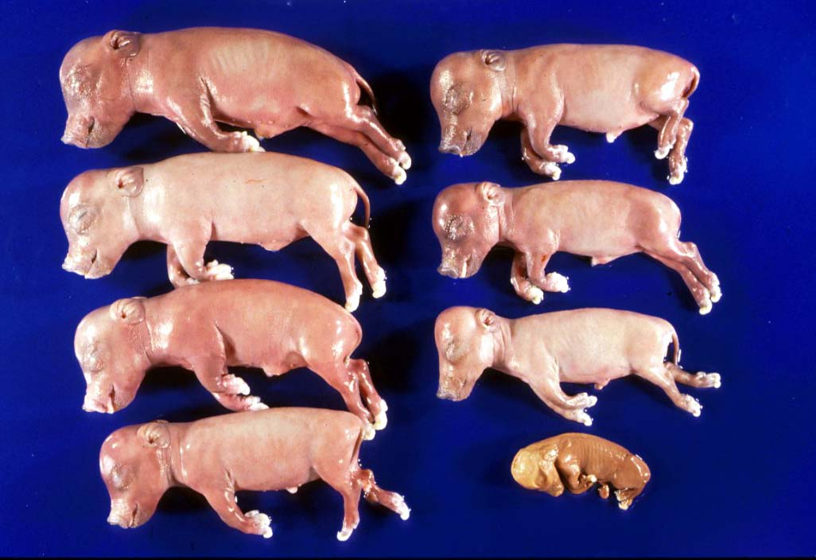

Slide 30
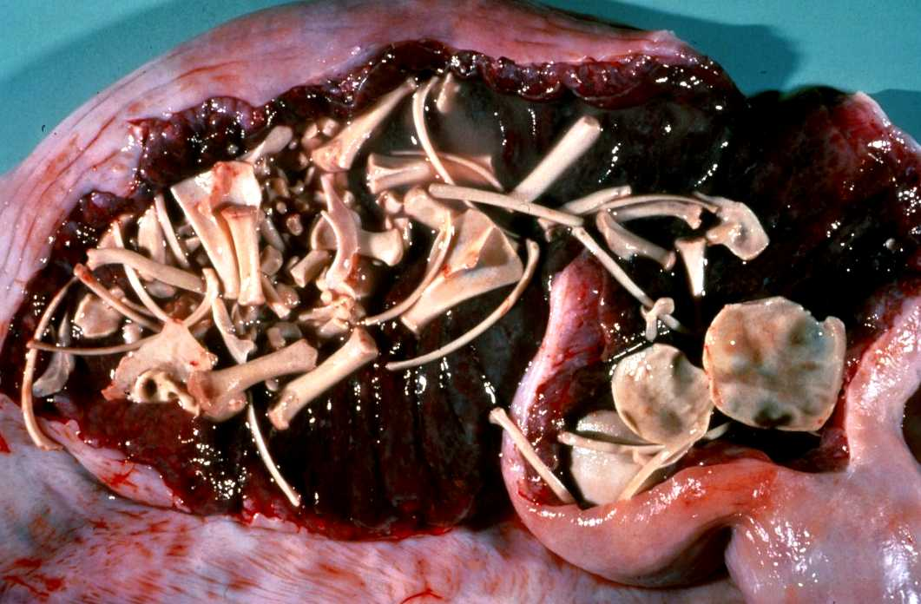
Porcine Maceration

Slide 31
Protozoal Etiologies
Toxoplasma gondii (ovine)
Ingestion
Necrotic, “rice grain” on cotyledons
Leukoencephalomalacia, fetus
Placentitis
Neospora caninum (bovine)
Abort in 2nd trimester, few lesions
Necrosis in the brain and heart with cysts
Vertical transmission
Variable pathogenicity
Tritrichomonas foetus (bovine)
Mild placentitis, may have severe endometritis => pyometra
No fetal lesions
Protozoa within abomasal fluids, smegma, or vaginal swab
Giemsa highlights organism in placenta, lung, and abomasum

Slide 32
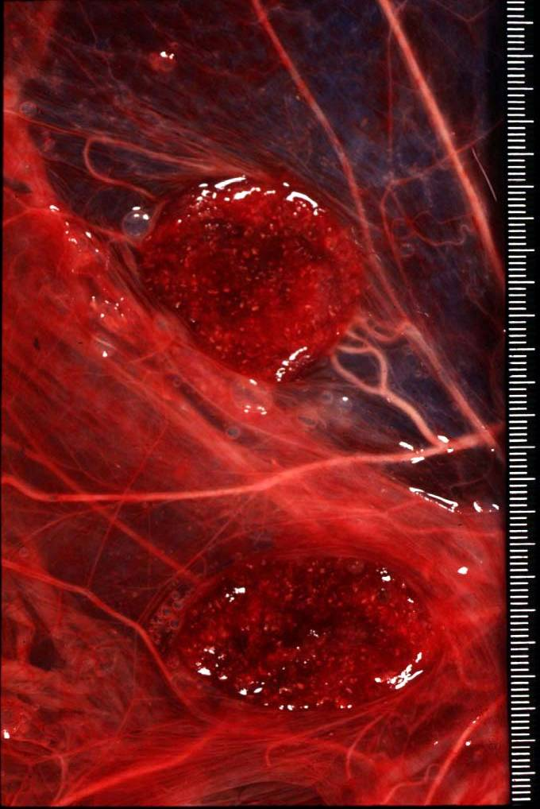
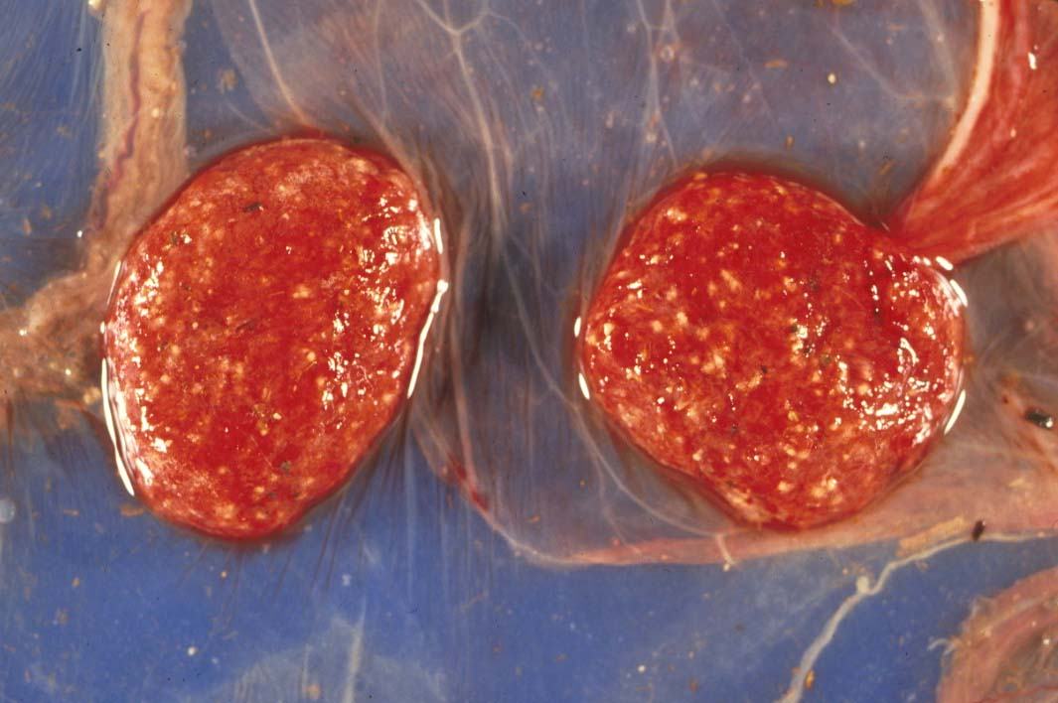
Toxoplasmosis gondii

Slide 33
Chlamydophila vs. Toxoplasma
Intercotyledonary
Cotyledonary

Slide 34
Neospora

Slide 35
Neospora

Slide 36
Fungal abortions
MC assoc’d with plaques on the skin
MC cause of abortion Aspergillus sp.
Others: Mucor, Rhizopus, Absidia, Candida
MC in bovine & equine
Bovine => hematogenous
Equine => cervix
RARE in porcine, approximately 0.3% fungal
Fibrinous placentitis => identical to bacterial

Slide 37
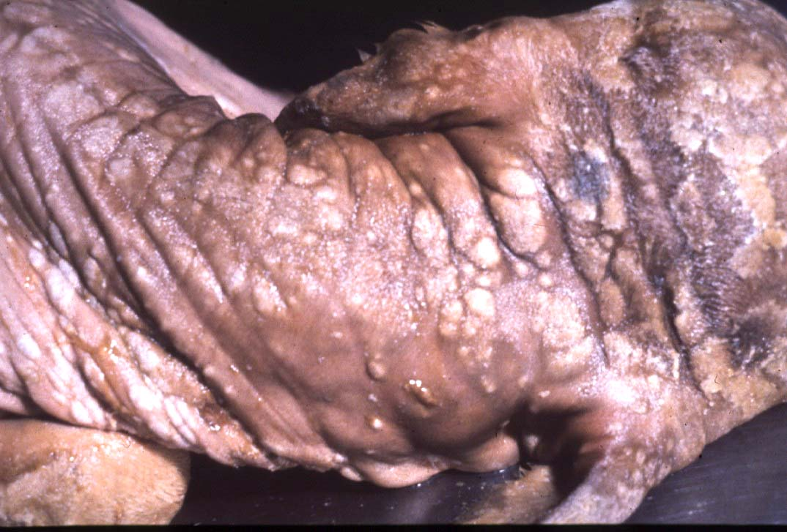

Slide 38
Canine & Feline
Virus
Herpesvirus
Canine Parvovirus type 1 / Panleukopenia
Necrotizing enteritis w/ eos i/b, no crypt necrosis
Adenovirus type 1
Bacteria
Brucella, E. coli, Staphylococcus aureus, Beta hemolytic Streptococcus spp.
Other
Feline: Antifungal drugs =>teratogenic effects
NSAIDS, glucocorticoids, tetracyclines, chloramphenicol

Slide 39
Other causes
Nitrate Toxicosis
Consumption of plants high in nitrates or contaminated water (nitrogen fertilizers)
Chocolate brown blood, no lesions
Test levels of nitrate in aqueous humor
CO in porcine (b/t 120 and 260 pppm)
Dx with 5-10 mL of thoracic fluid
Carboxyhemoglobin levels >2% are diagnostic
Variable Toxicity Teratogens
Pine needles, broomweed, swainsonine, Sweet pea,
Arthrogryposis
Lupine, Tobacco, Poison Hemlock, Locoweed
Clover => Estrogen => Infertility

Slide 40
Fetal anomalies
Synophthalmia (cyclopia) in ovines
Veratrum californicum, day 13-15
Schistosomas reflexus
Amorphous globosus
Spider Lamb Dz = > Suffolk
Torsion of the umbilical cord
Equines
XS twisting compromises umbilical vessels

Slide 41
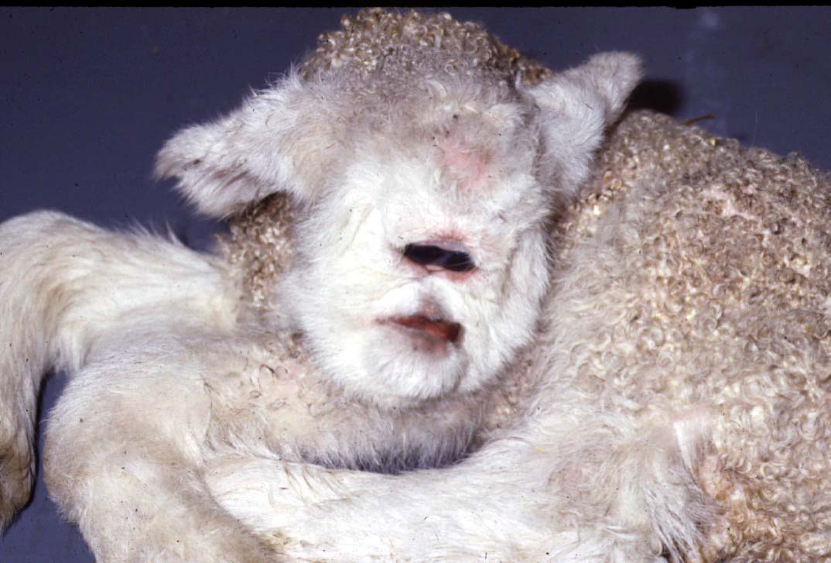
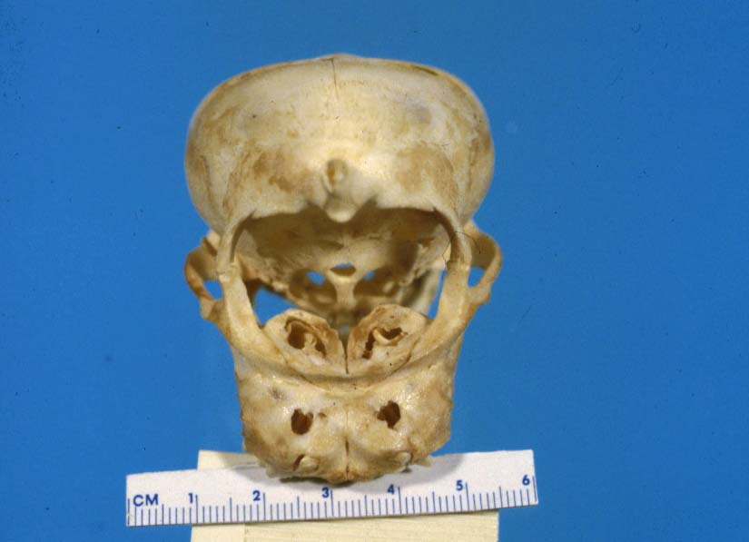

Slide 42
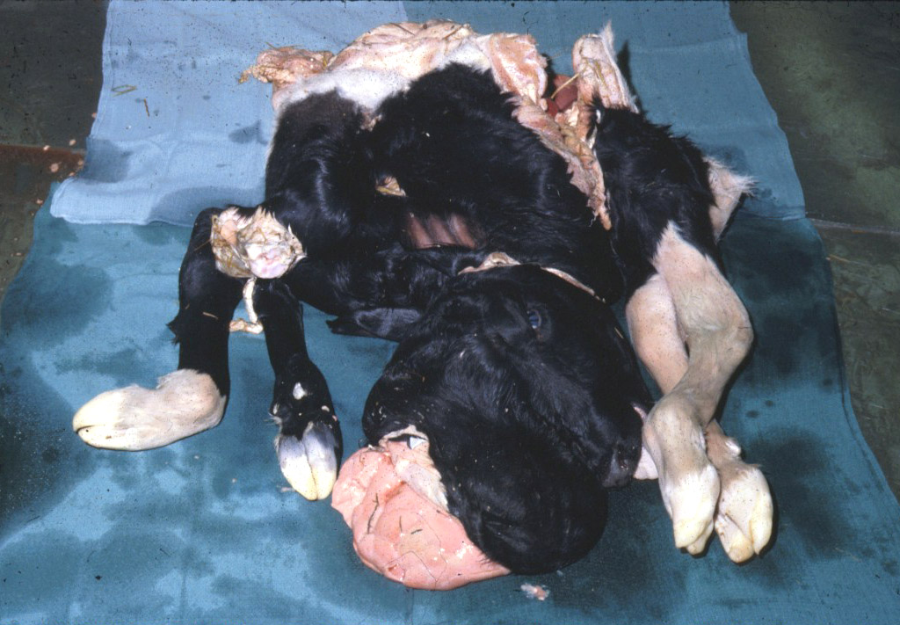

Slide 43
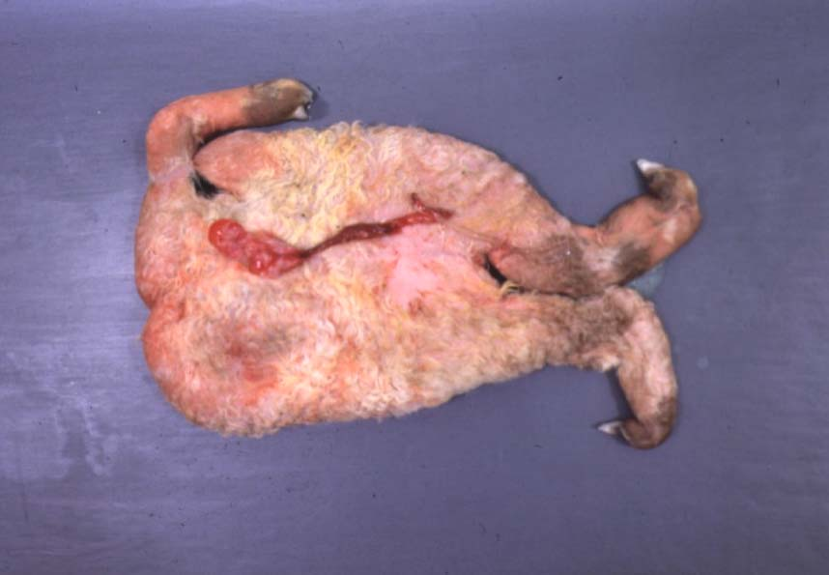
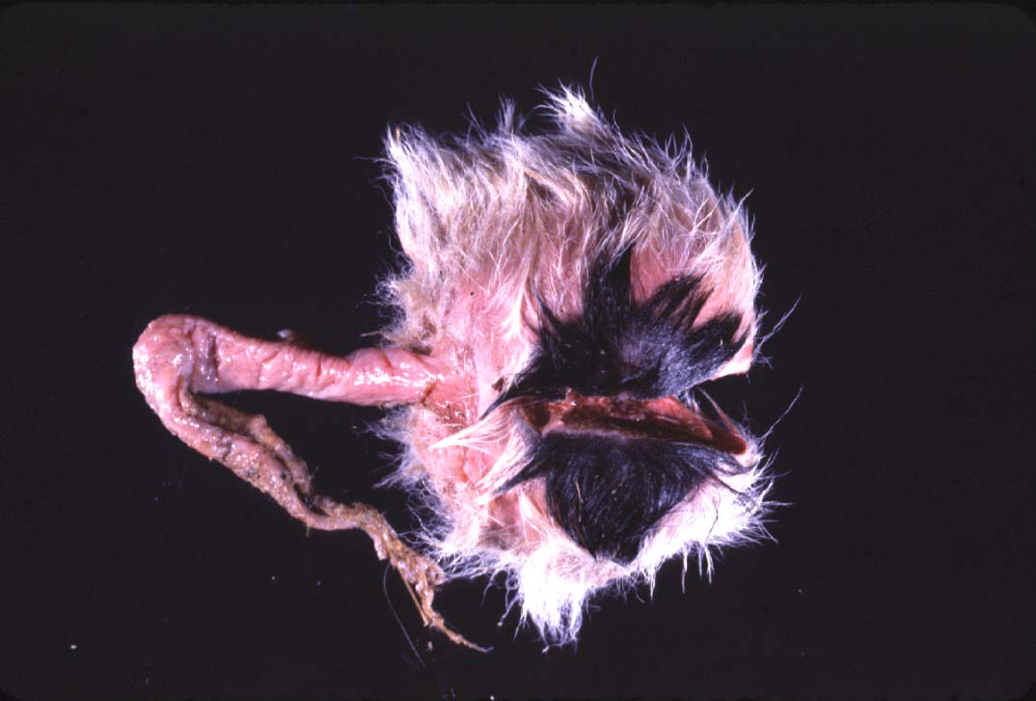

Slide 44
Fetal Necropsy Protocol
Determination of Fetal Age
CR length AND body weight
Developmental features
Timing of Fetal Death
Lungs, eponychium, colostrum in the stomach/abomasum, umbilical hematoma
Tissue collection
Bacterial
Lungs, Abomasal/stomach fluid, brain, placenta, liver
Viral
Lymphoid tissues, placenta

Slide 45
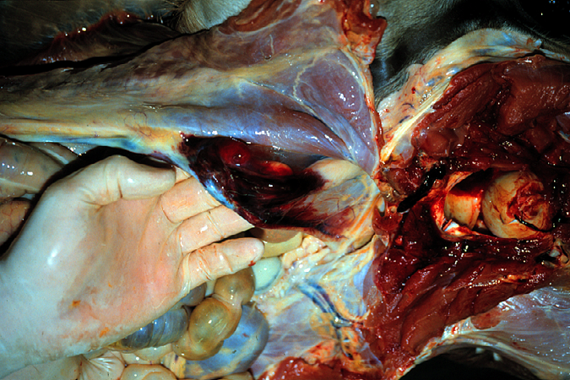
Umbilical Hematoma

Slide 46
Fetal Nx (cont’d)
Serology
Fetal fluids
Interpretation: What is normal?
Toxicology
Ocular fluid/eyes in bovines => Nitrates
Cytology
Impression smears
Histopathology
GI tract can be largely ignored

Slide 47
Questions?
Notes:
http://forums.au.reachout.com/t5/image/serverpage/image-id/941i6385EB477719EC2A?v=mpbl-1

