Slide 1
About OMICS Group
OMICS Group International is an amalgamation of Open Access publications and worldwide international science conferences and events. Established in the year 2007 with the sole aim of making the information on Sciences and technology ‘Open Access’, OMICS Group publishes 400 online open access scholarly journals in all aspects of Science, Engineering, Management and Technology journals. OMICS Group has been instrumental in taking the knowledge on Science & technology to the doorsteps of ordinary men and women. Research Scholars, Students, Libraries, Educational Institutions, Research centers and the industry are main stakeholders that benefitted greatly from this knowledge dissemination. OMICS Group also organizes 300 International conferences annually across the globe, where knowledge transfer takes place through debates, round table discussions, poster presentations, workshops, symposia and exhibitions.

Slide 2
About OMICS Group Conferences
OMICS Group International is a pioneer and leading science event organizer, which publishes around 400 open access journals and conducts over 300 Medical, Clinical, Engineering, Life Sciences, Phrama scientific conferences all over the globe annually with the support of more than 1000 scientific associations and 30,000 editorial board members and 3.5 million followers to its credit.
OMICS Group has organized 500 conferences, workshops and national symposiums across the major cities including San Francisco, Las Vegas, San Antonio, Omaha, Orlando, Raleigh, Santa Clara, Chicago, Philadelphia, Baltimore, United Kingdom, Valencia, Dubai, Beijing, Hyderabad, Bengaluru and Mumbai.

Slide 3


Are Rare-Earth Nitrides
the Future of Spintronics?
Franck Natali
School of Chemical and Physical Sciences,
Victoria University of Wellington, New Zealand
The MacDiarmid Institute for Advanced Materials and Nanotechnology

Slide 4
Outline
Motivation, why are they interesting?
Epitaxial film growth
Properties of (some) RENs
Conclusion & perspectives

Slide 5
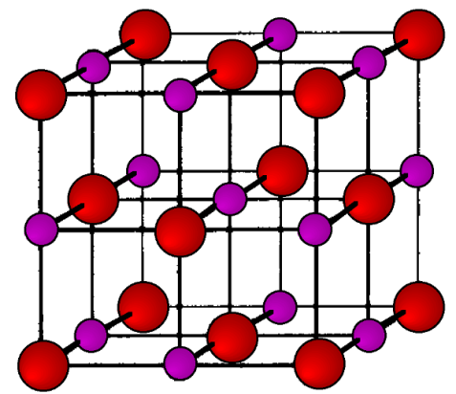
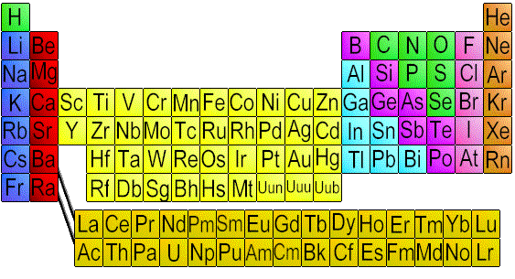
Rare-earth nitrides
15 rare earth mononitrides (RE-N).
Rocksalt structure.
Trivalent RENs; RE³⁺/N³⁻
Unstable in air: oxidation to RE₂O₃
= RE ion
= Nitrogen
iii
iv
v vi
ii

Slide 6
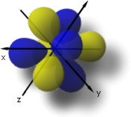
Rare-earth nitrides
?
Strongly correlated 4f electrons:
  - Simple rocksalt structure RE³⁺N³⁻
  - Band picture vs. atomic picture?
Magnetism:
  - Orbital and spin moments
  - Contrasting magnetic properties
  Semiconductors or half-metals?
Experimental picture murky (N vacancies, decomposition in air)
Spintronics?

Slide 7
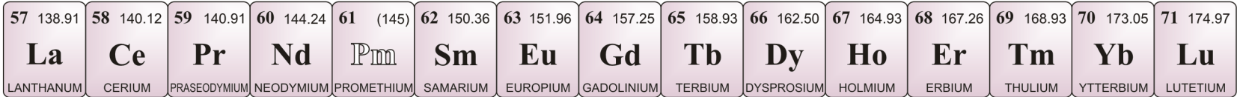
History of rare-earth nitrides
RE nitrides were studied in the 1960-1970s
Stoichiometry poor (N vacancies, O contamination)
Ferromagnetic structure known for most
Almost nothing was known about the electronic band structure
Theoretical interest strong since ~ 2000
Experimental activities since ~2006

Slide 8

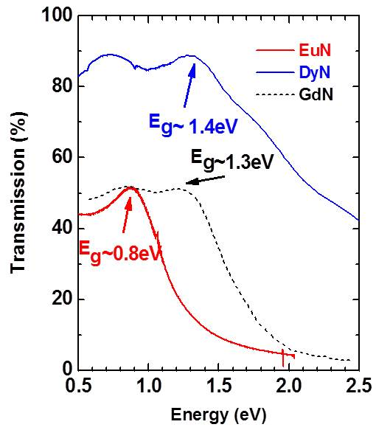
Rare-earth nitrides
semiconductors
Ferromagnetic
Optical Band Gap from ~0.7eV to ~1.8eV
Intrinsic ferromagnetic semiconductors : Eu chalcogenides (EuO, EuS…) and rare-earth nitrides
Magnetic ions are NOT introduced into a non-magnetic semiconductor host: every cation is magnetic
⇒ independent control of the carrier concentration (doping) and magnetism
Novel class of electronic technology: semiconductor-spintronic!!!
F. Natali et al., “Rare-earth mononitrides”, Progress in Materials Science 58, 1316 (2013)

Slide 9

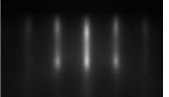
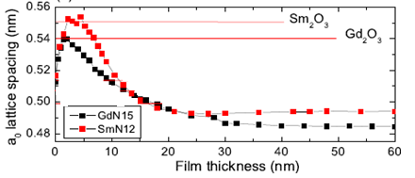
Epitaxial growth on (100) surfaces
GdN a = 4.974 Å
EuN a = 4.8 Å
SmN a = 5.035 Å
First epitaxial growth GdN(100) on MgO
Appl. Phys. Lett. 90, 061919 (2007)
SmN on YSZ by PLD
Reflection High-Energy Electron Diffraction
a)
b)
5 nm
60 nm
NEED a growth procedure layer to prevent RE and Si diffusion
⇒ formation of rare-earth silicide compounds
Ludbrook et al., J. Appl. Phys. 106, 063910(2009)
F. Natali et al., Phys. Status Solidi C 9, 605 (2012)

Slide 10
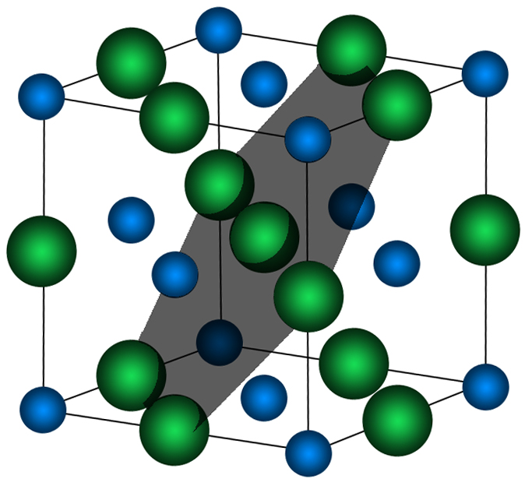
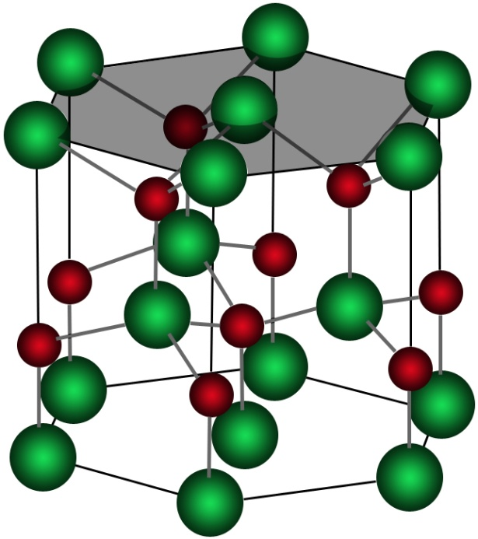
Epitaxial growth: combining rare-earth nitrides and group-III nitrides
Rocksalt (NaCl) structure Re³⁺N³⁺ - Rocksalt (111) surface ≡ hcp (0001) surface
= RE ion
= Gallium
= Nitrogen
Rocksalt RE-nitrides
Hexagonal III-nitrides
Indirect Semiconductors
Band Gap from ~0.7eV to ~1.8eV
Lattice parameter ~5 Å
Direct Semiconductor
Band Gap from ~6.2eV to ~0.8eV
Lattice parameter ~3.15 Å

Slide 11

Epitaxial growth: combining rare-earth nitrides and group-III nitrides
Rocksalt (NaCl) structure Re³⁺N³⁺ - Rocksalt (111) surface ≡ hcp (0001) surface
= RE ion
= Gallium
= Nitrogen
Rocksalt RE-nitrides
Hexagonal III-nitrides
RE-N {111} on III-N {0001} Lattice Mismatch (%)
AlN
GaN
InN Si(111)
GdN 3.518 13 10.3 -0.85 -8.38 EuN 3.522 13.2 11.3 0 -7.59
SmN 3.56 14.4 11.66 0.36 -7.26

Slide 12
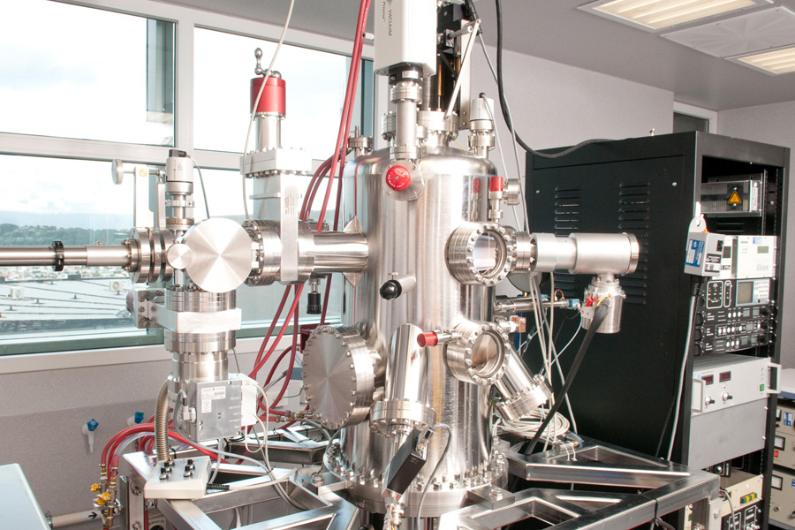
Molecular beam epitaxy
The films are grown by deposition of the RE in the presence of NH₃ or N₂ :
-pure N₂ and sometimes activated nitrogen
-RE thermal evaporation
-Characterisation by RHEED
-Passivation AlN/GaN cap layers
-ambient T for polycrystalline films
-high-temperature for epitaxial growth, 2’’ substrate holder.
-Base pressure : <10⁻⁸Torr
-Press. Process : 10⁻⁵- 10⁻⁴Torr
To date: GdN, SmN, DyN, ErN, EuN, LuN, NdN, YbN
Notes:
12

Slide 13
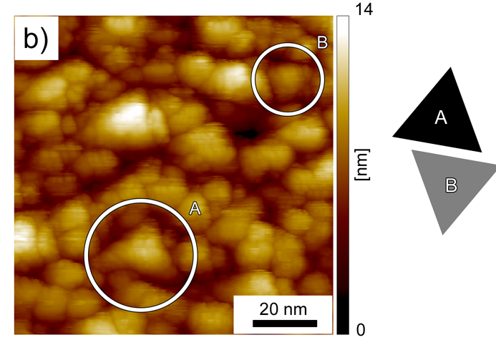
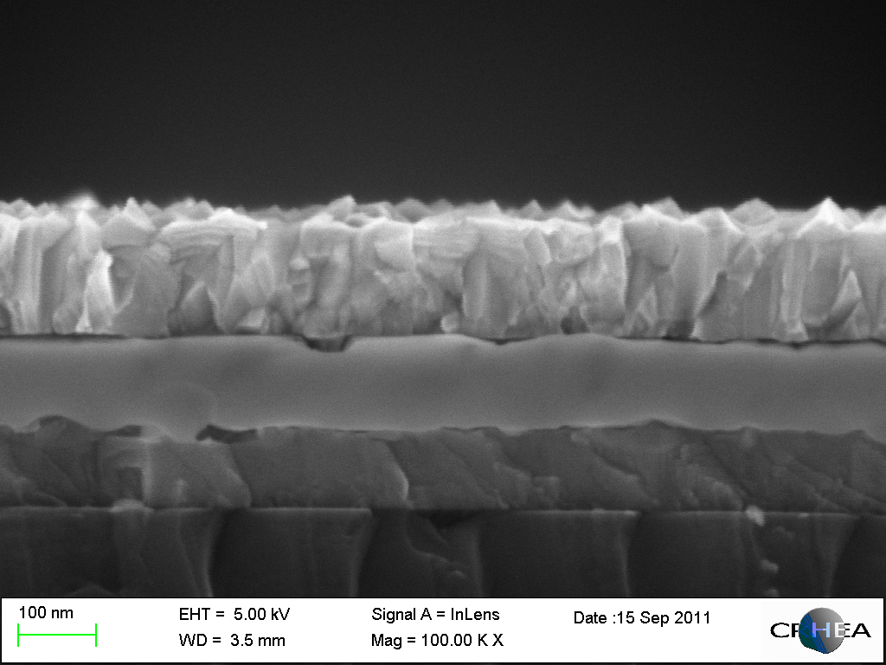
Molecular beam epitaxy
STM – GdN surface
Structure & Growth Conditions:
N₂/NH₃ flux = 10²-10³ Gd flux
Vg = 120nm/h - Tg = 470-850ºC
SEM
GaN 120 nm
GaN > 30 nm
GdN
GdN
100 nm
(0001) AlN – 50-100nm
AlN 100 nm
Si (111) substrate
Silicon
Twin islands
Two GdN in-plane orientations

Slide 14
Molecular beam epitaxy
STM – GdN surface
Structure & Growth Conditions:
N₂/NH₃ flux = 10²-10³ Gd flux
Vg = 120nm/h - Tg = 470-850ºC
SEM
GaN 120 nm
GaN > 30 nm
GdN
GdN
100 nm
(0001) AlN – 50-100nm
AlN 100 nm
Si (111) substrate
Silicon
Twin islands
Two GdN in-plane orientations
X-ray Diffraction : 2θ-scans
GdN (111) epitaxial on AlN (0001)
GdN (111) // AlN (0001)
AlN’s hexagonal face favours a fully (111)-oriented GdN film.
Phi-scan : 6 fold symmetry of GdN (002) reflections (not shown)

Slide 15
Molecular beam epitaxy
STM – GdN surface
Structure & Growth Conditions:
N₂/NH₃ flux = 10²-10³ Gd flux
Vg = 120nm/h - Tg = 470-850ºC
SEM
GaN 120 nm
GaN > 30 nm
GdN
GdN
100 nm
(0001) AlN – 50-100nm
AlN 100 nm
Si (111) substrate
Silicon
Twin islands
Two GdN in-plane orientations
X-ray Diffraction : 2θ-scans
GdN (111) epitaxial on AlN (0001)
GdN (111) // AlN (0001)
AlN’s hexagonal face favours a fully (111)-oriented GdN film.
Demonstrated for SmN and EuN as well on AlN and GaN surfaces!!!
Phi-scan : 6 fold symmetry of GdN (002) reflections (not shown)

Slide 16
Rare-earth nitrides: properties
So far the most studied have been : GdN, SmN and EuN

Slide 17
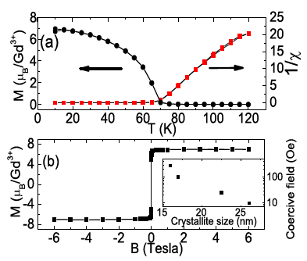
Rare-earth nitrides: GdN
Noteworthy elements:
TC of 70 K (the largest among the RENs)
7 Bohr magnetons/Gd³⁺
remarkably small coercive field (<0.05 Tesla)
T_{c}
Ludbrook et al., J. Appl. Phys. 106, 063910 (2009) - F. Natali et al., J. Cryst. Growth 312, 3583 (2010)

Slide 18
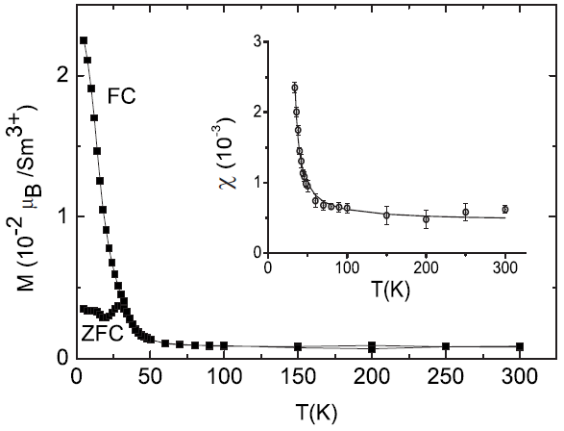
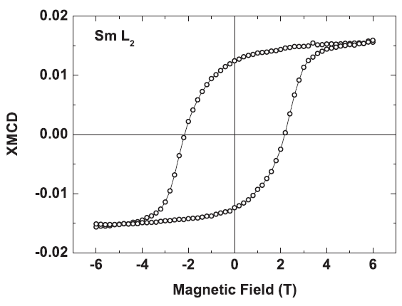
Rare-earth nitrides : SmN
Noteworthy element:
Only near-zero moment ferromagnetic semiconductor. Spin and orbital moments nearly cancel
m_{tot} ~0.03 Bohr magnetons/Sm³⁺
T_{c}=27K.
coercive field of >2 Tesla at 15K signaling the weak coupling of the small net moment to an external field.
C. Meyer et al., Phys. Rev. B 78, 174406 (2008)

Slide 19
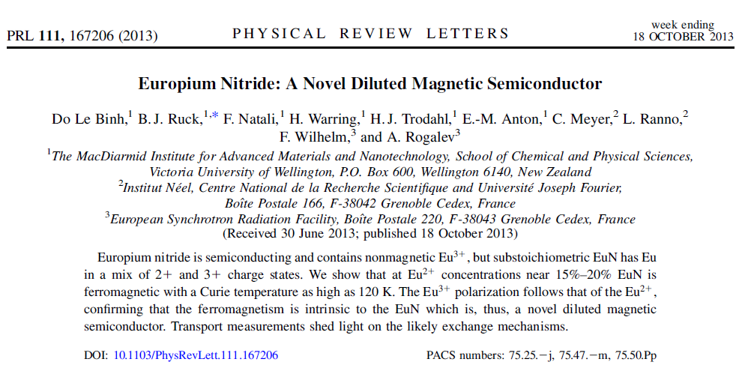
Rare-earth nitrides: EuN
So far the most studied have been : GdN, SmN and EuN

Slide 20
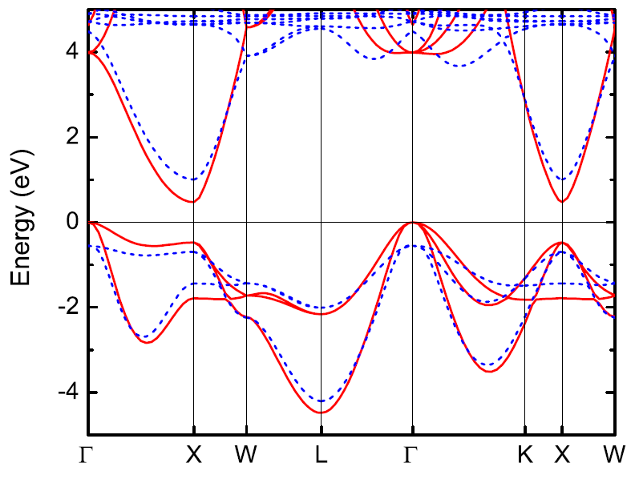
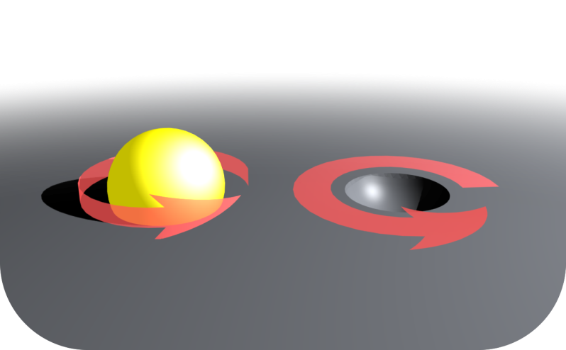
Applications /Speculation
The holes and electrons have a common (majority) spin.
GdN band structure
Gd 5d
N 2p
Red-majority spin
Blue dashed-minority spin
Is it possible to exploit that in spin-resolved electronic devices?
Trodahl et al., Phys Rev. B 76, 085211 (2007)

Slide 21
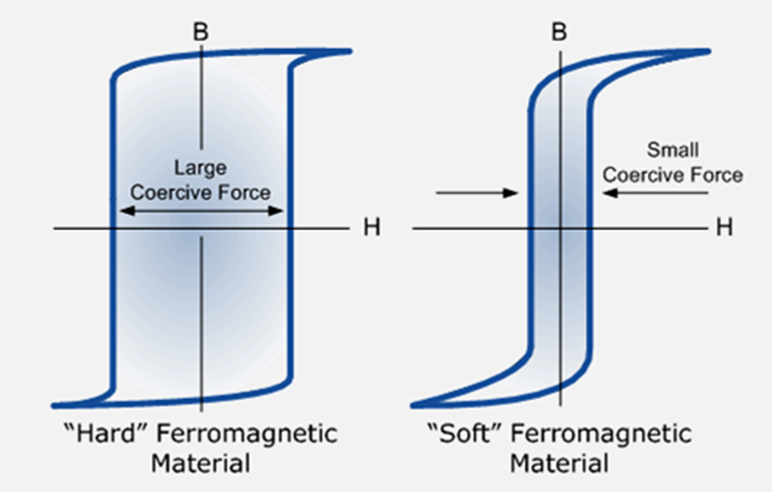
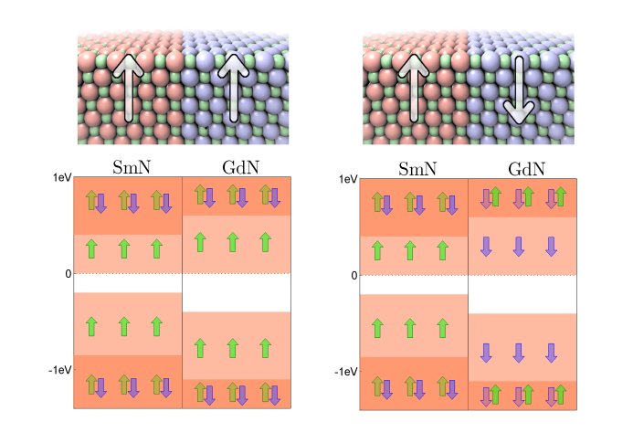
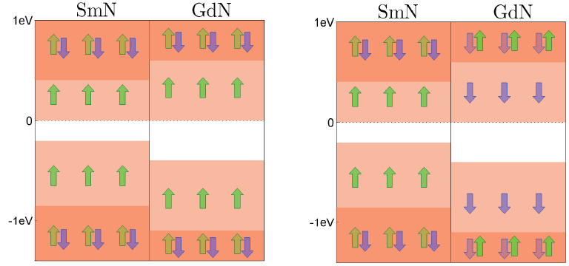
GdN/SmN superlattice for MRAM applications?
Based on the huge coercive-field contrast between SmN (>6T) and GdN (<0.5T)
Switching of a SmN/GdN MRAM expected to be eased by the 10³ contrast of their coercive fields.
SmN
GdN
SmN
GdN
SmN
GdN
Low resistance
parallel M
High resistance
antiparallel M

Slide 22





Acknowledgements
VUW collaborators
B. Ruck, J. Trodahl, E. Anton, B. Le Do, H. Warring, T. Maity, J. McNulty, L. Figueras, S. Granville.
International collaborators
S. Vézian, B. Damilano, F. Semond (CRHEA/CNRS, Valbonne), C. Meyer (Institut Neel/CNRS, Grenoble), W. Lambrecht (Case Western Reserve University)..
Funding from the MacDiarmid Institute, FRST (New Economy Research Fund), Marsden Fund, VUW...
Marsden grant (2014-2017) : “Semiconductor-based spintronics: can rare-earth nitrides and group III-nitrides get it together?”

Slide 23
Let Us Meet Again
We welcome you all to our future conferences of OMICS Group International
Please Visit:
http://materialsscience.conferenceseries.com/
Contact us at
materialsscience.conference@omicsgroup.us
materialsscience@omicsgroup.com

