Slide 1

Venereal transmission of Toxoplasma gondii in goats after a buck was experimentally infected
Dra. FLAVIANA SANTOS WANDERLEY
Universidade Estadual de Ciências da Saúde de Alagoas
Brazil

Slide 2

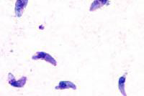
Toxoplasma gondii
Toxoplasma gondii: obligate intracellular affecting humans, domestic and wild animals (Beaman et al., 1995);
Most common transmission forms: carnivorism in felines and fecal-oral route (oocysts) for herbivores hosts (Dubey et al., 1996)
ICB-UFMG
ICB-UFMG
ICB-UFMG
Tachyzoite
Cyst
Oocyst

Slide 3
Figure - Life cycle of Toxoplasma gondii (Dubey et al.,1998)

Slide 4
First evidence in goats: Feldman and Miller (1956) in New York;
Munday & Mason (1979): Toxoplasmosis an important cause of reproductive losses in goats (Dubey, 1987);
Abortion and repeated neonatal loss in subsequent pregnancies (Dubey, 1982);

Slide 5
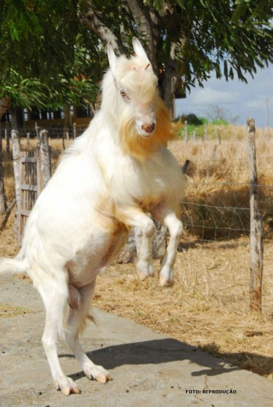
T. gondii: semen from goats infected orally (oocysts) from day 7 post infection by bioassay (DUBEY; Sharma, 1980);
Moraes et al. (2010a): confirmed infection in sheep through semen experimentally contaminated .

Slide 6
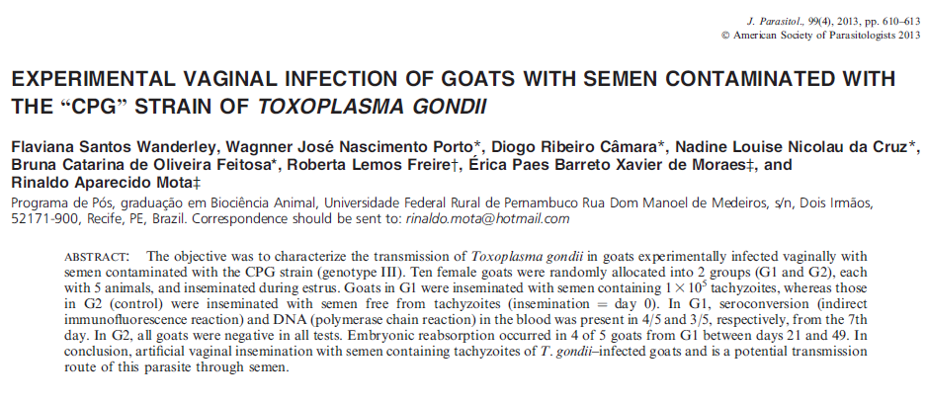
Wanderley et al. (2013): vaginal insemination with semen infected with tachyzoites of Toxoplasma gondii is able to infect goats.

Slide 7
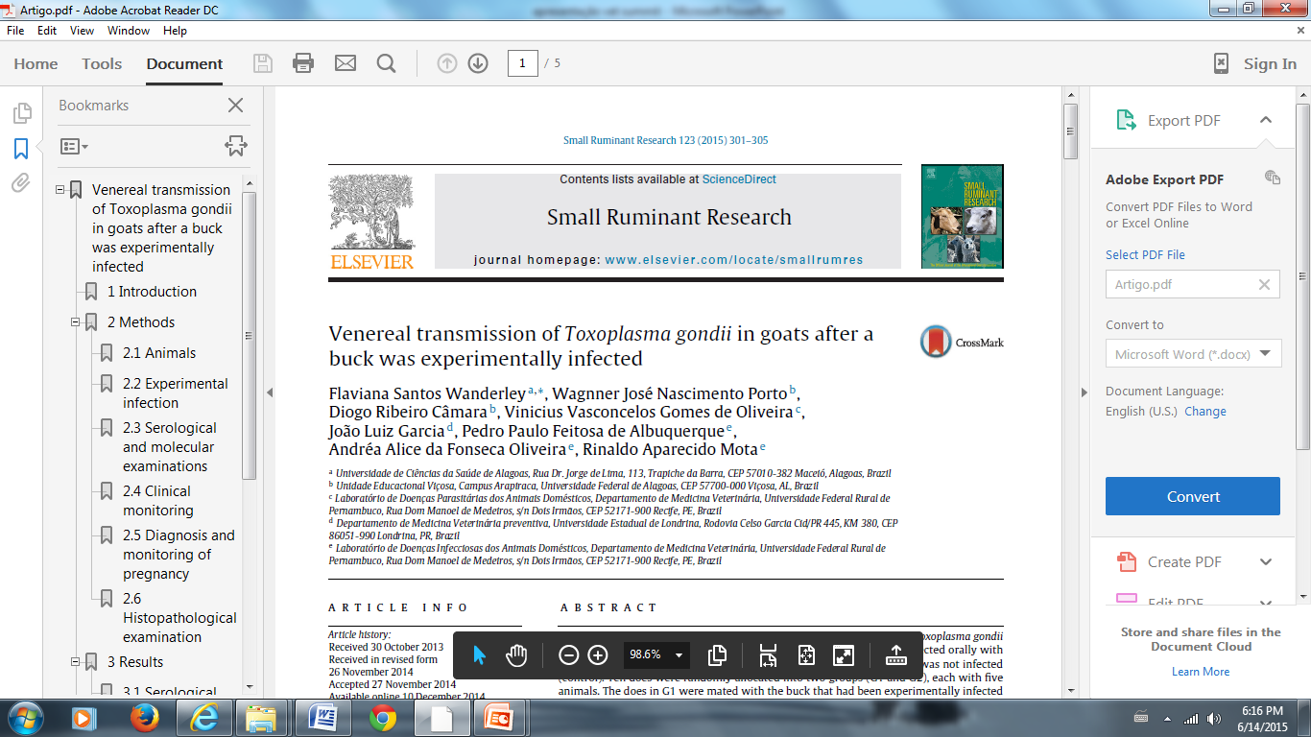

Slide 8
OBJECTIVE
The objective was to prove the venereal transmission of Toxoplasma gondii in goats

Slide 9
METHODS

Slide 10
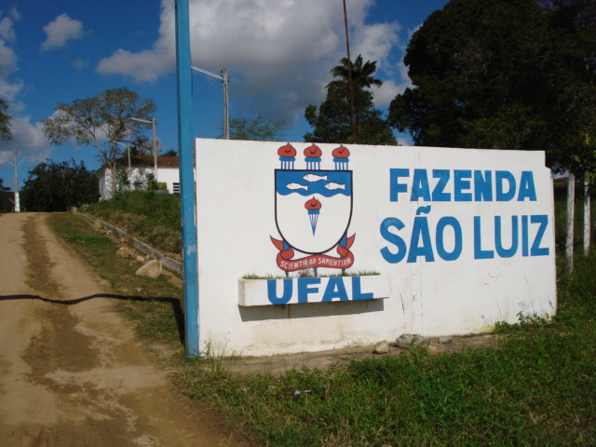
Development of the experiment
São Luiz farm,
UFAL, Viçosa, Al, Brazil.
Course in Veterinary Medicine
License: CEUA-UFRPE – Protocol 007/2010

Slide 11
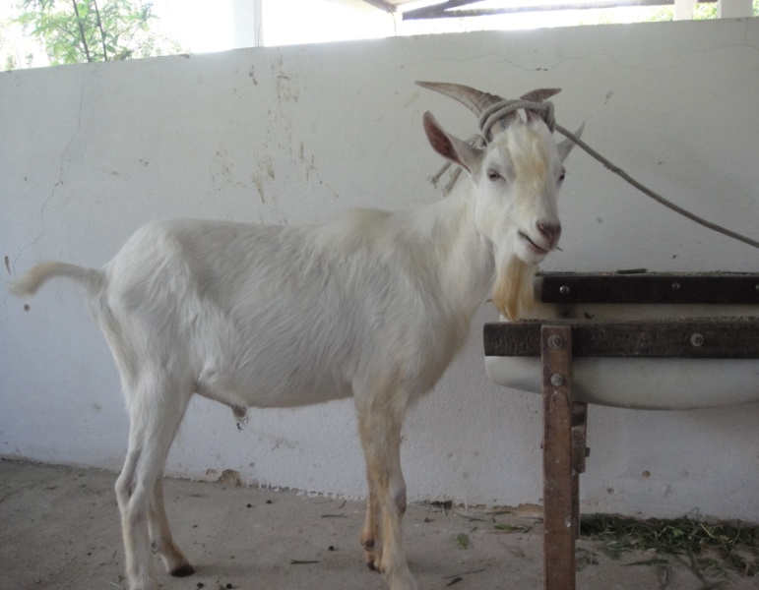
Animals
Two Saanen bucks with history of fertility (CBRA, 1998).
Andrologycal examination
History, general examination and genital system;
Behavior (libido);
Spermiogram (morphology,
motility, vigor) (CBRA, 1998).

Slide 12
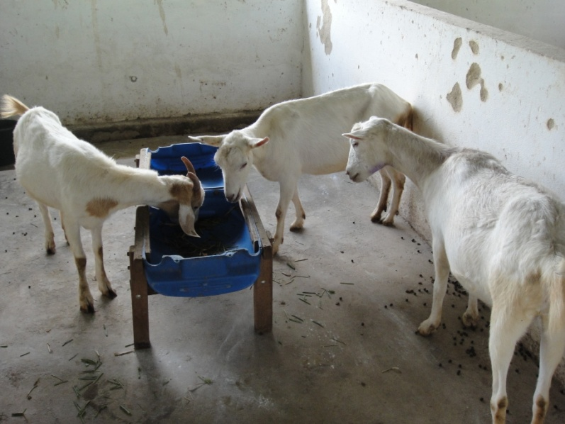
Composition of the experimental groups
Goats: 10 multiparous does,
G1 = 5 animals (infected group)
G2 = 5 animals (control group)

Slide 13
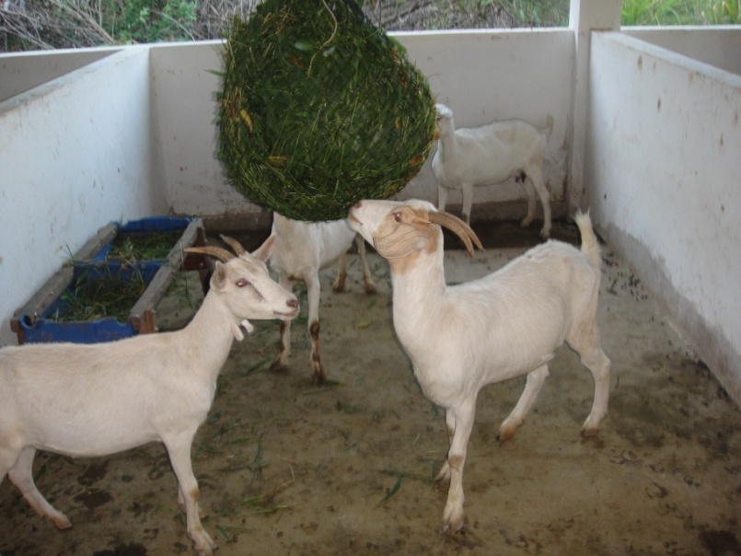
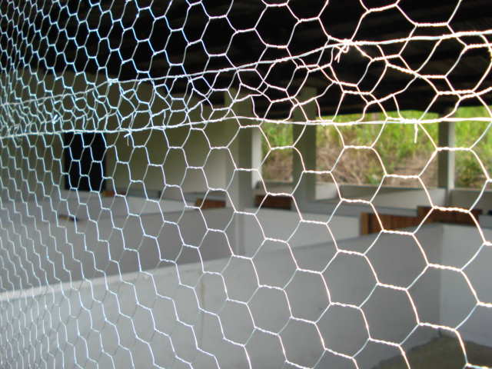
Vaccinated (Rabies and Clostridial
diseases
Dewormed
Negative Serology for:
T. gondii (RIFI)
N. caninum (RIFI)
B. abortus (BAA)
Chlamydophila abortus (CF)
Maintained in a intensive
screened bay system.

Slide 14
Strain
ME-49 strain;
Oocysts were provided by the research group at the Universidade Estadual de Londrina;
Kept under refrigeration.
Experimental Infection
Orally: syringe (5 ml) coupled to a catheter;
Dosage: 2x10⁵ oocysts.

Slide 15
Induction of estrus
.
G1/G2: Sodium Cloprostenol (Ciosin® Shering Plough, Brazil)- 0,3 ml intramuscular route.
Synchronization
01 female → synchronized 04 days post-infection (d.p.i.) of the buck;
03 females → synchronized 06 d.p.i.;
01 female → synchronized 10 d.p.i.

Slide 16
Natural mating
G1
02 females → 08 d.p.i.
01 female → 09 d.p.i.
01 female → 10 d.p.i.
01 female → 13 d.p.i.
G2
01 female → 08 d.p.i.
02 females→ 09 d.p.i.
01 female →10 d.p.i.
01 female →12 d.p.i
2 a 3 times during estrus
G1: infected buck
G2: uninfected buck

Slide 17
Serological (RIFI) and molecular examinations (PCR)
Blood
Females: collected in 0, 7, 14, 21, 28, 49, 63, 90 and 123 days after natural mating and on the day of birth;
Kids: after the birth and before ingestion of colostrum;
Blood and semen
Bucks: 0, 3, 5, 7, 11, 14, 21, 28, 35, 42, 49, 56, 63 e 70 d.p.i.

Slide 18
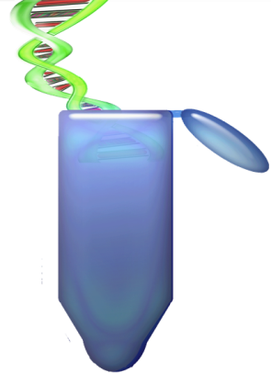
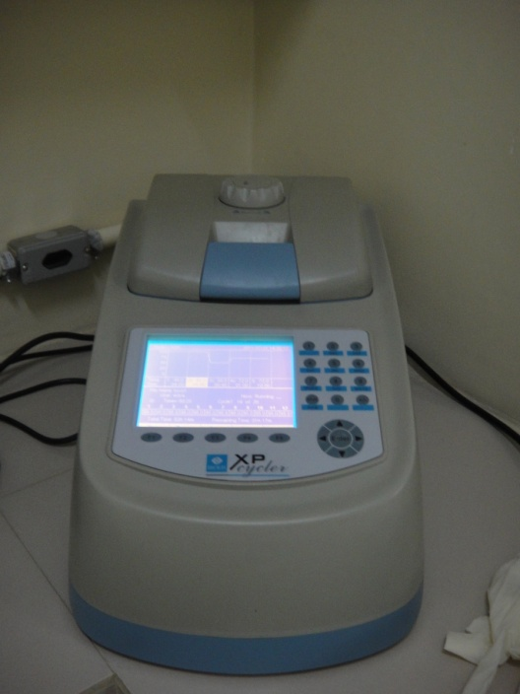
Polymerase Chain Reaction - PCR
DNA extraction: “Qiagen DNA Easy Blood and Tissues Kit” (Qiagen®, Hilden, Germany);
Primers: TOX4 e TOX5 (Homan et al., 2000);
Amplifying a repeat region of 529 bp.

Slide 19
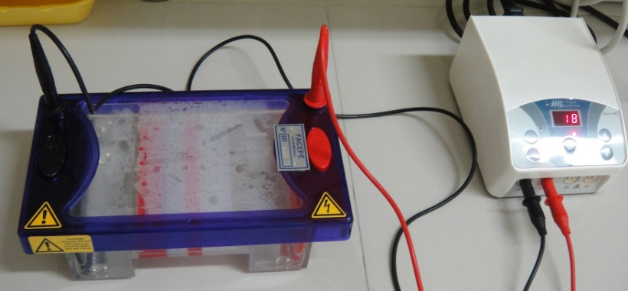
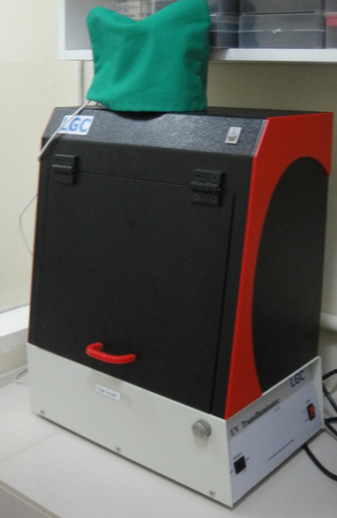
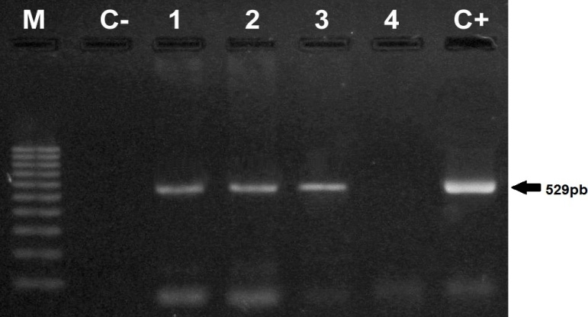
Polymerase Chain Reaction – PCR
Detected by eletrophoresis
Agarose gel (2%)
Visualized under ultraviolet light
Photodocumented

Slide 20
Genetic sequencing
Reactions: both strands of primers (TOX4 e TOX5) de based on the Big Dye Terminator v3.1 Cycle Sequencing Kit (Applied Biosystems), using ABI PRISM 3100 (Applied Biosystems);
Sequence analisis: BioEdit e MEGA 5 software; compared with the NCBI database using BLASTn.

Slide 21
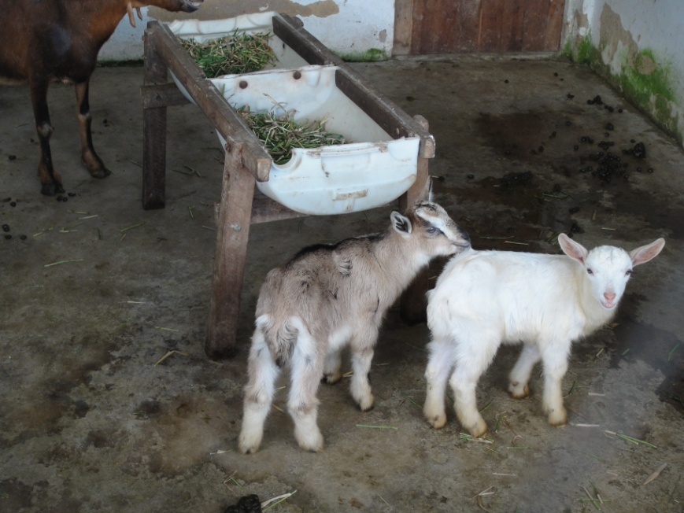
Clinical monitoring
Daily
Measured parameters: respiratory rate, heart rate, temperature, general condition.

Slide 22
Diagnosis and monitoring of pregnancy
Ultrasound examinations
Between 15 and 60 days of pregnancy, weekly, trans- rectal;
After 60 days of pregnancy, at intervals of 15 days, trans-abdominally;
Birth followed with collecting placentas (PCR, histopathology).

Slide 23
Histopathological examination
At the end of the experiment, euthanasia of all animals (CFMV, 2012)
Does: 240 days after mating;
Kids: 90 days after birth;
Buck: 240 d.p.i.
Organs: liver, spleen, kidneys, medulla, brain, lung, heart, uterus, ovaries and testicles.

Slide 24
RESULTS

Slide 25
Serological diagnosis
Infected buck
Soroconversão
Day 7: titer 64;
Day 11: maximal titer of 1024 , mantained for 70 days;
G1: 2/5 females on the 123 days after mating (titer 32);
Buck uninfected, G2 : seronegatives.

Slide 26
Molecular diagnosis
Toxoplasma gondii DNA
Infected buck
Blood and semen (day 3 to day 70 post-infecction)
Kidney and spleen
G1
Blood: 2/5 females,
1/5 7⁰ day after mating and
1/5 day of the birth;
Organs: 2/5 females e 4/5 kids positives in at least one
Buck uninfected,G2: T. gondii DNA was not found.

Slide 27
Table 1 – Results of PCR in tissues from bucks, does, and kids in G1, infected with Toxoplasma gondii.
Animal | Liver | Spleen | Kidney | Medulla | Brain | Lung | Heart | Placenta | Ovary
1
1 * |  |  | +
2
3 |  |  |  |  | + |  |  |  | +
4 | + | + | +
4 * |  |  |  |  | + |  | +
4 * |  |  | +
5
5 * |  |  |  |  |  |  | +
5*
Buck |  | + | +
* kids

Slide 28
Genetic sequencing
Molecular amplicon identities were confirmed: 99% similarity with the T. gondii DNA sequences (GenBank).

Slide 29
Clinical signs
Infected buck
Between the 3rd and 8th d.p.i.
Apathy, hyporexia, coughing, hyperthermia (maximal temperature of 41.3◦C), tachycardia, and tachypnea;
Females G1
Dry cough, with rales beginning on the 9th day after mating;
Buck and does (G2): no clinical alterations.

Slide 30
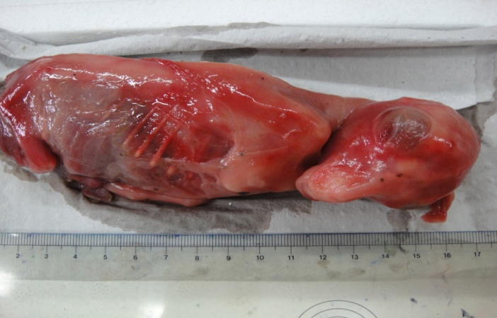
Monitoring of pregnancy
G1: 3 out of 5 of the females gave birth at full term with kids clinically healthy ;
Embryonic reabsorption in 1 out of 5 (34 days);
Abortion in 1 out of 5 (42 days).
G2: all females gave birth to full-term clinically healthy kids.
Figure 1 – abortion in goats at 42 days of pregnancy

Slide 31
Histopathological examination
Lung: hemorrhage; thickening of the alveolar septa; perivascular mononuclear and interstitial infiltration; compatible with interstitial pneumonia;
Liver: multifocal necrosis and the presence of predominantly neutrophilic polymorphonuclear infiltration;
Brain: perivascular gliosis with focal hemorrhage.

Slide 32
Table 2 –Results of laboratory examinations of does and viable newborn goats when does were mated with a buck infected with Toxoplasma gondii
Animal/ Group | Serology | PCR blood | PCR organs | Pregnancy Diagnosis | Reabsorption | Abortion
G1
1 | + | + |  | x
1* |  |  | +
2 | + |  |  | x | x
3 |  |  | + | x |  | x
4 |  | + | + | x
4 * |  | + | +
4* |  |  | +
5 |  |  |  | x
5* |  |  | +
5 *
G2
6 |  |  |  | x
6*
7 |  |  |  | x
7*
7*
8 |  |  |  | x
8*
8*
9 |  |  |  | x
9 *
10 |  |  |  | x
10*
+, positive; serology (titration = 32); * viable newborns.

Slide 33
CONCLUSION
The results obtained in the present study allowed the authors to conclude that T. gondii was transmitted via goat semen.

Slide 34






Acknowledgements

Slide 35
Thank you!
E-mail: flavianasw@hotmail.com
Notes:
If you have any questions, I kindly (caindli) ask you to adress it by e-mail
Here’s my e-mail
Since I don’t speak english very well
I would hate there to be any misunderstanding

