Slide 1
ETHNOMEDICAL STUDIES OF PLANTS USED FOR TREATMENT OF DISEASES IN EASTERN PART OF NIGERIA. MBAGWU, F. N. FACULTY OF SCIENCE DEPARTMENT OF PLANT SCIENCE AND BIOTECHNOLOGY IMO STATE UNIVERSITY, OWERRI, NIGERIA E-mail: mbagwu101@ yahoo.co.uk +2348037453703

Slide 2
ABSTRACT
An investigation into the ethnomedical studies on plants used for the treatment of certain diseases in Eastern Nigeria was carried out. The results showed that different plant species belonging to different families of flowering plants were used for the treatment of one aliment or the order. The plants were made up of cultivated, wild and protected species. Species of plant such as Cocos nucifera, Newbouldia laevis, Asmina triloba, lcacina trichantha, Azadirachta indica, Musa paradisaca etc were implicated in the treatment of more than one disease. Different diseases including such serious cases as madness, fibroid, diabetes, gonorrhea etc were reported curable by the plants. Aspects of ingredients such as the maintenance of standard quality by the use of specific quantities of plant extracts and a tendency towards specialization by the practitioners were apparent in this study. The fear of lack of government approval due to lack of medical certificate was reportedly hindering the growth of the practice. Based on this investigation, the researcher recommended among other things, that the Federal Government of Nigeria should as a matter of urgency consider publishing the National Policy on ethnomedical research.
Keywords: Ethnobotany, Diseases, treatment, medicinal plants, Eastern Nigeria.

Slide 3
INTRODUCTION
Ethnomedicine is that branch of cultural medicine that produces and administers drugs by the use of plants and plant products while a herb in cultural medicine is a plant or plant material which can be used for therapeutic purposes. It could well be that the initial selection of plant materials for medicinal purposes was influenced by religious thoughts and, its collection and administration was accompanied by a magic ritual. It has also been proposed that knowledge of medicinal plants was gained by accident, although this theory has been refuted by a number of traditional medical practitioners who claimed that information on such plants was communicated to their ancestors in various ways (Akpata, 1979: Lambo, 1979).

Slide 4
The uncertainty of its modes of acquisition notwithstanding, ethomedicine have been in use in various parts of the world at every period of human history. Abayomi (1982) reported the use of species of Hydnocarpus in the treatment of leprosy in China between 3000 and 2730 BC. He further indicated that the excavation of Papaver somniferum and Ricinus communis from tombs in Egypt revealed the use of phytomedicine in that part of Africa as far back as 1500 BC.
With the invention of writing, the Greeks became the earliest groups of Europeans to produce plant documents based initially on folk or cultural practices, and later on investigations into plants and plant products. They established physic gardens for the training of physicians and generated considerable impetus in the description, naming and classification of plants.
Knowledge of the state of ethnomedicine in the new world is dependent on the starting point of literacy in each area.

Slide 5
It is therefore not surprising that the earliest records of ethnomedicine in Nigeria were by expatriates working on the flora of Nigeria. As the accounts of these authors were not, in most cases, based on first hand information, the authenticity of their records cannot therefore be asserted.
Recent years have witnessed a turn of events in the practice throughout the world owing to:

Slide 6
The preference of many consumers for products of natural origin
The efficacy of plant medicines especially in certain cases like diabetes, hepatitis and sickle cell where modern medicines have little or no effect,
The fact that ethnomedicine is now scientific in approach, especially since the active ingredients in the plant have been identified and categorized in most cases, while the production methods have been standardized.
Following the new trend, many countries have either co-recognized cultural medicine or have integrated it into their healthcare programms . In Nigeria, the decree on the National Policy on Cultural Medicine is ready for promulgation (Anonymous, 1979). This is sequel to the achievements of the new trend (Abayomi, 1986; Kafaru, 1994; Ilonze, 1995; Nwagwu, 1997). Apart from moving the nation forward in the health sector, these practitioners have made gigantic landmarks in inventorising of the medicinal plants of Nigeria.

Slide 7
A checklist of medicinal plants is very important to any nation, especially in Eastern Nigeria where majority depend on plant remedies. It forms a database for medicinal plants research and constitutes a conservatory of the rich culture of phytomedicine. It is an important tool for the establishment of botanical gardens and a permanent record of the botanical resources of any nation. It provides a justification for the protection or conservation of some of the species in the list under the threat of extinction. In Nigeria where majority of the practitioners are illiterate, the onus of recording their plants lies on the plant taxonomists.
This work therefore is the study of plants used for the treatment of diseases in Eastern part of Nigeria. It is aimed at providing the scientific names of the plants, their families, common names, parts used, disease cured, quantity used and their vernacular names in such a way that someone without the knowledge of the plant can

Slide 8
A checklist of medicinal plants is very important to any nation, especially in Eastern Nigeria where majority depend on plant remedies. It forms a database for medicinal plants research and constitutes a conservatory of the rich culture of phytomedicine. It is an important tool for the establishment of botanical gardens and a permanent record of the botanical resources of any nation. It provides a justification for the protection or conservation of some of the species in the list under the threat of extinction. In Nigeria where majority of the practitioners are illiterate, the onus of recording their plants lies on the plant taxonomists.
This work therefore is the study of plants used for the treatment of diseases in Eastern part of Nigeria. It is aimed at providing the scientific names of the plants, their families, common names, parts used, disease cured, quantity used and their vernacular names in such a way that someone without the knowledge of the plant can practically identify these plants on his/her own and can administer the treatment.

Slide 9
MATERIALS AND METHODS
The investigation was designed into three component parts-oral interviews, field identifications and laboratory identification. For the oral interviews, ethnomedical practitioners were visited in their homes, each on an appointed day. During the interviews, each practitioner was asked a set of pre-documented questions (Appendix 1) covering his personal data, the plants he used and the diseases cured by the plants. The responses were recorded. The interview component of the survey was made oral because most of the practitioners were illiterate. Also on appointed days, each practitioner took me to the field to familiarize me with some of the plants mentioned during the oral interviews. Specimens of the plants were collected and carefully numbered. Attempts were made

Slide 10
at this stage to asertain from them, the local names of the plants. Photograph of some of the plants were taken plate 1. Back to the preparation room of the herbarium, the scientific names of the plants were determined using Hutchinson and Dalziel (1954 and 1968): Keay, et al.(1964): Stanfield (1970): Lowe & Stanfied (1974) and Burkill (1985). The specimens were finally dried, numbered poisoned, mounted and deposited at the herbarium of Imo State University, Owerri, Nigeria.
Finally all the accruing data were processed and arranged in a table showing an inventory of the plants they put into use, a checklist of the diseases cured by the plants, the parts used, quantity, common names, vernacular names and families. Table 1.

Slide 11
RESULTS
The results of this investigation were organized and arranged as shown in table 1. indicating the scientific names and families of the plants, the common and vernacular names of the plants, the parts used, the growth methods, the quantities and the diseases cured by the plants.
The results showed that a total of 23 different species of plants belonging to 23 families of plants were used to cure one disease or the other. (Table 1). Out of the above number of species, 11 are cultivated, 9 are wild, 2 are protected, 3 are wild and cultivated and only 1 is wild & protected. Although the recorded number of plant species as observed in this work is 23 but in some cases, the same species were used to cure more than one disease.
About 22 different diseases including such more serious cases as ulcer, madness, fibroid, gonorrhea etc were cured by the plants. The result also indicated that just as the same plant could be used for the treatment of different diseases, so could a combination of plants be used to treat one disease. Details of the diseases and the drugs, including their quantities, preparation methods and dosage are as shown in table 1.

Slide 12
TABLE 1: CHECKLIST OF PLANT SPECIES AND THE DFISEASES CURED BY THEM
S/N | SPECIE | FAMILY | COMMON NAME | VENACULAR NAME | PART(S) USED | QUANTITY | PREPARATION METHOD | DOSAGE | GROWTH METHOD | DISEASE(S) CURED
1 | Cocos nucifera linn | Araceae | Cocunt palm | Akioyibo | Endosperm | 32.41g | Extracted | - | cultivated | Antidote
2 | Chrysophyllum albidum G. Don | Sapotaceae | - | Udara | Roots | 41.60g | Ground and extracted with water | 1-shot twice daily for 2 days | Wild and Cultivated | Antidote
3 | Canarium Schweinfurthii Engl. | Burseraceae | Wild pear | Ubemgba | Stem bark | 25.61 | Cut into pieces and extracted with water | 1-glass daily for 7 days | wild | Arthritis
4 | Napoleona imperalis P. Beauv | Rubiaceae | - | Ikennemereoche | Roots and Fruits | 221.66g | Macearted and extracted with water | 1 glass daily for 6 days | Wild | Fibroid. Arthritis
5 | Newbouldia Laevis (P.Beaur) Bureau | Bignoniaceae | - | Ogirishi | Leavers and Root | 204.40g | Crushed and extracted with water | 1 shot twice daily for 7 days | Wild and Cultivated | Bleeding in Woman, Migrane
6 | Citrus Parachisi Linn | Rutaceae | Grape | Grape | Juice | - | Made into paste with horney | Rubbed once daily for 7 days | Cultivated | Body aches
7 | Citrus aurantifolia Swingle | Rutaceae | Lime | Oroma-nkirisi | Juice | - | Made into paste with shear-butter | Rubbed at the affected part once daily for 7 days | Cultivated | Dermatitis
8 | Cymbopogon Citratus (DC) Staff | Poaceae | Lemon grass | Achara tii | Stems and Leaves | 180.32g | Boiled with water | Inhale the vapour regularly for 4 days | Wild | Catarrh

Slide 13
S/N | SPECIE | FAMILY | COMMON NAME | VENACULAR NAME | PART(S) USED | QUAN- TITY | PREPARATION METHOD | DOSAGE | GROWTH METHOD | DISEASE(S) CURED
9 | Dacryodes edulis Vahl | Burseraceae | Native pear | Uba | Leaves and Stembark | 36,56g | Extracted with water | ^{½ glass twice daily for 7 days} | Cultivated | Chest pain
10 | Chromolaena odorata (Linn) King & Rob | Asteraceae | Siam Weed | Awolowo | Leaves & Roots | 26.67g | Marceratea | Applied at the affected part | Wild | Wounds
11 | Raphia hookeri Mann. & Wendl | Aracaceae | Raphia palm | Ngwo | Roots | 46.16g | Extracted with little water | One tablespoon twice daily for 3 days | cultivated | Convulsion
12 | Ivingia gabonensis (O’Rorke) Baill | Invingiaceae | - | Agbadu | Roots | 34.66g | Extracted with water | 1 shot daily for 6 days | Cultivated | Gonorrhea
13 | Baphia nitida Lodd | Fabaceae | - | Abosi | Leaves & Stembark | 60.10g | Extracted with water | 1 shot daily for 1 month | Wild | Diabetes & Fibroid
14 | Ceiba pentandra (Linn) Geartn | Bonbacaceae | Silkcottontree | Apu | leaves | 80.20g | Extracted with water | ^{½} glass daily for 7 days | Protected | High blood pressure
15 | Icacina trichantha Oliv | Icacinaceae | - | Ehi-ala | Tuber | 33.61 | Macerated and cooked with water | 1 shot daily for 12 days | Wild | Fibroid
16 | Uvaria cheame P.Beauv | Annonaceae | - | Mmimi-ohia | Roots | 28.60g | Ground & extracted with water | 1 shot twice daily for 8 days | Wild | Fibroid
17 | Dialium guinieensis Willd | Leguminosae | Velvet lamarind | Icheku | Roots | 32.63g | Ground & dissolved in water | 1 glass daily for 7 days | Wild & Protected | Infertility in women
18 | Rauwolfia vomitoria Alzel | Apocynaceae | - | Akata | Roots | 66.24g | Ground and dissolved in water | 1 glass daily for 7 days | Wild | Madness and Reduction of labour pain.
S/N | SPECIE | FAMILY | COMMON NAME | VENACULAR NAME | PART(S) USED | QUANTITY | PREPARATION METHOD | DOSAGE | GROWTH METHOD | DISEASE(S) CURED
19 | Azadirachta indica A.Juss Psidium guajava Linn Asmina triloba Anacardium occidentale Linn | Meliaceae Myrtaceae Caricaceae Anacardiaceae | Neem Guava Pawpaw Cashew | Dogwojaro Gova Okworobeke Kashu | Leaves Leaves Leaves & Seeds Leaves & Stem | 104.00g 106.11g 100.61g 96.21g | All cooked with water together | 1-glass 3-times daily for 3 days | Cultivated Cultivated Cultivated Cultivated | Malaria
20 | Xylopia aethiopica (Dunal)A.Rich | Annonaceae | - | Uda | Leaves | 34.30g | Extracted with water | ½ glass daily for 7 days | Wild | Obesity
21 | Persea americana Mill | Lauraceae | Avocado Pear | Uba-beke | Leaves | 34.97g | Macerated and extracted with water | 1 glass Daily for 7 days | Cultivated | Rheumatism
22 | Moringa Oleifera | Moringaceae | - | - | Seeds | 26.56g | Ground and used in food | 2 to 3 spoons at each mean | Wild & cultivated | Strength and healthiness
23 | Alstonia boonei De. Wild | Apocynaceae | - | Egbu | Roots | 39.16g | Extracted with water | 1 glass daily for 8 days | protected | Ulcer

Slide 14
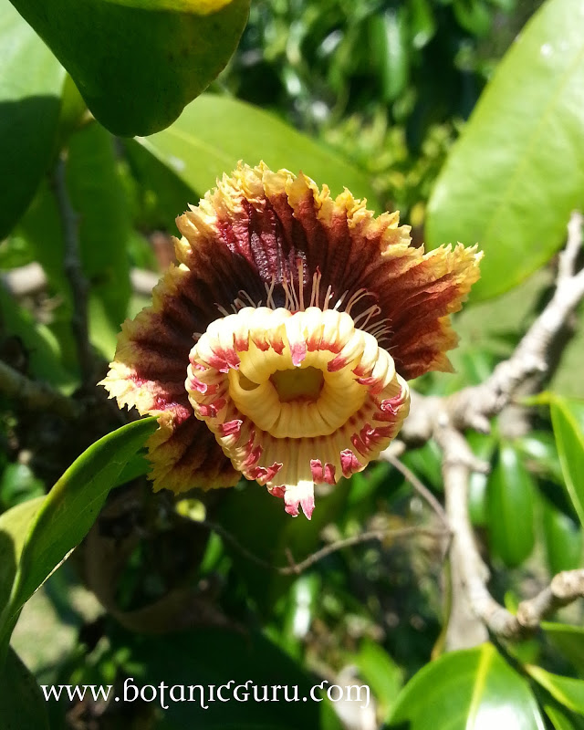
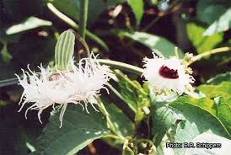
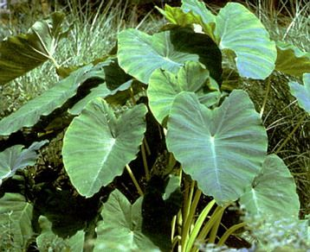
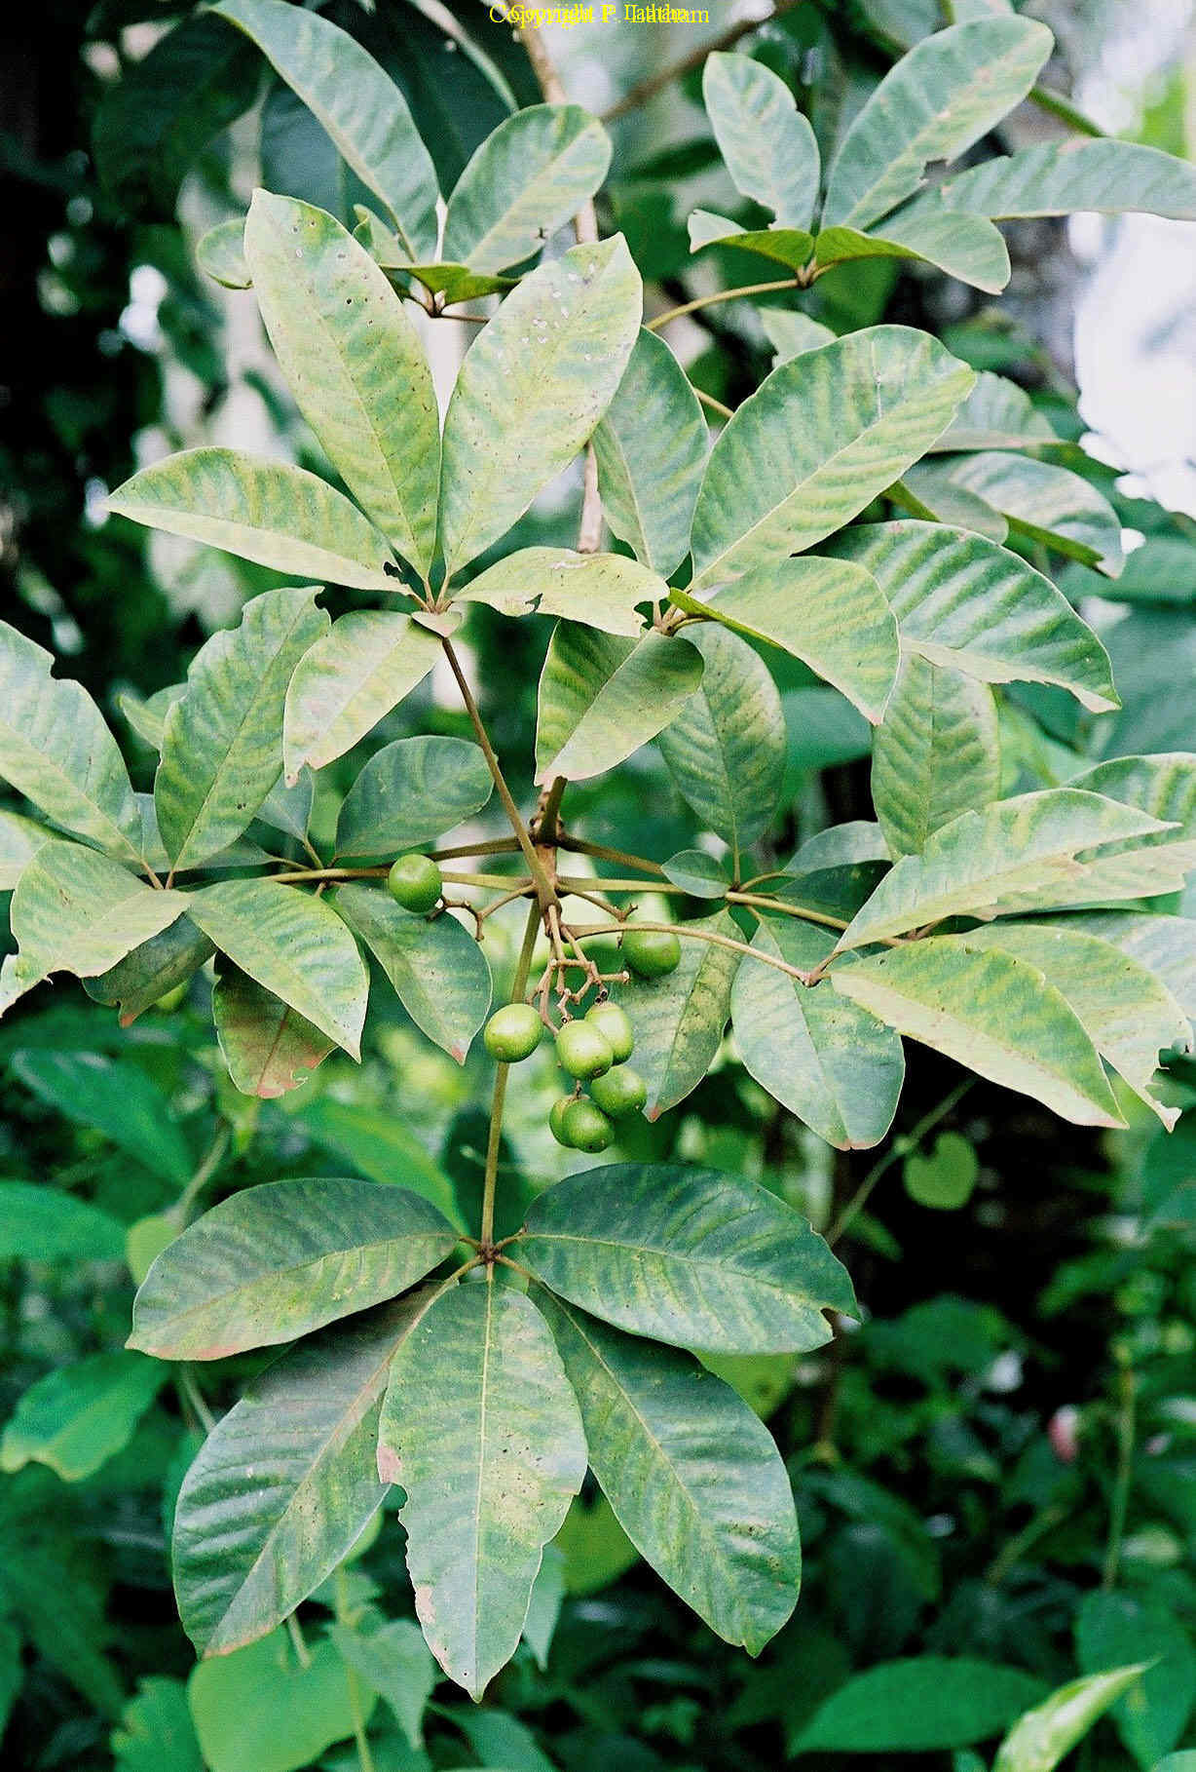
PLATE 1: PHOTOGRAPHS OF SOME OF THE PLANTS USED.
B
A
B = Telfaira occidentalis Hook. f.
A = Napoleoniao imperialis P. Beauv
D
C
C = Colocassia esculenta (Linn.) Schott
D = Icacina trichantha Oliv.

Slide 15
DISCUSSION
This survey is important in many aspects. It represents one of the pioneer efforts to document the folk medicinal plants of Eastern Nigeria as most of the available medical plants (eg. llonze, 1995; Kafaru, 1994; Nwagwu, 1997) were devoted to the plants which the authors themselves had put into use. The survey offers some insight to the range of diseases treated ethnomedically. It further attempts to preserve for generations yet onborn, aspects of this rich culture. This great number of recorded medical plants could be taken as an index of two factors:
(a).Considerable patronage by patients and the efficacy of plant drugs. The great number of diseases cured by the plants tend to support the view of Kafaru (1994) that there is a plant for every disease. There is the need, therefore, to explore more into the medicinal values of all the plants around us to enable us make the best use of them. Consequently, the fear that the present

Slide 16
generation has lost total heritage of the plants of folk medicine may not be absolutely true.
One interesting aspect of the results is the way distantly related species of plants can produce drugs for treating the same disease. Many evidences from the study reflected a primitive state of ethnomedical research in Nigeria. These include the fetish ingredients associated with some of the practices, collection of herbs from the bush instead of cultivating them in botanical garden, considerable secrecy associated with the practices, reservation of the practice for the aging population and the apparent domination of illiterates in the practice. On the other hand, evidences of modern research were also tenable in the practice. These include the standardization of drug quality reflected by the specific quantities of material for the preparation of the drugs, specific dosage and a trend toward specialization by the practitioners. These modern attributes conform to the W.H.O. (1991) guidelines for

Slide 17
traditional medicine. The above facts indicated that ethnomedical research in Nigeria is growing, and that the elimination of its primitive features is but a matter of time.
The total number of medical plants 23 recorded by this survey constitutes enough raw data for medicinal plants research. There is the need to confirm the efficiency of the plants put into use as observed in this study. Although the safety of the drugs seems to have been assumed by the users, there is also the need to confirm these claims in the interest of the masses that use herbal drugs. The validation of these claims is important as it is the only way to appreciate the contributions of ethnomedicine to the healthcare delivery services of the study area. Another significant result of this investigation is that some of the recorded species grow in the wild and therefore belong to group constantly and indiscriminately destroyed during farming and developmental projects because they are thought to be valueless. Some of them like Rauwolfia vomitoria.

Slide 18
Afzel, Uvaria chemea P. Beauv and Baphia nitida Lodd are involved respectively in the treatment of such serious diseases as madness, fibroid and diabetes. That was why Ayensu (1985), lamenting the continuous indiscriminate destruction of medical plants in West Africa, observed that the rural African inhabitants are sitting on a goldmine and does not know it. On the same issue, Forsberg (1973) warned that since tropical plant species have not been fully investigated, the destruction of any one of them before its value becomes ascertained is calamity because it might have suffered extinction by the time we want to put it into use. On these grounds therefore, efforts should be made to conserve these species now facing the threat of extinction so that we can reap the benefits that abound in them.

Slide 19
RECOMMENDATIONS.
On the basis of some issues arising from this study, the following measures likely to promote the growth and progress of ethnomedical research in Nigeria and beyond are recommended.
The National Policy on cultural/traditional Medicine should be publish without further delay so that the practitioners will practice without fears and at the same time abide by the ethics of the profession.
The conservation of species which is more or less a neglected issue in Nigeria today should now be pursued vigorously before the species disappear completely and thus impede proper functioning of ethnomedical research.
All the Institutions in the country concerned with medicinal plants research are requested to undertake studies to confirm the claims made in this study as a way of generating more confidence in this type of research.
Finally, this type of study should be extended to other parts of Nigeria to enable the achievement of full compilation of the inventory of the medicinal plants as part of the measures to preserve aspects of phytomedicine.

Slide 20
REFERENCES
Abayomi, S. (1982): Medicinal Plants and Traditional Medicine in Africa. New
York. John Willey & Sons, 256pp.
Abayomi, s. (1986): The Stae of Medicinal Plants Research in Nigeria. Ibadan;
Ibadan University Press 404pp.
Akpata, L. (1979): The Practice of herbalism in Nigeria. In Abayomi S. (ed)
African Medicinal Plants Ife; University of Ife Press.
Anonymous, (1979): Welcome address; International Work shop on
Standardization and Regulation of Herbal Medicine. Abuja, 29th – 30th
September.
Burkill , H. M. (1985): The Useful Plants of West Tropical African. Vol.1. Kew.
Royal Botanic Garden.
Forsberg (1973): The Temperate zone influence on Tropical Forest Land
Use. A plea for sanity. In Meggers, B. J. et al (ed). Tropical Forest
Ecosystem in Africa and South America. A Comparative review.
Washington. Smithsorian Institution Press.
Hutchinson, J. and Dalziel, J.M. (1954): Flora of West Tropical Africa Vol.1-3
(ed.2), Revised by Keay, R.W.J. and Hepper, F.N. London. Crown Agents.
Hutchinson, J. and Dalziel, J.M. (1968): Flora of West Tropical Africa Vol.4.
(ed 3) Rerised by Kecy, R.W.J. and Hepper, F.N. London. Crown Agnets
150pp.
Ilonze, F.I.N.(1995): You and Your Health with phytomedicine. Lagos;
Guardian Royal Exchange 26pp.

Slide 21
Abayomi, S. (1982): Medicinal Plants and Traditional Medicine in Africa. New
York. John Willey & Sons, 256pp.
Abayomi, s. (1986): The Stae of Medicinal Plants Research in Nigeria. Ibadan;
Ibadan University Press 404pp.
Akpata, L. (1979): The Practice of herbalism in Nigeria. In Abayomi S. (ed)
African Medicinal Plants Ife; University of Ife Press.
Anonymous, (1979): Welcome address; International Work shop on
Standardization and Regulation of Herbal Medicine. Abuja, 29th – 30th
September.
Burkill , H. M. (1985): The Useful Plants of West Tropical African. Vol.1. Kew.
Royal Botanic Garden.
Forsberg (1973): The Temperate zone influence on Tropical Forest Land
Use. A plea for sanity. In Meggers, B. J. et al (ed). Tropical Forest
Ecosystem in Africa and South America. A Comparative review.
Washington. Smithsorian Institution Press.
Hutchinson, J. and Dalziel, J.M. (1954): Flora of West Tropical Africa Vol.1-3
(ed.2), Revised by Keay, R.W.J. and Hepper, F.N. London. Crown Agents.
Hutchinson, J. and Dalziel, J.M. (1968): Flora of West Tropical Africa Vol.4.
(ed 3) Rerised by Kecy, R.W.J. and Hepper, F.N. London. Crown Agnets
150pp.
Ilonze, F.I.N.(1995): You and Your Health with phytomedicine. Lagos;
Guardian Royal Exchange 26pp.

Slide 22
Kafaru, E. (1994): Immense Help from Nature’s Workshop. Lagos;
Elikaf Health Services Ltd. 212pp.
Keay, R.W.J., Onochie, C.F.A. and Stanfield, D.P. (1964): Nigerian Trees.
Ibadan. Federal Department of Forest Research.
Lambo, J.O. (1979): The Healing Power of herbs with special reference to
obstetrics and gyncecology. In: African Medicinal Plants (Abayoni S. (ed))
Ife. University of Ife Press.
Lowe, J. and Stanfield, D.P. (1974): Flora of Nigeria; Sedges. Ibadan University
Press.
Nwagwu, M.A. (1997): Insight into Herbal Medicine. Okigwe; Whytem
Publishers 89pp.
Stanfield, D.P. (1970): Flora of Nigeria; Grasses, Ibadan; Ibadan University
Press.
W.H.O. (1991) Guidelines for the Assessment of Traditional Medicine.
Geneva.

Slide 23
