Slide 1
PAIN MANAGEMENT FOR SURGERY AND ANESTHESIA

Slide 23
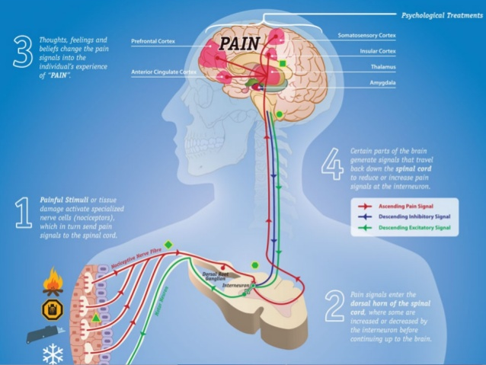

Slide 51
THANK YOU

