Slide 1
About OMICS Group
OMICS Group International is an amalgamation of Open Access publications and worldwide international science conferences and events. Established in the year 2007 with the sole aim of making the information on Sciences and technology ‘Open Access’, OMICS Group publishes 400 online open access scholarly journals in all aspects of Science, Engineering, Management and Technology journals. OMICS Group has been instrumental in taking the knowledge on Science & technology to the doorsteps of ordinary men and women.
Research Scholars, Students, Libraries, Educational Institutions, Research centers and the industry are main stakeholders that benefitted greatly from this knowledge dissemination. OMICS Group also organizes 300 International conferences annually across the globe, where knowledge transfer takes place through debates, round table discussions, poster presentations, workshops, symposia and exhibitions.

Slide 2
About OMICS Group Conferences
OMICS Group International is a pioneer and leading science event organizer, which publishes around 400 open access journals and conducts over 300 Medical, Clinical, Engineering, Life Sciences, Pharma scientific conferences all over the globe annually with the support of more than 1000 scientific associations and 30,000 editorial board members and 3.5 million followers to its credit.
OMICS Group has organized 500 conferences, workshops and national symposiums across the major cities including San Francisco, Las Vegas, San Antonio, Omaha, Orlando, Raleigh, Santa Clara, Chicago, Philadelphia, Baltimore, United Kingdom, Valencia, Dubai, Beijing, Hyderabad, Bangalore and Mumbai.

Slide 3
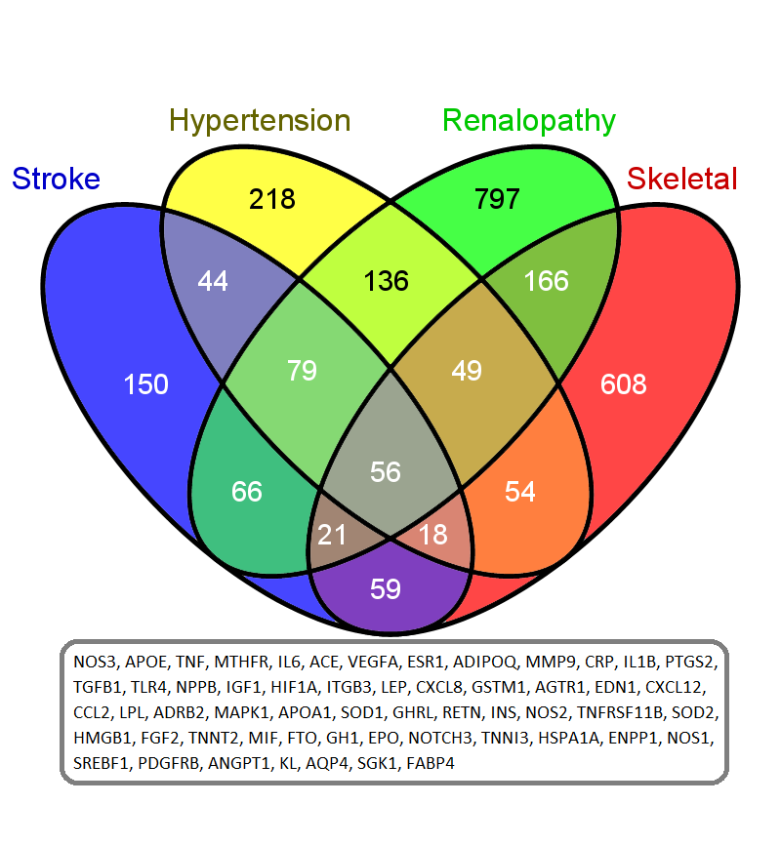

Slide 4
Phenotype segregation network analysis (PSNA) identifies chronic complex disease triggers in substructured human groups
Fatimah L.C. Jackson, Ph.D.
Professor of Biology
Director, W. Montague Cobb Research Laboratory
Howard University
Washington, DC 20059
USA

Slide 5
Thanks to my collaborators
Dr. Latifa Jackson, computational biologist
Department of Biomedical Sciences
Drexel University
Philadelphia, PA
USA
lfj27@drexel.edu
Dr. Raouf Ghomrasni, mathematician
African Institute for Mathematical Sciences
6-8 Melrose Road
7945 Muizenberg
South Africa
raouf@aims.ac.za

Slide 6
Complex chronic diseases
36,000,000 deaths by 2015
30% cardiovascular disease
13% cancer (especially breast, colon, prostate)
7% chronic respiratory disease
2% diabetes
Chronic kidney disease (chronic kidney failure)
describes the gradual loss of kidney function resulting in the build up of dangerous levels of fluid, electrolytes and toxins in the body.

Slide 7
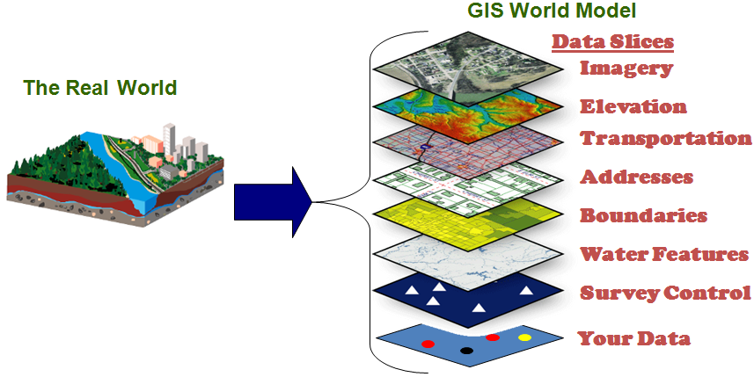
Ethnogenetic Layering
Microethnic Groups
References:
Jackson, F. 2004 Human genetic variation and health: Ethnogenetic layering as a way of detecting relevant population substructuring. British Medical Bulletin. 69:215-235. http://bmb.oxfordjournals.org/content/69/1/215.short
Jackson, F. 2006 Illuminating cancer health disparities using ethnogenetic layering (EL) and phenotype segregation network analysis (PSNA). J Cancer Education 21(1):69-79. http://ukpmc.ac.uk/abstract/MED/17020506
Jackson, FLC 2008 Ethnogenetic Layering (EL): An alternative to the traditional race model in human variation and health disparity studies. Annals of Human Biology Mar-Apr 35(2):121-144. http://informahealthcare.com/doi/pdf/10.1080/03014460801941752
Jackson, FLC 2003 Ethnogenetic Layering: A Novel Approach to Determining Environmental Health Risk Potentials Among Children from Three US Regions. Journal of Children's Health, 1(3):369-386. http://informahealthcare.com/doi/abs/10.3109/15417060390254355

Slide 8
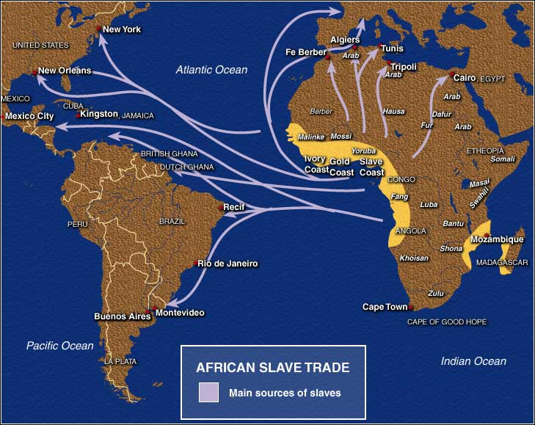
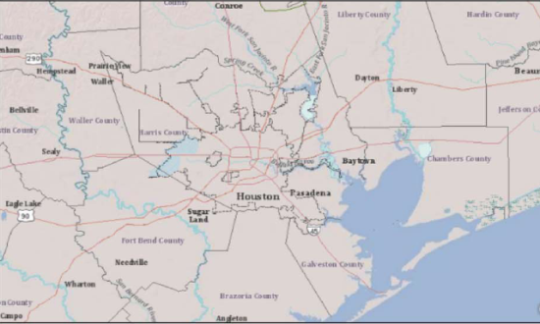
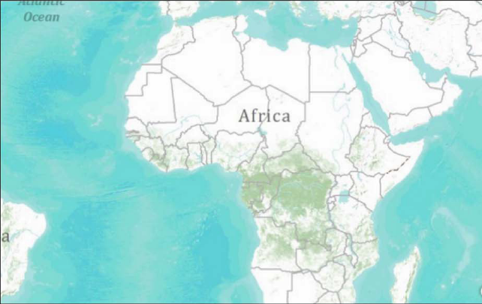
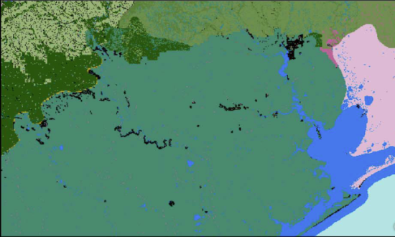
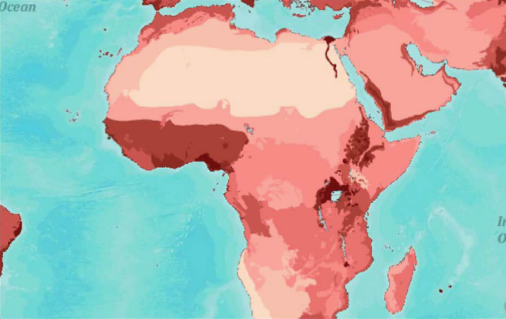
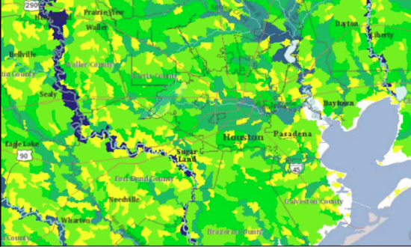
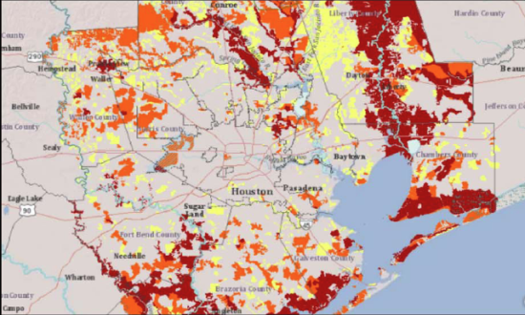
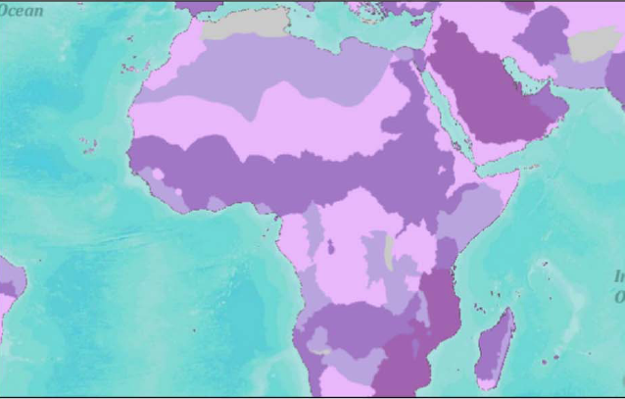
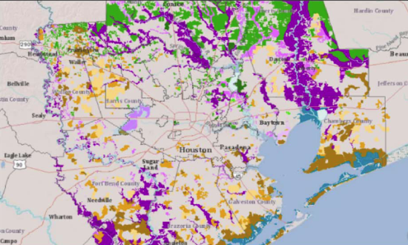
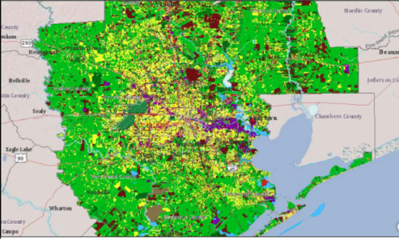
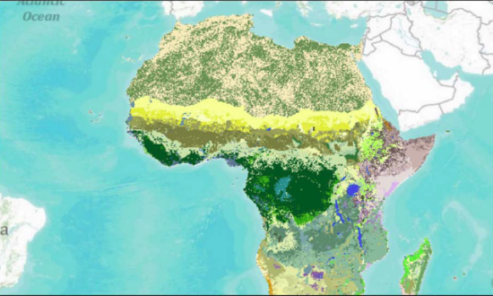
Ethnogenetic Layering General Methods
Collect and digitize measures; create geographic maps
Layer raster/vector maps; associate with research interest
Integrate ethnogenetic and other data
Calculate meta-data analysis for hypothesis testing
Environmental variables group 1: abiotic factors
Environmental variables group 2:
biotic factors
Environmental variables group 3:
social and cultural factors
Ancestral genetics
Phenotypic expression patterns

Slide 9
What is PSNA?
Phenotype Segregation Network Analysis
Relies on high throughput assessments of MEGs by environmental variables and ancestral genetics and then by phenotypic traits.
Permits the representation (i.e., networks) of relationships between phenotypic traits and MEGs.
Serves as a “pointer” to identify which MEGs have the highest probability of revealing the underlying causes of specific disease-associated phenotypic correlations.

Slide 10
FIGURE 1. Ethnogenetic layering sorts a pool of MEGs by geographical region. This initial step can be contrasted with the traditional pattern of lumping MEGs into macroethnic or racial clusters across geographical space and ignoring both within-group substructure and between- group disease-relevant commonalities.

Slide 11
Figure 2. Aggregated microethnic groups in the traditional racial model. When microethnic groups are clumped based upon classic racial designations, “racial” groups are found in each geographical region of interest but the nuanced analysis of local genetic, cultural, and environmental factors in disease causation is compromised.

Slide 12
Environmental Sources of
Genotype-Phenotype Discontinuity
diet
subsistence
occupation
psychosocial stress
anthropometry
Expressed genotype
These factors provide additional sources of variation to the expressed genotype (the phenotype) and modify the coded genotypic message. While these factors are not genetic, they can behave in ways that influence gene expression over generations.
toxicants
humidity
altitude
radiation
precipitation
Abiotic Environmental Filters
infectious diseases
bioactive phytochemicals
viruses
Biotic Environmental Filters
Sociocultural Environmental
Filters
language
religion
ethnic identity
socialization
class structure
Coded genotype
Redrawn from Jackson 2004 Br. Med. Bull. 69:215-235

Slide 13
Table 1: Environmental variables and ancestral genetic factors used to sort MEGs.
MEG | Abiotic environmental variables | Biotic environmental variables | Sociocultural environmental variables | Ancestral genetic factors
1
2
3
4
5
6
7
8
9
10
11
12

Slide 14
Figure 3. Affinity matrix of microethnic groups based upon presentation patterns of exposure to relevant environmental traits and ancestral genetic backgrounds. Heavy bars represent two or more traits in common while thin bars represent only one trait in common (based upon data presented in Table 1).

Slide 15
CKD- Associated Phenotypic Trait | Recent Reference
Tables 2.0 – 2.3 A subsample of 50 phenotypic traits associated with chronic renal disease for use in PSNA.

Slide 16
Table 2.0
1 | Diabetes | Bjornstad et al 2014; Gosmanov et al 2014; Prakash 2013
2 | Cognitive impairment | Pulignano et al 2014; Seidel et al 2014; Miwa et al 2014
3 | Urine miRNA levels | Szeto 2014; Zununi Vahed et al 2014
4 | Urinary proteome biomarkers | Gu et al 2014; Caliskan and Kiryluk 2014
5 | Glomerular filtration rate (est.) | Rausch et al 2014; Ajayi et al 2014; Levey et al 2014
6 | Heart failure | Segall et al 2014; Chawla et al 2014
7 | Hypothyroidism | Paudel 2014; Prajapti et al 2013
8 | 2,8-dihydroxyadeine urolittuasis | Ceballos-Picot et al 2014
9 | Folate receptor alpha | Somers and O’Shannessy, 2014
10 | Dyspea and lung function | Palamidas et al 2014

Slide 17
Table 2.1
CKD-Associated Phenotypes for PSNA
11 | Glycosylated hemoglobin A1c | Shipman et al 2014
12 | Proteinuria | Cvitković et al 2014
13 | Left atrial remodeling | Sciacqua et al 2014
14 | Health literacy | Chow et al 2014; Roomizadeh et al 2014; Lopez-Vargas et al 2014; Burke et al 2014
15 | Renal Anemia | Kelepouris and Kalantar-Zadeh 2014; Dousdampanis et al 2014
16 | Vascular calcification | Knežević et al 2014
17 | Urinary electrolytes/conductivity | Wang et al 2014; Blann 2014
18 | Depression | Bantovich et al 2014; Knuth et al 2014; Schell et al 2014
19 | Serum creatine | Proule et al 2014
20 | Osteoporosis and osteopenia | Miller 2014; Gupta 2014; Salam et al 2014; Khan et al 2014
21 | Cystatin C | Vigil et al 2014; Fox et al 2014; Jeon et al 2013; Li et al 2013
22 | Renal Inflammation | Wu et al 2014; Kelepouris and Kalantar-Zadeh 2013
23 | Atrial fibrillation | Buiten 2014
24 | Dietary complements | Dori et al 2014; Hsieh et al 2014; Steiber 2014
25 | Carotid artery stenting | AbuRahma et al 2014; Hakimi et al 2014

Slide 18
Table 2.2
26 | APOL1 polymorphism | Freedman et al 2014; Cooke Bailey et al 2014
27 | Platelet reactivity | Mangiacapra et al 2014
28 | Chronological age | Tonelli and Riella 2014; Nitta et al 2013
29 | Serum complement C3 | Molad et al 2014
30 | Physical function and gait speed | Painter and Marcus 2013; Baumgaertel et al 2014
31 | Albuminuria | Komenda et al 2014; Liu et al 2014; Abdelmalek et al 2014
32 | Pleural effusion | Ray et al 2013
33 | Peridontal disease | Mohangi et al 2013
34 | Oxidative stress (mitochondria) | Daehn et al 2014
35 | Auditory acuity | Lopez et al 2014; D’Andrea et al 2013
36 | Nephrotoxic exogenous agents | Roxanas et al 2014; Ingrasciotta et al 2014; Akilesh et al 2014; Sánchez-González et al 2013
37 | Cardiovascular disease | Cai et al 2013; Ahmadi et al 2014; Chawla et al 2014
38 | Dyslipidemia | Omran et al 2013
39 | Obesity | Park et al 2014
40 | Hyperphosphataemia | Collinson et al 2014

Slide 19
Table 2.3
41 | Insomnia and sleep apnea | Ahmed et al 2013
42 | Microvascular function | Imamura et al 2014
43 | Nutritional status | dos Santos et al 2013
44 | WT1 or TRIB3 polymorphisms | Lipska et al 2014; Ding et al 2014
45 | Treatment resistant hypertension | Tanner et al 2014
46 | Renal histology | Wijetunge et al 2013; Tarnoki et al 2013
47 | Dopamine D2 receptor polymorphism | Jiang et al 2014
48 | Inflammatory myopathy | Couvrat-Desvergnes et al 2014
49 | FSGS and nephropathic biomarkers | Nafar et al 2014 ; Nkuipou-Kenfack et al 2014
50 | Diastolic function | Farshid et al 2013

Slide 20
Figure 4. A simplified version of the correlational matrix in PSNA for the traits listed in Tables 2.0-2.3. Z represents a statistically significant correlation between traits (p<0.05).

Slide 21
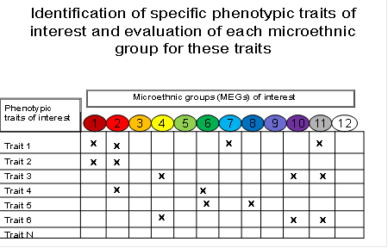
Figure 5. Validated phenotypic traits are evaluated in each MEG of interest and the results compared. X indicates the presentation of a specific phenotypic trait. MEGs with similar phenotypic presentations of the chronic disease of interest are studied further. Notice that MEGs 3, 5, 9, and 12 do not display any of the phenotypic traits under study.

Slide 22
Figure 6. Identification of MEGs for subsequent genetic, cultural, and/or environmental analysis in chronic disease causation. In the case CKD-associated traits, microethnic groups 1 and 2 display linked phenotypic traits 1 and 2; microethnic grous 4, 10, and 11 display linked phenotypic traits 3 and N and microethnic group 6 displays linked traits 4 and 5.

Slide 23
Figure 7. Re-association of correlated traits with MEGs and “racial” identifications of identified MEGs. The lack of racial agreement (see Figure 4) with the traits suggests that regional genetic, cultural, and/or environmental importance may be playing more important roles than “race” per se in disease causation.

Slide 24
9 Step Algorithm for PSNA
Identification of MEGs using EL
Quantify the environmental and ancestral genetic variables for each MEG
Determine the networks of MEGs interrelationships
Identify chronic complex disease phenotypes of interest
Determine phenotype correlations, take top 5%
Assess of phenotypes in MEGs of interest
Link paired correlated phenotypes to MEGs
Identify the specific MEGs with significantly correlated disease phenotypes
Investigate the likely underlying causes of specific chronic disease associated phenotypic correlations by environmental and ancestral genetic variables

Slide 25
Applications of PSNA
PSNA should prove useful in a number of applications in the identification of risk factors in complex chronic diseases. For example, these include:
Ranking of classic diagnostic procedures and techniques for specific subgroups. In chronic disease studies, classic diagnosis and treatment procedures often find human biodiversity problematic. The recognition of substructure in macroethnic groups (=races) can, with PSNA, be used productively to provide more sensitive disease recognition strategies.
Improved specificity of treatment regimes for particular individuals and groups within targeted MEGs. Unlike “individualized medicine” which does not integrate social, cultural, and environmental factors into diagnosis and treatment, or “race medicine” which ignores within group variability, PSNA focuses on the microethnic group level of analysis. This means that chronic disease intervention strategies can be localized to the specific social, cultural, environmental, and ancestral dynamics of regional MEGs.
Increased resolution of roles of social, cultural, and biological contributors to existing disparities. Integrative biology is particularly well poised to quantify the contributions of social, biological, and biocultural contributors to complex chronic disease health disparities. PSNA reduces some of the ambiguity in these quantifications by identifying the MEGs most likely to express specific correlated phenotypes. This makes association studies much less of a “shot in the dark”. Our procedure also makes for more informed design in clinical trials/medical research.
Integration of sophisticated genetic, sociocultural, and environmental data in disease assessments. Finally the data on disease assessment must be meaningfully integrated for incorporation into local models of chronic disease. PSNA provides the context for these integrations and reduces the tendency in race-based studies to overextend research results to other MEGs with little more in common with the study group than a remote shared past.

Slide 26
Limitations of PSNA
Important independent phenotypic traits that are not linked to other phenotypic traits could be missed in our PSNA calculations.
Causation is not specifically implied by our analysis; PSNA simply points to statistical matches in the phenotypes examined and identifies the MEGs harboring those phenotypes. Causation requires additional analyses.
It is possible that in some cases, no MEGs will correspond with statistically correlated traits. However, our technique still recognizes geographic ‘clusters’ of people of equal public health significance.
Once the list of 100 phenotypic traits is finalized, the discovery of new phenotypic traits would require that the number correlations performed would have to be increased to include these in the analyses. On the other hand, if some of the studied phenotypic traits from the finalized list are subsequently discounted, the number of correlations undertaken would have to be decreased.
MEGs have to be periodically revisited since these are dynamic groups and all aspects of their composition are potentially undergoing change, particularly given the magnitude of recent immigration and ongoing assimilation.
PSNA is based on a nonreductionist, integrative platform. As such, its statistical analysis and application includes many different kinds of data, for example, behavioral, demographic, toxicological, pharmacologic, genetic, dietary, historical, etc.

Slide 27
Why is this research important?
Geneticists have been handicapped by (unknown) population substructure in the search for robust and consistent disease-associated genes.
Many of our GWAS results are of little clinical significance across population groups.
As health disparities grow, we need computation-assisted methods to sort through the high degree of variability in heterogeneous human groups to accurately identify the biological bases for these inequities.
Thank you for your attention.

Slide 28
Let Us Meet Again
We welcome you all to our future conferences of OMICS Group International
Please Visit: www.omicsgroup.com
www.conferenceseries.com
www.pharmaceuticalconferences.com

