Slide 1
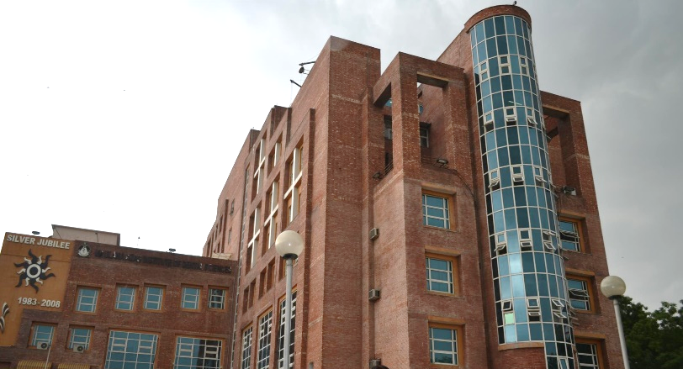
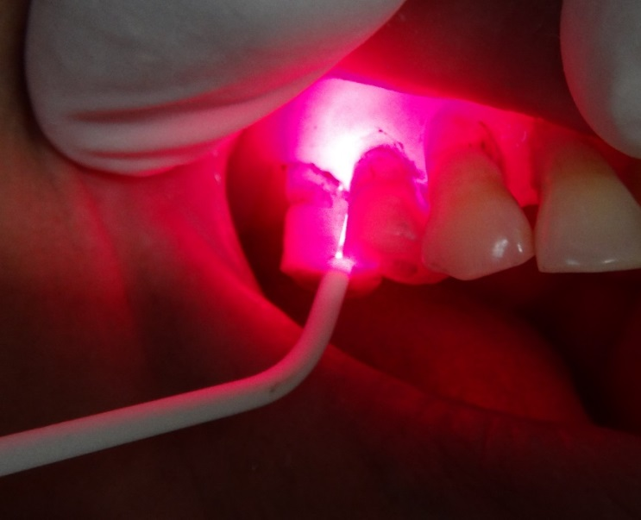
Antimicrobial Photodynamic Therapy as an Adjunct to Non-Surgical Treatment of Deep Periodontal Pockets : A Clinical Study
Dr. Farrukh Faraz
Assoc. Prof .
Maulana Azad Institute of Dental Sciences. New Delhi (India)

Slide 2
Historical perspective
Use of light as therapy dates back to ancient Egyptian, Indian & Greek civilizations.
Danish physician Niels Finsen invented Finsen Lamp.
John Toth of Cooper Medical devices, acknowledged the “ photodynamic Chemical Effect” of therapy using early clinical Argon Lasers.

Slide 3
INTRODUCTION
Pathogenic bacteria are the main cause of treatment failure in dentistry!
The biofilm provides a safe habitat for them.
Quorum Sensing enables bacteria to communicate with one another and coordinate their activities.
The more mature the biofilm, the more resistant the bacteria within it become.

Slide 4
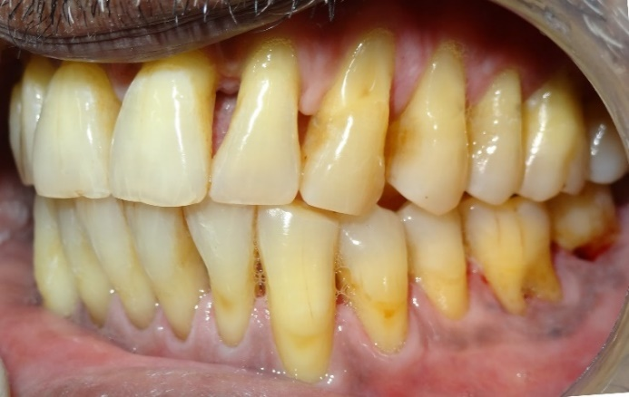
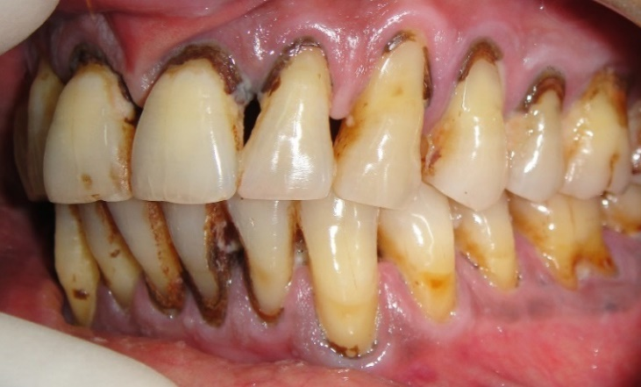
Rationale of Conventional Treatment for Chronic Periodontitis
Decreased Bacterial load
Disease Progression stops
Supra- and Sub-gingival debridement
Notes:
Although, physical plaque biofilms removal by SRP is an essential part of periodontal therapy, BUT complete removal of plaque, and calculus is not always possible especially in inaccessible sites such as deeper pockets and furcation areas.

Slide 5
Treatment options
Mechanical debridement (closed / open)
  Removes plaque and calculus (sub-and supragingival)
  Has no influence on the germ spectrum, can cause hard tissue damage, can be painful
Rinsing solutions
  Can remove superficial or unattached bacteria
  Are rinsed out from the sulcus, can cause staining & taste dysfunction
Antibiotics
  Side Effects
  Interaction with other medicines
  Risk of Resistance

Slide 6

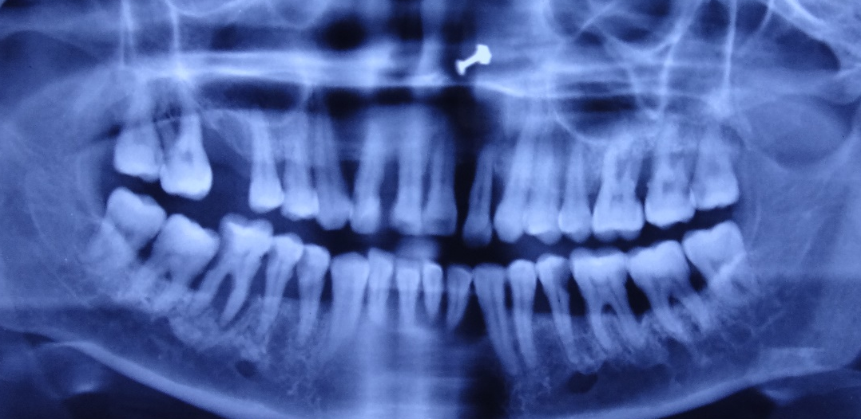
Adjunctive modalities
Local and systemic antibiotics.
Laser assisted pocket therapy
Antimicrobial Photodynamic Therapy
Notes:
To supplement the armament of antibacterial measures, different adjunctive modalities have been evaluated

Slide 7
Local Antibiotics
Plaque Biofilm confers resistance
Systemic Antibiotics
Insufficient concentration of the drug in GCF
Disturbance of intestinal microflora
Antibiotic resistance

Slide 8
Photodynamic Therapy
Photodynamic therapy (PDT), also known as photo radiation therapy, phototherapy or photo chemotherapy is a new treatment modality that has been developing rapidly within various medical specialties since the 1960s.

Slide 9
Photodynamic Therapy
It has been defined as “the light induced athermal inactivation of cells, microorganisms or molecules.”
Reduces pathogenic bacteria by > 99%
Stops inflammation/infection

Slide 10

Mode of Action of aPDT
By using a colorant, the bacteria are:
  stained
  sensitized
  destroyed after irradiation with light of a
  suitable wavelength and energy density

Slide 11
PHOTODYNAMIC THERAPY
An agent (photosensitizer) which absorbs light can be preferentially taken up by bacteria
It is subsequently activated by light of appropriate wavelength, in the presence of oxygen,
Generation of singlet oxygen and free radicals
Cytotoxic to microorganisms
Injection of dye into the pocket
Dye left for 3 minutes
Photo activation by light of 660 nm

Slide 12
The chemical/physical process is carried out in 3 steps……

Slide 13
Step 1: Staining the microorganisms
Diffusion-determining step
Migration and attachment of the dye molecules on the wall of microorganisms
Process parameters are viscosity, pH-value, temperature, charge, time, structure of the plaque etc.

Slide 14
Step 2: Exposure and activation of the photosensitiser
Laser light at 660 nm
Excited
stained molecules
Absorptionn
bacterium
Energy-controlled step
Determined by physical-optical properties
With excitation of the sensitizer molecules
From singlet state to triplet state
Process parameters are optical, electronic/ chemical states, pH-value, time etc.

Slide 15
Step 3: Oxygen radical formation & destruction of the microorganisms
Local
oxygen
bacterium
Singlet oxygen
Exposure and activation of photosensitiser leads to the build-up of singlet-oxygen radicals and oxidative destruction of membrane lipids and enzymes

Slide 16
In principle, all molecules are affected by oxygen radicals.
Unsaturated fatty acids in the bacterial membranes are particularly susceptible to damage by oxygen radicals, as these do not have the body’s own enzyme defences as is the case with healthy cells.
It is thus specifically the pathogenic bacteria that are destroyed by antimicrobial photodynamic therapy.
Healthy cells are at no risk!

Slide 17
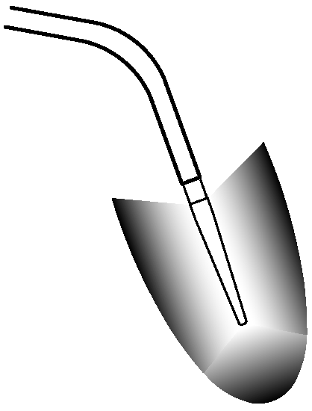
3D Pocket/Endo Probe: For infected Pocket/canals
For three dimensional, even exposure
• With overload protection through flexible design
• Angled for optimum access to all areas, even distal
• Sterile disposable product to prevent spread of bacteria
•Power density > 60mW/cm2
Micro-lens for even light distribution
3D Pocket / Endo Probe

Slide 18
3D Pocket/Endo Probe - Indications
Periodontal Pocket
Periimplantitis
Alveolar ostitis
Endodontics

Slide 19
What is achieved by the photobiological effect?
      Inflammation is suppressed
      Wounds heal faster
      Pain is reduced

Slide 20
How does the photobiological effect work?
The mitochondria in the cells are stimulated.
Inhibiting influences on the metabolism and the energy supply are reduced.

Slide 21
Why does the photobiological effect work?
Radiation with blue to red laser light (wavelength 380nm to 700nm) stimulates synthesis from ADP to ATP through oxidative phosphorylation.

Slide 22


Simplify your therapy
No eye protection needed
No warning signs
… no other preventive measures necessary!!!
=> the therapy is delegable!!!

Slide 23
AIM
To evaluate the additional benefit of antimicrobial photodynamic therapy, if any in the non-surgical treatment of deep periodontal pockets.

Slide 24
MATERIALS AND METHODS
Prospective, split mouth, controlled clinical trial.
30 adult patients (21M+9F)

Slide 25
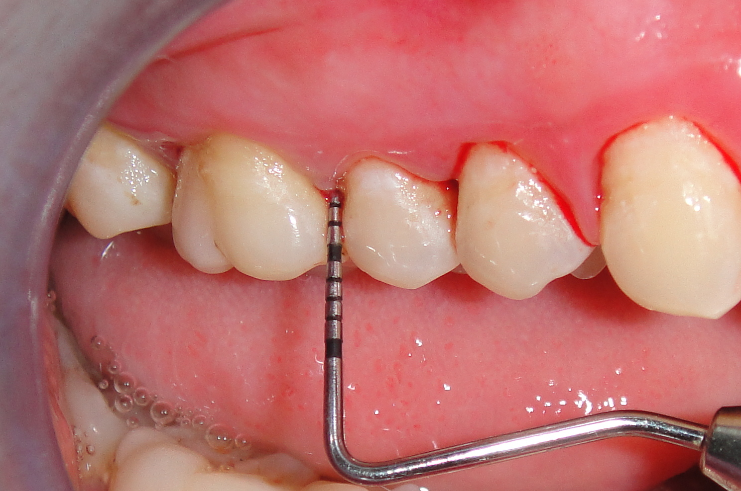
SAMPLE SELECTION
Inclusion criteria
Adults, with age above 18 years.
Presence of at least 2 teeth in different quadrants with probing depth ≥6 mm, and bleeding on probing.

Slide 26
SAMPLE SELECTION
Exclusion criteria
Systemic conditions which can modify the outcome of treatment, like uncontrolled diabetes mellitus.
Any acute systemic disease/ life threatening disease.
Pregnant or lactating mothers.
Any history of smoking or smokeless tobacco use.
History of antibiotic use in last 1 month.
Undergoing long term treatment with immunosuppressant, NSAIDs, phenytoin, anticoagulants or calcium channel blockers.
Presence of carious lesion or restoration on the root surface

Slide 27
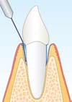
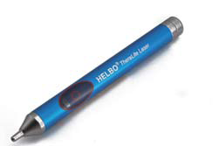
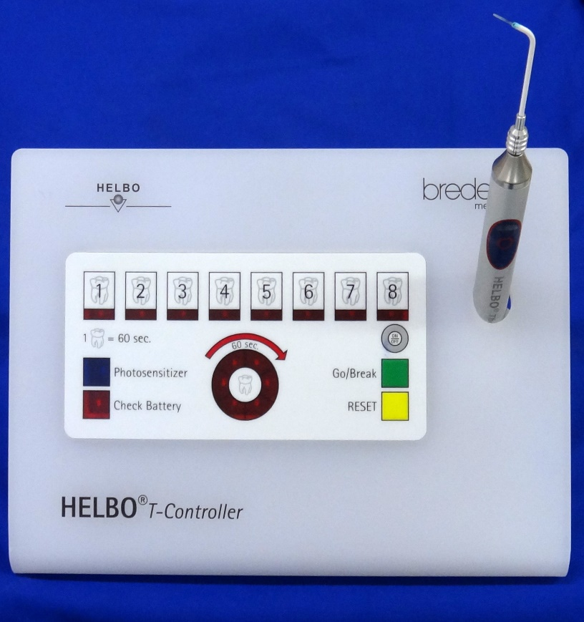
MATERIALS
The Photodynamic laser system includes….
1. A battery-operated diode laser (HELBOs minilaser 2075 F dent, , Bredent Medical, Germany).
    Wavelength of 660 nm
    Power density of 75 mW/cm2
2. A fiber optic applicator (HELBO 3D Pocket Probe, Bredent Medical, Germany).

Slide 28
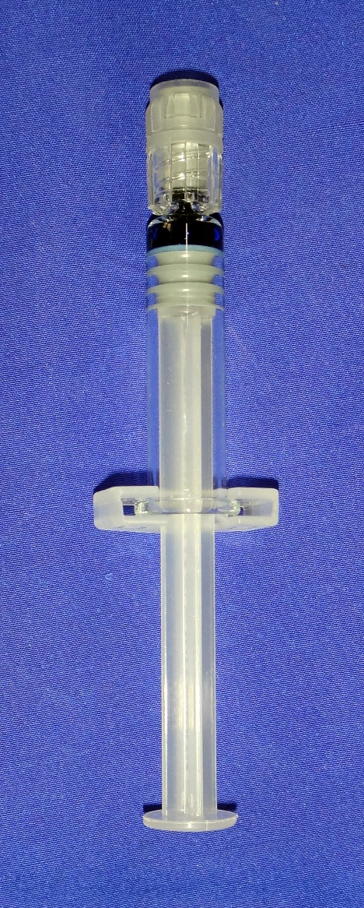

MATERIALS
3. Photosensitizer- Phenothiazine chloride
10mg/ml
(HELBO Blue, Bredent Medical, Germany)

Slide 29
CLINICAL PARAMETERS
  Plaque Index ( Silness & Loe-1964)
  Modified Sulcular Bleeding Index ( Mombelli- 1987)
  Probing Pocket Depth
  Clinical Attachment Level
Notes:
Before treatment, and at follow up visit, following clinical parameters were recorded

Slide 30
STUDY METHODOLOGY
Selection of patients based on inclusion criteria and after informed consent (n= 30)
2 sites with deepest probing depth selected, and stents were fabricated
Full mouth SRP
Flip of Coin
Recording of baseline clinical parameters :
mSBI, PI, PD, CAL
Test site
Control site
Photodynamic therapy & Oral Hygiene instructions
Oral Hygiene instructions
Follow up at 1 month & 3 months : recording of clinical parameters
Follow up at 1 month & 3 months : recording of clinical parameters
Statistical Analysis

Slide 31
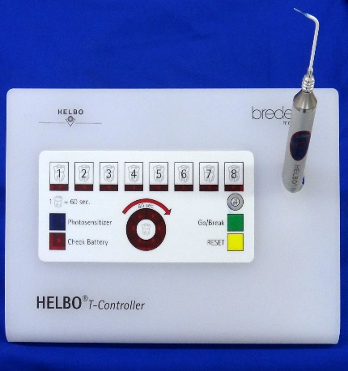
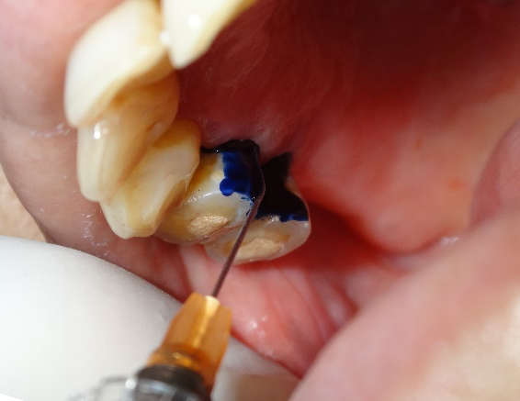
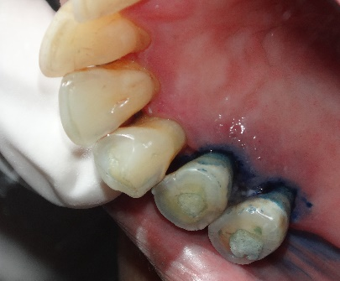
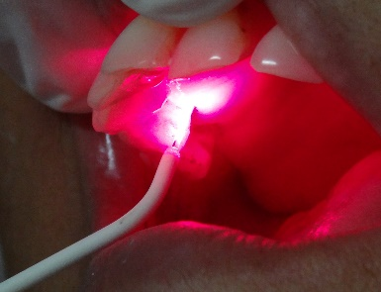
Steps in PDT
Photosensitizer dye injected in the pocket and left for 3 minutes
Pocket irrigated with saline
Diode laser applied for 10 seconds X 6 sites
Notes:
Very few studies have been conducted evaluating clinical effectiveness of PDT in treatment of periodontitis, particularly in deep pockets, that too with conflicting results.

Slide 32
FOLLOW UP
….after 1 week to reinforce oral hygiene instructions.
&
After 1 month & 3 months of therapy to record Clinical parameters
Modified Sulcular Bleeding Index ( Mombelli- 1987)
Plaque Index ( Silness & Loe-1964)
Probing Pocket Depth
Clinical Attachment Level

Slide 33
COMPARISON OF MEAN VALUES OF PARAMETERS AT BASELINE
Parameters | SRP | SRP+aPDT | p- value
PI | 1±0.45 | 1.09±0.47 | 0.07
mSBI | 1.17±0.38 | 1.28±0.41 | 0.06
PD (mm) | 7.53±1.31 | 7.90±1.71 | 0.26
CAL (mm) | 8.46±1.81 | 8.7±1.91 | 0.27

Slide 34
Comparison of mean values of PI at Baseline, 1 month and 3 months
 | SRP | SRP+aPDT | p-value
Baseline | 1±0.45 | 1.09±0.47 | 0.07
1 month | 0.57±0.40 | 0.54±0.41 | 0.25
3 months | 0.46±0.17 | 0.47±0.18 | 0.32

Slide 35
Comparison of mean values of mSBI at Baseline, 1 month and 3 months
 | SRP | SRP+aPDT | p-value
Baseline | 1.17±0.38 | 1.28±0.41 | 0.06
1 month | 0.63±0.40 | 0.43±0.42 | 0.02
3 months | 0.46±0.27 | 0.31±0.30 | 0.03

Slide 36
Comparison of mean change in mSBI
 | SRP | SRP+aPDT | p-value
1 month | 0.54±0.47 | 0.85±0.41 | 0.002
3 months | 0.73±0.42 | 0.97±0.45 | 0.015

Slide 37
Comparison of mean values of PD at Baseline, 1 month and 3 months
 | SRP | SRP+aPDT | p-value
Baseline | 7.53±1.31 | 7.90±1.71 | 0.26
1 month | 6.17±1.20 | 6.27±1.44 | 0.64
3 months | 5.37±0.85 | 5.43±1.36 | 0.77

Slide 38
Comparison of mean change in PD
 | SRP | SRP+aPDT | p-value
1 month | 1.3±0.95 | 1.77±0.86 | 0.01
3 months | 2.13±1.22 | 2.37±1.10 | 0.47

Slide 39
Comparison of mean values of CAL at Baseline, 1 month and 3 months
 | SRP | SRP+aPDT | p-value
Baseline | 8.47±1.81 | 8.70±1.91 | 0.54
1 month | 7.53±1.52 | 7.43±1.43 | 0.74
3 months | 6.73±1.31 | 6.67±1.45 | 0.83

Slide 40
Comparison of mean change in CAL
 | SRP | SRP+aPDT | p-value
1 month | 0.97±0.96 | 1.27±1.11 | 0.12
3 months | 1.73±1.26 | 2.10±1.35 | 0.18

Slide 41
DISCUSSION
Deep periodontal pockets were selected as they are difficult to be debrided completely by SRP alone. (5mm)
Antimicrobial PDT was done after haemostasis was achieved as heavy bleeding after SRP may prematurely flush the photosensitizer out of the pockets
Notes:
However, there is no statistically significant difference between the groups.

Slide 42

DISCUSSION
At the baseline no statistically significant difference between two groups in terms of PI, mSBI, PD and CAL was recorded.
All these parameters improved in both treatment groups after 1 month and 3 months post-treatment interval as observed in many previous studies.
Notes:
However, there is no statistically significant difference between the groups.

Slide 43
DISCUSSION
Larger reduction in mSBI in SRP+aPDT group, statistically significant at both 1 month and 3 months post treatment interval.
aPDT has a positive effect on patient care, mainly due to the considerably faster resolution of overt inflammation in the gingival tissues, as a result of bacterial load reduction and inactivation of bacterial virulence factors and cytokines when the methylene blue is irradiated with laser.
Notes:
However, there is no statistically significant difference between the groups.

Slide 44
DISCUSSION
Inter- group difference in reduction of PD at 1 month was statistically significant, in favour of SRP+aPDT group.
Plausible explanation being additional shrinkage in inflamed pocket wall after reduction in microbial load achieved by photodynamic therapy.
Notes:
However, there is no statistically significant difference between the groups.

Slide 45
DISCUSSION
Incomplete debridement in deep pockets might have prevented significant reduction in PD.
Notes:
evaluated antibacterial effect of photodynamic therapy in samples of dental plaque. They reported

Slide 46
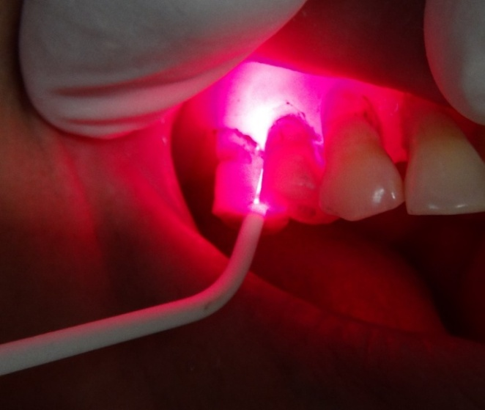
Advantages of aPDT
Photodynamic therapy damages only the pathogenic bacteria sparing the host cells.
Unsaturated fatty acids in the bacterial membranes are particularly susceptible to damage by oxygen radicals, as these do not have the body’s own enzyme defences as is the case with healthy cells.
Notes:
However, there is no statistically significant difference between the groups.

Slide 47

Advantages of aPDT
It significantly reduces inflammation without antibiotics and without surgical intervention while providing maximum therapeutic safety.
PDT is safe for both human tissue and dental materials. Because it utilizes cold laser light for activation of the sensitizing solution, there is no risk of thermal damage to patient tissues, prosthetics or implants.
Notes:
However, there is no statistically significant difference between the groups.

Slide 48
Other Advantages
Antimicrobial PDT has other advantages as well, like:
Broad spectrum of antimicrobial effect
No development of resistance
Easy application
No repetition required until BOP reappears.
Notes:
However, there is no statistically significant difference between the groups.

Slide 49
Conclusion
It would be worthwhile to include larger sample and follow the outcomes for longer periods to assess the outcome in terms of CAL gain.
Notes:
And of course, we need a larger controlled clinical trial with long term follow up to explore the advantages of PDT

Slide 50
Conclusion
Antimicrobial Photodynamic Therapy (aPDT) plays an important adjunctive role in improvement of bleeding on probing obtained through Scaling and Root Planing (SRP) in deep periodontal pockets.
Notes:
And of course, we need a larger controlled clinical trial with long term follow up to explore the advantages of PDT

Slide 51
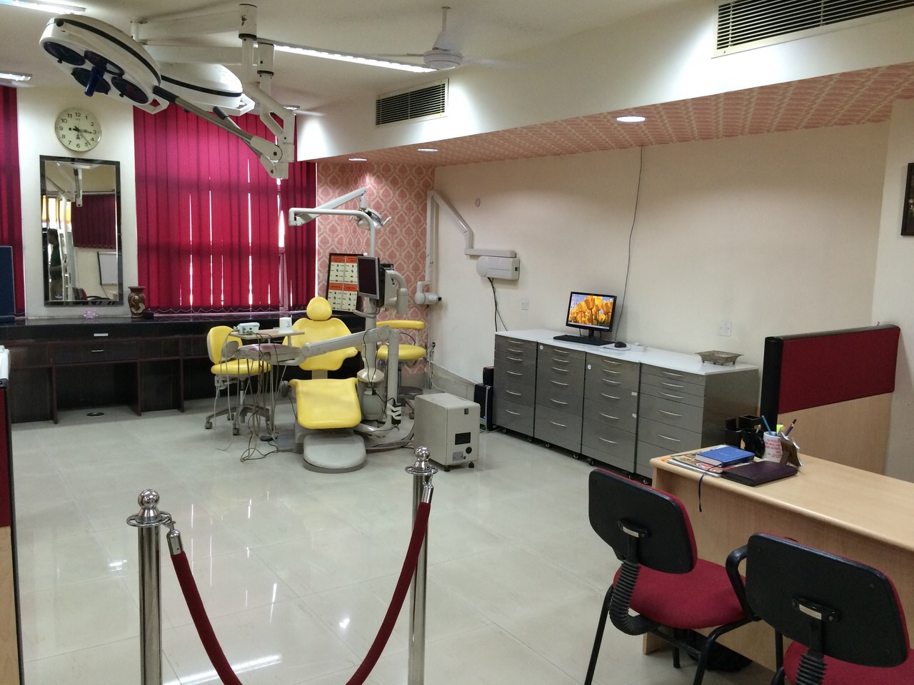

Slide 52
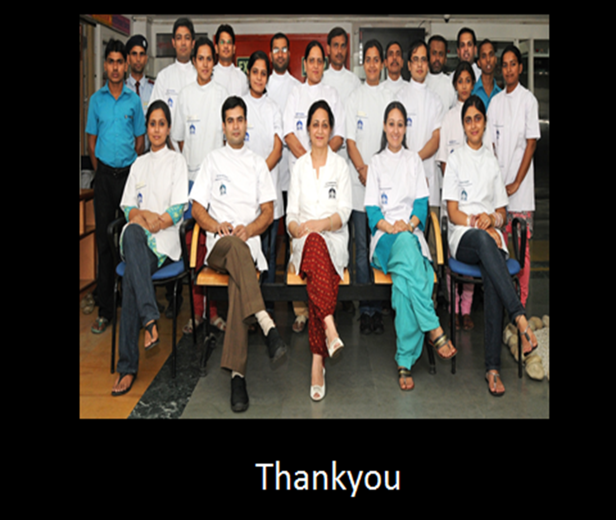

Slide 53
Thank You
Notes:
And I conclude with these words by ……

Slide 55
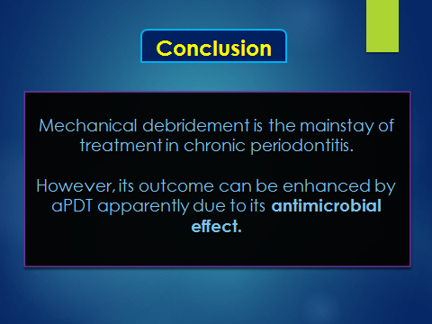

Slide 56
DISCUSSION
Clinical Attachment Level (CAL) improved significantly in both groups, however, inter-group difference was not significant either at 1 month or 3 months confirming results of study by
Balata et al (2013)
They had evaluated the parameters in deep periodontal pockets (PD ≥7 mm), similar to present study.
Notes:
However, there is no statistically significant difference between the groups.

Slide 57
Comparison of mean change in PI
 | SRP | SRP+aPDT | p-value
1 month | 0.43±0.50 | 0.48±0.60 | 0.59
3 months | 0.47±0.53 | 0.62±0.47 | 0.12

Slide 58
Conclusion
Antimicrobial PDT seems to have little role in improvement of Clinical Attachment Level.
Notes:
And of course, we need a larger controlled clinical trial with long term follow up to explore the advantages of PDT

Slide 59
DISCUSSION
Bactericidal activity of aPDT explains the additional improvement in bleeding scores
Notes:
evaluated antibacterial effect of photodynamic therapy in samples of dental plaque. They reported

Slide 60
Effect on Biofilm
Biofilms reduce the effectiveness of PDT , but not as much as reported in cases of antibiotics.
Fontana et al. (2009)
63% killing of bacteria in suspension, while
32% killing in biofilms
made of the same samples.
Notes:
evaluated antibacterial effect of photodynamic therapy in samples of dental plaque. They reported

