Slide 1
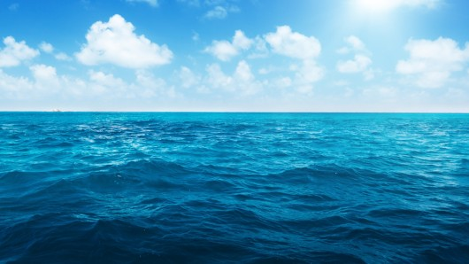
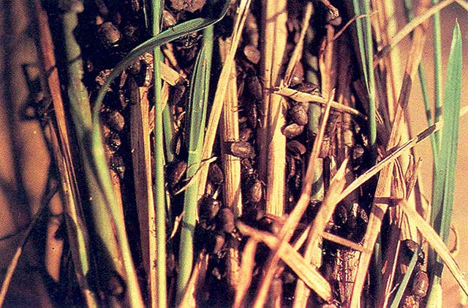
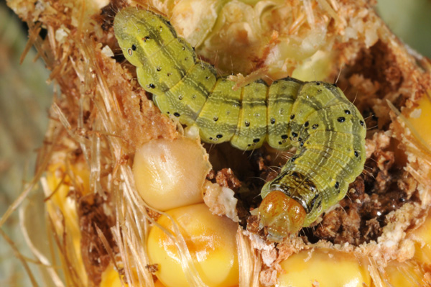
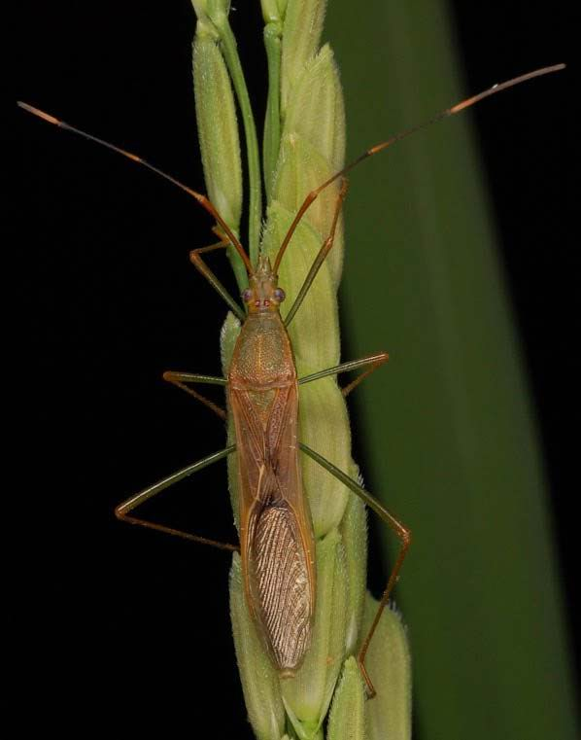
INTRODUCTION
What happened to the commercially-important crops
during pest outbreak?
Source:http://www.knowledgebank.irri.org/index.php?option=com_zoo&task=item&item_id=926&Itemid=757
Source:http://www.farmindustrynews.com/insecticides/worst-pests-corn-and-soybeans-which-insects-look-out-2013
Source:http://knowledgebank.irri.org/training/factsheets/pestmanagement/insects/item/rice-bug

Slide 2
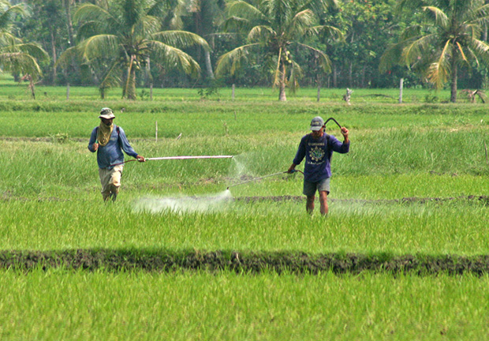
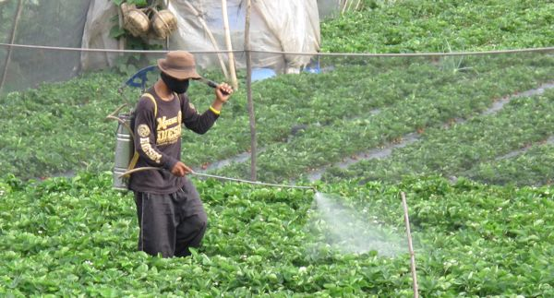
INTRODUCTION
What was the immediate option of the farmers?
Source:http://www.mindanews.com/top-stories/2016/06/philippines-must-catch-up-with-asean-neighbors-duterte/
Source:http://www.marketmanila.com/archives/insecticides-on-the-strawberry-fields-of-la-trinidad-benguet

Slide 3
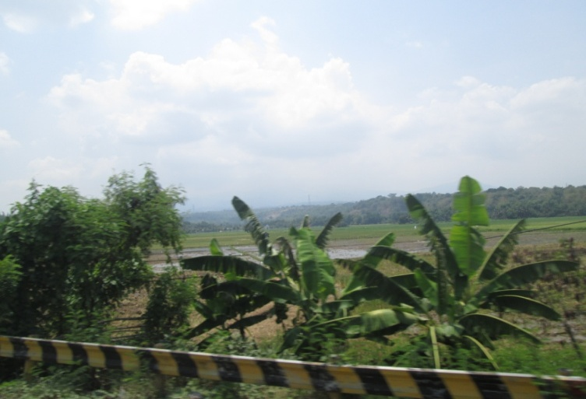
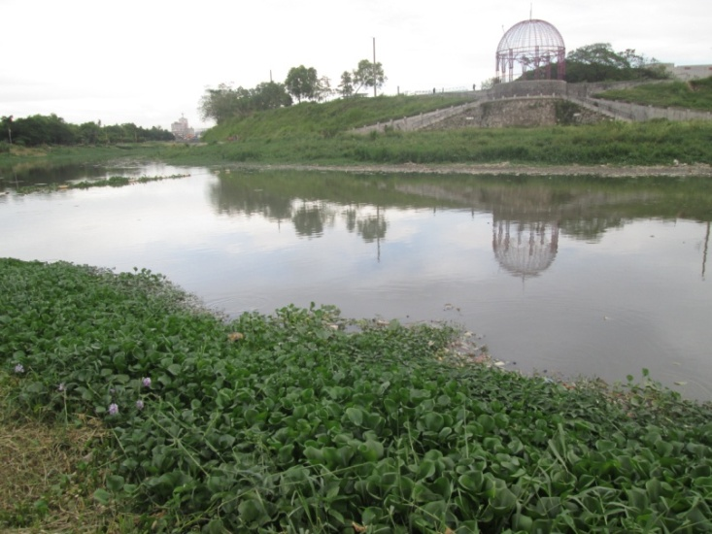
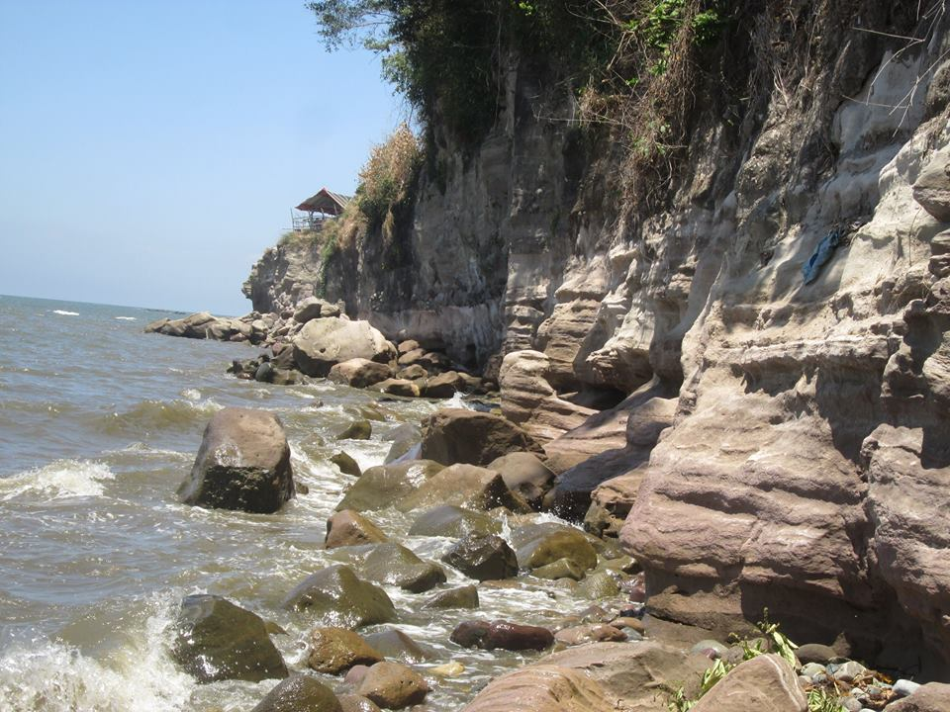
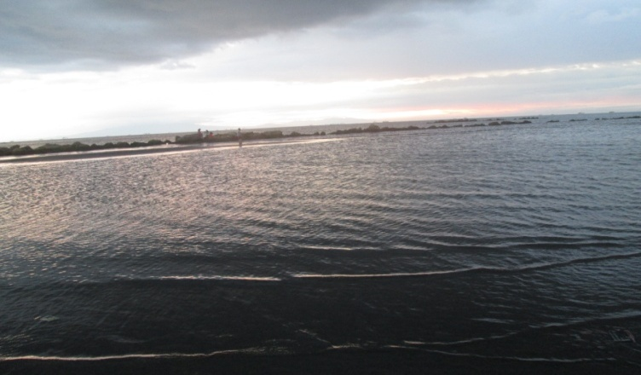
INTRODUCTION
Where did this pesticide go?
Pesticide residue in the farm
Transported to the river
Harmed the marine organisms
Continued its route to the ocean

Slide 4
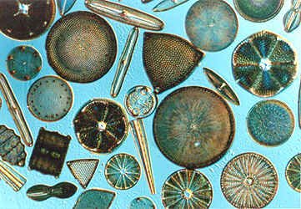
INTRODUCTION
How these organisms were harmed
by the pesticides?
Source: http://www.daviddarling.info/encyclopedia/D/diatom.html

Slide 5
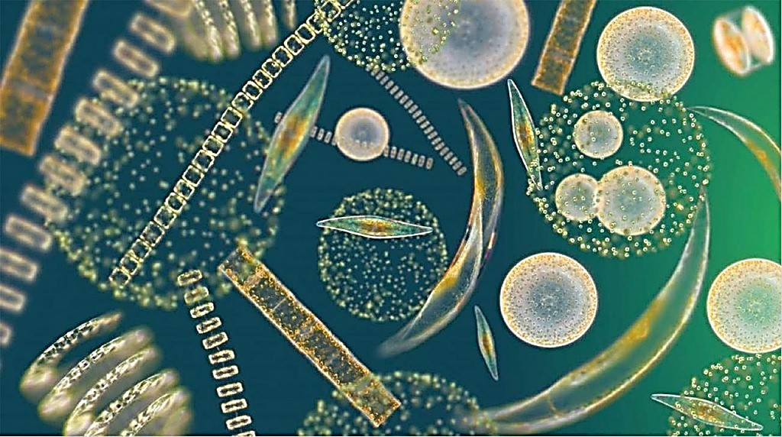
CELL DENSITY AND CHLOROPHYLL a CONTENT OF Navicula sp. EXPOSED TO THE DIFFERENT CONCENTRATIONS OF PESTICIDE CYPERMETHRIN
Fantonalgo, Raymund N.^{1,2,3}*, Calfaforo, Cyna E.⁵, and Escarpe, Jerlyn T.⁴
¹Graduate Student, Marine Science Institute, College of Science,
University of the Philippines Diliman, Quezon City, Philipines
²Faculty of Natural Sciences, Senior High School Department, College of Education, University of the East-ManilaCampus, Claro M. Recto Avenue, Sampaloc, Manila, Philippines
³Department of Environmental Science, School of Science and Engineering
Ateneo de Manila University, Loyola Heights, Quezon City, Philippines
⁴Department of Sciences, College of Arts and Sciences, Western Institute of Technology,
La Paz, Iloilo City, Philippines
⁵Project Evaluation Officer, Forestland Management Project, Department of Environment and Natural Resources VI, Parola St., Iloilo City Philippines

Slide 6
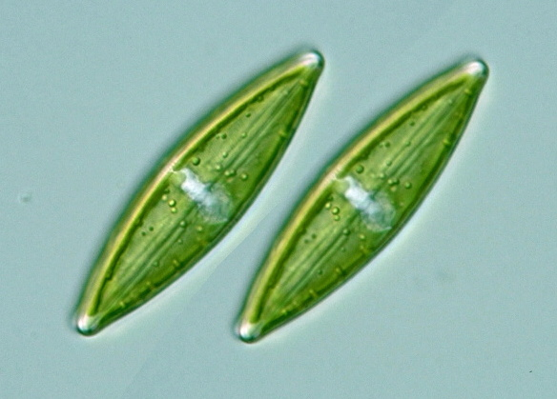
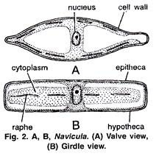
INTRODUCTION
What is Navicula sp.?
Latin for "small ship”
English for a “boat shaped incense-holder”
Taxonomic classification
Domain Eukarya
Kingdom Chromalveolata
Division Heterokontophyta
Class Bacillariophyceae
Order Naviculales
Family Naviculaceae
Source:http://protist.i.hosei.ac.jp/PDB/Images/Heterokontophyta/Raphidineae/Navicula/sp_06.html
Source: http://cdn.biologydiscussion.com/wp-content/uploads/2016/09/clip_image006_thumb2-1.jpg

Slide 7
INTRODUCTION
What is Cypermethrin?
One of the widely used insecticides
Use as a foliar application on food and feed crops
Very low volatility and water solubility
Source:https://www.chemservice.com/cypermethrin-n-11545-100mg.html

Slide 8
INTRODUCTION
Objectives of the Study
GENERAL
Evaluate the effects of cypermethrin to the cell density and chlorophyll a content of Navicula sp.
SPECIFIC
Determine the cell density of Navicula sp. during its log phase of culture at different concentrations of cypermethrin
Determine the chlorophyll-a content of Navicula sp. during the said phase of culture at various concentrations of cypermethrin
Determine if the cell density and the amount of chlorophyll a of Navicula sp. varied with the different concentrations of cypermethrin

Slide 9
INTRODUCTION
Significance of the Study
Inform the general public about the undesirable effects of pesticides on the aquatic environment which serves as habitat of the aquatic organisms like phytoplankton.
They may able to make precautionary measures on the utilization of the pesticides.
Furthermore, the results of the current study will create an avenue for the people to realize the value of the diatoms in the aquatic communities.

Slide 10
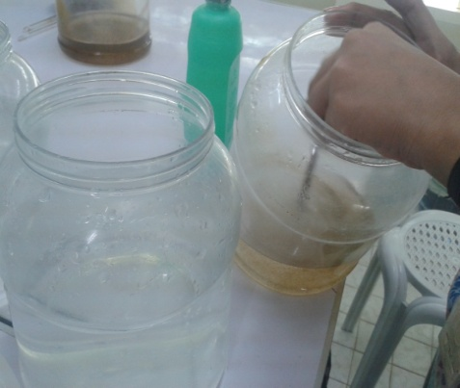
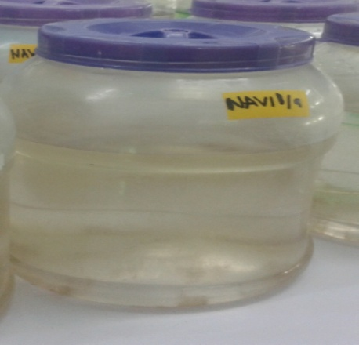
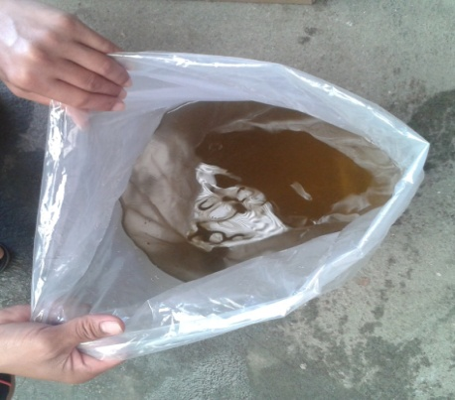
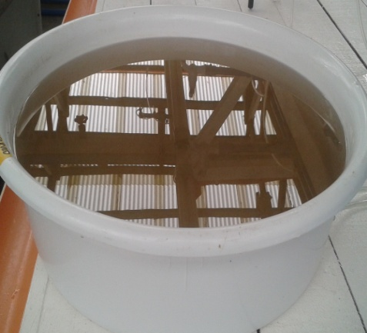
MATERIALS AND METHODS
CULTURE OF Navicula sp.
Pure culture
1-L pure culture enriched with F medium
3-L culture
enriched with TMRL
Transport of the diatoms

Slide 11
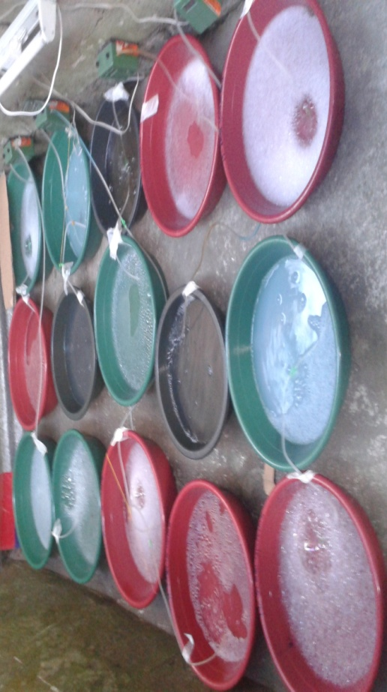
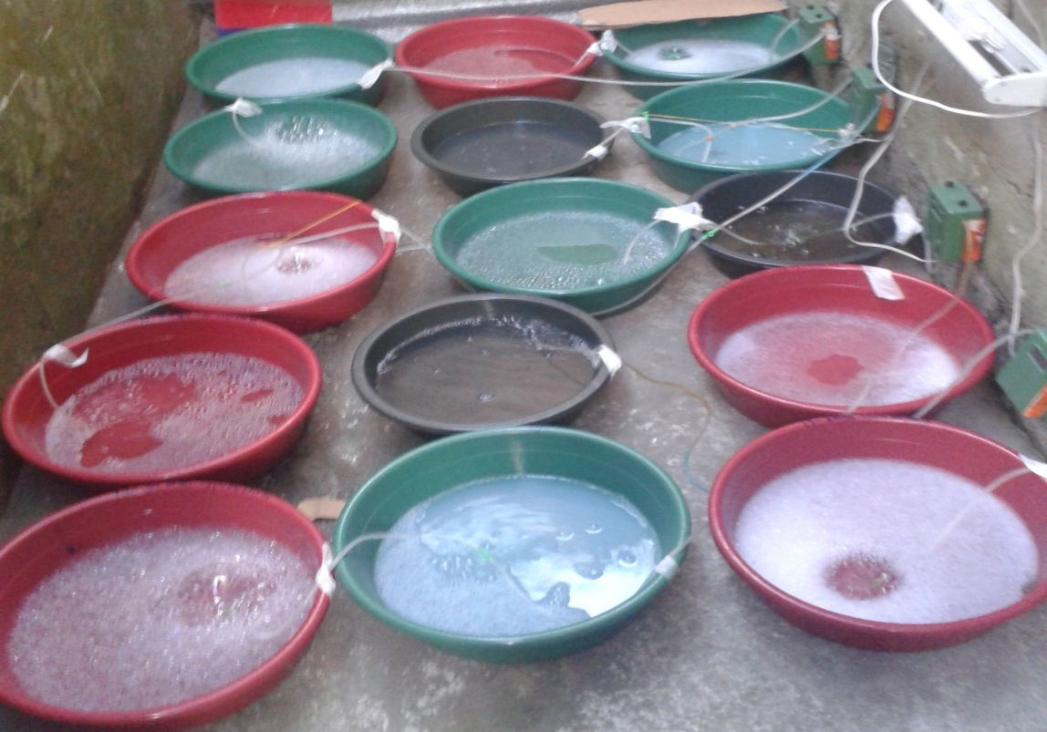
MATERIALS AND METHODS
EXPERIMENTAL SET UP
Design – Randomized Complete Block Design (RCBD)
TREATMENT 1 (without pesticide)
TREATMENT 2 (32ppm Cypermethrin)
TREATMENT 3 (16ppm Cypermethrin)
TREATMENT 4 (8 ppm Cypermethrin)
TREATMENT 5 (328ppm Chlorpyrifos)
T5
T3
T5
T4
T1
T3
TREATMENT 1 (without pesticide)
TREATMENT 2 (32ppm Cypermethrin)
TREATMENT 3 (16ppm Cypermethrin)
TREATMENT 4 (8 ppm Cypermethrin)
TREATMENT 5 (328ppm Chlorpyrifos)
T3
T1
T2
T2
T1
T4
T5
T2

Slide 12
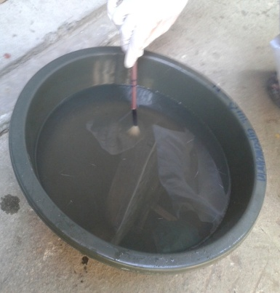
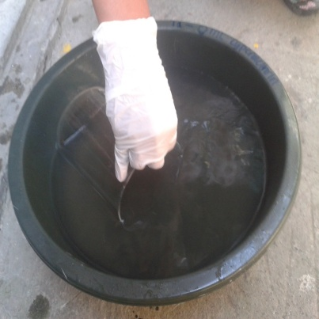
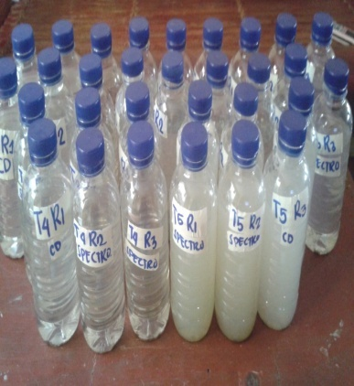
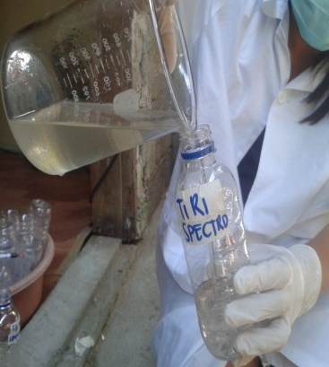
MATERIALS AND METHODS
HARVESTING OF Navicula sp.
Brushing the surface
of the basin
Getting 300 mL of Navicula sp. solution in each sample
Transport of 300mL Navicula sp. solution
Transfer to the
sterilized bottle
HARVESTING OF Navicula sp.

Slide 13
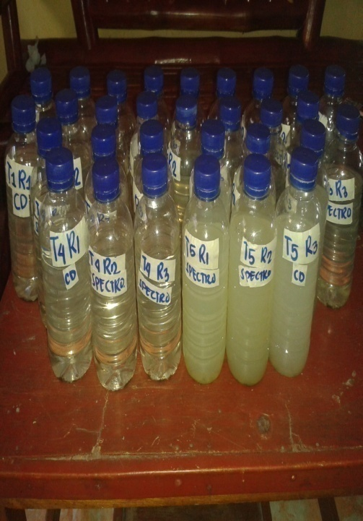
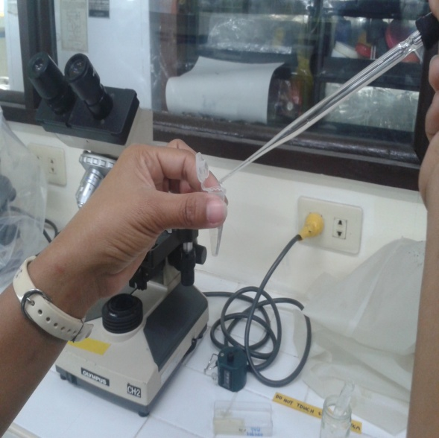
MATERIALS AND METHODS
PROCESSING OF THE SAMPLES
for Cell Counting
300mL Navicula sp. solution
Sample was placed in the Eppendorf tube
A drop of sample solution was placed in the hemaecytometer
A drop of bleach was added in the sample

Slide 14
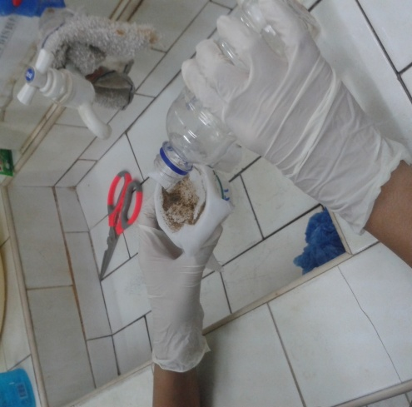
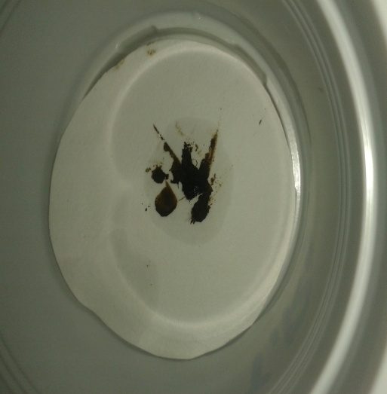
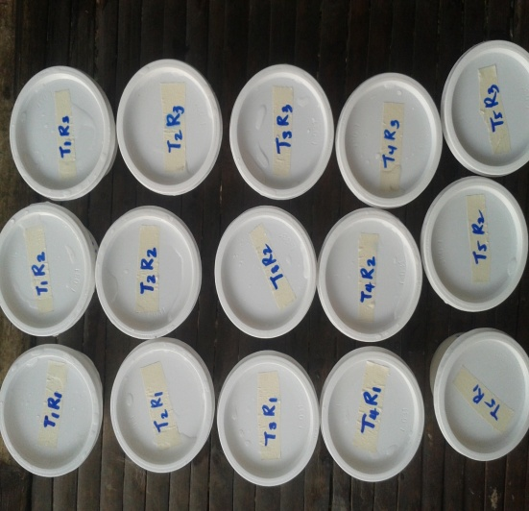
MATERIALS AND METHODS
PROCESSING OF THE SAMPLES
for Cholorophyll- a Content Analysis
Draining of the sample
Filtration
Storage

Slide 15
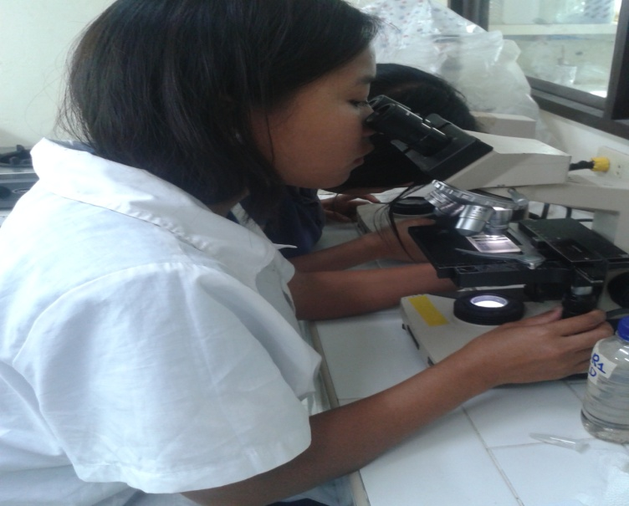
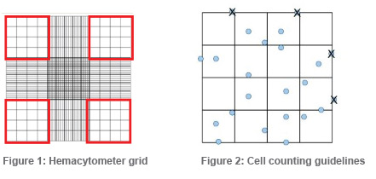
MATERIALS AND METHODS
DETERMINATION OF Cell Density of Navicula Sp.
Cell Density = (X .10⁴)/v
where: X = total cell count/no. of blocks counted
v= volume of sample put in a hemaecytometer
Total Cell Count= A + B + C + D + E
where:
A= number of cells in block A
B= number of cells in block B
C= number of cells in block C
D= number of cells in block D
E= number of cells in block E

Slide 16
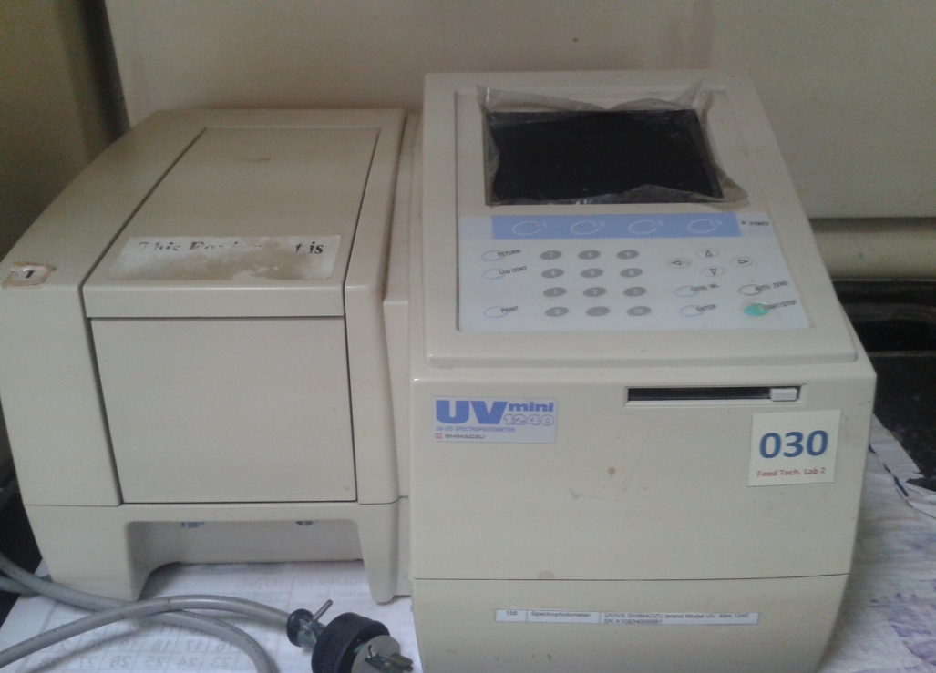
MATERIALS AND METHODS
DETERMINATION OF CHLOROPHYLL–a
Using spectrometric method
Formula for chlorophyll-a:
Chlorophyll a
= 11.6 E₆₆₅-1.31 E₆₄₅-0.14 E₆₃₀
The values were expressed in mg/m³.

Slide 17
MATERIALS AND METHODS
Statistical Analysis
Statistical Package for Social Sciences (SPSS) version 20.0 was used to process and analyze all the data collected.
One Way- Analysis of Variance (One- Way ANOVA) (p 0.05) was used to determine the significant differences in the cell density and chlorophyll a content in all treatments tested.
Duncan’s Multiple Range Test (DMRT) (p 0.05) was used a Post-Hoc test to determine the significance difference between the treatments tested.

Slide 18
RESULTS AND DISCUSSION
Figure 1. Cell Density (cells/mL) of Navicula sp. exposed to the different concentrations of cypermethrin

Slide 19
RESULTS AND DISCUSSION
Figure 2. Difference among the cell density of Navicula sp. exposed to the different concentrations of Cypermethrin p<0.05
 | Sum of Squares | df | Mean Square | F | Sig.
Between Groups | 285906666666.667 | 4 | 71476666666.667 | 7.948
Within Groups | 89933333333.333 | 10 | 8993333333.333
Total | 375840000000.000 | 14
.004

Slide 20
RESULTS AND DISCUSSION
Figure 3. Chlorophyll a content (mg/m³) of Navicula sp. exposed to the different concentrations of Cypermethrin
b
a
a
a

Slide 21
RESULTS AND DISCUSSION
Figure 4. Difference among the chlorophyll a content of Navicula sp. exposed to the different concentrations of Cypermethrin p<0.05
 | Sum of Squares | df | Mean Square | F | Sig.
Between Groups | 102845.873 | 4 | 25711.468 | 4.769
Within Groups | 53909.608 | 10 | 5390.961
Total | 156755.481 | 14
.021

Slide 22
RESULT AND DISCUSSION
RESULTS AND DISCUSSION
Cell Density of Navicula sp.
Results of the current study revealed that there was significant difference in the cell density of Navicula sp. among the treatments tested.
It is indicated that the cell density of this organism decreased as the concentration of cypermethrin was increased.
The reduction in the cell density of this diatom could be linked to the action of the cypermethrin as a pesticide.

Slide 23
RESULTS AND DISCUSSION
Cypermethrin consistently inhibited the algal population growth in concentrations from 50 to 250 mg/L (Sampson and Pickett-Heaps ., 2001)
Sampson and Pickett-Heaps (2001) observed that cytoskeleton, a cell part involved in cell division and management of the internal layout of the cell, is prone to damage, degradation and disruption once exposed to pesticides.

Slide 24
RESULTS AND DISCUSSION
Chlorophyll- a Content of Navicula sp.
Findings of the present study showed that there was significant difference in the chlorophyll a content of Navicula sp. among the treatments tested.
Chlorophyll a content of the diatoms decreased as the concentration of cypermethrin increased.
The decline in the chlorophyll a content of this organism can be linked to the action of the cypermethrin as a pesticide itself.

Slide 25
RESULTS AND DISCUSSION
The inhibition of photosynthesis of Anabaena by cypermethrin enhanced the degradation of pigments mainly for producing carbon skeleton to satisfy the energy demand of cells (Patra et. al., 2000)
The degradation of these photosynthetic pigments could be also due to the pesticide-thylakoid membrane interaction (Mohapatra and Schiewer, 2002).

Slide 26
CONCLUSION
Cypermethrin significantly reduced the cell density of Navicula sp. at its log phase the same way the positive control did to the diatoms.
Cypermethrin also reduced the chlorophyll-a content of Navicula sp. statistically the same as to the positive control.

Slide 27
RECOMMENDATION
The effects of cypermethrin on the cell density and chlorophyll-a content of Navicula sp should be tested in a lower dose or application.
Investigating the effects of cypermethrin on the cell density and chlorophyll-a content of other diatoms should be done in the future studies.
Investigating the effects of other pesticides on the cell density and chlorophyll-a content of other diatoms should be done in the succeeding research endeavor.

Slide 28
LIST OF REFERENCES
Antle, J. M., and P. L. Pingali .(1994). Pesticides, Productivity and Farmer Health – A Philippine Case-Study.
American Journal of Agricultural Economics 76:418-430.
Aoyama K, Iwahori K, Miyata N. (2003). Application of Euglena gracilis cells to comet assay: Evaluation of
DNA damage and repair. Mutant Rest/ Genet Toxicol Environ Mutagen , 538 (1-2): 155-162.
Arboleda Jr., G.J. (1998). General description ofthe fertilizer sector. Philippine Fertilizer and Pesticide
Authority. Available at:http://fpa.da.gov.ph/home2.html
Armstrong GA, Hearst JE (1996). "Carotenoids 2: Genetics and molecular biology of
carotenoid pigment biosynthesis". FASEB J. 10 (2): 228–37.
Badgley, C., J. Moghtader, E. Quintero, E. Zakem,M. J. Chappell, K. Avilés-Vázquez, A.Samulon, and I.
Perfecto. 2007. Organic agriculture and the global food supply. Renewable Agriculture and Food Systems 22:86-108.
Baldia, S. F., M. C. G. Conaco, T. Nishijima, S.Imanishi, and K.-I. Harada
Casotti R, Mazza S, Brunet C, Vantrepotte V,Ianora A,Miralto A(2005) Growth inhibition and to
Toxicity of the diatom aldehyde 2-trans, 4-trans-decadienal on Thalassiosira weissflogii
(Bacillariophyceae). J Phycol 41, 7- 20.
Castro, P. and Huber, M.E. (2013). Marine Biology, 9th Ed. McGraw-Hill Comapanies,
New York, USA.
Crossland, N. (1982) Aquatic toxicology of cypermethrin. II. Fate and biological effects in pond
experiments.Aquatic Toxicology 2:205-222.
Dahl B, Blanck H (1996) Toxic effects of the antifouling agent Irgarol 1051 on periphyton Communities
in coastal water microcosms. Mar Pollut Bull. 32 (4): 342-350.

Slide 29
LIST OF REFERENCES
De la Peña M.R.,Villegas, C.T., 2005. Cell growth, effect of filtrate and nutritive value of the tropical
Prasinophyte Tetraselmis tetrathele Butcher at different phases of culture. Aquac Res. 36, 1500–1508.
De Noyelles F, Kettle WD, Sinn DE (1982) The responses of plankton communities in Experimental
ponds to atrazine, the most heavily used pesticide in the United States. Ecology. 63 (5): 1285-1293.
Debenest T, Silvestre J, Coste M, Delmas F, Pinelli E (2008) Herbicide effects on freshwater Benthic
diatoms: Induction of nucleus alterations and silica cell wall abnormalities. Aquat Toxicol
88(1) :84-94.
Desai S, Verlicar X, Nagarajappa N, Goswami U (2006) Genotoxicity of cadmium in marine Diatom
Chaetoceros tenuissimus using the alkaline Comet assay. Ecotoxicology 15(4): 359-363.
Dioquino, C.C. (2002). Report on pesticide poisoning in the Philippines. National
Institute of Health and Sciences. 7th GINC meeting. Tokyo, Japan. Available at: http://www.nihs.go.jp/GINC/meeting/7th/profile.html
Dougherty, R.C.; Strain, H. H.; Svee, W. A.; Uphaus, R. A.; Katz, J. J. (1990). "The Structure, Properties, and Distribution of Chlorophyll c". J. Am. Chem. Soc. 92 (9): 2826–2833.
Dudley, G.H., Sumich J. L., and Cass- Dudley, V. L. (2012). Laboratory and Field
Investigatioins in Marine Life 10th Edition. Jones and Bartlett Learning, LLC, USA
Eisen JA, Nelson KE, Paulsen IT, et al. (2002). "The complete genome sequence of Chlorobium
tepidum TLS, a photosynthetic, anaerobic, green-sulfur bacterium". Proc. Natl. Acad. Sci. U.S.A. 99 (14): 9509–14.
Fantonalgo, RN., de la Pena, M., Seraspe, EB., Pahila, IG., & Katalbas, MSFS. (2009).
Pharmacological Activities of the Crude Methalonic Extracts of Nitzschia paleacea Grunow
Food and Agriculture Organization. (2004).Gateway to Land and Water Information.Country Reports:
the Philippines. Available at:http://www.fao.org/ag/AGL/swlwpnr/reports/y_ta/z_ph/ph.htm

Slide 30
LIST OF REFERENCES
Gold C, Feurtet-Mazel A, Coste M, Boudou A (2003) Effects of cadmium stress on Periphytic Diatom communities in
indoor artificial streams. Freshwater Biol 48 (2): 316-328.
Gomez N, Licursi M (2003) Abnormal forms in Pinnularia gibba (Bacillariophyceae) in a Polluted lowland
stream from Argintina. Nova Hedwigia 77 (3-4): 389-398.
Guiry, M.D. and Guiry, G.M. (2008). "Navicula". AlgaeBase. World-wide electronic National University of Ireland, Galway.
Gupta S. & Agrawal SC. (2007). Survival and motility of diatoms Navicula grimmei and Nitzschia palea
affected by some physical and chemical factors. Folia Microbiol (Praha), 52(2):127-34.
Jeffrey, S. W. (2014). "The Occurrence of Chlorophyll c₁ and c₂ in Algae". Journal of Phycology 12 (3): 349–354.
Mohapatra P.K., Schiewer U. (2000). Arch. Hydrobiol.Suppl., 134, 79.
Mostafa FI, and Helling CS. (2002). Impact of four pesticides on the growth and metabolic activities of two
photosynthetic algae. J Environ Sci Health37: 417-444.
Nystrom B, Becker-van Slooted K, Berard A, Grandjean D, Druart JC, Leboulanger C.Toxic effects of
Irgarol 1051 on phytoplankton and macrophytes in Lake Geneva.Water Resources 36(8): 2020-2028.
Papageorgiou,G, and Govindjee,M. (2004). "Chlorophyll a Fluorescence, A Signature of Photosynthesis" 19.
Springer. p. 14,48,86.
Pickett-Heaps J, Spurck PT. (1989). Studies on kinetochore function in mitosis.II. The effects of
colchicine and cytochalasin on mitosis in the diatom Hantzschia amphioxys. Eur J Phycol 28: 83-91.
Pickett-Heaps J, Spurck T, Tippit D (1984) Chromosome motion and the spindle matrix. J Cell Biol 99 (1): 137-143.
Raven, P.H.; Evert, R.F.; Eichhorn, S.E. (2005). "Photosynthesis, Light, and Life". Biology of
Plants (7th ed.). W.H. Freeman. pp. 119–127.
Umemura K, Haneda T, Tanabe M, Suzuki A, Kumashiro Y, Itoga K, Okano T, Mayama S. (2013). Semi-circular
microgrooves to observe active movements of individual Navicula pavillardii cells. J Microbiol Methods.
92(3):349-54.

Slide 31
ACKNOWLEDGEMENT
Ms. Ana Fia Japitana, Biological Science Laboratory Custodian & Mrs. Jerlyn Solatorio, Chemistry Laboratory Custodian of Western Institute of Technology , Iloilo City, Philippines for attending our laboratory needs
Western Institute of Technology for allowing us to process our algal samples
Southeast Asia Fisheries Development Center/ Aquaculture Department (SEAFDEC/AQD Department), Tigbauan, Iloilo, Philippines for allowing us to analyze the chlorophyll content of Navicula sp. and to determine its cell density.
Ma’am Annie Franco and the rest of the researchers in the Natural Larval Food Laboratory, SEAFDEC for providing us the pure culture and teaching us how to culture and to count the count the Navicula cells.
Engr. Marget Arnaiz (Laboratory Manager) and Ma’am Panizales (Chemist) of Analytical Chemistry Laboratory of SEAFDEC for helping us to determine the chlorophyll content of our diatoms.
University of the East Manila and Ateneo de Manila University, Philippines for supporting my travel

Slide 32
THANK YOU VERY MUCH FOR LISTENING ATTENTIVELY !!!!
- The researchers

