Slide 1

About OMICS Group
OMICS Group International is an amalgamation of Open Access publications and worldwide international science conferences and events. Established in the year 2007 with the sole aim of making the information on Sciences and technology ‘Open Access’, OMICS Group publishes 400 online open access scholarly journals in all aspects of Science, Engineering, Management and Technology journals. OMICS Group has been instrumental in taking the knowledge on Science & technology to the doorsteps of ordinary men and women. Research Scholars, Students, Libraries, Educational Institutions, Research centers and the industry are main stakeholders that benefitted greatly from this knowledge dissemination. OMICS Group also organizes 300 International conferences annually across the globe, where knowledge transfer takes place through debates, round table discussions, poster presentations, workshops, symposia and exhibitions.

Slide 2
About OMICS Group Conferences
OMICS Group International is a pioneer and leading science event organizer, which publishes around 400 open access journals and conducts over 300 Medical, Clinical, Engineering, Life Sciences, Pharma scientific conferences all over the globe annually with the support of more than 1000 scientific associations and 30,000 editorial board members and 3.5 million followers to its credit.
OMICS Group has organized 500 conferences, workshops and national symposiums across the major cities including San Francisco, Las Vegas, San Antonio, Omaha, Orlando, Raleigh, Santa Clara, Chicago, Philadelphia, Baltimore, United Kingdom, Valencia, Dubai, Beijing, Hyderabad, Bengaluru and Mumbai.

Slide 3
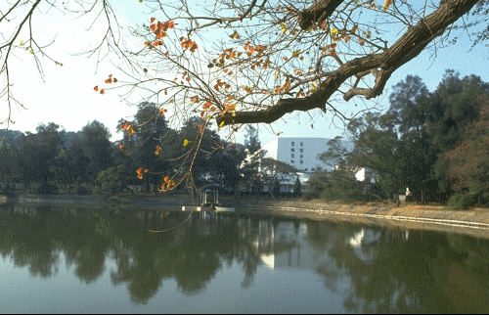


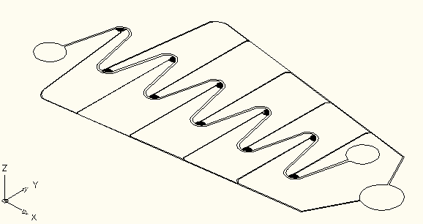
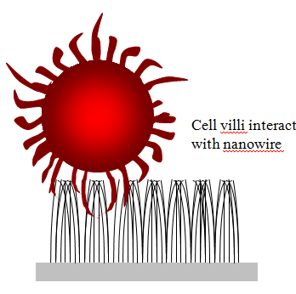
A Nano/Micro Fluidic System for
Circulating Tumor Cells (CTCs) Rapid Detection and Diagnosis
Red/White blood cell separation
CTCs Detection by
SACA
CTCs enrichment
Fan-Gang Tseng^{a,b,c,} Ren-Guei Wu^{a,b,} Tsung-Ru Chenª, Yu-Cheng Changª, Wei-Ru Tseng^{b}, Hsuan-Hsuan Linª, Chung-Shi Yang ^{a,b}
ªDepartment of Engineering and System Science,
National Tsing Hua University, Hsinchu, Taiwan 300
^{b} Center for Nanomedicine Research,
National Health Research Institutes, Zhunan, Taiwan 350
^{c} Division of Mechanics, Research Center for Applied Sciences, Academia Sinica, Taipei, Taiwan 115

Slide 4
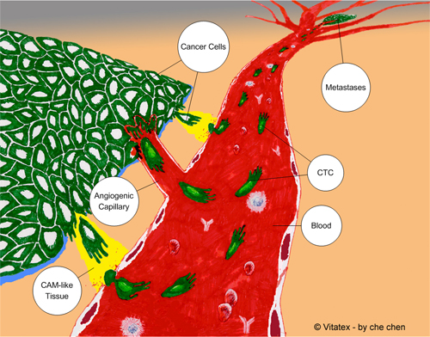
The main technical challenge of CTCs detection
Cancer
cells
Main spread way of metastases
1. nearby tissues spread
2. blood system spread
3. lymphatic system spread
The importance of CTCs amount
Challenge:
rare amount of CTC: 1-10 CTCs/1ml
low separation effcientcy: 1 CTCs/10⁶⁻⁷ WBCs
low sensitivity: 40-50% (specific antibody)
Metastases
CTC
Blood
4

Slide 5
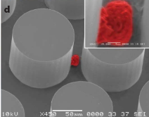
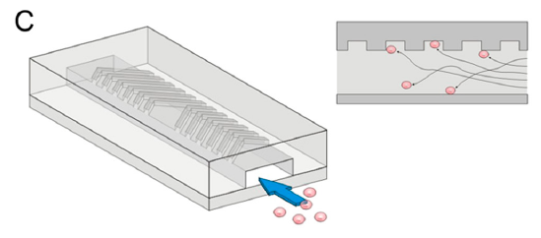
CTCs separation and capturing in whole blood
A
Posts fabricated from Si wafer
  100 µm diameter
  100 µm tall
Posts coated with anti-EpCAM
Whole blood flowed through device by pressure source
mL-scale volumes
SEM of Si posts with captured cancer cell (S Nagrath, et al. Nature, 2007)
Shannon L. Stotta, PNAS, 2010
High sensitivity (1 target cell in 1 billion blood cells)
Selectivity (47%(A), 63%(B) capture efficiency)
High yield (99(A)% ,95%(B)).
B
Max flow of ~1 mL/hr to 2.5 mL/hr
4-12 hours to run sample
Non-specific binding and clogged
Without sample preconcentration

Slide 6
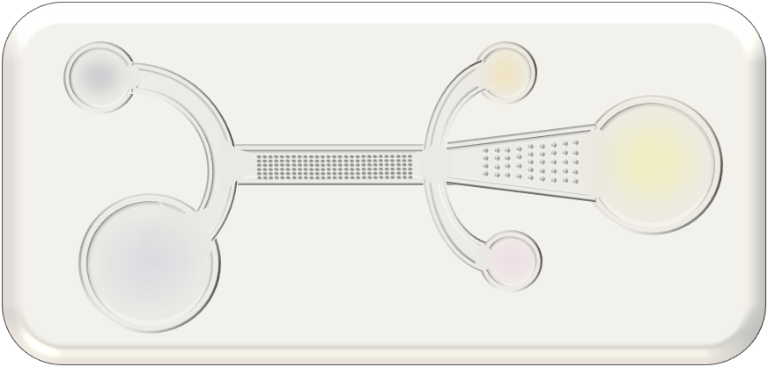

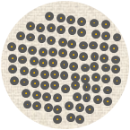
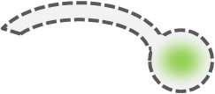
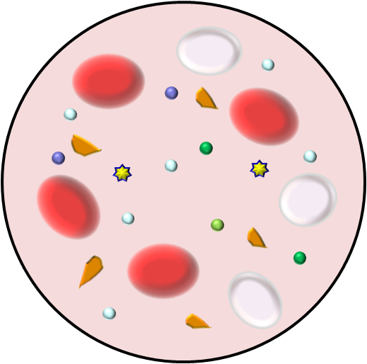
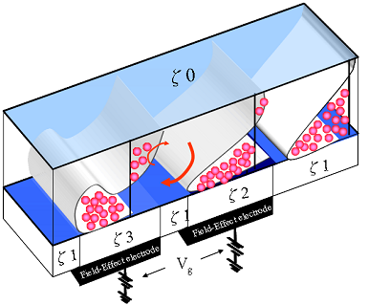
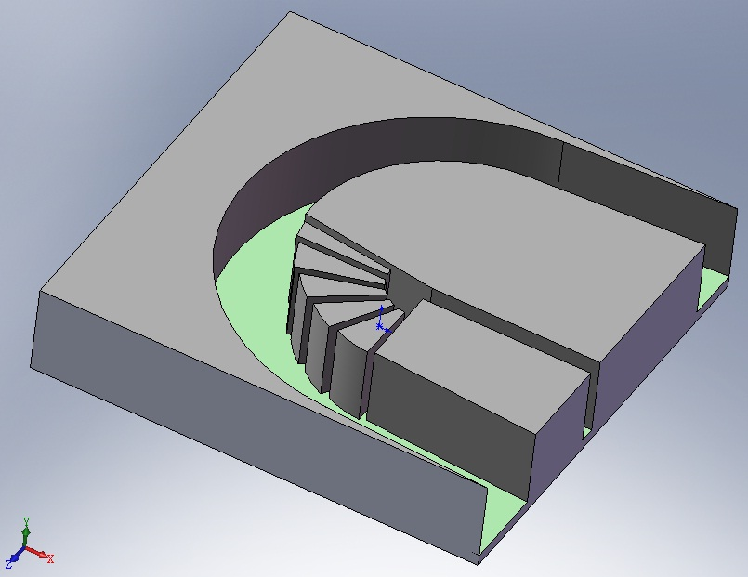
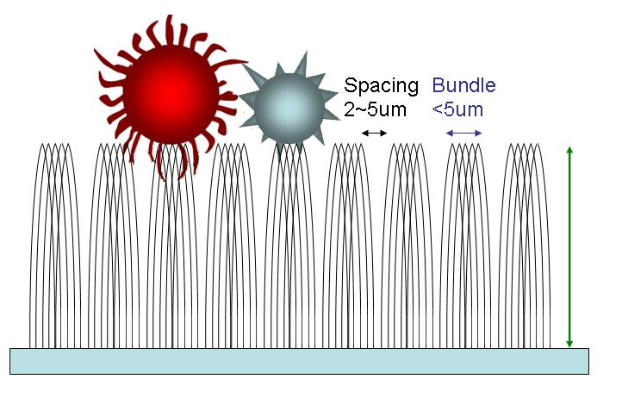
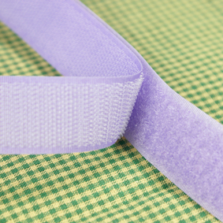
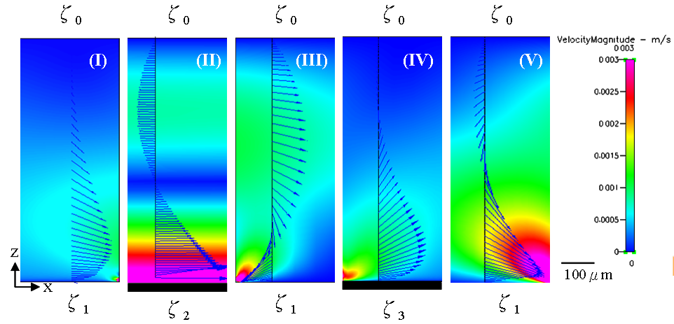

RBCs : WBCs : CTCs
10¹ : 10⁴ : 10¹
RBCs : WBCs : CTCs
10⁸⁻⁹ : 10⁶ : 10¹
RBCs : WBCs : CTCs
10⁶ : 10⁶ : 10¹
Washing
Blood
Nanofluidic channel
Dual-Asymmetry Electrokinetic Flow (DAEKF) Focusing
High Density Cell Self-assembly Array
Hydrodynamic and Inertial Force for cells separation
Silicon Nanowire Enhance CTCs Capture Yield
Red blood cell
CTCs
WBCs
Cancer Cell
Proteins, minerals, salts…etc
Tumor cells
gap: 7μm
White blood cells
Other cells
6-20um
Platelet
White blood cell

Slide 7
Part I:
High-Throughput Blood Cells Separation

Slide 8
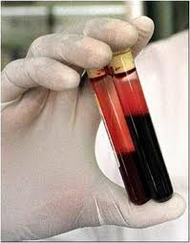
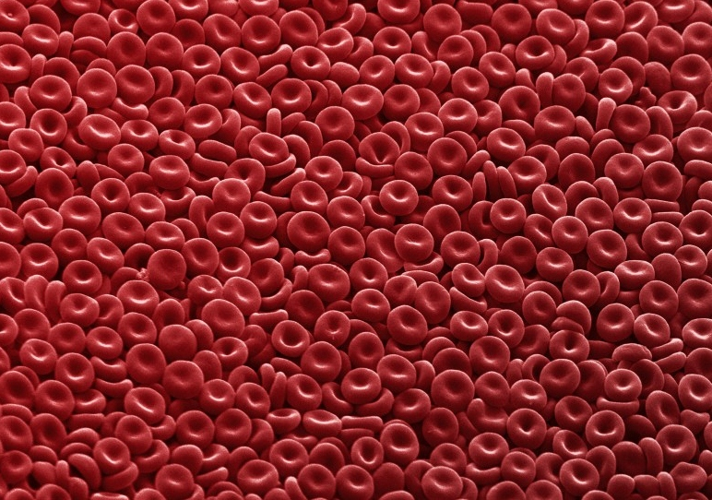
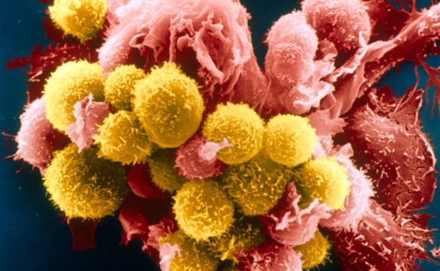
The Challenge in early CTCs detection
?
?
?
?
?
?
Science Photo Library
Science Photo Library
Red Blood Cell Count (RBCs, 7-9 µm) (Male)
3.8-5.5x10⁹/mL (Female)
3.8-5.5x10⁹/mL (Infant/Child)
White Blood Cell Count
(WBCs, 8-12µm)
Cancer cell (CTCs) count
Stage O/I:
Stage II : 20-50/ml
Stage III : 50-100/ml
Stage IV: >100/ml
4.3-6.2x10⁹/mL
5-20/mL
4.1-10.9x10⁶/mL
Limits of current detection:
Low sensitivity and reliability
Take a long processing time and low recovery rate
>20cells/mL (possibility: 20~60%)
>1hr & 80~%

Slide 9
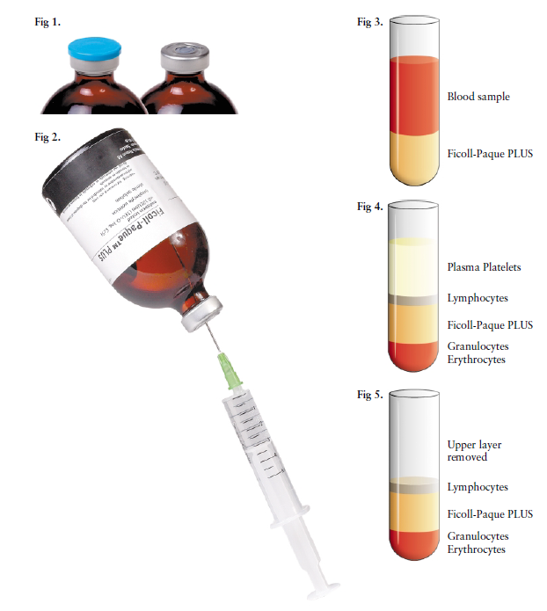
Current technologies for cells separation
Flow Cytometry
3. Lysis Buffer (細胞裂解溶劑)
Microfluidic System
Laminar flow
By using chemical buffer to create osmotic pressure difference between the cell membrane and environmental, specifically use to cleavage and removal of mammalian red blood cells or without nuclei cells in whole blood samples 。
~10⁴cells/s
Cells Detection
Optical System
Laser excitation
~10⁴/s, 1hr for 1cc, 90% purity
Recover rate~40-50%
~28 Hrs for 1cc
Cells Sorting
Electronic System
Histogram FSC & SSC
~ 90~99% purity
Recovery rate~95%
2. Magnetic-Activated Cells Sorting (磁性細胞分選儀)
By using magnetic-beads combine with high specific monoclonal antibody bind onto the surface antigen of target cells。When the cell enter into magnetic field, label and unlabeled cells can be separated 。
The magnetic-beads diameter is 50nm。
~10⁷cells/s, ~10 min for 1cc, 99% purity
Recovery rate~70-90%
Notes:
FACS 所偵測的訊號是以一個細胞或顆粒，被雷射光激發後產生的光學訊號，再轉換成電子訊號由電腦分析細胞或顆粒的特性，稱為FACS scanner。加上正或負的電荷，並利用高壓電場使水滴產生偏折，則可篩選所要的細胞。
當細胞或顆粒被雷射光激發後，則會產生0.5– 5 之前散射光（forward scatter， FSC）及15– 150 之側散射光（side scatter 或 right-angle scatter 或SSC）。當顆粒本身帶有 螢光物質（fluorochrome），或被帶有螢光物質的抗體或被其它螢光物質染上的話，則會產 生波長不等的螢光（見圖四）。由於入射光的波長小於螢光的波長，因此由光的波長及強度 變化，即可測出顆粒的大小（與FSC 成正比），顆粒性（與SSC成正比）與特定抗體或螢光物質結合情形。例如細胞可被帶FITC（黃綠色螢光）的anti-CD3 抗體及帶PE（紅色螢光）的anti-CD4 抗體結合，當細胞以波長488 nm argon laser 激發後，則除了FSC 及SSC外，還會發出520 nm（FITC）及576 nm（PE）的螢光，這4 種波長及強度，則可透過一連串的光學鏡片及偵測器，轉變成電子訊號，並以電腦加以記錄及分析，或可進一步依所要求的參數（parameter）將細胞分離篩選（sorting）。

Slide 10
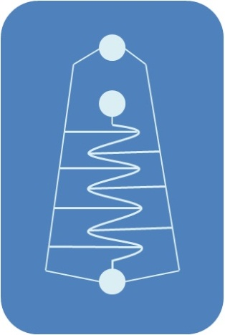
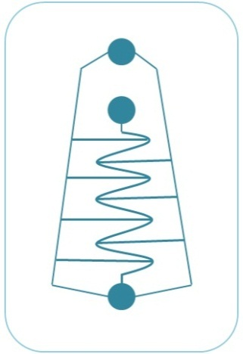
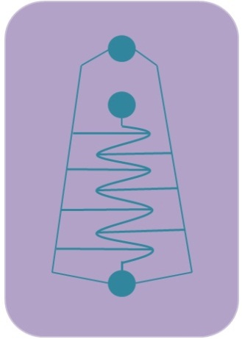
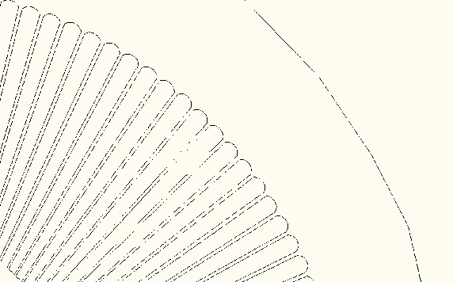
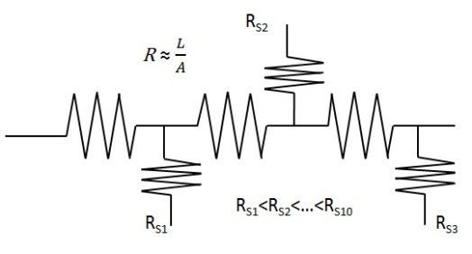
High Efficient Blood Cells Separation
Chip Size | Sample load | Process tIme
Main channel (L) 28 cm (WxH) 200 x 580 µm² | 10X dilution 4.3x10⁸ cells/mL | (~400µL/min) 25min.
SU-8
Inlet
(Whole Blood)
Master
Collection Chamber
(Leukocytes)
PDMS
Waste Chamber
(Erythrocytes)
gap: 7μm

Slide 11
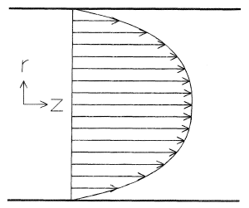


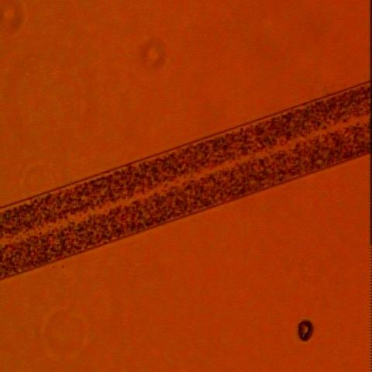
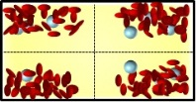
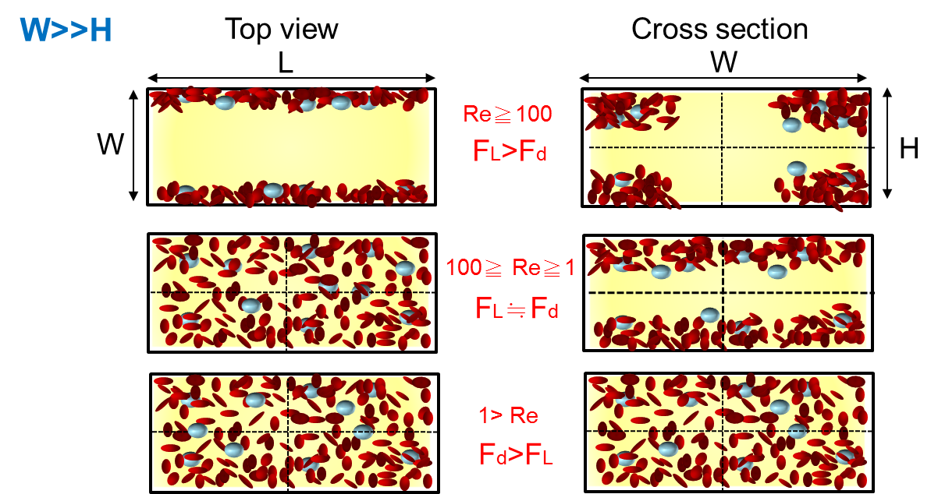
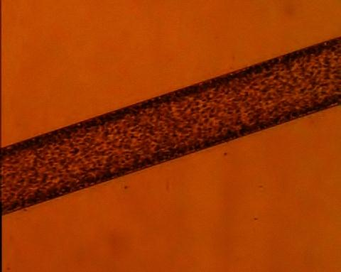
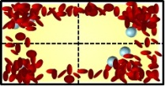
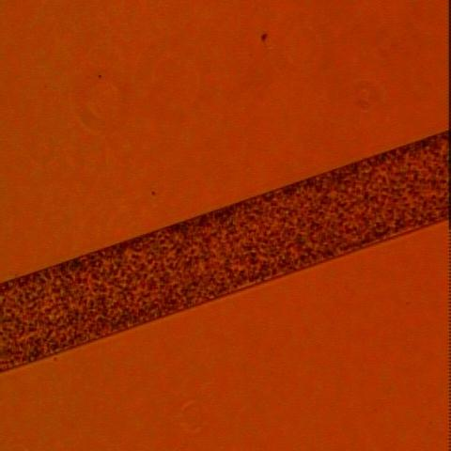
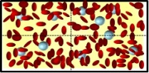
Theory analysis of Hydrodynamic and Inertial Force
1. Straight Channel
Lift Force (F_{L})
Stokes Drag (F_{D})
FL
u
Shear Rate (G)
Viscosity (µ)
Fd
2WH
W
2
L=
ap
3(W+H)Re
(a)
Re >100
L: Length for enough separation
Cross section view
Mag. 4x
100μm
(b)
1< Re <100
Cross section view
Mag. 4x
100μm
(c)
Re <1
Cross section view
Mag. 4x
100μm

Slide 12

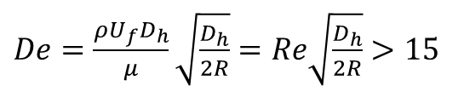
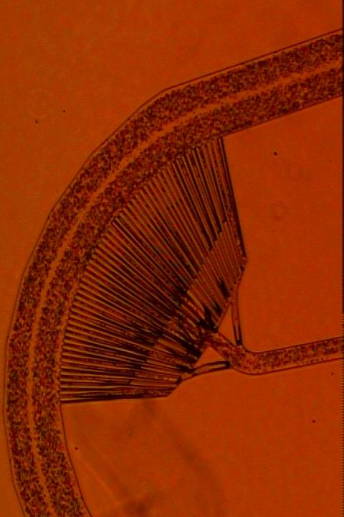
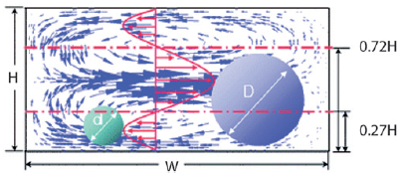
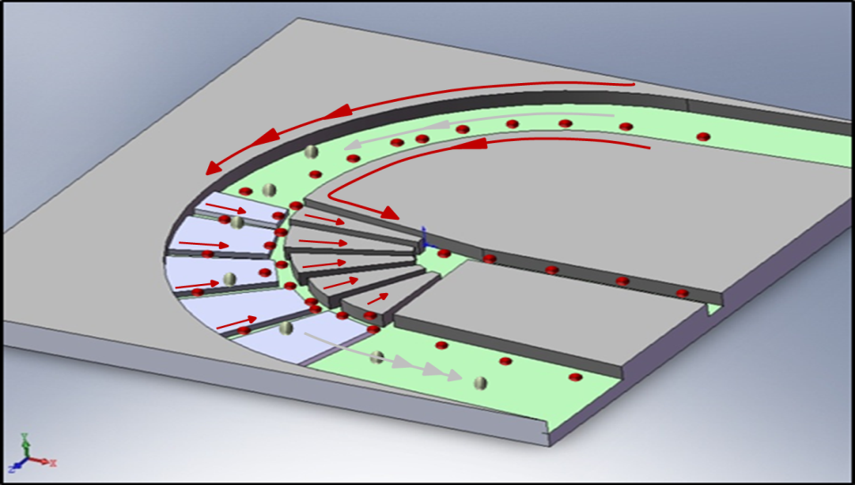
Theory analysis of Hydrodynamic and Inertial Force
2. Curved Channel
Injection rate: 100 µL/min.
Cross section
Top view
R
Suction rate: 20 µL/min.
100μm
3. Obstacle Channel
Side of view
Top of view

Slide 13

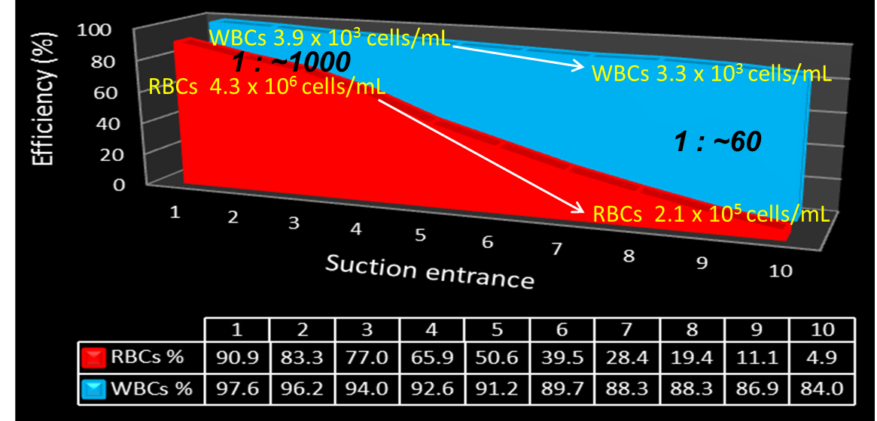
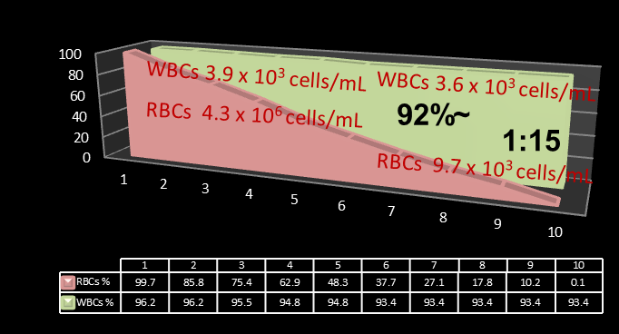
Results
Re≧100

Slide 14
Part II: Silicon nanowire biochip applied
on circulating tumor cells detection

Slide 15
Nano structure enhance capture yield
Microvilli are cellular membrane protrusions, important for of cells to interact with environment, forming brush border, common in epithelial cells
  Microvilli also appears on the cell surface of white blood cells, help the migration of white blood cells.
  The microvilli on the surface appears longer on cancer cell(left, 5&2.6 um) than normal cell(right, 2.4 um).
  our research plan to enhance cancer cell capture rate from WBCs by utilizing the length of microvilli.
5um
SEM
TEM
2um
Igor Sokolov et al, 2009,
Nature nanotechnology
Notes:
1.Microvilli (or microvillus) are microscopic cellular membrane protrusions(突出物) that increase the surface area of cells, and are involved in a wide variety of functions, including absorption, secretion(分泌), cellular adhesion
2. Thousands of microvilli form a structure called the brush border that is found on the apical(頂端) surface of some epithelial cells, such as the small intestinal enterocyte(intestinal absorptive cells) and the kidney proximal tubule
3. Microvilli are also of importance on the cell surface of white blood cells, as they aid in the migration of white blood cells.
4.由於癌細胞表面絨毛結構較一般正常細胞長(圖為癌化子宮頸細胞與正常子宮頸細胞) ，因此奈米柱結構可以增加癌細胞捕捉效率，

Slide 16
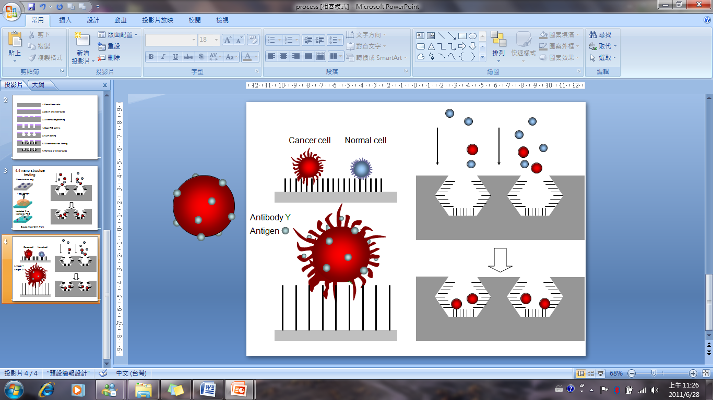
Principle of nanowire-cell villi interaction
Cancer cell capture
Cell villi interact with nanowire
Gap
2-5um
Boundle
< 5um
6-20um
Velcro
Notes:
細胞的捕捉原理是藉由癌細胞表面較長的絨毛部分與奈米線反應,
概念與魔鬼氈相似,長纖毛深入奈米線後比短纖毛更易被卡住

Slide 17
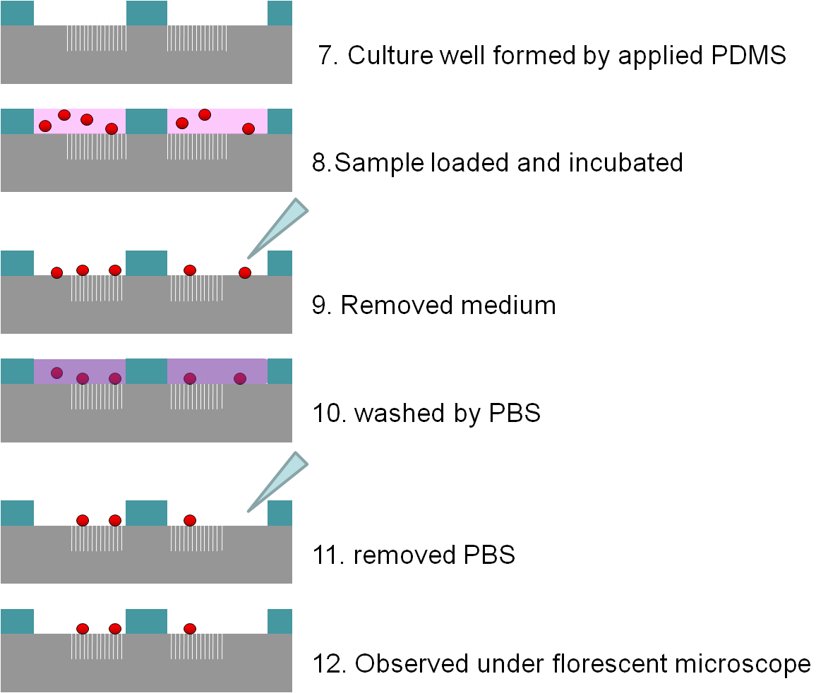
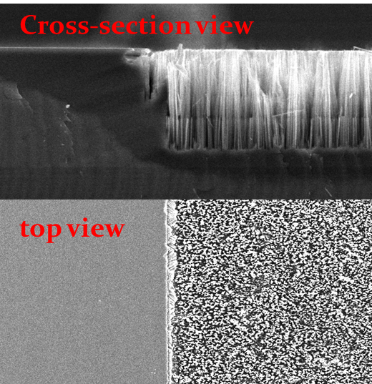
Experimental process and chip fabrication
Conditions:
Incubated time
Nanowire length
Si nanowire forming
Wafer
AgNO3+HF
HF etching
Gap:1.5~2um
aggregation:1~1.5um

Slide 18
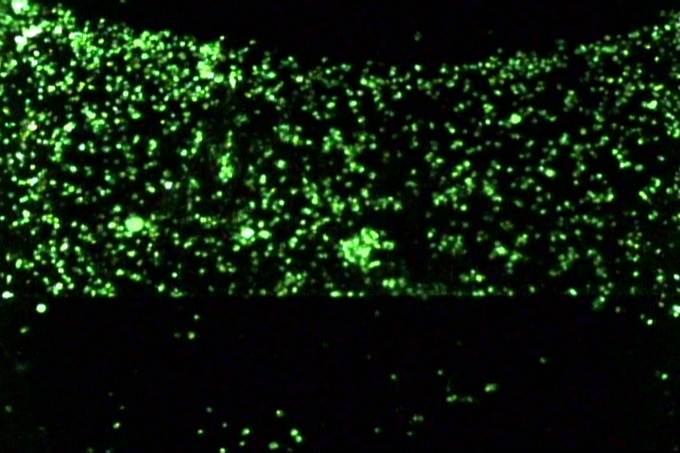

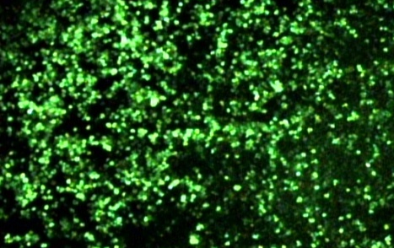

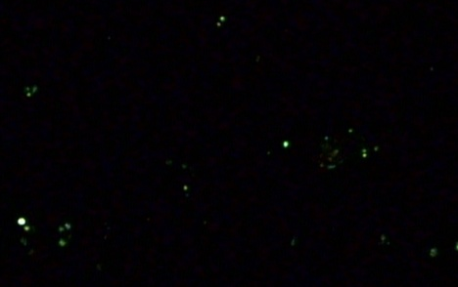

Cancer cell (HCT-8) with WBCs(1:1) capture ratio
with variable Incubated time
Incubated time | Green emission | Red emission
3hr
6hr
8hr

Slide 19
The capture result of different incubated time
Retention rate of two phase chip
1.Maximun of cancer cell number appears at 4 hours
2.Mixed two cell result in lower capture cell number

Slide 20
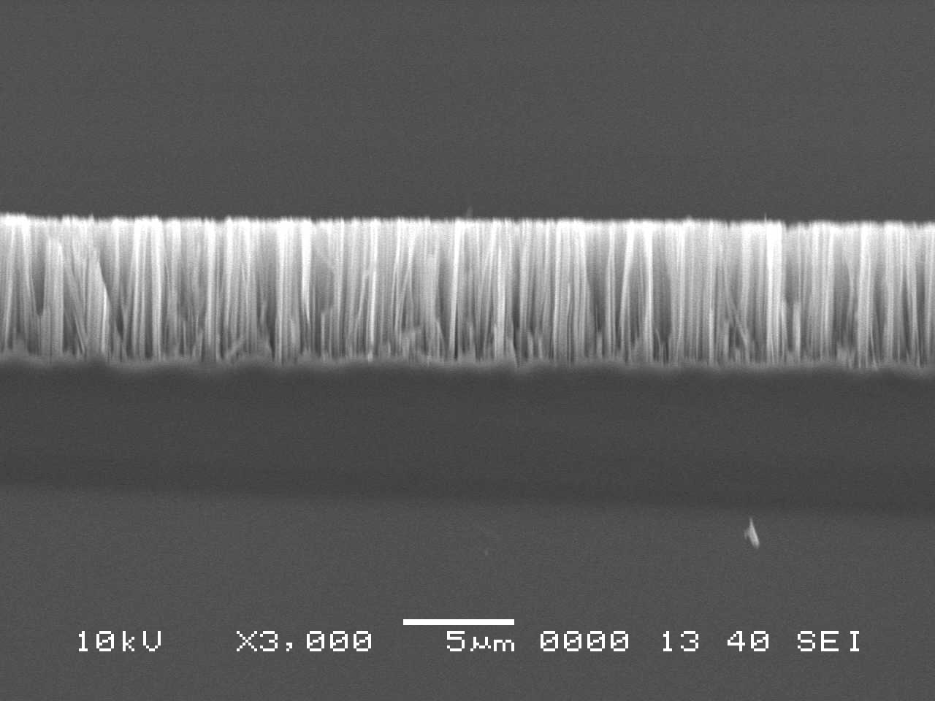
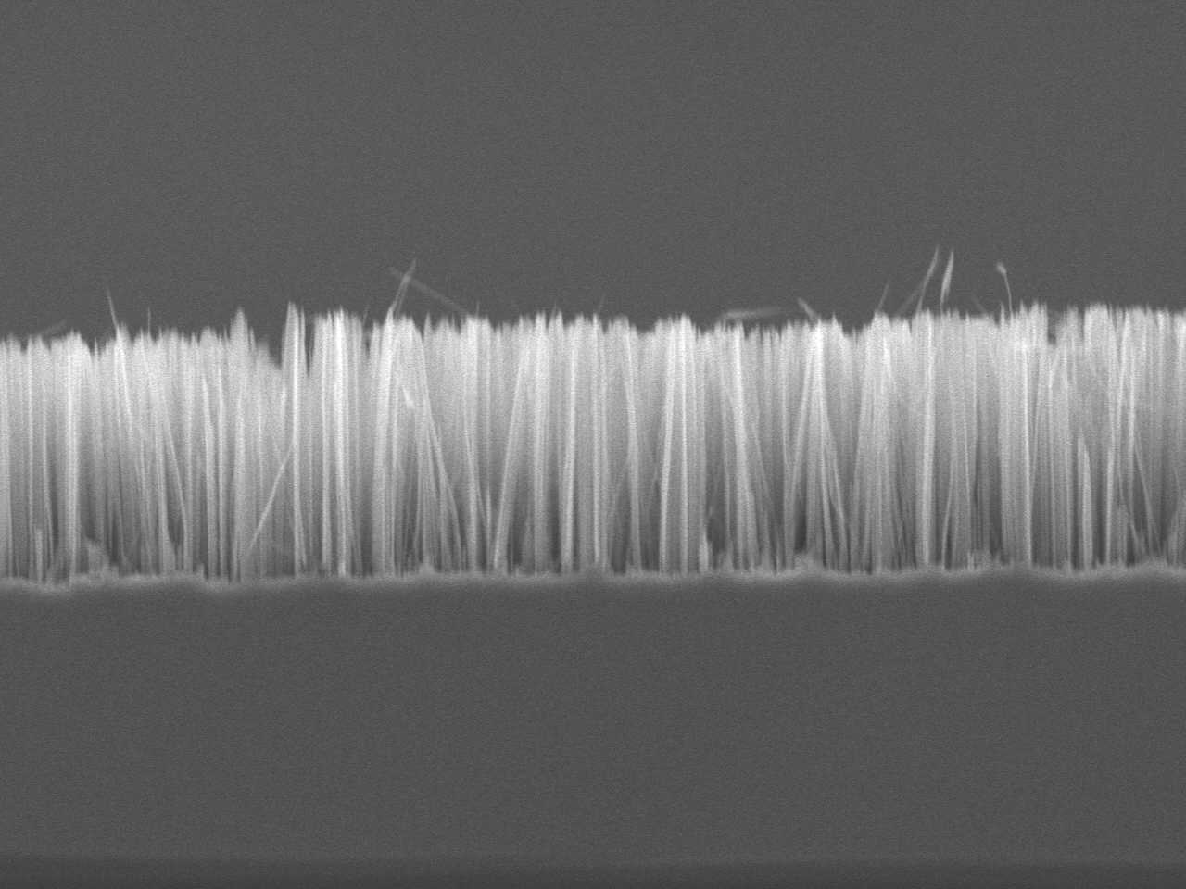
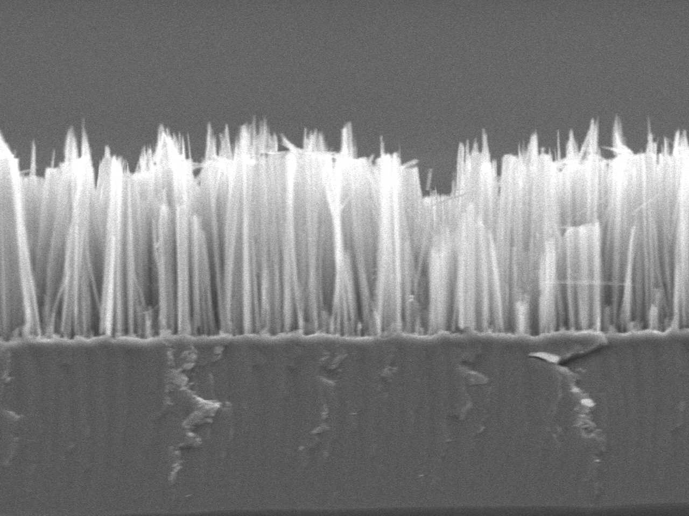
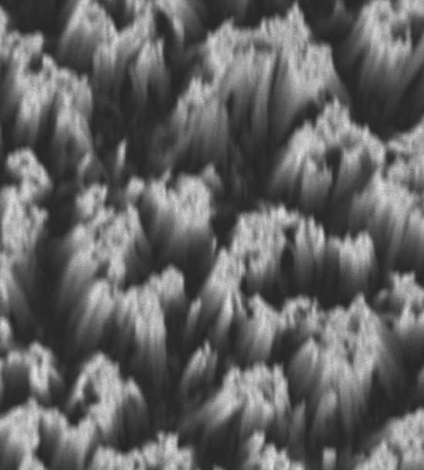
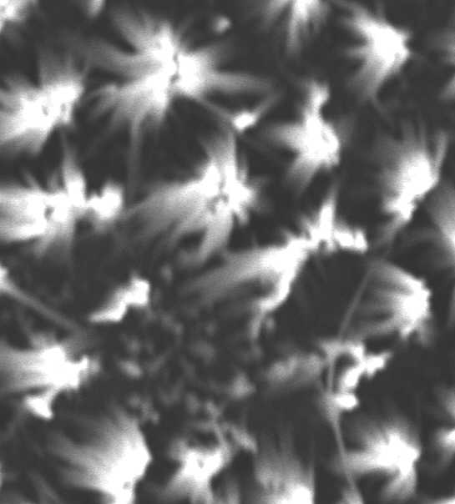
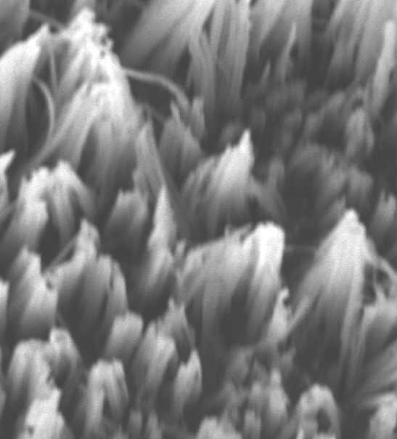






Etching time V.S. nanowire length
3 mins
5 mins
7 mins
13 mins
15 mins
20 mins
Notes:
可以藉由調控蝕刻時間成長出不同長度的奈米線
右下角為上視圖

Slide 21










Cancer cell (HCT-8)/WBCs(1:1) capture ratio
with variable length
Notes:
雙相晶片 with different lngth:上半部為平面silicon,下半部為矽奈米線

Slide 22
The capture result of different length
Retention rate of two phase chip
capture rate of two phase chip
When incubated under the same time, the highest retention rate appeared at 14.8 um length nanowire.
The 14.8 um length nanowire corresponds to 80% capture rate.
Notes:
Density : boundle area/ whole area
Spacing : between boundle and boundle

Slide 23
Part II: High Density Cell Array Chip
for In-Parallel Detection of CTCs

Slide 24
High Density Cell Monolayer Array
for in-parallel Detection
Distinguishing ratio>100,000:1
Tumor cells
White blood cells
Assembly time <10 min
Other cells
High throughput: (10⁶ cells)/cm²)
Step 1:
Step 2:
Step 3:
Cells stained with dye
Cells with GTA fixation
647nm : Background cells
Cells stained with dye
488nm : Target cells
Single type cells
Two type cells with one stained
Two type cells stained differently

Slide 25
Principle of high density
Self-Assembly Cell Array (SACA)
Major mechanisms:
Gravitation force
lateral flow by evaporation
3.Cell restriction into the ceter
Cell dispensing pore
Liquid evaporation
Cell restriction channel
8mm
10 μm厚 SU-8
>10μm
10μm
8mm
FOTS 修飾
1mm
gravity
Glass substrate
PBS
10μm
Glass substrate
Side flow

Slide 26














Self Assembled Cell Array (SACA) Chip
With side channel
NO side channel
A
C
10μm
B
Gravity force
Side fluid force
Side channel block cells
10X white blood cells
Hela cells in white blood cells
1 M cells/cm²
1:100
1:10000
20X white blood cells
100μm
200μm
T.J Chang, and FG Tseng, Biomicrofluidics, 2014

Slide 27

Mechanism for Cell Self-Assembly
Radiation flow
Brownian Motion
Slide over

Slide 28










Two different cells
Target cells: HeLa with Alexa Fluor 488nm (green)
Backgroud cells: MCF-7 with Alexa Fluor 647nm (red)
1:10
1:100
Ex 647nm
100μm
100μm
1:10
1:100
Ex 488nm
100μm
100μm
Merged

Slide 29










Two different cells (cont.)
Target cells: HeLa with Alexa Fluor 488nm (green)
Backgroud cells: MCF-7 with Alexa Fluor 647nm (red)
1:1000
1:10000
100μm
400μm
1:1000
1:10000
Easy to identify target cells
100μm
400μm
Distinguish ratio reaches: 10000:1

Slide 30

Distinguishing Ratio
More than 10,000 to 1

Slide 31



Sensitivity Test
HeLa: WBC | Mixed HeLa cells number | Detected HeLa cells number | Average deviation value
1:10,000 | 29 34 41 | 27 30 38 | 8%
1:100,000 | 35 39 42 | 33 34 38 | 9%
1:1,000,000 | 34 36 39 | 30 31 34 | 12.7%
1:10,000,000 | 33 37 38 | 29 30 32 | 15.2%
50μm
Notes:
做完下結論

Slide 32




CTCs Detection from Real Patient Samples (VGH, Taiwan)
Stage Ⅵ breast cancer patient
(under treatment)
Spotted average 5 CTCs in wells
A well contain 10⁶ WBCs (monolayer)
6x10⁶ WBCs in 1 ml full blood
Predicted- 30 CTCs in 8 ml full blood
EpCAM
HER-2
CD45
endothelium cells
CTC
WBCs
20μm
20μm

Slide 33

Tumor cells on-site Incubation

Slide 34
Conclusions
Blood cell separation: by using hydrodynamic and centrifugal forces, RBC/WBC:1000/1=>60/1=>15/1 ==> <1/1 (goal)
2. CTC enrichment: by using Nanoboundle arrays, CTC/WBC: 1/10⁷=>~1/10⁵ (80%:2% retention)
3. High density Cell Arrays: cell self assembly in descending flow, Density>10⁴ cells/mm² (>10⁶ cells/1cm²), Distinguish ratio 1/10⁶ => 1/10⁷

Slide 35
Acknowledgements
The works were/are supported by National Science Council, Taiwan, through:
National Nanotechnology project, NSC, Taiwan
Biomedical and Pharmaceutical National Project Program, NSC, Taiwan
NSC Integration Research Program, Taiwan
VUST Interdisciplinary Project, Taiwan
Collaborators:
Prof. C. C. Chieng(錢景常),BC Wang(王本誠), ESS Dept., NTHU, Taiwan
Prof. P. K. Wei(魏培坤), Applied Science, Academia Sinica, Taiwan
Prof. C. C. Yang(楊重熙), Director/Nanomedicine Center, NHRI, Taiwan
Prof. L. C. Pan(潘力誠), TMU, Taiwan
Prof. R. L. Pan(潘榮隆), HY Chang（張晃猷）,H. M. Huang(黃海美), Life Science Dept., NTHU, Taiwan

Slide 36

Thanks very much for Attention!!
NTHU ESS
μ-Nano Bio & fluidic Systems Lab
國立清華大學 工科系
奈微米生醫暨流體系統實驗室
Tsung-Ru Chen
Wei-Ru Tseng^{b}
Ren-Guei Wuª
Yu-Cheng Changª

Slide 37



The importance of the Micro Slit
0.25 million cells
1 mm
High cell arraying density in mono layer:
1,000,000 cells/cm²!!

