Slide 1
About OMICS Group
OMICS Group International is an amalgamation of Open Access publications and worldwide international science conferences and events. Established in the year 2007 with the sole aim of making the information on Sciences and technology ‘Open Access’, OMICS Group publishes 400 online open access scholarly journals in all aspects of Science, Engineering, Management and Technology journals. OMICS Group has been instrumental in taking the knowledge on Science & technology to the doorsteps of ordinary men and women. Research Scholars, Students, Libraries, Educational Institutions, Research centers and the industry are main stakeholders that benefitted greatly from this knowledge dissemination. OMICS Group also organizes 300 International conferences annually across the globe, where knowledge transfer takes place through debates, round table discussions, poster presentations, workshops, symposia and exhibitions.

Slide 2
About OMICS Group Conferences
OMICS Group International is a pioneer and leading science event organizer, which publishes around 400 open access journals and conducts over 300 Medical, Clinical, Engineering, Life Sciences, Phrama scientific conferences all over the globe annually with the support of more than 1000 scientific associations and 30,000 editorial board members and 3.5 million followers to its credit.
OMICS Group has organized 500 conferences, workshops and national symposiums across the major cities including San Francisco, Las Vegas, San Antonio, Omaha, Orlando, Raleigh, Santa Clara, Chicago, Philadelphia, Baltimore, United Kingdom, Valencia, Dubai, Beijing, Hyderabad, Bengaluru and Mumbai.

Slide 3
Low Characteristic Temperature
Glass Ceramic for LED Lighting
Fan-Bean Wu
Associate Professor and Chairperson
Materials Science and Engineering
National United University
Miaoli, TAIWAN
fbwu@nuu.edu.tw
Notes:
AAO

Slide 4

Outline
Introduction
Experimental Procedure
  Phosphor embedding into softened glass
Results and Discussion
  Low characteristic temperatures
  Glass structure and bonding
  Optical performance
Conclusion

Slide 5
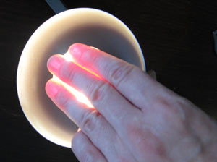
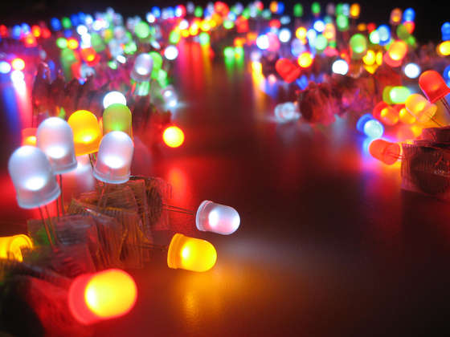
Introduction
Long life time (~10⁵ hours, even at 50ºC still has 4*10⁴ hour)
Low on/off time (~10⁻⁹ sec)
Low power loss
High shock resistant
Small size (less than 2 mm)
Easy focus
Low flicker
No pollution
High monochromatic
Source: http://www.digitalversus.com
/ Low energy consumption: how to choose your LED lights

Slide 6
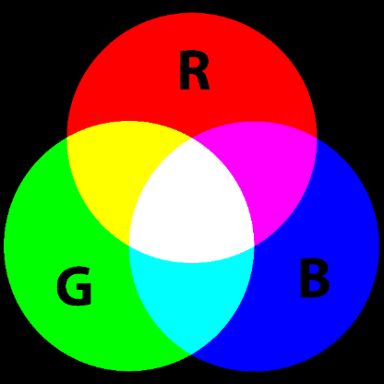
Introduction
White light” usually means a multi-color mixed light.
To mix red, green, blue
and light to get a tri-chromatic white light.
Using blue light and yellow light to obtain a di-chromatic white light, two complementary colors combine to form white light.
+
=
Source: BPI COLOR

Slide 7
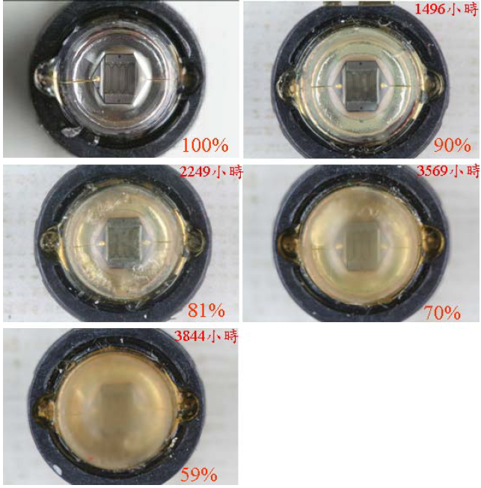
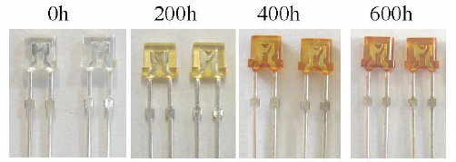
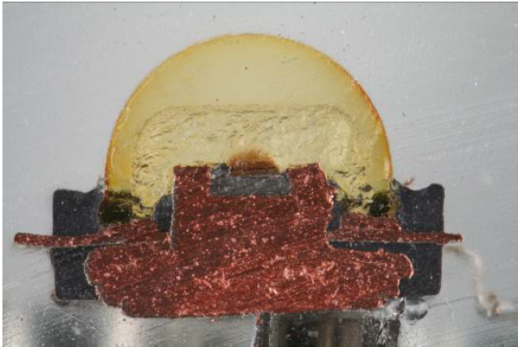
Critical issues
beginning
1496hrs
2249hrs
3569hrs
Source : F. Shunsuke, YAG glass-ceramic phosphor for white LED (I)
The blue LED chip excite light making the temperature of chip increase.
The epoxy degenerated significantly due to thermal annealing, leading to decrease the life time and luminous efficiency.
3844hrs
failed
Source :C.C Tsai, The Reliability Study of Optical Power and Radiation Pattern for High-Power Light-Emitting Diodes Modules in Aging Test

Slide 8
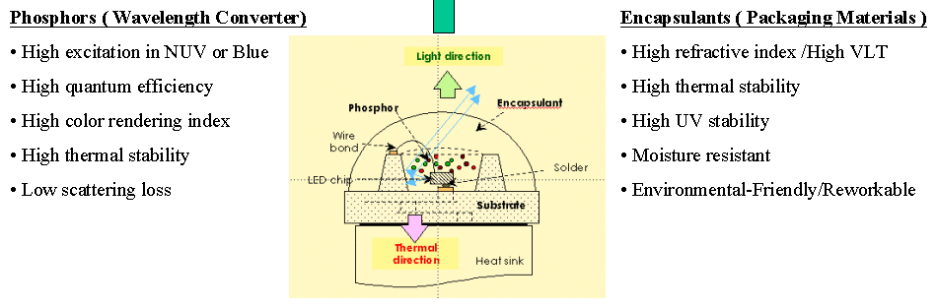
Critical issues Materials
Higher Power, Enhanced Efficiency, elongated Lifetime …
Applications, like Car, Building, Spotlight, Lighthouse…
The replacement of polymer-based encapsulate by quality
”glass materials”

Slide 9
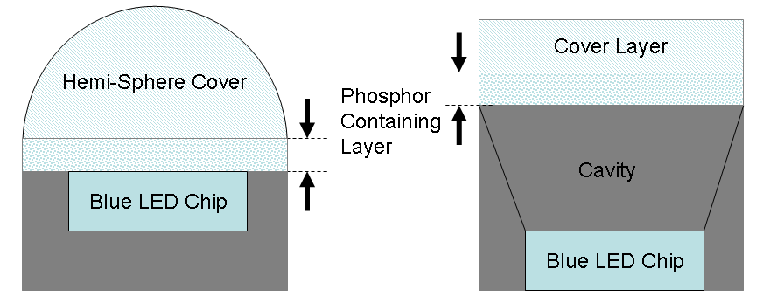
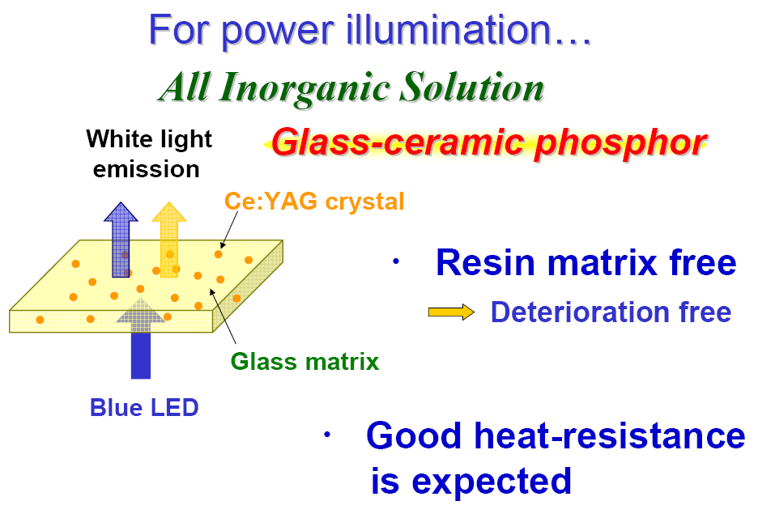
Challenges
? Sheet (tape) phosphor/glass
? High process temperature
? Phosphor “in” glass
? Match in physical/thermal/optical properties
like Density, CTE, Refractive Index…

Slide 10
Experimental Design for Glass
Raw materials mixing
Melting
Forming
Annealing
Physical/chemical properties
Density
Thermal properties
Analyzing
Optical properties
Refractive index & Abbe number
Structural analysis
FTIR Spectrum
Raman Spectrum

Slide 11
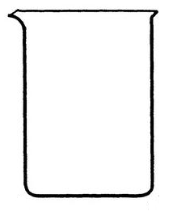
Experimental procedures
Coating
Heat treatment
Annealing
LED lighting measuring
Suspension of YAG phosphor, in alcohol.
YAG phosphor condensation on the glass substrate.
Phosphors dispersed on the glass surface evenly.
Phosphors
Glass
Phosphors
The incorporation of phosphors in the low-characteristic-temperature glass is conducted by the embedding of phosphor powders at softened glass surface.
Glass Substrate

Slide 12
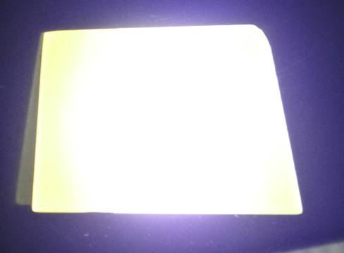
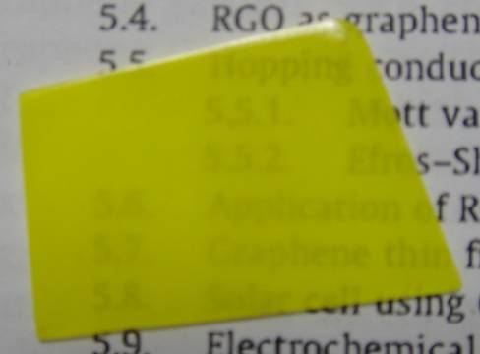
YAG GCP under Blue light
Glass Ceramics-Phosphor Optical Performance
Glass Ceramics-Phosphor & Phosphor Emission Spectrum
The result shows an intense emission peak at 550 nm for the GCP sample, which is a unanimous result as the YAG phosphors of emission spectra.
Blue + GCP plate

Slide 13
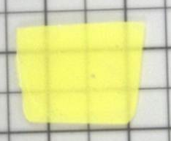
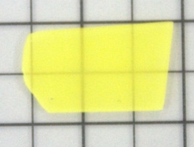
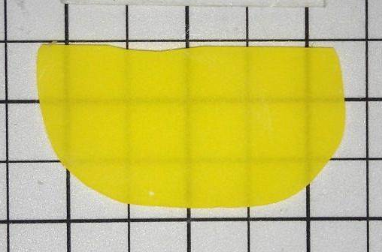
YAG GCP by Various Glass Systems
Glass Ceramics-Phosphor
Appearances
(a) Phosphate-SrK
(b) Phosphate- NbLi
(c) Borosilicate-BiZn
Phosphate systems are not well-wetted with phosphors. Shallow incorporation and limited YAG into glasses are detrimental for lighting.
Borosilicate glasses are chemically stable, yet higher thermal characteristic temperatures are expected.

Slide 14
YAG GCP by Various Glass Systems
Glass Substrate Characteristics Measure
Thermal & Optical properties
Glass systems | T_{g}(℃) | T_{d}(℃) | T_{c}(℃) | CTE(10⁻⁶/K) | T_{c} - T_{d} (℃) | Refractive Index | Abbe number
P-40Sr10K | 618 | 661 | 853 | 4.5 | 192 | 1.616 | 38.93
P-30Sr20K | 579 | 614 | 889 | 6.3 | 275 | 1.601 | 40.29
P-20Sr30K | 543 | 582 | 917 | 8.6 | 335 | 1.584 | 45.97
P-25Nb0Li | 529 | 570 | 905 | 5.8 | 335 | 1.791 | 27.75
P-20Nb5Li | 533 | 569 | 856 | 7.0 | 287 | 1.759 | 32.42
P-15Nb10Li | 527 | 567 | 794 | 7.4 | 227 | 1.720 | 35.15
B-30Zn6Bi | 549 | 586 | 784 | 5.9 | 198 | 1.774 | 37.90
B-27Zn9Bi | 552 | 574 | 775 | 6.2 | 201 | 1.796 | 34.96
B-24Zn12Bi | 547 | 569 | 770 | 6.1 | 201 | 1.816 | 32.03
The greater T_{s} and the smaller Td of the glass substrate, leading to a layer operating temperature range (T_{c} – T_{d}) for the glass ceramic preparation was expected.
In this study, the glass systems all exhibit a (T_{c} – T_{d}) over 200 °C, which is quite sufficient in glass ceramic fabrication.

Slide 15
Designed Glass systems
Glass systems | T_{g}(ºC) | T_{d}(ºC) | T_{c}(ºC) | CTE(10⁻⁶/K) | T_{c} - T_{d} (ºC) | Refractive index | Abbe number
50B0Si | 464 | 495 | 627 | 6.97 | 132 | 1.89 | 28.32
45B5Si | 461 | 494 | 684 | 7.49 | 172 | 1.89 | 26.63
40B10Si | 461 | 489 | 690 | 7.86 | 201 | 1.89 | 23.7
35B15Si | 466 | 487 | 737 | 6.21 | 250 | 1.90 | 24.02
30B20Si | 474 | 497 | 738 | 6.49 | 241 | 1.90 | 26.1
25B25Si | 474 | 499 | 764 | 6.55 | 265 | 1.90 | 24.3
15Bi35Zn | 483 | 524 | 737 | 6.02 | 213 | 1.85 | 28.32
20Bi30Zn | 472 | 508 | 684 | 7.05 | 176 | 1.85 | 27.6
25Bi25Zn | 461 | 494 | 666 | 7.49 | 172 | 1.88 | 24.11
30Bi20Zn | 455 | 488 | 639 | 7.67 | 151 | 1.91 | 24.36
35Bi15Zn | 447 | 476 | 626 | 6.79 | 150 | 1.94 | 22.53
Working range(WR): T_{c} – T_{d} (ºC) : Glass can be shaped (worked) without devitrification
More NBOs lead to a more relaxed structure when the Bi₂O₃ content increases.
All working ranges are grater than 150ºC.
When Bi₂O₃ increases, refractive index increases.
The refractive index of all developed glass systems are greater than 1.85.

Slide 16
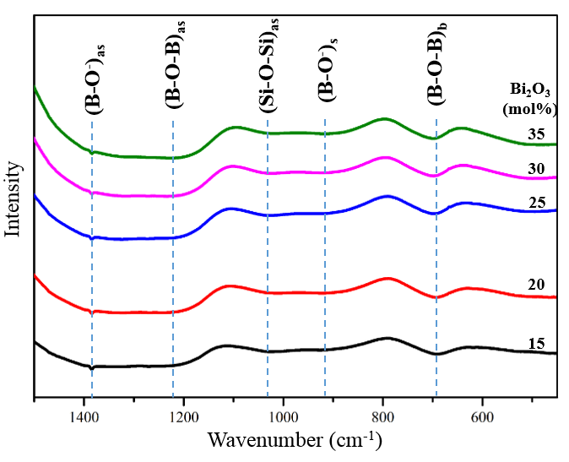
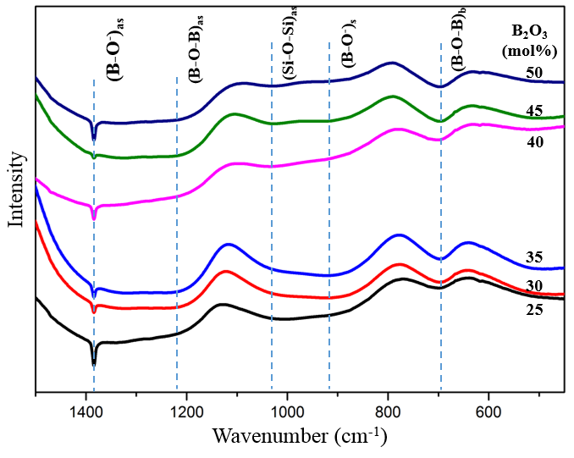
Glass structure FTIR spectra
B/Si system
Bi/Zn system
B-O⁻ reflections shift toward low wavenumbers as Bi₂O₃ increases .

Slide 17
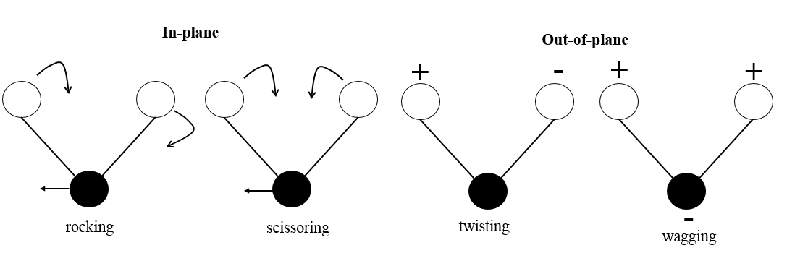
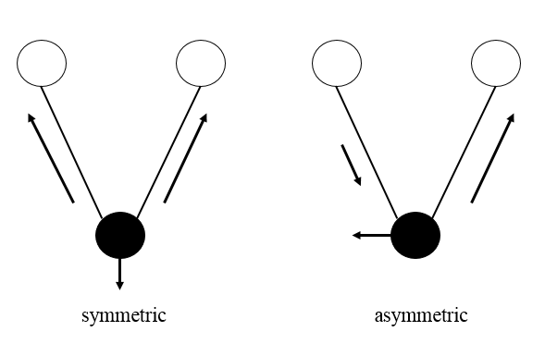
Molecular absorption spectrometry
Bending vibration
Bending vibration means a change in the angle but no change in the length between two bonds at molecular vibration.
Stretching vibration
Stretching vibration means the variation in bonding length between two atoms. Atom stretches along bond axis and no change between bond angle.
Stretching vibrations are divided into two parts: symmetric stretching and asymmetric stretching.

Slide 18
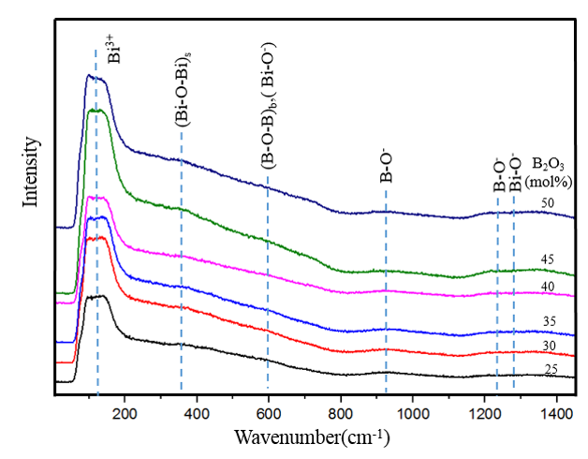
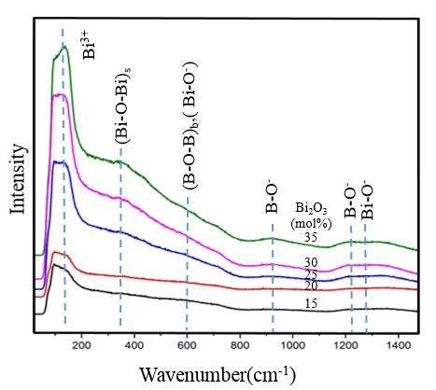
Glass structure Raman spectra
B/Si system
Bi/Zn system
Intensity
Intensity
Wavenumber(cm⁻¹)
Wavenumber(cm⁻¹)
All bonds become stronger with increasing Bi₂O₃ content.
(B-O⁻)_{as} and (Bi-O⁻)_{s} vibrations get stronger with Bi addition, indicating the increase in NBOs.
The glass structure becomes relaxed when Bi₂O₃ increases.

Slide 19
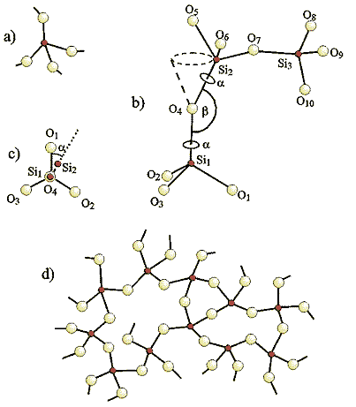
Structure of Glass systems
SiO₄ unit
Bond angle
in silicate
*Typical borate structure with boroxol rings.
*Stable [BO₃] plane unit dominated.
*Further stabilization when other oxides are added to form [BO₄] tetrahedron.
Torsion angle
Network of silicate glass

Slide 20
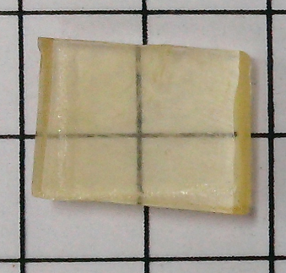
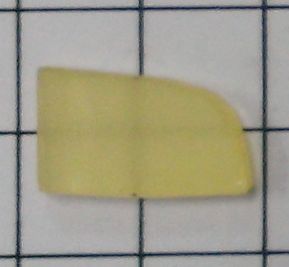
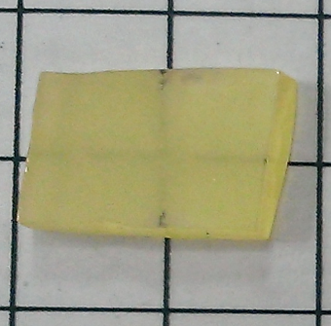
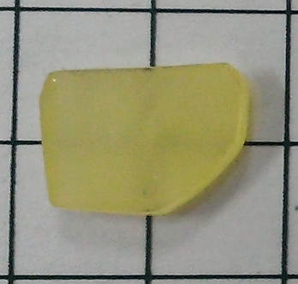
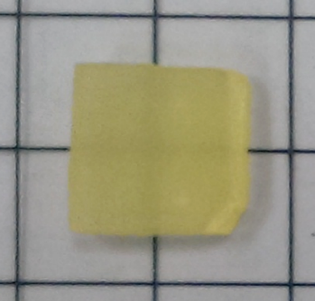
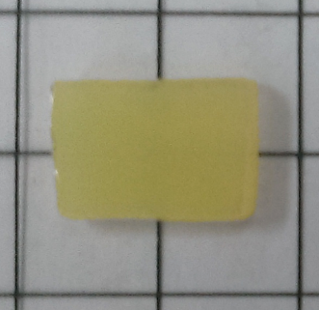
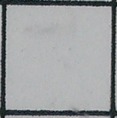
GCP Appearances
BiZn-borosilicate at 520ºC
The YAG phosphor embedded into the 35Bi15Zn glass substrate at 520ºC for various time.
As heat treatment time increased, the surface of the GCPs become darker yellow.
5 min
10 min
20 min
7mm
30 min
60 min
90 min

Slide 21
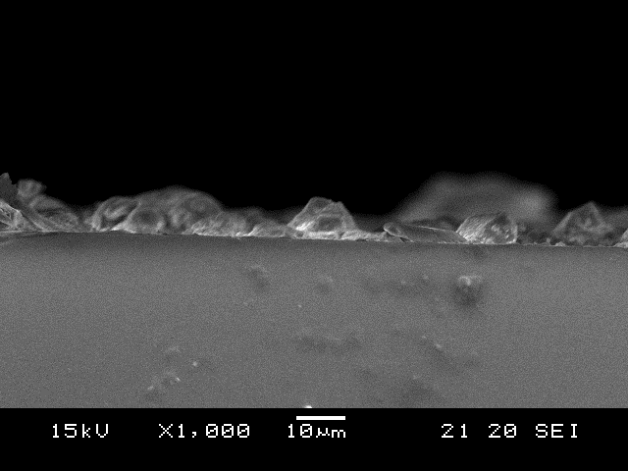
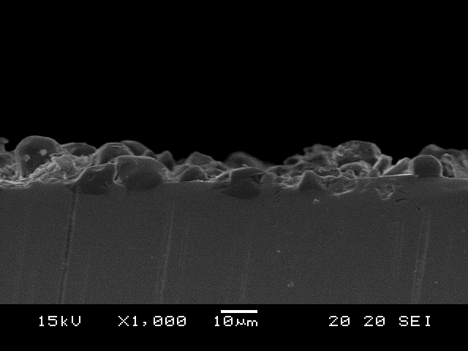
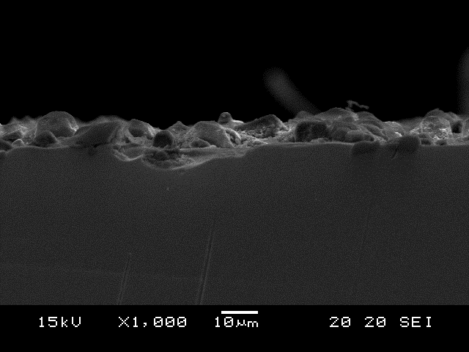
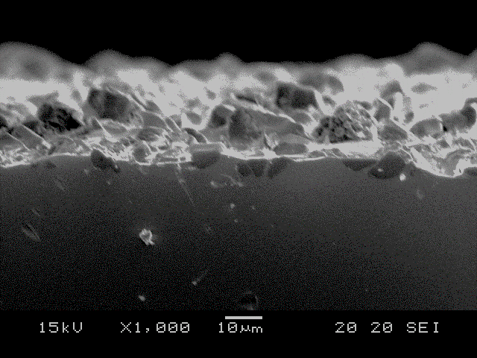
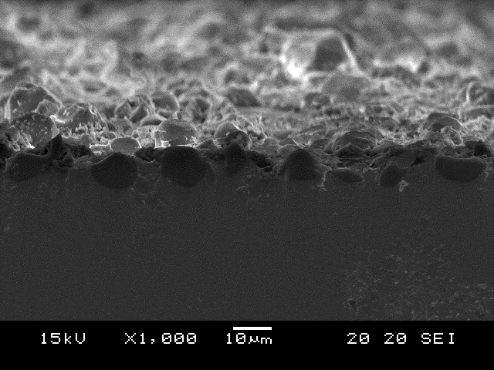
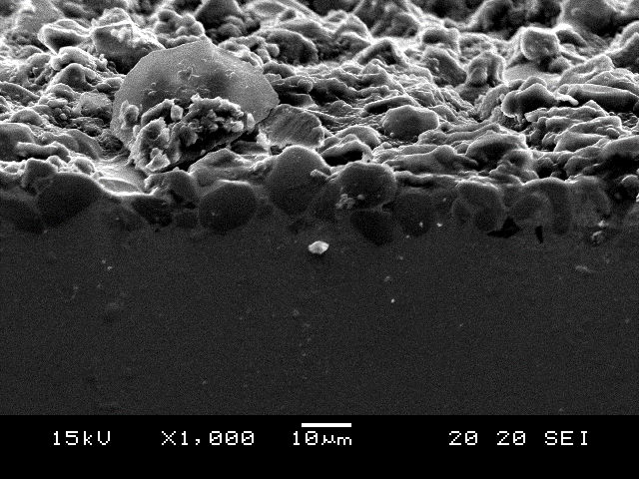
GCP Cross-sectional SEM view
35Bi15Zn –borosilicate at 520ºC
“Sticking” “Attached” on Glass surface
(a)
(b)
5 min
10 min
20 min
“Driven-in” at localized points
Forming of the “GCP layer”
30 min
60 min
90 min

Slide 22
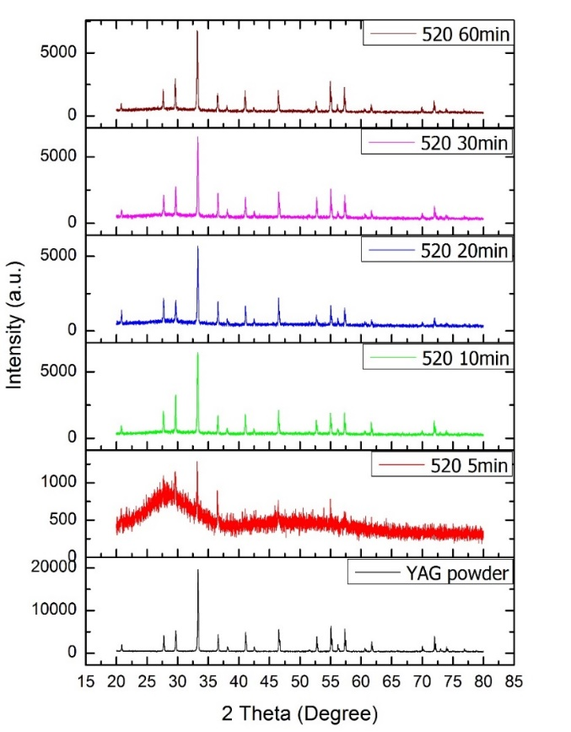
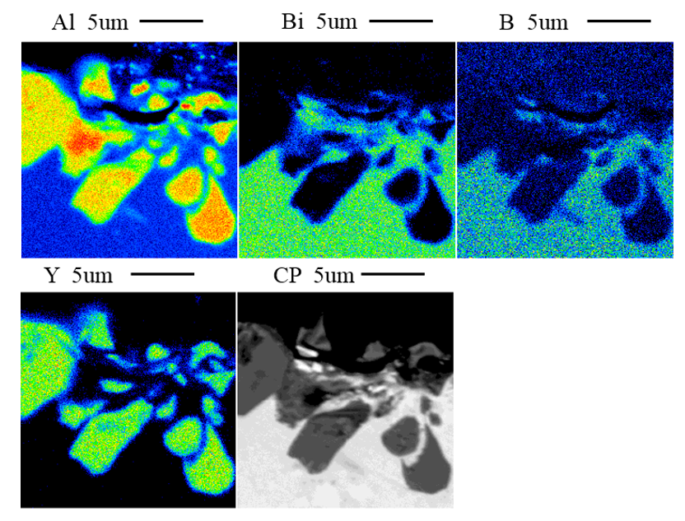
GCP Chemical and Phase Stability
YAG GCP:35Bi15Zn-borosilicate at 520ºC for 90 min
EPMA color mapping: showing that YAG phosphor and glass substrate are stable without chemical reaction.
X-ray patterns: showing a stable YAG phase after embedding.

Slide 23
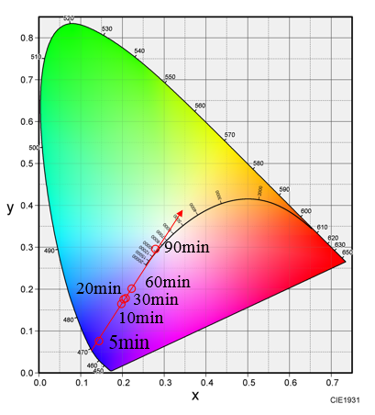
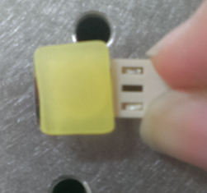
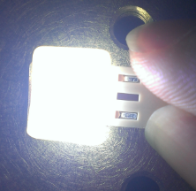
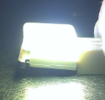
GCP CIE coordinate
YAG GCP:35Bi15Zn-borosilicate at 520ºC
35Bi15Zn-borocilicate at 520ºC for 90min
YAG GCP
Blue light on
Side view
The emission lights were turned from blue, light blue and white according to phosphor driven-in depth and distribution.
The white light could be reached with the YAG embedded 35Bi15Zn borosilicate GCP and the emission light was adjustable by controlling heat treatment time.

Slide 24
Conclusion Remarks
The developed borosilicate glasses with functional element incorporation, including Bi, Li, Sr, K, Nb, and Zn, exhibit low characteristic temperature and high refractive index and are applicable in fabricating phosphor embedded glass ceramic layer for Phosphor-Conversion LED lighting system.
The addition of Bi and Zn induces the relaxation of the borosilicate structure and lower down the characteristic temperatures. Furthermore a large working temperature range of 150°C and above can be obtained.
The phosphor-embedded glass layer with controllable phosphor distribution can be manipulated through heat treatment temperature and time design associated with the softening temperatures of the glass systems.
The feasibility of the glass ceramic phosphor, GCP, layer on LED lighting package is verified. White light can be approached using GCP/blue-LED with designed phosphor distributed glass system.

Slide 25
Acknowledgement
This study funded by Ministry of Science and Technology, MOST, Taiwan under contract No. MOST-102-2221-E-239-006-MY3.
The great efforts from lab group and partner, C.K Chang, Y.R. Chung, J.H. Liao, Y.H. Tsai, C.Y. Huang, and Prof. H.W. Yang, are highly appreciated.
and Thank You!

Slide 26
Let Us Meet Again
We welcome you all to our future conferences of OMICS Group International
Please Visit:
http://materialsscience.conferenceseries.com/
Contact us at
materialsscience.conference@omicsgroup.us
materialsscience@omicsgroup.com

