Slide 1
World Congress on Breast Cancer 05.08.2015
How pregnancy at early age protects against
breast cancer
Fabienne Meier-Abt, MD PhD

Slide 2
Background:
Early age pregnancy protects against breast cancer.
MacMahon, B. et al. 1970, Lambe, M. et al. 1996
Notes:
It is well established that early pregnancy protects against breast cancer. Numerous epidemiological studies have shown that a first full-term pregnancy occurring before the age of 20 years leads to a 50% decrease in a woman’s life-time risk to develop breast cancer. This is shown in yellow with the relative breast cancer risk compared to age-matched nulliparous individuals on the y-axis and age on the x-axis. Interestingly, immediately following parturition, there is an increase in breast cancer risk. But most importantly, as the age at first full-term pregnancy increases, the life-long protective effect of pregnancy decreases. This is shown in green. And if the age at first full-term pregnancy is greater than 35 years, then there is even an increase in the life-time breast cancer risk. This is shown in red. Given the trend in the developed world to delay childbirth until later and later, ways to mimic the breast cancer protective effect of an early pregnancy are warranted. For this we need to understand the underlying cellular and molecular mechanisms. And even though this phenomenon was known for hundreds of years – breast cancer used to be called ‘nun’s disease’ – so despite that, little is known about putative cellular and molecular mechanisms that can explain the breast cancer protective effect of early pregnancy.
Interestingly, a similar cancer protective effect of early pregnancy is observed in rodents. Experimental studies in mice and rats have shown an over 75% protective effect of full-term pregnancy against mammary tumors. (both carcinogen administration and genetic models) Hence, rodents can be used as model systems to study the cellular and molecular mechanism underlying the breast cancer protective effect of early pregnancy.

Slide 3
Background:
Early age pregnancy protects against breast cancer.
Rodents can be used as model system.
In rodents: early age pregnancy >75% protective effect against
mammary tumors
Medina, D. 2005
MacMahon, B. et al. 1970, Lambe, M. et al. 1996
Notes:
It is well established that early pregnancy protects against breast cancer. Numerous epidemiological studies have shown that a first full-term pregnancy occurring before the age of 20 years leads to a 50% decrease in a woman’s life-time risk to develop breast cancer. This is shown in yellow with the relative breast cancer risk compared to age-matched nulliparous individuals on the y-axis and age on the x-axis. Interestingly, immediately following parturition, there is an increase in breast cancer risk. But most importantly, as the age at first full-term pregnancy increases, the life-long protective effect of pregnancy decreases. This is shown in green. And if the age at first full-term pregnancy is greater than 35 years, then there is even an increase in the life-time breast cancer risk. This is shown in red. Given the trend in the developed world to delay childbirth until later and later, ways to mimic the breast cancer protective effect of an early pregnancy are warranted. For this we need to understand the underlying cellular and molecular mechanisms. And even though this phenomenon was known for hundreds of years – breast cancer used to be called ‘nun’s disease’ – so despite that, little is known about putative cellular and molecular mechanisms that can explain the breast cancer protective effect of early pregnancy.
Interestingly, a similar cancer protective effect of early pregnancy is observed in rodents. Experimental studies in mice and rats have shown an over 75% protective effect of full-term pregnancy against mammary tumors. (both carcinogen administration and genetic models) Hence, rodents can be used as model systems to study the cellular and molecular mechanism underlying the breast cancer protective effect of early pregnancy.

Slide 4
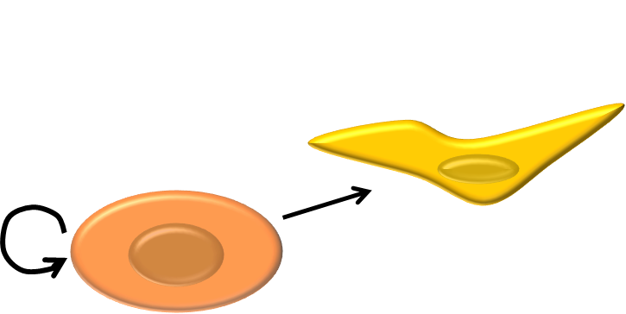
Background:
Hypothetical mechanisms:
change in the proliferation/differentiation potential of specific mammary epithelial cells
Russo, J. et al. 2005
Siwko, S.K. et al. 2008
Britt, K.L. et al. 2009
systemic changes in circulating hormones
Thordarson, G. et al. 1995
changes in the stromal composition of the mammary gland
Schedin, P. et al. 2004
Notes:
Regarding the hypothetical cellular and molecular mechanisms that underly this phenomenon, several suggestions have been made. It was proposed that changes in the proliferation and differentiation potential of specific mammary epithelial cells are responsible for the breast cancer protective effect of an early pregnancy. Data supporting this hypothesis were provided by one study, but questioned by another study. Alternative hypotheses include systemic changes in circulating hormones, as well as changes in the composition of the mammary gland stroma and its extracellular matrix. Importantly, these hypotheses are not mutually exclusive!!! And probably, several mechanisms act together to bring about the full breast cancer protective effect of early pregnancy.

Slide 5
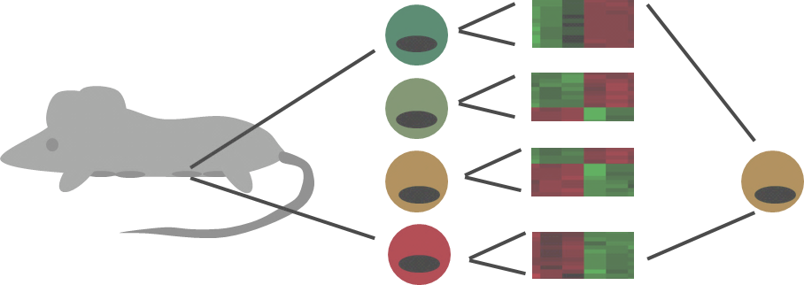
Research Question:
What is the effect of an early pregnancy on the gene expression profile and on the proliferation/differentiation potential of the various mouse mammary epithelial cell subpopulations?
Notes:
So it is well established that an early pregnancy protects. But the mechanism is unclear.
In our study, we addressed this by investigating the effects of an early pregnancy on the various mammary epithelial cell subpopulations in mice, since these are the cells that give rise to mammary cancer. Specifically, we looked at the effect of an early pregnancy on the gene expression profile and on the proliferation and differentiation potential of the specific cell subpopulations.

Slide 6
Mammary Cell Type Hierarchy:
Notes:
Before going into the details of our project, I’d like to give a brief overview of the mammary cell type hierarchy. The breast contains acinar structures as well as ducts. This is shown here. Over here you can see a cross-section through one of the mammary acini. Lining the lumen is the luminal compartment. It is surrounded by the basal compartment. Together, the luminal and the basal compartment form the mammary epithelium. The luminal compartment contains cells that are responsible for milk production and secretion. The basal compartment contains cells that are responsible for milk ejection. A basement membrane separates the mammary epithelium from the stroma.
On the bottom, you can see a cross-section through the mammary epithelium with the luminal compartment shown in green and the basal compartment shown in red or orange.
Within the luminal compartment, there are differentiated luminal cells, luminal estrogen and progesterone sensing cells, and luminal progenitor cells. Within the basal compartment, there are differentiated myoepithelial cells and basal stem and progenitor cells. In mice, the marker Krt18 labels luminal cells, whereas Krt14 labels basal cells. Similarly, CD24 expression allows to discriminate between luminal and basal cells. Sca1 expression characterizes cells enriched in hormone sensing cells, whereas CD49f expression characterizes cells enriched in basal stem and progenitor cells.

Slide 7
Basal compartment
Mammary Cell Type Hierarchy:
Milk
Stroma
Luminal compartment
Basement membrane
Notes:
Before going into the details of our project, I’d like to give a brief overview of the mammary cell type hierarchy. The breast contains acinar structures as well as ducts. This is shown here. Over here you can see a cross-section through one of the mammary acini. Lining the lumen is the luminal compartment. It is surrounded by the basal compartment. Together, the luminal and the basal compartment form the mammary epithelium. The luminal compartment contains cells that are responsible for milk production and secretion. The basal compartment contains cells that are responsible for milk ejection. A basement membrane separates the mammary epithelium from the stroma.
On the bottom, you can see a cross-section through the mammary epithelium with the luminal compartment shown in green and the basal compartment shown in red or orange.
Within the luminal compartment, there are differentiated luminal cells, luminal estrogen and progesterone sensing cells, and luminal progenitor cells. Within the basal compartment, there are differentiated myoepithelial cells and basal stem and progenitor cells. In mice, the marker Krt18 labels luminal cells, whereas Krt14 labels basal cells. Similarly, CD24 expression allows to discriminate between luminal and basal cells. Sca1 expression characterizes cells enriched in hormone sensing cells, whereas CD49f expression characterizes cells enriched in basal stem and progenitor cells.

Slide 8
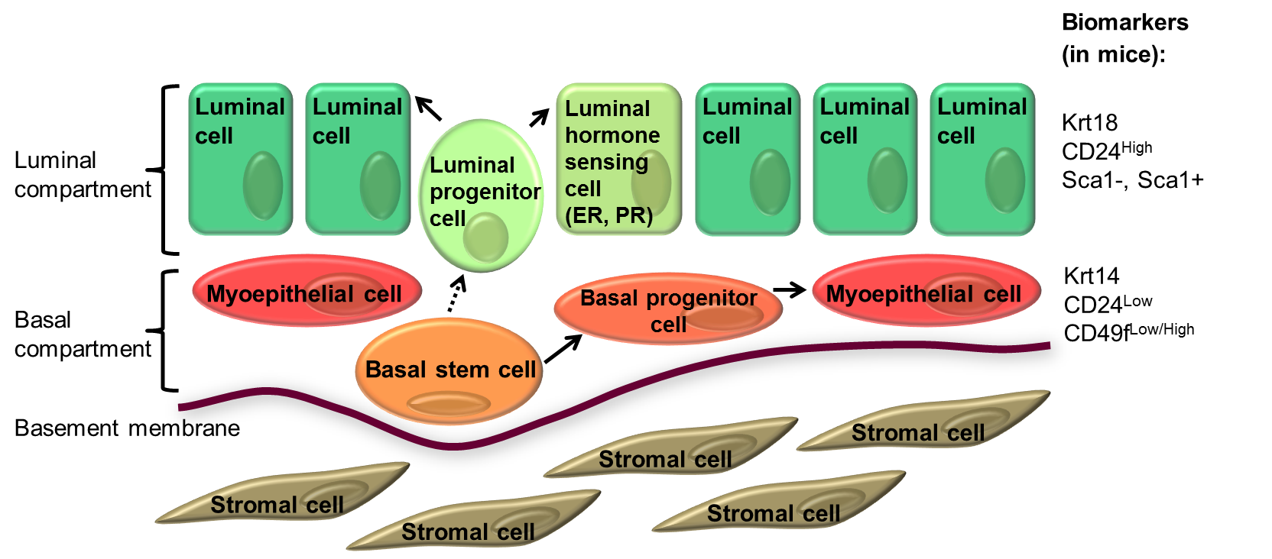
Basal compartment
Mammary Cell Type Hierarchy:
Milk
Stroma
Luminal compartment
Basement membrane
Notes:
Before going into the details of our project, I’d like to give a brief overview of the mammary cell type hierarchy. The breast contains acinar structures as well as ducts. This is shown here. Over here you can see a cross-section through one of the mammary acini. Lining the lumen is the luminal compartment. It is surrounded by the basal compartment. Together, the luminal and the basal compartment form the mammary epithelium. The luminal compartment contains cells that are responsible for milk production and secretion. The basal compartment contains cells that are responsible for milk ejection. A basement membrane separates the mammary epithelium from the stroma.
On the bottom, you can see a cross-section through the mammary epithelium with the luminal compartment shown in green and the basal compartment shown in red or orange.
Within the luminal compartment, there are differentiated luminal cells, luminal estrogen and progesterone sensing cells, and luminal progenitor cells. Within the basal compartment, there are differentiated myoepithelial cells and basal stem and progenitor cells. In mice, the marker Krt18 labels luminal cells, whereas Krt14 labels basal cells. Similarly, CD24 expression allows to discriminate between luminal and basal cells. Sca1 expression characterizes cells enriched in hormone sensing cells, whereas CD49f expression characterizes cells enriched in basal stem and progenitor cells.

Slide 9
Methodology:
Isolation of mammary epithelial cell subpopulations by FACS
2. Transcriptome and bioinformatic transcription factor activity analysis
3. Ingenuity IPA and GSEA analysis
4. Colony formation assay
5. Mammary gland reconstitution assay
6. Immunohistochemistry for progesterone receptor
7. Rescue experiments
Notes:
The following methods were used in my study. Mammary epithelial cell subpopulations were isolated by fluorescence activated cell sorting or FACS using the previously mentioned markers. Then transcriptome and bioinformatic transcription factor activity analyses were performed, the results of which were validated by qPCR and IHC. This was followed by further trancription factor and signaling pathway analyses with Ingenuity and gene set enrichment analysis. Functional studies were performed including colony formation and mammary gland reconstitution assays. Immunohistochemical analyses were carried out for progesterone receptor. And rescue experiments were performed with recombinant proteins.

Slide 10
Methods:
Early age parturition protocol
Notes:
This slide illustrates the parturition protocol used in the subsequent experiments unless stated otherwise. Mice were mated when 42 days old, which is very young for mice. This age was chosen to model the early pregnancy scenario. The mice underwent gestation for 21 days. They were allowed to lactate their pups for 21 days, and 40 days were allocated until cell harvest to allow for complete involution. All parous mice were compared to age-matched virgin control animals.
In the lower part you can see the fluorescence activated cell sorting strategy for the isolation of mammary epithelial cell subpopulations in parous mice. The same gates were used as for the age-matched virgin control mice. Notably, the adopted experimental procedure permitted the isolation of all epithelial cell subpopulations from parous mice at levels adequate for transcriptomic and functional analyses.
Representative flow cytometry pseudocolor plot.

Slide 11
Results
I – Transcriptome analysis in mammary epithelial cell subpopulations
from parous and age-matched virgin control mice
II – Effects of early parity on the clonogenic and proliferation potential of
basal stem/progenitor cells
III – Putative mechanism of early parity-induced biofunctional alterations
in basal mammary stem/progenitor cells
IV – Duration and age dependency of early parity-induced changes
Notes:
This leads me to the results section which is divided into four parts:

Slide 12
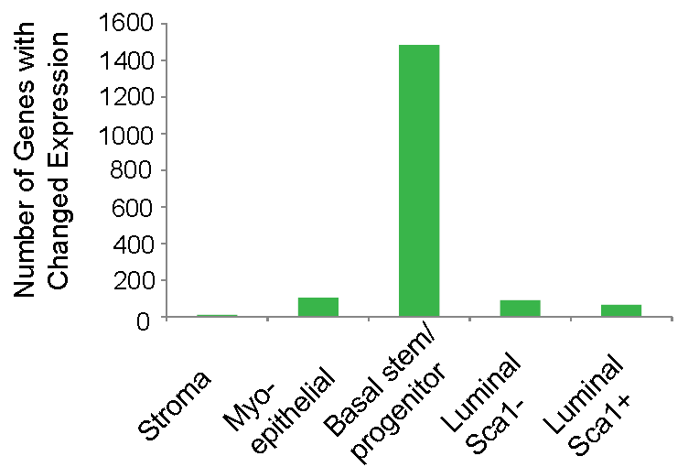
Results I:
Early age pregnancy-induced changes in gene expression in murine mammary epithelial cell subpopulations.
Notes:
As you can see here on the left, there were changes in gene expression in all epithelial cell subpopulations, but not in the stroma. Amongst the various mammary epithelial cell subpopulations, by far the greatest number of genes with changed expression was observed for the basal stem/progenitor cell subpopulation. When analysing the genes with changed expression in basal stem/progenitor cells, we found an upregulation of differentiation genes – shown in blue - , a decrease in Wnt signaling – shown in green - , and an increase in Notch signaling – shown in orange. In brackets, you can see the average fold changes from the microarray analyses. For example, the differentiation gene casein alpha was upregulated 41 fold, whereas the classic Wnt target versican was downregulated 13 fold and the Notch co-activator Maml2 was upregulated 5 fold in basal stem/progenitor cells from parous mice as compared to the same cells from age-matched virgin control mice. The genes were validated by quantitative PCR.
To those of us who are not familiar with cellular signaling pathways in the mammary gland: Wnt and Notch are major cell fate determining pathways, whereby Wnt signaling has been linked to cell proliferation and carcinogenesis in basal stem/progenitor cells in the mammary gland whereas Notch signaling has been linked to reduced proliferation in basal stem/progenitor cells in the mammary gland.

Slide 13
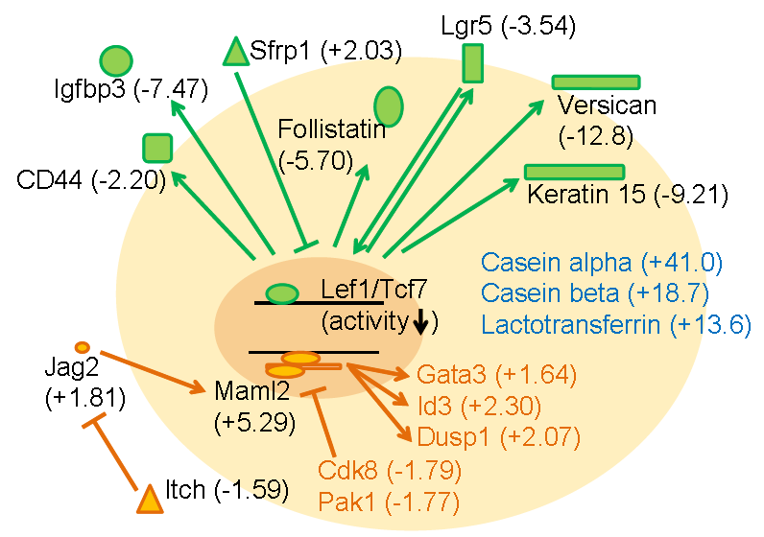
Results I:
Upregulation of differentiation genes (blue), decreased Wnt signaling (green) and increased Notch signaling (orange) in basal stem/progenitor cells from parous mice.
Gene expression in basal stem/progenitor cells from parous mice as compared to virgin control mice
Notes:
As you can see here on the left, there were changes in gene expression in all epithelial cell subpopulations, but not in the stroma. Amongst the various mammary epithelial cell subpopulations, by far the greatest number of genes with changed expression was observed for the basal stem/progenitor cell subpopulation. When analysing the genes with changed expression in basal stem/progenitor cells, we found an upregulation of differentiation genes – shown in blue - , a decrease in Wnt signaling – shown in green - , and an increase in Notch signaling – shown in orange. In brackets, you can see the average fold changes from the microarray analyses. For example, the differentiation gene casein alpha was upregulated 41 fold, whereas the classic Wnt target versican was downregulated 13 fold and the Notch co-activator Maml2 was upregulated 5 fold in basal stem/progenitor cells from parous mice as compared to the same cells from age-matched virgin control mice. The genes were validated by quantitative PCR.
To those of us who are not familiar with cellular signaling pathways in the mammary gland: Wnt and Notch are major cell fate determining pathways, whereby Wnt signaling has been linked to cell proliferation and carcinogenesis in basal stem/progenitor cells in the mammary gland whereas Notch signaling has been linked to reduced proliferation in basal stem/progenitor cells in the mammary gland.

Slide 14
Results I:
Upregulation of differentiation genes (blue), decreased Wnt signaling (green) and increased Notch signaling (orange) in basal stem/progenitor cells from parous mice.
Wnt signaling:
major cell fate determining pathway linked to cell proliferation and carcinogenesis in basal stem/progenitor cells in the mammary gland
Notch signaling:
major cell fate determining pathway linked to reduced proliferation in basal stem/progenitor cells in the mammary gland
Gene expression in basal stem/progenitor cells from parous mice as compared to virgin control mice
Notes:
As you can see here on the left, there were changes in gene expression in all epithelial cell subpopulations, but not in the stroma. Amongst the various mammary epithelial cell subpopulations, by far the greatest number of genes with changed expression was observed for the basal stem/progenitor cell subpopulation. When analysing the genes with changed expression in basal stem/progenitor cells, we found an upregulation of differentiation genes – shown in blue - , a decrease in Wnt signaling – shown in green - , and an increase in Notch signaling – shown in orange. In brackets, you can see the average fold changes from the microarray analyses. For example, the differentiation gene casein alpha was upregulated 41 fold, whereas the classic Wnt target versican was downregulated 13 fold and the Notch co-activator Maml2 was upregulated 5 fold in basal stem/progenitor cells from parous mice as compared to the same cells from age-matched virgin control mice. The genes were validated by quantitative PCR.
To those of us who are not familiar with cellular signaling pathways in the mammary gland: Wnt and Notch are major cell fate determining pathways, whereby Wnt signaling has been linked to cell proliferation and carcinogenesis in basal stem/progenitor cells in the mammary gland whereas Notch signaling has been linked to reduced proliferation in basal stem/progenitor cells in the mammary gland.

Slide 15
Results
I – Transcriptome analysis in mammary epithelial cell subpopulations
from parous and age-matched virgin control mice
II – Effects of early parity on the clonogenic and proliferation potential of
basal stem/progenitor cells
III – Putative mechanism of early parity-induced biofunctional alterations
in basal mammary stem/progenitor cells
IV – Duration and age dependency of early parity-induced changes
Notes:
This leads me to the results section which is divided into four parts:

Slide 16
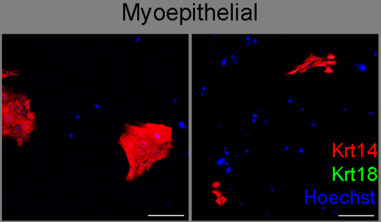
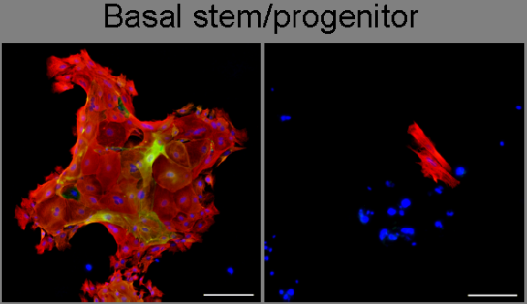
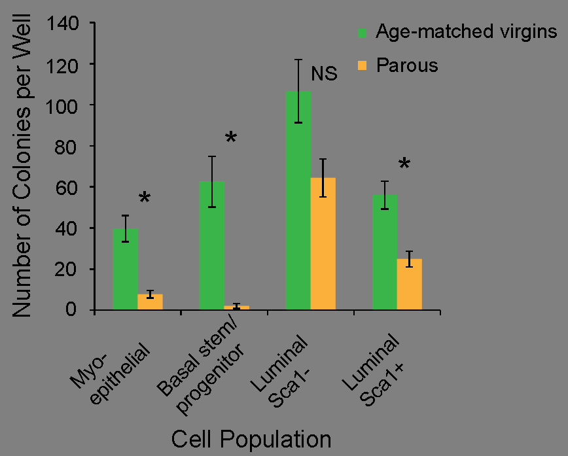
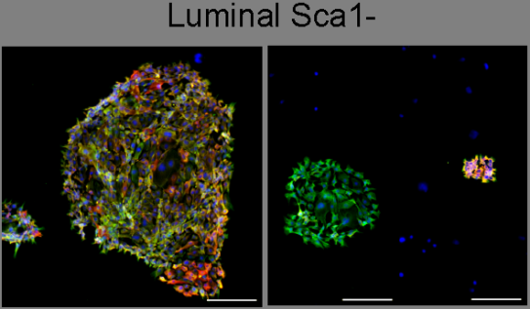
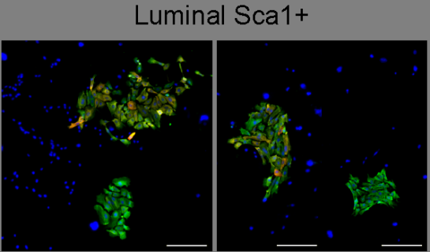
Results II:
Early parity decreases the number of cells with colony formation capacity with the most prominent effect in basal stem/progenitor cells.
* P <0.015
Notes:
Having observed major changes in cell fate determining signaling pathways, we next assessed the effect of parity on the clonogenic potential of the mammary epithelial cell subtypes by performing colony forming assays. Here on the right you can see representative examples of colonies grown from the various cell subpopulations from age-matched virgins on the left and from parous mice on the right. Here on the left you can see the quantification of the number of colonies grown per well. Consistent with the decrease in the Wnt/Notch signaling ratio in basal stem/progenitor cells, parity decreases the number of cells with colony formation capacity to the greatest extent in basal stem/progenitor cells.

Slide 17
Results II:
Early parity decreases the in vivo reconstitution efficiency but not the number of mammary repopulating units (MRUs) of basal stem/progenitor cells.
fat pad
3-week old mammary gland
Notes:
Next, we investigated the effect of parity on the in vivo reconstitution capacity of isolated basal stem/progenitor cells. On the top is an illustration of the procedure. In 3-week old mammary glands where the epithelium has not yet invaded beyond the lymph node, the epithelial structures are surgically removed. This results in the so-called Cleared Fat Pads. Basal stem/progenitor cells are then transplanted into the cleared fat pads, and 8 weeks are allocated for reconstitution of the epithelial structures. On the bottom are the results from limiting dilution transplantations. On the left you can see the results for outgrowths greater than 25% of fat pad filled. On the right you can see the results for outgrowths greater than 3% of fat pad filled. A significant decrease in the frequency of large outgrowths was observed in basal stem/progenitor cells from parous mice, but no significant difference was seen in the frequency of small or rudimentary outgrowths. Hence, parity decreases the in vivo reconstitution efficiency but not the number of mammary repopulating units of the basal stem/progenitor cell subpopulation. (Concept of seeding)

Slide 18
Results II:
Early parity decreases the in vivo reconstitution efficiency but not the number of mammary repopulating units (MRUs) of basal stem/progenitor cells.
fat pad
3-week old mammary gland
Cleared fat pad
Notes:
Next, we investigated the effect of parity on the in vivo reconstitution capacity of isolated basal stem/progenitor cells. On the top is an illustration of the procedure. In 3-week old mammary glands where the epithelium has not yet invaded beyond the lymph node, the epithelial structures are surgically removed. This results in the so-called Cleared Fat Pads. Basal stem/progenitor cells are then transplanted into the cleared fat pads, and 8 weeks are allocated for reconstitution of the epithelial structures. On the bottom are the results from limiting dilution transplantations. On the left you can see the results for outgrowths greater than 25% of fat pad filled. On the right you can see the results for outgrowths greater than 3% of fat pad filled. A significant decrease in the frequency of large outgrowths was observed in basal stem/progenitor cells from parous mice, but no significant difference was seen in the frequency of small or rudimentary outgrowths. Hence, parity decreases the in vivo reconstitution efficiency but not the number of mammary repopulating units of the basal stem/progenitor cell subpopulation. (Concept of seeding)

Slide 19
Results II:
Early parity decreases the in vivo reconstitution efficiency but not the number of mammary repopulating units (MRUs) of basal stem/progenitor cells.
fat pad
Basal stem/progenitor cells
3-week old mammary gland
Cleared fat pad
Transplantation
Notes:
Next, we investigated the effect of parity on the in vivo reconstitution capacity of isolated basal stem/progenitor cells. On the top is an illustration of the procedure. In 3-week old mammary glands where the epithelium has not yet invaded beyond the lymph node, the epithelial structures are surgically removed. This results in the so-called Cleared Fat Pads. Basal stem/progenitor cells are then transplanted into the cleared fat pads, and 8 weeks are allocated for reconstitution of the epithelial structures. On the bottom are the results from limiting dilution transplantations. On the left you can see the results for outgrowths greater than 25% of fat pad filled. On the right you can see the results for outgrowths greater than 3% of fat pad filled. A significant decrease in the frequency of large outgrowths was observed in basal stem/progenitor cells from parous mice, but no significant difference was seen in the frequency of small or rudimentary outgrowths. Hence, parity decreases the in vivo reconstitution efficiency but not the number of mammary repopulating units of the basal stem/progenitor cell subpopulation. (Concept of seeding)

Slide 20
Results II:
Early parity decreases the in vivo reconstitution efficiency but not the number of mammary repopulating units (MRUs) of basal stem/progenitor cells.
fat pad
Basal stem/progenitor cells
8 wks
3-week old mammary gland
Cleared fat pad
Transplantation
Reconstituted mammary gland
Notes:
Next, we investigated the effect of parity on the in vivo reconstitution capacity of isolated basal stem/progenitor cells. On the top is an illustration of the procedure. In 3-week old mammary glands where the epithelium has not yet invaded beyond the lymph node, the epithelial structures are surgically removed. This results in the so-called Cleared Fat Pads. Basal stem/progenitor cells are then transplanted into the cleared fat pads, and 8 weeks are allocated for reconstitution of the epithelial structures. On the bottom are the results from limiting dilution transplantations. On the left you can see the results for outgrowths greater than 25% of fat pad filled. On the right you can see the results for outgrowths greater than 3% of fat pad filled. A significant decrease in the frequency of large outgrowths was observed in basal stem/progenitor cells from parous mice, but no significant difference was seen in the frequency of small or rudimentary outgrowths. Hence, parity decreases the in vivo reconstitution efficiency but not the number of mammary repopulating units of the basal stem/progenitor cell subpopulation. (Concept of seeding)

Slide 21
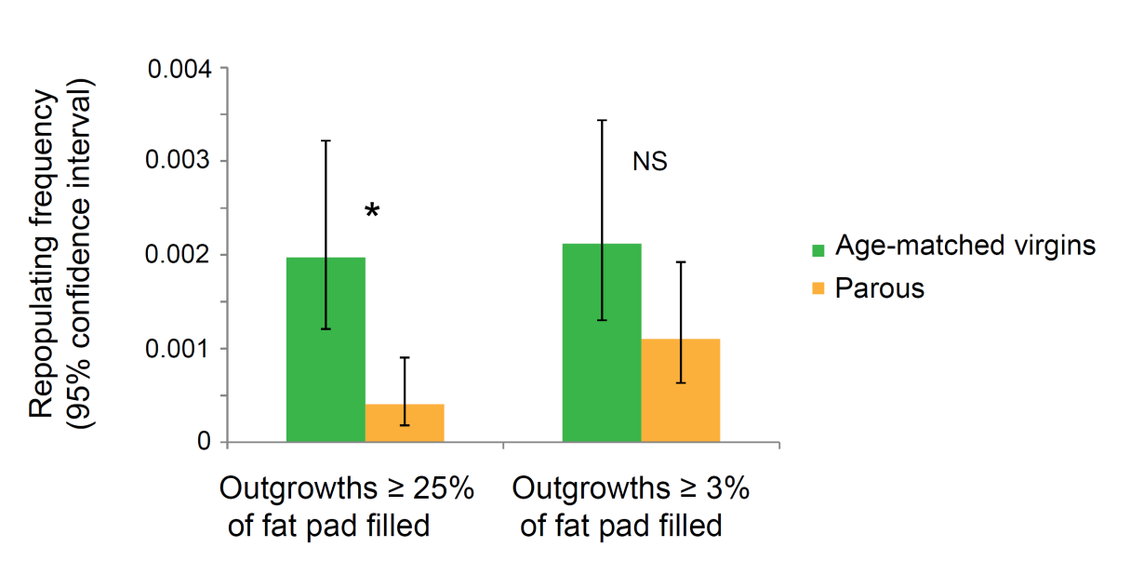
Results II:
Early parity decreases the in vivo reconstitution efficiency but not the number of mammary repopulating units (MRUs) of basal stem/progenitor cells.
fat pad
Basal stem/progenitor cells
8 wks
3-week old mammary gland
Cleared fat pad
Transplantation
Reconstituted mammary gland
* P =0.0004
Notes:
Next, we investigated the effect of parity on the in vivo reconstitution capacity of isolated basal stem/progenitor cells. On the top is an illustration of the procedure. In 3-week old mammary glands where the epithelium has not yet invaded beyond the lymph node, the epithelial structures are surgically removed. This results in the so-called Cleared Fat Pads. Basal stem/progenitor cells are then transplanted into the cleared fat pads, and 8 weeks are allocated for reconstitution of the epithelial structures. On the bottom are the results from limiting dilution transplantations. On the left you can see the results for outgrowths greater than 25% of fat pad filled. On the right you can see the results for outgrowths greater than 3% of fat pad filled. A significant decrease in the frequency of large outgrowths was observed in basal stem/progenitor cells from parous mice, but no significant difference was seen in the frequency of small or rudimentary outgrowths. Hence, parity decreases the in vivo reconstitution efficiency but not the number of mammary repopulating units of the basal stem/progenitor cell subpopulation. (Concept of seeding)

Slide 22
Results
I – Transcriptome analysis in mammary epithelial cell subpopulations
from parous and age-matched virgin control mice
II – Effects of early parity on the clonogenic and proliferation potential of
basal stem/progenitor cells
III – Putative mechanism of early parity-induced biofunctional alterations
in basal mammary stem/progenitor cells
IV – Duration and age dependency of early parity-induced changes
Notes:
This leads me to the results section which is divided into four parts:

Slide 23
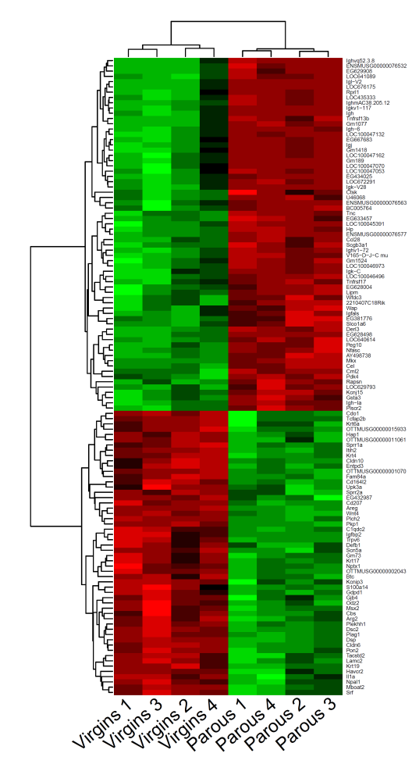
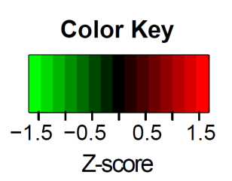
Results III:
Parity leads to a >3-fold decrease in Wnt4 expression in total cell suspensions
Wnt4
Notes:
When looking at the gene expression profile of total mammary cell suspensions, then we observed a greater than three-fold decrease in Wnt ligand Wnt4 gene expression in cell suspensions from parous mice. Wnt4 is known to be secreted in response to progesterone by hormone-sensing luminal cells, thus inducing canonical Wnt signaling in mammary stem/progenitor cells.
We next performed immunohistochemical analysis of mammary gland sections for progesterone receptor. On top, you can see representative images for progesterone receptor staining for virgins on the left and for parous mice on the right. In brown, you can see cells positive for progesterone receptor, in blue, you can see cells negative for progesterone receptor. Over here, you can see the quantification. Hence, parity leads ...

Slide 24
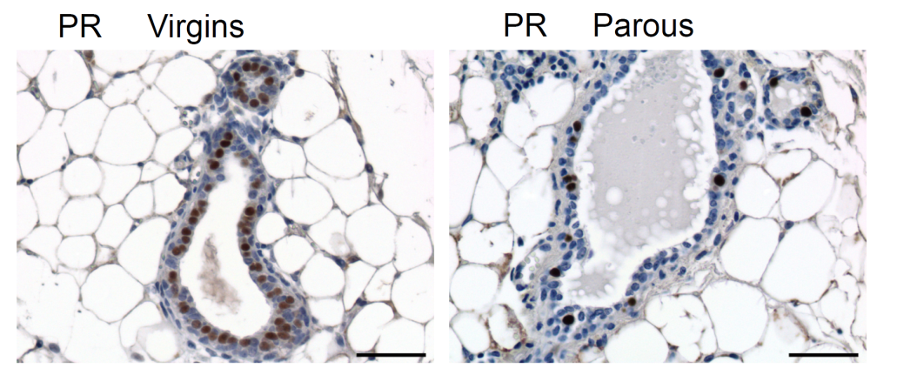
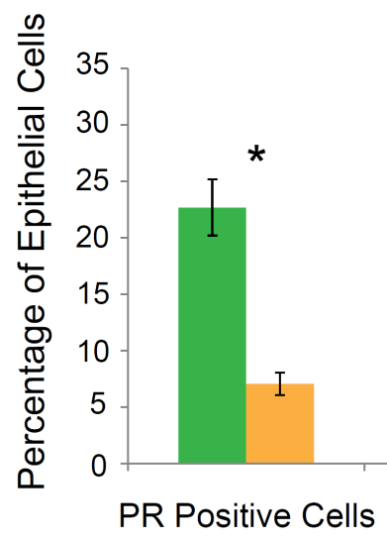
Results III:
Parity leads to a >3-fold decrease in Wnt4 expression in total cell suspensions & to a 3-fold decrease of PR positive (Wnt4-secreting) mammary epithelial cells.
Wnt4
* P =3.70E-07
Notes:
When looking at the gene expression profile of total mammary cell suspensions, then we observed a greater than three-fold decrease in Wnt ligand Wnt4 gene expression in cell suspensions from parous mice. Wnt4 is known to be secreted in response to progesterone by hormone-sensing luminal cells, thus inducing canonical Wnt signaling in mammary stem/progenitor cells.
We next performed immunohistochemical analysis of mammary gland sections for progesterone receptor. On top, you can see representative images for progesterone receptor staining for virgins on the left and for parous mice on the right. In brown, you can see cells positive for progesterone receptor, in blue, you can see cells negative for progesterone receptor. Over here, you can see the quantification. Hence, parity leads ...

Slide 25
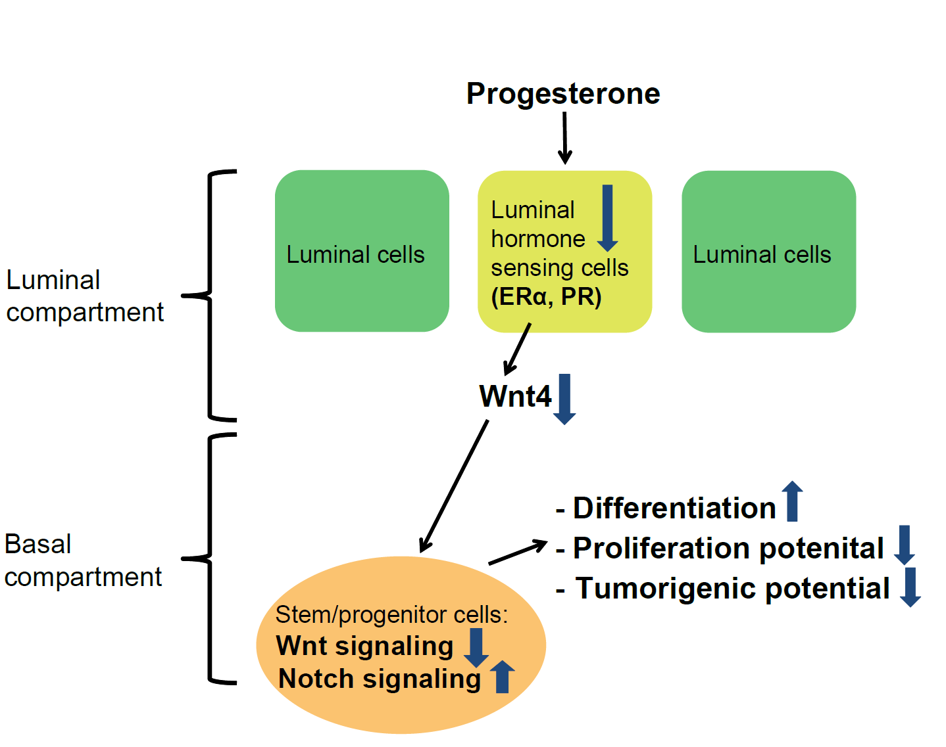
Mechanistic model of the effect of an early age pregnancy
Notes:
Taken together, our data support the following mechanistic model: The mammary gland of parous mice shows reduced responsiveness to plasma progesterone because of decreased proportions of luminal hormone sensing cells. This manifests in reduced expression of the progesterone target Wnt4. Decreased Wnt4 expression in luminal cells leads to reduced Wnt signaling in basal stem/progenitor cells, which in turn leads to a concurrent increase in Notch signaling. The decrease in the Wnt/Notch signaling ratio in basal stem/progenitor cells causes a differentiated phenotype, a reduced proliferation potential in vitro and in vivo, and a decreased tumorigenic potential.
However, two open questions remained: ...

Slide 26
Results
I – Transcriptome analysis in mammary epithelial cell subpopulations
from parous and age-matched virgin control mice
II – Effects of early parity on the clonogenic and proliferation potential of
basal stem/progenitor cells
III – Putative mechanism of early parity-induced biofunctional alterations
in basal mammary stem/progenitor cells
IV – Duration and age dependency of early parity-induced changes
Notes:
This leads me to the results section which is divided into four parts:

Slide 27
Summary:
Early parity leads to the following changes in mammary cell subpopulations:
1. an induction of differentiation and a downregulation of the Wnt/Notch
signaling ratio in basal stem/progenitor cells
2. a downregulation of potentially tumorigenic biofunctions in the basal
stem/progenitor cell subpopulation
3. a decrease in the in vitro and in vivo proliferation potential of isolated basal
stem/progenitor cells
4. a reduction in progesterone-responsive and Wnt4-secreting luminal cells
These early age pregnancy-induced changes are of life-long duration, and NOT induced by late age pregnancy. This is fully consistent with the life-long breast cancer protective effect of early but not late age pregnancy in women.

Slide 28
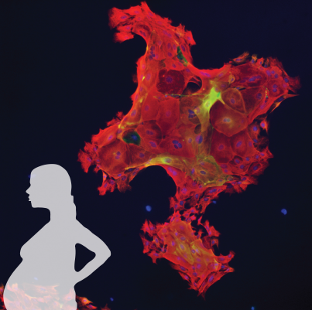
Conclusions and Perspectives:
Early age pregnancy induces life-long cellular and molecular changes in mammary glands of mice which potentially explain the breast cancer protective effect of early age pregnancy.
The decrease in the Wnt/Notch signaling ratio in basal stem/progenitor cells has now been confirmed in humans but further validations in humans are warranted.
The results provide deeper understanding of the role of parity and open the door to future studies assessing whether inhibitors of the Wnt pathway might be useful to mimic the early parity-induced protective effect against breast cancer.
Notes:
The decrease … Having said this, studies in humans have shown a decrease in PRA positive cells in humans following pregnancy. This suggests that the same mechanism occurs in humans.
These data shed light on the long term consequences of an early pregnancy and open the door to future studies assessing whether inhibitors of the Wnt pathway might be useful to mimic the parity-induced protective effect against breast cancer.
Several Wnt inhibitors are in development and at least two have entered Phase I clinical trials.
Parts of this study were recently published in Breast Cancer Research and were featured by Prof. Dan Medina.
Further experiments:
Mimicking breast cancer protective effect with Wnt inhibitors.
Epigenetic changes.
Same findings in humans. Initial studies suggest yes, but it’s difficult to control for confounding factors in humans and noice is substiantial.

Slide 29
Acknowledgements:
M. Bentires-Alj, S. Gasser, C. Rochlitz, D. Schübeler, M. Smalley
Current and former Bentires-Alj lab members
Genomics Facility: Tim Roloff, Stéphane Thiry
Bioinformatics: Michael Stadler, Dimosthenis Gaidatzis
MARA: Piotr Balwierz, Erik van Nimwegen
FACS: Hubertus Kohler
Imaging: Laurent Gelman, Steven Bourke, Raphael Thierry
Histology: Sandrine Bichet, Augustyn Bogucki
Funding: Swiss National Science Foundation, Novartis Research Foundation, European Research Council, Swiss Cancer League, Krebsliga beider Basel

Slide 30
Thank you!

Slide 31
Results I:
Wnt targets are reduced on the protein level
Mean number of versican (brown) pixels per image:
Virgins: 38,700 ± 6954
Parous: 127 ± 33 P=5.48E-07
Notes:
Validation on the protein level comes from IHC studies for the classical Wnt target versican. This is shown over here. Parity led to a dramatic decrease in the mean expression of versican protein in the mammary epithelium.
Furthermore, staining for nuclear beta catenin, an essential pre-requisite for active Wnt signaling, showed a three-fold decrease in the percentage of mammary epithelial cells with nuclear beta catenin in parous mice. Here you can see representative images from age-matched virgins on the top and from parous mice on the bottom. Full arrows depict basal mammary epithelial cells with nuclear beta catenin, whereas arrowheads depict basal mammary epithelial cells devoid of nulcear beta catenin.
These results further validate the transcriptome data.

Slide 32
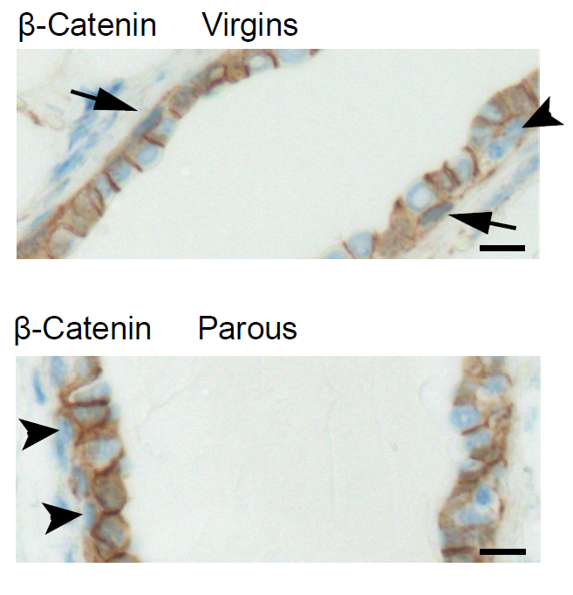
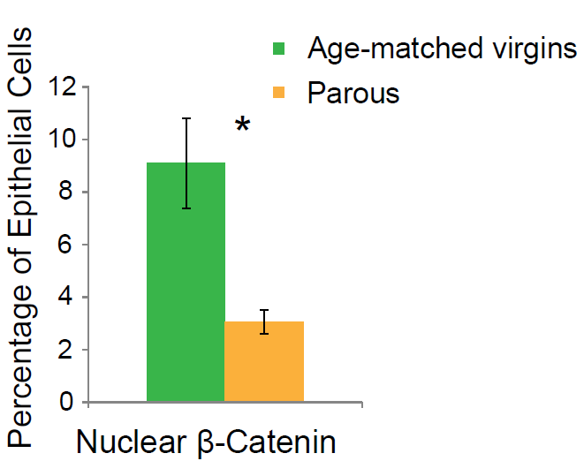
Results I:
Wnt targets are reduced on the protein level and nuclear β-catenin is decreased in basal mammary epithelial cells from parous mice.
Mean number of versican (brown) pixels per image:
Virgins: 38,700 ± 6954
Parous: 127 ± 33 P=5.48E-07
Notes:
Validation on the protein level comes from IHC studies for the classical Wnt target versican. This is shown over here. Parity led to a dramatic decrease in the mean expression of versican protein in the mammary epithelium.
Furthermore, staining for nuclear beta catenin, an essential pre-requisite for active Wnt signaling, showed a three-fold decrease in the percentage of mammary epithelial cells with nuclear beta catenin in parous mice. Here you can see representative images from age-matched virgins on the top and from parous mice on the bottom. Full arrows depict basal mammary epithelial cells with nuclear beta catenin, whereas arrowheads depict basal mammary epithelial cells devoid of nulcear beta catenin.
These results further validate the transcriptome data.

Slide 33
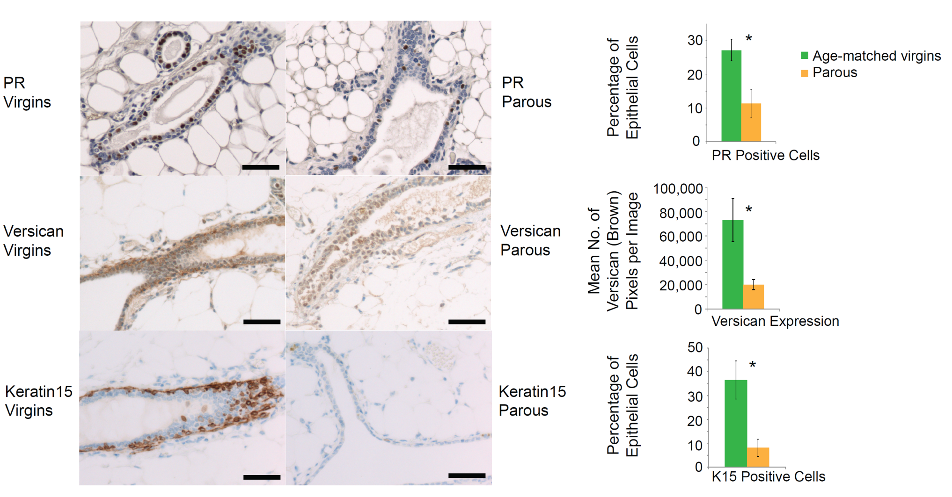
Results:
Early age pregnancy-induced decreases in progesterone receptor positive cells and Wnt target versican and keratin 15 expression persist in mammary glands of postmenopausal (22 months old) mice.
*P =1.53E-04
*P =0.004
*P =0.0049
Notes:
This slides shows the results. Here you can see staining for PR, a representative image from virgin postmenopausal mice on the left and from parous postmenopausal mice on the right. Again, cells positive for PR are brown, whereas cells negative for PR are blue. As you can see from the quantification here on the right, the early pregnancy-induced reduction in PR positive cells was of life-long duration.
Similarly, when staining for the Wnt targets versican and keratin 15, then the early pregnancy-induced reduction in versican and keratin 15 expression was found to be of life-long duration. Here are representative images and here is the quantification.
These results were further verified by qPCR and by immunohistochemistry for nuclear beta catenin.
Scale bar, 50 um. For progesterone, quantitative data represent the mean ± s.d., counting 500 cells per mouse from 5 virgin and 5 parous mice. For versican, quantitative data represent the mean ± s.e.m. from 70 randomly selected images from 5 virgin and 5 parous mice. For keratin 15, quantitative data represent the mean ± s.d., counting 500 cells per mouse from 3 virgin and 3 parous mice.

Slide 34
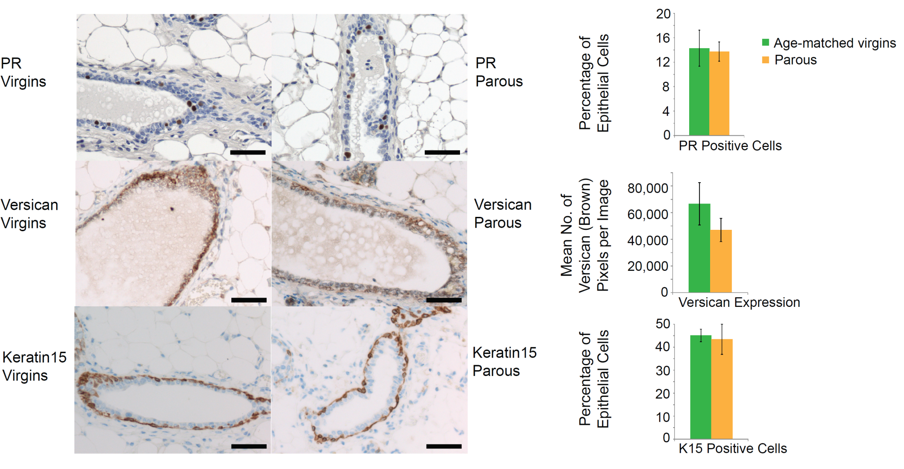
Results IV:
In contrast to early parity, late age pregnancy (24wks) has NO effect on PR positive cells and on Wnt target versican and keratin 15 expression.
P =0.72
P =0.28
P =0.71
Notes:
This slides shows the results for mice which had undergone pregnancy at 24 wks and whose glands had been harvested 40 days after weaning. The top panel shows again staining for PR. As you can see from the quantification here on the right, late pregnancy did not lead to discernible changes in the percentage of PR positive cells. Similarly, late pregnancy did not decrease the expression of the Wnt targets versican and keratin 15 significantly.
Again, these results were further verified by qPCR and by immunohistochemistry for nuclear beta catenin.

