Slide 1
Antibacterial effect of plant oils rich in medium chain fatty acids and their possible interactions with antibiotics
Skrivanova E., Lalouckova K., Soukup J. University of Life Sciences in Prague, CZ

Slide 2
Introduction
Antibiotic resistance
Ban of using in-feed antibiotics in animal production
Search for new alternatives

Slide 3
Alternatives?
Probiotics
Prebiotics
Bacteriocins
Enzymes
Bacteriophages
Plant extracts
Organic acids
WHY?

Slide 4
MCFA as a possible alternative to in-feed antibiotics?
Inhibitory activity in vitro
Mechanism of action
In vivo testing
The influence of production traits, GIT microbiota, toxicology,…
Experimental infections
Application form
Economy, combinations

Slide 5
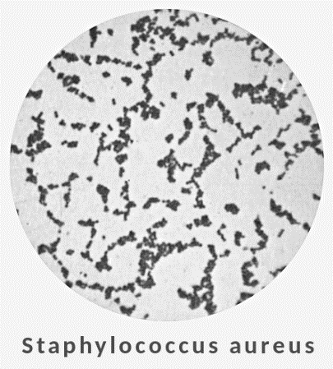
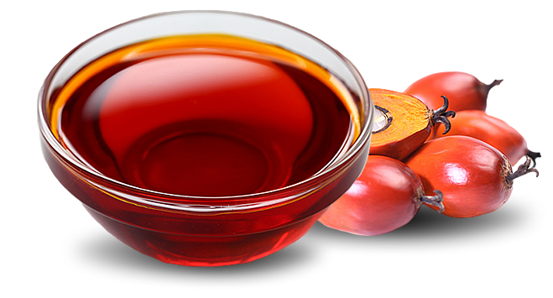
Aims
To determine the antibacterial effect of medium-chain fatty acids (MCFA) and oils rich in MCFA
To analyse MCFA contents of the tested oils

Slide 6
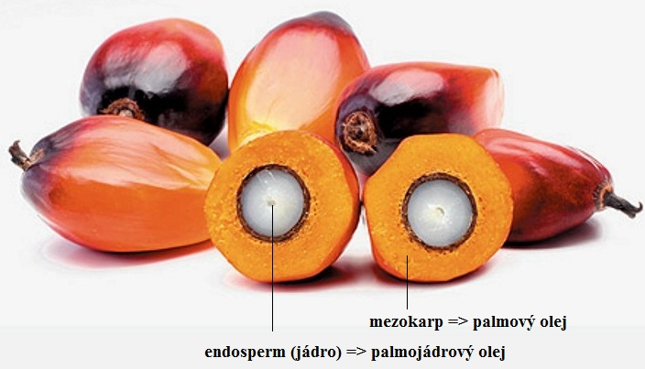
MCFA & oils
Free MCFA: C₆ – C₁₂
dissolved in DMSO + Tween 80, diluted in growth medium for a certain bacterium
with or without pancreatic lipase
37°C dissolved and/or hydrolyzed

Slide 7
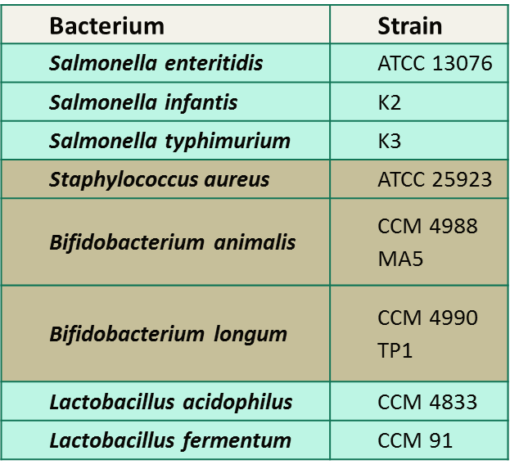
Bacterial strains

Slide 8
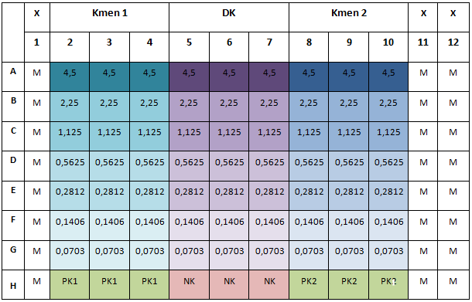
In vitro determination of MIC
Broth microdilution method in 96-well plate
24/48 h incubation in aerobic/microaerophilic/anaerobic conditions at 37 °C
96-well plate design (according to Cos et al., 2006; Hecht et al., 2007)
Strain 1
Strain 2
legenda:
DK − dilution control
PK − positive control
NK − negative control
M − pure medium

Slide 9
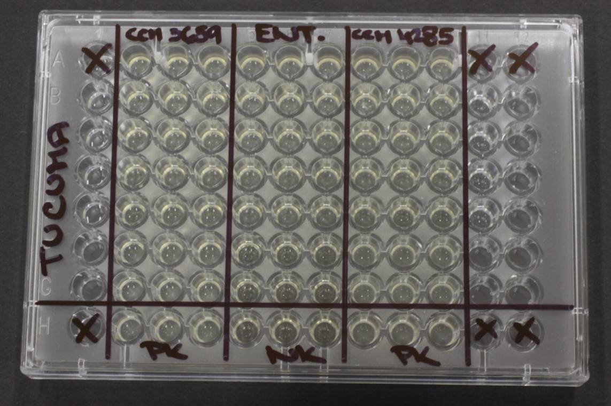
In vitro determination of MIC
After the incubation: absorbance at 405 nm (Infinite ® 200 PRO Microplate Reader; Tecan)
Pipetting performed by the automatic pipetting station Freedom EVO 100 (Tecan)
MIC = minimal concentration, where at least 80% cell growth reduction occured (vs. positive control)
MCFA contents of oils: gas chromatography (GC-FID) according to ISO 5509 (2001)

Slide 10
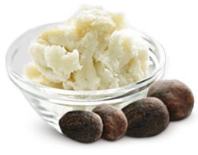
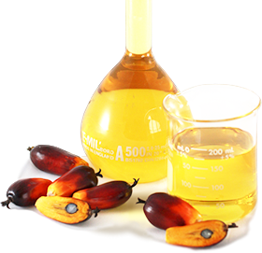
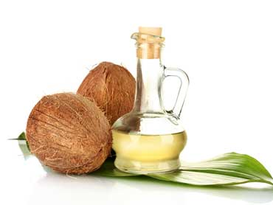
Results: MCFA profile of selected oils (mg/kg)

Slide 11
Results: MIC (mg/mL)
 | BA |  | BL |  | CJ |  | CP |  |  | ECe |  | ECo |  | LA | LF | LM | SE | SI | ST | SA
Oil origin | CCM 4988 | MA5 | CCM 4990 | TP1 | CAMP/VFU 612/21 | CCM 6189 | CNCTC 3659 | UGent 56 | CIP 105178 | CCM 3659 | CCM 4285 | ATCC 29522 | C6 | CCM 4833 | CCM 91 | ATCC 7644 | ATCC 13076 | K2 | K3 | ATCC 25923
coconut
palm
red palm
palm kernel
Cuphea
muru-muru
tucuma
babassu

Slide 12
Conclusion
Gram-positive bacteria were sensitive after lipase digestion
Free MCFA or monoglycerides
Cuphea oil
the widest effect (7 bacterial strains)
Tucuma oil
the strongest effect (MIC 0.14 mg/mL)
No effect on benefitial bacteria!

Slide 13
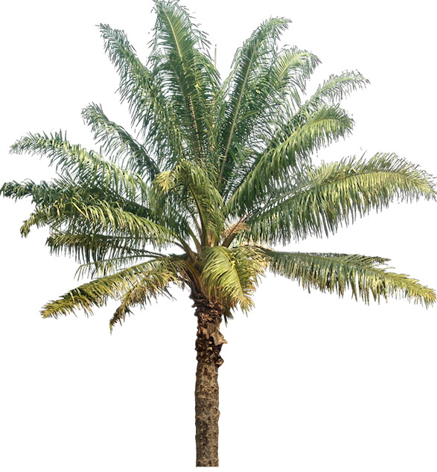
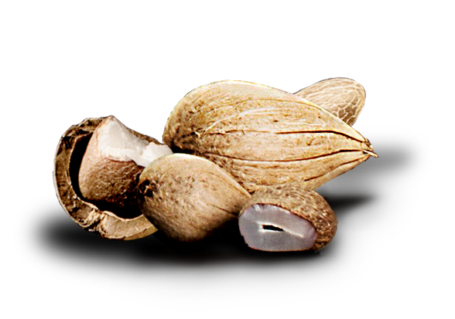
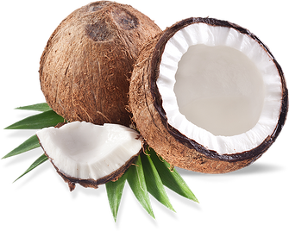
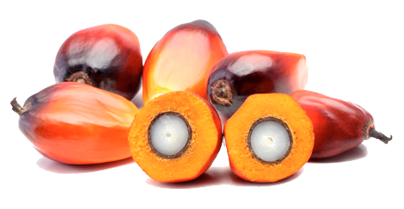
Thank you!
University of Life Sciences in Prague
Faculty of Agrobiology, Food and Natural Resources
Faculty of Tropical AgriSciences
Institute of Animal Science Prague
Dpt. of Physiology of Nutrition and Animal Products Quality

