Slide 1
The Story of HIV in Njinikom The Journey of Project Hope
Dr Eugene Chiabi
Director, TB/HIV Treatment Center
St. Martin de Porres Catholic General Hospital – Njinikom Cameroon

Slide 2
Introduction
Population in Cameroon 22 million
HIV Prevalence
2003 5.3%
2011 4.6%
2012 4.5%
2013 4.3%
Njinikom located in North West Region
Population in Njinikom about 20 K
HIV Prevalence about 5%
St. Martin de Porres Catholic General Hospital

Slide 3
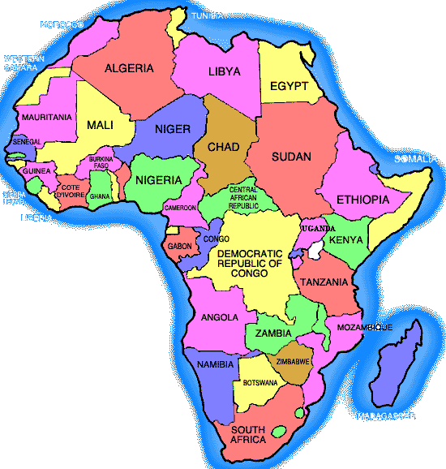
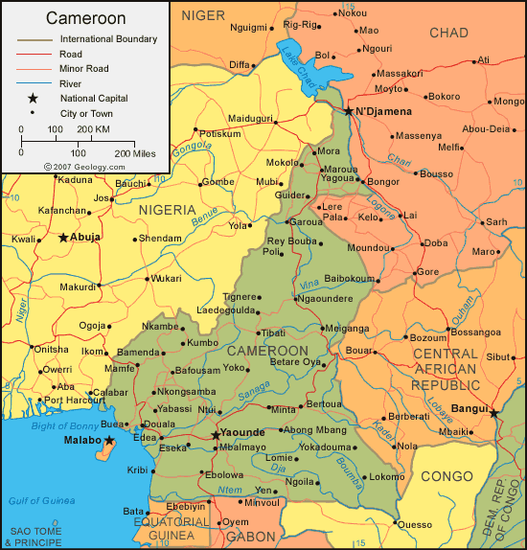

Slide 4
HIV/AIDS Treatment Center Goals
To reduce the prevalence and the impact of HIV and AIDS in children, youths, and adults
Strengthening the capacities of communities to address and cope with the impact of the HIV/AIDS epidemic
To promote health and reduce morbidity and mortality related to HIV/AIDS

Slide 5
Intervention Populations
Mothers seeking pre-natal care and joint services with hospital
Children infected or affected by HIV
People Living With HIV/AIDS (PLWHA)
Orphans and Vulnerable Children (OVC)
Caregivers to PLWHA and OVCs
Traditional Healers, Hairdressers, Taxi Drivers, Barbers, Youths, etc…
Community Based Organizations (CBOs)

Slide 6
HIV Basic Services in a Continuum of Care
Prevention
Services
Treatment
Services
Care & Support
Services

Slide 7
Prevention
Services
Youth Programs
Outreach and
Education
VCT
Voluntary Counseling & Testing (VCT)

Slide 8
Treatment
Services
PMTCT / PC
HAART
PEP
Prevention of Mother To Child Transmission (PMTCT)
Pediatric Care (PC)
Highly Active Antiretroviral Therapy (HAART)
Post Exposure Prophylaxis (PEP)

Slide 9
Care & Support
Services
Community
Home Based
Care
Orphan Support
PLWHA
Support Groups
People Living with HIV/AIDS (PLWHA)

Slide 10
Planned Results.
To improve knowledge on HIV and AIDS, STIs and adolescent reproductive Health.
To identify and re-orientate the skills of Youth and promote activities that encourage Youth participation in disease prevention.
To build the capacity of the community as a whole and traditional practitioners in particular to adopt less risky practices.

Slide 11
To improve access of women to quality information on HIV and quality health care in general.
To assist communities to develop and run structures that take care of orphans and vulnerable children.
To provide services to reduce Mother-To-Child Transmission of HIV and care for their exposed/infected babies.

Slide 12
7. To increase access to ART and treatment of opportunistic infections to our clients at zero or minimal cost.
8. To further reduce the prevalence of HIV in Cameroon from 4.3 (2013) to the bearest minimum.

Slide 13
Achievements.
Primary Prevention: Youth Activities
A total of 500 Peer Educators have been trained both in and out of school youth and are actively involved in sensitization in schools and back in the communities.

Slide 14
45 Health clubs have been created and members trained on life skills, Risk and vulnerability mapping, communication for behavioral change, HIV and AIDS, STIs.
A marked reduction in HIV prevalence among youth age 15-24 years from 10.9% in 2004 to 6.8 in 2012.
1 Youth Markets and 1 Youth motor park awareness corner have been created and are functional in Njinikom.

Slide 15
A Youth friendly centre and a Children's’ Friendly club have been created and are currently functional.
6. Youth are actively involved in sensitizing their peers during special events. More than 30,000 Youth have been reached with messages on prevention.
7. Community mobilization and sensitization in HIV prevention is ongoing with active community participation.

Slide 16
Participatory training seminars especially on risky practices have been effected to over 240 traditional practitioners in Njinikom, Bum Belo and Fundong subdivisions, most recent chaired by the Divisional officer for Njinikom..

Slide 17
HIV Free Holidays
Cross section of youth during games
District Officer chairs the final games

Slide 18
Training of Youth
Presentation of group work in Plenary by youth.
Drawing up Risk maps of Kichu - Belo

Slide 19
Youth Motor Park Awareness Creation Corner
Inner view
Outer view

Slide 20
Community Mobilization and Screening.
Women‘s Day 2013
Muloin village

Slide 21
In-School Health Clubs Sensitizing during Special Events

Slide 22
Trained In-School Health Clubs Sensitizing during Special Events

Slide 23
Treatment Unit.
HAART:
Over 2000 HIV tests are done yearly
Over 2233 client have benefited from ART (1536F, 697M, 132 children).
1300 files are currently active.

Slide 24
PMTCT and Pediatric Care
Health education talks are given every ANC and each pregnant woman is counseled for HIV testing which is now integrated into routine activities of the clinic. 99.9% accept to take the test and the opt - out approach is used.
Screening for HIV and prophylaxis or treatment to those tested positive is provided free of charge
160 service providers (Nurses, Midwives, lab technicians and counselors) have received training and are actively implementing PMTCT interventions within the entire District in 16 sites.

Slide 25
Over 210 community stakeholders (D.O, Mayor, Religious authorities, Traditional rulers, leaders of CBOs, teachers, etc…) have been trained and are actively involved in communication for PMTCT and Pediatric care (we use both community and Hospital approach).
80 children on ARV are benefitting Pediatric care and counseling. Caregivers are trained on provision of appropriate care and support to the children.
100% pregnant women at our hospital ANC go for HIV screening.

Slide 26
Through the early infant diagnosis (EID) program, there have been active tracing and follow up of babies born to HIV positive mothers.
340 tested. (306 Negative,34 Positive).
The treatment center has created and sponsored 5 support groups involving PLWHA

Slide 27
Therapeutic Committee Meeting

Slide 28
Treatment Unit Staff

Slide 29
Dispensing ARVs at Treatment Unit

Slide 30
Uptake of PMTCT Services

Slide 31
Training of service providers in PMTCT.

Slide 32
Pic of comm
Cross section of community stakeholders after a workshop in communication for PMTCT/PC

Slide 33
Children infected with HIV received nutritional support

Slide 34
Children’s Club
Children play with toys while waiting for their ARVs
Unicef / Andorra delegation visits children club.

Slide 35
Care and Support.
Over 70 Community Based Groups (CBO) have been trained and are working with OVCs.
A total of 100 PLWHA and caregivers to OVCs have benefitted from an Income Generating Activity since 2007.
Over 6000 home visits have been effected to 820 HIV infected clients. Activities of home visits include tracing of clients lost to follow up, adherence monitoring, nutritional and hygienic assessment and psychosocial and spiritual support.

Slide 36
Judicial Assistance to OVCs

Slide 37
Vocational Training

Slide 38
Home Visits
Supply ARV at home.
Donations

Slide 39
Home Visits

Slide 40
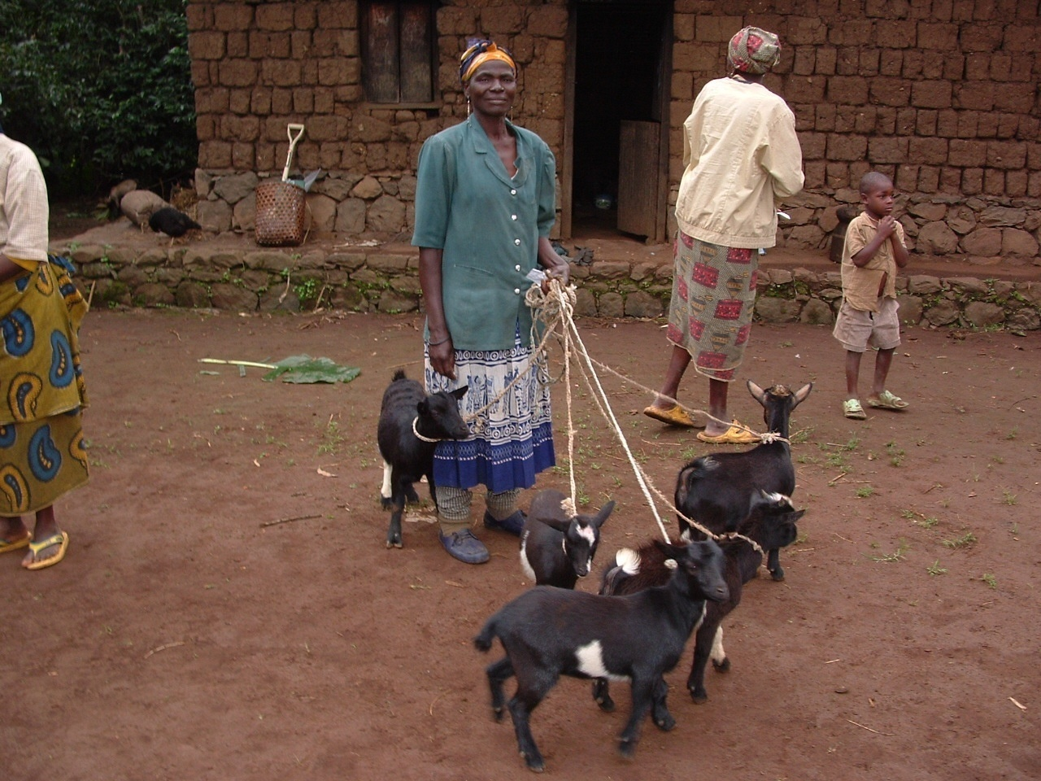
Building the capacity of OVC caregivers in an effort towards self sustainability.
A pilot project sponsored by Heifer project, Plan Cameroon and Project Hope

Slide 41
Orphans receiving Educational Support
Orphans receiving Judicial Support

Slide 42
Challenges.
Behavioral change is an observable and gradual process.
Addressing the multitude of needs concerning the increasing number of orphans and PLWHA in our community (lack of adequate funds).
Working towards project sustainability and continuity
Stigma still exist and it’s a barrier to testing especially in the remote communities.

Slide 43
Difficult terrain (inaccessibility to client which calls for a mountain bike and a four wheel drive vehicle for a team work).
Low participation of men in PMTCT program.
Rupture of reagents (CD4, FBC, FBS, Liver function)
Ever increasing clients on ARV demands for more data collecting and processing material needed (computers, printer, scanner) for the treatment unit.

Slide 44
Way Forward.
Continuous intensification of a combination of intervention in the fight against HIV transmission .
Continuous sensitization of the communities on issues related to HIV and AIDS.
Refresher workshops should be organised for service providers in areas of HIV infection prevention, treatment, care and support.

Slide 45
Continue to protect orphans and vulnerable children in our communities.
Intensify youth programs geared towards HIV prevention in order to bring about behavioural change and continue to reduce the rate of new infections among young people.
Continue to seek for other sources of additional funds to meet up with the increasing needs of the population we serve.

Slide 46
We look forward to learning from other institutions, their experiences and efforts in HIV and AIDS, as well as attend international seminars, workshops or meetings in the field of HIV and AIDS so as to build up our capacity and improve on our services to our communities.
Above all, to Share the best practices recorded by the Project with other communities especially in line with our new strategic Plan 2010 – 2015.

Slide 47
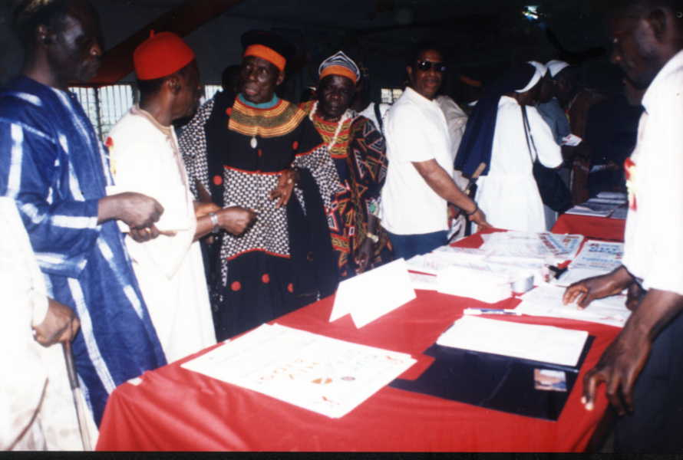
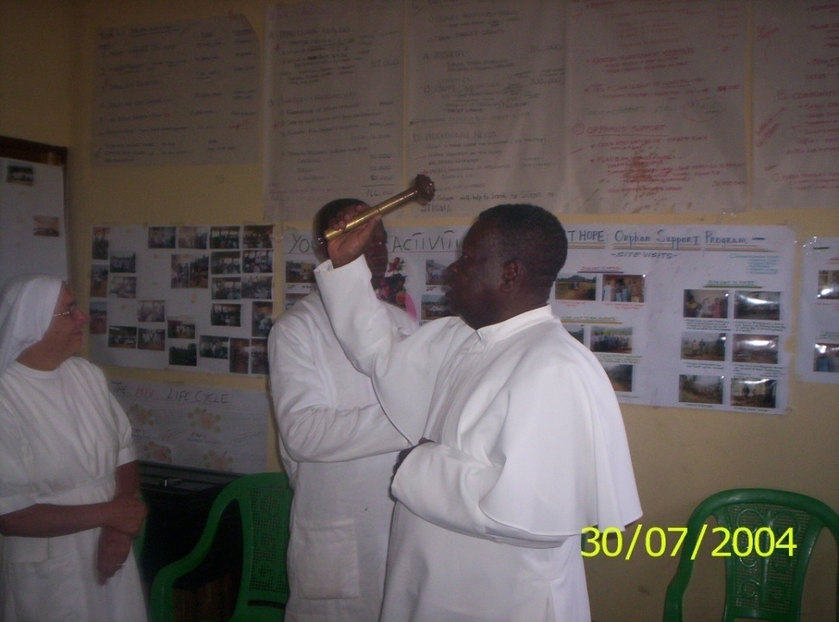
PROJECT HOPE COMMUNITY SERVICES FIGHTING HIV/AIDS
Community oriented
Care and support
Prevention
Faith based
treatment
Integrated and comprehensive services
Empowering and strengthening the capacity of communities to address and cope with the impact of HIV/AIDS

Slide 48
Thank You for your Kind attention.

