Slide 1
Role of microRNAs and CD4+ t cell SUBSETS in the regulation of the immune system during pregnancy
Estibalitz Laresgoiti-Servitje, MD MSc PhD
National Institute of Perinatology, Mexico
Tecnológico de Monterrey, Mexico

Slide 2
miRNAs
Micro RNAs are single-stranded non-coding RNAs that regulate expression of complementary RNAs
They may regulate aprox. 50% of protein coding genes (post-transcriptional regulation) by promoting degradation of target mRNA or repression of protein translation.
Trophoblasts secrete exosomes which contain placenta-specific miRNAs
miRNAs have been linked to physiological and pathological processes during pregnancy

Slide 3
miRNAome of the placenta

Slide 4
Placental microRNAs
The majority of placenta-derived exosomes contain miRNAs of the C19MC cluster.
Some placental miRNA are highly abundant and rise as pregnancy progresses
Gilad et al. propose miR-520, miR-526 and miR-527 as microRNAs that can help distinguish between pregnant and non-pregnant women
Biological role of many of these miRNAs is not fully understood

Slide 5
Pregnancy-associated microRNAs at 36w

Slide 10
C19MC miRNAs as immunomodulators in pregnancy
Chromosome 19 miRNA cluster C19MC is usually silent except for embrionic stem cells and the placenta
These are derived from placenta-derived exosomes
May play a role in placental/maternal communication and possibly in immune system regulation during pregnancy, preventing the embryo from being attacked

Slide 11
C19MC microRNAs participate in normal pregnancy but may also be involved in obstetrical/placental diseases.

Slide 13
Embryo/baby is considered as a semi-allograft! Trophoblast must promote maternal immune tolerance in order to survive. microRNAs seem to modulate the immune system very early in the gestational period

Slide 14
Placenta-derived exosomes can share membrane components and target immune cells locally at the maternal/fetal interphase or systemically by binding to immune system cells’ membranes
However, activated lymphocytes may also release miRNA containing exosomes…

Slide 16
miRNAs as immunomodulators during pregnancy
miR152: Overexpression supresses HLA-G expression, thus promoting NK cell cytolysis
Important, considering that 70% of leukocytes in early decidua are uterine NK cells
miR-148:Targets HLA-G expression in EVT and specially HLA-C expression
miR-210: Is up-regulated in CD4+ T cells by sHLA-G, affecting their function

Slide 18
miRNAs as immunomodulators during pregnancy
miR-155: Positively regulates Treg and Th17 differentiation and IL-17 production by targeting SOCS1 (supressors of cytokine signaling). miR-155 deficient mice have decreased numbers of Tregs.
miR-326: Promotes Th17 differentiation.

Slide 20
miRNAs as immunomodulators during pregnancy
miR- 126: Expressed by plamacytoid dendritic cells. Is a regulator of innate immunity, regulating TLR7,9 and VEGFR2. Considered to be proangiogenic

Slide 21
miRNAs released by the immune system
miRNAs of CD4+ T cell exosomes are different from the intracellular versions of the same cells

Slide 22
Intracellular miRNAs relevant for the development of CD4+ T cell subsets

Slide 23
Th1,Th2,Th17, Treg paradigm in pregnancy

Slide 24
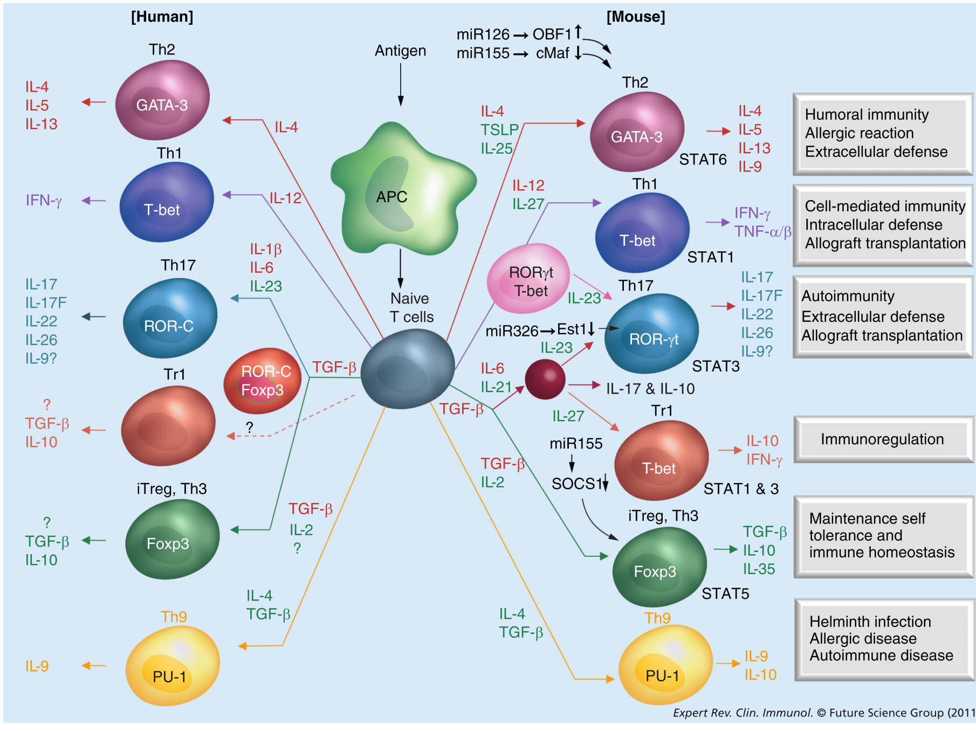

Slide 25
Immune regulation during pregnancy

Slide 26
Conclusions
miRNAs may play an important role in the regulation of the immune system during the gestational period
The role of placenta-derived microRNAs is not fully understood
microRNAs are produced by trophoblast, immune system cells and other cells (exosomes and intracellular)
They not only participate in immune system regulation, they may regulate placental functions and angiogenesis…and they may be involved in pregnancy complications as well.

Slide 27
Thank you!

